Slide 1
10.3 Continuity

Slide 2
Example 1 – Applying the Definition of Continuity
Show that
is continuous at 7.
Solution: First,
so f is defined at
Second,
thus, f has a limit as
Third,
Therefore, f is continuous at 7.
Show that
is continuous at
Solution: The function g is defined at
Also,
Therefore, g is continuous at

Slide 3
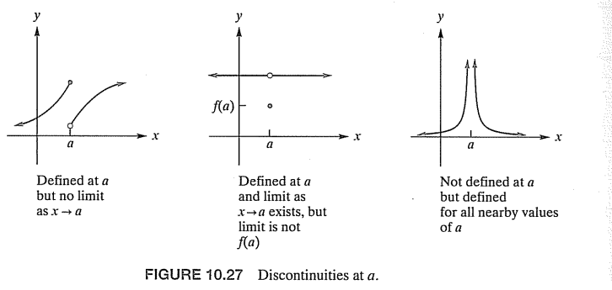
(B) Types of discontinuity

Slide 4
$$f\left(x\right)=\frac{x−2}{\left(x−2\right)\left(x+2\right)}=\frac{1}{x+2}, x≠2$$
$$\lim_{x→2}{f\left(x\right)=\lim_{x→2}{\frac{1}{x+2}=\frac{1}{4},}}$$
but f(2) undefined
$$\lim_{x→−2}{f\left(x\right)=\lim_{x→−2}{\frac{1}{x+2}=±∞,}}$$
Infinite discontinuity
$$f\left(x\right)=\frac{x−2}{x\left(x^{2}−4\right)}=\frac{x−2}{x\left(x−2\right)\left(x+2\right)}=\frac{1}{x\left(x+2\right)}, x≠2$$
Removable discontinuity at 2,but not removable at 0 and -2

Slide 5
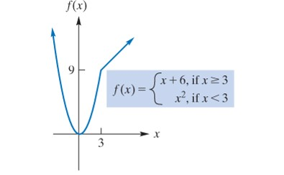
(C) Discontinuity in compound functions
Example
For each of the following functions, find all points of discontinuity.
We can conclude that
and the function has no points of discontinuity.

Slide 6
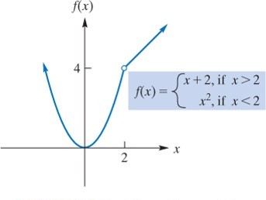
b.

Slide 8
