Slide 1
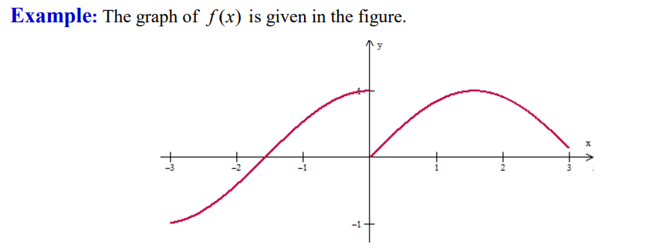
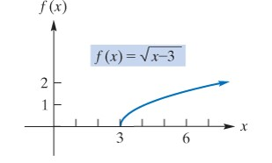
10.2 Limit (Continued)
A. One sided Limit
$$\left(c\right) \lim_{n→0}{f\left(x\right)=DNE}$$

Slide 2
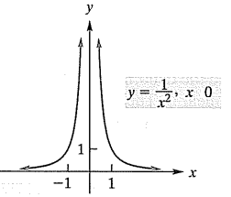
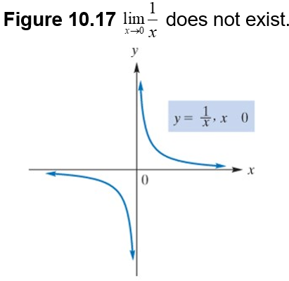
B. Infinite Limits

Slide 3
Example 1 – Infinite Limits
$$a) \lim_{x→−3}{f\left(x\right)=\lim_{x→−3}\frac{x+3}{x^{2}−9}=\frac{0}{0}=}$$
$$\lim_{x→−3}\frac{x+3}{\left(x+3\right)(x−3)}=$$
$$−\frac{1}{6}$$
$$b) \lim_{x→3+}{f\left(x\right)=\lim_{x→3+}\frac{x+3}{x^{2}−9}=\frac{0}{0}=}$$
$$\lim_{x→3+}\frac{x+3}{\left(x+3\right)(x−3)}=$$
$$\lim_{x→3+}\frac{1}{x−3}=$$
$$∞$$
$$c) \lim_{x→3−}{f\left(x\right)=\lim_{x→3−}\frac{x+3}{x^{2}−9}=\frac{0}{0}=}$$
$$\lim_{x→3−}\frac{x+3}{\left(x+3\right)(x−3)}=$$
$$\lim_{x→3−}\frac{1}{x−3}=$$
$$−∞$$
$$d) \lim_{x→3}{f\left(x\right)=DNE}$$

Slide 4
Example 2 – Infinite Limits
Find the limit (if it exists)
Solution: As x approaches
from the right,
approaches 0 but
always positive.
Thus,
and the limit does not exist.
Solution: Here we are dividing numbers near 4 by numbers near 0.
At this stage we can write.
does not exist.
Notice that
Since
and
is neither
nor

Slide 5
C. Limits at Infinity
$$Remark \frac{a}{±∞}=0$$
Example:
$$\underset{x→∞}{a) lim}{\frac{1}{x}=0}$$
$$\underset{x→∞}{b) lim}{\sqrt{x−4}=}$$
$$\sqrt{∞−4}=\sqrt{∞}=∞$$
$$c) \lim_{x→−∞}{\sqrt{4−x}=}$$
$$\sqrt{4+∞}=\sqrt{∞}=∞$$

Slide 6
Example 3
$$a) \lim_{x→∞}{4x^{3}+x^{2}−5=}$$
$$\lim_{x→∞}{4x^{3}=}$$
$$4∞=∞$$
b$) \lim_{x→∞}−{4x^{3}+x^{2}−5=}$
$$\lim_{x→∞}{−4x^{3}=}$$
$$−4∞=−∞$$
c$) \lim_{x→−∞}{4x^{3}+x^{2}−5=}$
$$\lim_{x→−∞}{4x^{3}=−∞}$$
Example:

Slide 7
$$\lim_{x→∞}{\frac{2x^{3}}{3x^{2}}=}$$
$$\lim_{x→∞}{\frac{2}{3}x=}$$
$$∞$$
$$v) \lim_{x→−∞}{\frac{2x^{3}−2x^{2}+5x}{3x^{2}−5x−2}}=$$
$$\lim_{x→−∞}{\frac{2x^{3}}{3x^{2}}=}$$
$$\lim_{x→−∞}{\frac{2}{3}x=−∞}$$
$$\lim_{x→1}{f\left(x\right)=2}$$

Slide 8
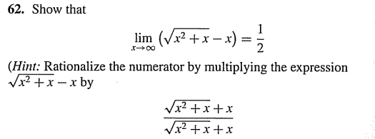
$$\lim_{x→∞}\left(\sqrt{x^{2}+x}−x\right){\frac{\sqrt{x^{2}+x}+x}{\sqrt{x^{2}+x}+x}=}$$
$$\lim_{x→∞}{\frac{x^{2}+x−x^{2}}{\sqrt{x^{2}+x}+x}=}$$
$$\lim_{x→∞}{\frac{x}{\sqrt{x^{2}+x}+x}=}$$
Divided by |x|=x, x$→∞$
$$\lim_{x→∞}{\frac{\frac{x}{x}}{\frac{\sqrt{x^{2}+x}+x}{x}}=}$$
$$\lim_{x→∞}{\frac{1}{\sqrt{1+\frac{1}{x}}+1}=}$$
$$\frac{1}{\sqrt{1+0}+1}=$$
$$\frac{1}{2}$$
$$\lim_{x→∞}{\frac{1}{\sqrt{\frac{x^{2}+x}{x^{2}}}+\frac{x}{x}}=}$$

Slide 9
