Slide 1
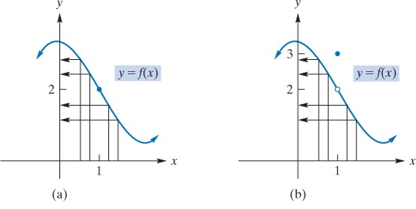
10.1 Limits

Slide 2
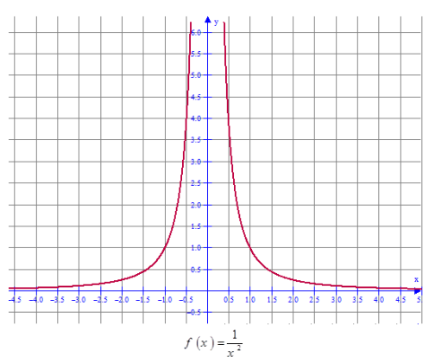
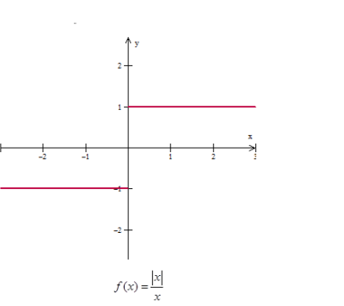
$$\frac{\left|x\right|}{x}=\left\{\begin{aligned}\frac{x}{x}=1, x≥0 \\ \frac{−x}{x}=−1, x≤0\end{aligned}\right.$$

Slide 3
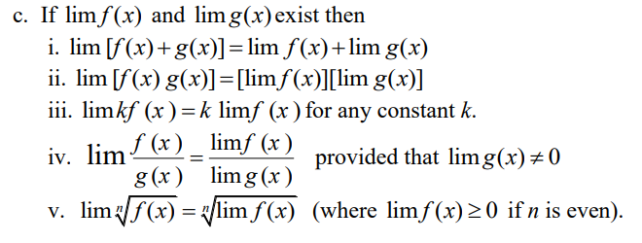
Example 1

Slide 4
$\frac{0}{0}$=
$$\frac{0}{0}=$$
$$\frac{0}{0}=$$

Slide 5
Example
If
find
Solution:
As
both the numerator and denominator approach 0.
Therefore, we will try to express the quotient in a different
form, for

Slide 6
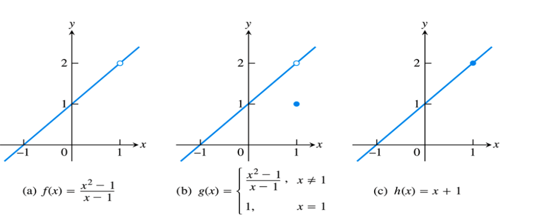

Slide 7
