Slide 1

King Fahad University of Petroleum & Minerals
Problem Design
Non-linear Air Resistance
Group # 4
Bin Mahfoud, Saud Faisal Malawi, Ahmad
Al Osaimi, Saad Radhwan, Ayman
AL Hadi,Mohammad

Slide 2
Non-linear Air Resistance
Problem # 16, Page # 110
In this problem a cannonball is shot vertically upward
How High? We are asked to find the maximum height.
Given that
V = 300ft/s at t = 0
F_{res} α V²
F_{res} = KV²

Slide 3
Non-linear Air Resistance
Problem # 16, Page # 110
F_{total} = KV² + W
Where W is the weight of the ball, V is the instantaneous velocity and K 0.0003
We have F = ma where a= dv/dt
So we have
dv/dt = -(+KV² + W)/m

Slide 4
Solve, we get
t = -49/12*3^(1/2)*atan(1/400*V*3^(1/2))+ C
Using the boundary condition
C= 6.4696
t at V = 0 (Max.hight) t= 6.4696 sec.

Slide 5
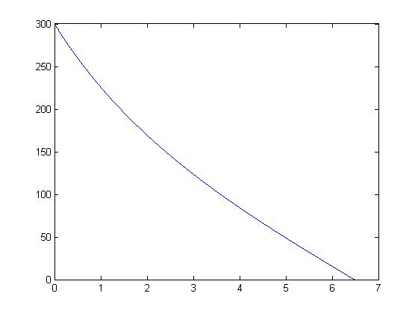
V vs t (Time)

Slide 6
We can use V = ds/dt , where S is the traveled distance.
We get S= -353625/433*log(1+tan(400/2829*t)^2)+C
Using the boundary Condition S=0 At t = 0
C = 0
Use t = 6.4696 sec then we get
S = 807.4091meter.

