Slide 1
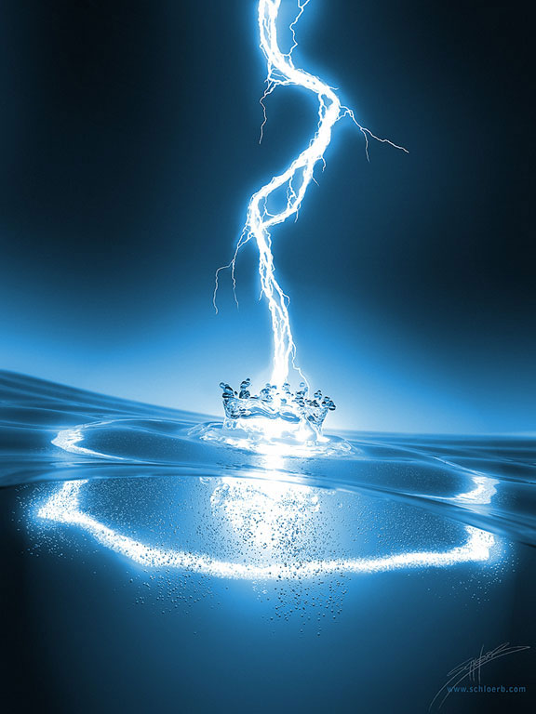
Power Generators
Mohammed Al-Qahtani
Abdulrahman Al Sonayen
Muaiyed Al-Mutawah
EE 205, 121

Slide 2
Outline
Introduction
How does a power generator work?
How are they manufactured?

Slide 3
Introduction
Definition of a power generator
The fundamental principle of an electrical generator
How is electricity generated
How does electricity reach the customer

Slide 4
Definition of a power generator
It is the device that generates electricity for any source of energy.

Slide 5
The fundamental principle of an power generator
The fundamental principles of electricity generation were discovered during the 1820s and early 1830s by the British scientist Michael Faraday. His basic method is still being used today.

Slide 6
How is electricity generated
Electromechanical generators
Chemical combustion
- Kinetic energy
- Solar photovoltaics
Geothermal power

Slide 7
How does electricity reach the consumer
Electric Utilities
Electricity Transmission
Distribution
Electrical Power Storage and Recovery

Slide 8
Where did the idea of electricity generation come from?
Faraday's law of induction
Michael Faraday, (1791 – 1867)
*electromotive force
*the magnetic flux

Slide 9
Mechanical Energy to Electrical Energy (Generation)

Slide 10
Electrical Energy to Mechanical Energy (Electrical Motor)

Slide 11
What can we use as a mechanical input?
Water turbine (Hydroelectricity)
Internal combustion engine (Dynamo)

Slide 12
How does an internal combustion engine (dynamo) works?
Fuel
Air
Exhaust system
Mechanical output (shaft)

Slide 13
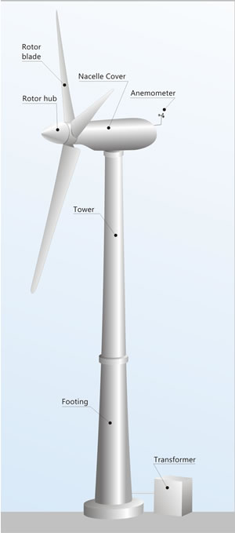
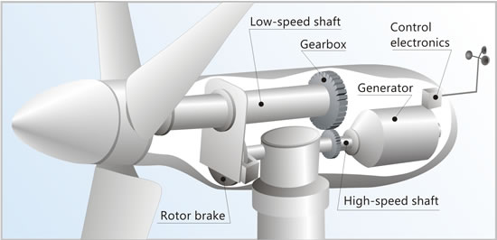
Wind Turbines
(All in one)

Slide 14
The Manufacturing

Slide 15
Simple & Elegant

Slide 16
To conclude
Introduction
How does a power generator work?
How are they manufactured?

Slide 17
any questions?

Slide 18
References
Electric generator. (2012, December 13). In Wikipedia, The Free Encyclopedia. Retrieved 08:14, December 20, 2012, from http://en.wikipedia.org/w/index.php?title=Electric_generator&oldid=527872164
Electric motor. (2012, December 19). In Wikipedia, The Free Encyclopedia. Retrieved 08:12, December 20, 2012, from http://en.wikipedia.org/w/index.php?title=Electric_motor&oldid=528815342
Electricity generation. (2012, December 17). In Wikipedia, The Free Encyclopedia. Retrieved 08:14, December 20, 2012, from http://en.wikipedia.org/w/index.php?title=Electricity_generation&oldid=528461575
Faraday's law of induction. (2012, December 14). In Wikipedia, The Free Encyclopedia. Retrieved 08:04, December 20, 2012, from http://en.wikipedia.org/w/index.php?title=Faraday%27s_law_of_induction&oldid=528021289
Hydroelectricity. (2012, December 15). In Wikipedia, The Free Encyclopedia. Retrieved 08:13, December 20, 2012, from http://en.wikipedia.org/w/index.php?title=Hydroelectricity&oldid=528147693
Internal combustion engine. (2012, December 19). In Wikipedia, The Free Encyclopedia. Retrieved 08:13, December 20, 2012, from http://en.wikipedia.org/w/index.php?title=Internal_combustion_engine&oldid=528739518
Michael Faraday. (2012, December 20). In Wikipedia, The Free Encyclopedia. Retrieved 08:04, December 20, 2012, from http://en.wikipedia.org/w/index.php?title=Michael_Faraday&oldid=528903368

