Slide 2
Outline :
Introduction
- Definition
- Background
- Classification
Power Generation
Power Distribution
Conclusion

Slide 3
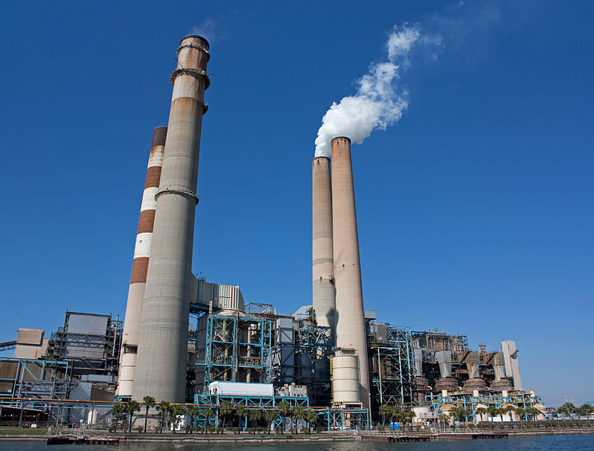
What is power plants “?”
It is simply an industrial facility for the generation of electric power

Slide 4
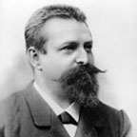
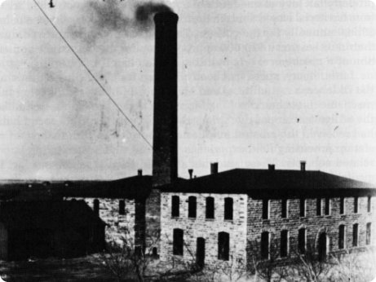
History of power plants
The world's first power station was built by the German scientist Sigmund Schuckert in 1878
The station consisted of 24 dynamo electric generators which were driven by a steam engine
Sigmund Schuckert

Slide 6
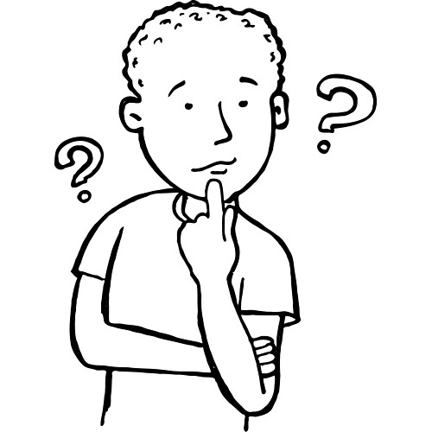
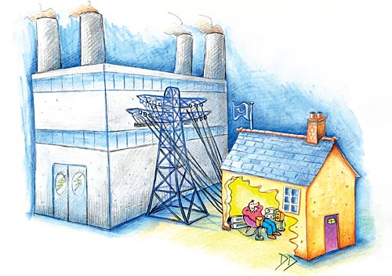
How does power
plant work ?!

Slide 8
How to get electricity from the Turbine ?

Slide 9
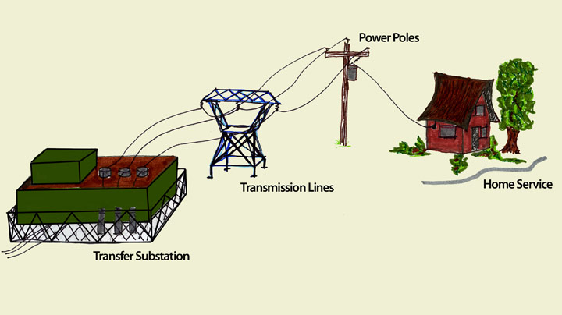
Electricity distribution

Slide 11
This video will illustrate
The principle of power plants

Slide 12
Thanks for your listening

Slide 13
References
1 - Distribution, P. (2011, December 27). Power distribution. Retrieved from http://en.wikipedia.org/wiki/Electric_power_distribution
2- Nave, N. R. (2000, August). Electricity generation and distribution. Retrieved from
http://hyperphysics.phy-astr.gsu.edu/hbase/electric/powerp.html
3- Teachers across Ontario. (2010). How it works: Electricity generation. OPG. Retrieved from http://www.opg.com/education/kits/grade9student.pdf
4- Wikipedia contributors. (30 N). Wikipedia, the free encyclopedia. Retrieved from http://en.wikipedia.org/wiki/Power_station
5- https://www.youtube.com/watch?v=GI7AhajfhWE
6http://www.okstate.edu/utilities/index.php?option=com_content&view=article&id=23&Itemid=24

