Slide 1
Distribution Function properties

Slide 2
Density Function
We define the derivative of the distribution function F_{X}(x) as the probability density function f_{X}(x).

Slide 4
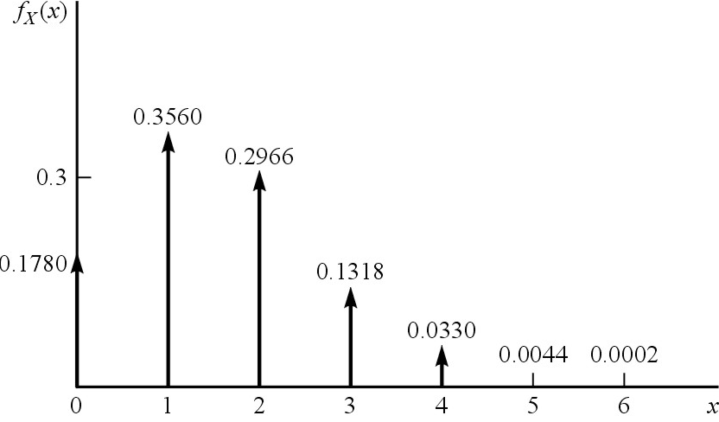
Binomial
Let 0 < p < 1, N = 1, 2,..., then the function
is called the binomial density function.

Slide 6
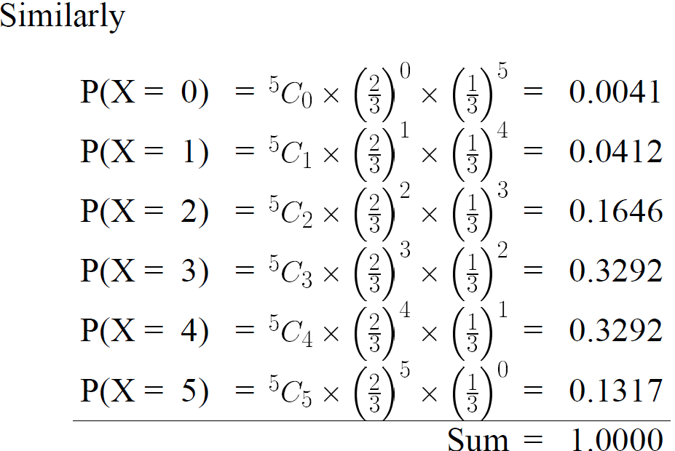

Slide 9
In our book

Slide 13
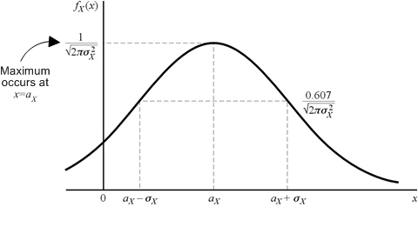
The Gaussian Random Variable

Slide 14
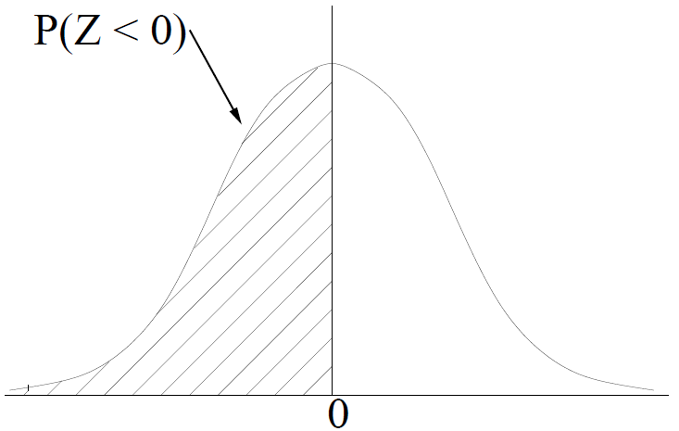

Slide 15
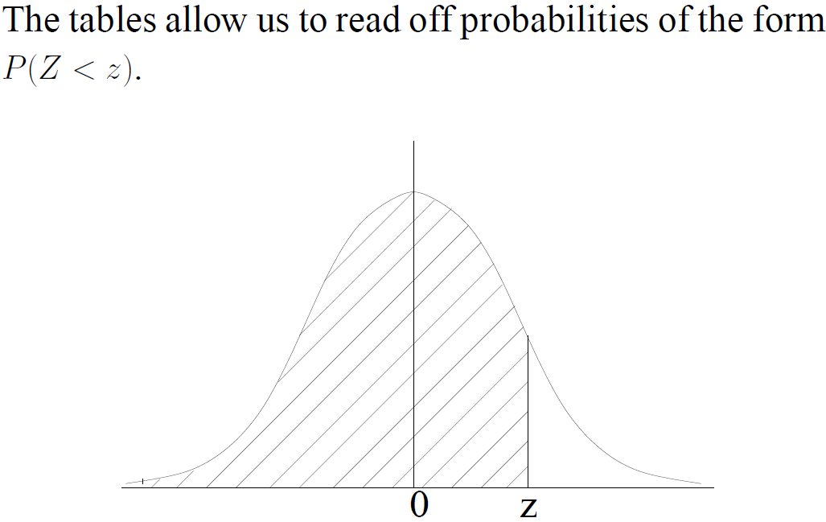

Slide 16
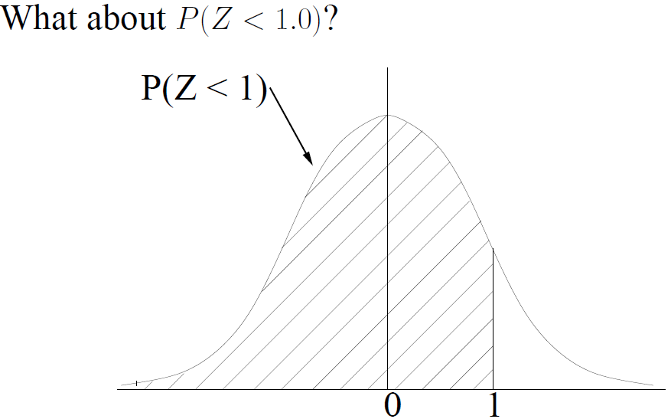

Slide 17
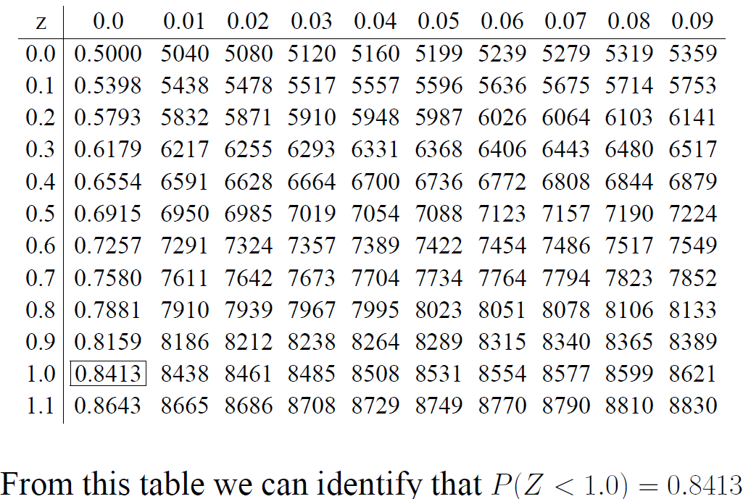

Slide 18
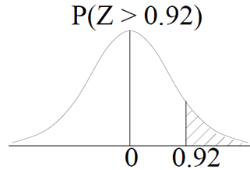
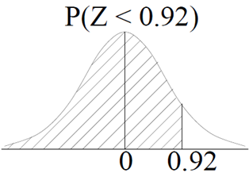

Slide 20
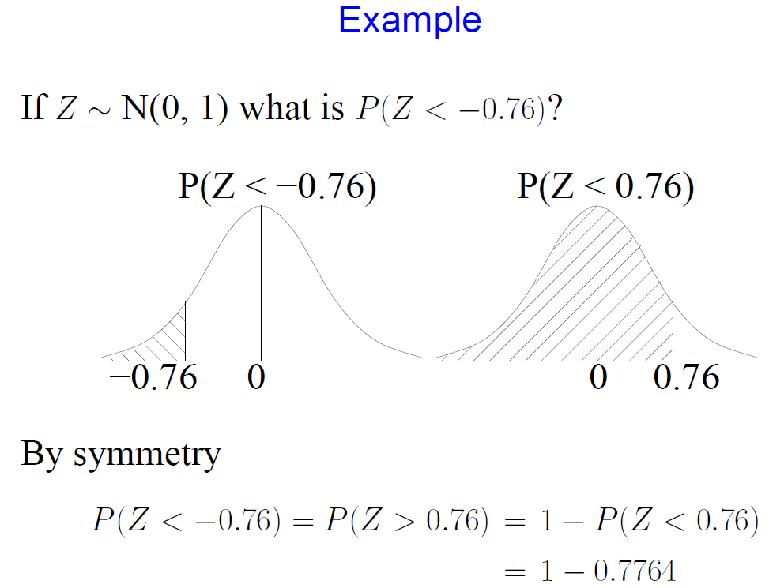

Slide 21
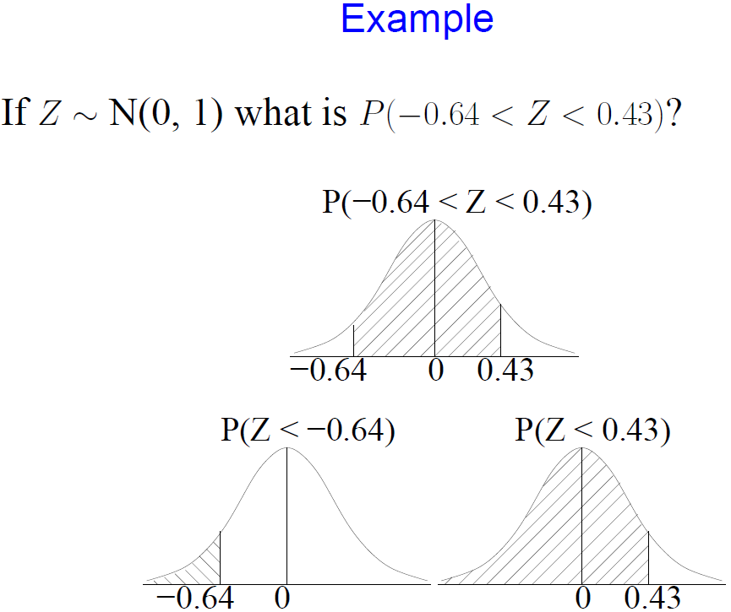

Slide 22
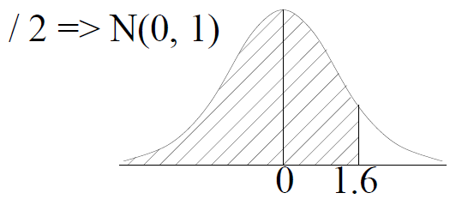

Slide 23
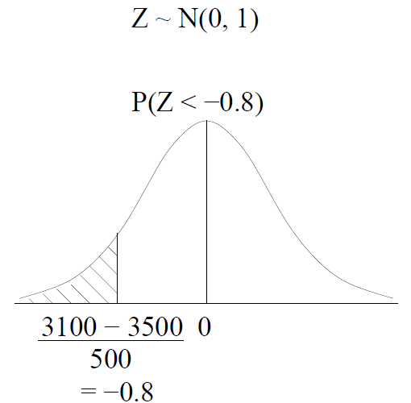
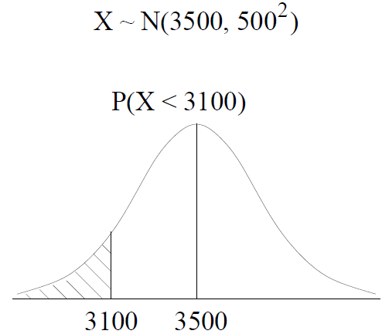

Slide 28
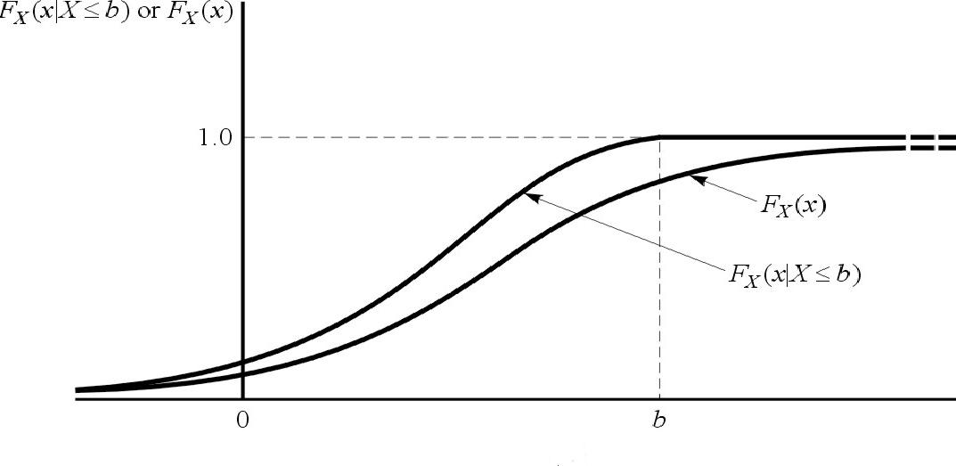

Slide 29
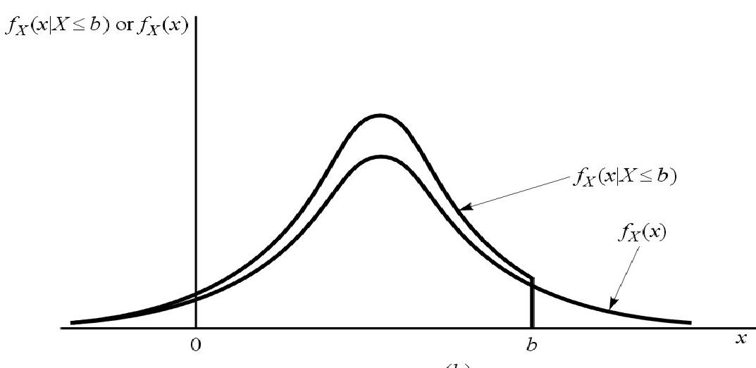
The conditional density function derives from the derivative
Similarly for the conditional density function

Slide 30
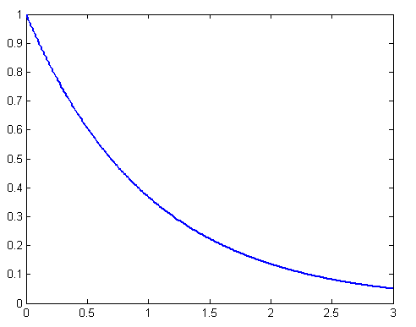
Example 8 Let X be a random variable with an exponential
probability density function given as
Find the probability P( X < 1 | X ≤ 2 )

Slide 32
Ch3 Operations on one random
variable-Expectation

Slide 34
Conditional Expectation
We define the conditional density function for a given event
we now define the conditional expectation in similar manner

Slide 35
Moments

Slide 37
Moments
Moments about the origin
Moments about the mean
called central moments

Slide 39
3.3 Function that Give moments

Slide 40
Example Let X be a random variable with an exponential
probability density function given as
Now let us find the 1st moment (expected value) using the characteristic function

Slide 41
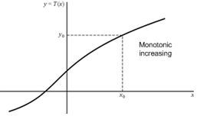
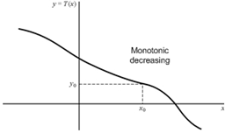
3.4 Transformations of A Random Variable

Slide 42
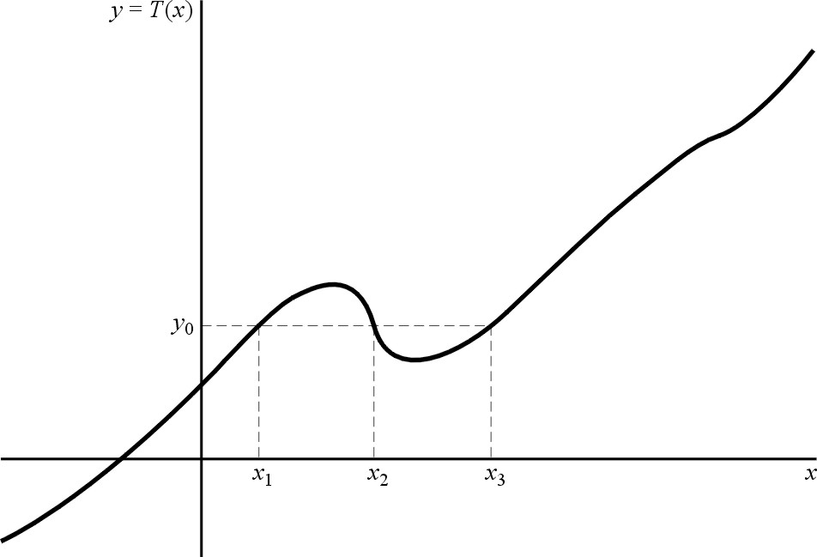
Nonmonotonic Transformations of a Continuous Random Variable

Slide 43
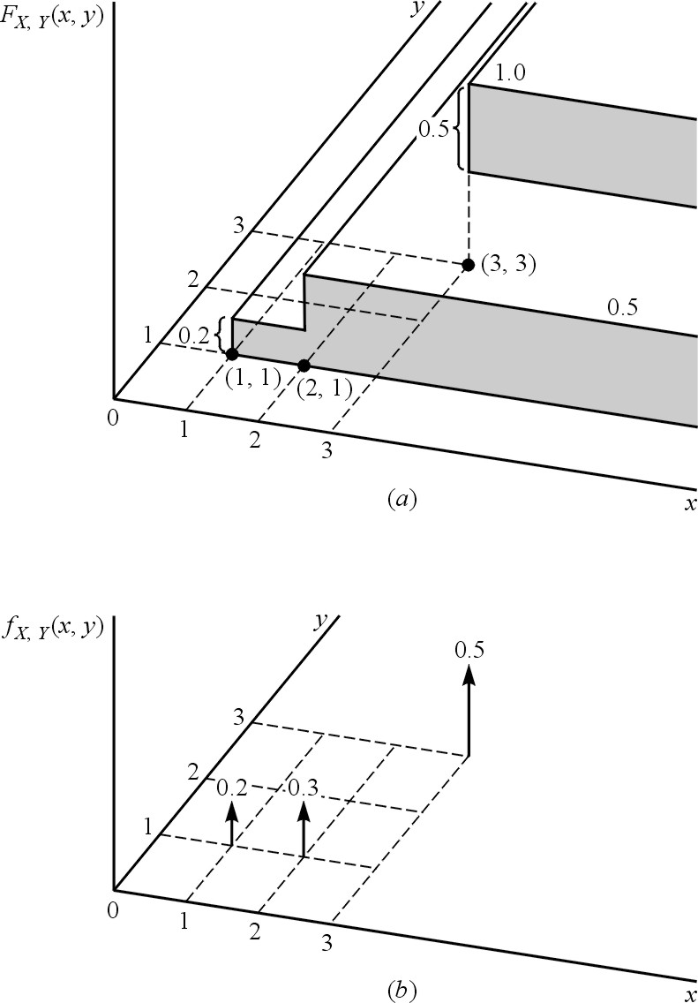
Ch4: Multiple Random Variables
Joint Distribution and its Properties

Slide 44
Properties of the joint distribution

Slide 45
Marginal Distribution Functions
Joint Density and its Properties

Slide 46
Properties of the Joint Density
Properties (1) and (2) may be used as sufficient test to determine if some function can be a valid density function
Marginal Distribution
Marginal Densities

Slide 47
Conditional Distribution and Density
The conditional distribution function of a random variable X given some event B was defined as
The corresponding conditional density function was defined through the derivative

Slide 48
(1) X and Y are Discrete
(2) X and Y are Continuous

Slide 49
STATICAL INDEPENDENCE

Slide 50
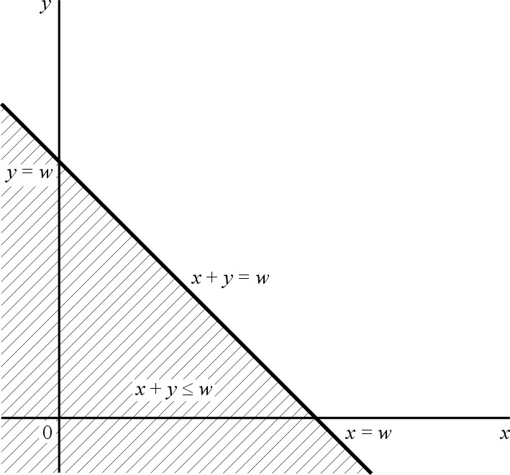

Slide 51
Operations on Multiple Random Variables

Slide 55
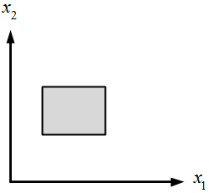
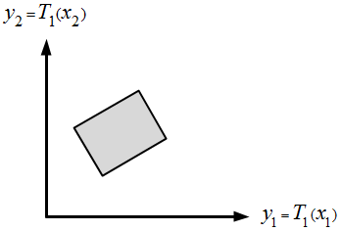

Slide 56
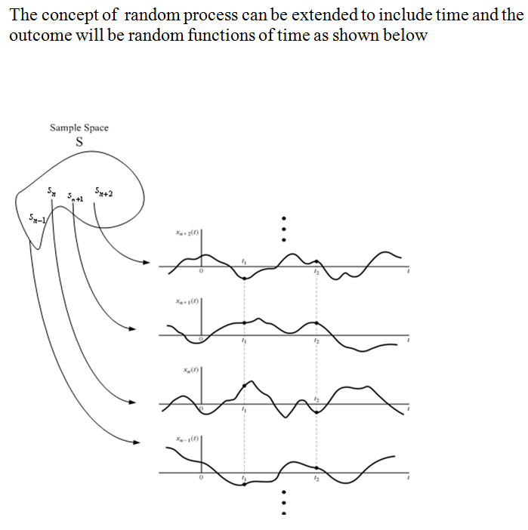
Random Process and its Applications to linear systems

Slide 57
Distribution and Density of Random Processes

Slide 60
