Slide 1
ICS103: Programming in C 8: Strings
Muhamed F. Mudawar

Slide 2
Outline
String Constants and Variables
String Input and Output
Character Related Functions
String Library Functions
Arrays of Strings and Arrays of Pointers

Slide 3
What is a String Constant?
A sequence of characters enclosed in double quotes
Example: "Hello World"
Can be used in a printf statement:
printf("Average = %.2f\n", avg);
Can also appear in #define directive, such as:
#define ERR_MSG "Error message: "

Slide 4
What is a String Variable?
In C, a string variable is an array of type char
We can declare a string variable as follows:
char string_var[20]; /* Array of char */
We can initialize a string variable as follows:
/* A list of chars terminated by '\0' */
char str[16] = {'H','e','l','l','o',' ',
'W','o','r','l','d','\0'};
/* A string enclosed between double quotes */
char str[16] = "Hello World";
0 | 1 | 2 | 3 | 4 | 5 | 6 | 7 | 8 | 9 | 10 | 11 | 12 | 13 | 14 | 15
H | e | l | l | o |  | W | o | r | l | d | \0 | ? | ? | ? | ?
array str[16]

Slide 5
String Variables (cont'd)
We can omit the string (array) size as follows:
char str2[] = "Hello World"; /* 12 chars */
Only 12 characters are allocated (including '\0')
We can also declare a pointer to a string as follows:
char *ptr = "Hello World";
0 | 1 | 2 | 3 | 4 | 5 | 6 | 7 | 8 | 9 | 10 | 11
H | e | l | l | o |  | W | o | r | l | d | \0
array str2[]
ptr
0 | 1 | 2 | 3 | 4 | 5 | 6 | 7 | 8 | 9 | 10 | 11
H | e | l | l | o |  | W | o | r | l | d | \0
string constant

Slide 6
The NULL Character '\0'
It is a byte that has the value zero
Used to mark the end of a string in C
A string constant is always ended with '\0'
For example: "Hello World" has 12 chars (not 11)
C functions use '\0' to compute the string length
To avoid passing the size of a string to a function
A string variable must also terminate with a NULL char
The empty string "" stores the NULL char '\0'
0 | 1 | 2 | 3 | 4 | 5 | 6 | 7 | 8 | 9 | 10 | 11
H | e | l | l | o |  | W | o | r | l | d | \0

Slide 7
Next . . .
String Constants and Variables
String Input and Output
Character Related Functions
String Library Functions
Arrays of Strings and Arrays of Pointers

Slide 8
Input a String with scanf
To input a string, the placeholder must be %s
char str[16];
/* str length must not exceed 15 chars */
scanf("%s", str);
/* when reading a string, scanf skips white */
/* space such as blanks, newlines, and tabs */
/* It stops reading at first white space */
/* It inserts '\0' at end of str */
scanf("%15s", str);
/* prevents reading more than 15 chars */
Notice that there is no need for & before str
Because str is an array, and it is passed by address

Slide 9
Output a String with printf
To print a string, the placeholder must also be %s
Example of string input and output:
char str[16]; /* must not exceed 15 chars */
printf("Enter your first name: ");
scanf("%15s", str);
printf("Hello %s\n", str);
If printf displays a string that does not end with '\0' then it causes a run-time error

Slide 10
Example of String Input / Output
#include <stdio.h>
int main(void) {
char dept[8], days[8];
int course_num, time;
printf("Enter course code, number, days, and time\n");
printf("Similar to this: MATH 101 UTR 1100\n");
printf("\n> ");
scanf("%s%d%s%d", dept, &course_num, days, &time);
printf("%s %d meets %s at %d\n", dept, course_num,
days, time);
return 0;
}

Slide 11
Placeholders Used with printf
Value | Placeholder | Output (  is blank)
'a' | %c %3c %-3c | a a a
-10 | %d %6d %-6d | -10 -10 -10
49.76 | %.3f %9.1f %9.2e | 49.760 49.8 4.98e+01
"fantastic" | %s %12s %-12s | fantastic fantastic fantastic

Slide 12
The gets and puts functions
A problem with scanf it that it stops reading a string when it encounters a blank (or any whitespace).
Blanks are natural separators between numeric data values, but it is a valid character in a string.
To read a full line, the gets function continues reading until the newline char (Enter key) is read.
The '\n' character representing the Enter key is not stored in the string. It is replaced with '\0'.
The puts function is used to print a string.
puts automatically prints '\n' at end of the string.

Slide 13
Example of gets and puts
char line[80];
printf("Type anything: ");
gets(line);
printf("You typed: ");
puts(line);

Slide 14
File Input with fgets
For data files, the stdio library provides the fgets function that works similar to gets
char * fgets(char str[], int n, FILE *infile);
fgets reads characters from infile into str, until it reads'\n' or n-1 chars, whichever comes first.
fgets inserts '\0' at end of str
Unlike gets, fgets reads the '\n' char into str
fgets returns the address of str as its result value
If fgets cannot read from infile (End-Of-File or some error) then it returns the NULL pointer

Slide 15
File Output with fputs
In addition, the stdio library provides the fputs function that works similar to puts
int fputs(char str[], FILE *outfile);
fputs outputs str to outfile
Unlike puts, fputs does not output an extra newline character to outfile
fputs returns 0 if the file operation is successful
It returns -1 if it cannot write to outfile

Slide 16
Example of fgets and fputs
#include <stdio.h>
#define L_SIZE 100 /* line size */
#define N_SIZE 40 /* name size */
int main() {
char line[L_SIZE], inname[N_SIZE], outname[N_SIZE];
printf("Enter the name of input file: ");
scanf("%s", inname);
FILE *infile = fopen(inname, "r");
if (infile == NULL) {
printf("Can't open %s", inname);
return 1; /* terminate program */
}
printf("Enter the name of output file: ");
scanf("%s", outname);

Slide 17
Example of fgets and fputs
FILE *outfile = fopen(outname, "w");
if (outfile == NULL) {
printf("Can't open %s", outname);
return 1; /* terminate program */
}
char *status = fgets(line, L_SIZE, infile);
while (status != NULL) {
fputs(line, outfile);
status = fgets(line, L_SIZE, infile);
}
fclose(infile);
fclose(outfile);
return 0;
}

Slide 18
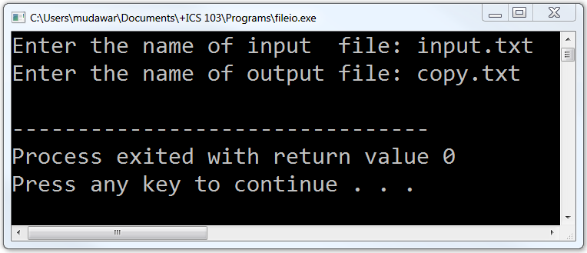
Sample Run . . .

Slide 19
Next . . .
String Constants and Variables
String Input and Output
Character Related Functions
String Library Functions
Arrays of Strings and Arrays of Pointers

Slide 20
Character Related Functions
In addition to the string library functions, C provides functions that facilitate character handling.
To use these functions #include <ctype.h>
Function | Description
int isalnum(ch); | true if ch is alphanumeric
int isalpha(ch); | true if ch is alphabetic
int isdigit(ch); | true if ch is digit
int isupper(ch); | true if ch is uppercase letter
int islower(ch); | true if ch is lowercase letter
int isspace(ch); | true if ch is whitespace
int iscntrl(ch); | true if ch is a control character
int ispunct(ch); | true if ch is a punctuation character
int toupper(ch); | convert ch to uppercase
int tolower(ch); | convert ch to lowercase

Slide 21
Converting a String to Uppercase
#include <stdio.h>
#include <ctype.h>
int main() {
char s[] = "ICS 103: Computer Programming in C";
int i;
for (i=0; s[i] != '\0'; i++)
s[i] = toupper(s[i]);
puts(s);
printf("The digits in the string are: ");
for (i=0; s[i] != '\0'; i++)
if (isdigit(s[i])) printf("%c", s[i]);
printf("\n");
return 0;
}

Slide 22
Counting Letters, Digits, Spaces, . . .
#include <stdio.h>
#include <ctype.h>
int main() {
char line[100];
int letters=0, digits=0, spaces=0, puncts=0, others=0;
int i, total=0;
printf("Type anything on the next line . . .\n");
gets(line);
for (i=0; line[i] !='\0'; i++) {
total++;
if (isalpha(line[i])) letters++;
else if (isdigit(line[i])) digits++;

Slide 23
Counting Letters, Digits, Spaces, . . .
else if (isspace(line[i])) spaces++;
else if (ispunct(line[i])) puncts++;
else others++;
}
printf("\nYou typed %d chars\n", total);
printf("The count of letters = %d\n", letters);
printf("The count of digits = %d\n", digits);
printf("The count of spaces = %d\n", spaces);
printf("Punctuation chars = %d\n", puncts);
printf("Other characters = %d\n", others);
return 0;
}

Slide 24
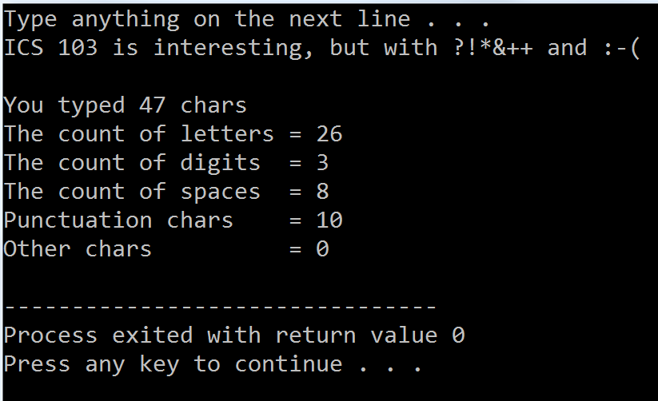
Sample Run . . .

Slide 25
Counting Vowels
#include <stdio.h>
int isvowel(char ch); /* Function Prototype */
int main( ) {
char line[100];
int i, vowels=0;
printf("Type anything on the next line . . .\n");
gets(line);
for (i=0; line[i] != '\0'; i++)
if (isvowel(line[i])) vowels++;
printf("\nNumber of vowels = %d\n", vowels);
return 0;
}

Slide 26
Function isvowel
/* Returns true if character ch is a vowel */
int isvowel(char ch) {
return (ch == 'a' || ch == 'A' ||
ch == 'e' || ch == 'E' ||
ch == 'i' || ch == 'I' ||
ch == 'o' || ch == 'O' ||
ch == 'u' || ch == 'U') ;
}

Slide 27
Next . . .
String Constants and Variables
String Input and Output
Character Related Functions
String Library Functions
Arrays of Strings and Arrays of Pointers

Slide 28
String Library Functions
The standard C library contains useful string functions
Can be used by including the following header file:
#include <string.h>
Here, we look at few string library functions:
strcpy, strlen, strcmp, strcat, strtok, strchr, strstr
The full list is available in appendix B
The string library functions expects all strings to be terminated with the null character '\0'

Slide 29
String Copy: strcpy
We typically use = to copy data into a variable
char c, t[16], s[16] = "Example string";
c = 'a'; /* this is ok */
t = "Test string"; /* this does not work */
t = s; /* this does not work */
We can use = to initialize a string, but not to assign
To assign a string, use the string copy function
strcpy copies the src string into the dest string:
char *strcpy(char dest[], char src[]);
strcpy copies all characters in the src string up to and including the null char into the dest string

Slide 30
Examples: strcpy
char t[16], s[16] = "Example string";
strcpy(t, "Test string");
strcpy(t, s);
0 | 1 | 2 | 3 | 4 | 5 | 6 | 7 | 8 | 9 | 10 | 11 | 12 | 13 | 14 | 15
E | x | a | m | p | l | e |  | s | t | r | i | n | g | \0 | ?
array s[16]
0 | 1 | 2 | 3 | 4 | 5 | 6 | 7 | 8 | 9 | 10 | 11 | 12 | 13 | 14 | 15
T | e | s | t |  | s | t | r | i | n | g | \0 | ? | ? | ? | ?
array t[16]
0 | 1 | 2 | 3 | 4 | 5 | 6 | 7 | 8 | 9 | 10 | 11 | 12 | 13 | 14 | 15
E | x | a | m | p | l | e |  | s | t | r | i | n | g | \0 | ?
array t[16]

Slide 31
String Length: strlen
strlen counts the number of characters in a string that appear before the null character '\0'
int strlen(char s[]);
The null character is NOT counted
The empty string "" that starts with a null character has a strlen equal to 0
Examples:
char s1[20] = "", s2[20] = "KFUPM, Dhahran"
int len1 = strlen(s1);
int len2 = strlen(s2);
/* returns 0 */
/* returns 14 */

Slide 32
String Comparison: strcmp
Characters are represented by numeric codes
We can compare characters using relational operators
For example: if (ch1 < ch2) { . . . }
However, if str1 and str2 are arrays of characters
We cannot compare strings like this: (str1 < str2)
To compare two strings, we use the strcmp function
int strcmp(char str1[], char str2[]);
Compares the two strings alphabetically (ASCII codes)
Returns 0 if str1 is equal to str2
Returns -1 if str1 is less than str2
Returns +1 if str1 is greater than str2

Slide 33
Examples: strcmp
char s1[16] = "Long string";
char s2[16] = "Short";
char s3[16] = "short";
char s4[16] = "";
printf("%d ", strcmp(s1, s2));
printf("%d ", strcmp(s2, s3));
printf("%d ", strcmp(s3, s4));
printf("%d ", strcmp(s4, s4));

Slide 34
String Concatenation: strcat
Concatenation means appending a source string at the end of a destination string to make it longer.
char * strcat(char dest[], char src[]);
The src string is copied at the end of the dest string
The position of the null char in the dest string is set after the appended copy of the src string.
Overflow is possible if the dest string does not have sufficient space to append the src string.
If overflow happens, other variables can be overwritten, which might cause a runtime error

Slide 35
Example: strcat
#include <stdio.h>
#include <string.h>
int main(void) {
char first[20], last[20], full[40];
printf("Enter your first name: ");
gets(first);
printf("Enter your last name: ");
gets(last);
strcpy(full, first);
strcat(full, " ");
strcat(full, last);
printf("Your full name is: ");
puts(full);
return 0;
}

Slide 36
String Tokenization: strtok
Tokenization means splitting a string into parts called tokens based on a specified set of delimiters.
char * strtok(char str[], char delims[]);
The first call to strtok should have str point to the string to be tokenized
Subsequent calls to strtok must use NULL as str
The strtok function returns a pointer to the next token in str that ends with a delimiter in delims
It modifies str by replacing delimiters with '\0'
It returns NULL when tokens are exhausted

Slide 37
Example: strtok
#include <stdio.h>
#include <string.h>
int main(void) {
char date[20];
printf("Enter a date like this: May 5, 2014\n> ");
gets(date);
char *month = strtok(date, " ,"); /* first call */
char *day = strtok(NULL, " ,"); /* subsequent call */
char *year = strtok(NULL, " ,"); /* subsequent call */
puts(month);
puts(day);
puts(year);
return 0;
}
month
day
year
J | a | n | u | a | r | y |  | 2 | 5 | , |  | 2 | 0 | 1 | 9 | , | \ 0 | ? | ?
\
0
\
0
\
0
array date[20]

Slide 38
Searching a String
Two functions for searching a string:
char * strchr(char str[], char target);
char * strstr(char str[], char target[]);
strchr returns a pointer to the first occurrence of target char in str, or NULL if target is not found
strstr returns a pointer to the first occurrence of target string in str, or NULL if no match is found

Slide 39
Example of strstr
#include<stdio.h>
#include<string.h>
int main(void) {
char sentence[100], word[40], *result;
printf("Enter a sentence: ");
gets(sentence);
printf("Enter a word to search: ");
gets(word);
result = strstr(sentence, word);
if (result != NULL) printf("%s was found\n", word);
else printf("%s was not found\n", word);
return 0;
}

Slide 40
Next . . .
String Constants and Variables
String Input and Output
Character Related Functions
String Library Functions
Arrays of Strings and Arrays of Pointers

Slide 41
Arrays of Strings
An array of strings is a 2D array of characters
The first dimension represents the number of strings
The second dimension represents the string itself
Example: declare an array to store up to 30 names, each of size 20 chars (including null character)
#define MAX_NAMES 30
#define NAME_SIZE 20
. . .
char names[MAX_NAMES][NAME_SIZE];

Slide 42
Arrays of Pointers
An array of pointers is a 1D array of addresses
char *ptr[30]; /* array of 30 pointers */
Initializing an array of strings:
char month[12][10] = {"January", "February",
"March", "April", "May", "June", "July",
"August", "September", "October",
"November", "December" };
Initializing an array of pointers:
char *month[12] = { "January", "February",
"March", "April", "May", "June", "July",
"August", "September", "October",
"November", "December" };

Slide 43
Array of Strings versus Pointers
char month[12][10]
char *month[12]
J | a | n | u | a | r | y | \0
F | e | b | r | u | a | r | y | \0
M | a | r | c | h | \0
A | p | r | i | l | \0
M | a | y | \0
J | u | n | e | \0
J | u | l | y | \0
A | u | g | u | s | t | \0
S | e | p | t | e | m | b | e | r | \0
O | c | t | o | b | e | r | \0
N | o | v | e | m | b | e | r | \0
D | e | c | e | m | b | e | r | \0
"January"
"February"
"March"
"April"
"May"
"June"
"July"
"August"
"September"
"October"
"November"
"December"

Slide 44
Sorting an Array of Names (1 of 4)
/* Sort an array of names alphabetically */
#include <stdio.h>
#include <string.h>
#define MAX_NAMES 30 /* maximum number of names */
#define NAME_SIZE 20 /* maximum name size */
/* read n names into array of strings */
void read_names(char array[][NAME_SIZE], int n);
/* print an array of n names */
void print_names(char array[][NAME_SIZE], int n);
/* sort an array of n names alphabetically */
void sort_names(char array[][NAME_SIZE], int n);

Slide 45
Sorting an Array of Names (2 of 4)
/* main function */
int main() {
int total;
char name[MAX_NAMES][NAME_SIZE];
printf("Enter total number of names: ");
scanf("%d", &total);
read_names(name, total);
sort_names(name, total);
printf("\nAlphabetical sorting of names\n\n");
print_names(name, total);
return 0;
}

Slide 46
Sorting an Array of Names (3 of 4)
/* read n names into array of strings */
void read_names(char array[][NAME_SIZE], int n) {
int i;
for (i=0; i<n; i++) {
printf("Enter name[%d]: ", i);
scanf("%s", array[i]);
}
}
/* print an array of n names */
void print_names(char array[][NAME_SIZE], int n) {
int i;
for (i=0; i<n; i++) puts(array[i]);
}

Slide 47
Sorting an Array of Names (4 of 4)
void sort_names(char array[][NAME_SIZE], int n) {
int fill, index_min, j;
char temp_name[NAME_SIZE]; /* temporary name */
for (fill=0; fill < n-1; fill++) {
index_min = fill;
for (j=fill+1; j<n; j++) {
if (strcmp(array[j], array[index_min]) < 0)
index_min = j; /* found a new min */
}
strcpy(temp_name, array[fill]);
strcpy(array[fill], array[index_min]);
strcpy(array[index_min], temp_name);
}
}

Slide 48
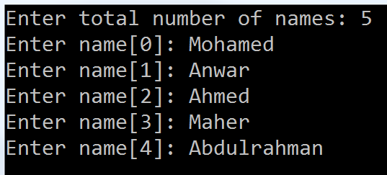
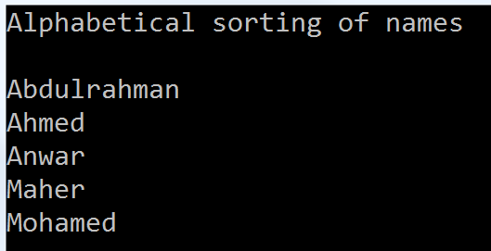
Sample Run . . .

