Slide 1
ICS103: Programming in C 7: Arrays
Muhamed F. Mudawar

Slide 2
Outline
Declaring, Initializing, and Indexing Arrays
Using Loops for Sequential Array Access
Using Array Elements as Function Arguments
Array Arguments
Partially Filled Arrays

Slide 3
What is an Array?
Scalar data types, such as int, store a single value
Sometimes, we need to store a collection of values
An array is a collection of data items, such that:
All data values are of the same type (such as int)
Are referenced by the same array name
Individual cells in an array are called array elements
An array is called a data structure
Because it stores many data items under the same name
Example: using an array to store exam scores

Slide 4
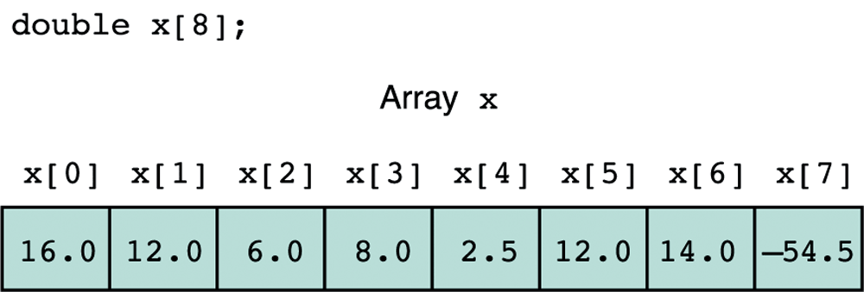
Declaring Arrays
To declare an array, we must declare:
The array name
The type of array element
The number of array elements
Example: double x[8];
Associate 8 elements with array name x

Slide 5
Initializing Arrays
You can declare a variable without initialization
double average; /* Not initialized */
You can also declare a variable with initialization
int sum = 0; /* Initialized to 0 */
Similarly, you can declare arrays without initialization
double x[20]; /* Not initialized */
You can also declare an array and initialize it
int prime[5] = {2, 3, 5, 7, 11};
No need to specify the array size when initializing it
int prime[] = {2, 3, 5, 7, 11};

Slide 6
Visualizing an Array in Memory
/* Array A has 6 elements */
int A[] = {9, 5, -3, 10, 27, -8};
Memory
Addresses
Array A
All arrays start at index 0
0
1
2
3
4
5
9
5
-3
10
27
-8
342900
342904
342908
342912
342916
342920
Array Index (subscript)
Array Element

Slide 7
Array Indexing
double x[8];
Each element of x stores a value of type double
The elements are indexed starting with index 0
An array with 8 elements is indexed from 0 to 7
x[0] refers to 0th element (first element) of array x
x[1] is the next element in the array, and so on
The integer enclosed in brackets is the array index
The index must range from zero to array size – 1

Slide 8
Array Indexing (cont'd)
An array index is also called a subscript
Used to access individual array elements
Examples of array indexing:
x[2] = 6.0; /* index 2 */
y = x[i+1]; /* index i+1 */
Array index should be any expression of type int
A valid index must range from 0 to array size – 1
C compiler does not provide array bound checking
It is your job to ensure that each index is valid

Slide 9
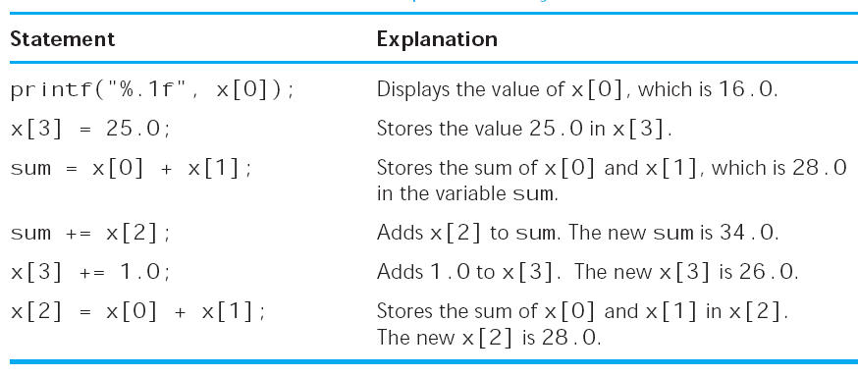
Statements that Manipulate Array x

Slide 10
Arrays of Characters
You can declare and initialize a char array as follows:
char vowels[] = {'A','E','I','O','U'};
You can also use a string to initialize a char array:
char string[] = "This is a string";
It is better to use a named constant as the array size:
#define SIZE 100
. . .
char name[SIZE]; /* Not initialized */
You can declare arrays and variables on same line:
char name[SIZE], answer;

Slide 11
Next . . .
Declaring, Initializing, and Indexing Arrays
Using Loops for Sequential Array Access
Using Array Elements as Function Arguments
Array Arguments
Partially Filled Arrays

Slide 12
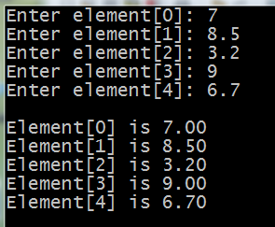
Array Input and Output
#include<stdio.h>
#define SIZE 5 /* array size */
int main(void) {
double x[SIZE];
int i;
for (i=0; i<SIZE; i++) {
printf("Enter element[%d]: ", i);
scanf("%lf", &x[i]);
}
printf("\n");
for (i=0; i<SIZE; i++)
printf("Element[%d] is %.2f\n", i, x[i]);
return 0;
}

Slide 13
Computing Sum and Sum of Squares
/* We use a for loop to traverse an
* array sequentially and accumulate
* the sum and the sum of squares
*/
double sum = 0;
double sum_sqr = 0;
for (i=0; i<SIZE; i++) {
sum += x[i];
sum_sqr += x[i] * x[i];
}

Slide 14
Computing Standard Deviation
The mean is computed as: sum / SIZE
The Standard Deviation is computed as follows:
$standard deviation=$ $\sqrt{\frac{\begin{matrix}\begin{matrix}\begin{matrix} \\ \end{matrix} \\ \end{matrix} \\ \end{matrix}}{ SIZE } −{mean}^{2}}$
$$\sum_{i=0}^{SIZE−1}{{x[i]}^{2}}$$

Slide 15
/* Program that computes the mean and standard deviation */
#include <stdio.h>
#include <math.h>
#define SIZE 8 /* array size */
int main(void) {
double x[SIZE], mean, st_dev, sum=0, sum_sqr=0;
int i;
/* Input the data */
printf("Enter %d numbers separated by blanks\n> ", SIZE);
for(i=0; i<SIZE; i++) scanf("%lf", &x[i]);
/* Compute the sum and the sum of the squares */
for(i=0; i<SIZE; i++) {
sum += x[i];
sum_sqr += x[i] * x[i];
}

Slide 16
/* Compute and print the mean and standard deviation */
mean = sum / SIZE ;
st_dev = sqrt(sum_sqr/SIZE - mean*mean);
printf("\nThe mean is %.2f.\n", mean);
printf("The standard deviation is %.2f.\n", st_dev);
/* Display the difference between an item and the mean */
printf("\nTable of differences ");
printf("\nBetween data values and the mean\n\n");
printf("Index Item Difference\n");
for(i=0; i<SIZE; i++)
printf("%3d %9.2f %9.2f\n", i, x[i], x[i]-mean);
return 0;
}

Slide 17
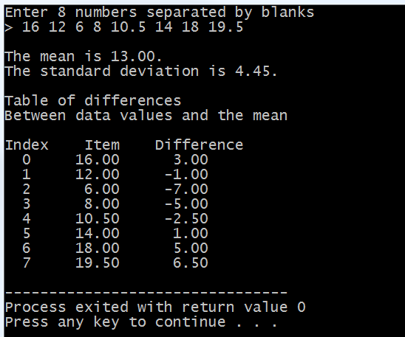
Sample Run . . .

Slide 18
Next . . .
Declaring, Initializing, and Indexing Arrays
Using Loops for Sequential Array Access
Using Array Elements as Function Arguments
Array Arguments
Partially Filled Arrays

Slide 19
Array Elements as Function Arguments
From the last example:
x[i] is used as an actual argument to printf
printf("%3d %9.2f %9.2f\n", i, x[i], x[i]-mean);
The value of x[i] is passed to printf
Similarly, &x[i] was an actual argument to scanf
scanf("%lf", &x[i]);
The address &x[i] is passed to scanf
Array elements are treated as scalar variables

Slide 20
Array Elements as Function Arguments
Suppose that we have a function do_it defined as:
void do_it(double x, double *p1, double *p2) {
*p1 = x + 5;
*p2 = x * x;
}
Let y be an array of double elements declared as:
double y[6]; /* not initialized */
y[0] = 3.0; /* initialize y[0] */
We can call the function do_it as follows:
do_it(y[0], &y[1], &y[2]);
It will change the values of y[1] and y[2]

Slide 21
do_it(y[0], &y[1], &y[2])
Data Area of Caller
do_it Data Area
Array y
x
y[0]
y[1]
y[2]
y[3]
y[4]
y[5]
3.0
8.0
9.0
?
?
?
3.0
p1
&y[1]
p2
&y[2]

Slide 22
Next . . .
Declaring, Initializing, and Indexing Arrays
Using Loops for Sequential Array Access
Using Array Elements as Function Arguments
Array Arguments
Partially Filled Arrays

Slide 23
Array Arguments
Besides passing array elements to functions, we can write functions that have arrays as arguments
Such functions can compute some or all of the array elements
Unlike scalar variables where we have the option of passing either the value or address of a variable to a function, C only passes the address of an array to a function array argument
An array cannot be passed by value to a function

Slide 24
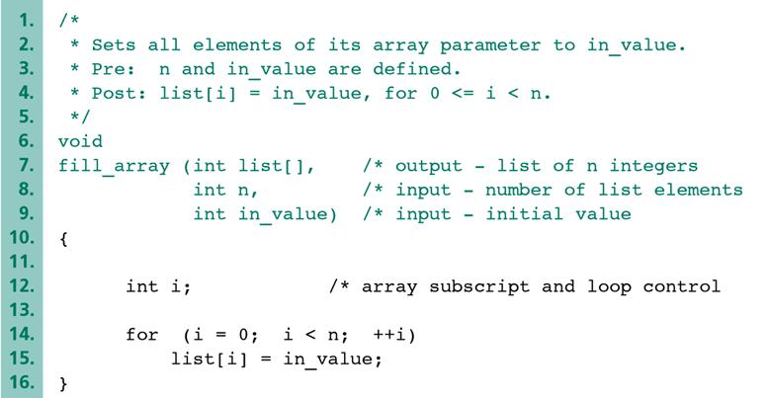
Example: Function fill_array
*/
*/
*/
*/
list[] parameter does not specify the array size
We can pass an array of any size to the function

Slide 25
Calling Function fill_array
To call fill_array, you must pass 3 arguments:
Actual array name to fill
Number of array elements to fill
Value to store in array
Examples of calling fill_array:
/* fill 5 elements of x with 1 */
fill_array(x, 5, 1);
/* fill 10 elements of y with num */
fill_array(y, 10, num);

Slide 26
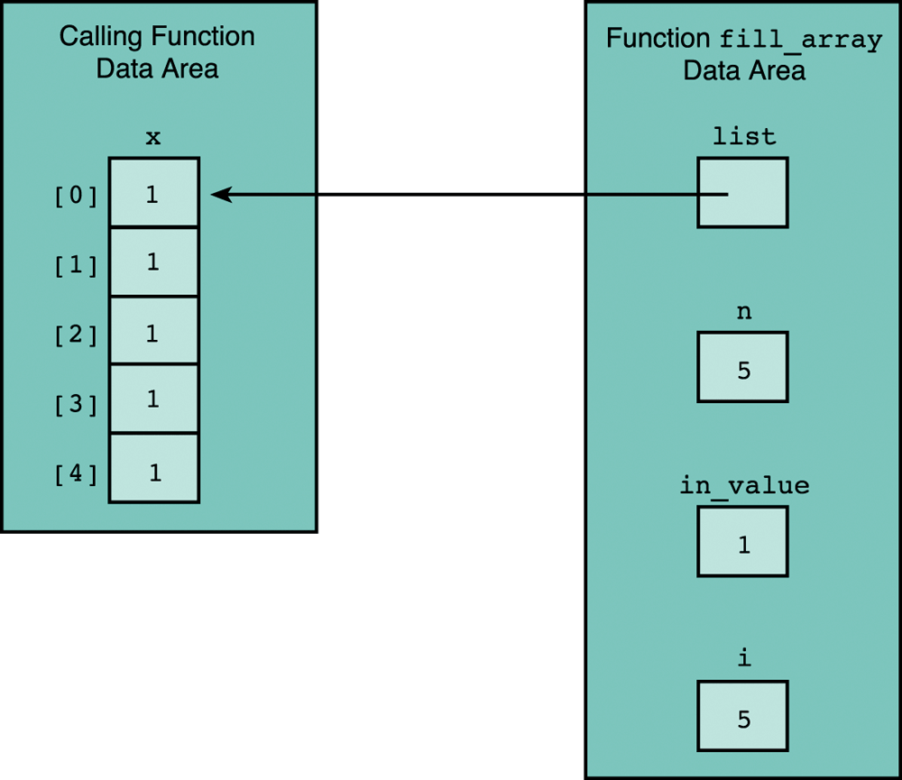
fill_array(x, 5, 1);
The address of array x is passed to list

Slide 27
An Array Argument is a Pointer
Equivalent declarations of function fill_array
void fill_array(int list[], int n, int val);
void fill_array(int *list, int n, int val);
The first declaration is more readable and preferable
Equivalent calls to function fill_array
fill_array(x, 5, num);
fill_array(&x[0], 5, num);
The first call is more readable and preferable

Slide 28
Arrays as Input Arguments
The const keyword indicates that list[] is an input parameter that cannot be modified by the function
/* Returns the max in an array of n elements */
/* Pre: First n elements of list are defined */
double get_max(const double list[], int n) {
int i;
double max = list[0];
for (i=1; i<n; ++i)
if (list[i] > max) max = list[i];
return max;
}

Slide 29
Compute Average of Array Elements
/* Returns the average of n array elements */
/* Pre: First n elements of list are defined */
double get_average(const double list[], int n)
{
int i;
double sum = 0;
for (i=0; i<n; ++i)
sum += list[i];
return (sum/n);
}
The const keyword indicates that list[] is an input parameter that cannot be modified by the function

Slide 30
Returning an Array Result
input
parameters
function
array result
(output parameter)
In C, the return type of a function cannot be an array
Thus, to return an array as result from a function, we can only have the array as an output parameter
Recall that output parameters for a function are declared as pointers
An array parameter is also a pointer
Thus, an array parameter is an output parameter, unless the const keyword is used

Slide 31
Example: read_array
/* read n doubles from the keyboard */
/* return an array of n doubles */
void read_array (double list[], int n) {
int i;
printf("Enter %d real numbers\n", n);
printf("Separated by spaces or newlines\n");
printf("\n>");
for (i = 0; i < n; ++i)
scanf("%lf", &list[i]);
}

Slide 32
/* Program to compute max and average of an array */
#include <stdio.h>
#define SIZE 8
void read_array (double list[], int n);
double get_max (const double list[], int n);
double get_average (const double list[], int n);
int main() {
double array[SIZE];
read_array(array, SIZE);
double max = get_max(array, SIZE);
double ave = get_average(array, SIZE);
printf("\nmax = %.2f, average = %.2f\n", max, ave);
return 0;
}

Slide 33
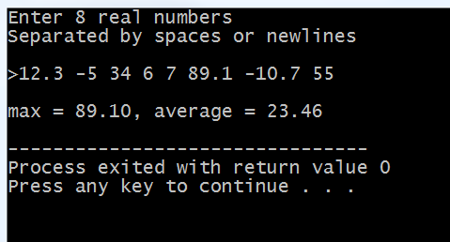
Sample Run . . .

Slide 34
Function to Add Two Arrays
/* Add n corresponding elements of arrays
a[] and b[], storing result in array sum[] */
void
add_arrays(const double a[], /* input array */
const double b[], /* input array */
double sum[], /* output array */
int n) /* n elements */
{
int i;
for (i=0; i<n; i++)
sum[i] = a[i] + b[i];
}

Slide 35
Next . . .
Declaring, Initializing, and Indexing Arrays
Using Loops for Sequential Array Access
Using Array Elements as Function Arguments
Array Arguments
Partially Filled Arrays

Slide 36
Partially Filled Arrays
The format of array declaration requires that we specify the array size at the point of declaration
Moreover, once we declare the array, its size cannot be changed. The array is a fixed size data structure
There are many programming situations where we do not really know the array size before hand
For example, suppose we want to read test scores from a data file and store them into an array, we do not know how many test scores exist in the file.
So, what should be the array size?

Slide 37
Partially Filled Arrays (cont'd)
One solution is to declare the array big enough so that it can work in the worst-case scenario
For the test scores data file, we can safely assume that no section is more than 50 students
We define the SIZE of the array to be 50
However, in this case, the array will be partially filled and we cannot use SIZE to process it
We must keep track of the actual number of elements in the array using another variable

Slide 38
Program to Read an Array from a File
#include <stdio.h>
#define SIZE 50 /* maximum array size */
int read_file(const char filename[], double list[]);
void print_array(const double list[], int n);
int main() {
double array[SIZE];
int count = read_file("scores.txt", array);
printf("Count of array elements = %d\n", count);
print_array(array, count);
return 0;
}

Slide 39
int read_file(const char filename[], double list[]) {
int count = 0;
FILE *infile = fopen(filename, "r");
if (infile == NULL) { /* failed to open file */
printf("Cannot open file %s\n", filename);
return 0; /* exit function */
}
int status = fscanf(infile, "%lf", &list[count]);
while (status == 1) { /* successful read */
count++; /* count element */
if (count == SIZE) break; /* exit while */
status = fscanf(infile, "%lf", &list[count]);
}
fclose(infile);
return count; /* number of elements read */
}

Slide 40
Function to Print an Array
void print_array(const double list[], int n) {
int i;
for (i=0; i<n; i++)
printf("Element[%d] = %.2f\n", i, list[i]);
}

Slide 41
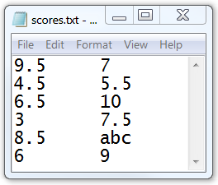
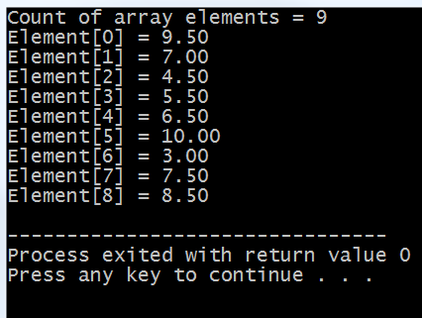
Sample Run . . .
Cannot read
abc as double

