Slide 1

ICS103: Programming in C
4: Selection Structures
Muhamed F. Mudawar

Slide 2
Outline
Control Structures
Conditions, Relational, and Logic Operators
The if Statement and Flowchart
if with Compound Statements
Nested if statements
The switch Statement
Operator Precedence, Complementing a Condition
Common Programming Errors

Slide 3
Control Structures
Control structure
  Control the flow of execution in a program or a function
Three kinds of control structures
  Sequence (Compound Statement)
  Selection (if and switch Statements)
  Repetition [Chapter 5]
Selection control structure
  Chooses among alternative program statements

Slide 4
Compound Statement
A group of statements bracketed by { and }
Executed Sequentially
A function body consists of a compound statement
{
statement₁ ;
statement₂ ;
. . .
statement_{n} ;
}
Compound
Statement
Specifies
Sequential
Execution

Slide 5
Conditions
Condition
  An expression that evaluates to false (0) or true (1)
Conditions are used in if statements, such as:
if (a >= b)
printf("a is greater or equal to b");
else
printf("a is less than b");
The condition in the above example: (a >= b)

Slide 6
Relational and Equality Operators
Operator | Meaning | Type
< | less than | relational
> | greater than | relational
<= | less than or equal to | relational
>= | greater than or equal to | relational
== | equal to | equality
!= | not equal to | equality
Evaluate to either false (0) or true (1)

Slide 7
Examples of Relational and
Equality Operators
x
i
MAX
y
item
mean
ch
num
-5
1024
1024
7
5.5
7.2
'M'
999
Operator | Condition | Value
<= | x <= 0 | true (1)
< | i < MAX | false (0)
>= | x >= y | false (0)
> | item > mean | false (0)
== | ch == 'M' | true (1)
!= | num != MAX | true (1)

Slide 8
Logical Operators
Three Logical Operators
&& logical AND
|| logical OR
! logical NOT
Truth Table for logical operators
A | B | (A && B) | (A || B) | !A
true | true | true | true | false
true | false | false | true | false
false | true | false | true | true
false | false | false | false | true

Slide 9
Logical Expressions
Logical Expression
  Condition that uses one or more logical operators
salary
children
temperature
humidity
n
1050
6
38.2
0.85
101
Logical Expression | Value
salary < 1000 || children > 4 | true (1)
temperature > 35.0 && humidity > 0.90 | false (0)
n >= 0 && n <= 100 | false (0)
!(n >= 0 && n <= 100) | true (1)

Slide 10
Comparing Characters
We can also compare characters in C
  Using the relational and equality operators
Expression | Value
'9' >= '0' | 1 (true)
'a' < 'e' | 1 (true)
'B' <= 'A' | 0 (false)
'Z' == 'z' | 0 (false)
'A' <= 'a' | 1 (true)
ch >= 'a' && ch <= 'z' | ch is lowercase?

Slide 11
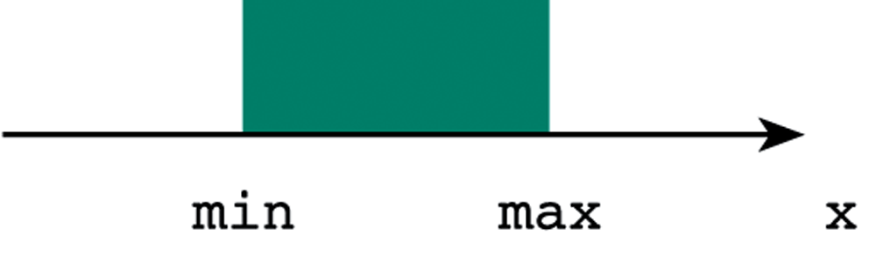

English Conditions as C Expressions
English Condition | Logical Expression
x and y are greater than z | x > z && y > z
x is equal to 1 or 3 | x == 1 || x == 3
x is in the range min to max | x >= min && x <= max
x is outside the range z to y | x < z || x > y

Slide 12
Next . . .
Control Structures
Conditions, Relational, and Logic Operators
The if Statement and Flowchart
if with Compound Statements
Nested if statements
The switch Statement
Operator Precedence, Complementing a Condition
Common Programming Errors

Slide 13
if Statement (One Alternative)
if (condition) statement_{T} ;
if condition evaluates to true then statement_{T} is executed; Otherwise, statement_{T} is skipped
Example:
if (x != 0.0)
product = product * x ;

Slide 14
if Statement (Two Alternatives)
if (condition) statement_{T} ;
else statement_{F} ;
if condition evaluates to true then statement_{T} is executed and statement_{F} is skipped; Otherwise, statement_{T} is skipped and statement_{F} is executed
Example:
if (x >= 0.0) printf("Positive");
else printf("Negative");

Slide 15
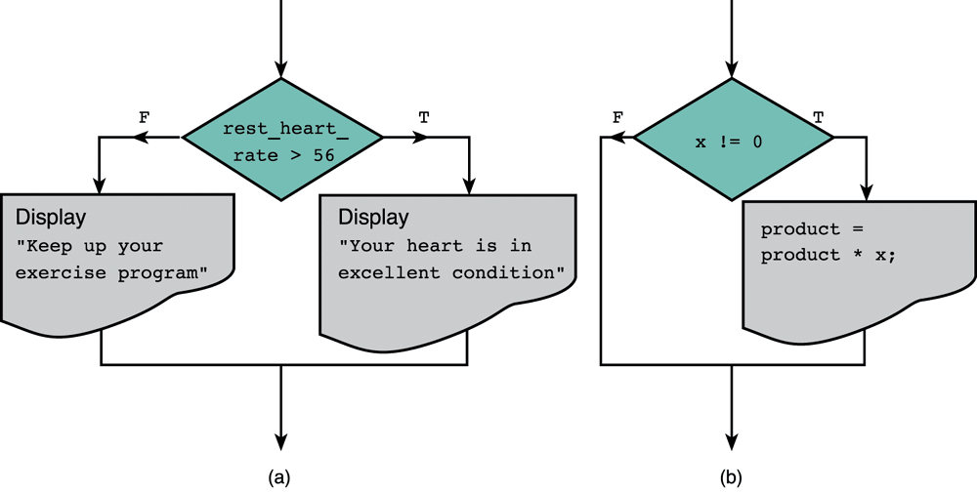
Flowcharts of if Statements
Two Alternatives
if-else statement
One Alternative
if statement

Slide 16
if with Compound Statements
if (ch >= 'A' && ch <= 'Z') {
printf("Letter '%c' is Uppercase\n", ch);
ch = ch – 'A' + 'a';
printf("Converted to lowercase '%c'\n", ch);
}
else {
printf("'%c' is not Uppercase letter\n", ch);
printf("No conversion is done\n");
}

Slide 17
Hand Tracing an if Statement
if (x > y) { /* switch x and y */
temp = x; /* save x in temp */
x = y; /* x becomes y */
y = temp; /* y becomes old x */
}
if statement | x | y | temp | Effect
 | 12.5 | 5.0 | ?
if (x>y) { |  |  |  | 12.5>5.0 is true
temp = x ; |  |  | 12.5 | Store old x in temp
x = y ; | 5.0 |  |  | Store y in x
y = temp ; |  | 12.5 |  | Store old x in y

Slide 18
Next . . .
Control Structures
Conditions, Relational, and Logic Operators
The if Statement and Flowchart
if with Compound Statements
Nested if statements
The switch Statement
Operator Precedence, Complementing a Condition
Common Programming Errors

Slide 19
Nested if Statements
Nested if statement
  if statement inside another if statement
  Program decisions with multiple alternatives
Example
if (x > 0)
num_pos = num_pos + 1;
else
if (x < 0)
num_neg = num_neg + 1;
else /* x equals 0 */
num_zero = num_zero + 1;

Slide 20
Multiple-Alternative Decision Form
The conditions are evaluated in sequence until a true condition is reached
If a condition is true, the statement following it is executed, and the rest is skipped
if (x > 0)
num_pos = num_pos + 1;
else if (x < 0)
num_neg = num_neg + 1;
else /* x equals 0 */
num_zero = num_zero + 1;
More
Readable

Slide 21
Sequence of if Statements
All conditions are always tested (none is skipped)
Less efficient than nested if for alternative decisions
if (x > 0)
num_pos = num_pos + 1;
if (x < 0)
num_neg = num_neg + 1;
if (x == 0)
num_zero = num_zero + 1;
Less
Efficient
than
nested if

Slide 22
Implementing a Decision Table
Use a multiple-alternative if statement to implement a decision table that describes several alternatives
Salary Range ($) | Base Tax | Rate
Salary < $15,000 | $0 | 15%
$15,000 ≤ Salary < $30,000 | $2,250 | 18%
$30,000 ≤ Salary < $50,000 | $4,950 | 22%
$50,000 ≤ Salary < $80,000 | $9,350 | 27%
Salary ≥ $80,000 | $17,450 | 33%

Slide 23
Computing the Tax from a Table
if (salary < 15000)
tax = 0.15*salary;
else if (salary < 30000)
tax = 2250 + (salary – 15000)*0.18;
else if (salary < 50000)
tax = 4950 + (salary – 30000)*0.22;
else if (salary < 80000)
tax = 9350 + (salary – 50000)*0.27;
else
tax = 17450 + (salary – 80000)*0.33;

Slide 24
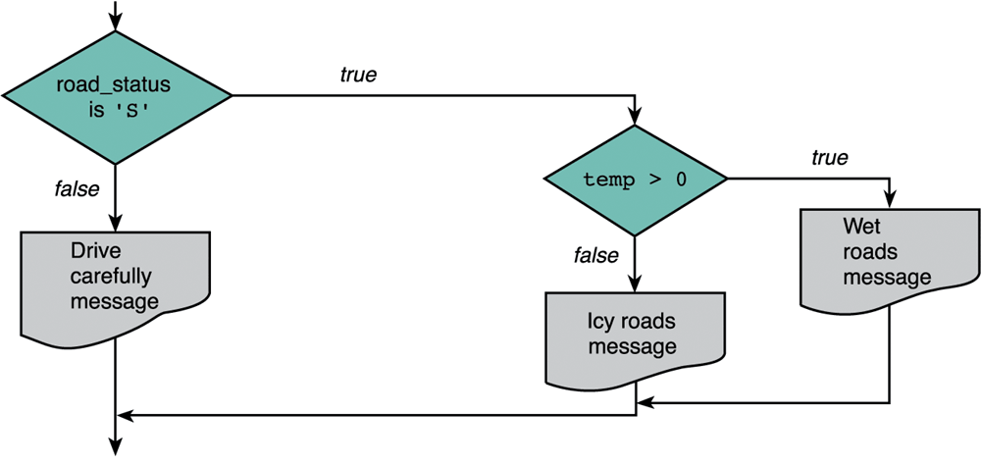
Road Sign Decision
You are writing a program to control the warning signs at the exists of major tunnels.
'S' means road is Slick or Slippery
temperature

Slide 25
Road Sign Nested if Statement
if (road_status == 'S')
if (temp > 0) {
printf("Wet roads ahead\n");
printf("Stopping time = 10 minutes\n");
}
else {
printf("Icy roads ahead\n"); printf("Stopping time = 20 minutes\n");
}
else
printf("Drive carefully!\n");
C associates else with the most recent incomplete if

Slide 26
Next . . .
Control Structures
Conditions, Relational, and Logic Operators
The if Statement and Flowchart
if with Compound Statements
Nested if statements
The switch Statement
Operator Precedence, Complementing a Condition
Common Programming Errors

Slide 27
The switch Statement
Can be used to select one of several alternatives
Based on the value of a variable or simple expression
Variable or expression may be of type int or char
But not of type double
Example: Simple Calculator
User Input | Operation
'+' | result = a + b;
'–' | result = a – b;
'*' | result = a * b;
'/' | result = a / b;

Slide 28
Example of a switch
Statement
switch (op) { // op must be of type char
case '+':
result = a + b;
break;
case '-':
result = a – b;
break;
case '*':
result = a * b;
break;
case '/':
result = a / b;
break;
default:
printf("Error: unknown operation %c\n", op);
return; // to terminate the function
}

Slide 29
Explanation of switch Statement
It takes the value of the character op and compares it to each of the cases in a top down approach.
It stops after it finds the first case that is equal to the value of the variable op.
It then starts to execute each line following the matching case till it finds a break statement.
If no case is equal to the value of op, then the default case is executed.
default is optional. If no other case is equal to the value of the controlling expression and there is no default case, the entire switch body is skipped.

Slide 30
More About the switch Statement
One or more C statements may follow a case label.
You do not need to enclose multiple statements in curly brackets after a case label.
You cannot use a string as a case label.
  case "Add": is not allowed
Do not forget break at the end of each alternative.
  If the break statement is omitted then execution falls through into the next alternative.
Do not forget the { } of the switch statement.

Slide 31
Nested if Versus switch
Nested if statements
  More general than a switch statement
  Can implement any multiple-alternative decision
  Can be used to check ranges of values
  Can be used to compare double values
switch statement
  Syntax is more readable
  Implemented more efficiently in machine language
  Use switch whenever there are few case labels
  Use default for values outside the set of case labels

Slide 32
Next . . .
Control Structures
Conditions, Relational, and Logic Operators
The if Statement and Flowchart
if with Compound Statements
Nested if statements
The switch Statement
Operator Precedence, Complementing a Condition
Common Programming Errors

Slide 33
Operator Precedence
Operator | Precedence
function calls | highest
! + - & (unary operators)
* / %
+ –
< <= >= >
== !=
&& (logical AND)
|| (logical OR)
= (assignment operator) | lowest

Slide 34
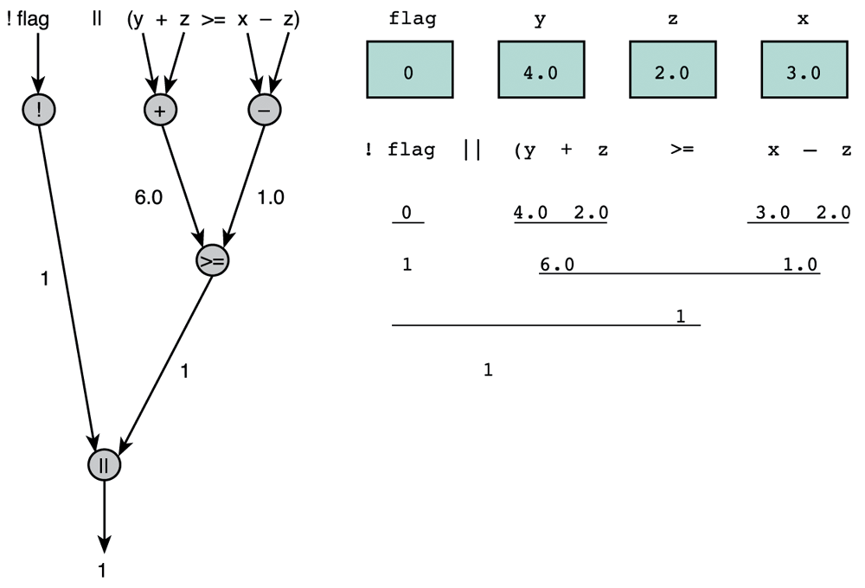
Evaluation Tree, Step-by-Step Evaluation
)

Slide 35
Short-Circuit Evaluation
Stopping the evaluation of a logical expression as soon as its value can be determined
Logical-OR expression of the form (a || b)
  If a is true then (a || b) must be true, regardless of b
  No need to evaluate b
  However, if a is false then we should evaluate b
Logical-AND expression of the form (a && b)
  If a is false then (a && b) must be false, regardless of b
  No need to evaluate b
  However, if a is true then we should evaluate b
Can be used to prevent division by zero
(divisor != 0 && x / divisor > 5)

Slide 36
Logical Assignment
  Use assignment to set int variables to false or true
  The false value is zero
  C accepts any non-zero value as true
  Examples of Logical Assignment
  senior_citizen = (age >= 65);
  even = (n%2 == 0);
  uppercase = (ch >= 'A' && ch <= 'Z');
  lowercase = (ch >= 'a' && ch <= 'z');
  is_letter = (uppercase || lowercase);

Slide 37
Complementing a Condition
DeMorgan's Theorem
  !(expr1 && expr2) == (!expr1 || !expr2)
  !(expr1 || expr2) == (!expr1 && !expr2)
Example | Equivalent Expression
!(item == 5) | item != 5
!(age >= 65) | age < 65
!(n > 0 && n < 10) | n <= 0 || n >= 10
!(x == 1 || x == 3) | x != 1 && x != 3
!(x>y && (c=='Y' || c=='y')) | (x<=y) || (c!='Y' && c!='y')

Slide 38
Common Programming Errors
Do Not write: if (0 <= x <= 4)
  0 <= x is either false (0) or true (1)
  Then, false(0) or true(1) are always <= 4
  Therefore, (0 <= x <= 4) is always true
Instead, write: if (0 <= x && x <= 4)
Do Not write: if (x = 10)
  = is the assignment operator
  x becomes 10 which is non-zero (true)
  if (x = 10) is always true
Instead, write: if (x == 10)

Slide 39
More Common Errors
In if statements:
  Don’t forget to parenthesize the if (condition)
  Don’t forget { and } in if with compound statements
Correct pairings of if and else statements:
  C matches else with the closest unmatched if
In switch statements:
  Make sure the controlling expression and case labels are of the same permitted type (int or char)
  Remember to include the default case
  Don’t forget { and } for the switch statement
  Don’t forget the break at the end of each case

