Slide 1
ICS103: Programming in C 2: Overview of C
Muhamed F. Mudawar

Slide 2
Outline
History of C
C Language Elements
Data Types and Variable Declarations
Executable Statements
Input and Output Functions
General form of a C program
Arithmetic Expressions
Formatting Numbers in Program Output

Slide 3
History of C
C was developed in 1972 by Dennis Ritchie at AT&T Bell Laboratories.
C was designed as a programming language to write the Unix Operating System.
C became the most commonly used language for writing system software.
C is machine independent: C programs can be compiled to run on a wide variety of processors and operating systems.

Slide 4
Why Learn C?
Many companies and software projects do their programming in C.
Looks good on your resume.
Small, compact size code.
Produces optimized programs that run fast.
Low-level access to computer memory via pointers.
Can be compiled to run on a variety of computers.

Slide 5
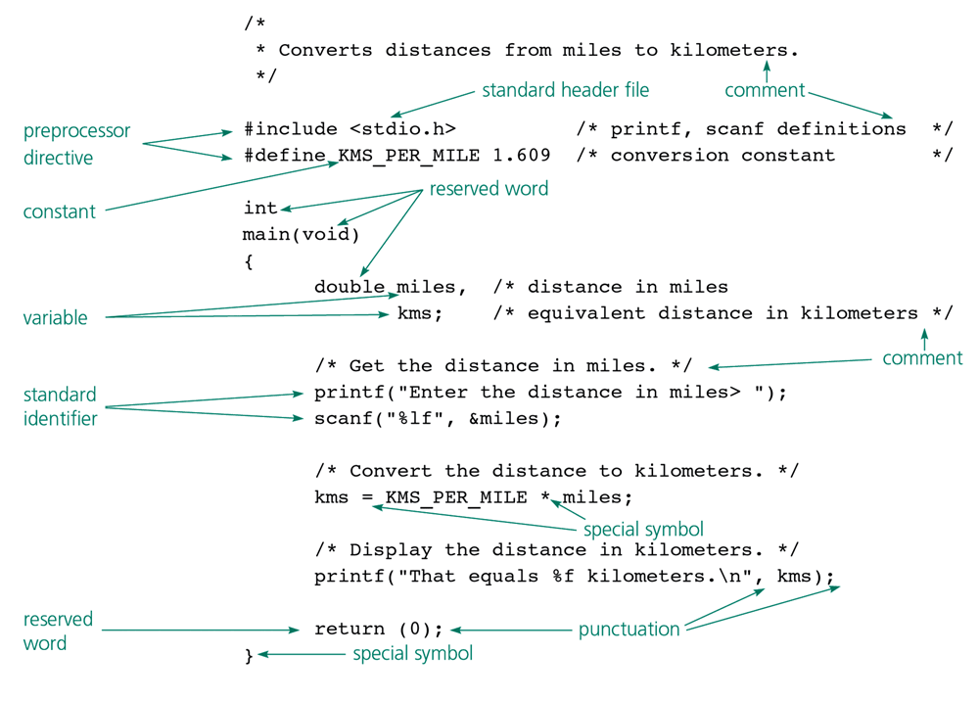
C Language Elements in Miles-to-Kilometers Conversion Program

Slide 6
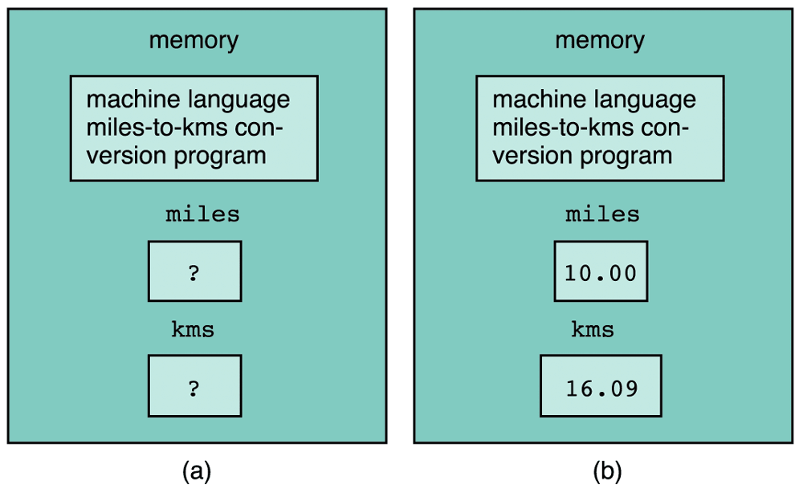
Program in Memory: Before (a) and After Execution of a Program (b)

Slide 7
Preprocessor Directives
Preprocessor directives are commands that give instructions to the C preprocessor.
The preprocessor modifies a C program prior to its compilation.
Preprocessor directives begin with #
#include <stdio.h>
Include Standard I/O Library header file (.h file)
#include <math.h>
Include Standard Math Library header file (.h file)
#define PI 3.141593
Define the constant PI

Slide 8
#include Directive
#include directive is used to include other source files into your source file.
The #include directive gives a program access to a standard library.
Standard Libraries contains useful functions and symbols that are predefined by the C language.
You must include <stdio.h> if you want to use the printf and scanf library functions.
stdio.h is called a header file (.h file). It contains information about standard input and output functions that are inserted into your program before compilation.

Slide 9
#define Directive
The #define directive instructs the preprocessor to replace each occurrence of a text by a particular constant value before compilation.
#define replaces all occurrences of the text you specify with the constant value you specify
#define NAME value
#define KMS_PER_MILE 1.609
#define PI 3.141593

Slide 10
The main Function
int main(void) marks the beginning of the main function where program execution begins.
Every C program has a main function.
Braces { and } mark the beginning and end of the body of function main.
A function body has two parts:
Declarations - tell the compiler what memory cells are needed in the function
Executable statements - (derived from the algorithm) are translated into machine language and later executed by the computer

Slide 11
Reserved words
A word that has special meaning to C and can not be used for other purposes.
These are words that C reserves for its own uses
Built-in Types: int, double, char, etc.
Control flow: if, else, for, while, return, etc.
Always lower case

Slide 12
Standard Identifiers
Identifier - A name given to a variable or a function
Standard Identifier - An identifier defined in a standard C library and has special meaning in C.
Examples: printf, scanf
Standard identifiers are not reserved words
You can redefine standard identifiers if you want to, but it is not recommended.
For example, if you define your own function printf, then you cannot use the C library function printf.

Slide 13
User-Defined Identifiers
We choose our own identifiers to
Name memory cells that will hold data and program results
Name functions that we define
Rules for Naming Identifiers:
An identifier consists only of letters, digits, and underscores
An identifier cannot begin with a digit
A C reserved word cannot be used as an identifier
A standard C identifier should not be redefined
Examples of Valid identifiers:
letter1, inches, KMS_PER_MILE
Examples of Invalid identifiers:
1letter, Happy$trout, return

Slide 14
Guidelines for Naming Identifiers
Uppercase and lowercase are different
LETTER , Letter, letter are different identifiers
Avoid names that only differ by case. They can lead to problems of finding bugs (errors) in the program.
Choose meaningful identifiers (easy to understand)
Example: distance = rate * time
Means a lot more than z = x * y
Choose #define constants to be ALL UPPERCASE
Example: KMS_PER_MILE is a defined constant
As a variable, we can probably name it:
KmsPerMile or Kms_Per_Mile

Slide 15
Next . . .
History of C
C Language Elements
Data Types and Variable Declarations
Executable Statements
Input and Output Functions
General form of a C program
Arithmetic Expressions
Formatting Numbers in Program Output

Slide 16
Data Types
Data Types: a set of values and a set of operations that can be performed on those values
int: Stores signed integer values: whole numbers
Examples: 65, -12345
double: Stores real numbers that use a decimal point
Examples: 3.14159 or 1.23e5 (which equals 123000.0)
char: Stores character values
Each char value is enclosed in single quotes: 'A', '*'
Can be a letter, digit, or special character symbol
Arithmetic operations (+, -, *, /) and compare can be performed on int and double variables. Compare operations can be performed on char variables.

Slide 17
Integer and Floating-Point Data Types
Integer Types in C
Type | Size in Memory | Range
short | 2 bytes = 16 bits | -32768 to +32767
unsigned short | 2 bytes = 16 bits | 0 to 65535
int | 4 bytes = 32 bits | -2147483648 to +2147483647
unsigned int | 4 bytes = 32 bits | 0 to 4294967295
long | 4 bytes = 32 bits | Same as int
long long | 8 bytes = 64 bits | -9×10¹⁸ to +9×10¹⁸
Floating-Point Types in C
Type | Size in Memory | Approximate Range | Significant Digits
float | 4 bytes = 32 bits | 10⁻³⁸ to 10⁺³⁸ | 6
double | 8 bytes = 64 bits | 10⁻³⁰⁸ to 10⁺³⁰⁸ | 15

Slide 18
Characters and ASCII Code
Character Type in C
Type | Size in Memory | ASCII Codes
char | 1 byte = 8 bits | 0 to 255
ASCII Codes and Special Characters
Character | ASCII Code
'0' | 48
'9' | 57
'A' | 65
'B' | 66
'Z' | 90
'a' | 97
'b' | 98
'z' | 122
Special Characters | Meaning
' ' | Space Character
'*' | Star Character
'\n' | Newline
'\t' | Horizontal Tab
'\'' | Single Quote
'\"' | Double Quote
'\\' | Backslash
'\0' | NULL Character

Slide 19
Variable Declarations
Variables: The memory cells used for storing a program’s input data and its computational results
The Value of a Variable can change at runtime
Variable declarations: Statements that communicate to the compiler the names of variables in the program and the type of data they can store.
Examples:
double miles, kms;
int count;
char answer;
C requires that you declare every variable in the program.

Slide 20
Executable Statements
Executable Statements: C statements used to write or code the algorithm. C compiler translates the executable statements to machine code.
Examples of executable Statements:
Assignment Statements
Function Calls, such as calling printf and scanf
return statement
if and switch statements (selection) - later
for and while statements (iteration) - later

Slide 21
Assignment Statement
Stores a value or a computational result in a variable
variable = expression;
= is the Assignment Operator
The assignment statement computes the expression that appears after the assignment operator and stores its value in the variable that appears to the left.

Slide 22
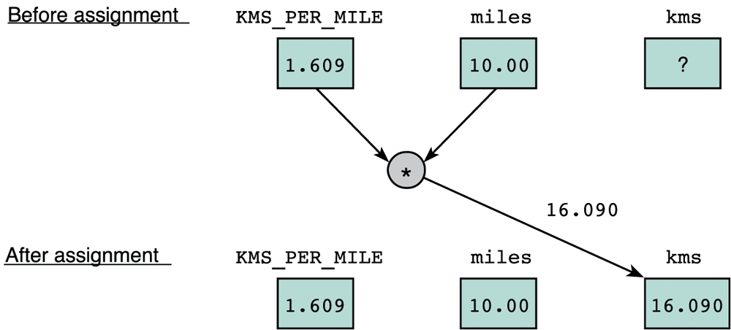
Effect OF kms = KMS_PER_MILE * miles
The value assigned to kms is the result of multiplying the constant KMS_PER_MILE by the variable miles.

Slide 23
Effect OF: sum = sum + item
Read = as
"becomes"
sum
item
Before assignment
90
20
The assignment operator does NOT mean equality
+
sum
After
assignment
110

Slide 24
Input/Output Operations and Functions
Input operation: data transfer from the outside world into computer memory
Output operation: program results can be displayed to the program user
Input/Output functions: special program units that do all input/output operations
printf : output function
scanf : input function
Function call: used to call or activate a function
Asking another piece of code to do some work for you

Slide 25
The printf Function
function name
function arguments
printf("That equals %f kilometers.\n", kms);
format string
place holder
print list
That equals 16.0900000 kilometers.

Slide 26
Placeholders
Placeholders always begin with the symbol %
% marks the place in a format string where a value will be printed out or will be read
Format strings can have multiple placeholders, if you are printing multiple values
Placeholder | Variable Type | Function Use
%c | char | printf / scanf
%d | int | printf / scanf
%f | double | printf
%lf | double | scanf

Slide 27
Displaying Prompts
When input data is needed in an interactive program, you should use the printf function to display a prompting message, or prompt, that tells the user what data to enter.
printf("Enter the distance in miles> ");
printf("Enter the object mass in grams> ");

Slide 28
The scanf Function
function
name
Number Entered
function arguments
30.5
miles
scanf("%lf", &miles);
30.5
place holders
input variables
The & is the address operator. It tells scanf the address of variable miles in memory.
When user inputs a value, it is stored in miles.
The placeholder %lf tells scanf the type of data to store into variable miles.

Slide 29
Reading Three Letters
char letter1, letter2, letter3;
scanf("%c%c%c",
&letter1,
&letter2,
&letter3);
Letters Entered
C
a
r
letter1
C
letter2
a
letter3
r

Slide 30
Return Statement
Syntax: return expression ;
Example: return (0);
Returning from the main function terminates the program and transfers control back to the operating system. Value returned is 0.
The return statement transfers control from a function back to the caller.
Once you start writing your own functions, you will use the return statement to return the result of a function back to the caller.

Slide 31
Next . . .
History of C
C Language Elements
Data Types and Variable Declarations
Executable Statements
Input and Output Functions
General form of a C program
Arithmetic Expressions
Formatting Numbers in Program Output

Slide 32
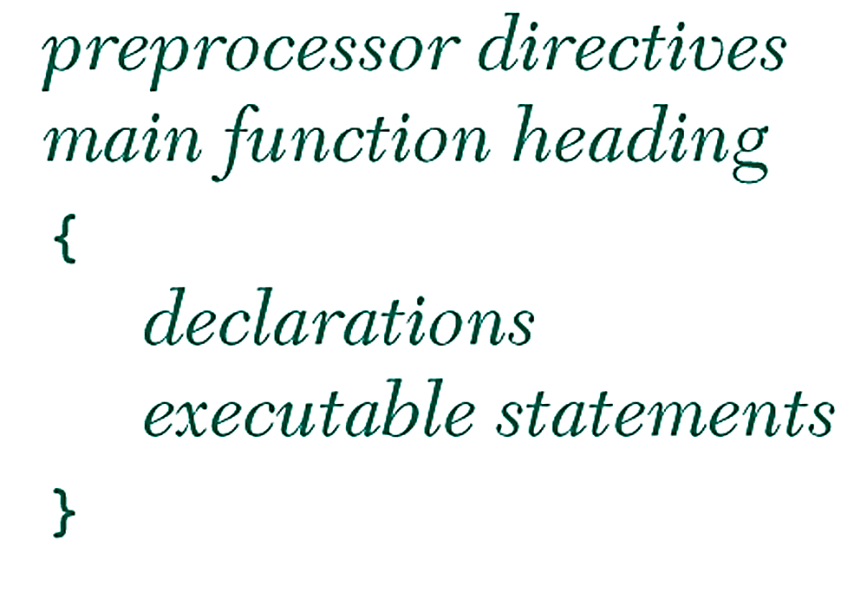
General Form of a C program
Preprocessor directives modify the text of a C program before compilation.
Every variable has to be declared before using it.
Executable statements are translated into machine language and eventually executed.
Executable statements perform computations on the declared variables or input/output operations.

Slide 33
Comments
Comments making it easier for us to understand the program, but are ignored by the C compiler.
Two forms of comments:
/* C comment */ anything between /* and */ is considered a comment, even if it spans on multiple lines.
// C++ comment anything after // is considered a comment until the end of the line.
Comments are used to create Program Documentation
Help others read and understand the program.
The start of the program should consist of a comment that includes programmer’s name, date, current version, and a brief description of what the program does.
Always Comment your Code!

Slide 34
Programming Style
Why we need to follow conventions?
A program that looks good is easier to read and understand than one that is sloppy.
80% of the cost of software goes to maintenance.
Hardly any software is maintained for its whole lifetime by the original author.
Programs that follow the typical conventions are more readable and allow engineers to understand the code more quickly and thoroughly.
Check your text book and expert programmers on how to improve your programming style.

Slide 35
White Spaces
The compiler ignores extra blanks between words and symbols, but you may insert space to improve the readability and style of a program.
You should always leave a blank space after a comma and before and after operators such as: + − * / and =
You should indent the lines of code in the body of a function.

Slide 36
White Space Example
Bad:
Good:
int main(void)
{ int foo,blah;
scanf("%d",&foo);
blah=foo+1;
printf("%d", blah);
return 0;}
int main(void)
{
int foo, blah;
scanf("%d", &foo);
blah = foo + 1;
printf("%d", blah);
return 0;
}

Slide 37
Bad Programming practices
Missing statement of purpose
Inadequate commenting
Variables names are not meaningful
Use of unnamed constant
Indentation does not represent program structure
Algorithm is inefficient or difficult to follow
Program does not compile
Program produces incorrect results
Insufficient testing (test case results are different than expected, program is not fully tested for all cases)

Slide 38
Arithmetic Expressions
To solve most programming problems, you need to write arithmetic expressions that compute data of type int and double (and sometimes char)
Arithmetic expressions contain variables, constants, function calls, arithmetic operators, as well as sub-expressions written within parentheses.
Examples:
sum + 1
(a + b) * (c – d)
(-b + sqrt(delta))/(2.0 * a)

Slide 39
Arithmetic Operators
Operator | Meaning | Examples
+ | addition | 5 + 2 is 7 5.0 + 2.0 is 7.0 'B' + 1 is 'C'
– | subtraction | 5 – 2 is 3 5.0 – 2.0 is 3.0 'B' – 1 is 'A'
* | multiplication | 5 * 2 is 10 5.0 * 2.0 is 10.0
/ | division | 5 / 2 is 2 5.0 / 2.0 is 2.5
% | remainder | 5 % 2 is 1

Slide 40
Operators / and %
Example | Result | Explanation
8 / 5 | 1 | Integer operands → integer result
8.0/5.0 | 1.6 | floating-point operands and result
8 /-5 | -1 | One operand is negative → negative result
-8 /-5 | 1 | Both operands are negative → positive result
8 % 5 | 3 | Integer remainder of dividing 8 by 5
8 %-5 | 3 | Positive dividend → positive remainder
-8 % 5 | -3 | Negative dividend → Negative remainder
(m/n)*n + (m%n) is always equal to m
/ and % are undefined when the divisor is 0.

Slide 41
Data Type of an Expression
What is the type of expression x+y when x and y are both of type int? (answer: type of x+y is int)
The data type of an expression depends on the type(s) of its operands
If both are of type int, then the expression is of type int.
If either one or both operands are of type double, then the expression is of type double.
An expression that has mixed operands of type int and double is a mixed-type expression.

Slide 42
Mixed-Type Assignment Statement
The expression being evaluated and the variable to which it is assigned have different data types
The expression is first evaluated; then the result is assigned to the variable to the left side of = operator
Example: what is the value of y = 5/2 when y is of type double? (answer: 5/2 is 2; y = 2.0)
Warning: assignment of a type double expression to a type int variable causes the fractional part of the expression to be lost.
Example: what is the type of the assignment y = 5.0 / 2.0 when y is of type int? (answer: 5.0/2.0 is 2.5; y = 2)

Slide 43
Type Conversion Through Casts
C allows the programmer to convert the type of an expression by placing the desired type in parentheses before the expression.
This operation is called a type cast.
(double)5 / (double)2 is the double value 2.5
(int)(9 * 0.5) is the int value 4
When casting from double to int, the decimal fraction is truncated (NOT rounded).

Slide 44
Example of The Use of Type Casts
/* Computes a test average */
#include <stdio.h>
int main(void)
{
int total; /* total score */
int students; /* number of students */
double average; /* average score */
printf("Enter total students score> ");
scanf("%d", &total);
printf("Enter number of students> ");
scanf("%d", &students);
average = (double) total / (double) students;
printf("Average score is %.2f\n", average);
return 0;
}

Slide 45
Expressions with Multiple Operators
Operators are of two types: unary and binary
Unary operators take only one operand
Unary minus (-) and Unary plus (+) operators
Binary operators take two operands
Examples: addition (+), subtraction (–), multiplication (*), division (/) and integer remainder (%) operators
A single expression could have multiple operators
Example: -a + b*c – d/2

Slide 46
Rules for Evaluating Expressions
Parentheses rule - All expressions in parentheses must be evaluated separately.
Nested parenthesized expressions must be evaluated from the inside out, with the innermost expression evaluated first.
Operator precedence rule – Multiple operators in the same expression are evaluated in the following order:
First: unary +, –
Second: *, /, %
Third: binary +, –
Associativity rule
Unary operators in the same subexpression and at the same precedence level are evaluated right to left
Binary operators in the same subexpression and at the same precedence level are evaluated left to right

Slide 47
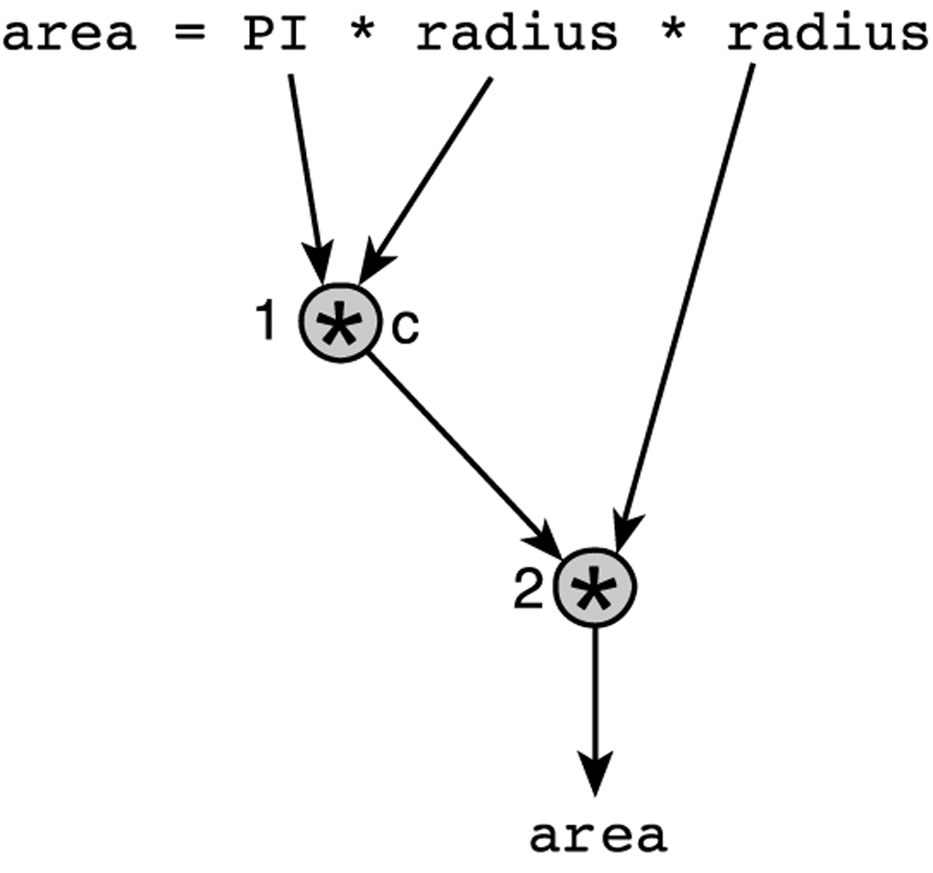
Step-by-Step Expression Evaluation
Evaluation
Tree

Slide 48
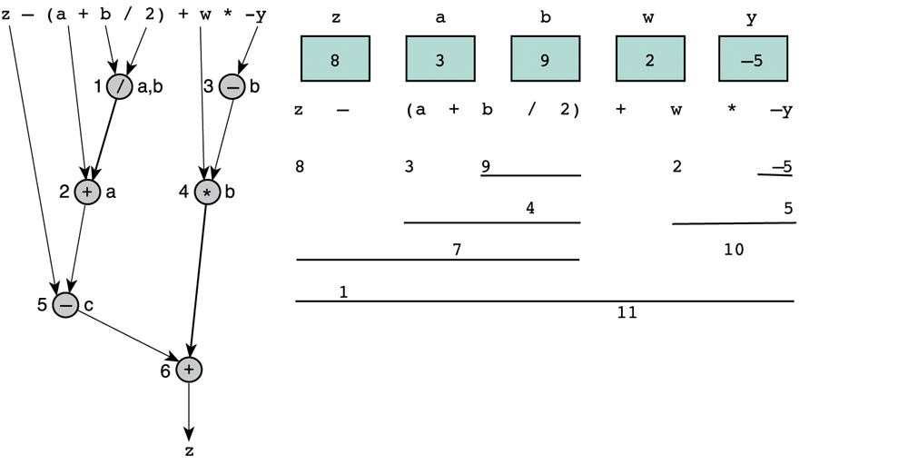
Evaluate: z - (a + b/2) + w*-y
Evaluation
Tree

Slide 49
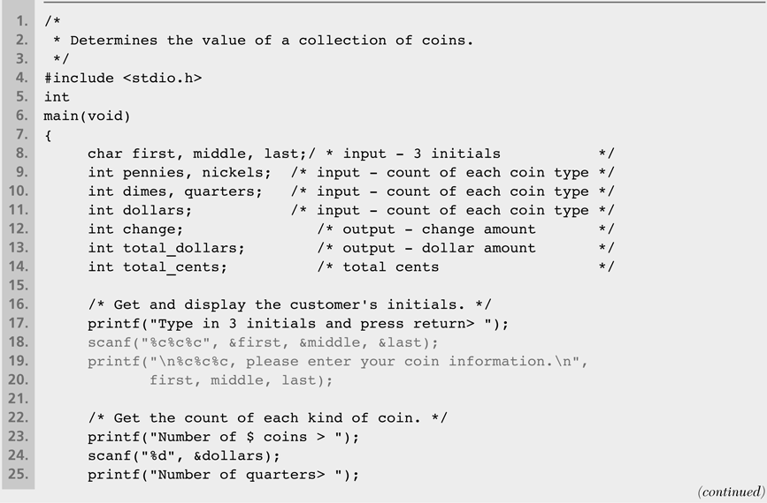
Supermarket Coin Processor

Slide 50
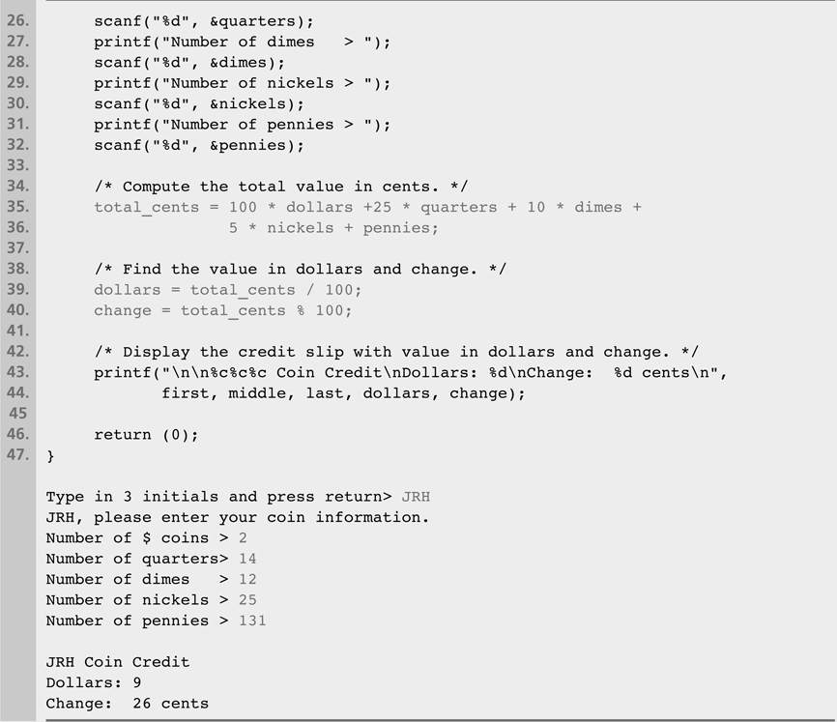
Supermarket Coin Processor (cont'd)

Slide 51
Formatting Integers in Program Output
You can specify how printf will display integers
For integers, use %nd
% start of placeholder
n is the optional field width = number of columns to display
If n is less than integer size, it will be ignored
If n is greater than integer size, spaces are added to the left
Value | Format | Output |  | Value | Format | Output
234 | %4d | 234 |  | -234 | %4d | -234
234 | %5d | 234 |  | -234 | %5d | -234
234 | %6d | 234 |  | -234 | %6d | -234
234 | %1d | 234 |  | -234 | %2d | -234

Slide 52
Formatting Type Double Values
Use %n.mf for double values
n is the optional field width = number of digits in the whole number, the unary minus, decimal point, and fraction digits
If n is less than what the number needs it will be ignored
.m is the number of decimal places (optional)
Value | Format | Output | Value | Format | Output
3.14159 | %5.2f | 3.14 | 3.14159 | %4.2f | 3.14
3.14159 | %3.2f | 3.14 | 3.14159 | %5.1f | 3.1
3.14159 | %5.3f | 3.142 | 3.14159 | %8.5f | 3.14159
0.1234 | %4.2f | 0.12 | -0.006 | %4.2f | -0.01
-0.006 | %8.3f | -0.006 | -0.006 | %8.5f | -0.00600
-0.006 | %.3f | -0.006 | -3.14159 | %.4f | -3.1416

Slide 53
Common Programming Errors
Syntax Errors (Detected by the Compiler)
Violating one or more grammar rules
Missing semicolon (end of variable declaration or statement)
Undeclared variable (using a variable without declaration)
Comment not closed (missing */ at end of comment)
Run-Time Errors (NOT detected by compiler)
Detected by the computer when running the program
Illegal operation, such as dividing a number by zero
Program cannot run to completion
Undetected and Logic Errors
Program runs to completion but computes wrong results
Input was not read properly
Wrong algorithm and computation

