Slide 1
COE 526 Data Privacy
Lecture 9: Differential Privacy III

Slide 2
Differential Privacy Models
Query f
x₁
…
x_{n}
$$f(D) + Lap\left(\frac{GS_{f}}{ε}\right)$$
Database D
Analyst
Global Differential Privacy Example: Laplacian Mechanism
Query f
$$f\left(U_{1}\right)+N_{1}$$
x₁
…
x_{n}
$$f\left(U_{2}\right)+N_{2}$$
Analyst
$$f\left(D\right)=∑f\left(U_{i}\right)+N_{i}$$
$$f\left(U_{3}\right)+N_{3}$$
Database D
Local Differential Privacy Example: Randomized Response

Slide 3
How to Achieve DP?
Randomized Response
Laplace Mechanism
Exponential Mechanism
Report Noisy Max

Slide 4
Differential Privacy for General Functions
How about functions that do not return a real number?
Consider some function $f$ (can be deterministic or probabilistic)
What is the most common second language in the class?
How to construct a differentially private version of f?
Using Exponential Mechanism
Database
Output space

Slide 5
Sensitivity of Scoring Function
Scoring function $w:D ×O→ ℝ$
Where $D$ is the set of all possible databases and $O$ is the set of all possible outputs
Example
$D$: nationalities of a set of people
$\#(D, r)$: # people with nationality $r∈O$ in D
E.g. $\#(D, "Egpyt")=2$
$f(D):$most frequent nationality in D
E.g. f(D) = "Saudi" and $\#\left(D, f\left(D\right)\right)=3$
$w\left(D, r\right)= \left|\#\left(D, r\right)− \#\left(D, f\left(D\right)\right)\right|$
E.g. $w\left(D, "Egypt"\right)=|\#\left(D, \text{Egpyt}\right)−\#(D, "Saudi")|$
Sensitivity of $w$ is
$Δ_{w}=\max_{r, D, D′}{|w\left(D,r\right)−w(D^{′},r)|}$
where D, D’ differ in one tuple
Nationality
Saudi
Saudi
Egypt
Syria
Saudi
Sudan
Egypt

Slide 6
Exponential Mechanism
Theorem: For a database $D$, output space $R$ and a utility score function $w: D×O →ℝ$, the algorithm $𝒜$
$$Pr⁡[𝒜(D) = r] ∝ exp⁡(\frac{εw(D, r)}{2Δ_{w}})$$
satisfies $ε$-differential privacy, where $Δ_{w}$ is the sensitivity of the utility score function
$$Δ_{w}=\max_{r, D, D′}{|w\left(D,r\right)−w(D^{′},r)|}$$

Slide 7
Intuition of Exponential Mechanism
Make high quality outputs exponentially more likely at a rate that depends on the sensitivity of the quality score (and the privacy parameter)
$$\operatorname{Pr}\left[𝒜\left(D\right)= r\right]=\frac{e^{\frac{εw(D,r)}{2Δ_{w}}}}{\sum_{r∈Output}{e^{\frac{εw(D,r)}{2Δ_{w}}}}}$$

Slide 8
Exponential Mechanism Proof
Theorem: The Exponential Mechanism preserves (𝜖, 0)-differential privacy

Slide 9
How to Achieve DP?
Randomized Response
Laplace Mechanism
Exponential Mechanism
Report Noisy Max

Slide 10
Max Response
Suppose that we have m candidates, we want to know which one received the most votes
Obviously, the answer is not a number; how can we release it under differential privacy?
Requirement:
We want to select the element that maximizes some values
The noise added for privacy should not destroy utility
Intuition:
We could compute the histogram, add Laplace noise to each score, and select the maximal noised score
Alice
Bob
Charlie
Dave

Slide 11
Report Noisy Max

Slide 12
Applications and Use cases
Differentially Privacy K-Means
Differentially Private Recommendation System for Netflix

Slide 13
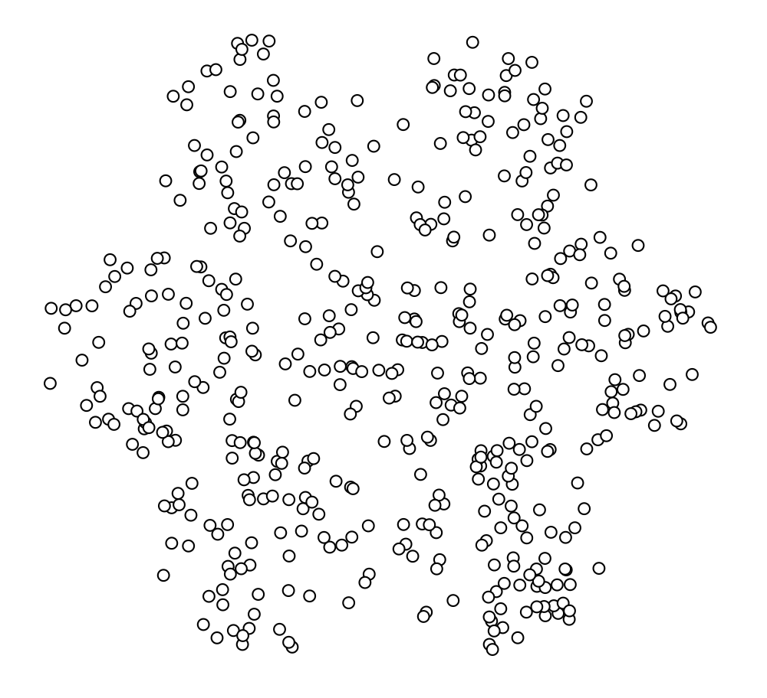
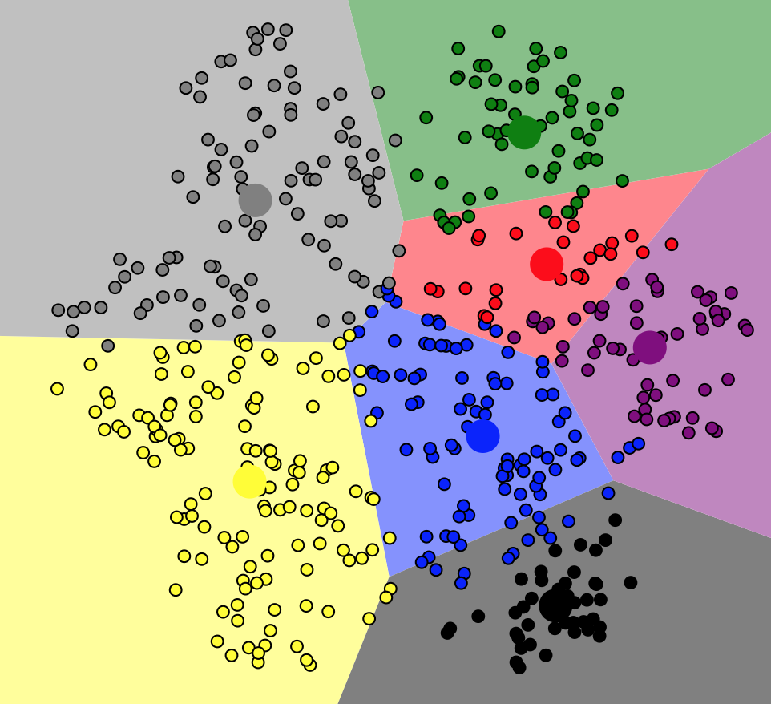
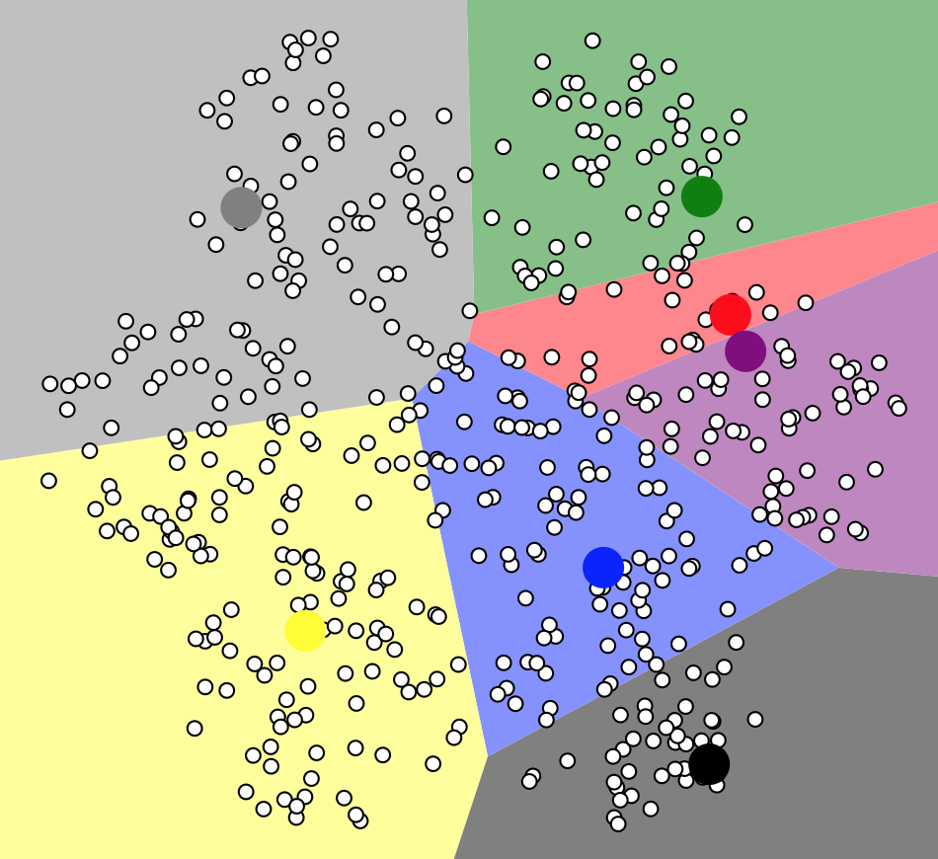
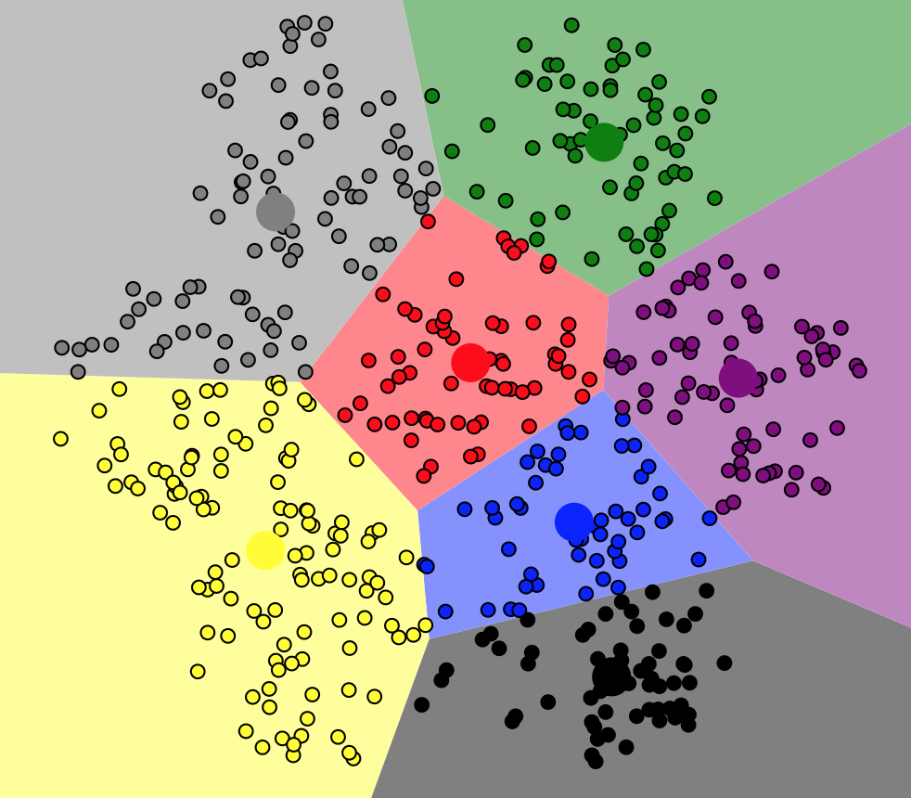
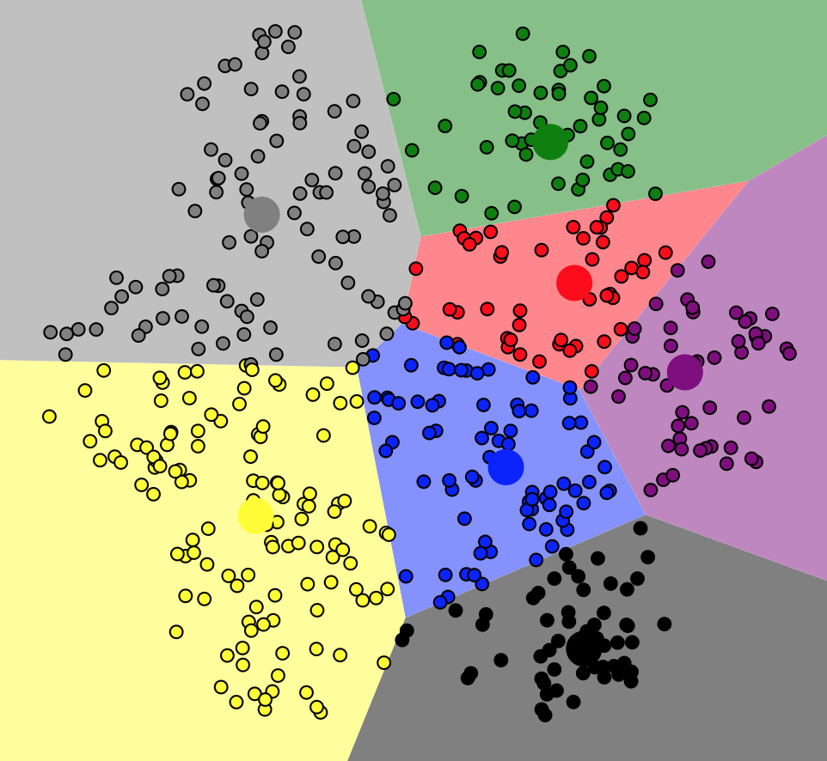
K-means Problem
Partition a set of points $x1, x2, …, xn$into k clusters $S1, S2, …, Sk$ such that the SSE is minimized:
$$\sum_{i=1}^{k}{\sum_{x_{j}∈S_{i}}{{\left|\left|x_{j}−μ_{i}\right|\right|}^{2}}}$$
$μ_{i}$: Mean of the cluster S_{i}
Initialize a set of k centers
Repeat until convergence
Assign each point to its nearest center
Update the set of centers
Output final set of k centers and the points in each cluster

Slide 14
Differentially Private K-means
Privacy Goal: output the centroid and number of points of each cluster with differential privacy
Initialize a set of k centers
Suppose we fix the number of iterations to T
In each iteration (given a set of centers):
Assign the points to the closest center
Compute the noisy size of each cluster
Compute the noisy sum (centroid) of points in each cluster
Output the final centroid and size of each cluster
Each iteration uses
$ε$/T privacy, total privacy is $ε$
What is the sensitivity?

Slide 15
Low and High Sensitivities
Example of low-sensitivity functions
Average
Histograms and contingency tables
Covariance matrix
Example of high-sensitivity functions
Order statistics
Clustering

Slide 16
Netflix Predictions – High Level
Q(i,j) – “How would user i rate movie j?”
Predicted rating may typically depend on
Global average rating over all movies and all users
Average movie rating of user i
Average rating of movie j
Ratings user i gave to similar movies
Ratings similar users gave to movie j
Sensitivity may be small for many of these queries

Slide 17
What do we need to make predictions?
For a large class of prediction algorithms it suffices to have:
Gavg – average rating for all movies by all users
Mavg – average rating for each movie by all users
Average Movie Rating for each user
Movie-Movie Covariance Matrix (COV)
To respect approximate differential privacy publish
Gavg + NOISE
Mavg + NOISE
COV + NOISE
GS(Gavg), GS(Mavg) are very small so they can be published with little noise (e.g., Laplacian)
GS(COV) requires more care (our focus)
7

Slide 18
Privacy Goal
Come up with differentially-private method of computing these covariance matrices
How should we do this?
Add independent Gaussian noise proportional to this sensitivity bound to each entry in covariance matrix

Slide 19
DP Pros, Cons, and Challenges
Many non-trivial DP algorithms require really large datasets to be practically useful
Privacy Vs. Utility (Amount of noise)
What privacy budget is reasonable for a dataset?
Privacy budget management and depletion
Given a task and privacy budget $ε$, how to design a set of queries (functions) and allocate the budget such that the error is minimized?
Allocation between users/computation providers
Allocation between tasks
In-task allocation
Between iterations
Between multiple statistics
Optimization problem

Slide 20
Differential Privacy: Summary
An approach to releasing privacy-preserving statistics
A rigorous privacy guarantee
Significant activity in theoretical CS community
Several applications to real data sets
Recommendation systems, network trace data,..
Some challenges
High sensitivity, identifying individual’s information, repeated querying

