Slide 1
COE426: Data Privacy
Lecture 13: Secure Data Outsourcing

Slide 2
Outline
Cloud computing challenges
Data outsourcing
Distributed machine learning
Secure/private platforms for distributed machine learning

Slide 3
What is Cloud Computing?
New computing paradigm that relies on sharing computing resources rather than having local servers or personal devices to handle applications
Cloud computing involves data and/or computation outsourcing, with
Infinite and elastic resource scalability
Ability to quickly scale in/out service
On demand “just-in-time” provisioning
No upfront cost … pay-as-you-go
Provides different service models "X-as-a-service"
IaaS, PaaS, SaaS, FaaS, MLaaS

Slide 4
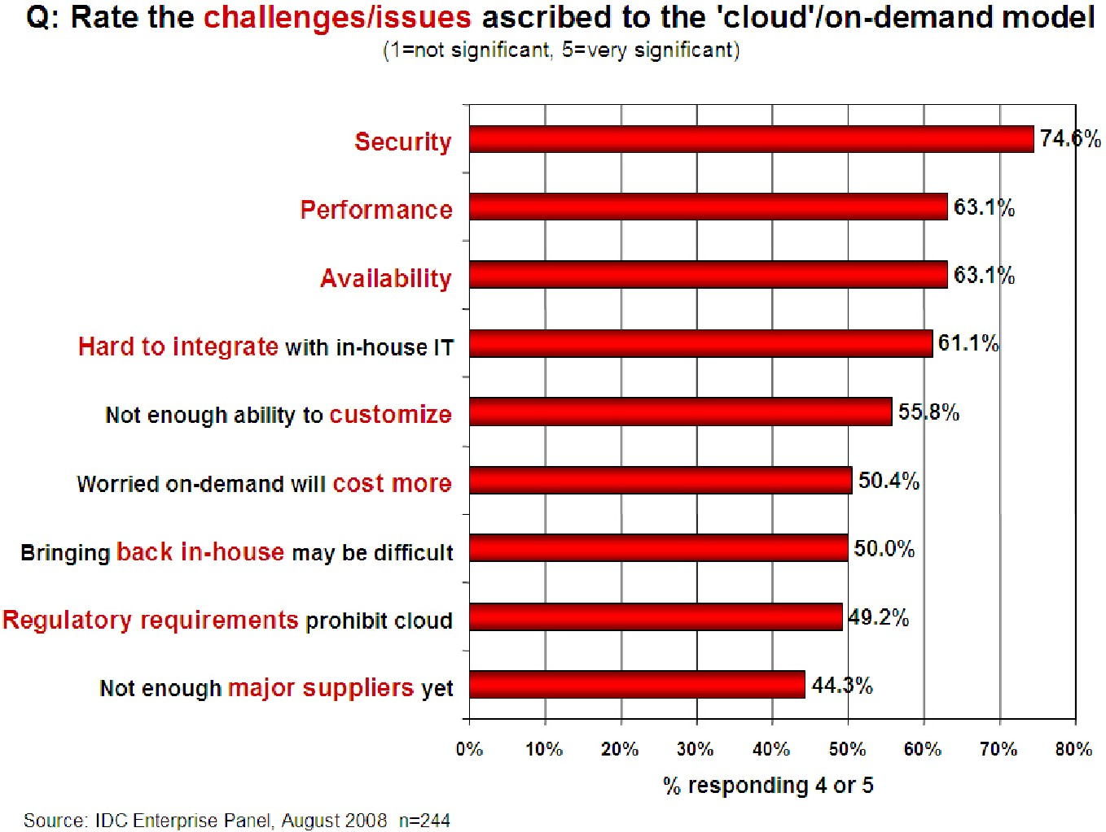
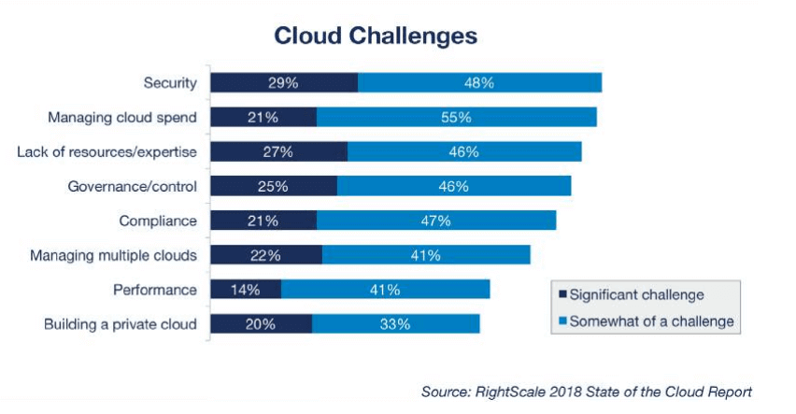
Cloud Challenges
Clouds are still subject to traditional data confidentiality, integrity, availability, and privacy issues, plus some additional attacks

Slide 5
Anatomy of fear …
Integrity
How do I know that the cloud provider is doing the computations correctly?
How do I ensure that the cloud provider really stored my data without tampering with it?
Availability
Will critical systems go down at the client, if the provider is attacked in a Denial of Service attack?
What happens if cloud provider goes out of business?
Confidentiality
Will the sensitive data stored on a cloud remain confidential? Will cloud compromises leak confidential client data (i.e., fear of loss of control over data)
Will the cloud provider itself be honest and won’t peek into the data?
Privacy issues raised via massive machine learning
Cloud now stores data from a lot of clients, and can run machine learning algorithms to get large amounts of information on clients

Slide 6
Ensuring confidentiality/Privacy of outsourced data
Most type of computations require decrypting data before any computations
If the cloud provider is not trusted, this may result in breach of confidentiality
How can we ensure confidentiality of data and computations in a cloud?
Existing Approaches: Homomorphic encryption, Trusted Cloud Computing Platform, Secure Multiparty Computation

Slide 7
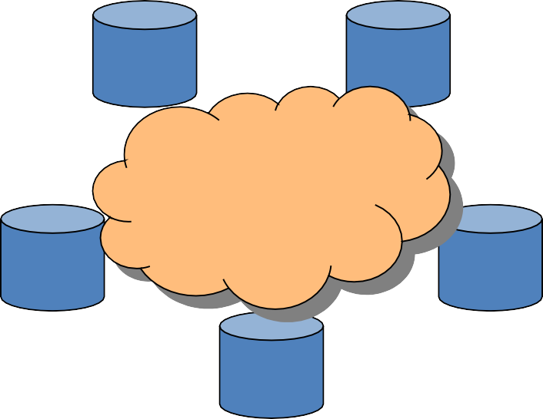
Data Outsourcing
Data owner outsources its data and processing functionalities to a cloud in order to reduce management cost and less overhead of data storage
Data outsourcing is necessary for full utilization of huge amount of data
Data outsourcing is required in applications like
Distributed data mining
Federated machine learning
x1
x2
f(x1,x2,…, xn)
x4
x3
xn
(e.g., hospitals, government bodies) or may be the individual him or herself

Slide 8
Distributed and Federated ML
Government/public agencies. Example:
The Centers for Disease Control want to identify disease outbreaks
Insurance companies have data on disease incidents, seriousness, patient background, etc.
But can/should they release this information?
Industry Collaborations. Example:
An industry trade group may want to identify best practices to help members
But some practices are trade secrets
How do we provide “commodity” results to all (Manufacturing using chemical supplies from supplier X have high failure rates), while still preserving secrets (manufacturing process Y gives low failure rates)?

Slide 9
Approaches to Preserve Privacy
Restrict Access to data (Protect Individual records)
Protect both the data and its source
Secure Multi-party computation (SMC)
Input Data Randomization
There is no such one solution that fits all purposes

Slide 10
Application of SMC to Private Machine Learning
Setting
Data is distributed at different sites
These sites may be third parties (e.g., hospitals, government bodies) or individuals
Aim
Compute the machine learning algorithm on the data so that nothing but the output is learned
That is, carry out a secure computation

Slide 11
Privacy Preserving Machine Learning Toolkit
Different machine learning techniques often perform similar computations at various stages (e.g., computing sum, counting the number of items)
Toolkit
simple computations – sum, union, intersection …
assemble them to solve specific mining tasks – association rule mining, bayes classifier, …
The protocols may not be truly secure but more efficient than traditional SMC methods
Tools for Privacy Preserving Data Mining, Clifton, 2002

Slide 12
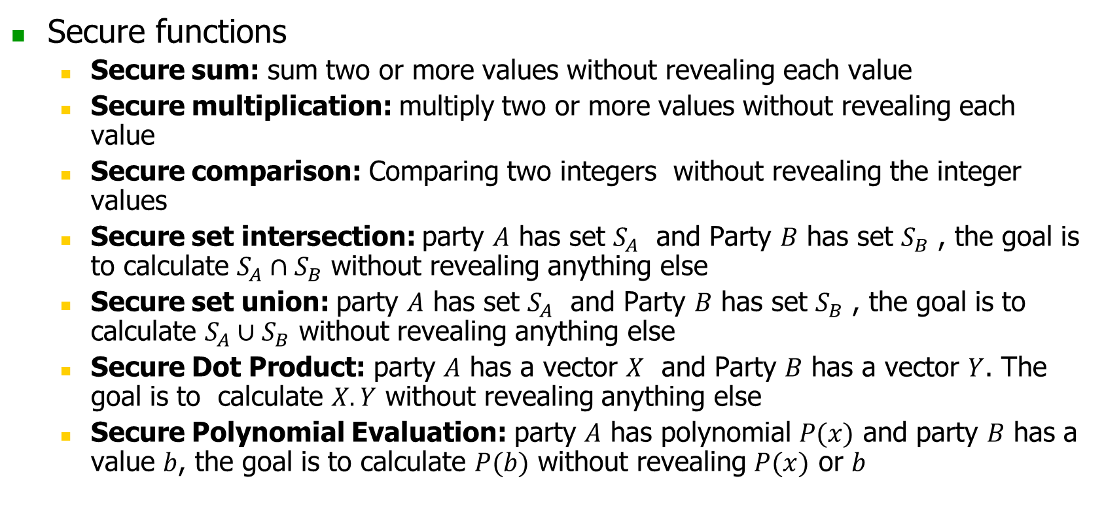
Primitive Protocols
Secure functions
Secure sum: sum two or more values without revealing each value
Secure multiplication: multiply two or more values without revealing each value
Secure comparison: Comparing two integers without revealing the integer values
Secure set intersection: party $A$ has set $S_{A}$ and Party $B$ has set $S_{B}$ , the goal is to calculate $S_{A}∩S_{B}$ without revealing anything else
Secure set union: party $A$ has set $S_{A}$ and Party $B$ has set $S_{B}$ , the goal is to calculate $S_{A}∪S_{B}$ without revealing anything else
Secure Dot Product: party $A$ has a vector $X$ and Party $B$ has a vector $Y$. The goal is to calculate $X.Y$ without revealing anything else
Secure Polynomial Evaluation: party $A$ has polynomial $P(x)$ and party $B$ has a value $b$, the goal is to calculate $P(b)$ without revealing $P(x)$ or $b$

Slide 13
Private Machine Learning
Specific Secure Tools
Secure Comparison
Secure Set Intersection
Secure Dot Product
Secure Logarithm
Secure Poly. Evaluation
Association Rule Mining
Decision Trees
K-means Clustering
Naïve Bayes Classifier
Outlier Detection

Slide 14
Drawbacks for SMC Based Machine Learning
Still not efficient enough for very large datasets
Semi-honest model may not be realistic

Slide 15
Privacy Preserving AI/ML Projects
OpenMined (https://github.com/OpenMined/PySyft)
PyVacy (https://github.com/ChrisWaites/pyvacy)
FATE (https://github.com/FederatedAI/FATE)
Many more…

Slide 16
Summary of SMC Based PP ML/AI
Mainly used for distributed machine learning
Learned models are accurate
Efficient/specific cryptographic solutions for many distributed machine learning problems are developed
Mainly semi-honest assumption (i.e. parties follow the protocols)
Malicious model is also explored recently

