Slide 1
A Restructuring Algorithm for CUDA (submitted to International Journal of Parallel Programming)
Ayaz ul Hassan Khan
Advisor: Dr. Mayez Abdullah Al-Mouhamed
CSE-702: Directed Research – II

Slide 2
Agenda
Introduction to GPU Architectures
GPGPU and CUDA
CUDA Program Execution
Problem Definition
Literature Review
Proposed Restructuring Algorithm
Application Results Comparison
Conclusion and Future Work

Slide 3
GPU
Graphics Processing Unit
GPUs are gaining ground in high-performance computing especially in arena of Massively Parallel Computing
Uses massive multithreading, fast context-switching, high memory bandwidth, and overlapping long-latency loads in stalled threads with computation in other threads
Programming using GPUs require an expert level understanding of the memory hierarchy and execution model to reach peak performance
Even for experts, rewriting a program to exploit the architecture in achieving high speedup can be tedious and error prone

Slide 4
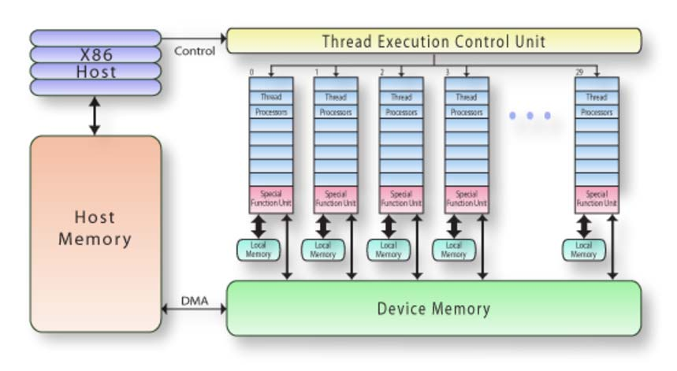
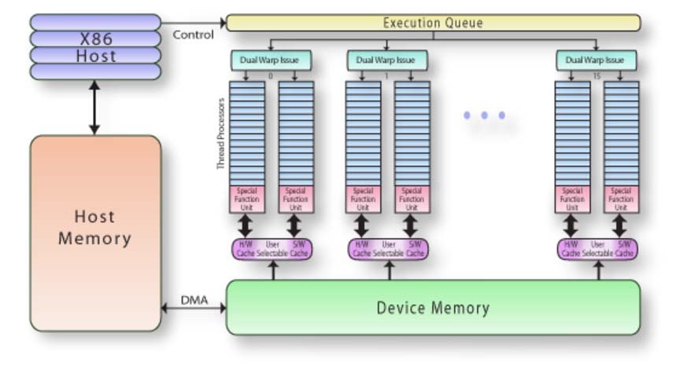
Architecture of a Modern GPU
NVIDIA Tesla Block Diagram
NVIDIA Fermi Block Diagram
Notes:
It is organized into an array of highly threaded streaming multiprocessors (SMs). In Figure 1.3, two SMs form a building block; however, the number
of SMs in a building block can vary from one generation of CUDA GPUs to another generation. Also, each SM in Figure 1.3 has a number of streaming
processors (SPs) that share control logic and instruction cache. Each GPU currently comes with up to 4 gigabytes of graphics double data rate (GDDR) DRAM, referred to as global memory.
The massively parallel G80 chip has 128 SPs (16 SMs, each with 8 SPs). Each SP has a multiply–add (MAD) unit and an additional multiply unit.
For those who are used to simultaneous multithreading, note that Intel CPUs support 2 or 4 threads, depending on the machine model, per core. The G80 chip supports up to 768 threads per SM, which sums up to about 12,000 threads for this chip. The more recent GT200 supports 1024 threads per SM and up to about 30,000 threads

Slide 5
Hardware Implementation: Memory Architecture (Device and Programmers Perspective)
Device
Grid
Multiprocessor N
Block (0, 0)
Block (1, 0)
Multiprocessor 2
Shared Memory
Shared Memory
Multiprocessor 1
Shared Memory
Registers
Registers
Registers
Registers
Registers
Registers
Registers
Instruction
Unit
Thread (0, 0)
Thread (1, 0)
Thread (0, 0)
Thread (1, 0)
Processor 1
Processor 2
…
Processor M
Local
Memory
Local
Memory
Local
Memory
Local
Memory
Constant
Cache
Texture
Cache
Host
Global
Memory
Constant
Memory
Device memory
Global, constant, texture memories
Texture
Memory
Device View
Programmer’s View

Slide 6
Concept of GPGPU and CUDA
Designed as numeric computing engines
Not perform well on some tasks on which CPUs are designed to perform
Combined approach:
Sequential part on CPU
Numerical intensive part on GPU
CUDA: Compute Unified Device Architecture
Widely used parallel programming framework for general purpose GPU computations
CUDA is designed to support GPGPU programming
Ideal GPGPU applications have large data set, high parallelism, and minimal dependency between data elements.

Slide 7
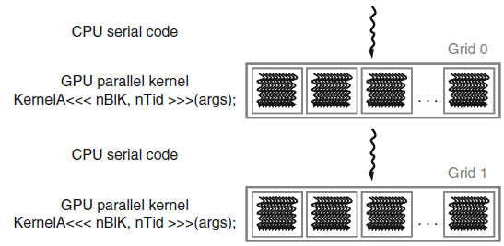
CUDA Program Execution (sequential code + kernels)
Notes:
A CUDA program consists of one or more phases that are executed on either the host (CPU) or a device such as a GPU. The phases that exhibit little or no data parallelism are implemented in host code. The phases that exhibit rich amount of data parallelism are implemented in the device code. A CUDA program is a unified source code encompassing both host and device code. The NVIDIA C compiler (nvcc) separates the two during the compilation process. The host code is straight ANSI C code; it is further compiled with the host’s standard C compilers and runs as an ordinary CPU process. The device code is written using ANSI C extended with keywords for labeling data-parallel functions, called kernels, and their associated data structures. The device code is typically further compiled by the nvcc and executed on a GPU device. In situations where no device is available or the kernel is more appropriately executed on a CPU, one can also choose to execute kernels on a CPU using the emulation features in CUDA software development kit (SDK) or the MCUDA tool [Stratton 2008].
The kernel functions (or, simply, kernels) typically generate a large number of threads to exploit data parallelism. In the matrix multiplication example, the entire matrix multiplication computation can be implemented as a kernel where each thread is used to compute one element of output matrix P.
The execution starts with host (CPU) execution. When a kernel function is invoked, or launched, the execution is moved to a device (GPU), where a large number of threads are generated to take advantage of abundant data parallelism. All the threads that are generated by a kernel during an invocation are collectively called a grid.

Slide 8
Grids, Blocks and Threads
A kernel is executed as a grid of thread blocks
All threads share data memory space
A thread block is a batch of threads that can cooperate with each other by:
Synchronizing their execution
For hazard-free shared memory accesses
Efficiently sharing data through a low latency shared memory
Two threads from two different blocks cannot cooperate
Threads and blocks have IDs
So each thread can decide what data to work on
Block ID: 1D or 2D (blockIdx.x, blockIdx.y)
Thread ID: 1D, 2D, or 3D (threadIdx.{x,y,z})
Host
Device
Grid 1
Kernel 1
Block
(0, 0)
Block
(1, 0)
Block
(2, 0)
Block
(0, 1)
Block
(1, 1)
Block
(2, 1)
Grid 2
Kernel 2
Block (1, 1)
Thread
(0, 0)
Thread
(1, 0)
Thread
(2, 0)
Thread
(3, 0)
Thread
(4, 0)
Thread
(0, 1)
Thread
(1, 1)
Thread
(2, 1)
Thread
(3, 1)
Thread
(4, 1)
Courtesy: NDVIA
Thread
(0, 2)
Thread
(1, 2)
Thread
(2, 2)
Thread
(3, 2)
Thread
(4, 2)
Notes:
In CUDA, a kernel function specifies the code to be executed by all threads during a parallel phase. Because all of these threads execute the same code, CUDA programming is an instance of the well-known single-program, multiple-data (SPMD) parallel programming style [Atallah 1998], a popular programming style for massively parallel computing systems.

Slide 9
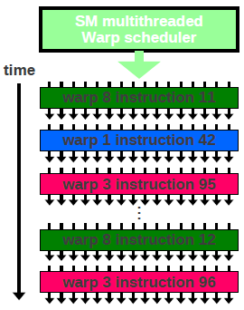
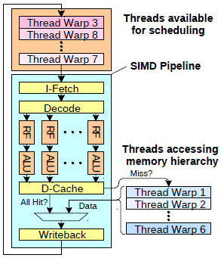
Kernel Execution Hierarchy

Slide 10
Problem Statement
Most execution of a scientific programs spent on loops
Loop tiling is one of the most important compiler optimizations for both parallel machines and uniprocessors with a memory hierarchy
Partition the loops into smaller chunks or blocks
Several algorithms already available for better cache utilizations

Slide 11
Problem Statement
In CUDA programming model, applying such transformations is not so straight forward
No support of automatic caching of data available among different memory hierarchies
Explicit transfer of data from global memory to shared memory
Linear List Allocation
Requires code transformation for proper effective address calculations based on blockID and threadID
Need a generalized algorithm to develop an automatic code restructuring tool

Slide 12
Literature Review
High-level Interfaces for CUDA: source-to-source translation
Based on programmer defined pragmas or annotations to generate CUDA programs claim to be less burden to the programmers
CUDA-Lite [1]
Performs shared memory usage, loop tiling, coalesced loads/stores
Generate code with performance same as handcoded
OpenMP to GPGPU [2]
Performs translation based on OpenMP pragmas
non-optimal shared memory usage
hiCUDA [3]
Directive-based language to write CUDA programs like OpenMP
No optimizations
CUDA-CHiLL [9]
Source-to-source compiler transformations with loop tiling, data copy and unrolling
Based on transformation recipe interface (a script need to written by the programmer)

Slide 13
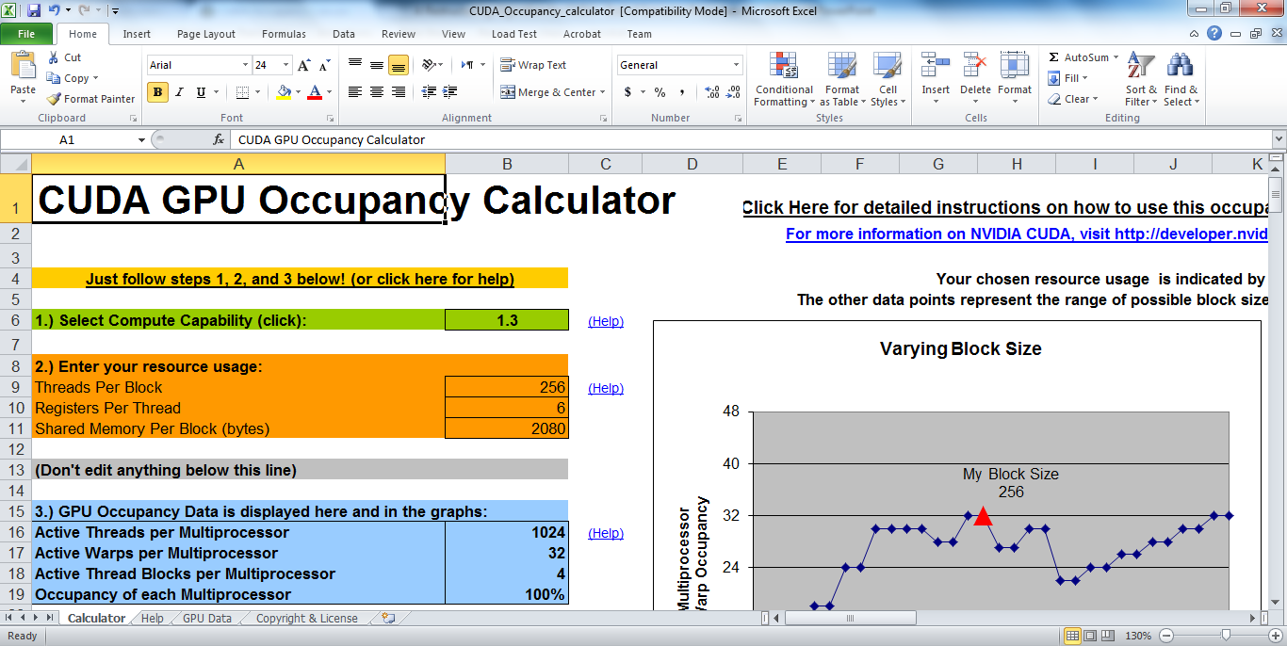
Literature Review

Slide 14
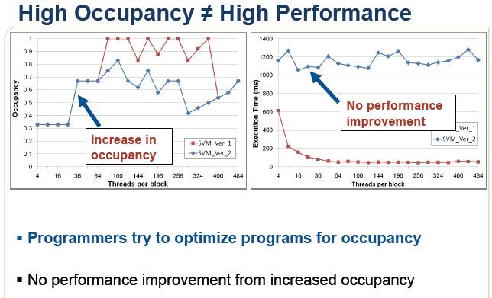
Literature Review
Analytical Model [11]: to estimate performance
First analytical model that calculates the execution cycles for GPU
Based on execution cycles estimation considering the overlap among memory and computation instructions
Difficult to analyze the complex memory operations
No systematic approach defined for optimizing applications

Slide 15
Proposed Restructuring Algorithm
3-Steps
Tiling
Coalesced Global Memory Access
Resource Optimization

Slide 16
Tiling
Tile the code to account for the small Shared Memory Capacity
Load data to calculate a Tile
Perform computations in shared memory
Store results
Select Tile Size to proper allocation of threads per block and shared memory per block
It may restrict active blocks per SM

Slide 17
Tiling: Example
void tiled_matrix_multiply(float **C, float **B,
float **A, int N)
{
for(int by=0; by < N; by+=TILE_Y)
for(int bx=0; bx < N; bx+=TILE_X)
for(int ty=0; ty < TILE_Y; ty++)
for(int tx=0; tx < TILE_X; tx++)
for(int bk=0; bk < N; bk+=TILE_X)
for(int k=0; k < TILE_X; k++)
C[by+ty][bx+tx] = A[by+ty][bk+k] * B[bk+k][bx+tx];
}
Code Listing 2(a): Matrix Multiplication Tiled Version
__global__ void
tiled_matrix_multiply(float *C, float *B,
float *A, int N)
{
int by = blockIdx.y * TILE_Y;
int bx = blockIdx.x * TILE_X;
int ty = threadIdx.y;
int tx = threadIdx.x;
for(int bk=0; bk < N; bk+=TILE_X)
for(int k=0; k < TILE_X; k++)
C[(by + ty) * N + bx + tx] =
A[(by + ty) * N + bk + k] *
B[(bk + k) * N + bx + tx];
}
Code Listing 2(b): Matrix Multiplication CUDA kernel

Slide 18
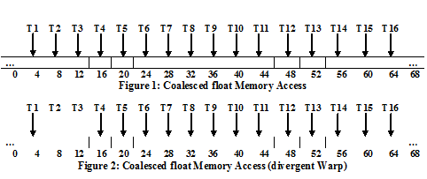
Coalesced Global Memory Access

Slide 19
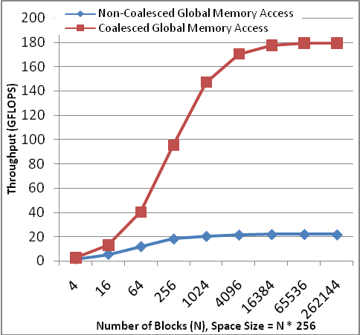
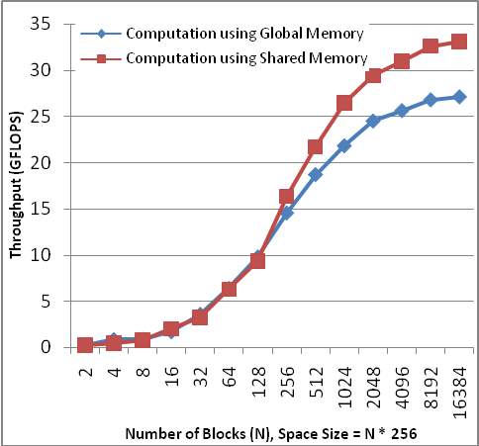
Performance: Memory Access Type
Figure 2: Matrix Multiplication using Shared Memory with (a) Non-Coalesced Global Memory Access and (b) Coalesced Global Memory Access.
Figure 3: Matrix Multiplication using Computations with (a) Global Memory and (b) Shared Memory

Slide 20
Kernel Mappings

Slide 21
Coalesced Global Memory Access: Example
__global__ void
coalesced_matrix_multiply(float *C, float *B, float *A, int N)
{
int by = blockIdx.y * TILE_Y;
int bx = blockIdx.x * TILE_X;
int ty = threadIdx.y;
int tx = threadIdx.x;
float Csub=0;
__shared__ float As[TILE_Y][TILE_X];
__shared__ float Bs[TILE_X][TILE_X];
for(int bk=0; bk < N; bk+=TILE_X){
As[ty][tx] = A[(by + ty) * N + bk + tx];
Bs[ty][tx] = B[(bk + ty) * N + bx + tx];
__syncthreads();
for(int k=0; k < TILE_X; k++)
Csub += As[ty][k] * Bs[k][tx];
}
__syncthreads();
C[(by + ty) * N + bx + tx] = Csub;
}
Code Listing 3: CUDA kernel with coalesced memory accesses
__global__ void
tiled_matrix_multiply(float *C, float *B,
float *A, int N)
{
int by = blockIdx.y * TILE_Y;
int bx = blockIdx.x * TILE_X;
int ty = threadIdx.y;
int tx = threadIdx.x;
for(int bk=0; bk < N; bk+=TILE_X)
for(int k=0; k < TILE_X; k++)
C[(by + ty) * N + bx + tx] =
A[(by + ty) * N + bk + k] *
B[(bk + k) * N + bx + tx];
}
Code Listing 2(b): Matrix Multiplication CUDA kernel

Slide 22
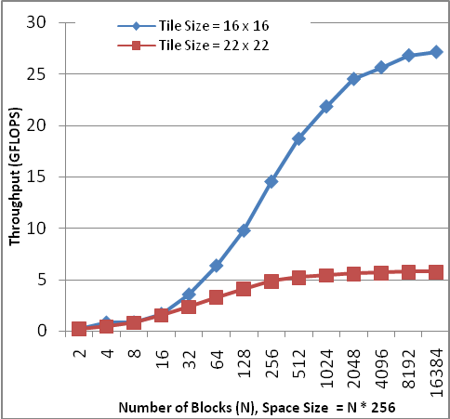
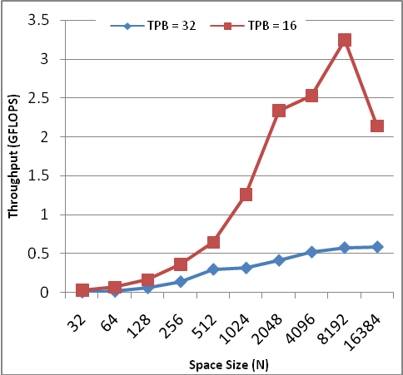
Performance: Kernel Parameters
Figure 4: Matrix Multiplication using only global memory with different number of threads per block (a) 16 x 16 = 256 threads/block and (b) 22 x 22 = 484 threads /block
Figure 5: Matrix Scaling using different size of shared memory per block (a) TPB = 32, 32 x 32 x 2 x 4 = 8KB and (b) TPB = 16, 16 x 16 x 2 x 4 = 2 KB

Slide 23
Resource Optimization
Massively and uniformly spreading of threads over the SMs
Can be identified by analyzing the repetition cycles
Two levels of repetition cycles due to two levels of kernel block scheduling

Slide 24
Optimized Kernel
__global__ void gen_coalesced_matrix_multiply(float *C, float *B, float *A, int N)
{
int by = blockIdx.y * TILE_Y;
int bx = blockIdx.x * TILE_X;
int ty = threadIdx.y;
int tx = threadIdx.x;
float Csub[TILE_Y/BLOCK_Y];
__shared__ float As[TILE_Y][TILE_X];
__shared__ float Bs[TILE_X][TILE_X];
for(int bk=0; bk < N; bk+=TILE_X){
for(int i=0; i < TILE_Y/BLOCK_Y; i++){
As[ty + i * BLOCK_Y][tx] = A[(by + ty + i * BLOCK_Y) * N + bk + tx];
}
for(int i=0; i < TILE_X/BLOCK_Y; i++){
Bs[ty + i * BLOCK_Y][tx] = B[(bk + ty + i * BLOCK_Y) * N + bx + tx];
}
__syncthreads();
for(int i=0; i < TILE_Y/BLOCK_Y; i++)
for(int k=0; k < TILE_X; k++)
Csub[i] += As[ty + i * BLOCK_Y][k] * Bs[k][tx];
}
__syncthreads();
for(int i=0; i < TILE_Y/BLOCK_Y; i++)
C[(by + ty + i * BLOCK_Y) * N + bx + tx] = Csub[i];
}
Code Listing 4: Optimized CUDA Kernel
Optimial Parameters for Tesla C2070:
TILE_X = 32
TILE_Y = 64
BLOCK_X = 32
BLOCK_Y = 16

Slide 25
Conditions on Repetition Cycles
Both AKBPSM and S-Cycles should be greater than or equal to 1.
S-Cycles should be an integer value to balance the threads among multiple SPs.
S-Cycles should be as large as possible.
AKBPSM should be the least possible to minimize serialization.
Tesla C2070 Machine (N = 2048 x 2048)
TPB | TS | AB | TKB | S-Cycles | AKBPSM | Exec. Time
512 | 2048 | 3 | 2048 | 48 | 146.28 | 2.45
512 | 1024 | 3 | 4096 | 48 | 292.57 | 2.47
256 | 1024 | 6 | 4096 | 48 | 292.57 | 2.51
512 | 512 | 3 | 8192 | 48 | 585.14 | 2.53
256 | 512 | 6 | 8192 | 48 | 585.14 | 2.55
256 | 256 | 6 | 16384 | 48 | 1170.28 | 2.62
Table 3: Repetitions Analysis of Matrix Multiplication for Resource Optimization

Slide 26
Application Results Comparison
Tesla C2070 (N = 2048 x 2048)
 | TPB | TS | AB | TKB | S-Cycles | AKBPSM | Exec. Time
Restructuring Algorithm | 512 | 2048 | 3 | 2048 | 48 | 146.2857143 | 2.4486
NVIDIA SDK | 256 | 256 | 6 | 16384 | 48 | 1170.285714 | 2.6268
CUDALite | 32 | 1024 | 1 | 4096 | 1 | 292.5714286 | 21.2396
Table 4: Parameters comparison of different implementations of Matrix Multiplication
Tesla C2070 (N = 2048 x 2048)
 | TPB | TS | AB | TKB | S-Cycles | AKBPSM | Exec. Time
Restructuring Algorithm | 512 | 4096 | 3 | 1024 | 48 | 73.14285714 | 0.0014
CUDALite | 32 | 1024 | 1 | 4096 | 1 | 292.5714286 | 0.0096
Table 5: Parameters comparison of different implementations of Matrix Scaling

Slide 27
Application Results Comparison
Quadro FX 7000 (N = 2048 x 2048)
 | TPB | TS | AB | TKB | S-Cycles | AKBPSM | Exec. Time
Restructuring Algorithm | 512 | 1024 | 3 | 4096 | 48 | 256 | 0.0776
NVIDIA SDK | 256 | 1024 | 5 | 4096 | 40 | 256 | 0.1084
Table 6: Parameters comparison of Matrix Transpose kernels with no shared memory bank conflicts
Quadro FX 7000 (N = 2048 x 2048)
 | TPB | TS | AB | TKB | S-Cycles | AKBPSM | Exec. Time
Restructuring Algorithm | 512 | 1024 | 3 | 4096 | 48 | 256 | 0.0800
NVIDIA SDK | 256 | 1024 | 5 | 4096 | 40 | 256 | 0.1234
Table 7: Parameters comparison of Matrix Transpose kernels with diagonal tiles mapping to blocks to avoid partition camping

Slide 28
Conclusion And Future Work
Presents a restructuring algorithm to optimize a CUDA program based on three major steps: Tiling, Coalesced Global Memory Access and Resource Optimization
Defined two new factors for selecting optimal values of kernel parameters
The lower bound on average kernel blocks per SM need to identified specifically for kernels having low data locality
This work is submitted to IJPP (International Journal of Parallel Programming)

Slide 29
References
S. Ueng, M. Lathara, S. S. Baghsorkhi, and W. W. Hwu. CUDA-lite: Reducing GPU programming complexity. International Workshop on Languages and Compilers for Parallel Computing (LCPC), 2008.
Seyong Lee, Seung-Jai Min, and Rudolf Eigenmann, “OpenMP to GPGPU: A Compiler Framework for Automatic Translation and Optimization”, PPoPP’09, February 14-18, 2009, ACM 978-1-60558-397-6/09/02
Tianyi David Han and Tarek S. Abdelrahman, “hiCuda: A high-level Directive-based Language for GPU Programming”, GPGPU’09, March 8, 2009, ACM 978-1-60558-517-8
David B. Kirk and Wen-mei W. Hwu, “Programming Massively Parallel Processors: A Hands-on Approach”, Published by Elsevier Inc. ISBN: 978-0-12-381472-2, 2010.
Shuai Che, Michael Boyer, Jiayuan Meng, David Tarjan, Jeremy W. Sheaffer, Kevin Skadron, “A Performance Study of General-Purpose Applications on Graphics Processors Using CUDA”, in The First Workshop on General Purpose Processing on Graphics Processing Units, October 2007.
R. Belleman, J. Bedorf, S.P. Zwart, High performance direct gravitational N-body simulations on graphics processing units – II: an implementation in CUDA, New Astronomy 13 (2) (2008) 103–112.
M. Garland et al., ‘‘Parallel Computing Experiences with CUDA,’’ IEEE Micro, vol. 28, no. 4, 2008, pp. 13-27.
J. Nickolls et al., ‘‘Scalable Parallel Programming with CUDA,’’ ACM Queue, vol. 6, no. 2, 2008, pp. 40-53.
Gabe Rudy, “CUDA-CHiLL: A Programming Language Interface for GPGPU Optimizations And Code Generation”, MS Thesis, School of Computing, University of Utah, USA, August 2010.
Long Chen, “Exploring Novel Many-Core Architectures For Scientific Computing”, PhD thesis, Faculty of Electrical and Computer Engineering, University of Delaware, USA, Fall 2010
Sunpyo Hong, Hyesoon Kim, “An Analytical Model for GPU Architecture with Memory-Level and Thread-Level Parallelism Awareness”, ISCA ‘09, Proceedings of the 36th annual international symposium on Computer Architecture

