Slide 1
COE 202: Digital Logic Design Combinational Circuits Part 4
Courtesy of Dr. Ahmad Almulhem

Slide 2
Objectives
Magnitude comparator
Design of 4-bit magnitude comparator
Design Examples using MSI components
Adding Three 4-bit numbers
Building 4-to-16 Decoders with 2-to-4 Decoders
Getting the larger of 2 numbers (Maximum)
Excess-3 Code Converter

Slide 3
Magnitude Comparator
Definition: A magnitude comparator is a combinational circuit that compares two numbers A & B to determine whether:
A > B, or
A = B, or
A < B
Inputs
First n-bit number A
Second n-bit number B
Outputs
3 output signals (GT, EQ, LT), where:
GT = 1 IFF A > B
EQ = 1 IFF A = B
LT = 1 IFF A < B
Note: Exactly One of these 3 outputs equals 1, while the other 2 outputs are 0`s
n-bit input
n-bit magnitude
comparator
GT
A
EQ
n-bit input
B
LT

Slide 4
Example 1: Magnitude Comparator (4-bit)
Problem: Design a magnitude comparator that compares 2 4-bit numbers A and B and determines whether:
A > B, or
A = B, or
A < B
4-bit input
4-bit magnitude
comparator
GT
A
EQ
4-bit input
B
LE

Slide 5
Example 1: Magnitude Comparator (4-bit)
Solution:
Inputs: 8-bits (A ⇒ 4-bits , B ⇒ 4-bits)
A and B are two 4-bit numbers
Let A = A₃A₂A₁A₀ , and
Let B = B₃B₂B₁B₀
Inputs have 2⁸ (256) possible combinations (size of truth table and K-map?)
Not easy to design using conventional techniques
4-bit input
4-bit magnitude
comparator
GT
A
EQ
4-bit input
B
LE
The circuit possesses certain amount of regularity
⇒ can be designed algorithmically.

Slide 6
Example 1: Magnitude Comparator (4-bit)
Designing EQ:
Define X_{i} = A_{i} xnor B_{i} = A_{i} B_{i} + A_{i}’ B_{i}’
➔ X_{i} = 1 IFF A_{i} = B_{i} ∀ i =0, 1, 2 and 3
➔ X_{i} = 0 IFF A_{i} ≠ B_{i}
Therefore the condition for A = B or EQ=1 IFF
A₃= B₃ → (X₃ = 1), and
A₂= B₂ → (X₂ = 1), and
A₁= B₁ → (X₁ = 1), and
A₀= B₀ → (X₀ = 1).
Thus, EQ=1 IFF X₃ X₂ X₁ X₀ = 1. In other words,
EQ = X₃ X₂ X₁ X₀

Slide 7
Example 1: Magnitude Comparator (4-bit)
Designing GT and LT:
GT = 1 if A > B:
If A₃ > B₃ → A₃ = 1 and B₃ = 0
If A₃ = B₃ and A₂ > B₂
If A₃ = B₃ and A₂ = B₂ and A₁ > A₁
If A₃ = B₃ and A₂ = B₂ and A₁ = B₁ and A₀ > B₀
Therefore,
GT = A₃B₃‘ + X₃ A₂ B₂‘ + X₃ X₂ A₁ B₁‘ + X₃ X₂ X₁A₀ B₀‘
Similarly, LT = A₃’B₃ + X₃ A₂‘B₂ + X₃ X₂ A₁’B₁ + X₃ X₂ X₁A₀’ B₀

Slide 8
Example 1: Magnitude Comparator (4-bit)
EQ = X₃ X₂ X₁ X₀
GT = A₃B₃’ + X₃A₂B₂’ + X₃X₂A₁B₁’ + X₃X₂X₁A₀B₀’
LT = B₃A₃’ + X₃B₂A₂’ + X₃X₂B₁A₁’ + X₃X₂X₁B₀A₀’
4-bit magnitude comparator

Slide 9
Example 1: Magnitude Comparator (4-bit)
Do you need all three outputs?
Two outputs can tell about the third one
Example: when A is NOT GREATER THAN B, and A is NOT LESS THAN B THEN A is EQUAL TO B
Therefore, we can save some logic gates:
4-bit input
4-bit magnitude
comparator
GT
A
EQ
EQ
4-bit input
B
LT

Slide 10
Example 2: Adding three 4-bit numbers
Problem: Add three 4-bit numbers using standard MSI combinational components
Solution:
Let the numbers be X₃X₂X₁X₀, Y₃Y₂Y₁Y₀, Z₃Z₂Z₁Z₀ ,
X₃X₂X₁X₀
+ Y₃Y₂Y₁Y₀
-------------------
C₄ S₃S₂S₁S₀
S₃S₂S₁S₀
+ Z₃Z₂Z₁Z₀
-------------------
D₄ F₃F₂F₁F₀
Note: C₄ and D₄ is generated in position 4. They must be added to generate the most significant bits of the result

Slide 11
Example 2: Adding three 4-bit numbers
Problem: Add three 4-bit numbers using standard MSI combinational components
Solution:
Let the numbers be X₃X₂X₁X₀, Y₃Y₂Y₁Y₀, Z₃Z₂Z₁Z₀ ,
X₃X₂X₁X₀
+ Y₃Y₂Y₁Y₀
-------------------
C₄ S₃S₂S₁S₀
S₃S₂S₁S₀
+ Z₃Z₂Z₁Z₀
-------------------
D₄ F₃F₂F₁F₀
Note: C₄ and D₄ is generated in position 4. They must be added to generate the most significant bits of the result

Slide 12
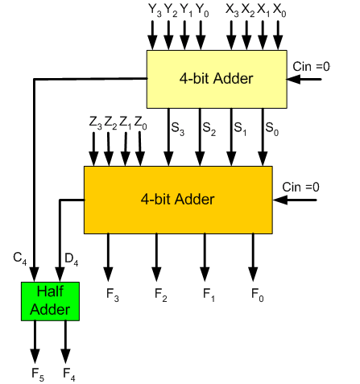
Example 2: Adding three 4-bit numbers

Slide 13
Example 3: 4-to-16 Decoder
A₃ | A₂ | A₁ | A₀ | Output
0 | 0 | 0 | 0 | D₀
0 | 0 | 0 | 1 | D₁
0 | 0 | 1 | 0 | D₂
0 | 0 | 1 | 1 | D₃
0 | 1 | 0 | 0 | D₄
0 | 1 | 0 | 1 | D₅
0 | 1 | 1 | 0 | D₆
0 | 1 | 1 | 1 | D₇
1 | 0 | 0 | 0 | D₈
1 | 0 | 0 | 1 | D₉
1 | 0 | 1 | 0 | D₁₀
1 | 0 | 1 | 1 | D₁₁
1 | 1 | 0 | 0 | D₁₂
1 | 1 | 0 | 1 | D₁₃
1 | 1 | 1 | 0 | D₁₄
1 | 1 | 1 | 1 | D₁₅
Problem: Design a 4x16 Decoder using 2x4 Decoders
Solution:
Each group combination holds a unique value for A₃A₂
- One Decoder can be therefore used with inputs: A₃A₂
- Four more decoders are needed for representing each individual color combination
A₃A₂ = 00
A₃A₂ = 01
A₃A₂ = 10
A₃A₂ = 11

Slide 14
Example 3: 4-to-16 Decoder
A₀ A₁
D₀ D₁ D₂ D₃
2x4 Decoder
A₀ A₁
D₄ D₅ D₆ D₇
2x4 Decoder
A₂ A₃
2x4 Decoder
A₀ A₁
D₈ D₉ D₁₀ D₁₁
2x4 Decoder
A₀ A₁
D₁₂ D₁₃ D₁₄ D₁₅
2x4 Decoder

Slide 15
Example 4: The larger of 2 numbers
Problem: Given two 4-bit unsigned numbers, design a circuit such that the output is the larger of the two numbers
Solution: We will use a magnitude comparator and a Quad 2x1 MUX. How?

Slide 16
Example 4: The larger of 2 numbers
B₀
B₁
B₂
B₃
A₀
A₁
A₂
A₃
Y₀
Y₁
Y₂
Y₃
QUAD
2X1
MUX
4-bit
Magnitude
Comparator
A>B
GT
LT
EQ
A₀
A₁
A₂
A₃
A<B
B₀
B₁
B₂
B₃
A=B
For So=1, A is selected,
For So=0, B is selected
S₀

Slide 17
Example 5: Excess-3 Code Converter
Problem: Design an excess-3 code converter that takes as input a BCD number, and generates an excess-3 output.
Solution: Use decoders and encoders
W | X | Y | Z | A | B | C | D
0 | 0 | 0 | 0 | 0 | 0 | 1 | 1
0 | 0 | 0 | 1 | 0 | 1 | 0 | 0
0 | 0 | 1 | 0 | 0 | 1 | 0 | 1
0 | 0 | 1 | 1 | 0 | 1 | 1 | 0
0 | 1 | 0 | 0 | 0 | 1 | 1 | 1
0 | 1 | 0 | 1 | 1 | 0 | 0 | 0
0 | 1 | 1 | 0 | 1 | 0 | 0 | 1
0 | 1 | 1 | 1 | 1 | 0 | 1 | 0
1 | 0 | 0 | 0 | 1 | 0 | 1 | 1
1 | 0 | 0 | 1 | 1 | 1 | 0 | 0

Slide 18
Example 5: Excess-3 Code Converter
4-to-16 line Decoder
16-to-4 line Encoder
O0
O1
O2
O3
O4
O5
O6
O7
O8
O9
O10
O11
O12
O13
O14
O15
I0
I1
I2
I3
I4
I5
I6
I7
I8
I9
I10
I11
I12
I13
I14
I15
Z
Y
X
W
D0
D1
D2
D3
D0
D1
D2
D3
?
?
?
?
What will be the output?

Slide 19
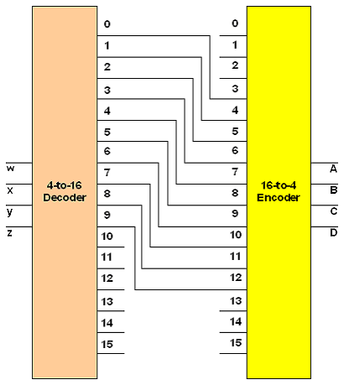
Example 5: Excess-3 Code Converter
A decoder can be used with the inputs being W,X,Y,Z
It will be a 4x16 decoder, with only a single output bit equal to 1 for any input combination
An encoder (16x4) will take as input the 16 bit output from the decoder, and will generate the appropriate output in excess-3 format
For this to function correctly, the output from the decoder must be displaced 3 places while being connected to the encoder input
It may be noted that outputs 10,11,12,13,14,15 of the decoder are not used – since we are dealing with BCD

Slide 20
Summary
Design = Different possibilities
Better designer = more practice
More design examples in the textbook

