Slide 1
COE 202: Digital Logic Design Combinational Circuits Part 1
Courtesy of Dr. Ahmad Almulhem

Slide 2
Objectives
Types of Logic Circuits
Combinational
Sequential
Designing Combinational Circuits
Procedure
Examples

Slide 3
Combinational Circuits
Two classes of logic circuits:
Combinational Circuits
Sequential Circuits
A Combinational circuit consists of logic gates
Output depends only on input
A Sequential circuit consists of logic gates and memory
Output depends on current inputs and previous ones (stored in memory)
Memory defines the state of the circuit.

Slide 4
Combinational Circuits
Combinational
Circuits
n inputs
m outputs
A combinational circuit has:
n Boolean inputs (1 or more),
m Boolean outputs (1 or more)
logic gates mapping the inputs to the outputs

Slide 5
Designing Combinational Circuits
How to design a combinational circuit?
Use all the information and tools you learned
Binary system, Boolean Algebra, K-Maps, etc.
Follow the step-by-step procedure given next

Slide 6
Design Procedure
Specification
Write a specification for the circuit if one is not already available
Specify/Label input and output
Formulation
Derive a truth table or initial Boolean equations that define the required relationships between the inputs and outputs, if not in the specification
Apply hierarchical design if appropriate
Optimization
Apply 2-level and multiple-level optimization (Boolean Algebra, K-Map, software)
Draw a logic diagram or provide a netlist for the resulting circuit using ANDs, ORs, and inverters

Slide 7
Design Procedure (Cont.)
Technology Mapping
Map the logic diagram or netlist to the implementation technology selected (e.g. map into NANDs)
Verification
Verify the correctness of the final design manually or using simulation
Practical Considerations:
Cost of gates (Number)
Maximum allowed delay
Fanin/Fanout

Slide 8
Example 1
Question: Design a circuit that has a 3-bit input and a single output (F) specified as follows:
F = 0, when the input is less than (5)₁₀
F = 1, otherwise
Solution:
Step 1 (Specification):
Label the inputs (3 bits) as X, Y, Z
X is the most significant bit, Z is the least significant bit
The output (1 bit) is F:
F = 1 → (101)₂, (110)₂, (111)₂
F = 0 → other inputs

Slide 9
Example 1 (cont.)
Question: Design a circuit that has a 3-bit input and a single output (F) specified as follows:
F = 0, when the input is less than (5)₁₀
F = 1, otherwise
Solution:
Step 1 (Specification):
Label the inputs (3 bits) as X, Y, Z
X is the most significant bit, Z is the least significant bit
The output (1 bit) is F:
F = 1 → (101)₂, (110)₂, (111)₂
F = 0 → other inputs

Slide 10
Example 1 (cont.)
Step 2 (Formulation)
Obtain Truth table
Step 3 (Optimization)
YZ
X
00 01 11 10
X | Y | Z | F
0 | 0 | 0 | 0
0 | 0 | 1 | 0
0 | 1 | 0 | 0
0 | 1 | 1 | 0
1 | 0 | 0 | 0
1 | 0 | 1 | 1
1 | 1 | 0 | 1
1 | 1 | 1 | 1
0
1
0 0 0 0
0 1 1 1
F = XZ + XY
Circuit Diagram
X
Z
F
X
Y

Slide 11
Example 2
Question (BCD to Excess-3 Code Converter)
Code converters convert from one code to another (BCD to Excess-3 in this example)
The inputs are defined by the code that is to be converted (BCD in this example)
The outputs are defined by the converted code (Excess-3 in this example)
Recall Excess-3 code is a decimal digit plus three converted into binary, i.e. 0 is 0011, 1 is 0100, etc.

Slide 12
Example 2 (cont.)
 | BCD Input |  |  |  | Excess 3 Output
Decimal | A | B | C | D | W | X | Y | Z
0 | 0 | 0 | 0 | 0 | 0 | 0 | 1 | 1
1 | 0 | 0 | 0 | 1 | 0 | 1 | 0 | 0
2 | 0 | 0 | 1 | 0 | 0 | 1 | 0 | 1
3 | 0 | 0 | 1 | 1 | 0 | 1 | 1 | 0
4 | 0 | 1 | 0 | 0 | 0 | 1 | 1 | 1
5 | 0 | 1 | 0 | 1 | 1 | 0 | 0 | 0
6 | 0 | 1 | 1 | 0 | 1 | 0 | 0 | 1
7 | 0 | 1 | 1 | 1 | 1 | 0 | 1 | 0
8 | 1 | 0 | 0 | 0 | 1 | 0 | 1 | 1
9 | 1 | 0 | 0 | 1 | 1 | 1 | 0 | 0
10-15 | All other inputs |  |  |  | X | X | X | X
Step 1 (Specification)
4-bit BCD input (A,B,C,D)
4-bit E-3 output (W,X,Y,Z)
Step 2 (Formulation)
Obtain Truth table

Slide 13
Example 2 (cont.)
 | BCD Input |  |  |  | Excess 3 Output
Decimal | A | B | C | D | W | X | Y | Z
0 | 0 | 0 | 0 | 0 | 0 | 0 | 1 | 1
1 | 0 | 0 | 0 | 1 | 0 | 1 | 0 | 0
2 | 0 | 0 | 1 | 0 | 0 | 1 | 0 | 1
3 | 0 | 0 | 1 | 1 | 0 | 1 | 1 | 0
4 | 0 | 1 | 0 | 0 | 0 | 1 | 1 | 1
5 | 0 | 1 | 0 | 1 | 1 | 0 | 0 | 0
6 | 0 | 1 | 1 | 0 | 1 | 0 | 0 | 1
7 | 0 | 1 | 1 | 1 | 1 | 0 | 1 | 0
8 | 1 | 0 | 0 | 0 | 1 | 0 | 1 | 1
9 | 1 | 0 | 0 | 1 | 1 | 1 | 0 | 0
10-15 | All other inputs |  |  |  | x | x | x | x
Step 1 (Specification)
4-bit BCD input (A,B,C,D)
4-bit E-3 output (W,X,Y,Z)
Step 2 (Formulation)
Obtain Truth table

Slide 14
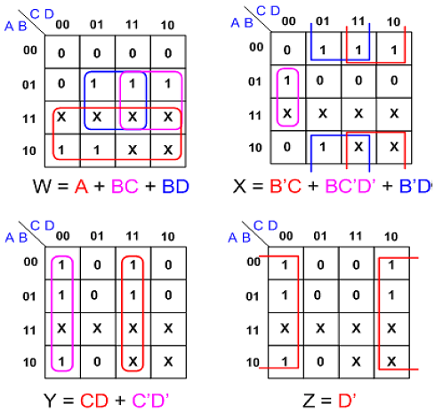
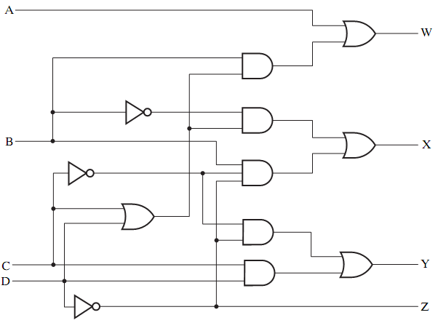
Example 2 (cont.)
Step 3 (Optimization)
src: Mano’s book
src: online CD

Slide 15
Example 3
Question (BCD-to-Seven-Segment Decoder)
src: Mano’s book
A seven-segment display is digital readout found in electronic devices like clocks, TVs, etc.
Made of seven light-emitting diodes (LED) segments; each segment is controlled separately.
A BCD-to-Seven-Segment decoder is a combinational circuit
Accepts a decimal digit in BCD (input)
Generates appropriate outputs for the segments to display the input decimal digit (output)

Slide 16
Example 3 (cont.)
Step 1 (Specification):
4 inputs (A, B, C, D)
7 outputs (a, b, c, d, e, f, g)
a b c d e f g
BCD-to-Seven-Segment
Decoder
A
B
C
D

Slide 17
Example 3 (cont.)
Step 2 (Formulation)
 | BCD Input |  |  |  | 7 Segment Decoder
Decimal | A | B | C | D | a | b | c | d | e | f | g
0 | 0 | 0 | 0 | 0 | 1 | 1 | 1 | 1 | 1 | 1 | 0
1 | 0 | 0 | 0 | 1 | 0 | 1 | 1 | 0 | 0 | 0 | 0
2 | 0 | 0 | 1 | 0 | 1 | 1 | 0 | 1 | 1 | 0 | 1
3 | 0 | 0 | 1 | 1 | 1 | 1 | 1 | 1 | 0 | 0 | 1
4 | 0 | 1 | 0 | 0 | 0 | 1 | 1 | 0 | 0 | 1 | 1
5 | 0 | 1 | 0 | 1 | 1 | 0 | 1 | 1 | 0 | 1 | 1
6 | 0 | 1 | 1 | 0 | 1 | 0 | 1 | 1 | 1 | 1 | 1
7 | 0 | 1 | 1 | 1 | 1 | 1 | 1 | 0 | 0 | 0 | 0
8 | 1 | 0 | 0 | 0 | 1 | 1 | 1 | 1 | 1 | 1 | 1
9 | 1 | 0 | 0 | 1 | 1 | 1 | 1 | 0 | 0 | 1 | 1
10-15 | All Other Inputs |  |  |  | 0 | 0 | 0 | 0 | 0 | 0 | 0
Invalid BCD codes
=
No Light

Slide 18
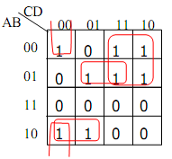
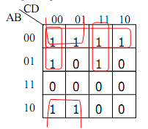
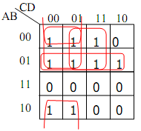
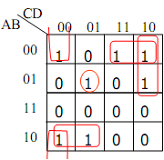
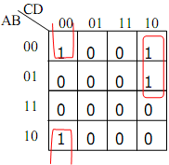
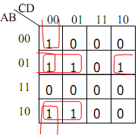
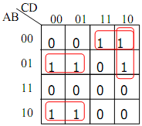
Example 3 (cont.)
Step 3 (Optimization)
a
b
c
d
e
f
g

Slide 19
Example 3 (cont.)
Step 3 (Optimization) (cont.)
a = A’C + A’BD + AB’C’ + B’C’D’
b = A’B’ + A’C’D’ + A’CD + B’C’
c = A’B + B’C’ + A’C’ + A’D
d = A’CD’ + A’B’C + B’C’D’+AB’C’+A’BC’D
e = A’CD’ + B’C’D’
f = A’BC’ + A’C’D’ + A’BD’ + AB’C’
g = A’CD’ + A’B’C + A’BC’ + AB’C’
Exercise: Draw the circuit

Slide 20
Conclusion
There are two types of logic circuits
Combinational
Sequential
Design Procedure
Specification *
Formulation *
Optimization *
Technology Mapping
Verification
Examples

