Slide 1
Symmetric Key Ciphers
Block Ciphers
Slides Original Source:
M. Stamp, “Information Security: Principles and Practice,” John Wiley
C. Paar and J. Pelzl, “Understanding Cryptography – A Textbook for Students and Practitioners,” Springer (www.crypto-textbook.com)

Slide 2
Outline
Intro to block ciphers
Examples of block ciphers
  DES
  3DES
  AES
Block cipher modes
  ECB
  CBC
  CTR
Integrity

Slide 3
Outline
Intro to block ciphers
Examples of block ciphers
  DES
  3DES
  AES
Block cipher modes
  ECB
  CBC
  CTR
Integrity

Slide 4
Block Ciphers in the Field of Cryptology
Cryptology
Cryptography
Cryptanalysis
Symmetric Ciphers
Asymmetric Ciphers
Protocols
Block Ciphers
Stream Ciphers

Slide 5
(Iterated) Block Cipher
Plaintext and ciphertext consist of fixed-sized blocks
Ciphertext obtained from plaintext by iterating a round function
Input to round function consists of key and output of previous round
Usually implemented in software

Slide 6
Feistel Cipher: Encryption
Feistel cipher is a type of block cipher, not a specific block cipher
Split plaintext block into left and right halves: P = (L₀,R₀)
For each round i = 1,2,...,n, compute
L_{i}= R_{i−1}
R_{i}= L_{i−1} ⊕ F(R_{i−1},K_{i})
where F is round function and K_{i} is subkey
Ciphertext: C = (L_{n},R_{n})

Slide 7
Feistel Cipher: Decryption
Start with ciphertext C = (L_{n},R_{n})
For each round i = n,n−1,…,1, compute
R_{i−1} = L_{i}
L_{i−1} = R_{i} ⊕ F(R_{i−1},K_{i})
where F is round function and K_{i} is subkey
Plaintext: P = (L₀,R₀)
Formula “works” for any function F
  But only secure for certain functions F

Slide 8
Outline
Intro to block ciphers
Examples of block ciphers
  DES
  3DES
  AES
Block cipher modes
  ECB
  CBC
  CTR
Integrity

Slide 9
Data Encryption Standard (DES)
DES developed in 1970’s
Based on IBM’s Lucifer cipher
DES was U.S. government standard
DES development was controversial
  NSA secretly involved
  Design process was secret
  Key length reduced from 128 to 56 bits
  Subtle changes to Lucifer algorithm

Slide 10
DES Numerology
DES is a Feistel cipher with…
  64 bit block length
  56 bit key length
  16 rounds
  48 bits of key used each round (subkey)
Each round is simple (for a block cipher)
Security depends heavily on “S-boxes”
  Each S-boxes maps 6 bits to 4 bits

Slide 11
L
R
key
32
28
28
expand
shift
shift
32
48
28
28
One
Round
of
DES
K_{i}
⊕
48
48
compress
S-boxes
28
28
32
P box
32
32
⊕
32
L
R
key

Slide 12
DES Expansion Permutation
Input 32 bits
0 1 2 3 4 5 6 7 8 9 10 11 12 13 14 15
16 17 18 19 20 21 22 23 24 25 26 27 28 29 30 31
Output 48 bits
31 0 1 2 3 4 3 4 5 6 7 8
7 8 9 10 11 12 11 12 13 14 15 16
15 16 17 18 19 20 19 20 21 22 23 24
23 24 25 26 27 28 27 28 29 30 31 0

Slide 13
DES S-box
8 “substitution boxes” or S-boxes
Each S-box maps 6 bits to 4 bits
S-box number 1
input bits (0,5)
↓ input bits (1,2,3,4)
| 0000 0001 0010 0011 0100 0101 0110 0111 1000 1001 1010 1011 1100 1101 1110 1111
------------------------------------------------------------------------------------
00 | 1110 0100 1101 0001 0010 1111 1011 1000 0011 1010 0110 1100 0101 1001 0000 0111
01 | 0000 1111 0111 0100 1110 0010 1101 0001 1010 0110 1100 1011 1001 0101 0011 1000
10 | 0100 0001 1110 1000 1101 0110 0010 1011 1111 1100 1001 0111 0011 1010 0101 0000
11 | 1111 1100 1000 0010 0100 1001 0001 0111 0101 1011 0011 1110 1010 0000 0110 1101

Slide 14
DES P-box
Input 32 bits
0 1 2 3 4 5 6 7 8 9 10 11 12 13 14 15
16 17 18 19 20 21 22 23 24 25 26 27 28 29 30 31
Output 32 bits
15 6 19 20 28 11 27 16 0 14 22 25 4 17 30 9
1 7 23 13 31 26 2 8 18 12 29 5 21 10 3 24

Slide 15
DES Subkey
56 bit DES key, numbered 0,1,2,…,55
Left half key bits, LK
49 42 35 28 21 14 7
0 50 43 36 29 22 15
8 1 51 44 37 30 23
16 9 2 52 45 38 31
Right half key bits, RK
55 48 41 34 27 20 13
6 54 47 40 33 26 19
12 5 53 46 39 32 25
18 11 4 24 17 10 3

Slide 16
DES Subkey
For rounds i=1,2,...,16
  Let LK = (LK circular shift left by r_{i})
  Let RK = (RK circular shift left by r_{i})
  Left half of subkey K_{i} is of LK bits
13 16 10 23 0 4 2 27 14 5 20 9
22 18 11 3 25 7 15 6 26 19 12 1
  Right half of subkey K_{i} is RK bits
12 23 2 8 18 26 1 11 22 16 4 19
15 20 10 27 5 24 17 13 21 7 0 3

Slide 17
DES Subkey
For rounds 1, 2, 9 and 16 the shift r_{i} is 1, and in all other rounds r_{i} is 2
Bits 8,17,21,24 of LK omitted each round
Bits 6,9,14,25 of RK omitted each round
Compression permutation yields 48 bit subkey K_{i} from 56 bits of LK and RK
Key schedule generates subkey

Slide 18
DES Last Word
An initial permutation before round 1
Halves are swapped after last round
A final permutation (inverse of initial perm) applied to (R₁₆,L₁₆)
  None of this serves security purpose!
DES Decryption: use key schedule in reverse order

Slide 19
Security of DES
Security depends heavily on S-boxes
  Everything else in DES is linear
Thirty+ years of intense analysis has revealed no “back door”
Attacks, essentially exhaustive key search
Inescapable conclusions
  Designers of DES knew what they were doing
  Designers of DES were way ahead of their time

Slide 20
Outline
Intro to block ciphers
Examples of block ciphers
  DES
  3DES
  AES
Block cipher modes
  ECB
  CBC
  CTR
Integrity

Slide 21
Block Cipher Notation
P = plaintext block
C = ciphertext block
Encrypt P with key K to get ciphertext C
  C = E(P, K)
Decrypt C with key K to get plaintext P
  P = D(C, K)
Note: P = D(E(P, K), K) and C = E(D(C, K), K)
  But P ≠ D(E(P, K₁), K₂) and C ≠ E(D(C, K₁), K₂) when K₁ ≠ K₂

Slide 22
Triple DES (3DES)
Today, 56 bit DES key is too small
  Exhaustive key search is feasible
But DES is everywhere, so what to do?
Triple DES or 3DES (112 bit key)
  C = E(D(E(P,K₁),K₂),K₁)
  P = D(E(D(C,K₁),K₂),K₁)
Why Encrypt-Decrypt-Encrypt with 2 keys?
  Backward compatible: E(D(E(P,K),K),K) = E(P,K)
  And 112 bits is enough

Slide 23
3DES
Why not C = E(E(P,K),K) ?
  Trick question --- it’s still just 56 bit key
Why not C = E(E(P,K₁),K₂) ?
A (semi-practical) known plaintext attack
  Pre-compute table of E(P,K₁) for every possible key K₁ (resulting table has 2⁵⁶ entries)
  Then for each possible K₂ compute D(C,K₂) until a match in table is found
  When match is found, have E(P,K₁) = D(C,K₂)
  Result gives us keys: C = E(E(P,K₁),K₂)

Slide 24
Outline
Intro to block ciphers
Examples of block ciphers
  DES
  3DES
  AES
Block cipher modes
  ECB
  CBC
  CTR
Integrity

Slide 25
Advanced Encryption Standard (AES)
Replacement for DES
AES competition (late 90’s)
  NSA openly involved
  Transparent process
  Many strong algorithms proposed
  Rijndael Algorithm ultimately selected (pronounced like “Rain Doll” or “Rhine Doll”)
Iterated block cipher (like DES)
Not a Feistel cipher (unlike DES)

Slide 26
AES Overview
Block size: 128 bits (others in Rijndael)
Key length: 128, 192 or 256 bits (independent of block size)
10 to 14 rounds (depends on key length)
Each round uses 4 functions (3 “layers”)
  ByteSub (nonlinear layer)
  ShiftRow (linear mixing layer)
  MixColumn (nonlinear layer)
  AddRoundKey (key addition layer)

Slide 27
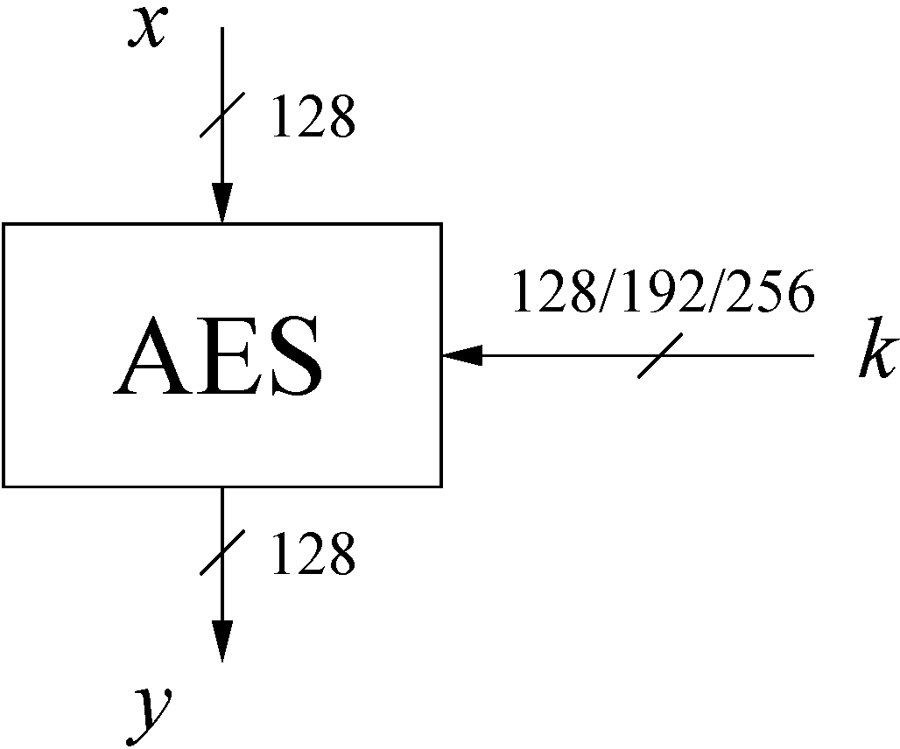
AES: Overview
The number of rounds depends on the chosen key length:
Key length (bits) | Number of rounds
128 | 10
192 | 12
256 | 14

Slide 28
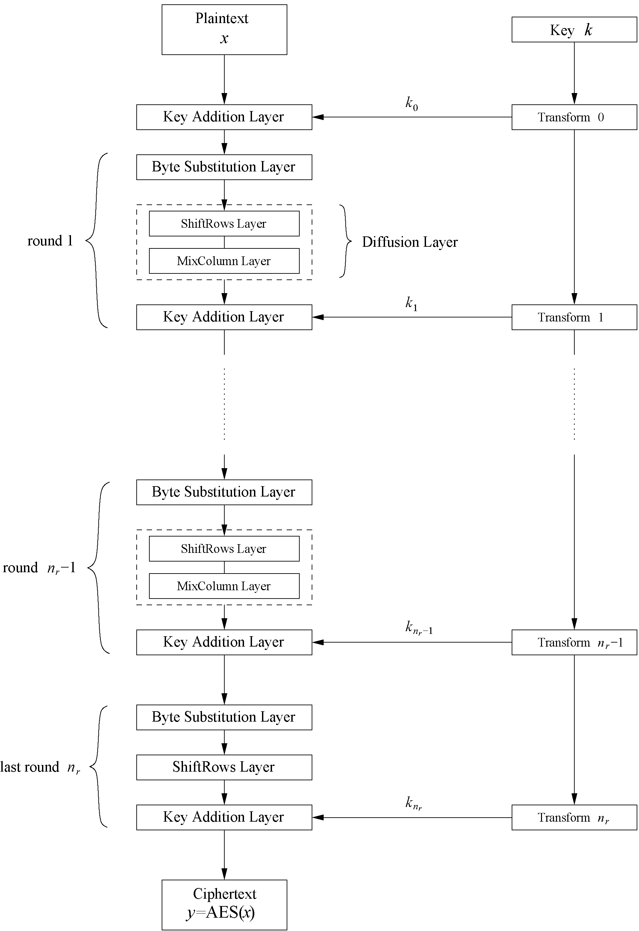
AES: Overview
Iterated cipher with 10/12/14 rounds
Each round consists of “Layers”

Slide 29
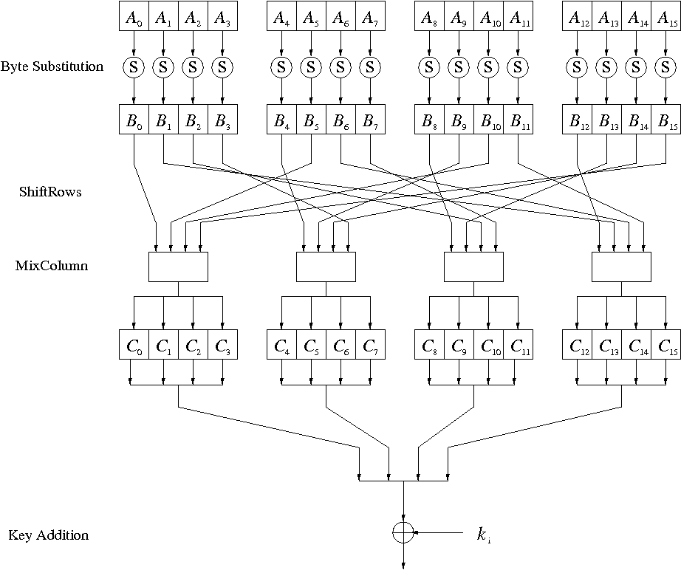
Internal Structure of AES
Round function for rounds 1,2,…,n_{r-1}:
Note: In the last round, the MixColumn tansformation is omitted

Slide 30
Diffusion Layer
The Diffusion layer
provides diffusion over all input state bits
consists of two sublayers:
  ShiftRows Sublayer: Permutation of the data on a byte level
  MixColumn Sublayer: Matrix operation which combines (“mixes”) blocks of four bytes

Slide 31

AES ByteSub
Treat 128 bit block as 4x4 byte array
ByteSub is AES’s “S-box”
Can be viewed as nonlinear (but invertible) composition of two math operations

Slide 32
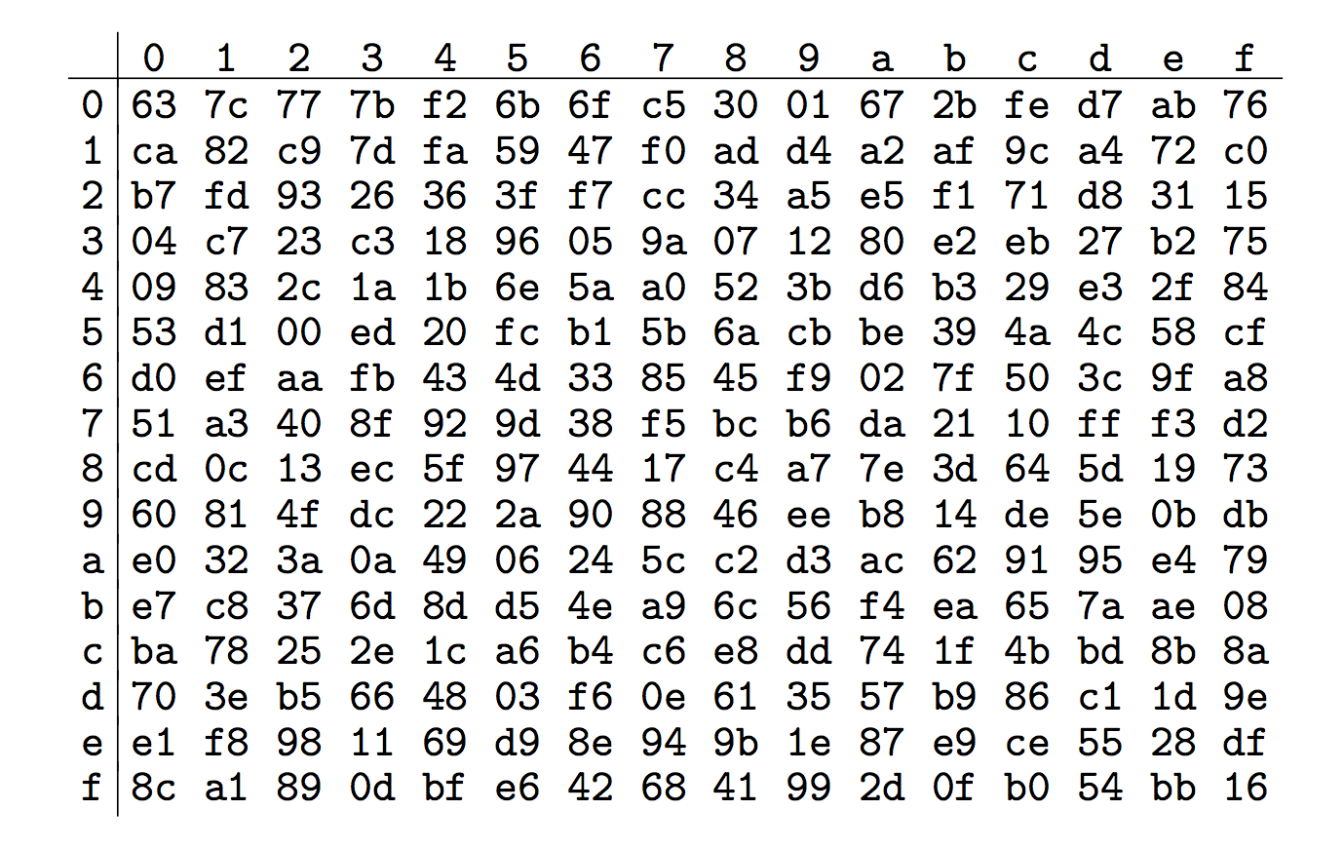
AES “S-box”
Last 4 bits of input
First 4
bits of
input

Slide 33

AES ShiftRow
Cyclic shift rows
← no shift
← one position left shift
← two positions left shift
← three positions left shift

Slide 34

AES MixColumn*
Invertible, linear operation applied to each column
Implemented as a (big) lookup table
* See backup slides for details

Slide 35

AES AddRoundKey
XOR subkey with block
Block
Subkey
RoundKey (subkey) determined by key schedule algorithm

Slide 36
Key Schedule
Subkeys are derived recursively from the original 128/192/256-bit input key
Each round has 1 subkey, plus 1 subkey at the beginning of AES
Key whitening: Subkey is used both at the input and output of AES
⇒ # subkeys = # rounds + 1
There are different key schedules for the different key sizes
Key length (bits) | Number of subkeys
128 | 11
192 | 13
256 | 15

Slide 37
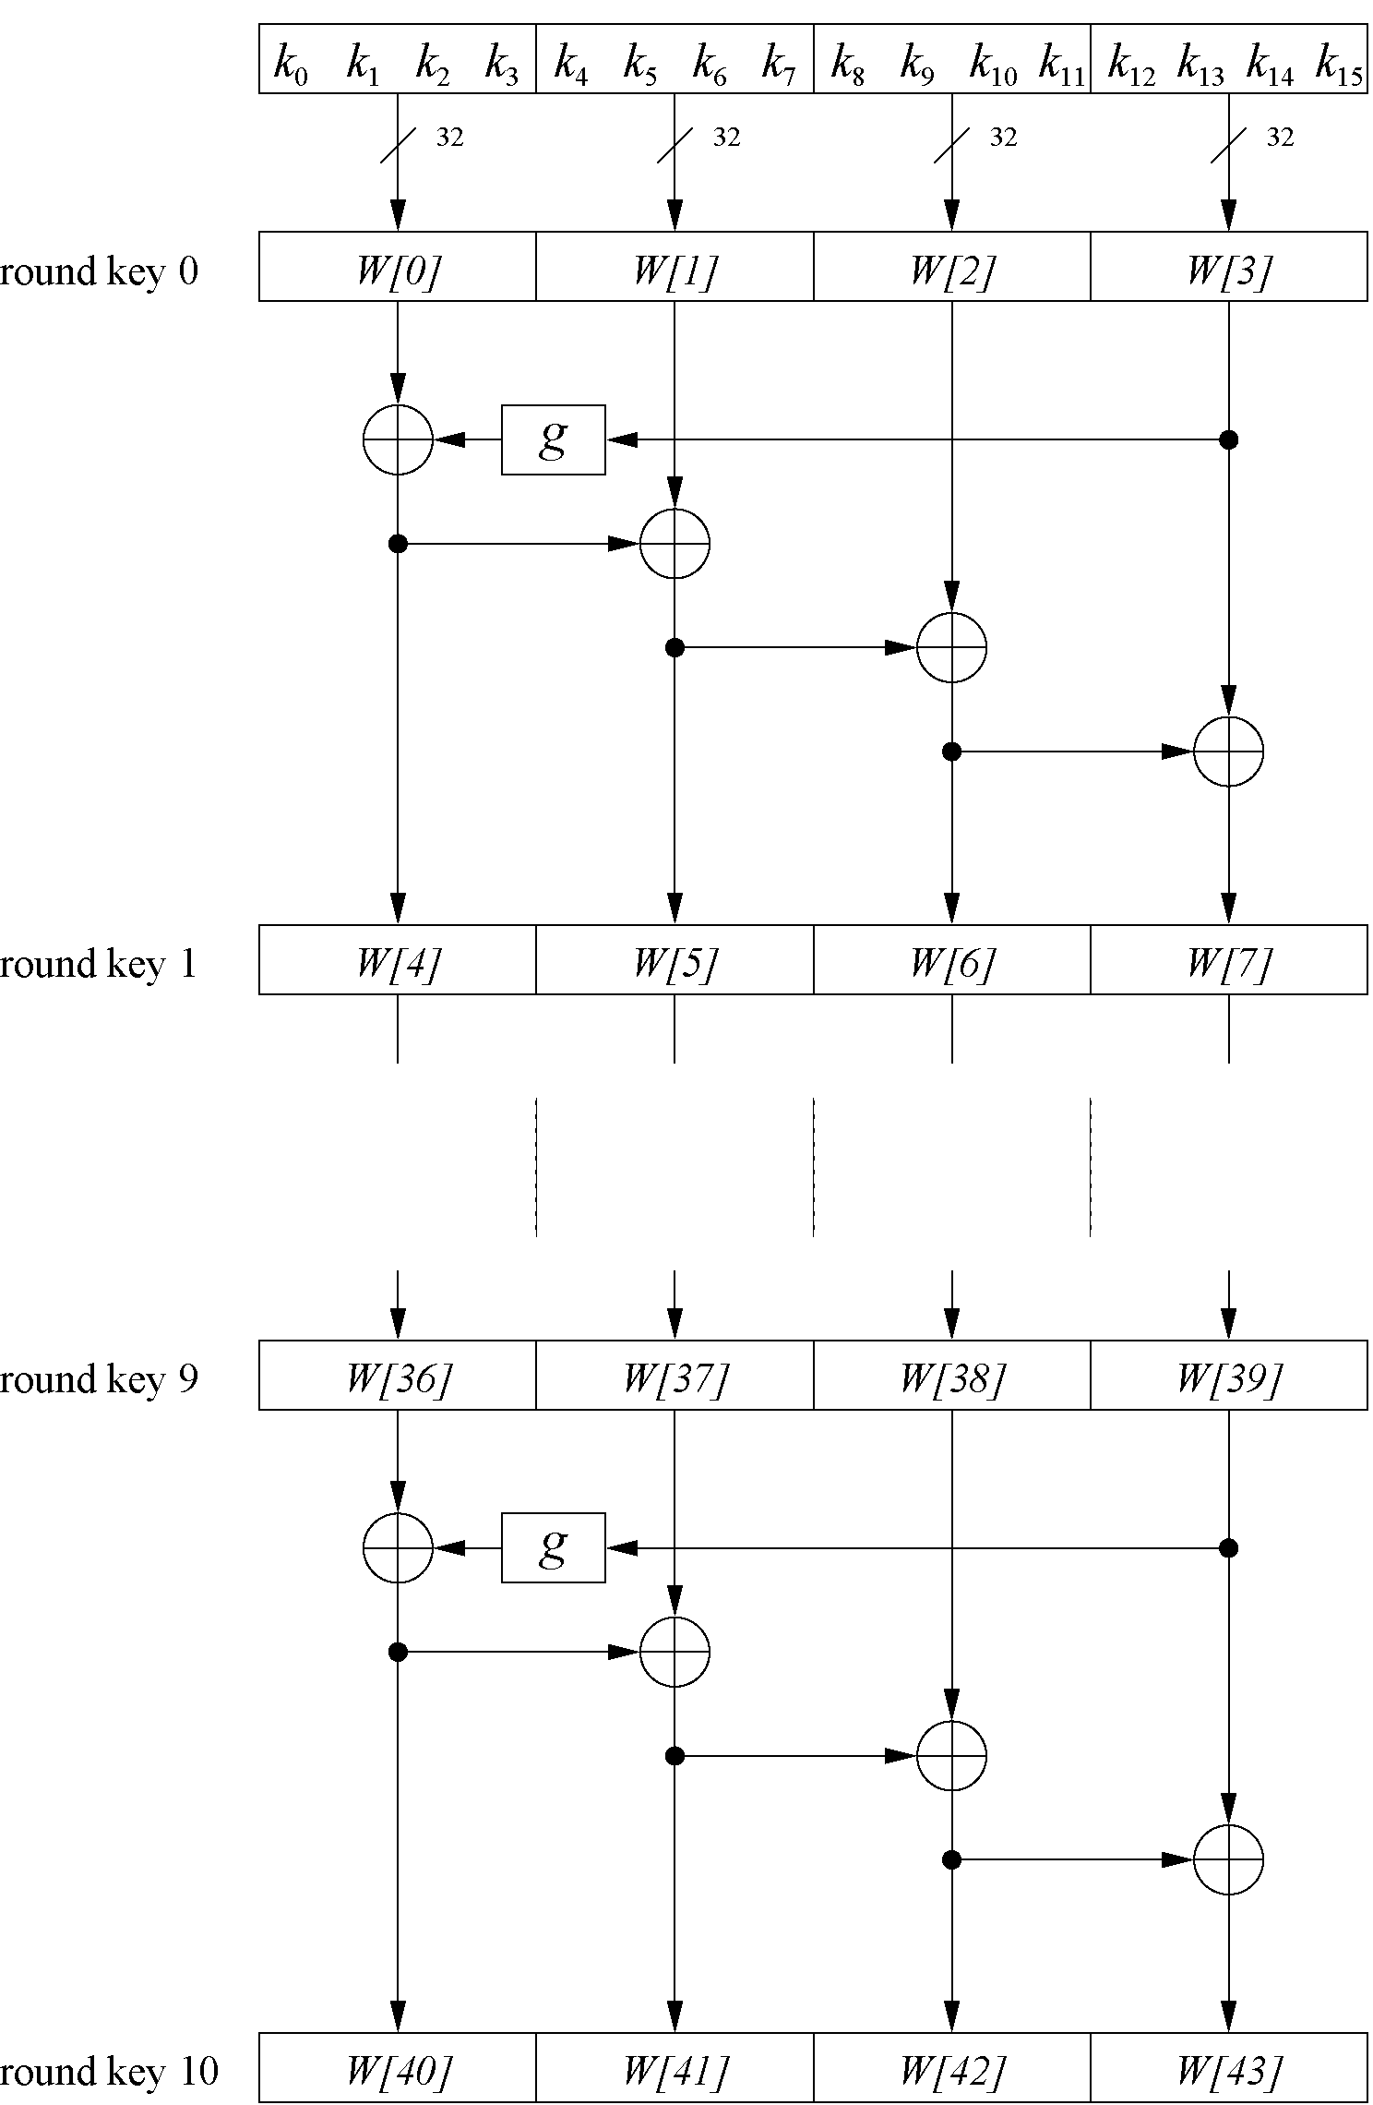
Key Schedule
Example: Key schedule for 128-bit key AES
Word-oriented: 1 word = 32 bits
11 subkeys are stored in W[0]…W[3], W[4]…W[7], … , W[40]…W[43]
First subkey W[0]…W[3] is the original AES key

Slide 38
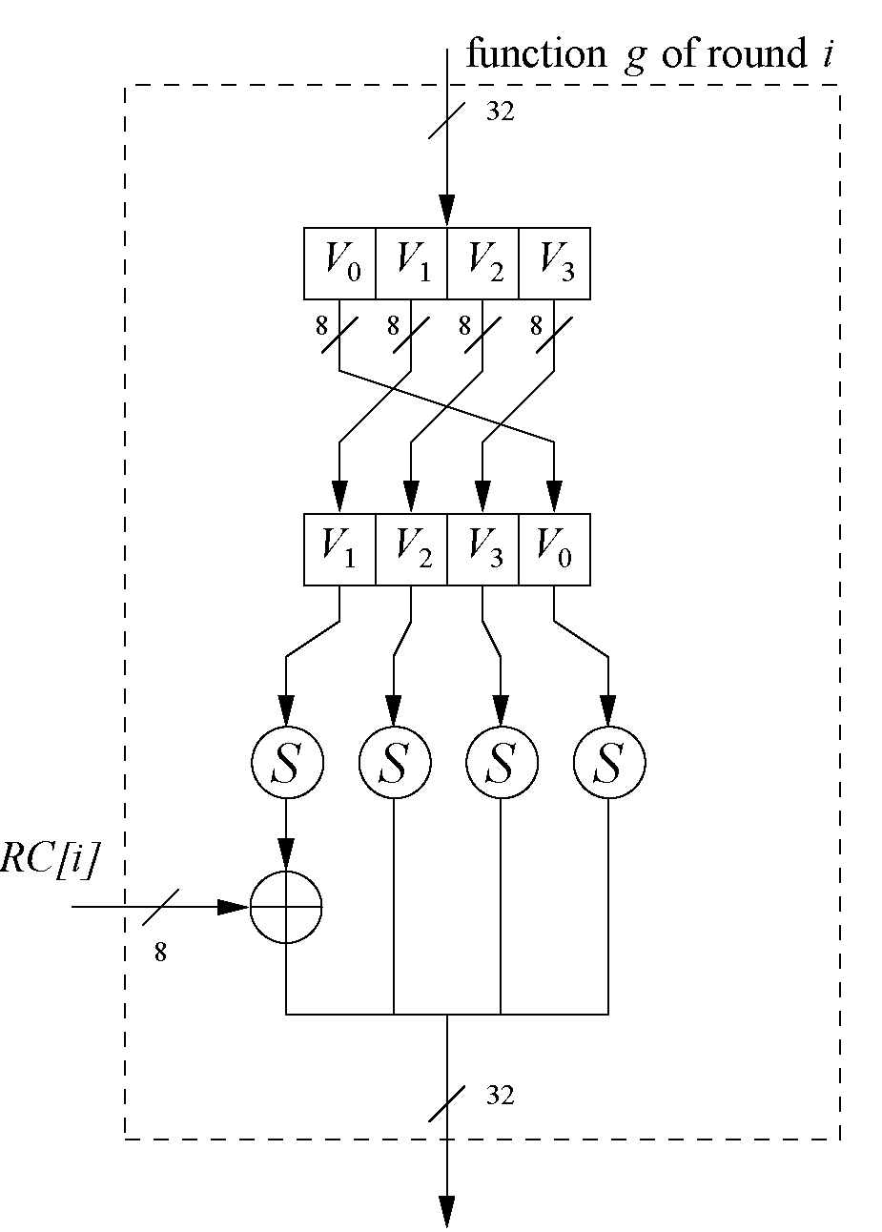
Key Schedule
Function g rotates its four input bytes and performs a bytewise S-Box substitution
⇒ nonlinearity
The round coefficient RC is only added to the leftmost
byte and varies from round to round:
RC[1] = x⁰ = (00000001)₂
RC[2] = x¹ = (00000010)₂
RC[3] = x² = (00000100)₂
...
RC[10] = x⁹ = (00110110)₂
x^{i} represents an element in a Galois field
(again, cf. Chapter 4.3 of Understanding Cryptography)

Slide 39
AES Decryption
AES is not based on a Feistel network
To decrypt, process must be invertible
Inverse of AddRoundKey is easy, since “⊕” is its own inverse
MixColumn is invertible (inverse is also implemented as a lookup table)
Inverse of ShiftRow is easy (cyclic shift the other direction)
ByteSub is invertible (inverse is also implemented as a lookup table)
Key schedule: Subkeys are in reversed order

Slide 40
Implementation in Software
One requirement of AES was the possibility of an efficient software implementation
Straightforward implementation is well suited for 8-bit processors (e.g., smart cards), but inefficient on 32-bit or 64-bit processors
A more sophisticated approach: Merge all round functions (except the key addition) into one table look-up
  This results in four tables with 256 entries, where each entry is 32 bits wide
  One round can be computed with 16 table look-ups
Typical SW speeds are more than 1.6 Gbit/s on modern 64-bit processors

Slide 41
Security
Brute-force attack: Due to the key length of 128, 192 or 256 bits, a brute-force attack is not possible
Analytical attacks: There is no analytical attack known that is better than brute-force
Side-channel attacks:
  Several side-channel attacks have been published
  Note that side-channel attacks do not attack the underlying algorithm but the implementation of it

Slide 42
A Few Other Block Ciphers
IDEA
Blowfish, Twofish, Threefish
RC6
TEA

Slide 43
Outline
Intro to block ciphers
Examples of block ciphers
  DES
  3DES
  AES
Block cipher modes
  ECB
  CBC
  CTR
Integrity

Slide 44
Multiple Blocks
How to encrypt multiple blocks?
Do we need a new key for each block?
  As bad as (or worse than) a one-time pad!
Encrypt each block independently?
Make encryption depend on previous block?
  That is, can we “chain” the blocks together?
How to handle partial blocks?
  We won’t discuss this issue

Slide 45
Modes of Operation
Many modes (ECB, CBC, CTR, OFB, CFB, GCM)
  we discuss 3 most popular
Electronic Codebook (ECB) mode
  Encrypt each block independently
  Most obvious, but has a serious weakness
Cipher Block Chaining (CBC) mode
  Chain the blocks together
  More secure than ECB, virtually no extra work
Counter Mode (CTR) mode
  Block ciphers acts like a stream cipher
  Popular for random access

Slide 46
Outline
Intro to block ciphers
Examples of block ciphers
  DES
  3DES
  AES
Block cipher modes
  ECB
  CBC
  CTR
Integrity

Slide 47
Electronic Codebook (ECB) Mode
Notation: C = E(P,K)
Given plaintext P₀,P₁,…,P_{m},…
Most obvious way to use a block cipher:
Encrypt Decrypt
C₀ = E(P₀, K) P₀ = D(C₀, K)
C₁ = E(P₁, K) P₁ = D(C₁, K)
C₂ = E(P₂, K) … P₂ = D(C₂, K) …
For fixed key K, this is “electronic” version of a codebook cipher (without additive)
  With a different codebook for each key

Slide 48
ECB Cut and Paste
Suppose plaintext is
Alice likes Bob.Trudy likes Tom.
Assuming 64-bit blocks and 8-bit ASCII:
P₀ = “Alice li”, P₁ = “kes Bob.”,
P₂ = “Trudy li”, P₃ = “kes Tom.”
Ciphertext: C₀,C₁,C₂,C₃
Trudy cuts and pastes: C₀,C₃,C₂,C₁
Decrypts as
Alice likes Tom.Trudy likes Bob.

Slide 49
ECB Weakness
Suppose P_{i} = P_{j}
Then C_{i} = C_{j} and Trudy knows P_{i} = P_{j}
This gives Trudy some information, even if she does not know P_{i} or P_{j}
Trudy might know P_{i}
Is this a serious issue?

Slide 50
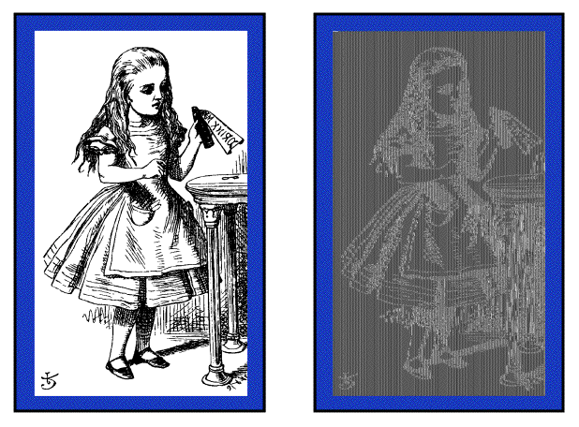
Alice Hates ECB Mode
Alice’s uncompressed image, and ECB encrypted (TEA)
Why does this happen?
Same plaintext yields same ciphertext!

Slide 51
Outline
Intro to block ciphers
Examples of block ciphers
  DES
  3DES
  AES
Block cipher modes
  ECB
  CBC
  CTR
Integrity

Slide 52
Cipher Block Chaining (CBC) Mode
Blocks are “chained” together
A random initialization vector, or IV, is required to initialize CBC mode
IV is random, but not secret
Encryption Decryption
C₀ = E(IV ⊕ P₀, K), P₀ = IV ⊕ D(C₀, K),
C₁ = E(C₀ ⊕ P₁, K), P₁ = C₀ ⊕ D(C₁, K),
C₂ = E(C₁ ⊕ P₂, K),… P₂ = C₁ ⊕ D(C₂, K),…
Analogous to classic codebook with additive

Slide 53
CBC Mode
Identical plaintext blocks yield different ciphertext blocks ⎯ this is good!
If C₁ is garbled to, say, G then
P₁ ≠ C₀ ⊕ D(G, K), P₂ ≠ G ⊕ D(C₂, K)
But P₃ = C₂ ⊕ D(C₃, K), P₄ = C₃ ⊕ D(C₄, K),…
Automatically recovers from errors!
Cut and paste is still possible, but more complex (and will cause garbles)

Slide 54
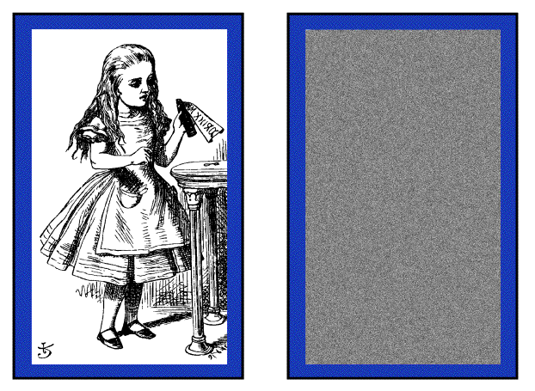
Alice Likes CBC Mode
Alice’s uncompressed image, Alice CBC encrypted (TEA)
Why does this happen?
Same plaintext yields different ciphertext!

Slide 55
Outline
Intro to block ciphers
Examples of block ciphers
  DES
  3DES
  AES
Block cipher modes
  ECB
  CBC
  CTR
Integrity

Slide 56
Counter (CTR) Mode
CTR is popular for random access
Use block cipher like a stream cipher
Encryption Decryption
C₀ = P₀ ⊕ E(IV, K), P₀ = C₀ ⊕ E(IV, K),
C₁ = P₁ ⊕ E(IV+1, K), P₁ = C₁ ⊕ E(IV+1, K),
C₂ = P₂ ⊕ E(IV+2, K),… P₂ = C₂ ⊕ E(IV+2, K),…
CBC can also be used for random access
  With a significant limitation…

Slide 57
Outline
Intro to block ciphers
Examples of block ciphers
  DES
  3DES
  AES
Block cipher modes
  ECB
  CBC
  CTR
Integrity

Slide 58
Data Integrity
Integrity ⎯ detect unauthorized writing (i.e., modification of data)
Example: Inter-bank fund transfers
  Confidentiality may be nice, integrity is critical
Encryption provides confidentiality (prevents unauthorized disclosure)
Encryption alone does not provide integrity
  One-time pad, ECB cut-and-paste, etc.

Slide 59
MAC
Message Authentication Code (MAC)
  Used for data integrity
  Integrity not the same as confidentiality
MAC is computed as CBC residue
  That is, compute CBC encryption, saving only final ciphertext block, the MAC

Slide 60
MAC Computation
MAC computation (assuming N blocks)
C₀ = E(IV ⊕ P₀, K),
C₁ = E(C₀ ⊕ P₁, K),
C₂ = E(C₁ ⊕ P₂, K),…
C_{N−1} = E(C_{N−2} ⊕ P_{N−1}, K) = MAC
MAC sent with IV and plaintext
Receiver does same computation and verifies that result agrees with MAC
Note: receiver must know the key K

Slide 61
Does a MAC work?
Suppose Alice has 4 plaintext blocks
Alice computes
C₀ = E(IV⊕P₀,K), C₁ = E(C₀⊕P₁,K),
C₂ = E(C₁⊕P₂,K), C₃ = E(C₂⊕P₃,K) = MAC
Alice sends IV,P₀,P₁,P₂,P₃ and MAC to Bob
Suppose Trudy changes P₁ to X
Bob computes
C₀ = E(IV⊕P₀,K), C₁ = E(C₀⊕X,K),
C₂ = E(C₁⊕P₂,K), C₃ = E(C₂⊕P₃,K) = MAC ≠ MAC
That is, error propagates into MAC
Trudy can’t make MAC == MAC without K

Slide 62
Confidentiality and Integrity
Encrypt with one key, MAC with another key
Why not use the same key?
  Send last encrypted block (MAC) twice?
  This cannot add any security!
Using different keys to encrypt and compute MAC works, even if keys are related
  But, twice as much work as encryption alone
  Can do a little better ⎯ about 1.5 “encryptions”
Confidentiality and integrity with same work as one encryption is a research topic

Slide 63
Uses for Symmetric Crypto
Confidentiality
  Transmitting data over insecure channel
  Secure storage on insecure media
Integrity (MAC)
Authentication protocols (later…)
Anything you can do with a hash function (upcoming chapter…)

Slide 64
Lessons Learned
DES was dominant symmetric cipher from the mid-1970s to the mid-1990s
DES with 56-bit key length can be broken relatively easily using exhaustive key search
56-bit DES keys are no longer secure ⇒ AES was created
By encrypting with DES three times in a row, triple DES (3DES) is created, against which no practical attack is currently known
The “default” symmetric cipher is nowadays often AES
AES has been studied intensively since the late 1990s and no attacks have been found that are better than brute-force
AES is not based on Feistel networks.
AES is part of numerous open standards such as IPsec or TLS
AES is efficient in software and hardware
ECB mode has security weaknesses, independent of the underlying block cipher
CTR mode allows parallelization of encryption ⇒ suited for high speed implementations

Slide 65
Backup Slides
Original Source:
C. Paar and J. Pelzl, “Understanding Cryptography – A Textbook for Students and Practitioners,” Springer (www.crypto-textbook.com)

Slide 66
A Brief Introduction to Galois Fields
Used in AES in most layers, especially in S-Box and MixColumn layers
Galois field is a set with finite number of elements in which we can add, subtract, multiply & invert
To define what is a field we need to define what is a group
⇒ Group is a set with one operation and the corresponding inverse operation. Examples:
  Z_{m} = {0,1, . . . ,m−1} with addition mod m form a group with the neutral element 0
  Z_{m} = {0,1, . . . ,m−1} with multiplication mod m is not a group. Why?

Slide 67
Fields
Example: Set R of real numbers is a field with the neutral element 0 for the additive group and the neutral element 1 for the multiplicative group

Slide 68
Finite/Galois Fields
In cryptography, we are interested in fields with a finite number of elements
  ⇒ finite fields or Galois fields.
  The number of elements in the field is called the order or cardinality of the field
Examples:
  Finite fields exist with 11 elements, with 81 elements (since 81 = 3⁴), with 256 elements (since 256 = 2⁸)
  No finite field with 12 elements since 12 = 2² · 3 ⇒ 12 is not a prime power
  ⇒ Choice of the cardinality is important for cryptography!

Slide 69
Prime Galois Fields
Most intuitive examples of finite fields are fields of prime order (i.e., fields with n = 1)
Elements of the field GF(p) can be represented by integers 0,1, . . . , p−1
The two operations of the field are modular addition and multiplication modulo p
Example:
  Integer set Zm with modular addition and multiplication with m being a prime
To do arithmetic in a prime field, we do addition and multiplication modulo p
  Additive inverse of any element a is given by a+(−a) = 0 mod p
  Multiplicative inverse of any nonzero element a is defined as a · a⁻¹ = 1 mod p

Slide 70
Prime Galois Fields (Continued)
Example: GF(5) = {0, 1, 2, 3, 4}
A very important prime field is GF(2) which is the smallest finite field that exists
  GF(2) addition is equivalent to an XOR gate
  GF(2) multiplication is equivalent to the logical AND gate

Slide 71
Extension Fields GF(2^{m})
In AES the Galois field contains 256 elements, GF(2⁸)
Chosen because each of the field elements can be represented by one byte
Since the order GF(2⁸) is not prime, then addition and multiplication operations cannot be performed in modulo 2⁸ (Why?)
Such fields with m > 1 are called extension fields
GF(2^{m}) elements are not represented as integers but as polynomials with coefficients in GF(2)
The polynomials have a maximum degree of (m−1) with m coefficients for every element
GF(2⁸) is used in AES has each element A ∈ GF(2⁸) represented as:
A(x) = a₇x⁷+· · ·+a₁x+a₀, where a_{i} ∈ GF(2) = {0,1}
There are exactly 256 = 2⁸ such polynomials ⇒ Set of these 256 polynomials forms GF(2⁸)
Every polynomial can simply be stored in digital form as an 8-bit vector
    A = (a₇,a₆,a₅,a₄,a₃,a₂,a₁,a₀)
Notes:
Since the order GF(2⁸) is not prime, then addition and multiplication operations cannot be performed in modulo 2⁸ (Why? Because not every element will have a multiplicative inverse in mod 2⁸)

Slide 72
Addition and Subtraction in GF(2^{m})
Achieved by performing standard polynomial addition and subtraction w.r.t. GF(2)
  Add or subtract coefficients with equal powers of x
  Coefficient additions or subtractions are done in GF(2)
Example: C(x) = A(x) + B(x) = A(x) – B(x) of two elements from GF(2⁸)
Notes:
Since the order GF(2⁸) is not prime, then addition and multiplication operations cannot be performed in modulo 2⁸ (Why? Because not every element will have a multiplicative inverse in mod 2⁸)

Slide 73
Multiplication in GF(2^{m})
Multiplication in GF(2⁸) is the core operation of the MixColumn transformation of AES
First step: two elements of GF(2^{m}) are multiplied using standard polynomial multiplication rule
Coefficients a_{i}, b_{i} and c_{i} are elements of GF(2) and coefficient arithmetic is performed in GF(2)
In general, C(x) will have a degree higher than m−1 and has to be reduced!
Similar to multiplication in GF(p), C(x) is divided by a certain polynomial, and we consider only the remainder after the polynomial division (modulo reduction)
Use irreducible polynomials (their only factors are 1 and itself) for the modulo reduction
Notes:
Since the order GF(2⁸) is not prime, then addition and multiplication operations cannot be performed in modulo 2⁸ (Why? Because not every element will have a multiplicative inverse in mod 2⁸)

Slide 74
Multiplication in GF(2^{m}) – (Continued)
Second step: perform modulo reduction for C(x) (i.e., consider only the remainder after the irreducible polynomial division)
Every GF(2^{m}) requires an irreducible polynomial P(x) of degree m with coefficients from GF(2)
Not all polynomials are irreducible
  Example: x⁴+x³+x+1 is reducible and cannot be used for GF(2⁴)
For AES, the irreducible polynomial P(x) = x⁸+x⁴+x³+x+1 is used
Notes:
Since the order GF(2⁸) is not prime, then addition and multiplication operations cannot be performed in modulo 2⁸ (Why? Because not every element will have a multiplicative inverse in mod 2⁸)

Slide 75
Multiplication in GF(2^{m}) – (Continued)
Example: multiply the two polynomials A(x) = x³+x²+1 and B(x) = x²+x in the field GF(2⁴). The irreducible polynomial of GF(2⁴) is P(x) = x⁴+x+1
Solution:
  Plain polynomial product is computed as C’(x) = A(x) ·B(x) = x⁵+x³+x²+x
  Can now reduce C(x) using the polynomial division method we learned in school
  However, it is easier to reduce each of the leading terms x⁴ and x⁵ individually:
      x⁴ = 1 ·P(x)+(x+1) ≡ x+1 mod P(x) – not needed in this case
      x⁵ ≡ x²+x mod P(x)
  Now, only have to insert the reduced expression for x⁵ into the intermediate result C’(x):
      C(x) ≡ x⁵+x³+x²+x mod P(x)
      C(x) ≡ (x²+x)+(x³+x²+x) = x³
      A(x) · B(x) ≡ x³
Notes:
Since the order GF(2⁸) is not prime, then addition and multiplication operations cannot be performed in modulo 2⁸ (Why? Because not every element will have a multiplicative inverse in mod 2⁸)

Slide 76
Inversion in GF(2^{m})
Core operation of the AES Byte Substitution transformation (i.e, S-Boxes)
For a given GF(2^{m}) and the corresponding irreducible P(x), the inverse A⁻¹ of a nonzero element A ∈ GF(2^{m}) is defined as:
    A⁻¹(x) · A(x) = 1 mod P(x)
For small fields (i.e., ≤ 2¹⁶ elements), inverse lookup tables (Inv.S-Box) which contain the precomputed inverses of all field elements are often used
  Inv.S-Box can’t be directly drived from S-Box!
Can verify that Inv.S-Box(A(x)) = A⁻¹(x) by showing that A⁻¹(x) · A(x) = 1 mod P(x)
An alternative to using lookup tables is to use the extended Euclidean algorithm (more later!)
Notes:
Since the order GF(2⁸) is not prime, then addition and multiplication operations cannot be performed in modulo 2⁸ (Why? Because not every element will have a multiplicative inverse in mod 2⁸)

Slide 77
Computing MixColumn
Multiplication in GF(2⁸) is the core operation of the MixColumn transformation of AES
Computed as follows:
          C = × B
  where C is the output of the MixCloumn step, and B is the input to the MixColumn step. Recall that the multiplication uses the following 2 steps:
    First step: two elements of GF(2⁸) are multiplied using standard polynomial multiplication rule but w.r.t. GF(2)
    Second step: perform modulo reduction for C(x) (i.e., consider only the remainder after the irreducible polynomial P(x) = x⁸+x⁴+x³+x+1 division)
Notes:
Since the order GF(2⁸) is not prime, then addition and multiplication operations cannot be performed in modulo 2⁸ (Why? Because not every element will have a multiplicative inverse in mod 2⁸)

Slide 78
Computing MixColumn (Continued)
Example (1): Assume that the input state to the MixColumn step is B = (25,25, . . . ,25)₁₆, find the output state of the MixColumn step, C
Solution:
  Only two multiplications in GF(2⁸) have to be done; 02 · 25 and 03 · 25
  ⇒ 02 · 25 = x · (x⁵+x²+1) = x⁶+x³+x
  03 · 25 = (x+1) · (x⁵+x²+1) = (x⁶+x³+x)+(x⁵+x²+1) = x⁶+x⁵+x³+x²+x+1
  Both intermediate values have a degree smaller than 8 ⇒ no modular reduction is necessary
  The output bytes of C result from the following addition in GF(2⁸):
    02 · 25 = x⁶+ x³+ x
    03 · 25 = x⁶+ x⁵+ x³+ x²+ x+1
    01 · 25 = x⁵+ x²+1
    01 · 25 = x⁵+ x²+1
  ⇒ C_{i} = x⁵+ x²+ 1, where i = 0, . . . , 15
  ⇒ Output state C = (25,25, . . . ,25)₁₆
Notes:
Since the order GF(2⁸) is not prime, then addition and multiplication operations cannot be performed in modulo 2⁸ (Why? Because not every element will have a multiplicative inverse in mod 2⁸)

Slide 79
Computing MixColumn (Continued)
Example (2): Assume that the first column of the input state to the MixColumn step is B = (D4,BF,5D,30)₁₆, find the 4th element of the corresponding column of the output state of the MixColumn step
Solution:
Notes:
Since the order GF(2⁸) is not prime, then addition and multiplication operations cannot be performed in modulo 2⁸ (Why? Because not every element will have a multiplicative inverse in mod 2⁸)

