Slide 1
COE 561 Digital System Design & Synthesis Logic Synthesis Background
Dr. Aiman H. El-Maleh
Computer Engineering Department
King Fahd University of Petroleum & Minerals
[Adapted from slides of Prof. G. De Micheli: Synthesis & Optimization of Digital Circuits]

Slide 2
Outline
Boolean Algebra
Boolean Functions
Basic Definitions
Representations of Boolean Functions
Binary Decision Diagrams (BDDs)
Ordered BDDs (OBDDs)
Reduced Ordered BDDs (ROBDDs)
If-then-else (ITE) DAGS
Satisfiability and Minimum Cover Problems
Branch and Bound Algorithm

Slide 3
Boolean Algebra
Boolean algebra
Quintuple (B,+, . , 0, 1)
Satisfies commutative and distributive laws
Identity elements are 0 and 1.
Each element has a complement: a + a’=1 ; a . a’ = 0
Binary Boolean algebra B = {0, 1}
Some properties of Boolean algebraic systems
Associativity | a+(b+c)=(a+b)+c | a(bc)=(ab)c
Idempotence | a+a=a | a.a=a
Absorption | a+(ab)=a | a(a+b)=a
De Morgan | (a+b)’=a’.b’ | (a.b)’=a’+b’
Involution | (a’)’=a

Slide 4
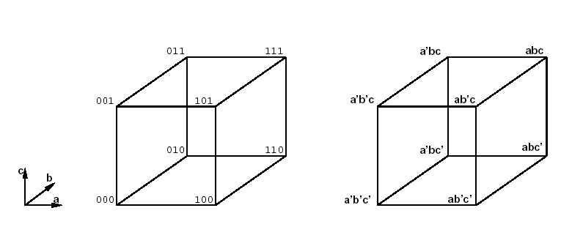
Boolean Functions
3-dimensional
Boolean Space
Boolean function
Single output:
Multiple output:
Incompletely specified
don't care symbol *.
Don’t care conditions
We don't care about the value of the function.
Related to the environment:
Input patterns that never occur.
Input patterns such that some output is never observed.
Very important for synthesis and optimization.

Slide 5
Definitions …
Scalar function
ON-Set: subset of the domain such that f is true.
Off-Set: subset of the domain such that f is false.
Don’t care Set: subset of the domain such that f is a don't care.
Multiple-output function
Defined for each component (output).
Boolean literal: variable or its complement.
Product or cube: product of literals.
Implicant: product implying a value of a function (usually TRUE).
Hypercube in the Boolean space.
Minterm: product of all input variables implying a value of a function (usually TRUE).
Vertex in the Boolean space.

Slide 6
… Definitions …
Let f(x₁,x₂,…,x_{n}) be a Boolean function of n variables.
The set (x₁,x₂,…,x_{n}) is called the support of the function.
The cofactor of f(x₁,x₂,…,x_{i},…,x_{n}) with respect to variable x_{i} is f_{xi} = f(x₁,x₂,…,x_{i}=1,…,x_{n})
The cofactor of f(x₁,x₂,…,x_{i},…,x_{n}) with respect to variable x_{i}’ is f_{xi’} = f(x₁,x₂,…,x_{i}=0,…,x_{n})
Theorem: Shannon's Expansion
Any function can be expressed as sum of products (product of sums) of n literals, minterms (maxterms), by recursive expansion.

Slide 7
… Definitions …
Example: f = ab + ac + bc
f_{a} = b + c
f_{a’} = bc
F = a f_{a} + a’ f_{a’} = a (b + c) + a’ (bc)
A Boolean function can be interpreted as the set of its minterms.
Operations and relations on Boolean functions can be viewed as operations on their minterm sets
Sum of two functions is the Union (∪) of their minterm sets
Product of two functions is the Intersection (∩ ) of their minterm sets
Implication between two functions corresponds to containment (⊆) of their minterm sets
f₁ → f₂ ≡ f₁ ⊆ f₂ ≡ f₁’ + f₂ = 1

Slide 8
… Definitions …
A function f(x₁,x₂,…,x_{i},…,x_{n}) is positive (negative) Unate with respect to variable x_{i} if f_{xi} ⊇ f_{xi’} (f_{xi} ⊆ f_{xi’} ).
A function is (positive/negative) Unate if it is (positive/negative) unate in all support variables, otherwise it is Binate (or mixed).
Example: f= a + b + c’
f is positive unate with respect to variable a
f_{a}=1 ⊇ f_{a’}= b + c’
Minterms of f_{a} ={bc, b’c,bc’,b’c’} ⊇ minterms of f_{a’}={bc,bc’,b’c’}
f is positive unate with respect to variable b
f is negative unate with respect to variable c
Thus, f is binate.

Slide 9
… Definitions
The Boolean Difference of a function f(x₁,x₂,…,x_{i},…,x_{n}) with respect to variable x_{i} is ∂f / ∂x_{i} = f_{xi} ⊕ f_{xi’}
Indicates whether f is sensitive to changes in x_{i}
The Consensus of a function f(x₁,x₂,…,x_{i},…,x_{n}) with respect to variable x_{i} is f_{xi} . f_{xi’}
Represents the component that is independent of x_{i}
The Smoothing of a function f(x₁,x₂,…,x_{i},…,x_{n}) with respect to variable x_{i} is f_{xi} + f_{xi’}
Corresponds to dropping the variable from the function
Example: f= ab + ac + bc
f_{a}=b+c f_{a’}= bc
Boolean difference = f_{a} ⊕ f_{a’}= (b+c) ⊕ bc = b’c+bc’
Consensus = f_{a} . f_{a’}= (b+c) . bc = bc
Smoothing = f_{a} + f_{a’}= (b+c) + bc = b+c

Slide 10
Boolean Expansion Based on Orthonormal Basis …
Let φ_{i} , i=1,2, …,k be a set of Boolean functions such that Σ_{i=1 to k} φ_{i} = 1 and φ_{i} . φ_{j} = 0 for ∀ i ≠ j ∈{1,2,…,k}.
An Orthonormal Expansion of a function f is
f= Σ_{i=1 to k} f_{φi .} φ_{i}
f_{φi} is called the generalized cofactor of f w.r.t. φ_{i} ∀ i.
The generalized cofactor may not be unique
f . φ_{i} ⊆ f_{φi} ⊆ f + φ_{i} ‘
Example: f = ab+ac+bc; φ₁ = ab; φ₂ = a’+b’;
ab ⊆ f_{φ1} ⊆ 1 ; let f_{φ1} = 1
a’bc+ab’c ⊆ f_{φ2} ⊆ ab+bc+ac ; let f_{φ2} = a’bc+ab’c
f = φ_{I} f_{φI .} + φ₂ f_{φ2} = ab (1) + (a’+b’)(a’bc+ab’c)=ab+bc+ac

Slide 11
… Boolean Expansion Based on Orthonormal Basis …
Theorem
Let f, g, be two Boolean functions expanded with the same orthonormal basis φ_{I} , i=1,2, …,k
Let ⊗ be a binary operator on two Boolean functions
Corollary
Let f, g, be two Boolean functions with support variables {x_{i}, i=1,2, …,n}.
Let ⊗ be a binary operator on two Boolean functions

Slide 12
… Boolean Expansion Based on Orthonormal Basis
Example:
Let f = ab + c; g=a’c + b; Compute f ⊕g
Let φ₁=a’b‘; φ₂=a’b; φ₃=ab‘; φ₄=ab;
f_{φ1} = c; f_{φ2} = c; f_{φ3} = c; f_{φ4} = 1;
g_{φ1} = c; g_{φ2} = 1; g_{φ3} = 0; g_{φ4} = 1;
f = a’b’ (c ⊕c) + a’b (c ⊕1) + ab’ (c ⊕0) + ab (1 ⊕1)
= a’bc’ + ab’c
F= (ab+c) ⊕ (a’c+b)= (ab+c)(a+c’)b’ + (a’+b’)c’(a’c+b)
= (ab+ac)b’ + (a’c+a’b)c’ = ab’c +a’bc’

Slide 13
Representations of Boolean Functions
There are three different ways of representing Boolean functions:
Tabular forms
Truth table
Implicant table
Logic expressions
Expressions of literals linked by the + and . Operators
Expressions can be nested by parenthesis
Two-level: sum of products or products of sum
Multilevel: factored form
Binary decisions diagrams
Represents a set of binary-valued decisions, culminating in an overall decision that can be either TRUE or FALSE

Slide 14
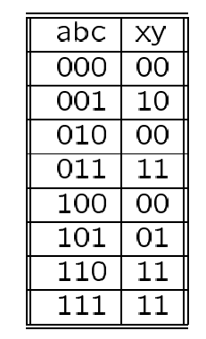
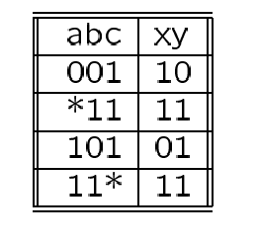
Tabular Representations
Truth table
List of all minterms of a function.
Implicant table or cover
List of implicants of a function sufficient to define a function.
Implicant tables are smaller in size.
Example: x = ab+a’c; y = ab+bc+ac
Truth
Table
Implicant
Table

Slide 15
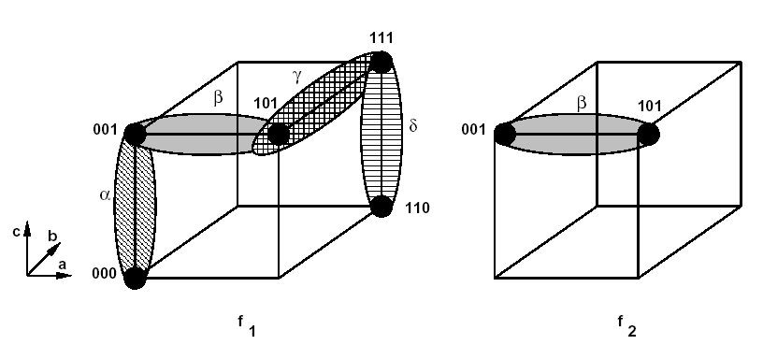
Cubical Representation of Minterms and Implicants
f1 = a’b’c’+a’b’c+ab’c+abc+abc’= a’b’+b’c+ac+ab
f2 = a’b’c+ab’c = b’c

Slide 16
Binary Decision Diagrams …
Binary decision diagrams (BDDs) can be represented by trees or rooted DAGs, where decisions are associated with vertices.
Ordered binary decision diagrams (OBDDs) assume an ordering on the decision variables.
Can be transformed into canonical forms, reduced ordered binary decision diagrams (ROBDDs)
Operations on ROBDDs can be made in polynomial time of their size i.e. vertex set cardinality
Size of ROBDDs depends on ordering of variables
Adder functions are very sensitive to variable ordering
Exponential size in worst case
Linear size in best case
Arithmetic multiplication has exponential size regardless of variable order.

Slide 17
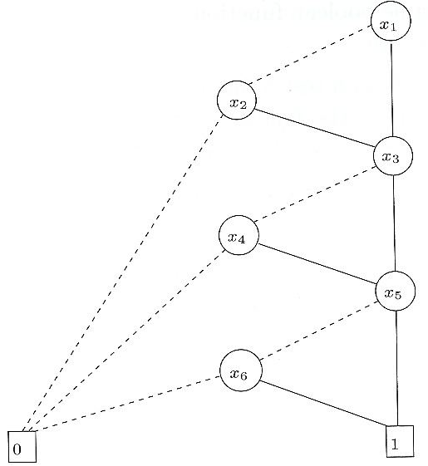
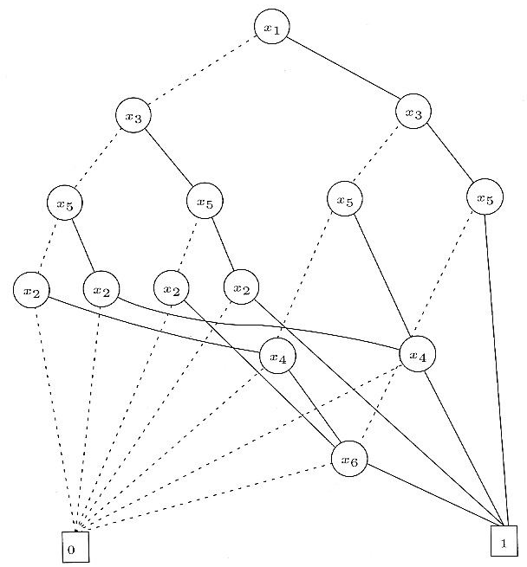
… Binary Decision Diagrams …
Consider the function: f= (x1+x2)(x3+x4)(x5+x6)
Variable ordering: x₁,x₂,x₃,x₄,x₅,x₆
Variable ordering: x₁,x₃,x₅,x₂,x₄,x₆

Slide 18
… Binary Decision Diagrams …
An OBDD is a rooted DAG with vertex set V. Each non-leaf vertex has as attributes
a pointer index(v) ∈ {1,2,…n} to an input variable {x₁,x₂,…,x_{i},…,x_{n}} .
Two children low(v) and high(v) ∈ V.
A leaf vertex v has as an attribute a value value(v) ∈ B.
For any vertex pair {v,low(v)} (and {v,high(v)}) such that no vertex is a leaf, index(v)<index(low(v)) (index(v)<index(high(v))
An OBDD with root v denotes a function f^{v} such that
If v is a leaf with value(v)=1, then f^{v}=1
If v is a leaf with value(v)=0, then f^{v}=0
If v is not a leaf and index(v)=i, then f^{v}= x_{i} ‘ . f^{low(v)} + x_{i .} f^{high(v)}

Slide 19
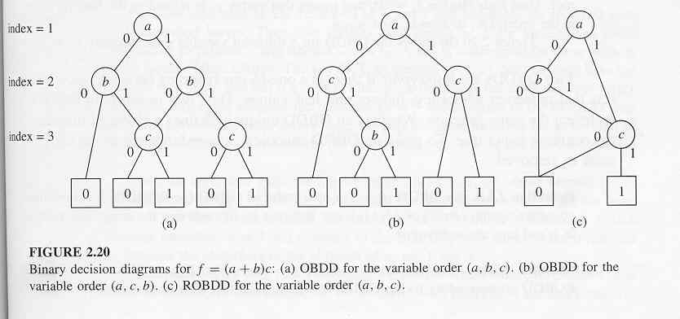
… Binary Decision Diagrams
Example: f=(a+b)c
Vertices {v1,v2,v3,v4,v5} (Fig. 2.20 (c) )
Variable x₁=a, x₂=b, x₃=c;
v1 is the root; index(v1)=1 meaning that v1 is related to first variable in the order i.e. x₁=a

Slide 20
Reduced Binary Decision Diagrams …
Two OBDDs are isomorphic if there is a one-to-one mapping between the vertex set that preserves adjacency, indices and leaf values.
Two isomorphic OBDDS represent the same function.
An OBDD is said to be reduced OBDD (ROBDD) if
It contains no vertex v with low(v)=high(v)
Not any pair {u,v} such that the subgraphs rooted in u and in v are isomorphic.
ROBDDs are canonical
All equivalent functions will result in the same ROBDD.

Slide 21
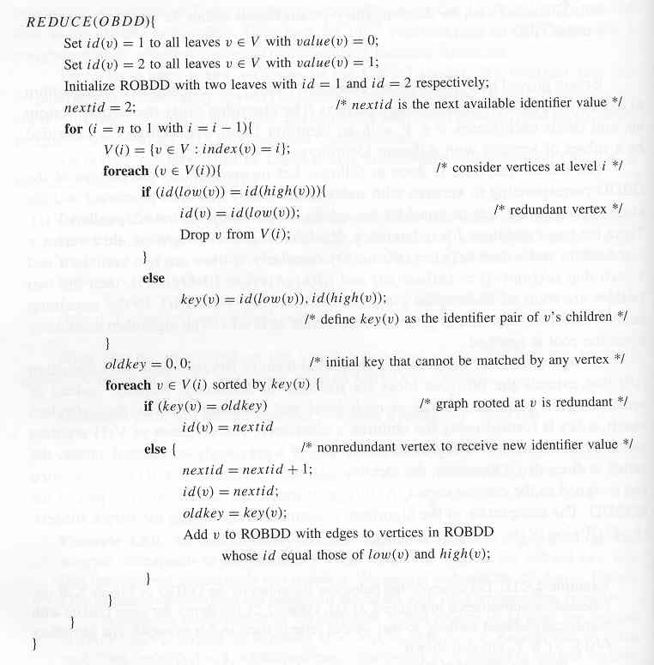
… Reduced Binary Decision Diagrams …

Slide 22
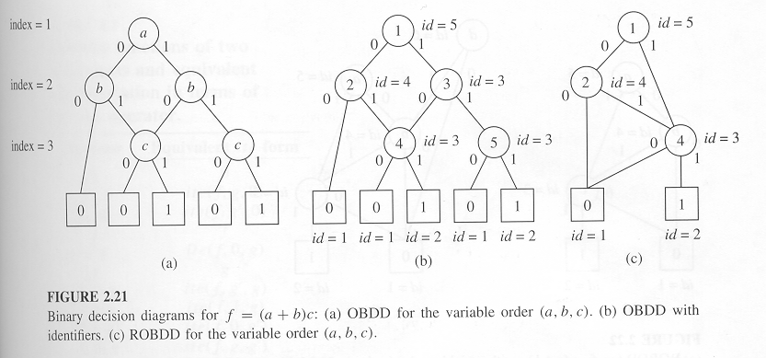
Reduced Binary Decision Diagrams …

Slide 23
If-then-else (ITE) DAGs …
ROBDD construction and manipulation can be done with the ite operator.
Given three scalar Boolean functions f, g and h
Ite(f, g, h) = f . g + f’ . h
Let z=ite(f, g, h) and let x be the top variable of functions f, g and h.
The function z is associated with the vertex whose variable is x and whose children implement ite(f_{x},g_{x},h_{x}) and ite(f_{x’},g_{x’},h_{x’}).
z = x z_{x} + x’ z_{x’}
= x( f g + f’ h)_{x} + x’ (f g + f’ h)_{x’}
= x( f_{x} g_{x} + f’_{x} h_{x}) + x’ (f_{x’} g_{x’} + f’_{x’} h_{x’})
=ite(x, ite(f_{x},g_{x},h_{x}) , ite(f_{x’},g_{x’},h_{x’}) )

Slide 24
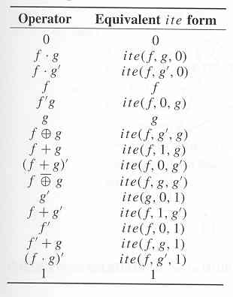
… If-then-else (ITE) DAGs
Terminal cases of ite operator
Ite(f,1,0)=f, ite(1,g,h)=g, ite(0, g, h)=h, ite(f, g, g)=g and ite(f, 0, 1)=f’.
All Boolean functions of two arguments can be represented in terms of ite operator.

Slide 25
ITE Algorithm …
ITE(f, g, h){
If (terminal case)
return (r = trivial result)
else {
if (computed table has entry {(f,g,h), r})
return (r from computed table)
else {
x top variable of f, g, h
t = ITE(f_{x}, g_{x}, h_{x})
e = ITE(f_{x’}, g_{x’}, h_{x’})
if ( t == e) return (t)
r = find_or_add_unique_table(x, t, e)
Update computed table with {(f,g,h), r})
return (r)
}
}
}

Slide 26
… ITE Algorithm …
Uses two tables
Unique table: stores ROBDD information in a strong canonical form
Equivalence check is just a test on the equality of the identifiers
Contains a key for a vertex of an ROBDD
Key is a triple of variable, identifiers of left and right children
Computed table: to improve the performance of the algorithm
Mapping between any triple (f, g, h) and vertex implementing ite(f, g, h).

Slide 27
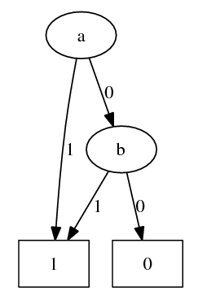
… ITE Algorithm
Example: Let f=a⊕b and g = a b. Draw the ITE DAG for the function f⊕g.
f⊕g=ITE(f,g’,g)=ITE(a⊕b ,a’+b’,a b)
X=a:
t= ITE(b’ ,b’, b)=1 (trivial case) =>t=2
e= ITE(b ,1, 0)=b (trivial case), we assign id=3 =>e=3
Since t≠e, an entry will be added in the table for (a,2,3) with id=4.
Unique Table
ID | Var | Right Child | Left Child
3 | b | 2 | 1
4 | a | 2 | 3

Slide 28
Applications of ITE DAGs
Implication of two functions is Tautology
f → g ≡ f’ + g = 1
Check if ite(f, g, 1) has identifier equal to that of leaf value 1
Alternatively, a function associated with a vertex is tautology if both of its children are tautology
Functional composition
Replacing a variable by another expression
f_{x=g} = f_{x} g + f_{x’} g’ = ite(g, f_{x}, f_{x’})
Consensus
f_{x} . f_{x’} ≡ ite(f_{x}, f_{x’}, 0)
Smoothing
f_{x} + f_{x’} ≡ ite(f_{x},1, f_{x’})

Slide 29
Satisfiability …
Many synthesis and optimization problems can be reduced to a fundamental one: satisfiability.
A Boolean function is satisfiable if there exists an assignment of Boolean values to the variables that makes the function TRUE.
Most common formulation requires the function to be expressed in a product of sum form
Sum terms are called clauses
Assignment must make all clauses true
Satisfiability problem is Intractable
3-satisfiability (i.e. clauses with max. 3 literals) is intractable
2-satisfiability can be solved in polynomial time

Slide 30
… Satisfiability
Example
F=(a+b+c')(a+b'+c')(a+b'+c)(a'+b+c)(a'+b+c')(a'+b'+c')(a'+b'+c)
Find an input assignment that makes F=1
Solution
A=1, B=1, C=0 => Fails
A=0, B=1, C=0 => Fails
A=1, B=0, C=1 => Fails
A=0, B=0, C=1 => Fails
A=1, B=1, C=1 => Fails
A=0, B=1, C=1 => Fails
A=1, B=0, C=0 => Fails
A=0, B=0, C=0 => Success!!

Slide 31
Satisfiability Formulation as Zero-One Linear Programming (ZOLP) Problem
Satisfiability problem can be modeled as a ZOLP
Example: Satisfiability problem
(a+b)(a’+b’+c)
Possible solution: a=1; b=1; c=1
ZOLP modeling
a + b ≥ 1
(1-a)+(1-b)+c ≥ 1
a, b, c ∈ B
Minimum-cost satisfiability problem
Find x ∈ B^{n} that minimizes the cost c^{T} x where c is a weight vector.

Slide 32
Minimum Covering Problem
Given a collection C (called groups) of subsets of a finite set S. A minimum-covering problem is the search of a minimum number of subsets from C that cover S.
Let A ∈ B^{nxm} , where #rows=n=|S| and #columns=m=|C|
A cover corresponds to a subset of columns having at least a 1 entry in all rows of A.
Corresponds to selecting x ∈ B^{m}, such that Ax ≥ 1
Minimum-weighted cover corresponds to selecting x ∈ B^{m}, such that Ax ≥ 1 and c^{T} x is minimum.
Intractable.
Exact method
Branch and bound algorithm.
Heuristic methods.

Slide 33
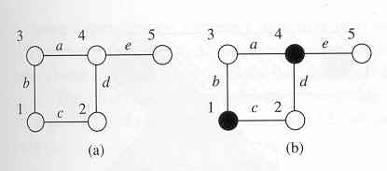
Minimum-Vertex Cover Example
Vertex/edge incidence matrix
0 1 1 0 0
0 0 1 1 0
1 1 0 0 0
1 0 0 1 1
0 0 0 0 1
A_{I} =
Minimum vertex cover
Edge set corresponds to S and vertex set to C
A = A_{I}^{T} and c = 1.
Possible covers: x¹=[10010]^{T} , x²=[01101]^{T}, x³=[01111]^{T}
Note that Ax ≥ 1 for x = x¹, x², x³
Vector x¹ is a minimum cover

Slide 34
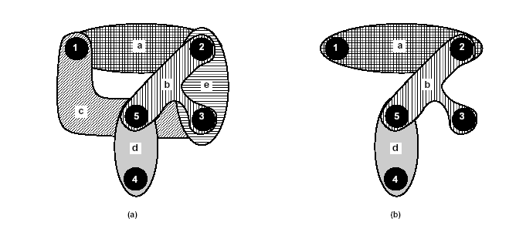
Minimum-Edge Cover Example
Vertex/edge incidence matrix
1 0 1 0 0
1 1 0 0 1
0 1 1 0 1
0 0 0 1 0
0 1 1 1 0
A_{I} =
Minimum edge cover
Vertex set corresponds to S and edge set to C
A = A_{I} and c = 1.
A minimum cover is {a, b, d} or x=[11010]^{T}
Let c=[1, 2, 1, 1, 1]^{T}; a minimum cover is {a, c, d},
x=[10110]^{T}

Slide 35
Covering Problem Formulated as Satisfiability Problem
Associate a selection variable with each group (element of C)
Associate a clause with each element of S
Each clause represents those groups that can cover the element
Disjunction of variables corresponding to groups
Note that the product of clauses is a unate expression
Unate cover
Edge-cover example
(x1+x3)(x1+x2+x5)(x2+x3+x5)(x4)(x2+x3+x4)=1
(x1+x3) denotes vertex v1 must be covered by edge a or c
x=[11010]T satisfies the product of sums expression

Slide 36
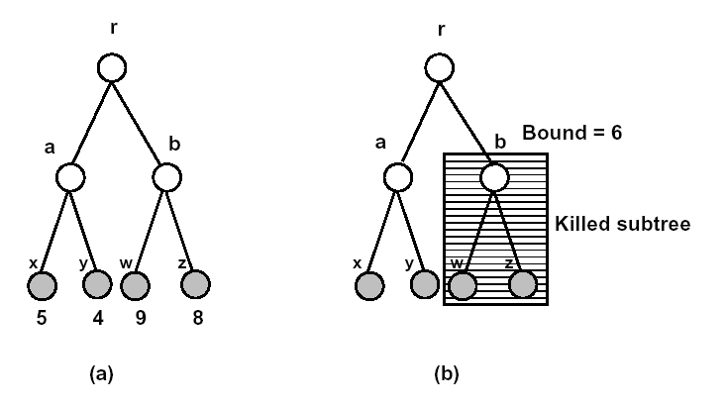
Branch and Bound Algorithm …
Tree search of the solution space
Potentially exponential search.
For each branch, a lower bound is computed for all solutions in subtree.
Use bounding function
If the lower bound on the solution cost that can be derived from a set of future choices exceeds the cost of the best solution seen so far
Kill the search.
Good pruning may reduce run-time.

Slide 37
… Branch and Bound Algorithm
BRANCH AND BOUND {
Current best = anything; Current cost = ∝ ; S = s0;
while (S ≠ 0) do {
Select an element s ∈ S; Remove s from S ;
Make a branching decision based on s yielding sequences {s_{i}, i = 1, 2, … , m};
for ( i = 1 to m) {
Compute the lower bound b_{i} of s_{i};
if (b_{i} ≥ Current cost) Kill s_{i};
else {
if (s_{i} is a complete solution )&(cost of s_{i} < Current cost) {
Current best = s_{i}; Current cost = cost of s_{i} ;
} else if (s_{i} is not a complete solution ) Add s_{i} to set S;
}
}
}
}
S denotes a solution or group of solutions with a subset of
decisions made
s0 denotes the sequence of zero length corresp. to initial state
with no decisions made

Slide 38
Covering Reduction Strategies …
Partitioning
If A is block diagonal
Solve covering problem for corresponding blocks.
Essentials
Column incident to one (or more) rows with single 1
Select column,
Remove covered row(s) from table.
Column dominance
If a_{ki} ≥ a_{kj} ∀ k: remove column j.
Dominating column covers more rows.
Row dominance
If a_{ik} ≥ a_{jk} ∀ k : remove row i.
A cover for the dominated rows is a cover for the set.

Slide 39
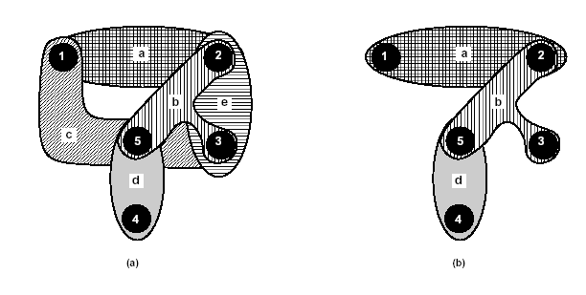
… Covering Reduction Strategies
1 0 1 0 0
1 1 0 0 1
0 1 1 0 1
0 0 0 1 0
0 1 1 1 0
A =
Fourth column is essential.
Fifth column is dominated by second column.
Fifth row dominates fourth row.
1 0 1
1 1 0
0 1 1
Reduced matrix
A =

Slide 40
Branch and Bound Exact Covering Algorithm
EXACT_COVER(A, x, b) {
Reduce matrix A and update corresponding x;
if (Current estimate ≥ |b|) return(b);
if ( A has no rows ) return (x);
Select a branching column c;
x_{c} = 1 ;
A~ = A after deleting c and rows incident to it;
x~ = EXACT_COVER(A~ , x, b);
if ( |x~| < |b|) b = x~ ;
x_{c} = 0 ;
A~ = A after deleting c ;
x~ = EXACT_COVER(A~ , x, b);
if ( |x~| < |b|) b = x~ ;
return (b);
}
x contains current solution
initially set to 0;
b contains best solution
initially set to 1;

Slide 41
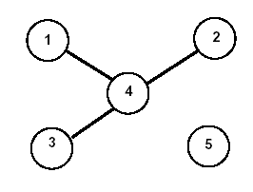
Bounding function …
Estimate lower bound on the covers derived from the current x.
The sum of 1’s in x, plus bound on cover for local A
Independent set of rows: no 1 in same column.
Build graph denoting pairwise independence.
Find clique number (i.e. largest clique)
Approximation (lower) is acceptable.
1 0 1 0 0
1 1 0 0 1
0 1 1 0 1
0 0 0 1 0
0 1 1 1 0
A_{I} =
Row 4 independent from 1,2, 3
Clique number is 2; Bound is 2

Slide 42
… Bounding function
1 0 1
1 1 0
0 1 1
There are no independent rows.
Clique number is 1 (1 vertex).
Bound is 1 + 1 (already selected essential).
Choose first column x₁
Recur with A~ = [11].
Delete one dominated column.
Take other col. (essential); assume it x₂
New cost is 3; x=[11010]^{T} and b=[11010]^{T}
Exclude first column x₁
Both columns are essential
x=[01110]^{T} ; cost is 3 (discarded)
Returned solution is x=[11010]^{T}
A =
0 1
1 0
1 1
A~ =

Slide 43
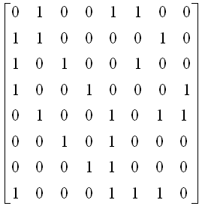
Detailed EXACT_COVER Example …
Consider the following given matrix representing a covering problem:
Find a minimum cover using EXACT_COVER procedure. Assume the following order in branching selection when needed: C₁, C₂, C₃, C₄, C₅, C₆, C₇, C₈.
c1 c2 c3 c4 c5 c6 c7 c8
r1
r2
r3
r4
r5
r6
r7
r8

Slide 44
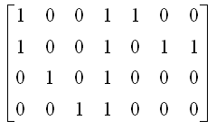
…Detailed EXACT_COVER Example…
Matrix cannot be reduced
No essential columns, no row dominance, no column dominance.
We select a branching column c1. So, c1 is selected, x1=1, and rows r2, r3, r4 and r8 are removed. Obtained matrix is:
Exact_Cover is called with x=(1,0,0,0,0,0,0,0) and b= =(1,1,1,1,1,1,1,1)
c2 c3 c4 c5 c6 c7 c8
r1
r5
r6
r7

Slide 45
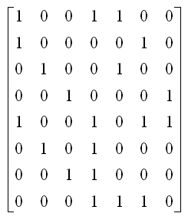
…Detailed EXACT_COVER Example…
Since c5 dominates all other columns, they are removed and c5 becomes essential and is selected.
Since matrix has no rows, the solution x=(1,0,0,0,1,0,0,0) is returned.
Next, we need to check the case when c1 is not selected i.e. x1=0. C1 is removed and obtained matrix is:
c2 c3 c4 c5 c6 c7 c8
r1
r2
r3
r4
r5
r6
r7
r8

Slide 46
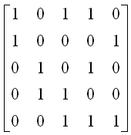
…Detailed EXACT_COVER Example…
Exact_Cover procedure is called with x=(1,0,0,0,0,0,0,0) and b=(1,0,0,0,1,0,0,0).
No essential columns, no column dominanace.
r5 dominates r2. r5 is removed.
Now, c4 dominates c8. c8 is removed.
C4 essential, r4 & r7 removed.
Then, x=(0,0,0,1,0,0,0,0)
Resulting matrix:
c2 c3 c4 c5 c6 c7 c8
r1
r2
r3
r4
r5
r6
r7
r8
c2 c3 c5 c6 c7
r1
r2
r3
r6
r8

Slide 47
…Detailed EXACT_COVER Example
We compute the current estimate by constructing the row dependency graph and find largest clique.
Since largest clique is 2, current estimate is 1+2=3 > |b|=2.
Thus returned solution is (1,0,0,0,1,0,0,0).
Since returned solution is not <|b|, the final returned solution is (1,0,0,0,1,0,0,0).
c2 c3 c5 c6 c7
r1
r2
r3
r6
r8
r1
r8
r2
r6
r3

