Slide 1
Sequential Circuit Analysis & Design
COE 202
Digital Logic Design
Dr. Aiman El-Maleh
College of Computer Sciences and Engineering
King Fahd University of Petroleum and Minerals

Slide 2
Outline
Sequential Circuit Model
Synchronous vs. Asynchronous Sequential Circuits
Latches and Flip Flops
Sequential Circuit Timing Constraints
Sequential Circuit Analysis
Mealy vs. Moore Sequential Circuit Models
Sequential Circuit Design Procedure
Sequential Circuit Design Examples

Slide 3
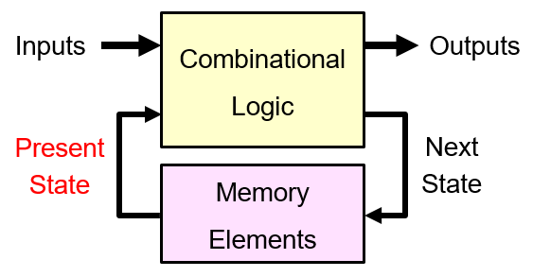
Combinational vs. Sequential Circuits
Combinational Circuit
Outputs are a function of inputs only
NO internal memory
Sequential Circuit
Outputs are a function of Inputs and internal Memory
Internal Memory stores information based on previous inputs
The content of the internal Memory is called State

Slide 4
Sequential Circuit Model
A Sequential circuit consists of:
1. Memory elements:
Latches or Flip-Flops
Store the Present State
2. Combinational Logic
Computes the Outputs of the circuit
Outputs depend on Inputs and Present State
Computes the Next State of the circuit
Next State also depends on the Inputs and the Present State

Slide 5
Synchronous vs. Asynchronous Sequential Circuits
Synchronous Sequential Circuit
Uses a clock signal to control changes in the memory elements
Changes happen at discrete instances of time
Asynchronous Sequential Circuit
Changes in the memory elements can happen at any instance of time
Our focus will be on Synchronous Sequential Circuits
Easier to design and analyze than asynchronous sequential circuits

Slide 6
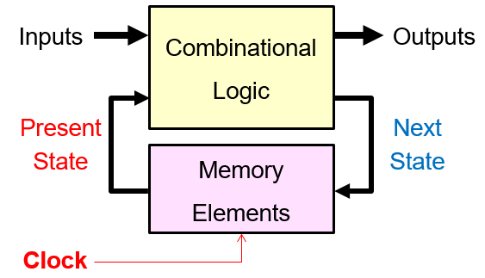
Synchronous Sequential Circuits
Synchronous sequential circuits use a clock signal
The clock signal is an input to the memory elements
The clock determines when memory should be updated
The present state = output value of memory (stored)
The next state = input value to memory (not stored yet)

Slide 7
The Clock
Positive
Pulse
Negative
Pulse
Clock Cycle
Clock Cycle
Time
Clock is a periodic signal = Train of pulses (1's and 0's)
The same Clock Cycle repeats indefinitely over time
Positive Pulse: when the level of the clock is 1
Negative Pulse: when the level of the clock is 0
Rising (Positive) Edge: when clock goes from 0 to 1
Falling (Negative) Edge: when clock goes from 1 down to 0

Slide 8
Clock Cycle versus Clock Frequency
Clock Cycle
Clock Cycle
Clock Cycle
Time
Clock Cycle (or period) is a time duration
Measured in seconds, milli-, micro-, nano-, or pico-seconds
1 ms = 10⁻³ sec, 1 µs = 10⁻⁶ sec, 1 ns = 10⁻⁹ sec, 1 ps = 10⁻¹² sec
Clock Frequency = number of cycles per second (Hertz)
1 Hz=1 cycle/sec, 1 KHz=10³ Hz, 1 MHz=10⁶ Hz, 1 GHz=10⁹ Hz
Clock Frequency = 1 / Clock Cycle
Example: Given the clock cycle=0.5 ns=0.5 ×10⁻⁹ sec
Then, the clock frequency=1/(0.5×10⁻⁹)=2×10⁹ Hz=2 GHz

Slide 9
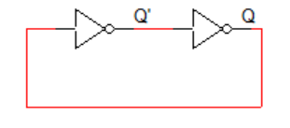
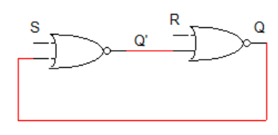
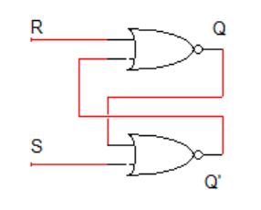
Memory Elements
A memory element may be constructed using cascaded inverters
Q will maintain the stored data
However, there is no input to change
the stored data.
If we replace the inverters by two 2-input NOR gates we get a memory element where we can store a 1 (S=1, R=0) or 0 (S=0, R=1). Note that when (S=0, R=0), the stored value is preserved.
This is called Set-Reset Latch (SR-Latch)

Slide 10
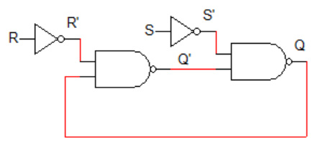
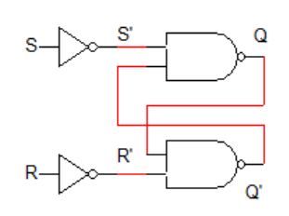
Memory Elements
If we replace the inverters by two 2-input NAND gates we get a memory element where we can store a 1 (S=1, R=0) or 0 (S=0, R=1). Note that when (S=0, R=0), the stored value is preserved.
Thus, an SR-Latch can be built using either two cascaded 2-input NOR gates or NAND gates.

Slide 11
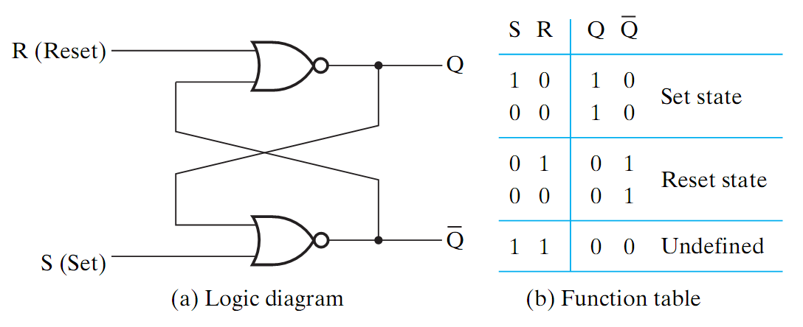
SR Latch Operation
If $S=1$ and $R=0$ then Set ($Q=1, \overline{Q}=0$)
If $S=0$ and $R=1$ then Reset ($Q=0, \overline{Q}=1$)
When $S=R=0$, $Q$ and $\overline{Q}$are unchanged
The latch stores its outputs $Q$ and $\overline{Q}$ as long as $S=R=0$
When $S=R=1$, $Q$ and $\overline{Q}$are undefined (should never be used)

Slide 12
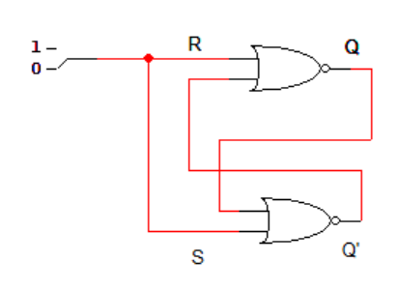
SR Latch Operation
If the forbidden input values $S=R=1$ are applied followed by $S=R=0,$ this will make the SR latch oscillate!!

Slide 13
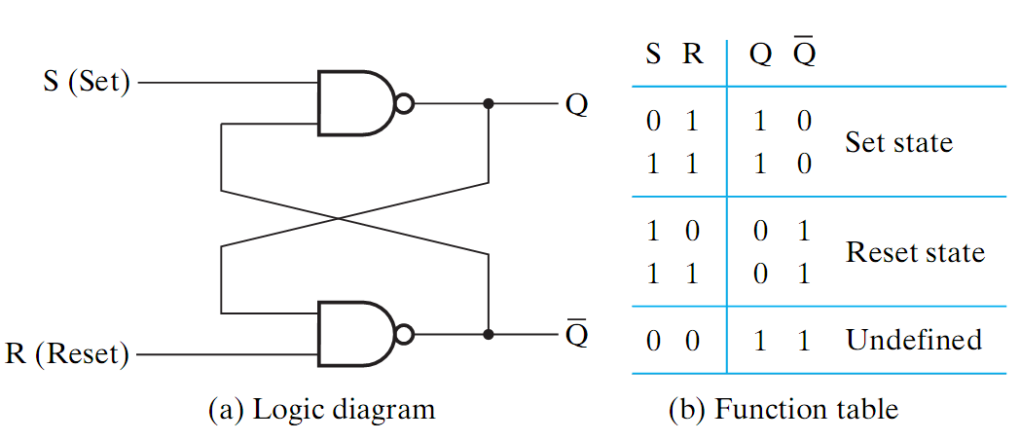
SR Latch with NAND Gates
Known as
the $\overline{S} \overline{R}$ Latch
If $\overline{S}=0$ and $\overline{R}=1$ then Set ($Q=1, \overline{Q}=0$)
If $\overline{S}=1$ and $\overline{R}=0$ then Reset ($Q=0, \overline{Q}=1$)
When $\overline{S}=\overline{R}=1$, $Q$ and $\overline{Q}$are unchanged (remain the same)
The latch stores its outputs $Q$ and $\overline{Q}$ as long as $\overline{S}=\overline{R}=1$
When $\overline{S}=\overline{R}=0$, $Q$ and $\overline{Q}$are undefined (should never be used)

Slide 14
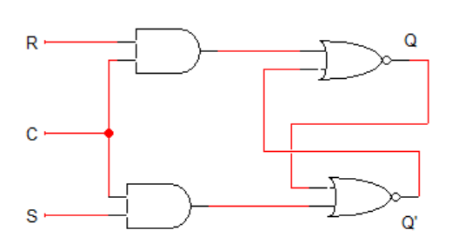
SR Latch with a Clock Input
C | S | R | Next State of Q
0 | X | X | No Change
1 | 0 | 0 | No Change
1 | 0 | 1 | Q=0; Reset State
1 | 1 | 0 | Q=1; Set State
1 | 1 | 1 | Undefined
An additional Clock input signal C is used
Clock controls when the state of the latch can be changed
When C=0, the S and R inputs have no effect on the latch
The latch will remain in the same state, regardless of S and R
When C=1, then normal SR latch operation

Slide 15
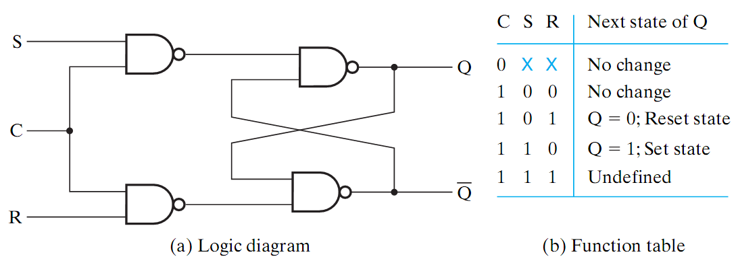
SR Latch with a Clock Input
S
R
An additional Clock input signal C is used
Clock controls when the state of the latch can be changed
When C=0, the S and R inputs have no effect on the latch
The latch will remain in the same state, regardless of S and R
When C=1, then normal SR latch operation

Slide 16
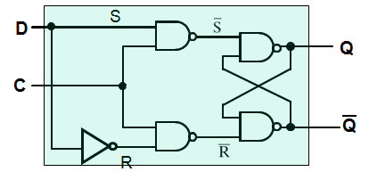
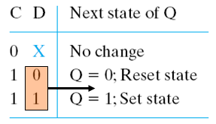
D-Latch with a Clock Input
Only one data input $D$
An inverter is added:$S=D$ and $R=\overline{D}$
$S$ and $R$ can never be 11 simultaneously ➔ No undefined state
When $C=0$, $Q$ remains the same (No change in state)
When $C=1$, $Q=D$ and $\overline{Q}=\overline{D}$
Transparent

Slide 17
Graphic Symbols for Latches
$$S$$
$S R$
$Latch$
$$Q$$
$$\overline{S}$$
$\overline{S} \overline{R}$
$Latch$
$$Q$$
$$D$$
$D$
$Latch$
$$Q$$
$$C$$
$$C$$
$$R$$
$$\overline{Q}$$
$$\overline{R}$$
$$\overline{Q}$$
$$C$$
$$\overline{Q}$$
A bubble appears at the complemented output $\overline{Q}$
Indicates that $\overline{Q}$ is the complement of $Q$
A bubble also appears at the inputs of an $\overline{S} \overline{R}$ latch
Indicates that logic-0 is used (not logic-1) to set (or reset) the latch (as in the NAND latch implementation)

Slide 18
Problem with Latches
A latch is level-sensitive (sensitive to the level of the clock)
As long as the clock signal is high, any change in the value of input $D$ appears in the output $Q$
Output $Q$ keeps changing its value during a clock cycle
Final value of output $Q$ is uncertain
Desired behavior: output changes only once per clock pulse
Due to this uncertainty, latches are NOT used as memory elements in synchronous circuits
$$D$$
$D$
$Latch$
$$X=1$$
$$Q$$
$$Clk$$
$$\overline{Q}$$

Slide 19
Flip-Flops
Latches can not be used as
Memory Elements in synchronous
sequential circuits as they are Level
Sensitive.
Flip Flops are Edge Sensitive; they
change their value on the edge of the clock (Edge-Triggered)
Flip Flops change their value once every clock cycle at either the rising edge or falling edge of the clock

Slide 20
Master Slave Rising (Positive) Edge-Trigerred D Flip Flop
Built using two latches in a master-slave configuration
When CLK=0, the master is activated and the value on D is copied to Qm. The slave is unactivated and keeps its previous value.
When CLK=1, the master is unactivated and it holds the last value stored at Qm while the slave is activated and copies the value of Qm.

Slide 21
Master Slave Rising (Positive) Edge-Trigerred D Flip Flop
The Flip Flop output q changes only once every clock cycle when the Clock changes from 0 to 1
The last value in the D input just before the edge of the clock is copied to the Q.

Slide 22
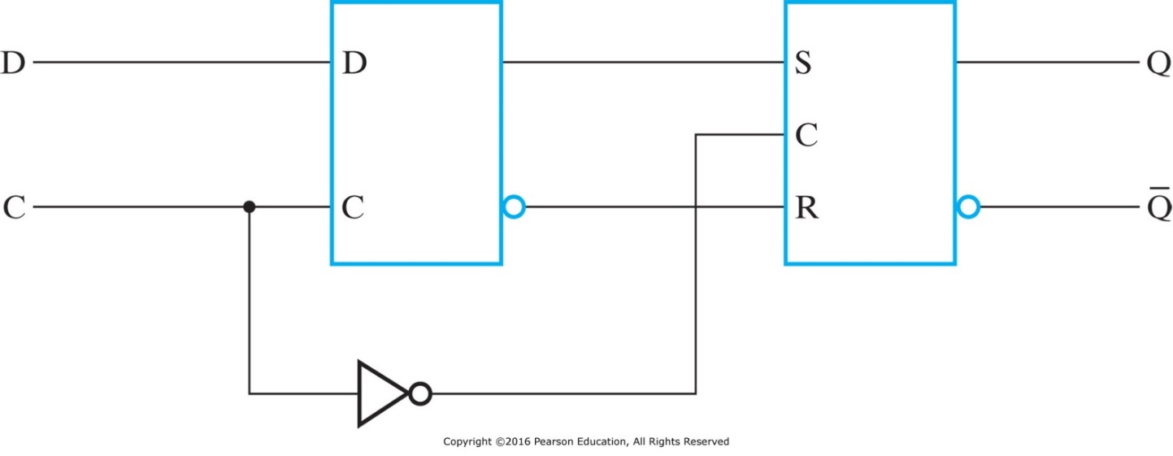
Master Slave Falling (Negative) Edge-Trigerred D Flip Flop
Similar to rising (positive) edge-triggered flip-flop
Only one latch is enabled at any given time
When C=1, the master is enabled and the D input is latched (slave disabled)
When C=0, the slave is enabled to generate the outputs (master is disabled)
$$Q_{1}$$
Output changes when C changes from 1 to 0
Master
Slave
$$\overline{Q_{1}}$$

Slide 23
Graphic Symbols for Flip-Flops
$$D$$
D Flip
Flop
$$Q$$
$$D$$
D Flip
Flop
$$Q$$
$$C$$
$$\overline{Q}$$
$$C$$
$$\overline{Q}$$
A Flip-Flop has a similar symbol to a Latch
The difference is the arrowhead at the clock input C
The arrowhead indicates sensitivity to the edge of the clock
A bubble at the C input indicates falling (negative) edge-triggered FF

Slide 24
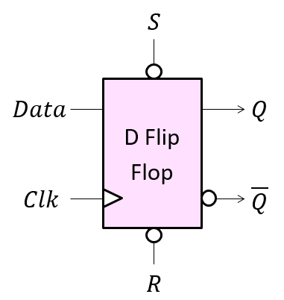
D Flip-Flop with Asynchronous Set/Reset
When Flip-Flops are powered, their initial state is unknown
Some flip-flops have Asynchronous Set/Reset
Sets/Resets state (to logic value 1/0), independent of clock
If S/R input is inverted (bubble), S/R = 0 sets/resets flip-flop
Inputs |  |  |  | Outputs
S | $$R$$ | $$Data$$ | $$Clk$$ | $$Q$$ | $$\overline{Q}$$
1 | 0 | X | X | 0 | 1
0 | 1 | X | X | 1 | 0
1 | 1 | 0 | ↑ | 0 | 1
1 | 1 | 1 | ↑ | 1 | 0

Slide 25
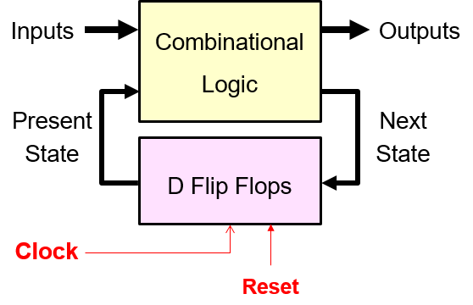
Synchronous vs. Asynchronous Set/Reset
When we start circuit operation
we must initialize the machine
to an initial state
This will initialize the flip-flops
to any desired values
Reset can be done either synchronously or asynchronously
Asynchronous set/reset initializes flip flops to 1/0 independent of the clock
Synchronous set/reset initializes flip flops to 1/0 synchronized with the edge of the clock

Slide 26
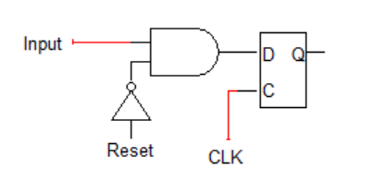
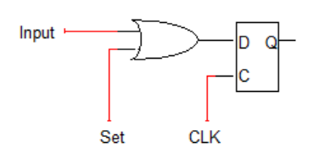
Synchronous vs. Asynchronous Set/Reset
Asynchronous set/reset is provided built in with flip-flops
However, synchronous set/reset has to be provided explicitly through added logic gates
0
1
0
1
1
Synchronous Reset
Synchronous Set

Slide 27
Sequential Circuit Timing Constraints
Setup Time (T_{s}): Time duration for which the data input must be valid and stable before the arrival of the clock edge.
Hold Time (T_{h}): Time duration for which the data input must not be changed after the clock transition occurs.
T_{s} and T_{h} must be ensured for proper operation of flip-flops
Rising
Edge
Clock
T_{s}
T_{h}
Valid data-in
Data Can be Modified after T_{h}

Slide 28
Sequential Circuit Timing Constraints
T_{clk→q} = Clock to q delay – Time between clock edge and data appearing at the output of the FF
T_{C} = worst case delay through combinational logic
Based on the FF & combinational logic timing parameters, the following timing constraints are required for correct operation of the circuit: T_{clk} ≥ T_{clk→q} + T_{C} + T_{s}

Slide 29
Sequential Circuit Analysis
Given a sequential circuit, the objective is to derive outputs & state behavior (outputs and next state) from (present states and inputs)
To analyze the behavior of a sequential circuit, the following procedure should be applied:
1. Initialize the sequential circuit to an initial state (Reset=1)
2. Apply Inputs
3. Observe Outputs
4. Pulse the Clock
(Copy Next State to Present State)
Repeat steps 2-4 for each input

Slide 30
Sequential Circuit Analysis
Two equivalent approaches to represent sequential circuit behavior:
State Table: A truth table-like approach
State Diagram: A graphical, more intuitive way of representing the state table and expressing the sequential circuit operation
State table: a truth table describing behavior of comb. logic
Combination Logic Inputs:
Present State: values of state variables for each state (FF outputs)
External Inputs
Combination Logic Outputs:
Next-state –value of the state (FF outputs) at time (t+1) based on present state and inputs. (Determined by FF inputs)
Outputs –value of the outputs as a function of the present state and (sometimes) the inputs.

Slide 31
Sequential Circuit Analysis
State Diagram: describes behavior of comb. Logic by
representing each state in a circle and
drawing arrows that show the transition from each present state to next states for each input and the corresponding output
Sequential Circuit Analysis Procedure:
Obtain the equations at the inputs of the Flip-Flops
Obtain the output equations
Fill the state table for all possible input and state values
Draw the state diagram

Slide 32
Moore and Mealy Sequential Circuit Models
There are two sequential circuit models:
Mealy Model: Outputs depend on present state and inputs
Moore Model: Outputs depend on present state only

Slide 33
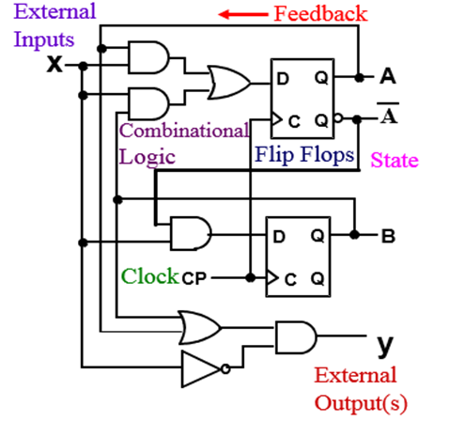
Sequential Circuit Analysis Example
What are the equations on the $D$ inputs of the flip-flops?
$D_{A}=A x+B x$
$D_{B}=A^{′} x$
$A$ and $B$ are the current state
$A(t)=A, B(t)=B$
$D_{A}$ and $D_{B}$ are the next state
$A(t+1)=D_{A}, B(t+1)=D_{B}$
The values of${ D}_{A}$and $D_{B} \text{will} \text{be}$
$A$ and $B$ at the next clock edge
What is the output equation? $y=\left(A+B\right) x′$

Slide 34
Sequential Circuit Analysis Example

Slide 35
Sequential Circuit Analysis Example

Slide 36
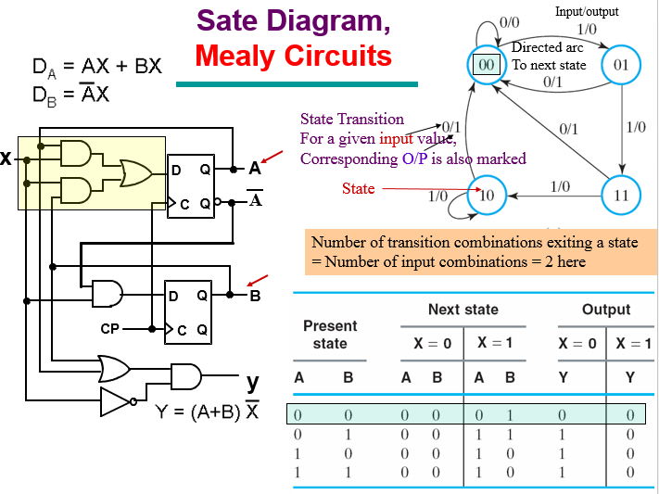
Sequential Circuit Analysis Example

Slide 37
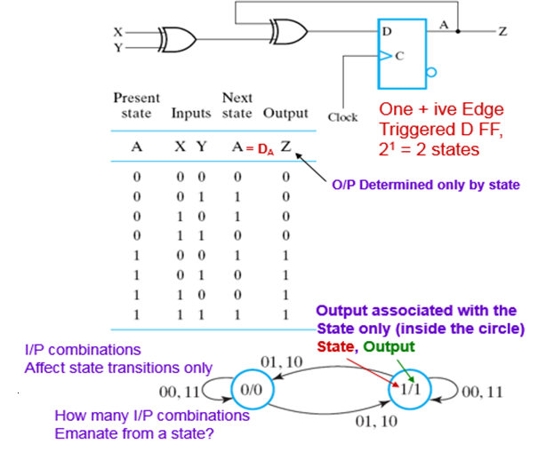
Moore Sequential Circuit Analysis Example
Flip-Flop Input Equation:
$D_{A}=A$ ⨁ $X$ ⨁ $Y$
Output Equation:
Z = $A$
Output does not depend on input: Moore Model

Slide 38
Mealy Machine
The outputs are a function of the present state and Inputs
The outputs are NOT synchronized with the clock
The outputs may change if inputs change during the clock cycle
The outputs may have momentary false values (called glitches)
The correct outputs are present just before the edge of the clock

Slide 39
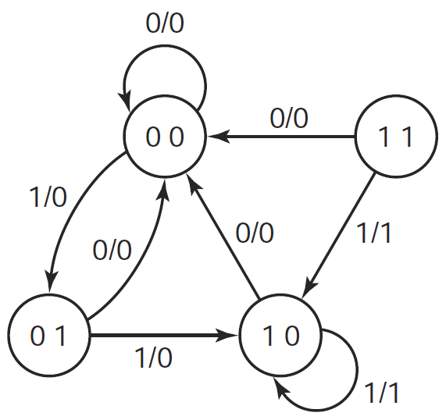
Mealy State Diagram
An example of a Mealy state diagram is shown on the right
Each arc is labeled with:
Input / Output
The output is shown on the arcs of the state diagram
The output depends on the current state and input
Notice that State 11 cannot be reached from the other states

Slide 40
Tracing a Mealy State Diagram
Cycle | 0 | 1 | 2 | 3 | 4 | 5 | 6 | 7 | 8
Input x | 0 | 1 | 1 | 0 | 1 | 1 | 1 | 1 | 0
Present State A B | ? | 0 | 0 | 1 | 0 | 0 | 1 | 1 | 1
 | ? | 0 | 1 | 0 | 0 | 1 | 0 | 0 | 0
Output z | 0 | 0 | 0 | 0 | 0 | 0 | 1 | 1 | 0
When the circuit is powered, the initial state (AB) is unknown
Even though the initial state is unknown, the input x = 0 forces a transition to state AB = 00, regardless of the present state
Sometimes, a reset input is used to initialize the state to 00

Slide 41
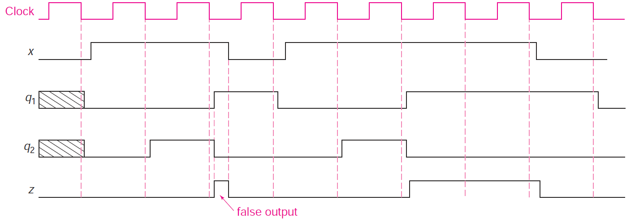
Tracing a Mealy State Diagram
Cycle | 0 | 1 | 2 | 3 | 4 | 5 | 6 | 7 | 8
Input x | 0 | 1 | 1 | 0 | 1 | 1 | 1 | 1 | 0
Present State A B | ? | 0 | 0 | 1 | 0 | 0 | 1 | 1 | 1
 | ? | 0 | 1 | 0 | 0 | 1 | 0 | 0 | 0
Output z | 0 | 0 | 0 | 0 | 0 | 0 | 1 | 1 | 0
Negative edge-triggered
A
B

Slide 42
Moore Machine
The outputs are a function of the Flip-Flop outputs only
The outputs depend on the current state only
The outputs are synchronized with the clock
Glitches cannot appear in the outputs (even if inputs change)
A given design might mix between Mealy and Moore

Slide 43
Moore State Diagram
An example of a Moore state diagram is shown on the right
Arcs are labeled with input only
The output is shown inside the state: (State / Output)
The output depends on the current state only
0
0
00
0
01
0
1
0
0
1
11
1
10
0
1
1

Slide 44
Tracing a Moore State Diagram
When the circuit is powered, the initial state (AB) and output are unknown
Input x = 0 resets the state AB to 00. Can also be done with a reset signal.
0
0
00
0
01
0
1
Cycle | 0 | 1 | 2 | 3 | 4 | 5 | 6 | 7 | 8
Input x | 0 | 1 | 1 | 0 | 1 | 1 | 1 | 1 | 0
Present State A B | ? | 0 | 0 | 1 | 0 | 0 | 1 | 1 | 1
 | ? | 0 | 1 | 0 | 0 | 1 | 0 | 1 | 1
Output z | ? | 0 | 0 | 0 | 0 | 0 | 0 | 1 | 1
0
0
1
11
1
10
0
1
1

Slide 45
Tracing a Moore State Diagram
Cycle | 0 | 1 | 2 | 3 | 4 | 5 | 6 | 7 | 8
Input x | 0 | 1 | 1 | 0 | 1 | 1 | 1 | 1 | 0
Present State A B | ? | 0 | 0 | 1 | 0 | 0 | 1 | 1 | 1
 | ? | 0 | 1 | 0 | 0 | 1 | 0 | 1 | 1
Output z | ? | 0 | 0 | 0 | 0 | 0 | 0 | 1 | 1
The output is synchronized with the clock. No false output (or glitch) can appear.
Negative edge-triggered
A
B

Slide 46
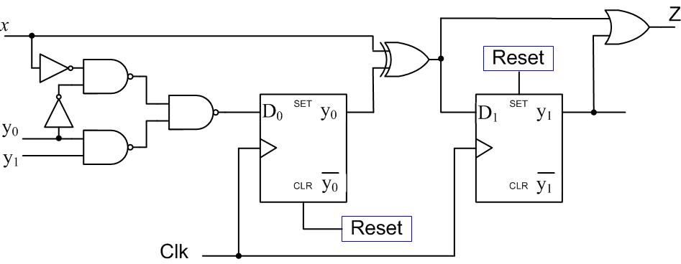
Sequential Circuit Analysis Example
Is the circuit type Mealy or Moore? Why?
Derive expressions for the D₀ and D₁ flip flop inputs and the external output Z.
What is the circuit initial state?
Derive the state transition table of the circuit.

Slide 47
Sequential Circuit Analysis Example
Is the circuit type Mealy or Moore? Why?
Mealy since Z depends on the input x.
Derive expressions for D₀ and D₁ flip flop inputs and output Z.
What is the circuit initial state? Initial state $y_{1}y_{0}=1 0$
Derive the state transition table of the circuit.

Slide 48
Sequential Circuit Design Procedure
1. Specification – e.g. Verbal description
2. Formulation – Interpret the specification to obtain a state diagram and a state table
3. State Assignment - Assign binary codes to symbolic states
4. Flip-Flop Input Equation Determination - Select flip-flop types and derive flip-flop input equations from next state entries in the state table
5. Output Equation Determination - Derive output equations from output entries in the state table
6. Verification - Verify correctness of final design

Slide 49
The State Diagram
A state is an abstraction of memory
Each state should store unique information that distinguishes it from other states
Examples:
State represents the fact that the last input is a 0 or 1
State represents the fact that the last two-input sequence is "11“
State represents that carry = 1
Obtaining the state diagram is the most important step in the design process

Slide 50
Example: Sequence Detector
A sequence detector is a sequential circuit that detects a specific sequence of bits in the input
The input is a serial bit stream: One input bit $x$ is fed to the sequence detector each cycle
The output is also a bit stream: One output bit $z$ each cycle that indicates whether a given sequence is detected or not
$$x$$
Sequence Detector
$$z$$
$$clk$$

Slide 51
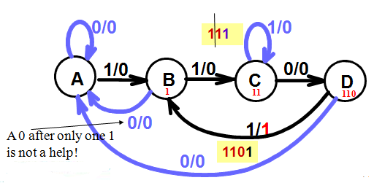
Example: Sequence Detector
1. Specifications: Detect the occurrence of bit sequence 1101 whenever it occurs on input X and indicate this detection by raising an output Z high assuming overlapping of detected sequences
2. Formulation: State Diagram
Reset

Slide 52
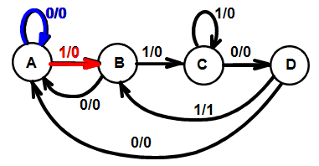
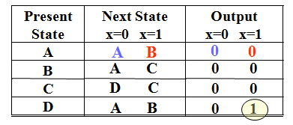
Example: Sequence Detector
From the State Diagram, we can fill in the 2-D State Table
There are 4 states, one input, and one output.
Two dimensional table with four rows, one for each current state.
State Diagram
State Table
Reset

Slide 53
Example: Sequence Detector
3. State Assignment: From abstract symbols to binary bit representation of states
Each of the m symbolic states must be assigned a unique binary code
Minimum number of state bits (state variables) (FFs) required is n_{b}, such that 2^{nb} ≥ n_{s}
If 2^{nb} > n_{s}, this leaves (2^{nb} – n_{s}) unused states
Utilize them as don’t care conditions to simplify CL design
But may need caution: e.g. what if the circuit enters an unused state by mistake
n_{b}= ⎡log₂ n_{s}⎤

Slide 54
Example: Sequence Detector
Also which code is given to which state? → different CL implementations → may influence optimization, e.g. (with 2 FFs) State A is assigned 00 or 01 or 10 or 11?
There are possible encodings = 24
Let A = 00 (to suit being a Reset state), B = 01, C = 11, D = 10

Slide 55
Example: Sequence Detector
For optimization of FF input equations we express A(t+1), B(t+1), Z(t) in terms of A(t), B(t) and X(t) (using one dimensional state table)

Slide 56
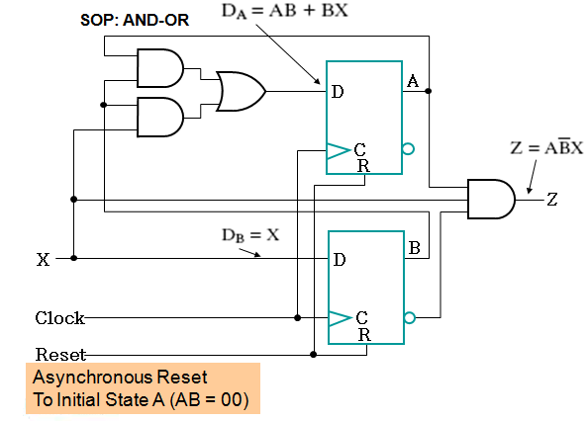
Example: Sequence Detector

Slide 57
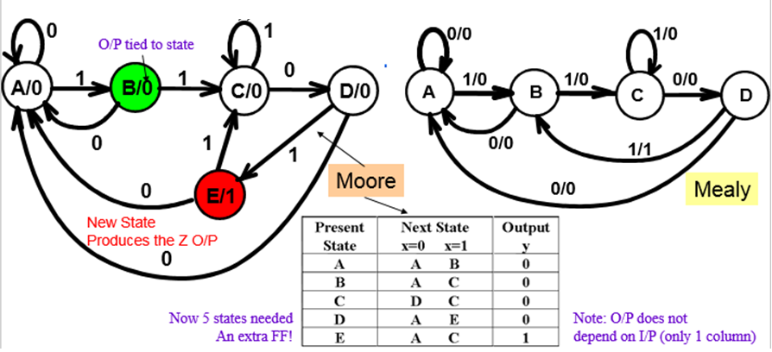
Example: Sequence Detector (Moore Model)
With the Moore model, output is associated with only a state not a state and an input as in Mealy model
This means that we need to add a fifth state (remembers the target sequence 1101) and produces the required Z=1 output

Slide 58
Example: Sequence Detector (Mealy Model)
Design Mealy type "111" sequence detector with sequence overlapping
State Diagram:
State Assignment:
Assign: S₀ = 00, S₁ = 01, and S₂ = 10 (State 11 is Unused)
0 / 0
0 / 0
1 / 1
0 / 0
Reset
S₀
S₁
S₂
1 / 0
1 / 0

Slide 59
Example: Sequence Detector (Mealy Model)
State Table:
Present State | Next State |  | Output $z$
 | $x$ = 0 | $x$ = 1 | $x$ = 0 | $x$ = 1
S₀ | S₀ | S₁ | 0 | 0
S₁ | S₀ | S₂ | 0 | 0
S₂ | S₀ | S₂ | 0 | 1
Present State | Next State |  | Output $z$
 | $x$ = 0 | $x$ = 1 | $x$ = 0 | $x$ = 1
0 0 | 0 0 | 0 1 | 0 | 0
0 1 | 0 0 | 1 0 | 0 | 0
1 0 | 0 0 | 1 0 | 0 | 1

Slide 60
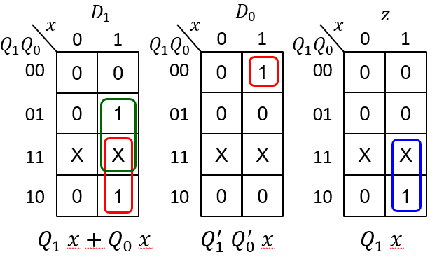
Example: Sequence Detector (Mealy Model)
Present State | Next State |  | Output $z$
 | $x$ = 0 | $x$ = 1 | $x$ = 0 | $x$ = 1
0 0 | 0 0 | 0 1 | 0 | 0
0 1 | 0 0 | 1 0 | 0 | 0
1 0 | 0 0 | 1 0 | 0 | 1
1 1 | X X | X X | X | X
Present State = Flip-Flop Outputs $Q_{1}$ and $Q_{0}$ (state 11 is unused)
Next State = Flip-Flop Inputs $D_{1}$ and $D_{0}$
Flip-Flop Input equations: $D_{1}=Q_{1} x+Q_{0} x$ and $D_{0}=Q_{1}^{′} Q_{0}^{′} x$
Output equation: $z=Q_{1} x$

Slide 61
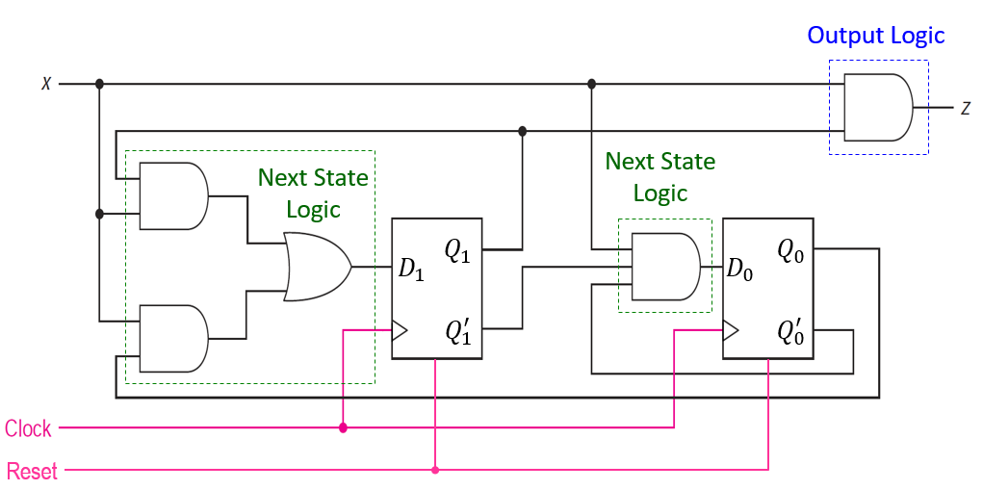
Example: Sequence Detector (Mealy Model)
$$D_{1}=Q_{1} x+Q_{0} x$$
$$D_{0}=Q_{1}^{′} Q_{0}^{′} x$$
$$z=Q_{1} x$$

Slide 62
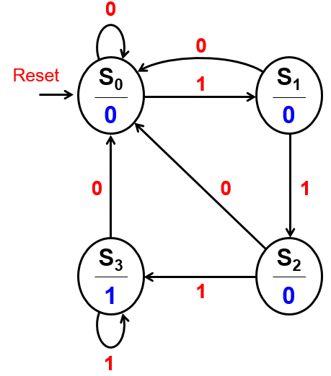
Example: Sequence Detector (Moore Model)
Dear Mealy type "111" sequence detector with sequence overlapping
State Diagram:
State Assignment:
S₀ = 00, S₁ = 01, S₂ = 10 and S₃ = 11

Slide 63
Example: Sequence Detector (Moore Model)
Present State | Next State |  | Output $$z$$
 | $x$ = 0 | $x$ = 1
S₀ | S₀ | S₁ | 0
S₁ | S₀ | S₂ | 0
S₂ | S₀ | S₃ | 0
S₃ | S₀ | S₃ | 1
Present State | Next State |  | Output $$z$$
 | $x$ = 0 | $x$ = 1
0 0 | 0 0 | 0 1 | 0
0 1 | 0 0 | 1 0 | 0
1 0 | 0 0 | 1 1 | 0
1 1 | 0 0 | 1 1 | 1
State Assignment
S₀ = 00, S₁ = 01
S₂ = 10, S₃ = 11

Slide 64
Example: Sequence Detector (Moore Model)
Present State | Next State |  | Output $$z$$
 | $x$ = 0 | $x$ = 1
0 0 | 0 0 | 0 1 | 0
0 1 | 0 0 | 1 0 | 0
1 0 | 0 0 | 1 1 | 0
1 1 | 0 0 | 1 1 | 1
$$x$$
$$D_{1}$$
$$x$$
$$D_{0}$$
$$Q_{1}Q_{0}$$
0
1
$$Q_{1}Q_{0}$$
0
1
00
0
0
00
0
1
01
0
1
01
0
0
0
1
0
1
11
11
10
0
1
10
0
1
$$Q_{1} x+Q_{0} x$$
$$Q_{1} x+Q_{0}^{′} x$$
Two D-type Flips-Flops
Present State = Flip-Flop Outputs $Q_{1}$ and $Q_{0}$
Next State = Flip-Flop Inputs $D_{1}$ and $D_{0}$
Next State equations: $D_{1}=Q_{1} x+Q_{0} x$ and $D_{0}=Q_{1} x+Q_{0}^{′} x$
Output equation: $z=Q_{1} Q_{0}$ (from the state diagram)

Slide 65
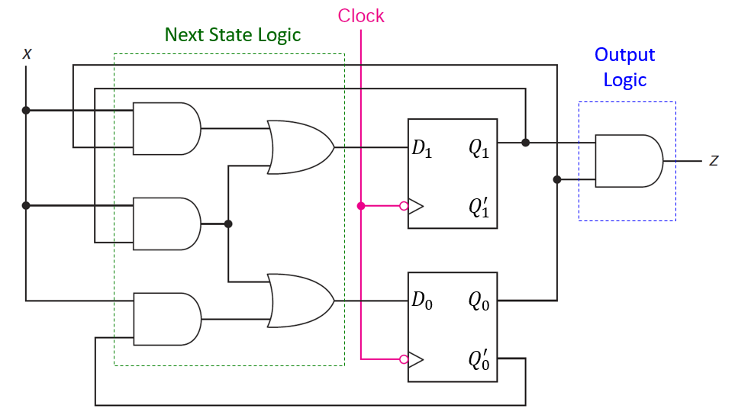
Example: Sequence Detector (Moore Model)
$D_{1}=Q_{1} x+Q_{0} x$ , $D_{0}=Q_{1} x+Q_{0}^{′} x$
$z=Q_{1} Q_{0}$

Slide 66
Mealy versus Moore Sequence Detector
Mealy Sequence Detector
Moore Sequence Detector
In general, Moore state diagrams have more states than corresponding Mealy.
The drawback of Mealy is that glitches can appear in the output if the input is not synchronized with the clock.

Slide 67
Sequential Circuit Verification
Sequential circuits should be verified by showing that the circuit produces the original state diagram
Verification can be done manually, or with the help of a simulation program
All possible input combinations are applied at each state and the state variables and outputs are observed
A reset input is used to reset the circuit to its initial state
Apply a sequence of inputs to test all the state-input combinations, i.e., all transitions in the state diagram
Observe the output and the next state that appears after each clock edge in the timing diagram

Slide 68
Verification Input Test Sequence
Required to verify the correct operation of a sequential circuit
It should test each state transition of the state diagram
Test sequences can be produced from the state diagram
Consider the Mealy sequence detector, starting at S₀ (reset), we can use an input test sequence to verify all state transitions:
Input test sequence: reset then x = 0, 1, 0, 1, 1, 0, 1, 1, 1, 1
Reset input forces initial state to be S₀

Slide 69
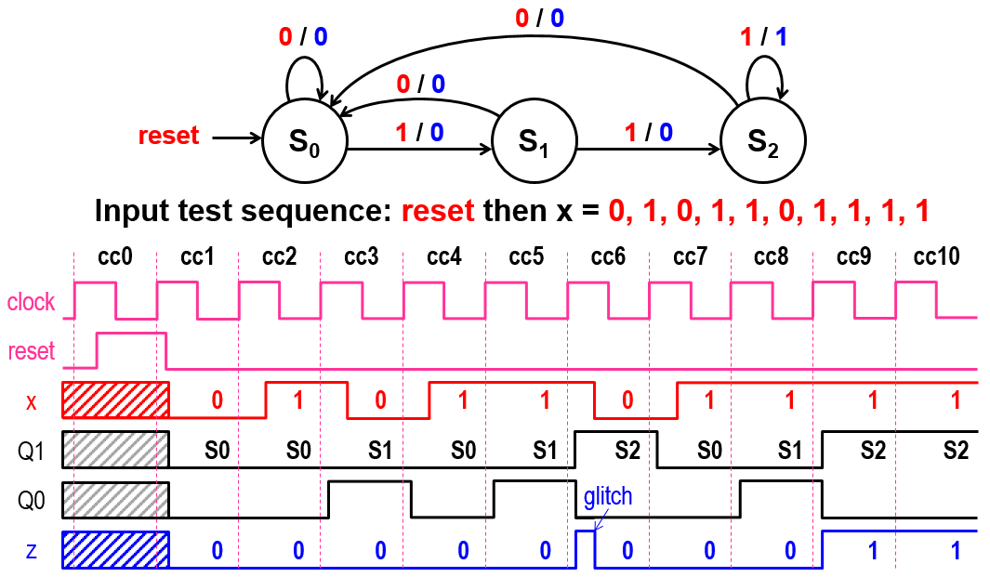
Verifying the Mealy Sequence Detector

Slide 70
Sequential Comparator
Design a sequential circuit that compares two numbers A and B
Two Inputs: A and B
A consists of n bits
B consists of n bits
Bit streaming starting at bit 0
Compare A₀ with B₀, A₁ with B₁, etc. (Bit 0 is least significant bit)
Two outputs: GT (Greater Than) and LT (Less Than)
$$A$$
Sequential
Comparator
$$GT$$
$$B$$
$$LT$$
$$Clock$$
$$Reset$$

Slide 71
Designing the State Diagram
Moore State Diagram
Reset: start initially in state EQ
EQ indicates Equality (output is 00)
Stay in EQ as long as A_{i}B_{i} = 00 or 11
Go to LT if A_{i} < B_{i} (A_{i}B_{i} = 01)
LT indicates Less Than (output is 01)
Go to GT if A_{i} > B_{i} (A_{i}B_{i} = 10)
GT is Greater Than (output is 10)
Complete the state diagram
LT → GT and GT → LT
LT → LT and GT → GT
00, 11
EQ
00
Reset
01
10
01
LT
01
GT
10
10
00, 11, 01
00, 11, 10

Slide 72
State Assignment and State Table
Three States ➔ Two Flip-Flops
D-type Flip-Flops will be used
State Assignment: EQ = 00, LT = 01, GT = 10
Output = Present State (Q₁ and Q₀)
00, 11
EQ
00
Reset
Present State Q₁ Q₀ | Next State (D₁ D₀)
 | A B 0 0 | A B 0 1 | A B 1 0 | A B 1 1
0 0 | 0 0 | 0 1 | 1 0 | 0 0
0 1 | 0 1 | 0 1 | 1 0 | 0 1
1 0 | 1 0 | 0 1 | 1 0 | 1 0
1 1 | X X | X X | X X | X X
01
10
01
LT
01
GT
10
10
00, 11, 01
00, 11, 10

Slide 73
Deriving the Next State Equations
Present State Q₁ Q₀ | Next State (D₁ D₀)
 | A B 0 0 | A B 0 1 | A B 1 0 | A B 1 1
0 0 | 0 0 | 0 1 | 1 0 | 0 0
0 1 | 0 1 | 0 1 | 1 0 | 0 1
1 0 | 1 0 | 0 1 | 1 0 | 1 0
1 1 | X X | X X | X X | X X
State 11 is unused
When present state is 11, don't cares are used to fill the next state.
Output = Present state
$$D_{1}$$
$$D_{0}$$
$$AB$$
$$AB$$
$$Q_{1}Q_{0}$$
00
01
11
10
$$Q_{1}Q_{0}$$
00
01
11
10
$D_{1}=Q_{1}A+Q_{1}B^{′}+AB′$
$D_{1}=Q_{1}(A+B^{′})+AB′$
$D_{0}=Q_{0}A^{′}+Q_{0}B+A^{′}B$
$D_{0}=Q_{0}(A^{′}+B)+A^{′}B$
00
0
0
0
1
00
0
1
0
0
01
0
0
0
1
01
1
1
1
0
11
X
X
X
X
11
X
X
X
X
10
1
0
1
1
10
0
1
0
0

Slide 74
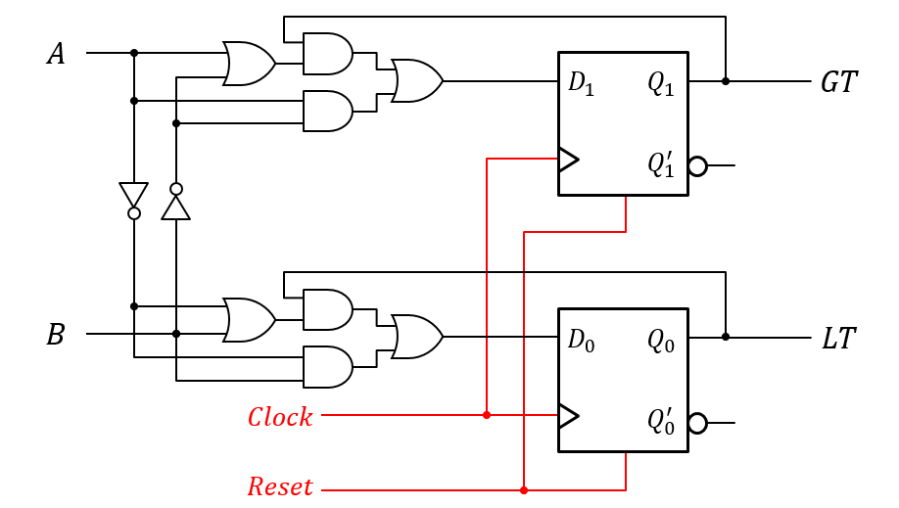
Sequential Comparator Circuit Diagram
$D_{1}=Q_{1}(A+B^{′})+AB′$ $D_{0}=Q_{0}(A^{′}+B)+A^{′}B$

Slide 75
Sequential Circuit Code Detector
It is required to design a sequential circuit that detects the 3-bit codes 010 or 110
Note that code detector is different from sequence detector
Code detector checks the code every 3 bits in this example
Reset
S0
X/0
S1
0/0
1/0
S2
S3
X/0
0/1
1/0

Slide 76
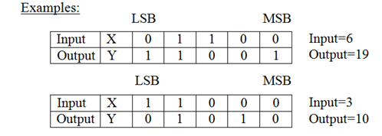
Sequential Circuit Design: Y = 3*X + 1
single input X and a single output Y.
The circuit receives an unsigned number serially through the input X from the least significant bit (LSB) to the most significant bit (MSB), and computes the equation Y=3*X+1 and generates the output serially from the least significant bit to the most significant bit.

Slide 77
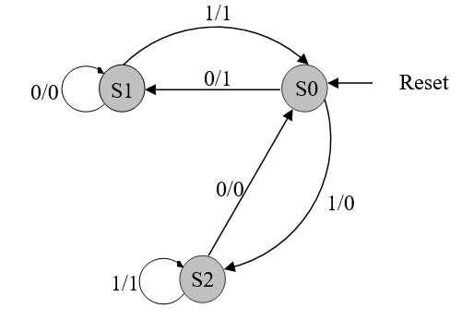
Sequential Circuit Design: Y = 3*X + 1
Present State | Next State |  | Output $z$
 | $x$ = 0 | $x$ = 1 | $x$ = 0 | $x$ = 1
S0 | S1 | S2 | 1 | 0
S1 | S1 | S0 | 0 | 1
S2 | S0 | S2 | 0 | 1
Present State | Next State |  | Output $z$
 | $x$ = 0 | $x$ = 1 | $x$ = 0 | $x$ = 1
0 0 | 0 1 | 1 0 | 1 | 0
0 1 | 0 1 | 0 0 | 0 | 1
1 0 | 0 0 | 1 0 | 0 | 1
1 1 | X X | X X | X | X
S0 (C=1), S1 (C=0), S2 (C=2)
State Assignment
S₀ = 00, S₁ = 01, S₂ = 10

Slide 78
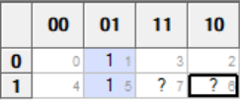
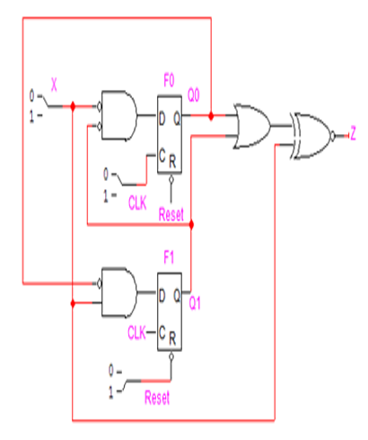
Sequential Circuit Design: Y = 3*X + 1
D1 = F0’ X
D0 = F1’ X’
Z = F1’ F0’ X’ + F1 X + F0 X
= F1’ F0’ X’ + X (F1 + F0)
= (X ⊕ (F1+F0))’

Slide 79
Sequential Circuit Design: Y = X - 1
Design a sequential circuit to compute the equation Y=X-1 serially.
Note that -1=11..111. Thus, we will add 1 with every bit.
Present State | Next State |  | Output $y$
 | $x$ = 0 | $x$ = 1 | $x$ = 0 | $x$ = 1
S0 | S0 | S1 | 1 | 0
S1 | S1 | S1 | 0 | 1
S0 (C=0), S1 (C=1))
State | S0 | S0 | S0 | S0 | S1
Input (X) | 0 | 0 | 0 | 1 | 0
Output (Y) | 1 | 1 | 1 | 0 | 0
Input: X=8
Output: Y=7

Slide 80
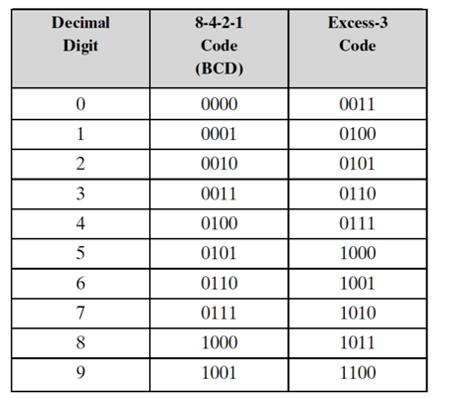
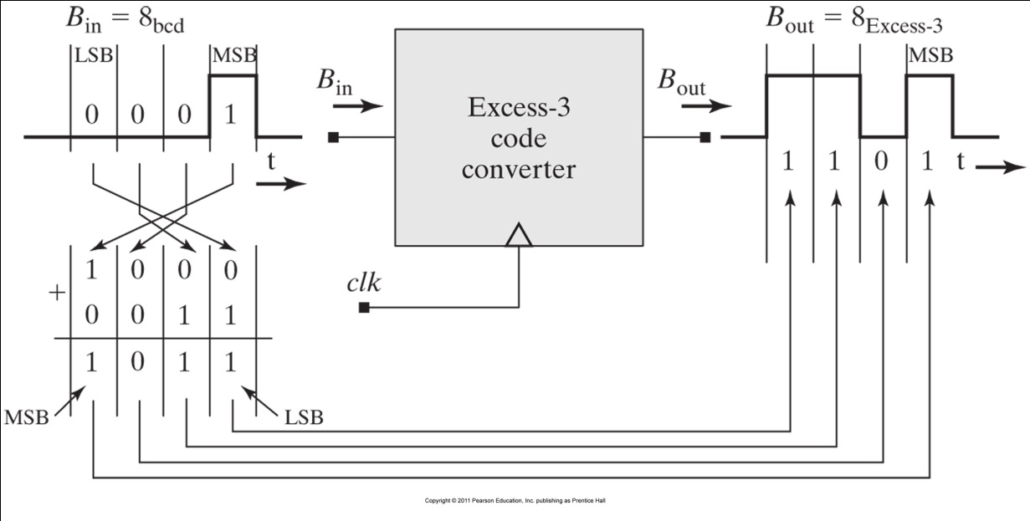
BCD to Excess-3 Serial Code Converter
It is required to design a serial BCD to Excess-3 converter.
Assume that once the machine is reset, a continues stream of BCD digits will be transmitted serially and converted to Excess-3 digits.

Slide 81
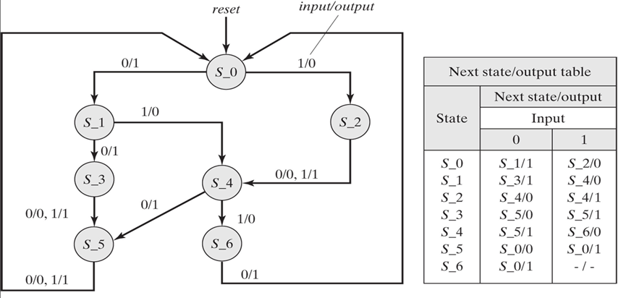
BCD to Excess-3 Serial Code Converter
State Diagram
State Table

Slide 82
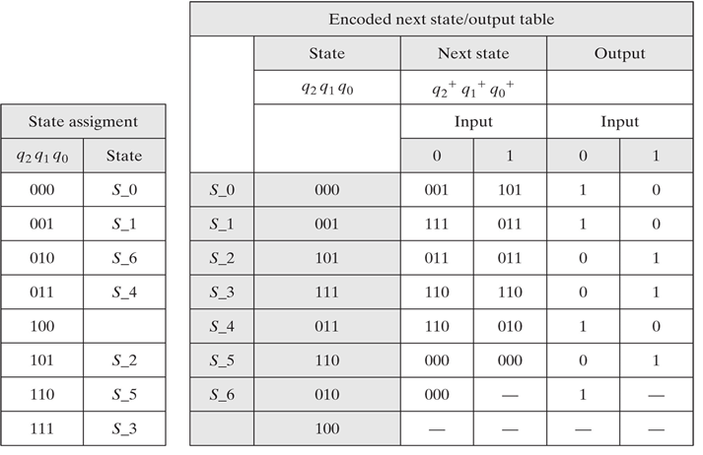
BCD to Excess-3 Serial Code Converter

Slide 83
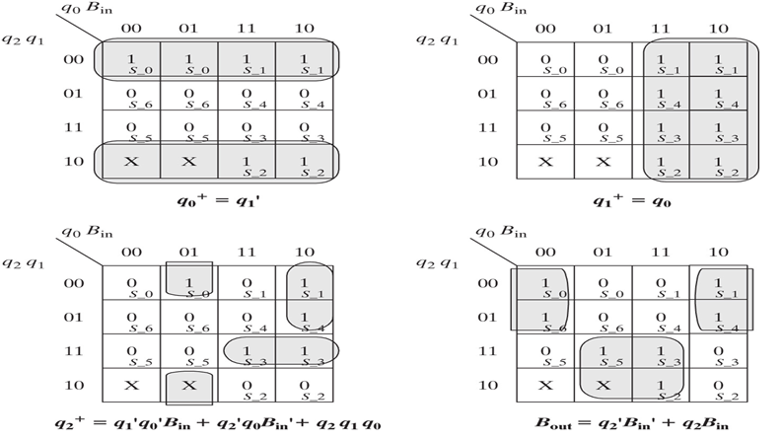
BCD to Excess-3 Serial Code Converter
Karnaugh maps for the encoded state bits and output bit (B_{out})

Slide 84
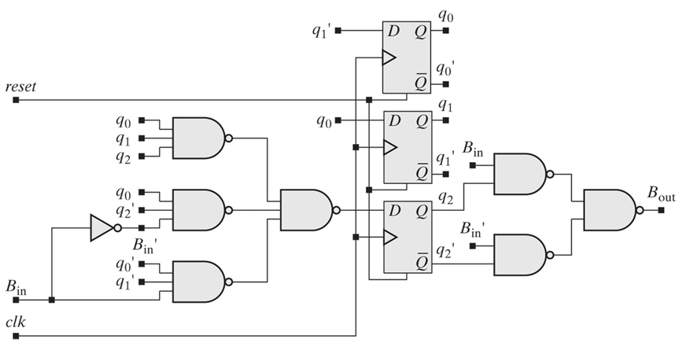
BCD to Excess-3 Serial Code Converter

