Slide 1
Arithmetic Functions & Circuits
COE 202
Digital Logic Design
Dr. Aiman El-Maleh
College of Computer Sciences and Engineering
King Fahd University of Petroleum and Minerals

Slide 2
Outline
Hierarchical Design
Iterative Arithmetic Combinational Circuits
Functional Blocks: Half-Adder, Full Adder
4-bit Ripple-Carry Adder (RCA)
Carry Lookahead Adder (CLA)
Iterative Design Examples
Signed Number Representation
Adder/Subtractor for Signed 2’s Complement
BCD Adder
Binary Multiplier

Slide 3
Hierarchical Design
Let us consider the design of a 4-bit Equal Comparator
Direct implementation
  8 input variables
  Truth table: 256 rows
  8-variable K-map!!
Go hierarchical: Solve a large problem as a set of smaller problems
  4 X 1-bit comparators
  + 1 Final comparator
Advantages:
  Handle simpler problem, Use fewer symbols, Repeated use
A
B
4 bits
4 bits
E = 1
If A = B

Slide 4
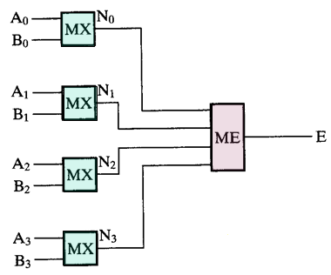
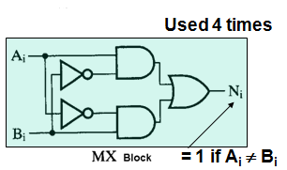
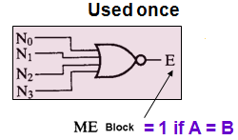
Hierarchical Design

Slide 5
Advantages of the Hierarchical Approach to Design
Simpler representation of complex systems:
  5 interconnected blocks in the hierarchical design
  Versus 21 interconnected gates in a flat approach
Shielding of complexity: Details of further complexity stop at the symbol of a predefined block (leaf)
Reusability reduces the design effort required (fewer different functional blocks to be designed):
  (Only 1 MX and 1 ME)
Easy to upgrade design later by using improved predefined blocks
Different teams can work simultaneously and independently on different parts→ Speed up the design

Slide 6
Iterative (Repetitive)
Arithmetic Combinational Circuits
Practical Arithmetic Functions:
  Operate on binary bit vectors (e.g. a 32-bit adder adds two 32-bit numbers and produces a 32-bit number)
  Same basic subfunction is used in each bit position
Designing for the input vectors directly can be very difficult (huge # of inputs & outputs!) (Huge truth tables/Maps!)
Solution: Design functional block for subfunction (e.g. for a bit) and repeat it (iterate it) to obtain a functional block for the overall operation
Cell = subfunction block
Iterative array = An array of interconnected cells

Slide 7
Iterative (Repetitive)
Arithmetic Combinational Circuits
An iterative array can be in a single dimension (1D) or multiple dimensions (spatially)
Iterative array takes advantage of the regularity to make design feasible
Block Diagram of a 1D Iterative Array

Slide 8
Functional Blocks: Addition
Binary addition is used frequently
“Addition” Development:
  Half-Adder (HA), a 2-input bit-wise addition functional block
  Full-Adder (FA), a 3-input bit-wise addition functional block
  Ripple Carry Adder, an iterative array to perform binary addition
  Carry-Look-Ahead Adder (CLA), Speeds up performance by generating carries from the input numbers directly to avoid carry ripple delay.
A half adder (HA) is an arithmetic circuit that is used to add two bits. The block diagram of HA is shown. It has two inputs and two outputs.

Slide 9
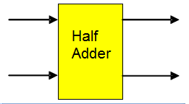
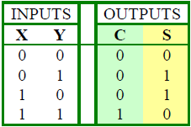
Functional Block: Half-Adder
A 2-input (no carry input), 1-bit width binary adder that performs the following computations:
A half adder adds two bits to produce two bits: S & C
The output is expressed as a sum bit , S and a carry bit, C
The half adder can be specified as a truth table for S and C
X
0
0
1
1
+ Y
+ 0
+ 1
+ 0
+ 1
C S
0 0
0 1
0 1
1 0

Slide 10
Logic Simplification: Half-Adder
The K-map for S, C is:
By inspection:
and
These equations lead to several implementations.
S
Y
C
Y
1
S
=
X
Y
+
X
Y
=
X
⊕
Y
0
1
0
1
X
1
X
1
=
+
+
2
3
2
3
S
(
X
Y
)
(
X
Y
)
C
=
X
Y
C
=
(
(
X
Y
)
)

Slide 11
Five Implementations: Half-Adder
We can derive following sets of equivalent equations for the half-adder:
(
a
)
S
=
X
Y
+
X
Y
(
d
)
S
=
(
X
+
Y
)
C
C
=
X
Y
C
=
(
X
+
Y
)
(
b
)
S
=
(
X
+
Y
)
(
X
+
Y
)
(
e
)
S
=
X
⊕
Y
C
=
X
Y
C
=
X
Y
(
c
)
S
=
(
C
+
X
Y
)
Most common implementation
For the half-adder
C
=
X
Y

Slide 12

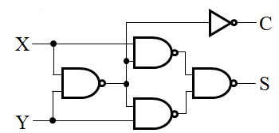
Implementations: Half-Adder
The most common half adder implementation is:
A NAND only implementation is:
X
S
Y
S
=
X
⊕
Y
C
C
=
X
Y

Slide 13
Functional Block: Full-Adder
A full adder is similar to a half adder, but includes a carry-in bit from lower stages. Like the half-adder, it computes a sum bit, S and a carry bit, C.
  For a carry-in (Z) of 0, it is the same as the half-adder:
  For a carry- in
  (Z) of 1:
Z
0
0
0
0
X
0
0
1
1
+ Y
+ 0
+ 1
+ 0
+ 1
C S
0
0
0 1
0 1
1 0
Z
1
1
1
1
X
0
0
1
1
+ Y
+ 0
+ 1
+ 0
+ 1
C S
0 1
1 0
1 0
1
1

Slide 14
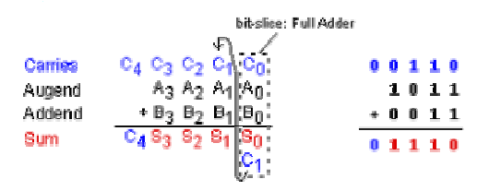
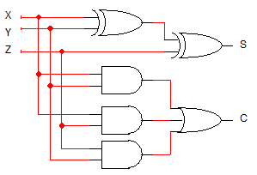


Logic Optimization: Full-Adder
Full Adder Truth Table
X
Y
Z
C
S
0
0
0
0
0
0
0
1
0
1
0
1
0
0
1
0
1
1
1
0
1
0
0
0
1
1
0
1
1
0
Full Adder K-Maps
1
1
0
1
0
1
1
1
1
1
S
Y
C
Y
1
1
1
0
1
3
2
0
1
3
2
X
1
1
X
1
1
1
4
5
7
6
4
5
7
6
Z
Z

Slide 15
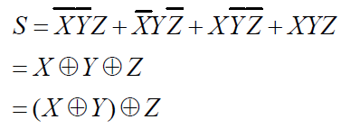
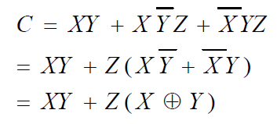
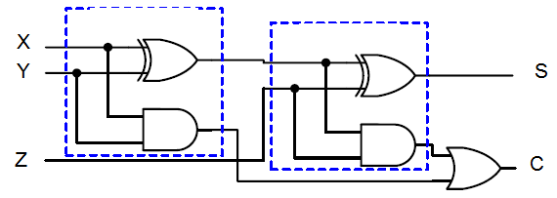
Equations: Full-Adder
The Boolean functions for the sum and carry outputs can be manipulated to simplify the circuit, as shown below:
Thus the full adder can be implemented using two half adders and an OR gate as shown below:

Slide 16
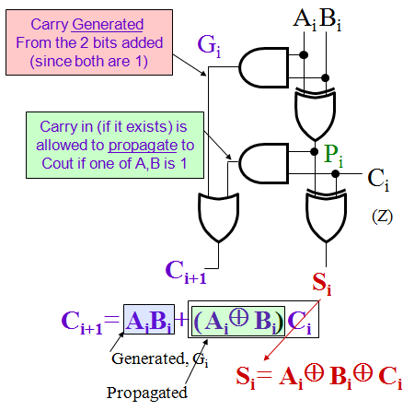
Implementation: 1-bit Full Adder
The term X·Y is “carry generate” at the bit position (i.e. from X and Y)
The term X⊕Y is “carry propagate” (i.e. allow Z to be passed as carry out)
The Carry bit C is 1 if both X and Y are 1 (the sum is 2), or if the sum is 1 and a carry-in (Z) occurs.
C
=
X
Y
+
(
X
⊕
Y
)
. Z
C_{i+1} = G_{i} + P_{i} · C_{i}
G_{i =} A_{i} B_{i}
P_{i =} A_{i} ⊕ B_{i}
Here X, Y, and Z, and C are A_{i}, B_{i}, C_{i} and C_{i+1},
respectively.

Slide 17
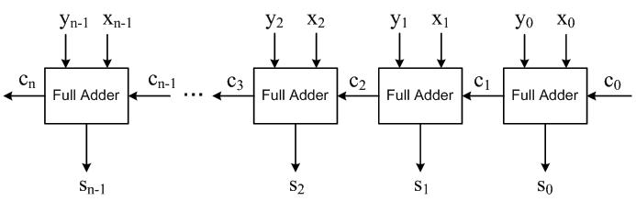
4-bit Ripple-Carry Adder (RCA)
A 4-bit Ripple-Carry Adder made from four 1-bit Full Adders:
N-bit Ripple-Carry Adder:

Slide 18
4-bit RCA: Carry Propagation & Delay
One problem with the addition of binary numbers is the length of time taken to propagate the ripple carry from the least significant bit to the most significant bit.
Gate-level propagation path for the 4-bit
ripple carry adder (XOR = 3 gate delays)
Critical (longest) delay path
(Worst case scenario)
A₃
A₂
A₁
A₀
B₃
B₂
B₁
B₀
C₃
C₂
Why not
from C0?
C₁
C₀
Why not
to C4?
C₄
S₃
S₂
S₁
S₀
Longest Total Carry Ripple Delay from inputs to S3 = 3 + 3 + 2(n-1) gate delays
where n is the number of stages (= 4 here) → 12 gate delays

Slide 19
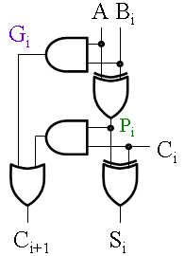
Carry Lookahead Adder (CLA)
Defining the equations for the Full Adder in terms of the P_{i} and G_{i}:
In the ripple carry adder:
  G_{i}, P_{i}, C_{i} and S_{i} are obtained locally at each bit cell of the adder (i.e. limited to that bit)
In the carry lookahead adder, in order to reduce the length of the ripple carry chain, C_{i} is changed to a more global function spanning multiple cells
P
=
A
⊕
B
G
=
A
B
i
i
i
i
i
i
S
=
P
⊕
C
C
=
G
+
P
C
i
i
i
i
+
1
i
i
i

Slide 20
Carry Lookahead Development
C_{i+1} can be removed from the cells and used to derive a set of carry equations spanning multiple cells.
Beginning at the cell 0 with carry in C₀:
Carry does not ripple anymore!
All 4 carry outputs can be generated in one go from:
The C0 and the two input numbers A,B
C₁ = G₀ + P₀ C₀
C₂ = G₁ + P₁ C₁ = G₁ + P₁(G₀ + P₀ C₀)
= G₁ + P₁G₀ + P₁P₀ C₀
2-Level logic
(Only 2 gate delays)
No Rippling
C₃ = G₂ + P₂ C₂ = G₂ + P₂(G₁ + P₁G₀ + P₁P₀ C₀)
= G₂ + P₂G₁ + P₂P₁G₀ + P₂P₁P₀ C₀
C₄ = G₃ + P₃ C₃ = G₃ + P₃G₂ + P₃P₂G₁+ P₃P₂P₁G₀ +P₃P₂P₁P₀ C₀
= G₀₋₃ + P₀₋₃ C₀ = GG + GP C₀

Slide 21
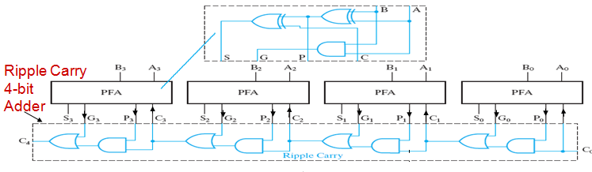
Carry Lookahead Development
Partial Full adder (PFA), (excludes carry handling stuff) to allow use of ripple or lookahead
4-bit Ripple-Carry adder

Slide 22
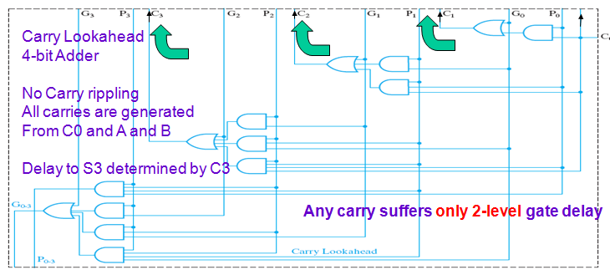
Carry Lookahead Development

Slide 23
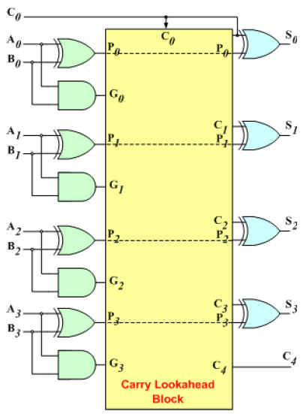
Carry Lookahead Development
The 4-bit carry look-ahead (CLA) adder consists of 3 levels of logic:
  First level: Generates all the P & G signals. Four sets of P & G logic (each consists of an XOR gate and an AND gate).
  Second level: The Carry Look-Ahead (CLA) logic block which consists of four 2-level implementation logic circuits. It generates the carry signals (C¹, C², C³, and C⁴).
  Third level: Four XOR gates which generate the sum signals (S^{i}) (S^{i} = P^{i} ⊕ C^{i}), (S⁰, S¹, S², and S³).

Slide 24
Delay for the 4-bit CLA Adder
A₃
B₃
Delay from {A₃,B₃, C₃} to S₃ (sum from last bit) is
3 gate delays (XOR) + max (delay in P3, Delay in C3)
G₃
C₃ = G₂ + P₂ C₂ = G₂ + P₂(G₁ + P₁G₀ + P₁P₀ C₀)
= G₂ + P₂G₁ + P₂P₁G₀ + P₂P₁P₀ C₀
3
P₃
5
P’s need 3 gate delays
+ 1 for the AND (Product)
+ 1 for the OR (Sum)
5 Gates
C₃
3
C₄
S₃
= 3 + max (3,5) = 3 + 5 = 8 gate delays
Vs 12 gate delays for the carry ripple adder
More significant improvements for wider adders,
e.g. 16-bit, 32-bit, and 64-bit
Lower delay
Critical delay path
Last of the 4-bit adder stages

Slide 25
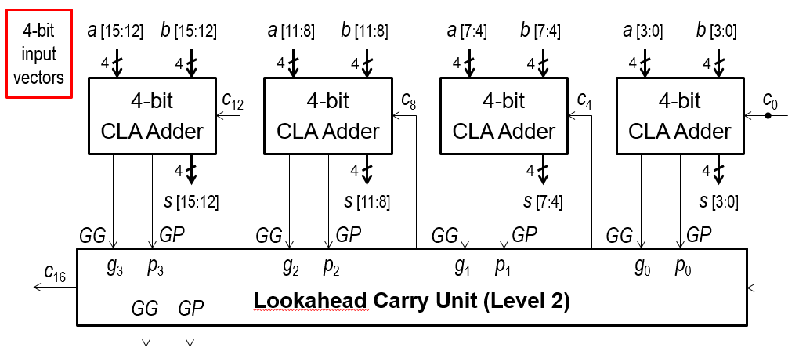
Hierarchical 16-Bit Carry Lookahead Adder
Designed with Four 4-bit Carry Lookahead Adders (CLA)
A Second-Level Lookahead Carry Unit is required
Uses Group Generate (GG) and Group Propagate (GP) signals

Slide 26
Iterative Design Examples: Y=3X
Suppose we want to design an iterative circuit to compute the equation Y=3X
First, we need to determine what information we should pass between cells
In this case, we can think of 3X as X+X+X. Thus, we need to pass carry information
We need to determine what is the maximum carry value that we need to pass between cells
We start with the first cell with carry-in=0 and consider when X=1. Then, the result will be 3*1=3 which is in binary is 11. Thus, the output will be 1 and carry-out=1.

Slide 27
Iterative Design Examples: Y=3X
We continue the process but now having carry-in=1 and X=1. Thus, the result will be 3*1+1=4, which is in binary is 100. The output will be 0 and carry-out=2 (10).
We continue the process but now having carry-in=2 and X=1. Thus, the result will be 3*1+2=5, which is in binary is 101. The output will be 1 and carry-out=2 (10).
Since carry-in=2 produced carry-out=2, this means that the maximum carry-out we will get is 2.
Thus, we need only 2 bits for representing the information that we need to pass among cells.

Slide 28
Iterative Design Examples: Y=3X
Thus, the single bit cell interface is as shown:
We next create the truth table.
Xi
Cin1 Cin0 Xi | Cout1 Cout0 Yi
0 0 0 | 0 0 0
0 0 1 | 0 1 1
0 1 0 | 0 0 1
0 1 1 | 1 0 0
1 0 0 | 0 1 0
1 0 1 | 1 0 1
1 1 0 | x x x
1 1 1 | x x x
Cout1
Cin1
Y=3X
Cout0
Cin0
Yi
Note that since we not get
Carry=3, the output in this
Case is don’t care.

Slide 29


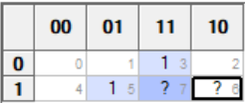
Iterative Design Examples: Y=3X
Yi = Cin0 ⊕ Xi
Cin0 = Cin1’ Cin0’ Xi + Cin1 Xi’
Cin1 = Cin1 Xi + Cin0 Xi = Xi (Cin1 + Cin0)

Slide 30
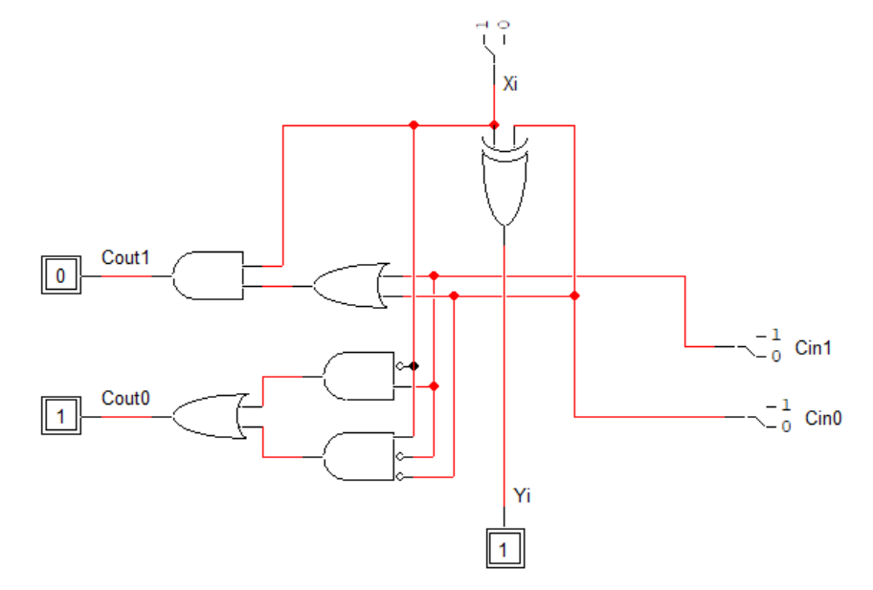
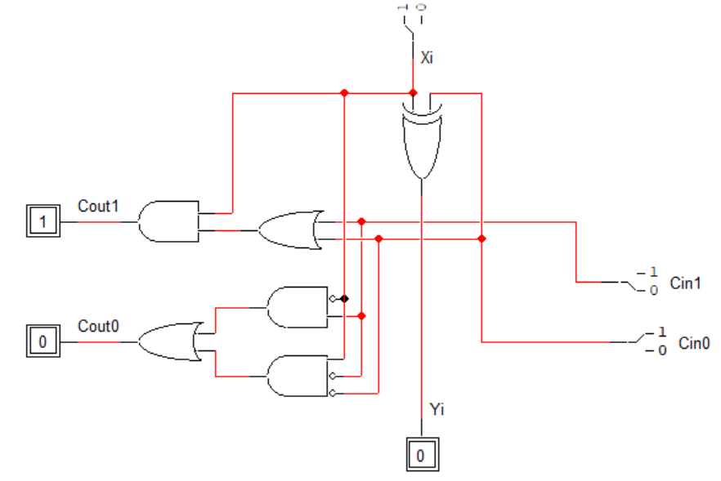
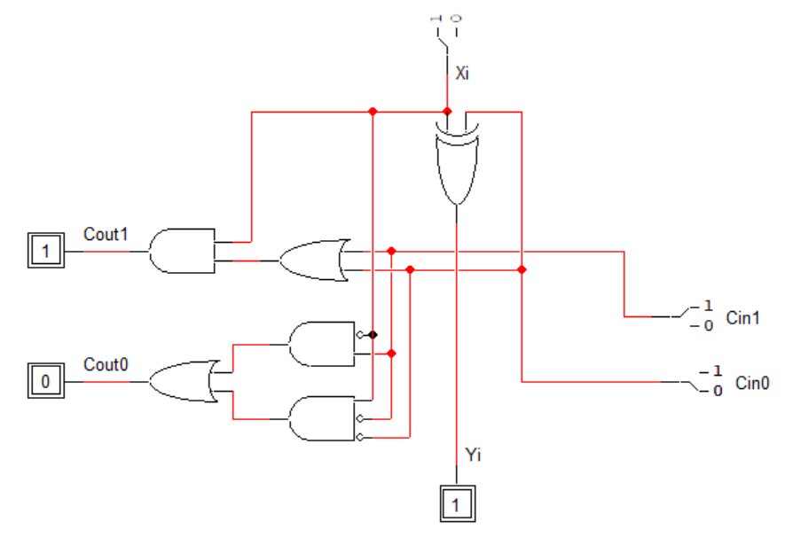
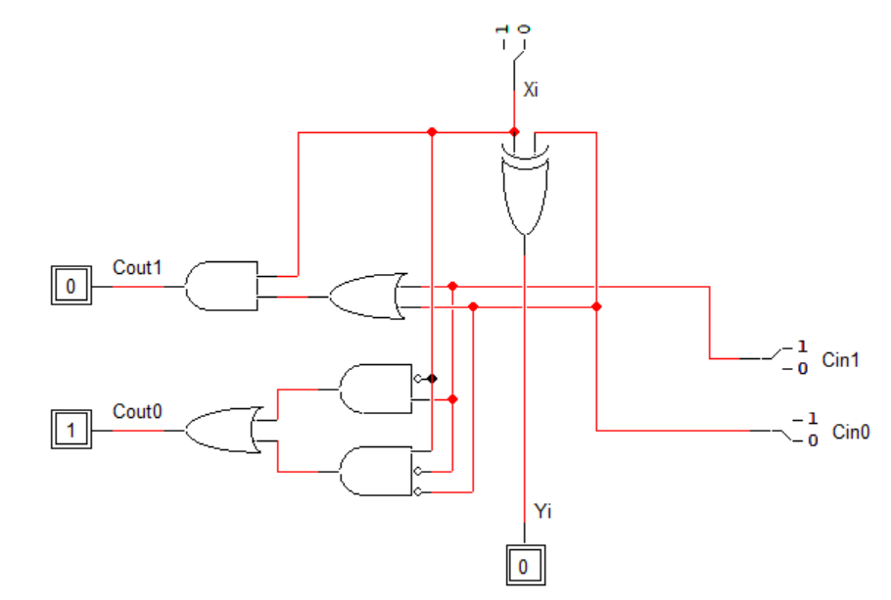
Iterative Design Examples: Y=3X

Slide 31
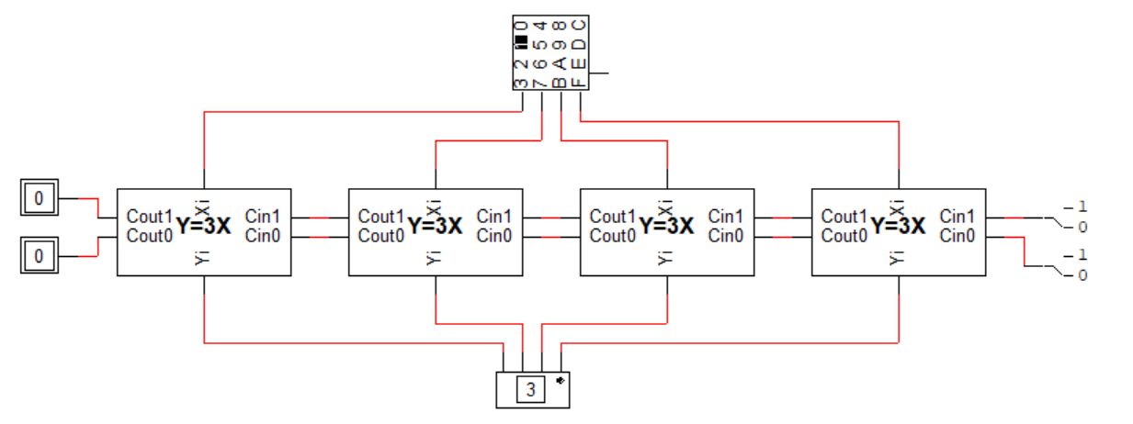
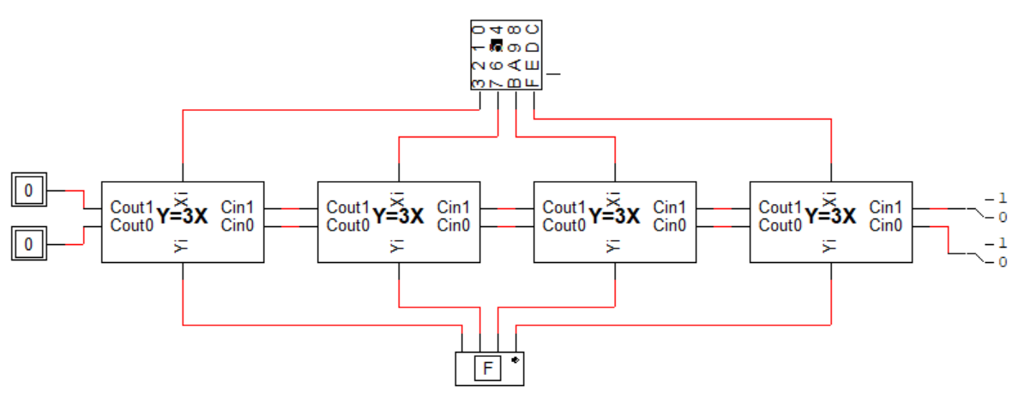
Iterative Design Examples: Y=3X
3*1=3=0x3
3*5=15=0xF

Slide 32
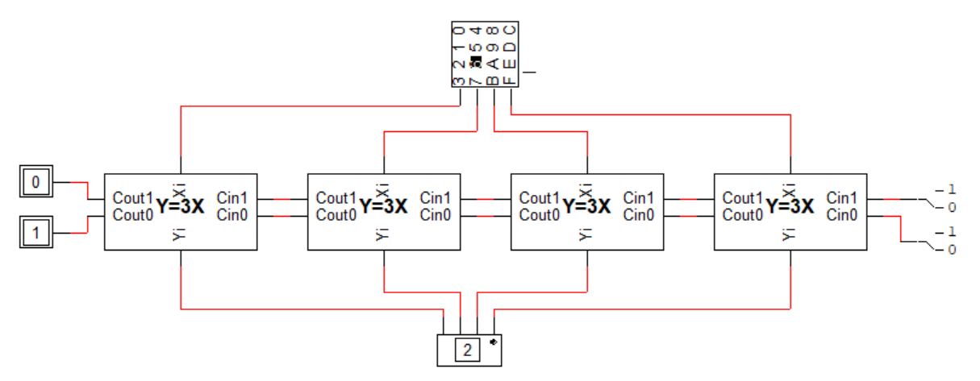
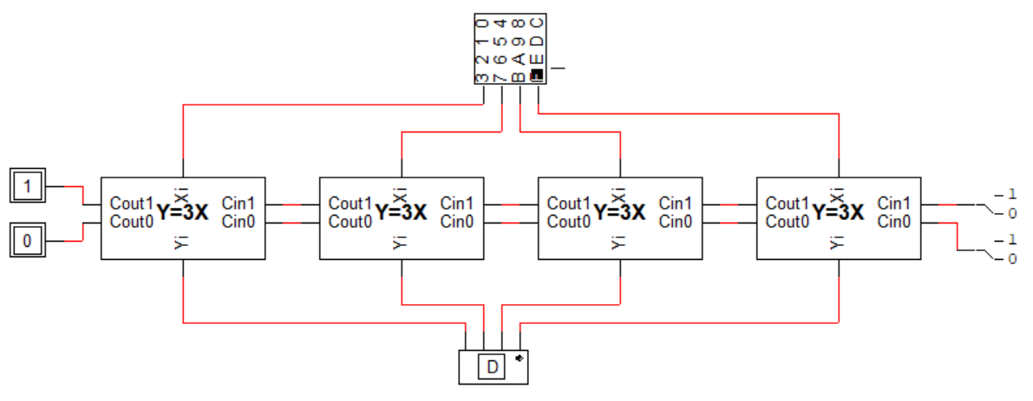
Iterative Design Examples: Y=3X
3*6=18=0x12
3*15=45=0x2D

Slide 33
Iterative Design Examples: Y=3X+C
For implementing the equation Y=3X+C, where C is a constant, this should follow the same principle as the constant C should be connected to the first cell only.
Thus, we repeat the analysis we did but starting with carry-in connected to the first cell to be C instead of 0.
Thus, for implementing Y=3X+1 or 3X+2, the same circuit design used for Y=3X should be used with just connecting the carry-in to 1 and 2 instead of 0.
However, for Y=3X+3 we need to reimplement the equations as we considered carry-in=3 don’t care.
For Y=3X+4 we need 3 bits to represent carry information. So, the whole truth table has to be redone.

Slide 34
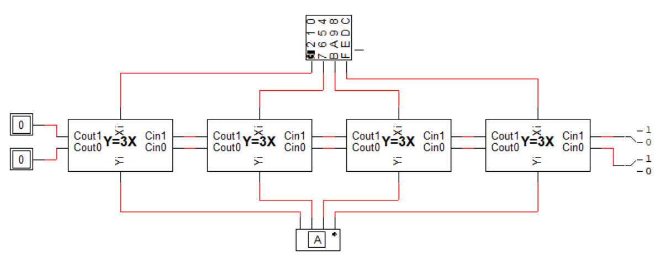
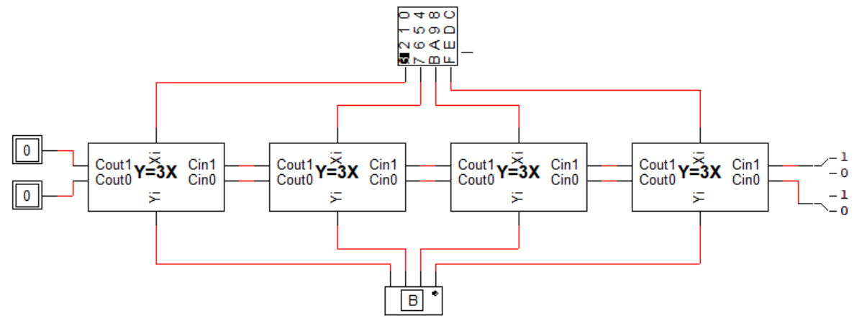
Iterative Design Examples: Y=3X+C
3*3+1=10=0xA
3*3+2=11=0xB

Slide 35
Iterative Design Examples: Z=X-Y
To implement the equation Z=X-Y, we need to pass here whether a cell borrows from the next cell or not
Thus, the cell interface is as shown:
Truth Table:
Xi
Yi
Bin Xi Yi | Bout Zi
0 0 0 | 0 0
0 0 1 | 1
0 1 0 | 0 1
0 1 1 | 0 0
1 0 0 | 1
1 0 1 | 0
1 1 0 | 0 0
1 1 1 | 1 1
Bout
Z=X-Y
Bin
Zi

Slide 36
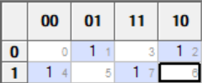
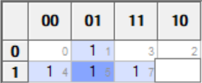
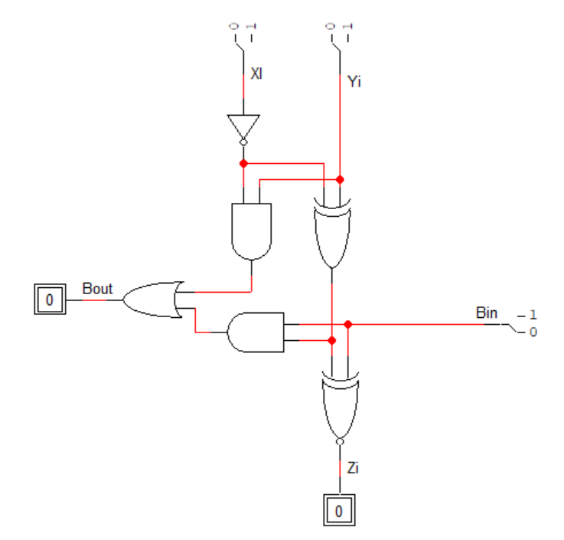
Iterative Design Examples: Z=X-Y
Zi = Bin ⊕ Xi ⊕ Yi = (Bin ⊕ Xi’) ⊕ Yi)’
Bout = Bin Xi’ + Bin Yi + Xi’Yi
= Xi’Yi + Bin Xi’Yi’ + Bin Xi Yi
=Xi’Yi + Bin (Xi’Yi’ + Xi Yi) = =Xi’Yi + Bin (Xi’ ⊕ Yi)
Note that the obtained
Circuit is similar to the
Full Adder

Slide 37
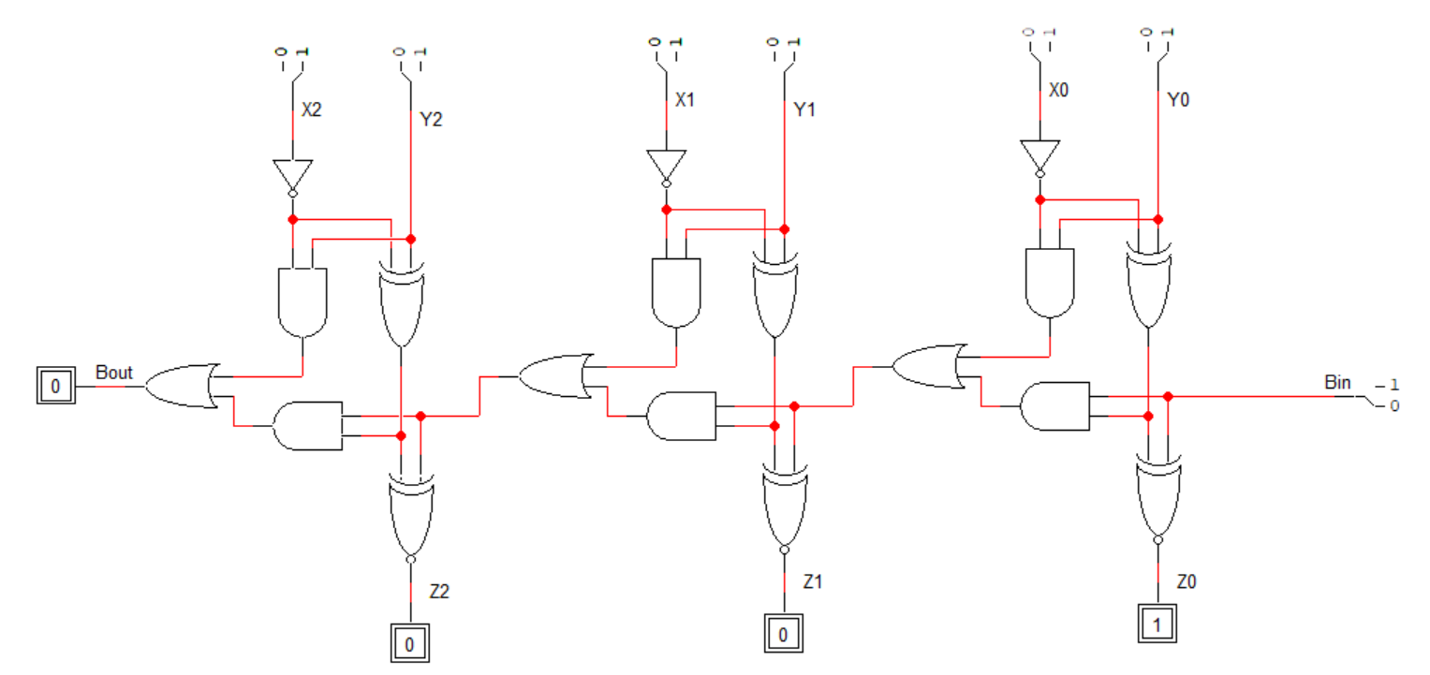
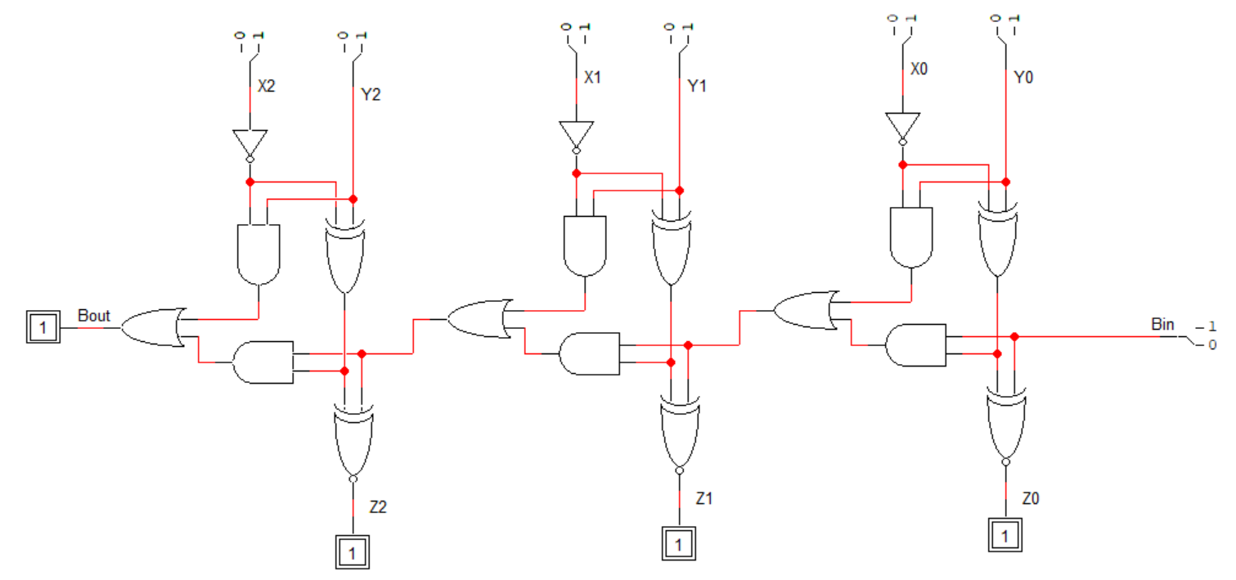
Iterative Design Examples: Z=X-Y
4-3=1, Bout=0
5-6=7, Bout=1
5+8-6=7

Slide 38
Iterative Design Examples: Comparator
We would like to design a circuit to compare two numbers whether (X>Y, X=Y, X<Y)
It is sufficient to pass two bits between cells to pass the results of comparison so far as shown in the table below:
Note that for comparators, we can process bits from least significant to most significant or from most significant to least significant.
Gi | Li | Meaning
0 | 0 | X=Y
0 | 1 | X<y
1 | 0 | X>Y
1 | 1 | Unused

Slide 39
Iterative Design Examples: Comparator
Processing bits from most significant to least significant results in smaller area.
The cell interface is as follows:
Truth Table:
Xi
Yi
Gi+1
Gi
Z=X-Y
Li+1
Li
Gi+1 Li+1 Xi Yi | Gi Li
0 0 0 0 | 0 0
0 0 0 1 | 0 1
0 0 1 0 | 1 0
0 0 1 1 | 0 0
0 1 0 0 | 0 1
0 1 0 1 | 0 1
0 1 1 0 | 0 1
0 1 1 1 | 0 1
Gi+1 Li+1 Xi Yi | Gi Li
1 0 0 0 | 1 0
1 0 0 1 | 0
1 0 1 0 | 0
1 0 1 1 | 1 0
1 1 0 0 | x x
1 1 0 1 | x x
1 1 1 0 | x x
1 1 1 1 | x x

Slide 40
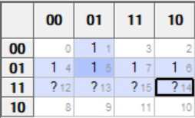
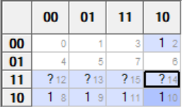
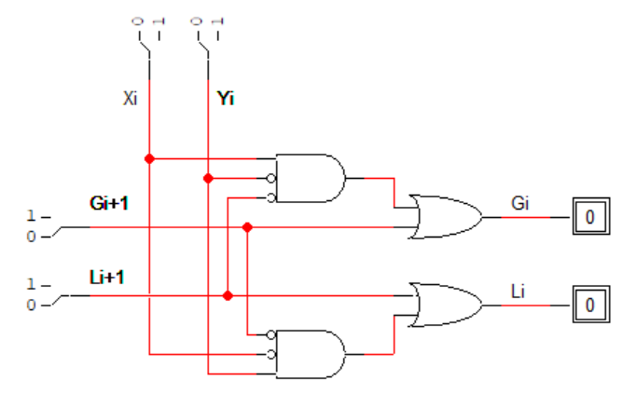
Iterative Design Examples: Comparator
Li = Li+1 + Gi+1’ Xi’ Yi
Gi = Gi+1 + Li+1’ Xi Yi’

Slide 41
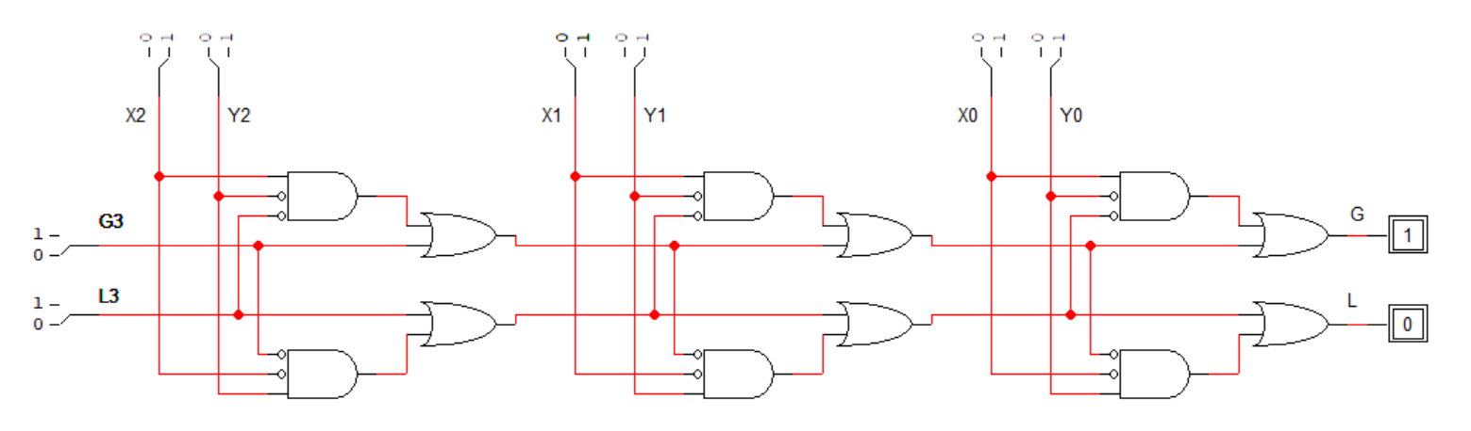
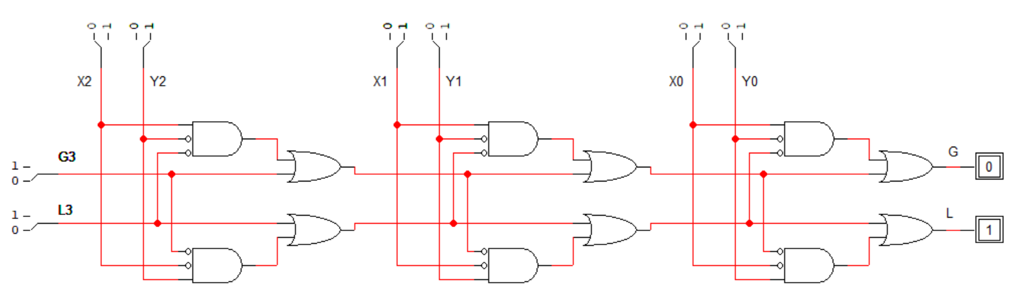
Iterative Design Examples: Comparator

Slide 42
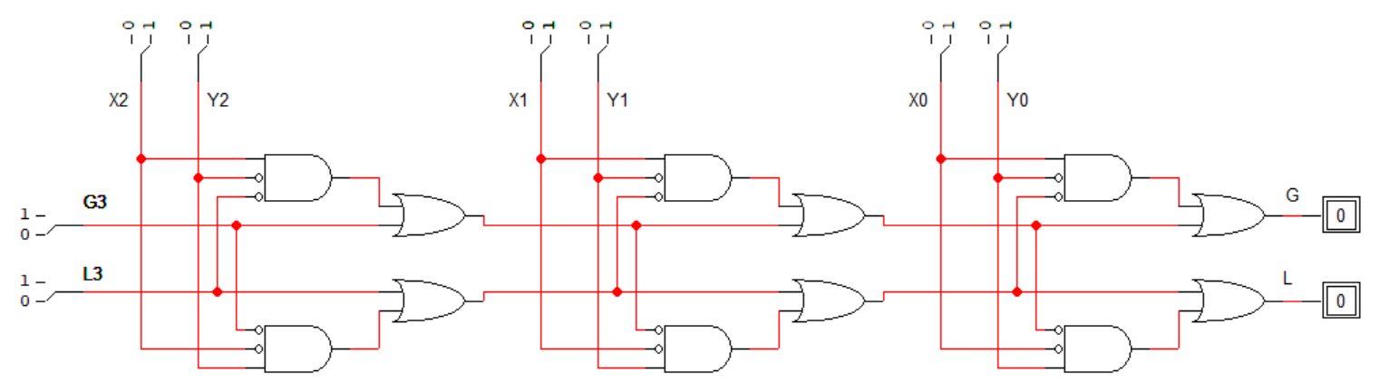
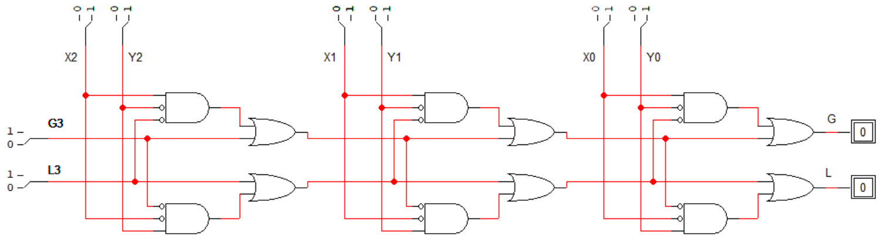
Iterative Design Examples: Comparator

Slide 43
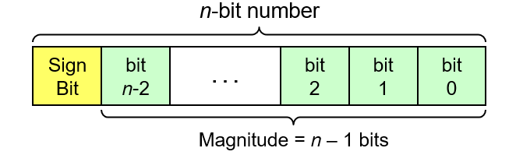
Signed Number Representation
To represent signed numbers, the most significant bit is used to indicate the sign of the number: 0 (+), 1 (-).
There are three representations for signed numbers:
  Sign-Magnitude Representation
  1’s complement Representation
  2’s complement Representation
Sign-Magnitude Representation
  The most significant bit is the sign bit and the remaining bits represent the value in binary format

Slide 44
Sign-Magnitude Representation
  Leftmost bit is the sign bit: 0 is positive and 1 is negative
  e.g. +9 is represented as 01001, -9 is represented as 11001
  Range: Using n bits, the range of numbers that can be represented is from -(2^{n-1} - 1) to +2^{n-1} - 1
  For example, if n = 8 bits then range is -127 to +127
Sign-magnitude
8-bit representation of +45
Sign-magnitude
8-bit representation of -45
0
0
1
0
1
1
0
1
1
0
1
0
1
1
0
1

Slide 45
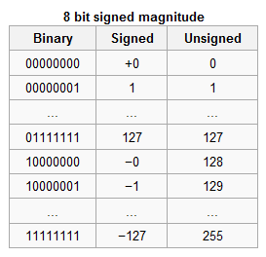
Sign-Magnitude Representation
Advantages: Simple (number representation is straight forward).
Disadvantages:
  Has the problem of double representing the 0 (-0 and +0),
  Harder to implement addition/subtraction
    The sign and magnitude parts have to be processed independently.
    Sign bits of the operands have to be examined to determine the actual operation (addition or subtraction).
    Separate circuits are required to perform the addition and subtraction operations.

Slide 46
Signed-Magnitude Addition/Subtraction
Eight cases for Sign-Magnitude Addition / Subtraction
Operation | ADD Magnitudes | Subtract Magnitudes
 |  | A >= B | A < B
(+A) + (+B) | +(A+B)
(+A) + (-B) |  | +(A–B) | -(B–A)
(-A) + (+B) |  | -(A–B) | +(B–A)
(-A) + (-B) | -(A+B)
(+A) – (+B) |  | +(A–B) | -(B–A)
(+A) – (-B) | +(A+B)
(-A) – (+B) | -(A+B)
(-A) – (-B) |  | -(A–B) | +(B–A)

Slide 47
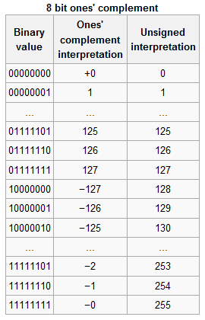
One’s Complement Representation
Positive numbers are represented using normal binary equivalent .
Negative numbers are represented by the 1's complement (complement) of the normal binary representation of the magnitude.
Example:
  +9 is represented as 01001
  -9 is represented as 10110 (obtained by complementing the binary representation of 9).

Slide 48
Why is it called “one’s complement?”
Complementing a single bit is equivalent to subtracting it from 1.
0’ = 1, and 1 - 0 = 1 1’ = 0, and 1 - 1 = 0
Similarly, complementing each bit of an n-bit number is equivalent to subtracting that number from 2^{n}-1.
For example, we can negate the 5-bit number 01101.
  Here n=5, and 2^{n}-1 = 31₁₀ = 11111₂.
  Subtracting 01101 from 11111 yields 10010:
1 1 1 1 1
- 0 1 1 0 1
1 0 0 1 0

Slide 49
One’s Complement Representation
Range: Using n bits, the range of numbers that can be represented is from -(2^{n-1} - 1) to +2^{n-1} - 1 .
Advantages:
  Still relatively simple to represent the numbers,
  Simpler Add/Subtract circuit design (subtracting a number from another involves complementing the subtracted and then adding it to the other number). A-B=A+B’
Disadvantages:
  Has the problem of double representing the 0 (-0 and +0),
  It may require two addition operations as if there is a carry out it has to be added to get the correct result
Overflow: occurs when the result is out of range

Slide 50
One’s Complement Addition
Example 1: Adding 0111 (+7) + 0111 (+7)
  The result is 1110 and the carry out is 0, hence an overflow has occurred (adding two positive numbers resulted in a negative number, -1 in this case).
Example 2: Subtracting 0001 (+1) – 0111 (+7)
  0001 (+1) + 1000 (-7) = 1001 (-6)
  The result is 1001 with no end carry. The result represents -6 (the correct result) and no further addition is required.
Example 3: Subtracting 0111 (+7) - 0001 (+1)
  0111 (+7) + 1110 (-1) = 0101 (+5) with carry out=1
  The result is 0101 with an end carry of 1. This carry has to be added to the previous result and yields 0110 (+6), the correct answer).

Slide 51
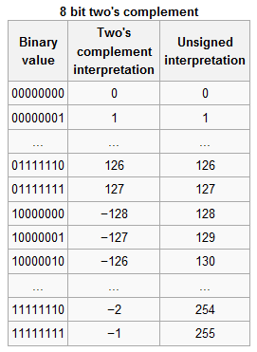
Two’s Complement Representation
Positive numbers are represented using normal binary equivalent.
Negative numbers are represented by the 2's complement of the normal binary representation of the magnitude.
The 2's complement of a binary number equals its 1's complement + 1.
Another easy way to obtain the 2's complement of a binary number:
  start at the LSB, leaving all the 0s unchanged, look for the first occurrence of a 1. Leave this 1 unchanged and complement all the bits after it.

Slide 52
Computing the 2's Complement
starting value | 00100100₂ = +36
step1: Invert the bits (1's complement) | 11011011₂
step 2: Add 1 to the value from step 1 | + 1₂
sum = 2's complement representation | 11011100₂ = -36
2’s complement of 11011100₂ (-36) = 00100011₂ + 1 = 00100100₂ = +36
The 2’s complement of A is the negative of A
Another way to obtain the 2's complement:
Start at the least significant 1
Leave all the 0s to its right unchanged
Complement all the bits to its left
Binary Value
= 00100 1 00
2's Complement
= 11011 1 00
least
significant 1

Slide 53
Two’s Complement Representation
Example:
  +9 is represented as 01001
  To represent -9, first obtain the binary equivalent of +9: 01001. Now leave the LSB 1 unchanged and complement all the remaining bits to get 10111, which represents -9 in 2's complement.
Range:
  Using n bits, the range of numbers that can be represented is from -2^{n-1} to +2^{n-1} - 1.
  The -2^{n-1} is represented by the 1000..000 code, which has no 2's complement, hence the unsymmetrical range. E.g. if 8 bits are used, the range of numbers that can be represented is from -128 to +127.

Slide 54
Two’s Complement Representation
To find the value of a number represented in two’s complement, check the sign bit
  If the sign bit is 0, the number is positive and find its value using weighted method
  If the sign is 1, the number is negative and you can find value in two ways
    Take the 2’s complement, you will get the corresponding positive value, then add a minus sign to it
    Use the weighted method using a negative weight for the sign bit
Example: Find the value of the 4-bit number 1011
  Take the 2’s complement-> 0101 = +5; thus 1011 represents -5
  Using the weighted method-> -8+2+1=-5

Slide 55
Two’s Complement Representation
Advantages:
  No double representation of 0 (the 2's complement of 0 is still 0),
  Simplest Add/Subtract circuit design (subtracting a number from another involves 2's complementing the subtracted and then adding it to the other number),
  Add/Subtract operations is done in one-step
  The end result is already represented in 2's complement (only if there is no overflow).
That is why this is the most preferred method for signed-number representations in computers.

Slide 56
Two’s Complement Representation
Disadvantages:
  The unsymmetrical range, which is not a serious problem,
  It is slightly more complex to obtain the 2's complement (it involves complementing and adding 1). However this can be accomplished very easily during the Add/Subtract operations (by making the first carry in 1 and complementing the subtrahend).
Overflow: occurs if the result is out of range
  Adding two positive numbers and getting a negative number
  Adding two negative numbers and getting a positive number
  If the last two carries are not equal

Slide 57
Two’s Complement Addition
Example 1: Adding 0111 (+7) + 0111 (+7)
  The result is 1110 (-2), hence an overflow has occurred (adding two positive numbers resulted in a negative number).
Example 2: Subtracting 0001 (+1) - 0111 (+7)
  0001 (+1) - 0111 (+7) = 0001 (+1) + 1001 (-7) = 1010 (-6)
  The result represents -6 in 2's complement (the correct result) and no further operation is required.
Example 3: Subtracting 0111 (+7) – 0001 (+1)
  0111 (+7) – 0001 (+1) = 0111 (+7) + 1111 (-1) = 0110
  The result is 0110 (+6, the correct result). Since the last two carries being 1 no overflow has occurred and no further operations are required.

Slide 58
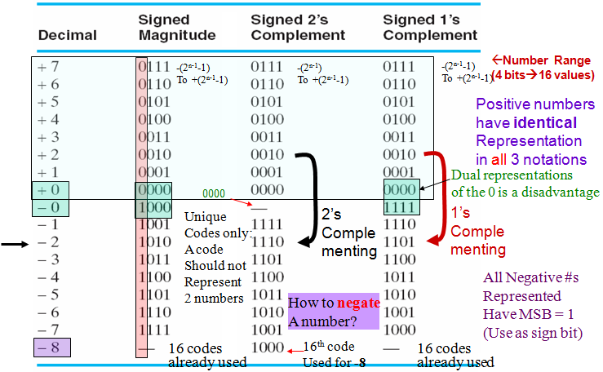
Signed Number Representation (n=4)

Slide 59
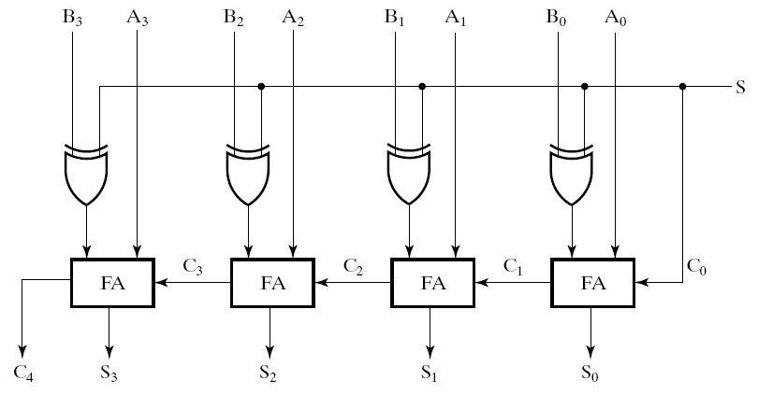
Adder/Subtractor for Signed 2’s Complement
One circuit computes A + B or A – B:
Subtraction is done by the addition of the 2's Complement
For S = 0 (add):
B is passed through
to the adder unchanged
For S = 1 (subtract):
→ 2’s complement
of B is obtained using
XORs to form
the 1’s comp + 1
applied to C₀ of
1st stage→ 2’s comp. added to A
Subtract/
Add
No correction
Needed

Slide 60
Carry and Overflow
Carry is important when …
  Adding or subtracting unsigned integers
  Indicates that the unsigned sum is out of range
Overflow is important when …
  Adding or subtracting signed integers
  Indicates that the signed sum is out of range
Overflow occurs when
  Adding two positive numbers and the sum is negative
  Adding two negative numbers and the sum is positive
Simplest way to detect Overflow: V = C_{n–1} ⊕ C_{n}
  C_{n-1} and C_{n} are the carry-in and carry-out of most-significant bit

Slide 61
Carry and Overflow Examples
We can have carry without overflow and vice-versa
Four cases are possible (Examples are 8-bit numbers)
1
1
1
1
1
1
0
0
0
0
1
1
1
1
15
0
0
0
0
1
1
1
1
15
+
+
0
0
0
0
1
0
0
0
8
1
1
1
1
1
0
0
0
248 (-8)
0
0
0
1
0
1
1
1
23
0
0
0
0
0
1
1
1
7
Carry = 0 Overflow = 0
Carry = 1 Overflow = 0
1
1
1
1
0
1
0
0
1
1
1
1
79
1
1
0
1
1
0
1
0
218 (-38)
+
+
0
1
0
0
0
0
0
0
64
1
0
0
1
1
1
0
1
157 (-99)
1
0
0
0
1
1
1
1
143
(-113)
0
1
1
1
0
1
1
1
119
Carry = 0 Overflow = 1
Carry = 1 Overflow = 1

Slide 62
Range, Carry, Borrow, and Overflow
Unsigned Integers: n-bit representation
Signed Integers: n-bit 2's complement representation
Numbers < min
Numbers > max
Borrow = 1
Subtraction
Finite Set of Unsigned Integers
Carry = 1
Addition
min = 0
max = 2^{n}–1
Numbers < min
Numbers > max
Negative
Overflow
Finite Set of Signed Integers
Positive
Overflow
min = -2^{n-1}
0
max = 2^{n-1}–1

Slide 63
Design by Contraction
Contraction is a technique for simplifying the logic
Applying 0s and 1s to some inputs and propagating values and simplifying equations
Converting a function block to a more simplified function
Examples of Design by Contraction
  Incrementing a number by a fixed constant
  Comparing a number to a fixed constant

Slide 64
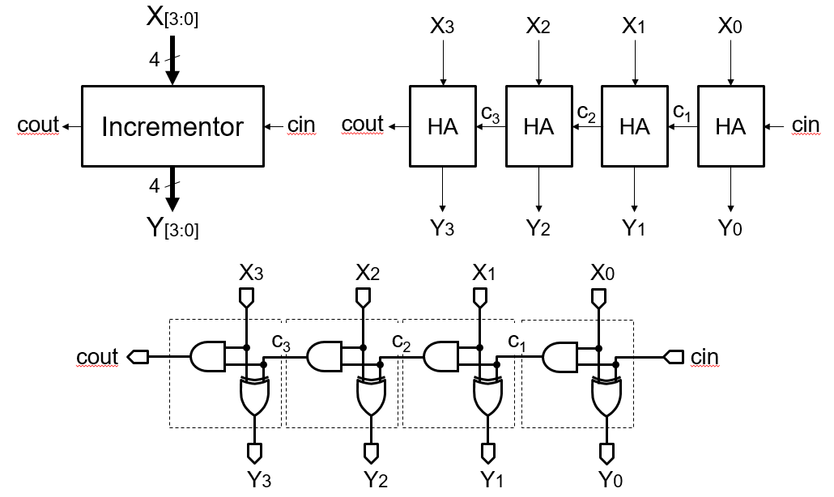
Designing an Incrementer
1
1

Slide 65
Designing an Incrementer
An incrementer is a special case of an adder
Sum = A + 1 (B = 0, C₀ = 1)
An n-bit Adder can be simplified into an n-bit Incrementer
$$a3$$
0
$$a2$$
0
$$a1$$
0
$$a0$$
0
0
$$a3$$
0
$$a2$$
0
$$a1$$
0
$$a0$$
$$c3$$
$$c2$$
$$c1$$
$$a0$$
1
$$c4$$
$$a_{0}^{′}$$
$$s3$$
$$s2$$
$$s1$$
$$s0$$

Slide 66
Simplifying the Incrementer Circuit
Many gates were eliminated
No longer needed when an input is a constant
Last cell can be replicated to implemented an n-bit incrementer
$$a3$$
$$a2$$
$$a1$$
$$a0$$
a [3:0]
4
$$c3$$
$$c2$$
$$c1$$
Incrementer
$$c4$$
c₄
4
s [3:0]
$$s3$$
$$s2$$
$$s1$$
$$s0$$

Slide 67
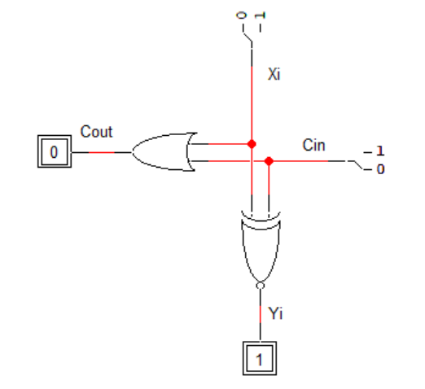
Iterative Design: Y=X-1
To design an iterative design to implement a decrementer, Y=X-1, we can convert this into Y=X+2’s complement of 1, i.e. Y=X+11…111
Thus, we need to add 1 to every cell
The cell interface is as follows:
Truth Table:
Xi
Cout
Y=X-1
Cin
Yi
Cin Xi | Cout Yi
0 0 | 0 1
0 1 | 0
1 0 | 1 0
1 1 | 1 1

Slide 68
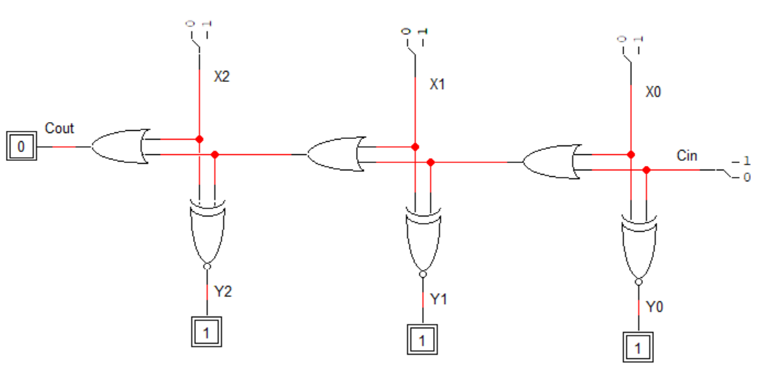

Iterative Design: Y=X-1
0-1=-1=111
7-1=6=110
-1-1=-2=110

Slide 69


Design by Contraction: Y=X-1

Slide 70

Design by Contraction: Y=X-1
Note that X1 + X1’ X0 can be simplified to X1 + X0. Thus, the AND gate can be eliminated in stage 2. Similarly, it can be eliminated in stage 3.
Also note that X1’ ⊕ X0 = (X1 ⊕ X0)’
Doing these optimizations we reach to the same solution obtained using iterative design.

Slide 71
Zero versus Sign Extension
Unsigned Integers are Zero-Extended
Signed Integers are Sign-Extended
Given that X is a 4-bit number
  If X is a 4-bit unsigned integer ➔ Range = 0 to 15
  If X is a 4-bit signed integer ➔ Range = -8 to +7
  If unsigned X = 4’b1101 (binary), then X = 13 (decimal)
  If signed X = 4’b1101 (binary), then X = -3 (decimal)
  If X is zero-extended from 4 to 6 bits then X = 6’b001101 = 13
  If X is sign-extended from 4 to 6 bits then X = 6’b111101 = -3

Slide 72
Unsigned Addition S = X + Y
Design a circuit that computes: S = X + Y (unsigned X and Y)
X[3:0] and Y[3:0] are 4-bit unsigned integers ➔ Range = 0 to 15
Solution:
Maximum S = 15 + 15 = 30 ➔ unsigned S must be 5 bits
X₃
Y₃
X₂
Y₂
X₁
Y₁
X₀
Y₀
Most-significant sum bit S₄ is the carry bit c₄
c₄
FA
c₃
FA
c₂
FA
c₁
FA
c₀
0
S₄
S₃
S₂
S₁
S₀

Slide 73
Signed Addition S = X + Y
Design a circuit that computes: S = X + Y (signed X and Y)
X[3:0] and Y[3:0] are 4-bit signed integers ➔ Range = -8 to +7
Solution:
Minimum S = (-8) + (-8) = -16, Maximum S = (+7) + (+7) = + 14
Therefore, signed range of S = -16 to +14 ➔ S must be 5 bits
X and Y are sign-extended
X₃ and Y₃ are replicated to produce S₄
X₃
Y₃
X₂
Y₂
X₁
Y₁
X₀
Y₀
FA
c₄
FA
c₃
FA
c₂
FA
c₁
FA
c₀
0
S₄
S₃
S₂
S₁
S₀

Slide 74
S = 2*X + Y (Unsigned X and Y)
Design a circuit that computes S = 2*X + Y (unsigned X and Y)
X[3:0] and Y[3:0] are 4-bit unsigned integers ➔ range = 0 to 15
Solution:
2*X + Y = X << 1 + Y (Shift-Left X by 1 bit)
Maximum value of S = 2*15 + 15 = 45 ➔ S is 6 bits = S[5:0]
X₃
0
X₂
Y₃
X₁
Y₂
X₀
Y₁
Y₀
c₅
FA
c₄
FA
c₃
FA
c₂
FA
c₁
0
S₅
S₄
S₃
S₂
S₁
S₀

Slide 75
S = 2*X + Y (Signed X and Y)
Design a circuit that computes S = 2*X + Y using Full Adders
X[3:0] and Y[3:0] are 4-bit signed integers ➔ range = -8 to +7
Solution:
Range of X and Y is -8 to +7 ➔ Minimum S = 2*(-8) + (-8) = -24
Maximum S = 2*(+7) + 7 = +21 ➔ S is 6 bits = S[5:0]
X₃
X₂
Y₃
X₁
Y₂
X₀
Y₁
Y₀
X and Y are
sign-extended.
Sign bits X₃ and Y₃ are replicated.
FA
c₅
FA
c₄
FA
c₃
FA
c₂
FA
c₁
0
S₅
S₄
S₃
S₂
S₁
S₀

Slide 76
Unsigned Less Than: LT = X < Y
Design a circuit that computes unsigned LT (unsigned X and Y)
Solution:
If (X < Y) then (X – Y) < 0, If (X == Y) then (X – Y == 0)
Do unsigned subtraction, LT = S₄ = sign-bit of the result
X₃
Y₃
X₂
Y₂
X₁
Y₁
X₀
Y₀
c₄
c₃
c₂
c₁
c₀
Equality
(X – Y == 0)
FA
FA
FA
FA
1
EQ
GE = c₄
LT = S₄
S₃
S₂
S₁
S₀

Slide 77
Signed Less Than: LT = X < Y
Design a circuit that computes signed LT (Signed X and Y)
Solution:
If (X < Y) then (X – Y) < 0, If (X == Y) then (X – Y == 0)
Do signed subtraction, LT = S₄ = sign-bit of the result
Sign Extension
X₃
Y₃
X₂
Y₂
X₁
Y₁
X₀
Y₀
Equality
(X – Y == 0)
FA
c₄
FA
c₃
FA
c₂
FA
c₁
FA
c₀
1
EQ
LT = S₄
S₃
S₂
S₁
S₀

Slide 78


BCD Adder
If two BCD digits are added then their sum result will not always be in BCD.
Consider the two given examples:
Whenever the sum result is > 9, it will not be in BCD and will require correction to get a valid BCD result.
Correction is done through the addition of 6 to the result to skip the six invalid values.

Slide 79



BCD Adder
Consider the given examples of non-BCD sum result and its correction:

Slide 80

BCD Adder
The maximum sum result of a BCD input adder can be 19. As maximum number in BCD is 9 and may be there will be a carry from previous stage also, so 9 + 9 + 1 = 19 .
The logic circuit that checks the necessary BCD correction can be derived by detecting the condition where the resulting binary sum is 01010 through 10011 (decimal 10 through 19).

Slide 81



BCD Adder
F is true when CO is true OR when (Z₃ Z₂ + Z₃ Z₁) is true.
Thus, the correction step (adding 0110) is performed if the following function equals 1:

Slide 82
Multiple Digit BCD Addition
Add: 2905 + 1897 in BCD
Showing carries and digit corrections
carry
+1
+1
+1
0010
0001
0100
0100
1001
1000
10010
0110
1000
0000
1001
1010
0110
0000
0101
0111
1100
0110
0010
+
digit correction
Final answer: 2905 + 1897 = 4802

Slide 83
Ripple-Carry BCD Adder
Inputs are BCD digits: 0 to 9
Sum are BCD digits: ones, tens, hundreds, thousands, etc.
Can be extended to any number of BCD digits
BCD adders are larger in size than binary adders
A [15:12]
B [15:12]
A [11:8]
B [11:8]
A [7:4]
B [7:4]
A [3:0]
B [3:0]
4
4
4
4
4
4
4
4
c₄
BCD
Adder
c₃
BCD
Adder
c₂
BCD
Adder
c₁
BCD
Adder
c₀
4
4
4
4
S [15:12]
S [11:8]
S [7:4]
S [3:0]
Thousands
Hundreds
Tens
Ones

Slide 84
Binary Multiplier
Multiplication of binary numbers is performed in the same way as with decimal numbers.
The multiplicand is multiplied by each bit of the multiplier, starting from the least significant bit.
The result of each such multiplication forms a partial product. Successive partial products are shifted one bit to the left.
The product is obtained by adding these shifted partial products.

Slide 85


Binary Multiplier
Example 1: Consider an example of multiplication of two numbers, say A and B (2 bits each), C = A x B.
The first partial product is formed by multiplying the B₁B₀ by A₀. The multiplication of two bits such as A₀ and B₀ produces a 1 if both bits are 1; otherwise it produces a 0 like an AND operation. So the partial products can be implemented with AND gates.
The second partial product is formed by multiplying the B₁B₀ by A₁ and is shifted one position to the left.

Slide 86


Binary Multiplier
Example 2: Consider the example of multiplying two numbers, say A (3-bit number) and B (4-bit number).
Since J = 3 and K = 4, 12 (J x K) AND gates and two 4-bit ((J - 1) K-bit) adders are needed to produce a product of seven (J + K) bits.

Slide 87
4-bit × 4-bit Binary Multiplier
Suppose we want to multiply two numbers A and B
  Example on 4-bit numbers: A = a₃ a₂ a₁ a₀ and B = b₃ b₂ b₁ b₀
Step 1: AND (multiply) each bit of A with each bit of B
  Requires n² AND gates and produces n² product bits
  Position of a_{i}b_{j} = (i+j). For example, Position of a₂b₃ = 2+3 = 5
A × B
a₃b₀
a₂b₀
a₁b₀
a₀b₀
a₃b₁
a₂b₁
a₁b₁
a₀b₁
a₃b₂
a₂b₂
a₁b₂
a₀b₂
a₃b₃
a₂b₃
a₁b₃
a₀b₃

Slide 88

Adding the Bits Vertically
ADD the product bits vertically using Carry-Save adders
  Full Adder adds three vertical bits
  Half Adder adds two vertical bits
  Each adder produces a partial sum and a carry
Use Carry-propagate adder for final addition

Slide 89
Carry Save Adder
A n-bit carry-save adder produces two n-bit outputs
  n-bit partial sum bits and n-bit carry bits
All the n bits of a carry-save adder work in parallel
  The carry does not propagate as in a carry-propagate adder
  This is why a carry-save is faster than a carry-propagate adder
Useful when adding multiple numbers (as in a multiplier)
a₃₁
b₃₁
a₁
b₁
a₀
b₀
a₃₁
b₃₁
c₃₁
a₁
b₁
c₁
a₀
b₀
c₀
+
. . .
+
+
+
. . .
+
+
c_{out}
c_{in}
s₃₁
s₁
s₀
c'₃₁
s'₃₁
c'₁
s'₁
c'₀
s'₀
Carry-Propagate Adder
Carry-Save Adder

Slide 90
Carry-Save Adders in a Multiplier
Step 1: Use carry save adders to add the partial products
  Reduce the partial products to just two numbers
Step 2: Use carry-propagate adder to add last two numbers
a₃b₁ a₂b₂
a₃b₀ a₂b₁
a₂b₀ a₁b₁
a₁b₀ a₀b₁
a₀b₀
a₁b₃
a₁b₂
a₀b₂
FA
FA
FA
HA
Carry Save
a₃b₂
a₂b₃
a₀b₃
FA
HA
FA
HA
Carry Save Adder
a₃b₃
FA
FA
FA
HA
Carry Propagate Adder
P₇
P₆
P₅
P₄
P₃
P₂
P₁
P₀

