Slide 1
Standard & Canonical Forms
COE 202
Digital Logic Design
Dr. Aiman El-Maleh
College of Computer Sciences and Engineering
King Fahd University of Petroleum and Minerals

Slide 2
Outline
Minterms
Maxterms
Expressing Functions as a Sum of Minterms and Product of Maxterms
Canonical Forms
Standard Forms
Two-Level Implementations of Standard Forms
Propagation Delay

Slide 3
MinTerms
Consider a system of 3 input signals (variables) x, y, & z.
A term which ANDs all input variables, either in the true or complement form, is called a minterm.
Thus, the considered 3-input system has 8 minterms, namely:
Each minterm equals 1 at exactly one particular input combination and is equal to 0 at all other combinations
Thus, for example, is always equal to 0 except for the input combination xyz = 000, where it is equal to 1.
Accordingly, the minterm is referred to as m₀.
In general, minterms are designated m_{i}, where i corresponds the input combination at which this minterm is equal to 1.

Slide 4
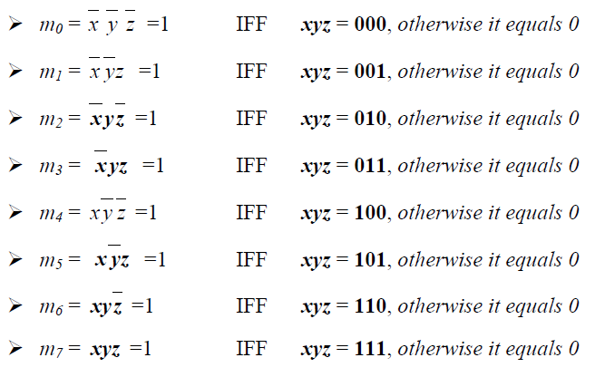
MinTerms
For the 3-input system under consideration, the number of possible input combinations is 2³, or 8. This means that the system has a total of 8 minterms as follows:

Slide 5
MinTerms
In general, for n-input variables, the number of minterms = the total number of possible input combinations = 2^{n}.
A minterm = 0 at all input combinations except one where the minterm = 1.
Example: What is the number of minterms for a function with 5 input variables?
Number of minterms = 2⁵ =32 minterms.

Slide 6
MaxTerms
Consider a circuit of 3 input signals (variables) x, y, & z.
A term which ORs all input variables, either in the true or complement form, is called a Maxterm.
With 3-input variables, the system under consideration has a total of 8 Maxterms, namely:
Each Maxterm equals 0 at exactly one of the 8 possible input combinations and is equal to 1 at all other combinations.
For example, (x + y + z) equals 1 at all input combinations except for the combination xyz = 000, where it is equal to 0.
Accordingly, the Maxterm (x + y + z) is referred to as M₀.

Slide 7
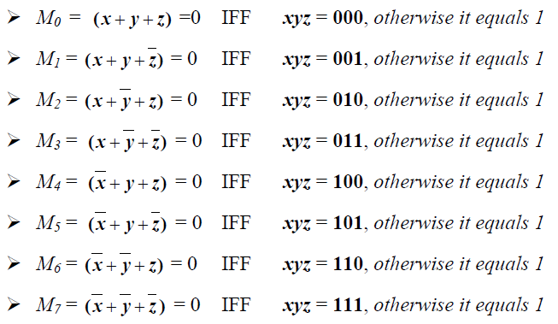
MaxTerms
In general, Maxterms are designated M_{i}, where i corresponds to the input combination at which this Maxterm is equal to 0.
For the 3-input system, the number of possible input combinations is 2³, or 8. This means that the system has a total of 8 Maxterms as follows:

Slide 8
MaxTerms
For n-input variables, the number of Maxterms = the total number of possible input combinations = 2^{n}.
A Maxterm = 1 at all input combinations except one where the Maxterm = 0.
Using De-Morgan’s theorem, or truth tables, it can be easily shown that:

Slide 9
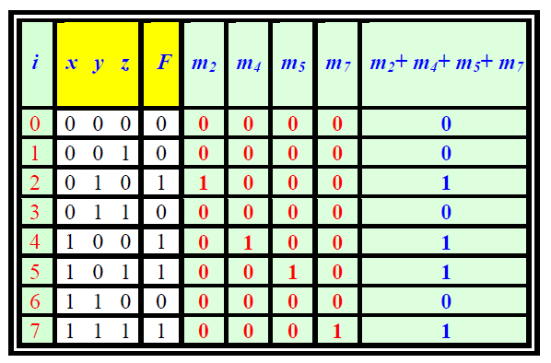
Expressing Functions as a Sum of Minterms
Consider the function F defined by the shown truth table:
Now let’s rewrite the table, with few added columns.
A column i indicating the input combination
Four columns of minterms m₂, m₄, m₅ and m₇
One last column OR-ing the above minterms (m₂+m₄+m₅+m₇)
From this table, we can clearly see that F = m₂+m₄+m₅+m₇

Slide 10
Expressing Functions as a Sum of Minterms
In general, Any function can be expressed by OR-ing all minterms (m_{i}) corresponding to input combinations (i) at which the function has a value of 1.
The resulting expression is commonly referred to as the SUM of minterms and is typically expressed as F = Σ(2, 4, 5, 7), where Σ indicates OR-ing of the indicated minterms. Thus, F = Σ(2, 4, 5, 7) = (m2 + m4 + m5 + m7)

Slide 11
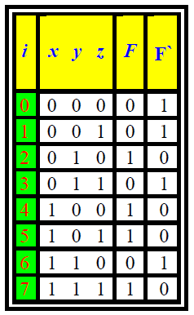
Expressing Functions as a Sum of Minterms
Consider the example with F and F`.
The truth table of F` shows that F` equals 1 at i = 0, 1, 3 and 6, then,
F` = m₀ + m₁ + m₃ + m₆,
F` = Σ(0, 1, 3, 6),
F = Σ(2, 4, 5, 7)
The sum of minterms expression of F` contains all minterms that do not appear in the sum of minterms expression of F.

Slide 12
Expressing Functions as a Product of Sums
Using De-Morgan theorem on equation:
This form is designated as the Product of Maxterms and is expressed using the Π symbol, which is used to designate product in regular algebra, but is used to designate AND-ing in Boolean algebra.
F` = Π (2, 4, 5, 7) = M₂. M₄. M₅. M₇
F` = Σ(0, 1, 3, 6) = Π (2, 4, 5, 7)

Slide 13
Expressing Functions as Sum of Minterms or Product of Maxterms
Any function can be expressed both as a sum of minterms (Σ mi) and as a product of maxterms (Π Mj).
The product of maxterms expression (Π Mj) of F contains all maxterms Mj (∀ j ≠ i) that do not appear in the sum of minterms expression of F.
The sum of minterms expression of F` contains all minterms that do not appear in the sum of minterms expression of F.
This is true for all complementary functions. Thus, each of the 2^{n} minterms will appear either in the sum of minterms expression of F or the sum of minterms expression of F` but not both.

Slide 14
Expressing Functions as Sum of Minterms or Product of Maxterms
The product of maxterms expression of F` contains all maxterms that do not appear in the product of maxterms expression of F.
This is true for all complementary functions. Thus, each of the 2^{n} maxterms will appear either in the product of maxterms expression of F or the product of maxterms expression of F` but not both.

Slide 15
Expressing Functions as Sum of Minterms or Product of Maxterms
Example: Given that F (a, b, c, d) = Σ(0, 1, 2, 4, 5, 7), derive the product of maxterms expression of F and the two standard form expressions of F`.
Since the system has 4 input variables (a, b, c & d), the number of minterms and maxterms = 2⁴= 16
F (a, b, c, d) = Σ(0, 1, 2, 4, 5, 7)
F = Π (3, 6, 8, 9, 10, 11, 12, 13, 14, 15)
F` = Σ (3, 6, 8, 9, 10, 11, 12, 13, 14, 15).
F` = Π (0, 1, 2, 4, 5, 7)

Slide 16
Finding the Sum of Minterms from a Given Expression
Let F(A,B,C)= A B + A’ C, express F as a sum of minterms
F(A,B,C)= A B (C+C’) + A’ C (B+B’)
= ABC + ABC’ + A’BC + A’B’C
= Σ(1, 3, 6, 7)
Short Cut Method:
A B = 1 1 - This gives us the input combinations 110 and 111 which correspond to m6 and m7
A’ C = 0 – 1 This gives us the input combinations 001and 011 which correspond to m1 and m3

Slide 17
Operations on Functions
The AND operation on two functions corresponds to the intersection of the two sets of minterms of the functions
The OR operation on two functions corresponds to the union of the two sets of minterms of the functions
Example
Let F(A,B,C)=Σm(1, 3, 6, 7) and G(A,B,C)=Σm(0,1, 2, 4,6, 7)
F . G = Σm(1, 6, 7)
F + G = Σm(0,1, 2, 3, 4,6, 7)
F’ . G = ?
F’ = Σm(0, 2, 4, 5)
F’ . G = Σm(0, 2, 4)

Slide 18
Canonical Forms
The sum of minterms and the product of maxterms forms of Boolean expressions are known as canonical forms.
Canonical form means that all equivalent functions will have a unique and equal representation.
Two functions are equal if and only if they have the same sum of minterms and the same product of maxterms.
Example:
Are the functions F1 = a' b' + a c + b c ' and F2 = a' c' + a b + b' c Equal?
F1 = a' b' + a c + b c ' = Σm(0, 1, 2 , 5, 6, 7)
F2 = a' c' + a b + b' c = Σm(0, 1, 2 , 5, 6, 7)
They are equal as they have the same set of minterms.

Slide 19
Standard Forms
A product term is a term with ANDed literals. Thus, AB, A’B, A’CD are all product terms.
A minterm is a special case of a product term where all input variables appear in the product term either in the true or complement form.
A sum term is a term with ORed literals. Thus, (A+B), (A’+B), (A’+C+D) are all sum terms.
A maxterm is a special case of a sum term where all input variables, either in the true or complement form, are ORed together.

Slide 20
Standard Forms
Boolean functions can generally be expressed in the form of a Sum of Products (SOP) or in the form of a Product of Sums (POS).
The sum of minterms form is a special case of the SOP form where all product terms are minterms.
The product of maxterms form is a special case of the POS form where all sum terms are maxterms.
The SOP and POS forms are Standard forms for representing Boolean functions.

Slide 21
Two-Level Implementations of Standard Forms
Sum of Products Expressions (SOP):
Any SOP expression can be implemented in 2-levels of gates.
The first level consists of a number of AND gates which equals the number of product terms in the expression.
Each AND gate implements one of the product terms in the expression.
The second level consists of a SINGLE OR gate whose number of inputs equals the number of product terms in the expression.

Slide 22
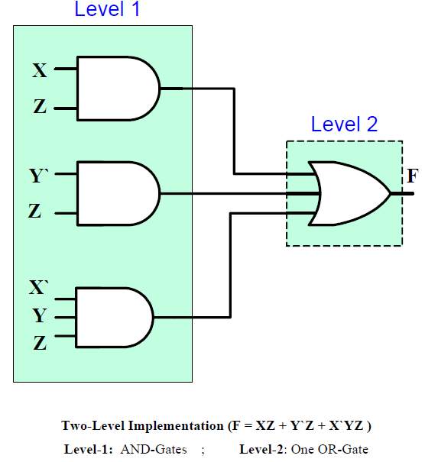
Two-Level Implementations of Standard Forms
Example: Implement the following SOP function
F = XZ + Y`Z + X`YZ

Slide 23
Two-Level Implementations of Standard Forms
Product of Sums Expression (POS):
Any POS expression can be implemented in 2-levels of gates.
The first level consists of a number of OR gates which equals the number of sum terms in the expression.
Each gate implements one of the sum terms in the expression.
The second level consists of a SINGLE AND gate whose number of inputs equals the number of sum terms.

Slide 24
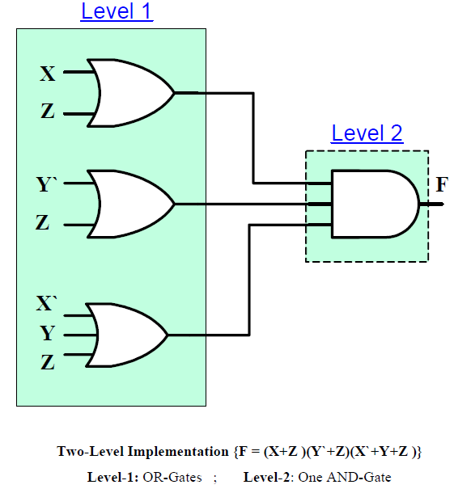
Two-Level Implementations of Standard Forms
Example: Implement the following POS function
F = (X+Z )(Y`+Z)(X`+Y+Z )

Slide 25
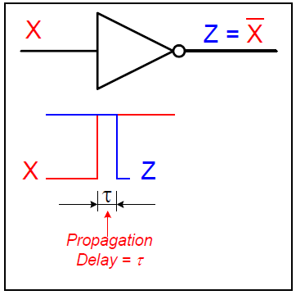
Propagation Delay
Consider the shown inverter with input X and output Z.
A change in the input (X) from 0 to 1 causes the inverter output (Z) to change from 1 to 0.
The change in the output (Z), however is not instantaneous. Rather, it occurs slightly after the input change.
This delay between an input signal change and the corresponding output signal change is what is known as the propagation delay.

Slide 26
Propagation Delay
A signal change on the input of some IC takes a finite amount of time to cause a corresponding change on the output.
This finite delay time is known as Propagation Delay.
Faster circuits are characterized by smaller propagation delays.
Higher performance systems require higher speeds (smaller propagation delays).

Slide 27
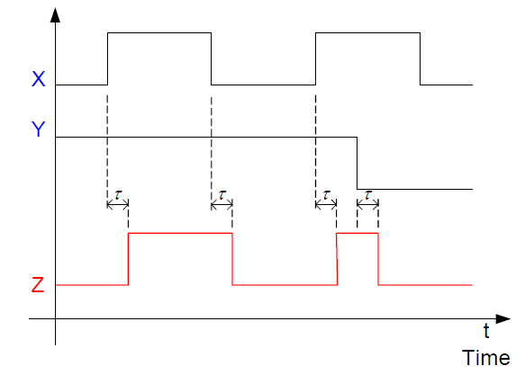
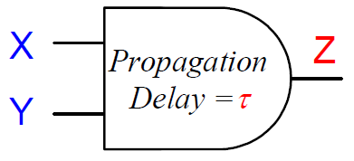
Timing Diagrams
A timing diagram shows the logic values of signals in a circuit versus time.
A signal shape versus time is typically referred to as Waveform.
Example:

Slide 28
Computing Longest Delay
Each gate has a given propagation delay.
We start at the inputs and compute the delay at the output of each gate as follows:
The delay at the output of a gate = gate propagation delay + maximum delay at its inputs
Maximum propagation delay from any input to any output is called the Critical Path.
The critical path determines the minimum clock period (T) and the maximum clock frequency (f).
Clock frequency (f) = 1 / T

Slide 29
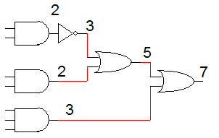
Computing Longest Delay
Example: Assume that delay of each gate is related to number of its inputs i.e. delay of 1 input gate is 1 ns, delay of 2-input gate is 2 ns. Compute longest propagation delay and maximum frequency.
Longest propagation delay = 7 ns
Maximum frequency = 1 / 7ns= 143 MHZ.

