Slide 1
Data Representation
COE 202
Digital Logic Design
Dr. Aiman El-Maleh
College of Computer Sciences and Engineering
King Fahd University of Petroleum and Minerals

Slide 2
Outline
Introduction
Numbering Systems
Binary & Hexadecimal Numbers
Base Conversions
Binary Addition, Subtraction, Multiplication
Hexadecimal Addition & Subtraction
Binary Codes for Decimal Digits
Character Storage & Parity

Slide 3
Introduction
Computers only deal with binary data (0s and 1s), hence all data manipulated by computers must be represented in binary format.
Machine instructions manipulate many different forms of data:
  Numbers:
    Integers: 33, +128, -2827
    Real numbers: 1.33, +9.55609, -6.76E12, +4.33E-03
  Alphanumeric characters (letters, numbers, signs, control characters): examples: A, a, c, 1 ,3, ", +, Ctrl, Shift, etc.
  Images (still or moving): Usually represented by numbers representing the Red, Green and Blue (RGB) colors of each pixel in an image,
  Sounds: Numbers representing sound amplitudes sampled at a certain rate (usually 20kHz).
So in general we have two major data types that need to be represented in computers; numbers and characters.

Slide 4
Binary Digit Representation
Using electric voltage
  Used in processors and digital circuits
  High voltage = 1, Low voltage = 0
Using electric charge
  Used in memory cells
  Charged memory cell = 1, discharged memory cell = 0
Using magnetic field
  Used in magnetic disks, magnetic polarity indicates 1 or 0
Using light
  Used in optical disks, encodes binary data (bits) in the form of pits (0, no light reflection when read) and lands (1, due to light reflection when read)
High = 1
Unused
Voltage Level
Low = 0

Slide 5
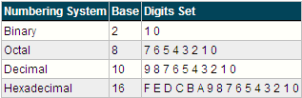
Numbering Systems
Numbering systems are characterized by their base number.
In general, a numbering system with a base r will have r different digits (including the 0) in its number set. These digits will range from 0 to r-1.
The most widely used numbering systems are listed in the table below:

Slide 6
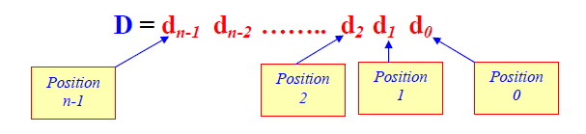
Weighted Number Systems
A number D consists of n digits with each digit having a particular position.
Every digit position is associated with a fixed weight.
If the weight associated with the ith position is w_{i}, then the value of D is given by:

Slide 7
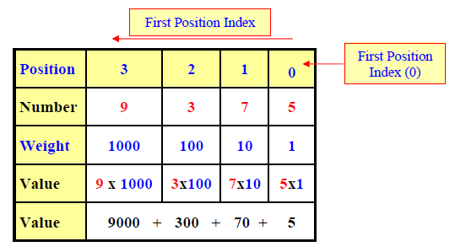
Example of Weighted Number Systems
The Decimal number system (النظام العشري) is a weighted system.
For integer decimal numbers, the weight of the rightmost digit (at position 0) is 1, the weight of position 1 digit is 10, that of position 2 digit is 100, position 3 is 1000, etc.
Thus, w₀ = 1, w₁ = 10, w₂=100, w₃ = 1000, etc.
Example:
  Show how the value of the decimal number 9375 is estimated.

Slide 8
The Radix (Base)
For digit position i, most weighted number systems use weights (w_{i}) that are powers of some constant value called the radix (r) or the base such that w_{i} = r^{i}.
A number system of radix r, typically has a set of r allowed digits ∈ {0,1, …,(r-1)}.
The leftmost digit has the highest weight → Most Significant Digit (MSD).
The rightmost digit has the lowest weight → Least Significant Digit (LSD).

Slide 9
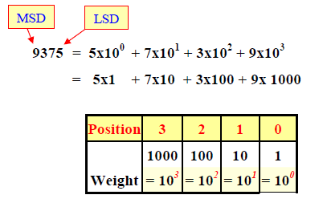
The Radix (Base)
Example: Decimal Number System
1. Radix (Base) = Ten
2. Since w_{i} = r^{i}, then
  w₀ = 10⁰ = 1,
  w₁ = 10¹ = 10,
  w₂= 10² = 100,
  w₃ = 10³ = 1000, etc.
3. Number of Allowed Digits is Ten:
  {0, 1, 2, 3, 4, 5, 6, 7, 8, 9}

Slide 10
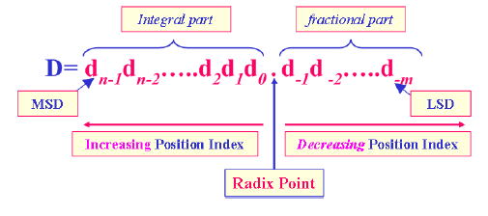
The Radix Point
A number D of n integral digits and m fractional digits is represented as shown:
Digits to the left of the radix point (integral digits) have positive position indices, while digits to the right of the radix point (fractional digits) have negative position indices.

Slide 11

The Radix Point
Position indices of digits to the left of the radix point (the integral part of D) start with a 0 and are incremented as we move left (d_{n-1}d_{n-2}…..d₂d₁d₀).
Position indices of digits to the right of the radix point (the fractional part of D) start with a -1 and are decremented as we move right(d₋₁d₋₂…..d_{-m}).
The weight associated with digit position i is given by w_{i} = r^{i}, where i is the position index ∀i= -m, -m+1, …, -2, -1, 0, 1, ……, n-1.
The Value of D is Computed as:

Slide 12
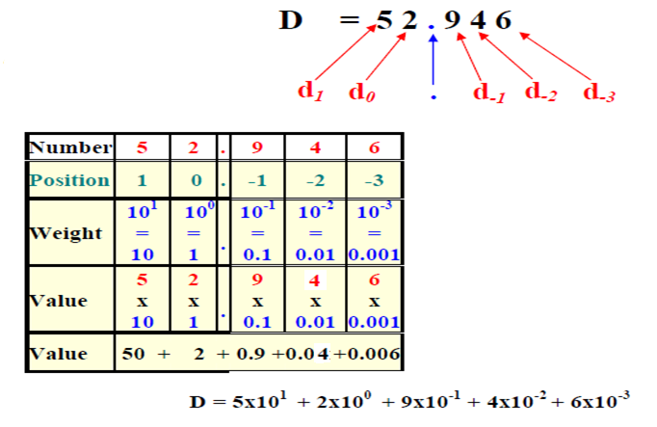
The Radix Point
Example: Show how the value of the decimal number 52.946 is estimated.

Slide 13
Notation
Let (D)_{r} denote a number D expressed in a number system of radix r.
In this notation, r will be expressed in decimal.
Examples:
(29)₁₀ Represents a decimal value of 29. The radix “10” here means ten.
(100)₁₆ is a Hexadecimal number since r = “16” here means sixteen. This number is equivalent to a decimal value of 16²=256.
(100)₂ is a Binary number (radix =2, i.e. two) which is equivalent to a decimal value of 2² = 4.

Slide 14
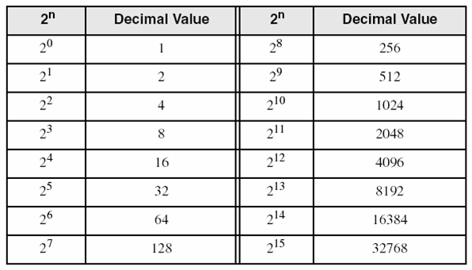
Binary System
r=2
Each digit (bit) is either 1 or 0
Each bit represents a power of 2
Every binary number is a sum of powers of 2
Some common powers of 2

Slide 15
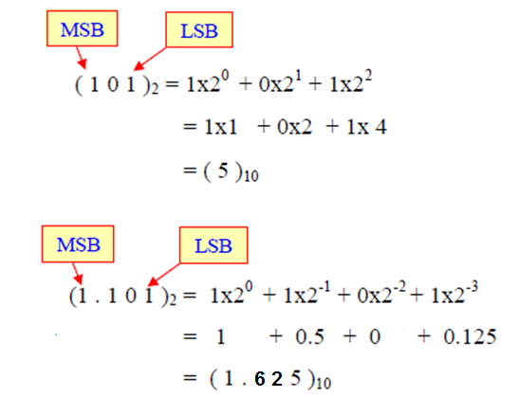
Binary System
Examples: Find the decimal value of the two Binary numbers (101)₂ and (1.101)₂

Slide 16
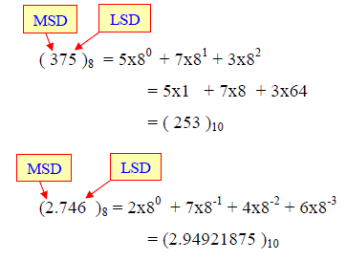
Octal System
r = 8 (Eight = 2³ )
Eight allowed digits {0, 1, 2, 3, 4, 5, 6, 7}
Examples: Find the decimal value of the two Octal numbers (375)₈ and (2.746)₈

Slide 17
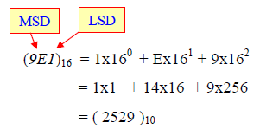
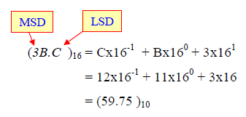
Hexadecimal System
r = 16 (Sixteen = 2⁴)
Sixteen allowed digits {0-to-9 and A, B, C, D, E, F}
Where: A = Ten, B = Eleven, C = Twelve, D = Thirteen, E = Fourteen & F = Fifteen.
Examples: Find the decimal value of the two Hexadecimal numbers (9E1)₁₆ and (3B.C )₁₆

Slide 18
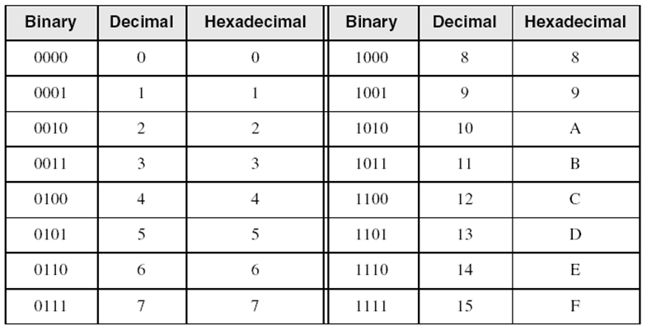
Hexadecimal Integers
Binary values are represented in hexadecimal.

Slide 19
Important Properties
The Largest value that can be expressed in n integral digits is (r^{n}-1).
  In binary: (111)₂ = 2³ – 1
  In octal: (777)₈ = 8³ – 1
  In decimal: (999)₁₀ = 10³ – 1
Total number of values (patterns) representable in n digits is r^{n}: 0 to r^{n}-1
The Largest value that can be expressed in m fractional digits is (1-r^{-m}).
The Largest value that can be expressed in n integral digits and m fractional digits is (r^{n} -r^{–m})

Slide 20
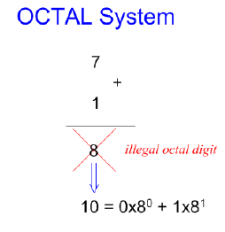
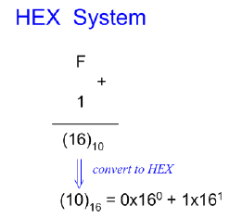
Important Properties
Q. What is the result of adding 1 to the largest digit of some number system??
  For the decimal number system, (1)₁₀ + (9)₁₀ = (10)₁₀
  For the binary number system, (1)₂ + (1)₂ = (10)₂ = (2)₁₀
  For the octal number system, (1)₈ + (7)₈ = (10)₈ = (8)₁₀
  For the hexadecimal system, (1)₁₆ + (F)₁₆ = (10)₁₆ = (16)₁₀

Slide 21
Important Properties
Q. What is the largest value representable in 3-integral digits?
A. The largest value results when all 3 positions are filled with the largest digit in the number system.
  For the decimal system, it is (999)₁₀
  For the octal system, it is (777)₈
  For the hex system, it is (FFF)₁₆
  For the binary system, it is (111)₂
Q. What is the result of adding 1 to the largest 3-digit number?
  For the decimal system, (1)₁₀ + (999)₁₀ = (1000)₁₀ = (10³)₁₀
  For the octal system, (1)₈+ (777)₈ = (1000)₈ = (8³)₁₀

Slide 22
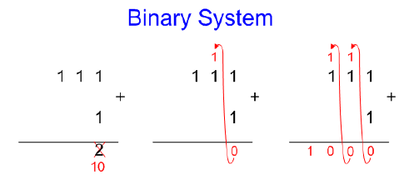
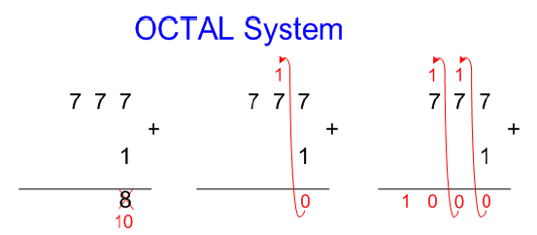
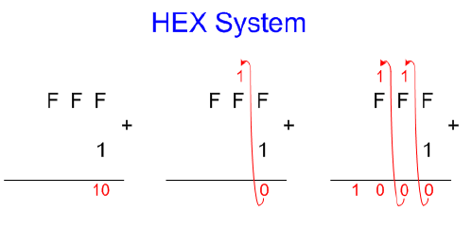
Important Properties
In general, for a number system of radix r, adding 1 to the largest n-digit number = r^{n}.
Accordingly, the value of largest n-digit number = r^{n} - 1.

Slide 23
Number Base Conversion
Given the representation of some number (X_{B}) in a number system of radix B, we need to obtain the representation of the same number in another number system of radix A, i.e. (X_{A}).
For a number that has both integral and fractional parts, conversion is done separately for both parts, and then the result is put together with a system point in between both parts.
Converting Whole (Integer) Numbers
  Assume that X_{B} has n digits (b_{n-1}………..b₂ b₁ b₀)_{B}, where b_{i} is a digit in radix B system, i.e. b_{i} ∈ {0, 1, ….., “B-1”}.
  Assume that X_{A} has m digits (a_{m-1}………..a₂ a₁ a₀)_{A}, where a_{i} is a digit in radix A system, i.e. a_{i} ∈ {0, 1, ….., “A-1”}.

Slide 24
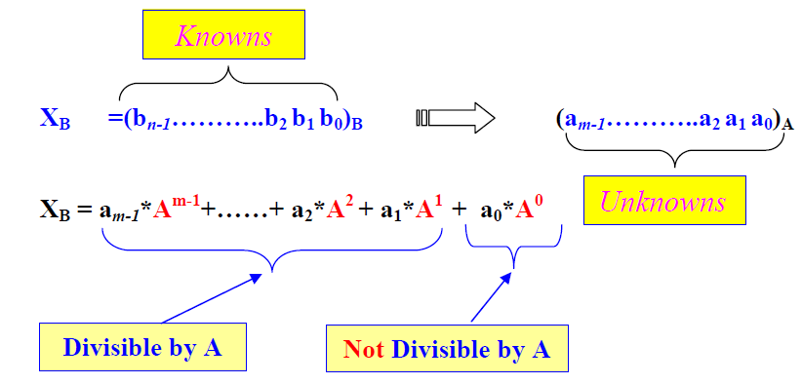
Converting Whole (Integer) Numbers
Dividing X_{B} by A, the remainder will be a₀.
In other words, we can write X_{B} = Q₀.A+a₀

Slide 25
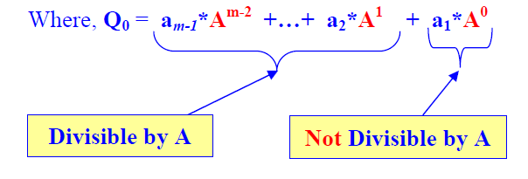
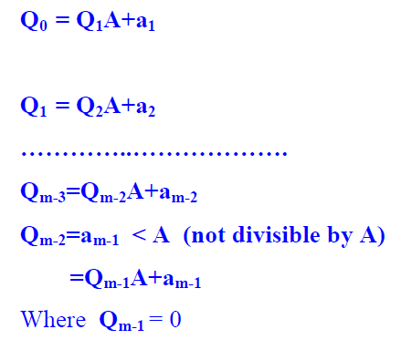
Converting Whole (Integer) Numbers

Slide 26
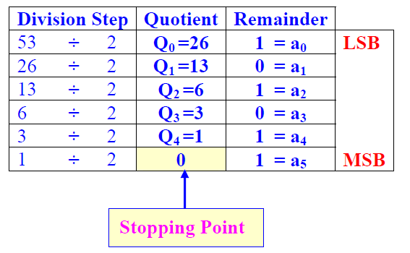

Converting Whole (Integer) Numbers
This division procedure can be used to convert an integer value from some radix number system to any other radix number system.
The first digit we get using the division process is a₀, then a₁, then a₂, till a_{m-1}
Example: Convert (53)₁₀ to (?)₂

Slide 27
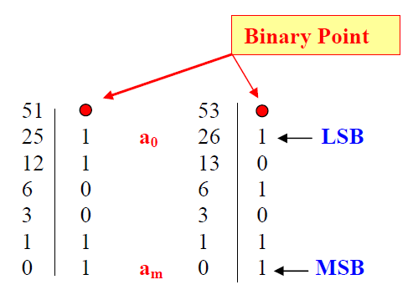

Converting Whole (Integer) Numbers
Since we always divide by the radix, and the quotient is re-divided again by the radix, the solution table may be compacted into 2 columns only as shown:

Slide 28
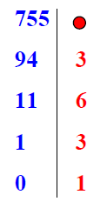
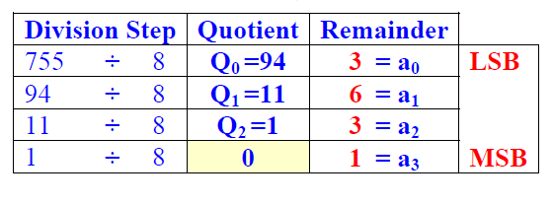

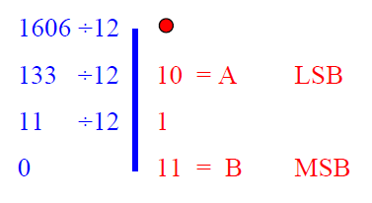
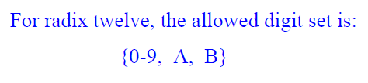

Converting Whole (Integer) Numbers
Example: Convert (755)₁₀ to (?)₈
Example: Convert (1606)₁₀ to (?)₁₂

Slide 29
Converting Binary to Decimal
Weighted positional notation shows how to calculate the decimal value of each binary bit:
Decimal = (d_{n-1} × 2^{n-1}) + (d_{n-2} × 2^{n-2}) + ... + (d₁ × 2¹) + (d₀ × 2⁰)
d = binary digit
binary 10101001 = decimal 169:
(1 × 2⁷) + (1 × 2⁵) + (1 × 2³) + (1 × 2⁰) = 128+32+8+1=169

Slide 30
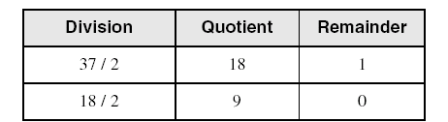
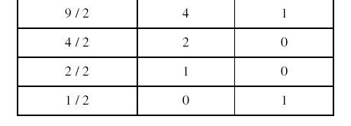
Convert Unsigned Decimal to Binary
Repeatedly divide the decimal integer by 2. Each remainder is a binary digit in the translated value:
least significant bit
most significant bit
37 = 100101
stop when quotient is zero

Slide 31
Another Procedure for Converting from Decimal to Binary
Start with a binary representation of all 0’s.
Determine the highest possible power of two that is less than or equal to the number.
Put a 1 in the bit position corresponding to the highest power of two found above.
Subtract the highest power of two found above from the number.
Repeat the process for the remaining number.

Slide 32
Another Procedure for Converting from Decimal to Binary
Example: Converting (76)₁₀ to Binary
  The highest power of 2 less than or equal to 76 is 64, hence the seventh (MSB) bit is 1
  Subtracting 64 from 76 we get 12.
  The highest power of 2 less than or equal to 12 is 8, hence the fourth bit position is 1
  We subtract 8 from 12 and get 4.
  The highest power of 2 less than or equal to 4 is 4, hence the third bit position is 1
  Subtracting 4 from 4 yield a zero, hence all the left bits are set to 0 to yield the final answer

Slide 33
Conversion for Numbers Close to Powers of 2
There is an efficient way for converting numbers that are close to powers of 2.
For example, let us consider converting the decimal number 28 to binary
  28 is close to 2^5=32. We know that 31=11111
  The difference between 28 and 31 is 3. Thus, we subtract 3 from 31 and we get 11100.
As another example, let us consider converting the decimal number 1000 to binary
  1000 is close to 2^10=1024. We know that 1023=1111111111
  The difference between 1023 and 1000 is 23. 23 is represent as 10111. Thus, we subtract 23 from 1023 and we get 1111101000

Slide 34
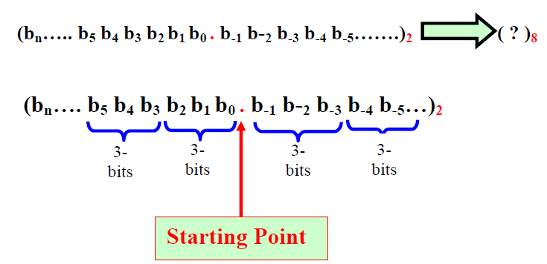
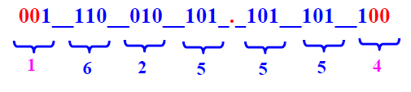

Binary to Octal Conversion
Each octal digit corresponds to 3 binary bits.
Example: Convert (1110010101.1011011)₂ into Octal.

Slide 35
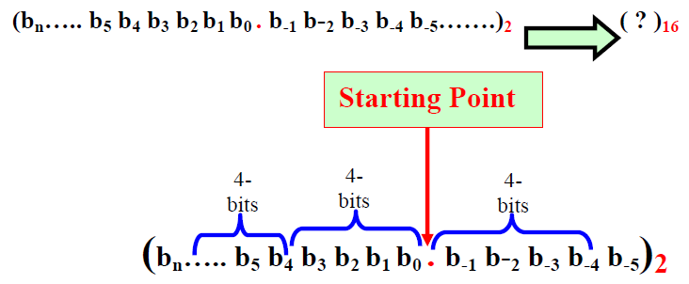
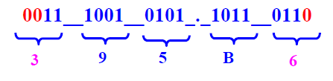

Binary to Hexadecimal Conversion
Each hexadecimal digit corresponds to 4 binary bits.
Example: Convert (1110010101.1011011)₂ into hex.

Slide 36
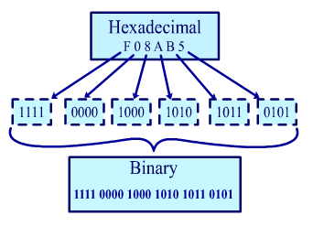
Converting Hexadecimal to Binary
Each Hexadecimal digit can be replaced by its 4-bit binary number to form the binary equivalent.

Slide 37
Converting Hexadecimal to Decimal
Multiply each digit by its corresponding power of 16:
Decimal = (d3 × 16³) + (d2 × 16²) + (d1 × 16¹) + (d0 × 16⁰)
d = hexadecimal digit
Examples:
  (1234)₁₆ = (1 × 16³) + (2 × 16²) + (3 × 16¹) + (4 × 16⁰) =
  (4,660) ₁₀
  (3BA4)₁₆ = (3 × 16³) + (11 * 16²) + (10 × 16¹) + (4 × 16⁰) =
  (15,268)₁₀

Slide 38
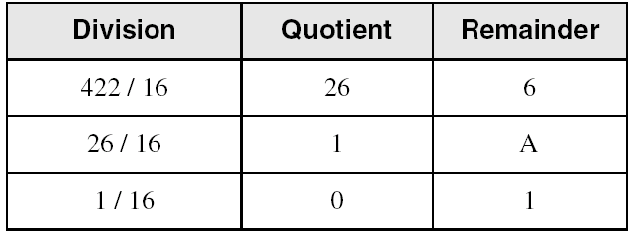
Converting Decimal to Hexadecimal
Repeatedly divide the decimal integer by 16. Each remainder is a hex digit in the translated value:
least significant digit
most significant digit
stop when quotient is zero
(422)₁₀ = (1A6)₁₆

Slide 39
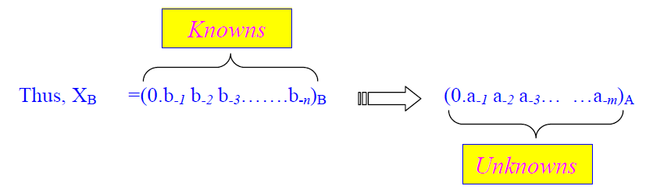
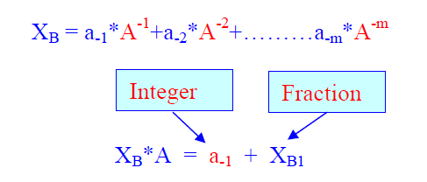



Converting Fractions
Assume that X_{B} has n digits, X_{B} = (0.b₋₁ b₋₂ b₋₃…….b_{-n})_{B}
Assume that X_{A} has m digits, X_{A} = (0.a₋₁ a₋₂ a₋₃…….a_{-m})_{A}

Slide 40
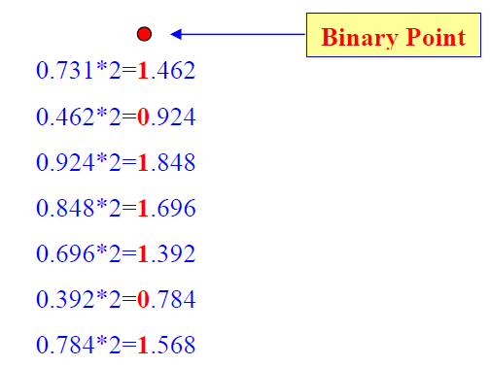

Converting Fractions
Example: Convert (0.731)₁₀ to (?)₂

Slide 41
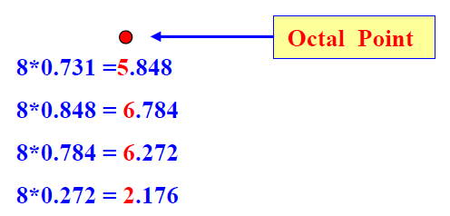

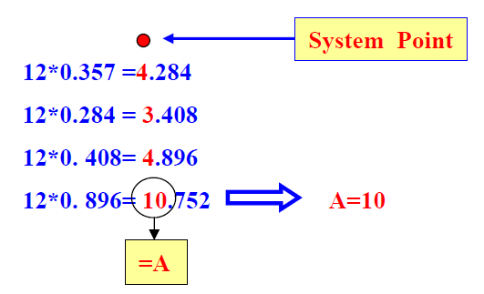

Converting Fractions
Example: Convert (0.731)₁₀ to (?)₈
Example: Convert (0.357)₁₀ to (?)₁₂

Slide 42
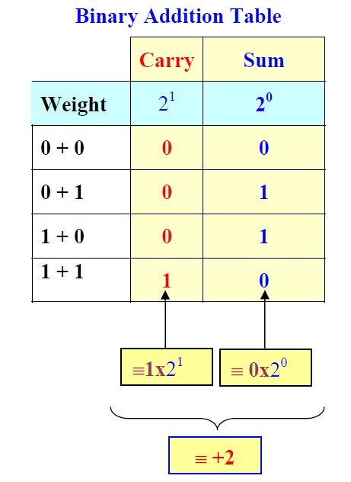
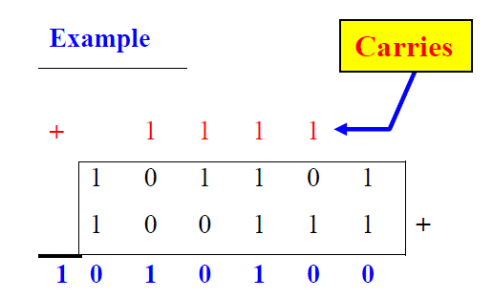
Binary Addition
1 + 1 = 2, but 2 is not allowed digit in binary
Thus, adding 1 + 1 in the binary system results in a Sum bit of 0 and a Carry bit of 1.

Slide 43
Binary Addition
Start with the least significant bit (rightmost bit)
Add each pair of bits
Include the carry in the addition, if present
carry:
1
0
0
0
0
0
1
0
0
(4)
+
0
0
0
0
0
1
1
1
(7)
0
0
0
0
1
0
1
1
(11)
bit position:
7
6
5
4
3
2
1
0

Slide 44
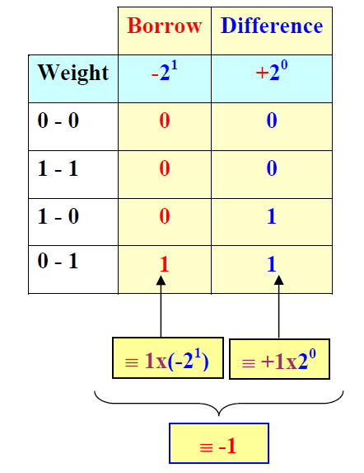
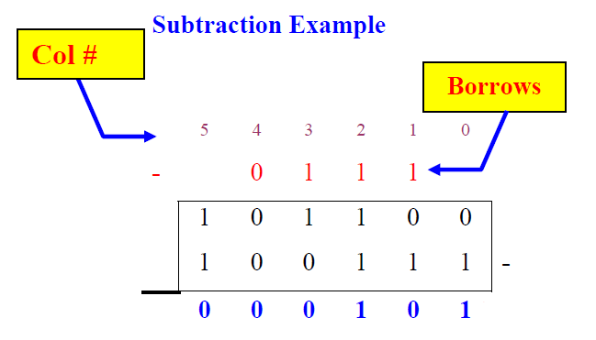
Binary Subtraction
The borrow digit is negative and has the weight of the next higher digit.

Slide 45
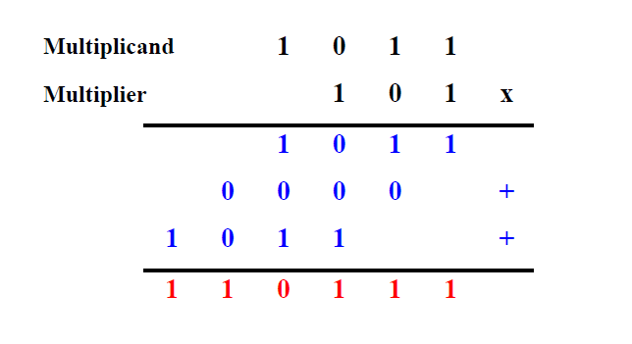
Binary Multiplication
Binary multiplication is performed similar to decimal multiplication.
Example: 11 * 5 = 55

Slide 46
Multiplication by Shifting Left
What happens if bits are shifted left by 1 bit position?
Multiplication
By 2
Before
0
0
0
0
0
1
0
1
= 5
After
0
0
0
0
1
0
1
0
= 10
What happens if bits are shifted left by 2 bit positions?
Multiplication
By 4
Before
0
0
0
0
0
1
0
1
= 5
After
0
0
0
1
0
1
0
0
= 20
Shifting Bits Left by n bit positions is multiplication by 2^{n}
As long as we have sufficient space to store the bits

Slide 47
Division by Shifting Right
What happens if bits are shifted right by 1 bit position?
Division
By 2
Before
0
0
1
0
0
1
1
0
= 38
After
0
0
0
1
0
0
1
1
= 19, r=0
What happens if bits are shifted right by 2 bit positions?
Division
By 4
Before
0
0
1
0
0
1
1
0
= 38
After
0
0
0
0
1
0
0
1
= 9, r=2
Shifting Bits to the Right by n bit positions is division by 2^{n}
The remainder r is the value of the bits that are shifted out

Slide 48
Hexadecimal Addition
Start with the least significant hexadecimal digits
Let Sum = summation of two hex digits
If Sum is greater than or equal to 16
  Sum = Sum – 16 and Carry = 1
Example:
carry
1
1
1
9
C
3
7
2
8
6
5
+
5 + B = 5 + 11 = 16
Since Sum ≥ 16
Sum = 16 – 16 = 0
Carry = 1
1
3
9
5
E
8
4
B
A
F
C
D
1
0
B
0

Slide 49
Hexadecimal Subtraction
Start with the least significant hexadecimal digits
Let Difference = subtraction of two hex digits
If Difference is negative
  Difference = 16 + Difference and Borrow = 1
Example:
borrow
1
1
1
9
C
3
7
2
8
6
5
-
1
3
9
5
E
8
4
B
Since 5 < B, Difference < 0
Difference = 16+5–11 = 10
Borrow = 1
8
8
A
1
4
0
1
A

Slide 50
Binary Codes
How to represent characters, colors, etc.?
Define the set of all represented elements
Assign a unique binary code to each element of the set
Given n bits, a binary code is a mapping from the set of elements to a subset of the 2^{n} binary numbers
Coding Numeric Data (example: coding decimal digits)
  Coding must simplify common arithmetic operations
  Tight relation to binary numbers
Coding Non-Numeric Data (example: coding colors)
  More flexible codes since arithmetic operations are not applied

Slide 51
Example of Coding Non-Numeric Data
Suppose we want to code 7 colors of the rainbow
As a minimum, we need 3 bits to define 7 unique values
3 bits define 8 possible combinations
Only 7 combinations are needed
Code 111 is not used
Other assignments are also possible
Color | 3-bit code
Red | 000
Orange | 001
Yellow | 010
Green | 011
Blue | 100
Indigo | 101
Violet | 110

Slide 52
Minimum Number of Bits Required
Given a set of M elements to be represented by a binary code, the minimum number of bits, n, should satisfy:
2^{(n - 1)} < M ≤ 2^{n}
n = log₂ M where x , called the ceiling function, is the integer greater than or equal to x
How many bits are required to represent 10 decimal digits with a binary code?
  Answer: log₂ 10 = 4 bits can represent 10 decimal digits

Slide 53
Binary Codes for Decimal Digits
Internally, digital computers operate on binary numbers.
When interfacing to humans, digital processors, e.g. pocket calculators, communication is decimal-based.
Input is done in decimal then converted to binary for internal processing.
For output, the result has to be converted from its internal binary representation to a decimal form.
To be handled by digital processors, the decimal input (output) must be coded in binary in a digit by digit manner.

Slide 54
Binary Codes for Decimal Digits
For example, to input the decimal number 957, each digit of the number is individually coded and the number is stored as 1001_0101_0111.
Thus, we need a specific code for each of the 10 decimal digits. There is a variety of such decimal binary codes.
One commonly used code is the Binary Coded Decimal (BCD) code which corresponds to the first 10 binary representations of the decimal digits 0-9.
  The BCD code requires 4 bits to represent the 10 decimal digits.
  Since 4 bits may have up to 16 different binary combinations, a total of 6 combinations will be unused.
  The position weights of the BCD code are 8, 4, 2, 1.

Slide 55
Binary Codes for Decimal Digits
Other codes use position weights of
  8, 4, -2, -1
  2, 4, 2, 1.
An example of a non-weighted code is the excess-3 code
  digit codes are obtained from their binary equivalent after adding 3.
  Thus the code of a decimal 0 is 0011, that of 6 is 1001, etc.

Slide 56
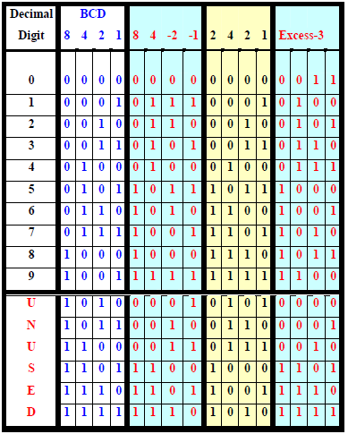
Binary Codes for Decimal Digits

Slide 57
Number Conversion versus Coding
Converting a decimal number into binary is done by repeated division (multiplication) by 2
Coding a decimal number into its BCD code is done by replacing each decimal digit of the number by its equivalent 4 bit BCD code.
Example: Converting (13)₁₀ into binary, we get 1101, coding the same number into BCD, we obtain 00010011.
Exercise: Convert (95)₁₀ into its binary equivalent value and give its BCD code as well.
Answer: (1011111)₂, and 1001 0101.

Slide 58
Character Storage
Character sets
  Standard ASCII: 7-bit character codes (0 – 127)
  Extended ASCII: 8-bit character codes (0 – 255)
  Unicode: 16-bit character codes (0 – 65,535)
  Unicode standard represents a universal character set
    Defines codes for characters used in all major languages
    Used in Windows-XP: each character is encoded as 16 bits
    Arabic codes: from 0600 to 06FF (hex)
  UTF-8: variable-length encoding used in HTML
    Encodes all Unicode characters
    Uses 1 byte for ASCII, but multiple bytes for other characters

Slide 59
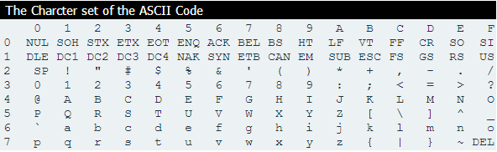
ASCII Codes
Examples:
  ASCII code for space character = 20 (hex) = 32 (decimal)
  ASCII code for ‘A' = 41 (hex) = 65 (decimal)
  ASCII code for 'a' = 61 (hex) = 97 (decimal)

Slide 60
Control Characters
The first 32 characters of ASCII table are used for control; codes = 00 to 1F (hexadecimal)
Examples of Control Characters
  Character 0 is the NULL character ⇒ used to terminate a string
  Character 9 is the Horizontal Tab (HT) character
  Character 0A (hex) = 10 (decimal) is the Line Feed (LF)
  Character 0D (hex) = 13 (decimal) is the Carriage Return (CR)
  The LF and CR characters are used together
    They advance the cursor to the beginning of next line
One control character appears at end of ASCII table
  Character 7F (hex) is the Delete (DEL) character

Slide 61
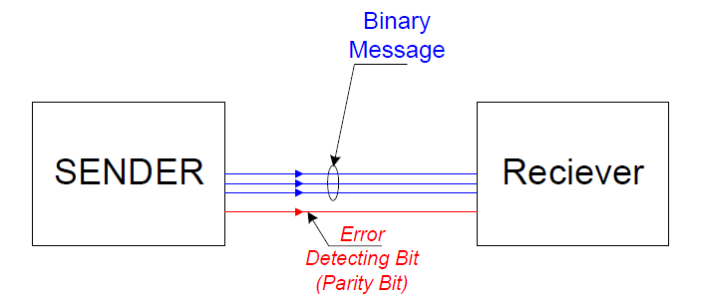
Error Detection
Binary information may be transmitted through some communication medium, e.g. using wires or wireless media.
A corrupted bit will have its value changed from 0 to 1 or vice versa.
To be able to detect errors at the receiver end, the sender sends an extra bit (parity bit) with the original binary message.

Slide 62
Parity Bit
A parity bit is an extra bit included with the n-bit binary message to make the total number of 1’s in this message (including the parity bit) either odd or even.
The 8th bit in the ASCII code is used as a parity bit.
There are two ways for error checking:
  Even Parity: Where the 8th bit is set such that the total number of 1s in the 8-bit code word is even.
  Odd Parity: The 8th bit is set such that the total number of 1s in the 8-bit code word is odd.
7-bit ASCII Character | With Even Parity | With Odd Parity
‘A’ = 1000001 | 0 1000001 | 1 1000001
‘T’ = 1010100 | 1 1010100 | 0 1010100

Slide 63
Detecting Errors using Parity
Parity can detect all single-bit errors
  If even parity is used and a single bit changes, it will change the parity to odd, which will be detected at the receiver end
  The receiver end can detect the error, but cannot correct it because it does not know which bit is erroneous
Can also detect some multiple-bit errors
  Error in an odd number of bits
Sender
7-bit ASCII character + 1 Parity bit
Receiver
Sent ‘A’ = 01000001, Received ‘A’ = 01000101

