Slide 1
ICS103: Programming in C Searching, Sorting, 2D Arrays
Muhamed F. Mudawar

Slide 2
Outline
Searching: Linear and Binary Search
Sorting: Selection Sort
2D Arrays

Slide 3
Searching
Traversing an array to locate a particular item
It requires the user to specify the target item
If the target item is found, its index is returned
If the target item is NOT found, -1 is returned
Two searching algorithms
Linear Search (works with any array)
Binary Search (works if the searched array is sorted)

Slide 4
Linear Search Algorithm
Initialize a flag (zero) to indicate whether target is found
Start at the first array element (at index 0)
Repeat while the target is not found and there are more array elements
If the current element matches the target then
Set the flag to indicate that the target is found
Else, Advance to the next array element
If the target is found then
Return the target index as the search result
Else, Return -1 as the search result

Slide 5
Linear Search Implementation
/* Search array a[] for target using linear search
* Returns index of target or -1 if not found */
int linear_search(const int a[], int target, int n) {
int i = 0, found = 0;
while (!found && i<n) {
if (a[i] == target)
found = 1;
else
++i;
}
if (found) return i;
else return -1;
}
For an array of n elements, linear search uses an average of n/2 comparisons to find an item. The worst case being n comparisons.

Slide 6
Binary Search Algorithm
If an array is ordered, it is a waste of time to look for an item using linear search. It would be like looking for a word in a dictionary sequentially.
Binary search works by comparing the target with the item at the middle of the array:
If the target is the middle item, we are done.
If the target is less than the middle item, we search the first half of the array.
If the target is bigger than the middle item, we search the second half of the array.
Repeat until target is found or nothing to search

Slide 7
Binary Search
first
mid
last
0
5
11
target = 22
[0]
[1]
[2]
[3]
[4]
[5]
[6]
[7]
[8]
[9]
[10]
[11]
4
7
8
10
14
21
22
36
54
71
85
92
first
mid
last
22>21
6
8
11
[0]
[1]
[2]
[3]
[4]
[5]
[6]
[7]
[8]
[9]
[10]
[11]
4
7
8
10
14
21
22
36
54
71
85
92
first
mid
last
22<54
6
6
7
[0]
[1]
[2]
[3]
[4]
[5]
[6]
[7]
[8]
[9]
[10]
[11]
4
7
8
10
14
21
22
36
54
71
85
92
22==22

Slide 8
Binary Search Implementation
int binary_search (int a[], int target, int n) {
int first=0, last=n-1, mid;
while (first <= last) { /* more to search */
mid = (first + last)/2;
if (target == a[mid])
return mid; /* target found */
else if (target < a[mid])
last = mid – 1;
else
first = mid + 1;
}
return -1; /* target not found */
}

Slide 9
Next . . .
Searching: Linear and Binary Search
Sorting: Selection Sort
2D Arrays

Slide 10
Sorting
Sorting is the ordering of a collection of data
It is a common activity in data management
Many programs execute faster if the data they process are sorted before processing begins
Other programs produce more understandable output if the data displayed is sorted
Many sorting algorithms have been designed
We shall consider the Selection Sort method.

Slide 11
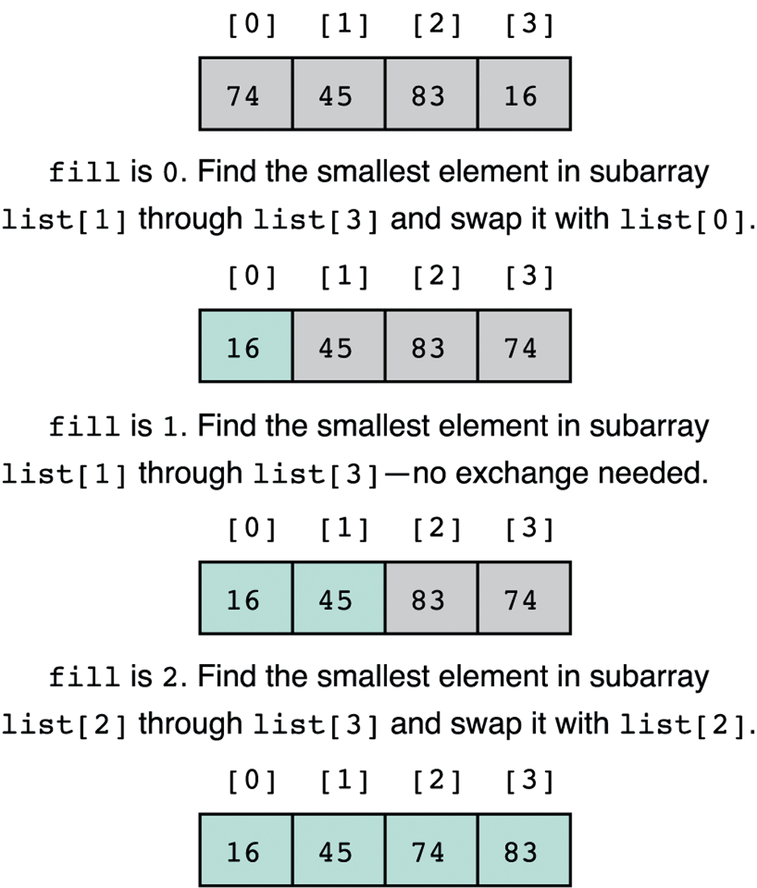
Selection Sort Algorithm
Find the index of the smallest element in the array.
Swap the smallest element with the first element.
Repeat for the 2nd, 3rd, …next smallest element.
0

Slide 12
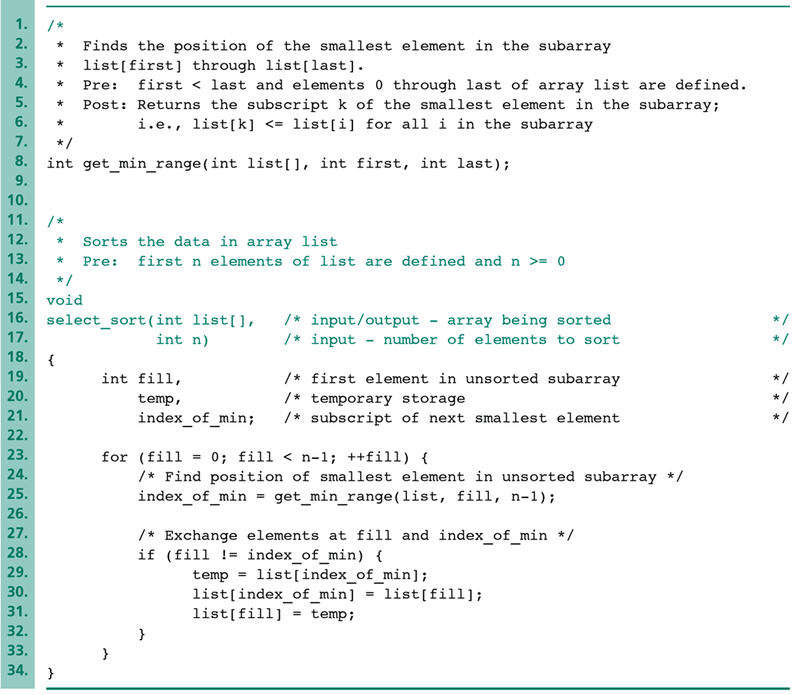
Selection Sort Function
*/
*/
*/
*/
*/

Slide 13
Smallest Element in Sub-Array
/* Find the smallest element in the sub-array list[first]
* through list[last], where first<last
* Return the index of the smallest element in sub-array
*/
int get_min_range(int list[], int first, int last) {
int i;
int index_min = first;
for (i=first+1; i<=last; i++) {
if (list[i] < list[index_min]) index_min = i;
}
return index_min;
}

Slide 14
Next . . .
Searching: Linear and Binary Search
Sorting: Selection Sort
2D Arrays

Slide 15
Two-Dimensional Arrays
A 2D array is a contiguous collection of elements of the same type, that may be viewed as a table consisting of multiple rows and multiple columns.
To store the grades of 30 students in five courses, it is better to use a 2D array than five 1D arrays.
Column
0
1
2
3
0
Row
1
2

Slide 16
2D Array Declaration
A 2D array is declared by specifying the type of element, the name of the variable, followed by the number of rows and the number of columns
As with 1D arrays, it is a good practice to declare the row and column sizes as named constants:
#define ROWS 3
#define COLS 4
. . .
int table[ROWS][COLS];
Both rows and columns are indexed from zero.
Column
0
1
2
3
0
Row
1
2

Slide 17
Indexing 2D Arrays
A 2D array element is indexed by specifying its row and column indices.
The following statement stores 64 in the cell with row index 1, and column index 3:
table[1][3] = 51;
Here is another example:
table[2][3] =
table[1][3] + 6;
0
1
2
3
0
1
51
2
0
1
2
3
0
1
51
2
57

Slide 18
Initializing 2D Arrays
As with 1-D arrays, you can declare and initialize a 2D array at the same time.
A nested list is used, where each inner list represents a row. For example:
int table[][4] = {{1,2,2,5},{3,4,6},{5,6,7,9}};
If you provide less values than the declared size, the remaining cells are set to zero (NOT a good practice!)
0
1
2
3
It is ok to omit the number of rows but not the number of columns
0
1
2
2
5
1
3
4
6
0
2
5
6
7
9

Slide 19
Processing 2D Arrays
To process a 2D array, we use a nested loop, and traverse the 2D array either row-wise or column-wise
To process the elements row-wise, we write:
for (i = 0; i < ROWS; i++)
for(j = 0; j < COLS; j++) {
/* process table[i][j] */
}
To process the elements column-wise, we write:
for (j = 0; j < COLS; j++)
for(i = 0; i < ROWS; i++) {
/* process table[i][j] */
}

Slide 20
2D Array As a Parameter
As with 1D arrays, it is possible to declare a function that takes a 2D array as a parameter.
The size of the first dimension (number of rows) need not be specified in the 2D array parameter.
However, the size of the second dimension (columns) must be specified as a constant.
One solution is to use a named constant defining the maximum number of columns and use additional parameters for the actual size of the 2D array:
void read_2d(double a[][COLS], int r, int c);

Slide 21
Program to Add 2D Arrays
#include <stdio.h>
#define ROWS 10 /* maximum number of rows */
#define COLS 10 /* maximum number of cols */
void read_2d (double a[][COLS], int r, int c);
void add_2d (double a[][COLS],
double b[][COLS],
double s[][COLS], int r, int c);
void print_2d(double a[][COLS], int r, int c);

Slide 22
Function to Read a 2D Array
void read_2d (double a[][COLS], int r, int c) {
int i, j;
printf("Enter a table with %d rows\n", r);
printf("Each row having %d numbers\n", c);
for (i=0; i<r; i++)
for (j=0; j<c; j++)
scanf("%lf", &a[i][j]);
}

Slide 23
Function to Add Two 2D Arrays
void add_2d (double a[][COLS],
double b[][COLS],
double s[][COLS], int r, int c) {
int i, j;
for (i=0; i<r; i++)
for (j=0; j<c; j++)
s[i][j] = a[i][j] + b[i][j];
}

Slide 24
Function to Print a 2D Array
void print_2d(double a[][COLS], int r, int c) {
int i, j;
for (i=0; i<r; i++) {
for (j=0; j<c; j++)
printf(" %6.1f", a[i][j]);
printf("\n");
}
}

Slide 25
Main Function
int main(void) {
double x[ROWS][COLS], y[ROWS][COLS], z[ROWS][COLS];
int rows, cols;
printf("Enter number of rows: ");
scanf("%d", &rows);
printf("Enter number of columns: ");
scanf("%d", &cols);
read_2d(x, rows, cols); /* read matrix x */
read_2d(y, rows, cols); /* read matrix y */
add_2d(x, y, z, rows, cols); /* Add x + y */
printf("The sum of two matrices is:\n");
print_2d(z, rows, cols); /* Print matrix z */
return 0;
}

Slide 26
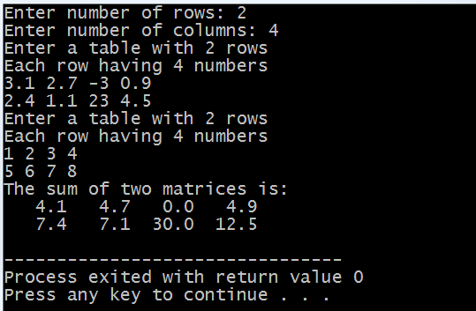
Sample Run . . .

