Slide 1
ICS103: Programming in C 6: Pointers and Modular Programming
Muhamed F. Mudawar

Slide 2
Outline
Pointer Variables
Address Operator and Indirect Reference
Functions with Output Parameters
Multiple Calls to a Function
Scope of Names
File Input and Output
Common Programming Errors

Slide 3
Pointer Variable
A pointer is a variable that stores a memory address
The address of another variable in memory
Pointer variable declaration:
type *variable;
Example:
double *p;
p is a pointer to a variable of type double
The value of a pointer is a memory address

Slide 4
Address Operator
How to initialize a pointer variable?
We can use the address operator &
Example:
double d;
double *p; /* pointer variable */
d = 13.5;
p = &d; /* p = address of d */
p = &d
d = 13.5

Slide 5
Indirect Reference (De-Reference)
We can access and modify a variable:
Either directly using the variable name
Or indirectly, using a pointer to the variable
Example:
double d = 13.5;
double *p = &d; /* p = address of d */
*p = -5.3; /* d = -5.3 */
printf("%.2f", d); /* -5.30 */

Slide 6
Triple Use of * (Asterisk)
As a multiplication operator:
z = x * y ; /* z = x times y */
To declare pointer variables:
char ch; /* ch is a character */
char *p; /* p is pointer to char */
As an indirection operator:
p = &ch; /* p = address of ch */
*p = 'A'; /* ch = 'A' */
*p = *p + 1; /* ch = 'A' + 1 = 'B' */

Slide 7
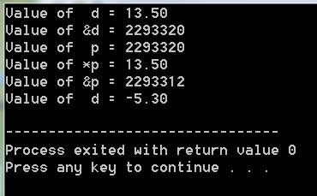
Example
&p:2293312
&d:2293320
#include <stdio.h>
int main(void) {
double d = 13.5;
double *p; /* p is a pointer to double */
p = &d; /* p = address of d */
printf("Value of d = %.2f\n", d);
printf("Value of &d = %d\n", &d);
printf("Value of p = %d\n", p);
printf("Value of *p = %.2f\n", *p);
printf("Value of &p = %d\n", &p);
*p = -5.3; /* d = -5.3 */
printf("Value of d = %.2f\n", d);
return 0;
}
p=2293320
d = 13.5

Slide 8
Pointer Summary
&p:2293312
&d:2293320
p=2293320
d = 13.5
Using a pointer variable p, one can access:
Its direct value: the value of pointer variable p
In the example, the value of p is 2293320
It is the address of variable d (&d is 2293320)
Its indirect value: using the indirection operator *
In the example, *p is the value of d, which is 13.5
Its address value: using the address operator &
In the example, &p is 2293312

Slide 9
Next . . .
Pointer Variables
Address Operator and Indirect Reference
Functions with Output Parameters
Multiple Calls to a Function
Scope of Names
File Input and Output
Common Programming Errors

Slide 10
Functions with Output Parameters
So far, we know how to:
Pass input parameters to a function
Use the return statement to return one function result
Functions can also have output parameters
To return multiple results from a function
Output parameters are pointer variables
The caller passes the addresses of variables in memory
The function uses indirect reference to modify variables in the calling function (for output results)

Slide 11
Example: Function separate
Write a function that separates a number into a sign, a whole number magnitude, and a fractional part.
void separate /* function separate */
(double num, /* input number */
char *signp, /* sign pointer */
int *wholep, /* whole number pointer */
double *fracp); /* fraction pointer */

Slide 12
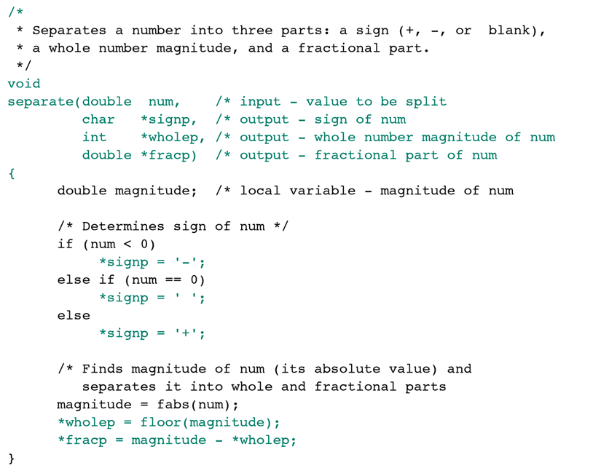
*/
*/
*/
*/
*/
*/

Slide 13
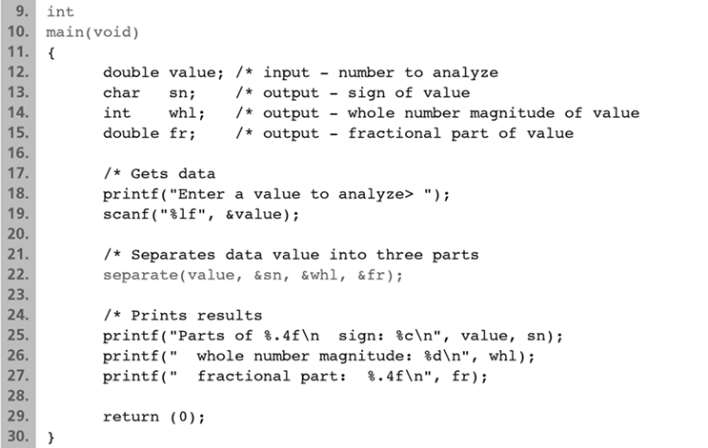
Calling the Function separate
*/
*/
*/
*/
*/
*/
*/

Slide 14
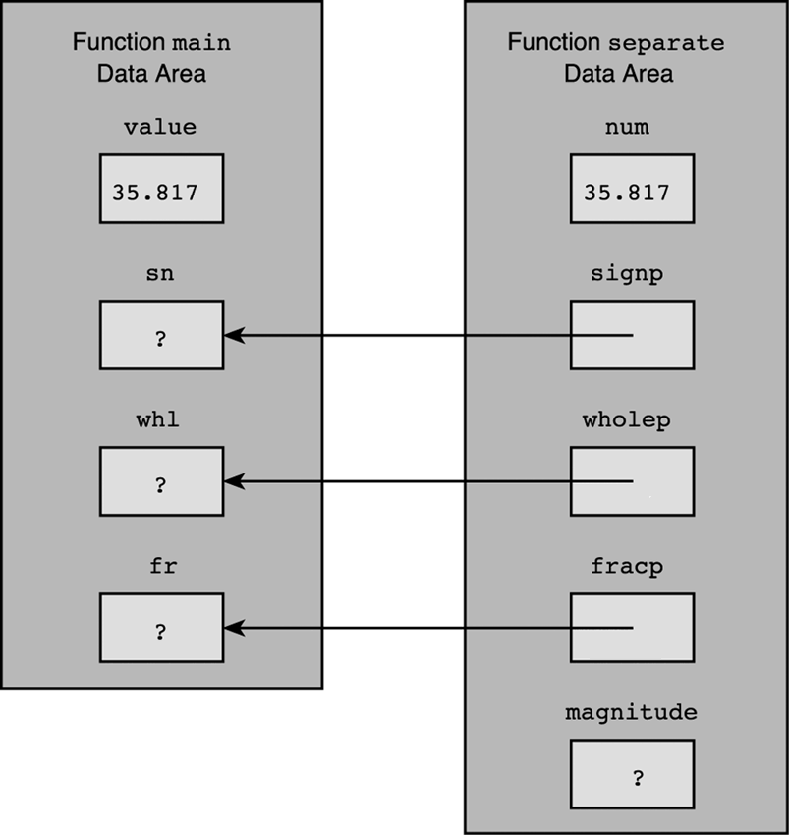
Parameter Passing for Function separate

Slide 15
Example 2: Function order
/* Arranges arguments in ascending order */
/* smp and lgp are pointer parameters */
/* Order variables pointed by smp and lgp */
void order(double *smp, double *lgp) {
double temp; /* temporary variable */
/* compare variables pointed by smp and lgp */
if (*smp > *lgp) {
temp = *smp; /* swap variables */
*smp = *lgp; /* pointed by smp and */
*lgp = temp; /* pointed by lgp */
}
}

Slide 16
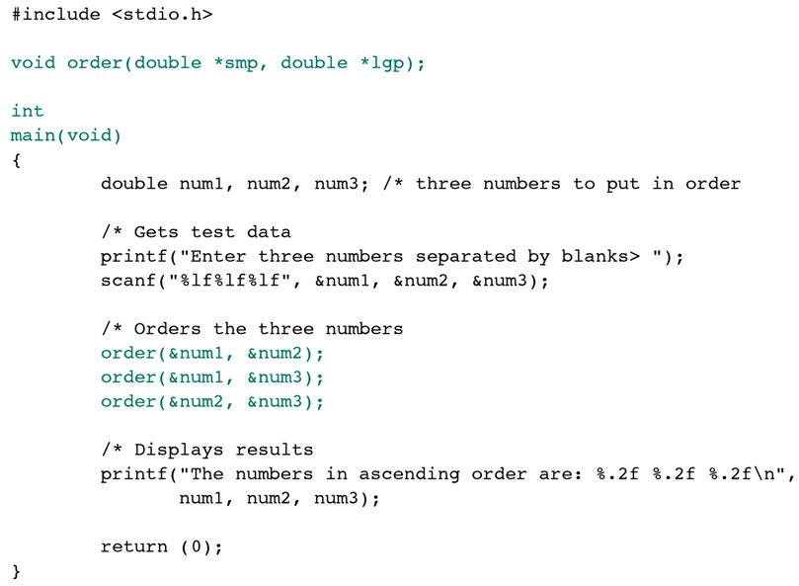
Multiple Calls to a Function
*/
*/
*/
Sorts 3 Numbers
*/

Slide 17
Tracing Program: Sort 3 Numbers
Statement | num1 | num2 | num3 | Effect
scanf(. . .); | 7.5 | 9.6 | 5.5 | Input Data
order(&num1, &num2); | 7.5 | 9.6 | 5.5 | No change
order(&num1, &num3); | 5.5 | 9.6 | 7.5 | swap num1, num3
order(&num2, &num3); | 5.5 | 7.5 | 9.6 | swap num2, num3
printf(. . .); |  |  |  | 5.50 7.50 9.60

Slide 18
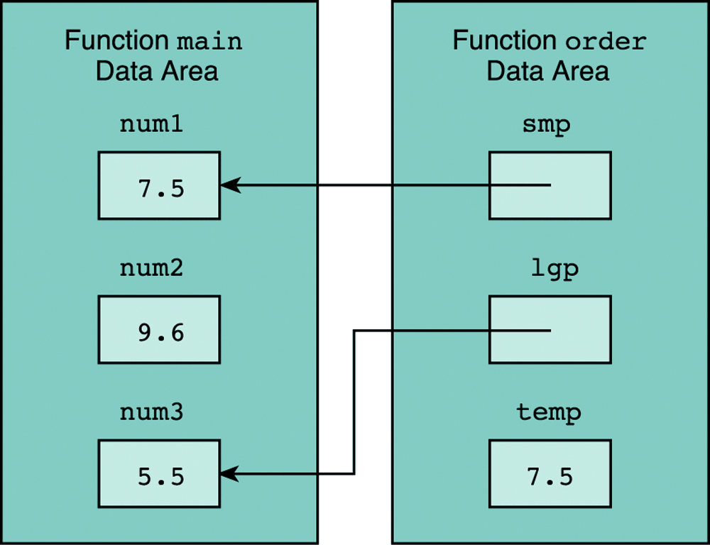
TRACE: order(&num1,&num3);
Data areas after: temp = *smp;

Slide 19
Scope of a Name
Region of program where a name is visible
Region of program where a name can be referenced
Scope of: #define NAME value
From the definition line until the end of file
Visible to all functions that appear after #define
Scope of a function prototype
Visible to all functions defined after the prototype
Scope of a parameter and a local variable
Visible only inside the function where it is defined
Same name can be re-declared in different functions

Slide 20
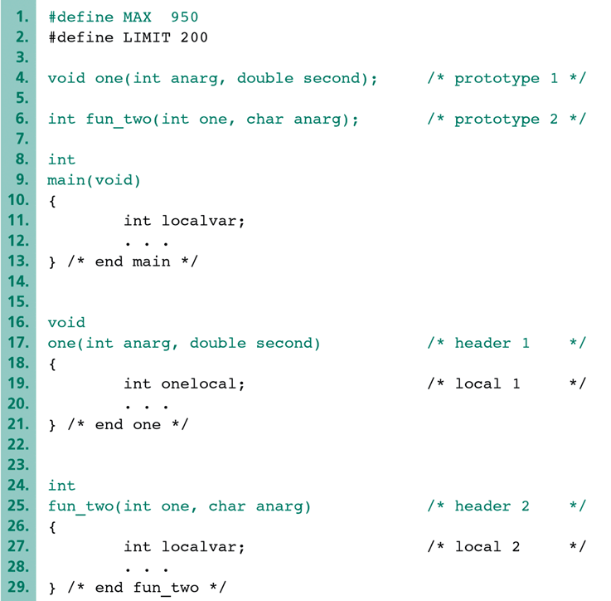
MAX and LIMIT are visible to all functions
prototypes are typically visible to all functions
function one is not visible to fun_two: has parameter one
localvar is visible inside main only
anarg, second, and onelocal are
visible inside function one only
one, anarg, and localvar are
visible inside fun_two only

Slide 21
Next . . .
Pointer Variables
Address Operator and Indirect Reference
Functions with Output Parameters
Multiple Calls to a Function
Scope of Names
File Input and Output
Common Programming Errors

Slide 22
Why Data Files?
So far, all our examples obtained their input from the keyboard and displayed their output on the screen
However, the input data can be large that it will be inconvenient to enter the input from the keyboard
Example: processing large number of employees data
Similarly, there are applications where the output will be more useful if it is stored in a file
The good news is that C allows the programmer to use data files, both for input and output

Slide 23
Using Data Files
The process of using data files for input/output involves four steps as follows:
Declare pointer variables of type FILE *
Open the files for reading/writing using fopen function
Read/write the files using fscanf and fprintf
Close the files after processing the data using fclose
In what follows, we explain each of these steps

Slide 24
Declaring FILE Pointer Variables
Declare pointer variables to files as follows:
FILE *inp; /* pointer to input file */
FILE *outp; /* pointer to output file */
Note that the type FILE is in upper case
The type FILE stores information about an open file
Also note the use of * before a pointer variable
inp and outp are pointer variables
Recall that pointer variables store memory addresses

Slide 25
Opening Data Files for Input/Output
The second step is to open a file for reading or writing
Suppose our input data exists in file: "data.txt"
To open a file for reading, write the following:
inp = fopen("data.txt", "r");
The "r" indicates the purpose of reading from a file
Suppose we want to output data to: "results.txt"
To open a file for writing, write the following:
outp = fopen("results.txt", "w");
The "w" indicates the purpose of writing to a file

Slide 26
Handling File NOT Found Error
inp = fopen("data.txt", "r");
If the above fopen operation succeeds:
It returns the address of the open FILE in inp
The inp pointer can be used in all file read operations
If the above fopen operation fails:
For example, if the file data.txt is not found on disk
It returns the NULL pointer value and assign it to inp
Check the pointer inp immediately after fopen
if (inp == NULL)
printf("Cannot open file: data.txt\n");

Slide 27
Creating a File for Writing
outp = fopen("results.txt", "w");
If the above fopen operation succeeds:
It returns the address of the open FILE in outp
The outp pointer can be used in all file write operations
If file results.txt does not exist on the disk
The OS typically creates a new file results.txt on disk
If file results.txt already exists on the disk
The OS typically clears its content to make it a new file
If fopen fails to create a new file for writing, it returns the NULL pointer in outp

Slide 28
Input from & Output to Data Files
The third step is to scan data from an input file and to print results into an output file
To input a double value from file data.txt, use:
fscanf(inp, "%lf", &data);
The fscanf function works the same way as scanf
Except that its first argument is an input FILE pointer
To output a double value to results.txt, use:
fprintf(outp, "%f", data);
Again, fprintf works similar to printf
Except that its first argument is an output FILE pointer

Slide 29
Closing Input and Output Files
The final step in using data files is to close the files after you finish using them
The fclose function is used to close both input and output files as shown below:
fclose(inp);
fclose(outp);
Warning: Do not forget to close files, especially output files. This is necessary if you want to re-open a file for reading after writing data to it. The OS might delay writing data to a file until closed.

Slide 30
Example Program of File Input & Output
/* This program reads numbers from an input file, formats and
* writes each number on a separate line in an output file */
#include <stdio.h>
int main(void) {
FILE *inp; /* pointer to input file */
FILE *outp; /* pointer to output file */
double num; /* number read */
int status; /* status of fscanf */
/* Prepare files for input and output */
inp = fopen("indata.txt", "r");
outp = fopen("outdata.txt", "w");
/* read each number, and then write it */
status = fscanf(inp, "%lf", &num);
while (status == 1) {
fprintf(outp, "%.2f\n", num);
status = fscanf(inp, "%lf", &num);
}
/* close the files */
fclose(inp);
fclose(outp);
return 0;
}

Slide 31
Sample Run
File: indata.txt
344 55 6.3556 9.4
43.123 47.596
File: outdata.txt
344.00
55.00
6.36
9.40
43.12
47.60

Slide 32
End-Of-File Controlled Loops
When reading input from a data file, the program does not know how many data items to read
Example: finding class average from student grades
The grades are read from an input file one at a time in a loop, until the end of file is reached
The question here is how to detect the end of file?
The good news is that fscanf returns a special value, named EOF, when it encounters End-Of-File
We can take advantage of this by using EOF as a condition to control the termination of a loop

Slide 33
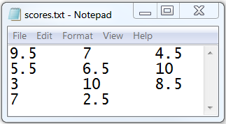
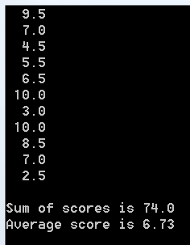
/* This program computes the average score of a class
The scores are read from an input file, scores.txt */
#include <stdio.h>
int main (void) {
FILE *infile;
double score, sum=0, average;
int count=0, status;
infile = fopen("scores.txt", "r");
status = fscanf(infile, "%lf", &score);
while (status != EOF)
{
printf("%5.1f\n", score);
sum += score;
count++;
status = fscanf(infile, "%lf", &score);
}
average = sum / count;
printf("\nSum of scores is %.1f\n", sum);
printf("Average score is %.2f\n", average);
fclose(infile);
return 0;
}

Slide 34
Common Programming Errors
Be careful when using pointer variables
A pointer should be initialized to a valid address before use
De-referencing an invalid/NULL pointer is a runtime error
Calling functions with output parameters
Remember that output parameters are pointers
Pass the address of a variable to a pointer parameter
Do not reference names outside their scope
Create a file before reading it in a program
Remember that fopen prepares a file for input/output
The result of fopen should not be a NULL pointer
Check the status of fscanf to ensure correct input
Remember to use fclose to close a file, when done

