Slide 1
ICS103: Programming in C 5: Repetition and Loop Statements
Muhamed F. Mudawar

Slide 2
Outline
Repetition in Programs
Counting loops
The while statement
The for statement
Conditional Loops
Nested Loops
The do-while statement
How to debug and test programs
Common Programming Errors

Slide 3
Recall: Control Structures
Three kinds of control structures
Sequence (Compound Statement)
Selection (if and switch Statements)
Repetition (discussed in this presentation)
The repetition of steps in a program is called a loop
Three loop control structures in C
The while statement
The for statement
The do-while statement

Slide 4
Repetition in Programs
Loop structure
A control structure that repeats a group of steps in a program
Loop body
The statements that are repeated inside the loop
Three questions to raise:
Are there any steps repeated in the problem?
If the answer to question 1 is yes, is the number of repetitions know in advance?
If the answer to question 2 is no, then how long to keep repeating the steps?

Slide 5
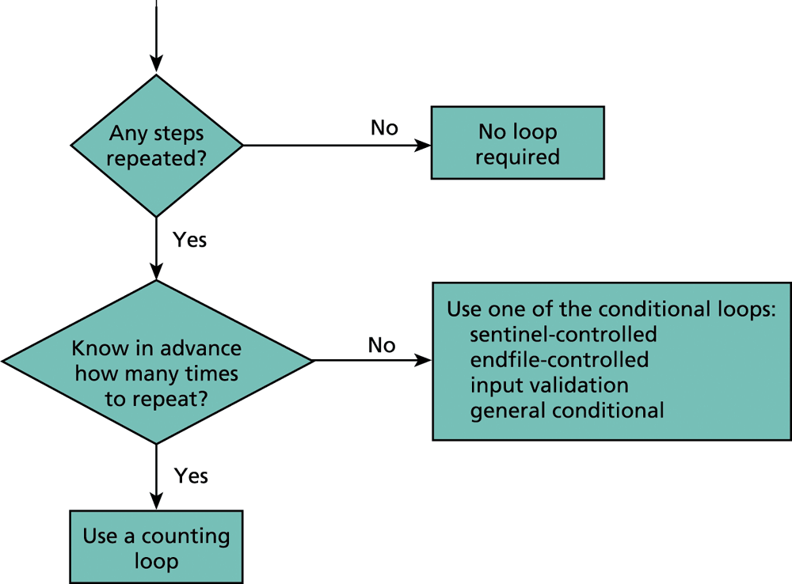
Flowchart of Loop Choice

Slide 6
Counting Loop
Called a Counter-controlled loop
A loop that can be controlled by a counter variable
Number of iterations (repetitions) can be determined before loop execution begins
General format of a counting loop:
Set loop control variable to an initial value
while (loop control variable < final value) {
/* Do something multiple times */
Increase loop control variable by 1
}

Slide 7
The while Statement
Syntax:
while (condition) {
statement₁ ;
statement₂ ;
. . .
statement_{N} ;
}
As long as condition is true, the loop body is executed
The condition is re-tested after each iteration
The loop terminates when condition becomes false
Loop Repetition Condition
Loop Body:
Can be one statement, or
Compound statement

Slide 8
Example of a while Loop
Compute and display the gross pay for 7 employees
Initialization: count_emp = 0;
Testing: (count_emp < 7)
Updating: count_emp = count_emp + 1;

Slide 9
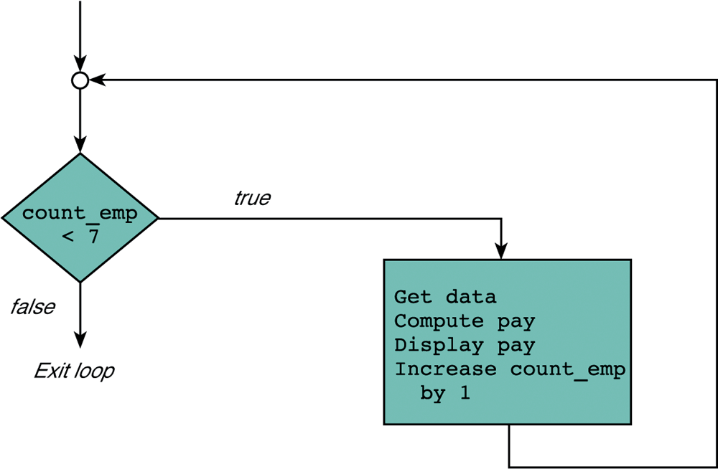
Flowchart of a while Loop
Loop repetition condition
Loop body
If count_emp is not updated,
the loop will execute forever.
Such a loop is called infinite loop.

Slide 10
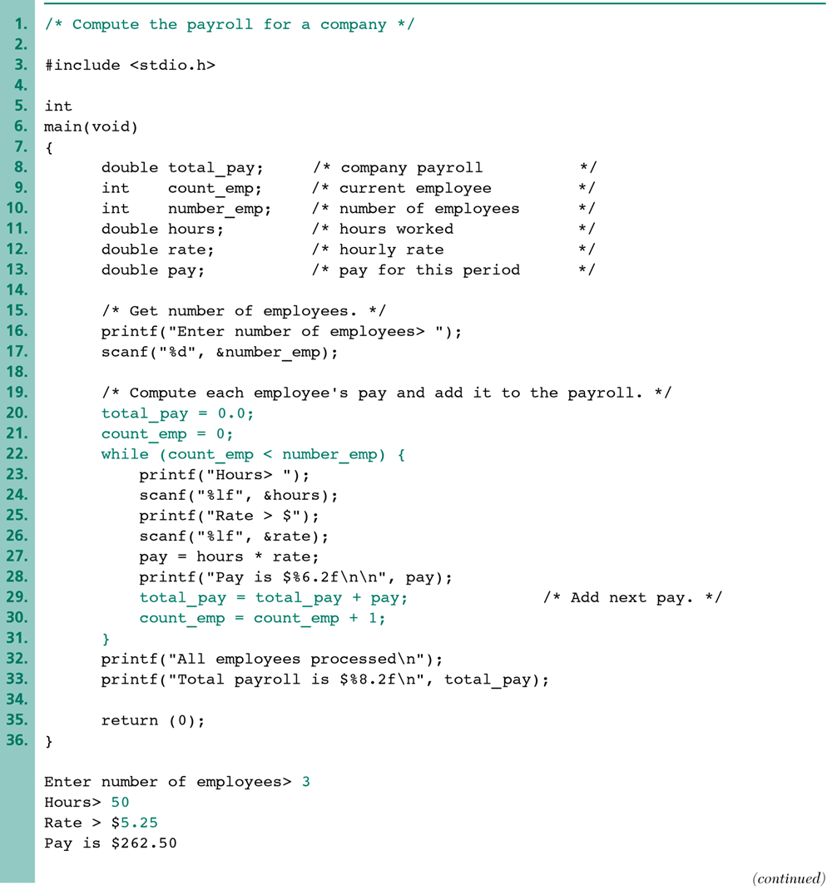
Total Payroll of a Company

Slide 11
Sample Run
Enter number of employees> 3
Hours> 50
Rate> $5.25
Pay is $262.50
Hours> 6
Rate> $5.0
Pay is $ 30.00
Hours> 15
Rate> $7.0
Pay is $105.00
All employees processed
Total payroll is $ 397.50

Slide 12
Next . . .
Repetition in Programs
Counting loops
The while statement
The for statement
Conditional Loops
Nested Loops
The do-while statement
How to debug and test programs
Common Programming Errors

Slide 13
The for Statement
Better way to write a counting loop
for (initialization expression;
loop repetition condition;
update expression)
Statement ; /* Can be Compound */
First, the initialization expression is executed
Then, the loop repetition condition is tested
If true, the Statement is executed , the update expression is computed, and the repetition condition is re-tested
Repeat as long as the repetition condition is true

Slide 14
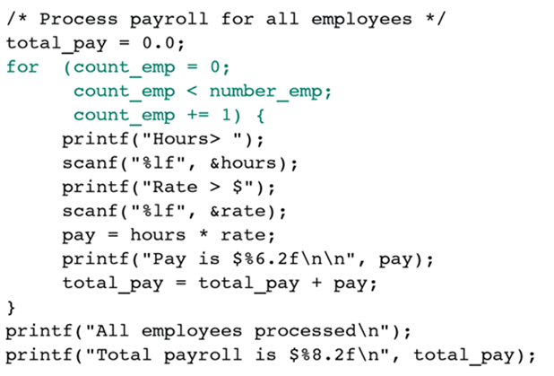
Accumulating a Sum: total_pay
/* initialization */
/* repetition condition */
/* update */

Slide 15
Compound Assignment Operators
variable op= expression ; is equivalent to
variable = variable op (expression) ;
Statement with Simple Assignment Operator | Equivalent with Compound Assignment Operator
count_emp = count_emp + 1; | count_emp += 1;
time = time - 1; | time -= 1;
product = product * item; | product *= item;
total = total / number; | total /= number;
n = n % (x+1); | n %= x+1;

Slide 16
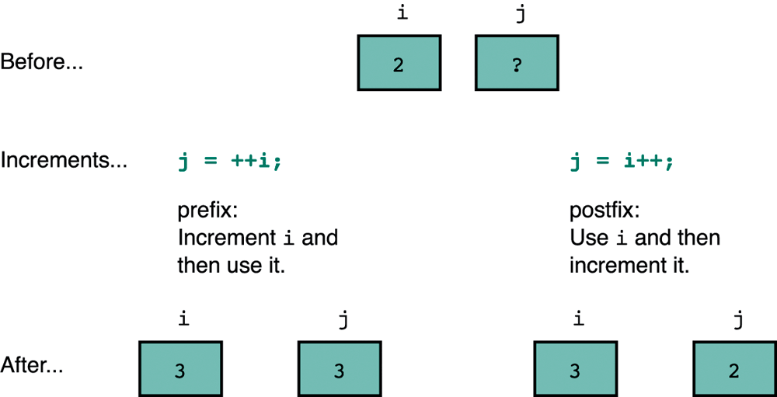
Prefix and Postfix Increments
C also provides the decrement operator -- that can be used in either the prefix or postfix position

Slide 17
Computing the Factorial
// Factorial: n! = n * (n-1) * . . . * 2 * 1
// Computed with a for-loop
printf("Enter value of n: ");
scanf("%d", &n);
factorial = 1; // Initialize
for (i=n; i>1; i--) {
factorial = factorial * i;
}

Slide 18
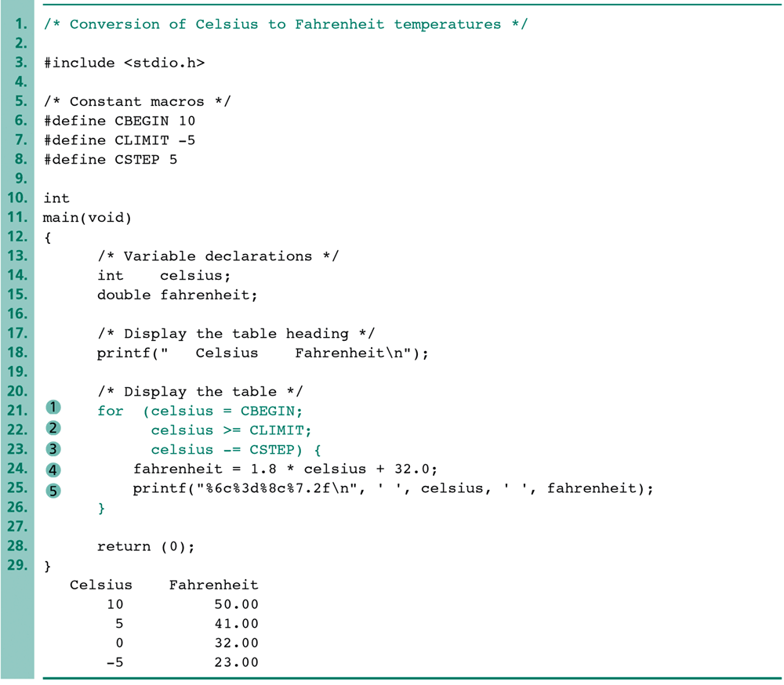
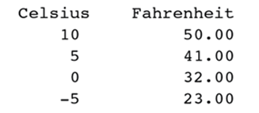
Conversion of Celsius to Fahrenheit
Display a Table of Values
Decrement by 5

Slide 19
Next . . .
Repetition in Programs
Counting loops
The while statement
The for statement
Conditional Loops
Nested Loops
The do-while statement
How to debug and test programs
Common Programming Errors

Slide 20
Conditional Loops
Not able to determine the exact number of loop repetitions before loop execution begins
Example of a conditional loop: input validation
printf("Enter number of students> ");
scanf("%d", &num_students);
while (num_students < 0) {
printf("Invalid negative number; try again> ");
scanf("%d", &num_students);
}
while loop rejects invalid (negative) input

Slide 21
Sentinel-Controlled Loops
In many programs, we input a list of data values
Often, we don’t know the length of the list
We ask the user to enter a unique data value, called a sentinel value, after the last data item
Sentinel Value
An end marker that follows the last value in a list of data
For readability, we used #define to name the SENTINEL
The loop repetition condition terminates a loop when the sentinel value is read

Slide 22
Sentinel-Controlled while Loop
#include <stdio.h>
#define SENTINEL -1 /* Marking end of input */
int main(void) { /* Compute the sum of test scores */
int sum = 0; /* Sum of test scores */
int score; /* Current input score */
printf("Enter first score (%d to quit)> ", SENTINEL);
scanf("%d", &score);
while (score != SENTINEL) {
sum += score;
printf("Enter next score (%d to quit)> ", SENTINEL);
scanf("%d", &score);
}
printf("\nSum of exam scores is %d\n", sum);
return (0);
}

Slide 23
Sentinel-Controlled for Loop
#include <stdio.h>
#define SENTINEL -1 /* Marking end of input */
int main(void) { /* Compute the sum of test scores */
int sum = 0; /* Sum of test scores */
int score; /* Current input score */
printf("Enter first score (%d to quit)> ", SENTINEL);
for (scanf("%d", &score);
score != SENTINEL;
scanf("%d", &score)) {
sum += score;
printf("Enter next score (%d to quit)> ", SENTINEL);
}
printf("\nSum of exam scores is %d\n", sum);
return (0);
}

Slide 24
Infinite Loop on Faulty Input Data
Reading faulty data can result in an infinite loop
scanf("%d", &score); /* read integer */
Suppose the user enters the letter X
Enter next score (-1 to quit)> X
scanf fails to read variable score as letter X
Variable score is not modified in the program
score != SENTINEL is always true
Therefore, Infinite Loop

Slide 25
Detecting Faulty Input Data
scanf can detect faulty input as follows:
status = scanf("%d", &score);
If scanf successfully reads score then status is 1
If scanf fails to read score then status is 0
We can test status to detect faulty input
This can be used to terminate the execution of a loop
In general, scanf can read multiple variables
It returns the number of successfully read inputs

Slide 26
Terminating Loop on Faulty Input
int main(void) { /* Compute the sum of test scores */
int sum = 0; /* Sum of test scores */
int score; /* Current input score */
int status; /* Input status of scanf */
printf("Enter first score (%d to quit)> ", SENTINEL);
status = scanf("%d", &score);
while (status != 0 && score != SENTINEL) {
sum += score;
printf("Enter next score (%d to quit)> ", SENTINEL);
status = scanf("%d", &score);
}
printf("\nSum of exam scores is %d\n", sum);
return (0);
}

Slide 27
Next . . .
Repetition in Programs
Counting loops
The while statement
The for statement
Conditional Loops
Nested Loops
The do-while statement
How to debug and test programs
Common Programming Errors

Slide 28
Nested Loops
Consist of an outer loop with one or more inner loops
Each time the outer loop is repeated, the inner loops are reentered and executed
Example:
int n = 5;
int i, j;
for (i=1; i<=n; i++) {
for (j=1; j<=i; j++) {
printf("*");
}
printf("\n");
}
*
**
***
****
*****
inner loop
outer loop

Slide 29
What is the Output?
/* Illustrates nested for loops */
#include <stdio.h>
int main(void) {
int i, j; /* loop variables */
printf(" I J\n");
for (i = 1; i < 4; i++) {
printf("Outer %6d\n", i);
for (j = 0; j < i; j++) {
printf(" Inner%9d\n", j);
} /* end of inner loop */
} /* end of outer loop */
return (0);
}
I J
Outer 1
Inner 0
Outer 2
Inner 0
Inner 1
Outer 3
Inner 0
Inner 1
Inner 2

Slide 30
The do-while Statement
The for and while statements evaluate the loop condition before the execution of the loop body
The do-while statement evaluates the loop condition after the execution of the loop body
Syntax:
do
statement; /* Can be compound */
while (loop repetition condition) ;
The do-while must execute at least one time

Slide 31
Using do-while to Repeat Program
int main() {
. . . /* Variable Declarations */
char ch; /* User response [y/n] */
do {
. . . /* Execute program */
printf("Repeat again [y/n]? ");
ch = getch(); /* read from keyboard */
printf("%c\n", ch); /* display character */
} while (ch=='y'|| ch=='Y');
}

Slide 32
Next . . .
Repetition in Programs
Counting loops
The while statement
The for statement
Conditional Loops
Nested Loops
The do-while statement
How to debug and test programs
Common Programming Errors

Slide 33
How to Debug and Test a Program
Using a debugger program
Debug option should be selected
Execute program one statement at a time (Next line)
Watch the value of variables at runtime (Add watch)
Set breakpoints at selected statements
Debugging without a debugger
Insert extra printf statements that display intermediate results at critical points in your program
if (DEBUG) printf(. . .);
Turn ON diagnostic calls to printf
#define DEBUG 1

Slide 34
Example: Debugging using printf
#define DEBUG 1 /* turn on diagnostics */
#define DEBUG 0 /* turn off diagnostics */
int main() {
int score, sum=0;
printf("Enter first score (%d to quit)> ", SENTINEL);
scanf("%d", &score); /* get first score */
while (score != SENTINEL) {
sum += score;
if (DEBUG) printf("score=%d, sum=%d\n", score, sum);
printf("Enter next score (%d to quit)> ", SENTINEL);
scanf("%d", &score); /* get next score */
}
printf("Total score is %d\n", sum);
return 0;
}

Slide 35
Off-by-One Loop Errors
A common logic error
A loop executes one more time or one less time
Example:
for (count = 0; count <= n; ++count)
sum += count;
for (count = 1; count < n; ++count)
sum += count;
Checking loop boundaries
Initial and final values of the loop control variable
Executes n + 1 times
Executes n – 1 times

Slide 36
Common Programming Errors (1/2)
Do not confuse if and while statements
if statement implements a decision step
while statement implements a loop
for loop: remember to end the initialization step and the loop repetition condition with semicolon (;)
Remember to use braces { and } around a loop body consisting of multiple statements
Remember to provide a prompt for the user, when using a sentinel-controlled loop
Make sure the sentinel value cannot be confused with a normal data input

Slide 37
Common Programming Errors (2/2)
Use do-while only when there is no possibility of zero loop iterations
Do not use increment, decrement, or compound assignment as sub-expressions in complex expressions
a *= b + c; /* a = a*(b+c); */
There is no shorter way to write: a = a*b + c;
Be sure that the operand of an increment/decrement operator is a variable:
z = ++j * k--; /* ++j; z=j*k; k--; */

Slide 38
Chapter Review
Two kinds of loops occur frequently in programming
Counting loop: controlled by a counter
Conditional loop: controlled by a condition
Sentinel-controlled loop
Input validation loop
General conditional loop
C provides three statements for implementing loops
while statement (can have zero repetitions)
for statement (can have zero repetitions)
do-while statement (must execute at least once)

