Slide 1
ICS103 Programming in C 1: Overview of Computers And Programming

Slide 2
Welcome to ICS 103
Instructor: Dr. Muhamed F. Mudawar
Office: Building 22, Room 328
Office Hours: http://faculty.kfupm.edu.sa/coe/mudawar/schedule/
Email: mudawar@kfupm.edu.sa
Web: http://faculty.kfupm.edu.sa/coe/mudawar/ics103

Slide 3
Assessment Plan
Lab: 20%
Lab Work + Assessment
Lab Project
Homework and Quizzes: 25%
Midterm Exam: 25%
Saturday, November 11, at 10 AM
Final Exam: 30%
Sunday, January 7, at 8 AM

Slide 4
Outline
Overview of Computers
Hardware
Software
Computer Languages
Software Development Method
Pseudo Code and Flowcharts

Slide 5
Computers
Computers receive input, store, process, and output information.
Computer can deal with numbers, text, images, graphics, and sound.
Computers are worthless without programming.
Programming Languages allow us to write programs that tell the computer what to do and to provide a way to communicate with computers.
Programs are then converted to machine instructions so the computer can understand it.

Slide 6
Hardware & Software
Hardware is the equipment used to perform the necessary computations.
Central Processing Unit (CPU), memory, disk storage, monitor, keyboard, mouse, printer, etc.
Software consists of the programs that enable us to solve problems with a computer by providing it with a list of instructions to follow
Word, Internet Explorer, Windows OS, etc.

Slide 7
Computer Hardware
Main Memory
RAM - Random Access Memory - Memory that can be read and written in any order (as opposed to sequential access memory), volatile.
ROM - Read Only Memory - Memory that cannot be written to, non-volatile.
Secondary Memory: Magnetic hard disks, Flash (solid state) disks, Optical disks (CDs and DVDs).
Central Processing Unit (CPU): Executes all computer operations and perform arithmetic and logical operations.
Input/Output Devices: keyboard, mouse, scanner, monitor, printer, and speakers.
Computer Networks – Computers that are linked together can communicate with each other.

Slide 8
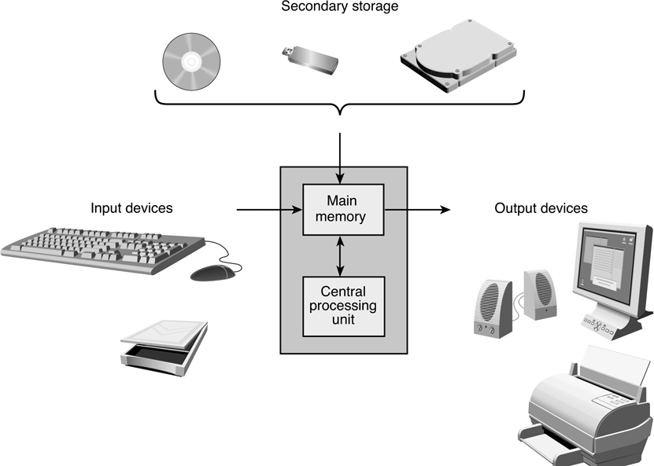
Components of a Computer

Slide 9
Memory
Memory: a large collection of memory cells
Each Memory Cell has an address and a value
Bit: Binary digit = Either 0 or 1
Byte: Made up of 8 bits
Memory Address: position of a memory cell
Memory Content: Value stored in memory
Every memory cell has content, whether we know it or not
Memory capacity
Kilobyte (KB) = 2¹⁰ = 1024 Bytes; Megabyte (MB) = 2²⁰ Bytes > 10⁶ Bytes
Gigabyte (GB) = 2³⁰ > 10⁹ Bytes; Terabyte (TB) = 2⁴⁰ Bytes > 10¹² Bytes
One bit
0
1
Byte = 8 bits
2
3
Memory Addresses
.
.
.
Byte at
address 16
value = 65
16
65
17
18
.
.
.

Slide 10
Computer Software
Operating System - controls the interaction between machine and user. Examples: Windows, Linux, etc.
Communicates with computer user.
Collects input and Displays output.
Manages memory and processor time.
Manages Storage Disk.
Application Software - developed to assist a computer user in accomplishing specific tasks. Example: Word, Excel, Internet Explorer.

Slide 11
Computer Languages
High-level Language: Combines algebraic expressions and high-level commands
High Level : Very far away from the actual machine language
Examples: Fortran, C, Prolog, C#, Perl, and Java.
Machine Language: A collection of machine instructions
Not standardized. There is a different machine language for every processor family.
Assembly Language: uses symbols (called mnemonics) that correspond to machine language instructions.
Low level: Very close to the actual machine language.

Slide 12
Compiler
Compilation is the process of translating the source code (high-level) into executable code (machine level).
Source file: contains the original program code
A Compiler turns the Source File into an Object File
Object file: contains machine language instructions
A Linker turns the Object File into an Executable
Integrated Development Environment (IDE): a program that combines simple text editor with a compiler, linker, loader, and debugger tool
For example, Eclipse or Visual Studio

Slide 13
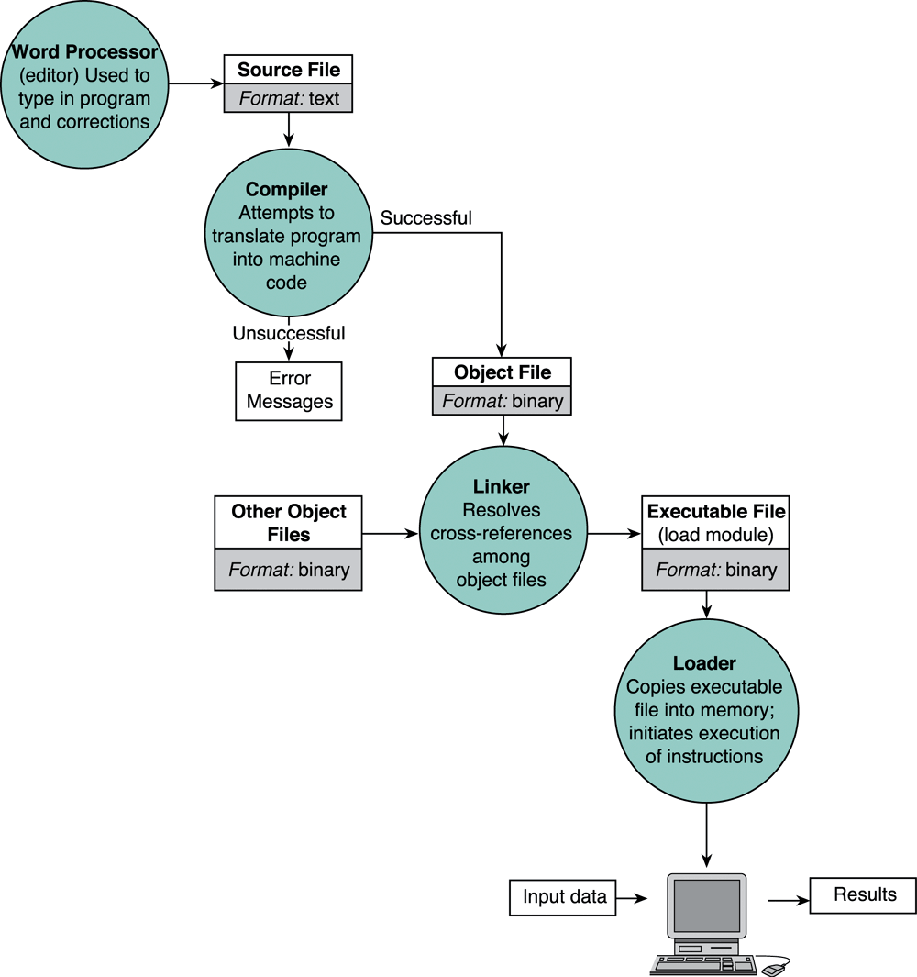
Editing, Translating, Linking, and Running High-Level Language Programs

Slide 14
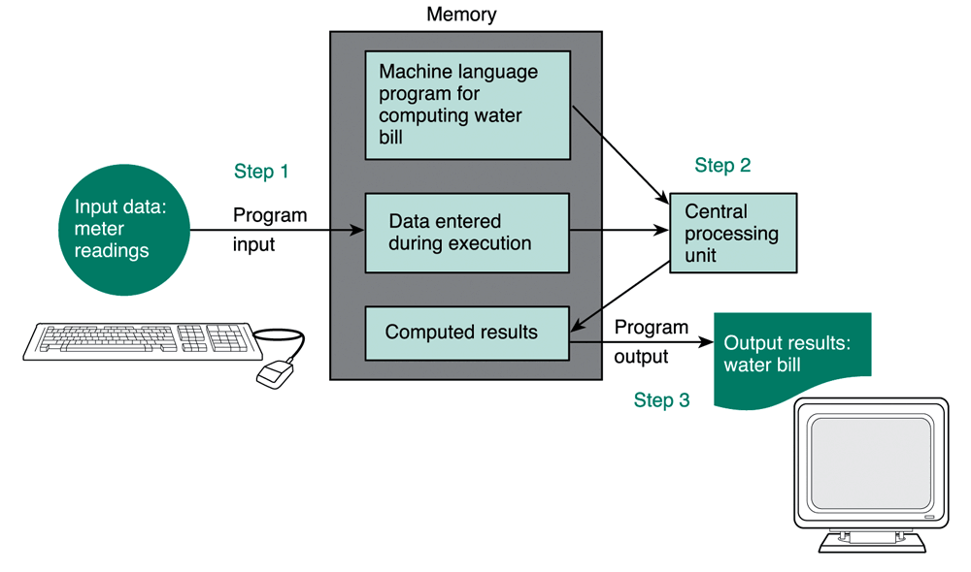
Flow of Information During Program Execution
Machine
Language
Program
Input
data
Output
Results

Slide 15
Software Development Method
Specify problem requirements
Analyze the problem
Design the algorithm to solve the problem
Implement the algorithm
Test and verify the completed program
Maintain and update the program

Slide 16
Steps Defined
Problem: statement that specifies the problem that should be solved on the computer.
Analysis: Understanding the problem and identifying the inputs, outputs, and required computation.
Design - Designing and developing the list of steps called algorithm to solve the problem.
Implementation: writing the algorithm as a program using a given programming language.
Testing - Testing requires checking and verifying that the program actually works as desired.
Maintenance - Maintaining involves finding previously undetected errors and keep it up-to-date.

Slide 17
Converting Miles to Kilometers
1. Problem: Your boss wants you to convert a list of miles to kilometers. Since you like programming, you decide to write a program to do the job.
2. Analysis
We need to receive miles as input
We need to output kilometers
We know 1 mile = 1.609 kilometers
3. Design
Get distance in miles
Convert to kilometers
Display kilometers

Slide 18
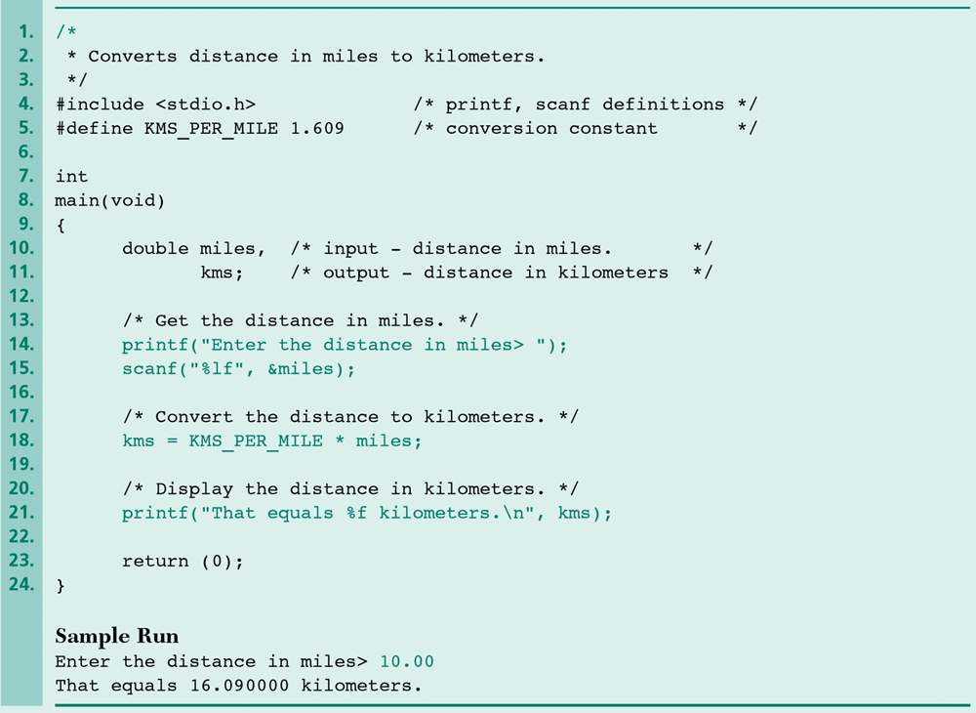
4. Implementation in C Language

Slide 19
Miles to Kilometers cont’d
5. Test
We need to test the previous program to make sure it works. To test we run our program and enter different values and make sure the output is correct.
6. Maintenance
Next time, your boss wants to add a new feature, so he wants you to add support for converting different units.

Slide 20
Pseudo code and Flowchart
Algorithm - A list of steps for solving a problem.
Pseudo code - A combination of English phrases and language constructs to describe the algorithm steps.
Flowchart - A diagram that shows the step-by-step execution of a program

Slide 21
Why use pseudo code?
The benefit of pseudo code is that it enables the programmer to concentrate on the algorithm without worrying about all the syntactic details of a particular programming language.
In fact, you can write pseudo code without even knowing what programming language you will use for the final implementation.
Pseudo code cannot be compiled or executed, and does not follow syntax rules. It is simply an important step in producing the final code.
Example:
Input Miles
Kilometers = Miles * 1.609
Output Kilometers

Slide 22
Another Example of Pseudo code
Problem: Calculate your final grade for ICS 103
Specify the problem: Get different grades and then compute the final grade.
Analyze the problem: We need to input grades for exams, labs, quizzes and the percentage each part counts for. Then we need to output the final grade.
Design
Get the grades: exams, quizzes, assignments, and labs.
Grade = 0.25 * Midterm Exam + 0.3 * Final Exam + 0.2 * Quizzes + 0.05 * Assignments + 0.2 * Lab
Output the Grade
Implement and Test: Learn how to program in C, Write the program, then Input some test values, calculate and check the final grade.

Slide 23
Flowchart
Flowchart uses boxes and arrows to show step by step execution of a program.
Process
Start or Terminal
Decision
Document
Display
Manual Input

Slide 24
Example of a Flowchart
Start
Get Grades and
percentages
Calculate
Final grade
Display
Grade
End

