Slide 1
Modeling Sequential Circuits in Verilog
COE 202
Digital Logic Design
Dr. Muhamed Mudawar
King Fahd University of Petroleum and Minerals

Slide 2
Presentation Outline
Modeling Latches and Flip-Flops
Blocking versus Non-Blocking Assignments
Modeling Sequential Circuit Diagrams
Modeling Mealy and Moore State Diagrams
Writing Test Benches for Sequential Circuits
Modeling Registers and Counters

Slide 3
Recall: Sensitivity List of always block
Syntax:
always @(sensitivity list) begin
procedural statements
end
Sensitivity list is a list of signals: @(signal1, signal2, …)
The sensitivity list triggers the execution of the always block
When there is a change of value in any listed signal
Otherwise, the always block does nothing until another change occurs on a signal in the sensitivity list

Slide 4
Guidelines for Sensitivity List
For combinational logic, the sensitivity list must include ALL the signals that are read inside the always block
Combinational logic can also use: @(*) or @*
For sequential logic, the sensitivity list may not include all the signals that are read inside the always block
For edge-triggered sequential logic use:
always @(posedge signal1, negedge signal2, …)
The positive edge or negative edge of each signal can be specified in the sensitivity list

Slide 5
Modeling a D Latch with Enable
// Modeling a D Latch with Enable and output Q
// Output Q must be of type reg
// Notice that the if statement does NOT have else
// If Enable is 0, then value of Q does not change
// The D_latch stores the old value of Q
module D_latch (input D, Enable, output reg Q);
always @(D, Enable)
if (Enable) Q <= D; // Non-blocking assignment
// No else means a latch (Q does not change)
endmodule

Slide 6
Modeling a D-type Flip-Flop
// Modeling a D Flip-Flop with outputs Q and Qbar
module D_FF (input D, Clk, output reg Q, Qbar);
// Q and Qbar change at the positive edge of Clk
// Notice that always is NOT sensitive to D input
always @(posedge Clk)
begin
Q <= D; // Non-blocking assignment
Qbar <= ~D; // Non-blocking assignment
end
endmodule

Slide 7
Negative-Edge Triggered D-type Flip-Flop
// Modeling a Negative-Edge Triggered D Flip-Flop
// The only difference is the negative edge of Clk
module D_FF2 (input D, Clk, output reg Q, Qbar);
// Q and Qbar change at the negative edge of Clk
always @(negedge Clk)
begin
Q <= D; // Non-blocking assignment
Qbar <= ~D; // Non-blocking assignment
end
endmodule

Slide 8
D-type Flip-Flop with Synchronous Reset
// Modeling a D Flip-Flop with Synchronous Reset input
module D_FF3 (input D, Clk, Reset, output reg Q, Qbar);
// always block is NOT sensitive to Reset or D
// Updates happen only at positive edge of Clk
// Reset is Synchronized with Clk
always @(posedge Clk)
if (Reset)
{Q, Qbar} <= 2'b01; // Non-blocking assignment
else
{Q, Qbar} <= {D, ~D}; // Non-blocking assignment
endmodule

Slide 9
D-type Flip-Flop with Asynchronous Reset
// Modeling a D Flip-Flop with Asynchronous Reset input
module D_FF4 (input D, Clk, Reset, output reg Q, Qbar);
// Q and Qbar change at the positive edge of Clk
// Or, at the positive edge of Reset
// Reset is NOT synchronized with Clk
always @(posedge Clk, posedge Reset)
if (Reset)
{Q, Qbar} <= 2'b01; // Non-blocking assignment
else
{Q, Qbar} <= {D, ~D}; // Non-blocking assignment
endmodule

Slide 10
Procedural Assignment
Procedural assignment is used inside a procedural block only
Two types of procedural assignments:
Blocking assignment:
variable = expression; // = operator
Variable is updated before executing next statement
Similar to an assignment statement in programming languages
Non-Blocking assignment:
variable <= expression; // <= operator
Variable is updated at the end of the procedural block
Does not block the execution of next statements

Slide 11
Blocking versus Non-Blocking Assignment
Guideline: Use Non-Blocking Assignment for Sequential Logic
q2
q1
q2
q1
in
D
Q
D
Q
D
Q
out
in
D
Q
out
clk
clk
module nonblocking
(input in, clk, output reg out);
reg q1, q2;
always @ (posedge clk) begin
q2 <= in;
q1 <= q2;
out <= q1;
end
endmodule
module blocking
(input in, clk, output reg out);
reg q1, q2;
always @ (posedge clk) begin
q2 = in;
q1 = q2; // q1 = in
out = q1; // out = in
end
endmodule
Read: in, q2, q1
Parallel Assignment at the end

Slide 12
Blocking versus Non-Blocking Assignment
Guideline: Use Blocking Assignment for Combinational Logic
a
a
x
x
b
Old x is
Latched
b
y
Old x
c
y
c
module blocking
(input a,b,c, output reg x,y);
always @ (a, b, c) begin
x = a & b; // update x
y = x | c; // y = a&b | c;
end
endmodule
module nonblocking
(input a,b,c, output reg x,y);
always @ (a, b, c) begin
x <= a & b;
y <= x | c;
end
endmodule
Evaluate all expressions
Parallel Assignment at the end

Slide 13
Verilog Coding Guidelines
When modeling combinational logic, use blocking assignments
When modeling sequential logic, use non-blocking assignments
When modeling both sequential and combinational logic within the same always block, use non-blocking assignments
Do NOT mix blocking with non-blocking assignments in the same always block
Do NOT make assignments to the same variable from more than one always block

Slide 14
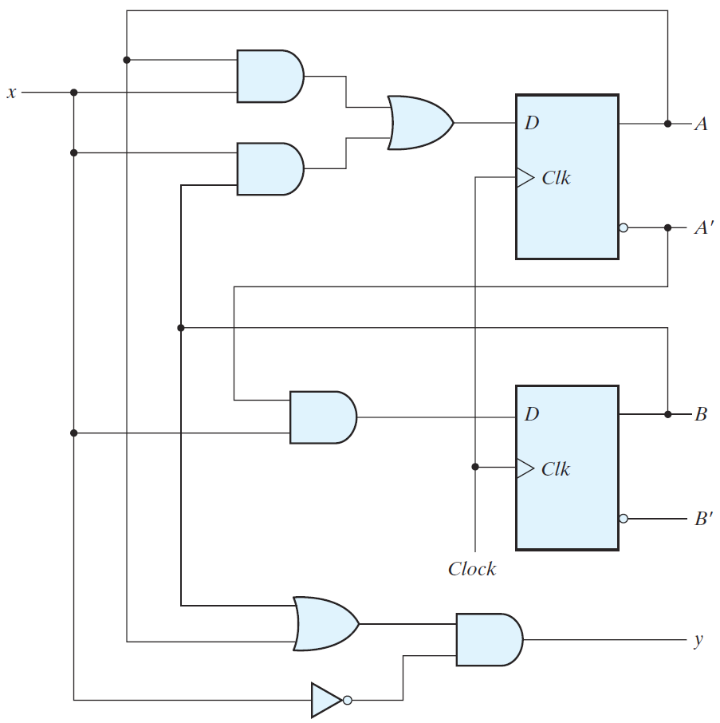
Structural Modeling of Sequential Circuit
Modeling the Circuit Structure
// Mixed Structural and assign
module Seq_Circuit_Structure
(input x, Clock, output y);
wire DA, DB, A, Ab, B, Bb;
// Instantiate two D Flip-Flops
D_FF FFA(DA, Clock, A, Ab);
D_FF FFB(DB, Clock, B, Bb);
// Next state and output logic
assign DA = (A & x) | (B & x);
assign DB = Ab & x;
assign y = (A | B) & ~x;
endmodule

Slide 15
Behavioral Modeling of Sequential Circuit
Modeling the Circuit Behavior
module Seq_Circuit_Behavior
(input x, Clock, output y);
// reg A, B for the Flip-Flops
reg A, B;
wire DA, DB;
// Modeling D FFs with always
// Update A, B at positive edge
// Non-Blocking assignment
always @(posedge Clock)
{A, B} <= {DA, DB};
// Next state and output logic
assign DA = (A & x) | (B & x);
assign DB = ~A & x;
assign y = (A | B) & ~x;
endmodule

Slide 16
Verifying Structural and Behavioral Models
module Seq_Circuit_TB; // Test Bench
reg x, clk;
wire y, z;
// Instantiate structural and behavioral sequential circuits
// Same inputs x and clk, but different outputs y and z
Seq_Circuit_Structure test1 (x, clk, y);
Seq_Circuit_Behavior test2 (x, clk, z);
// Generate a clock with period = 10
initial clk = 1;
always #5 clk = ~clk;
// Test sequence: x = 0, 1, 0, 1, 1, 0, 1, 1, 1, 1, 0, . . .
initial begin
x=0; #12 x=1; #10 x=0; #10 x=1; #20 x=0; #10 x=1; #40 x=0;
end
endmodule

Slide 17
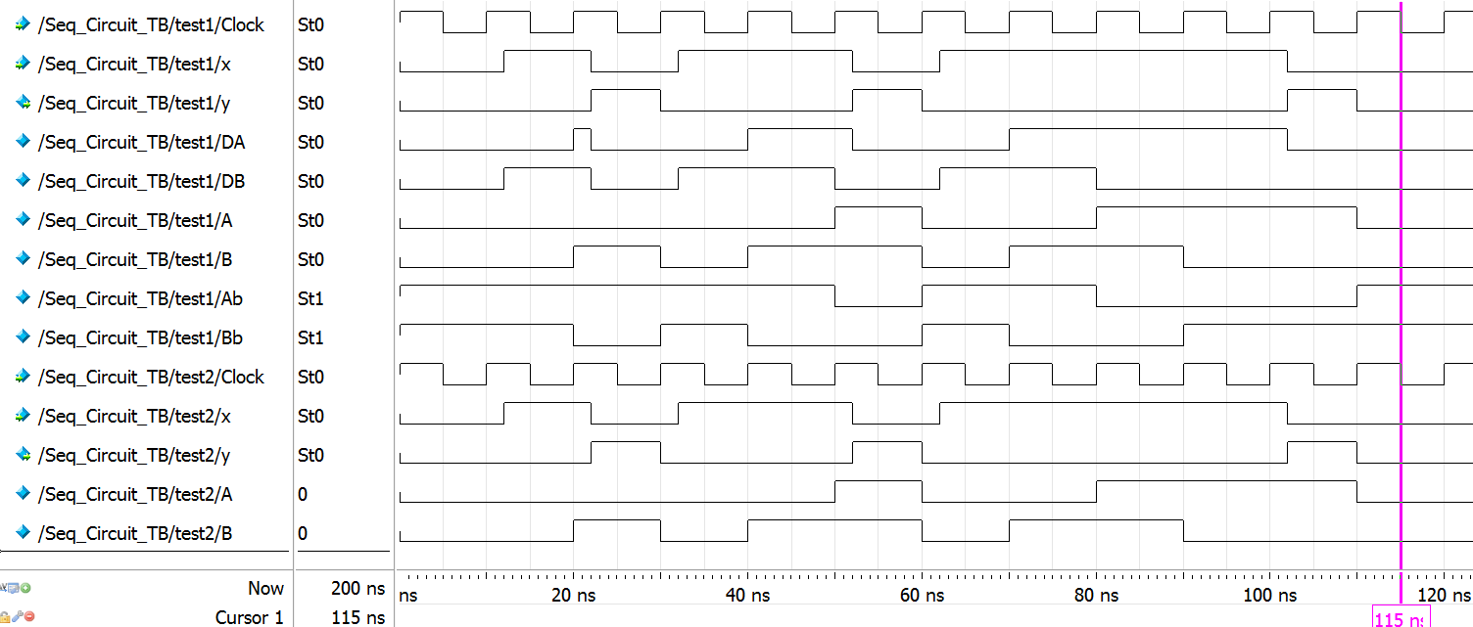
Simulation Waveforms
Structural and behavioral descriptions have identical waveforms

Slide 18
Modeling a State Diagram
A state diagram can be modeled directly in Verilog
Without the need of having the circuit implementation
An example of a Mealy state diagram is shown below
This is the state diagram of the 111 sequence detector
State assignment: S₀ = 00, S₁ = 01, and S₂ = 10
0 / 0
0 / 0
1 / 1
0 / 0
00
01
10
reset
1 / 0
1 / 0

Slide 19
Modeling a Mealy State Diagram
module Mealy_111_detector (input x, clock, reset, output z);
reg [1:0] state, next_state;
// Flip-flops with synchronous reset
always @(posedge clock)
if (reset) state <= 2'b00;
else state <= next_state;
// Next state logic
always @(*)
case(state)
2'b00: next_state = (x==1) ? 2'b01 : 2'b00;
2'b01: next_state = (x==1) ? 2'b10 : 2'b00;
2'b10: next_state = (x==1) ? 2'b10 : 2'b00;
default: next_state = 2'b00; // Unused state
endcase
// Output logic depends on present state and input x
assign z = (state == 2'b10) & x;
endmodule
0 / 0
0 / 0
1 / 1
0 / 0
reset
00
1 / 0
01
1 / 0
10

Slide 20
Modeling a Moore State Diagram
module Moore_Comparator (input A, B, clk, rst, output GT, LT, EQ);
reg [1:0] state, next;
// Flip-flops with asynchronous reset
always @(posedge clk, posedge rst)
if (rst) state <= 'b00; else state <= next;
// Next state logic (combinational)
always @(*)
case (state)
'b00: next = ({A,B}=='b01)?'b01:
({A,B}=='b10)?'b10:'b00;
'b01: next = ({A,B}=='b10)?'b10:'b01;
'b10: next = ({A,B}=='b01)?'b01:'b10;
default: next = 'b00; // Unused state
endcase
// Output logic
assign {GT, LT} = state;
assign EQ = ~(GT|LT);
endmodule
00, 11
00
001
rst
01
10
01
01
010
10
100
10
00
11
01
00
11
10

Slide 21
Test Bench for the Moore Comparator
module Moore_Comparator_TB; // Test Bench
reg A, B, clk, rst;
wire GT, LT, EQ;
Moore_Comparator test (A, B, clk, rst, GT, LT, EQ);
// Reset pulse
initial begin #2 rst = 1; #4 rst = 0; end
// Generate clock with period = 10
initial clk = 1;
always #5 clk = ~clk;
// Generate input test sequence
initial begin
{A,B}='b00; #12 {A,B}='b11; #10 {A,B}='b01; #10 {A,B}='b11;
#10 {A,B}='b10; #10 {A,B}='b00; #10 {A,B}='b01; #20 {A,B}='b10;
end
endmodule

Slide 22
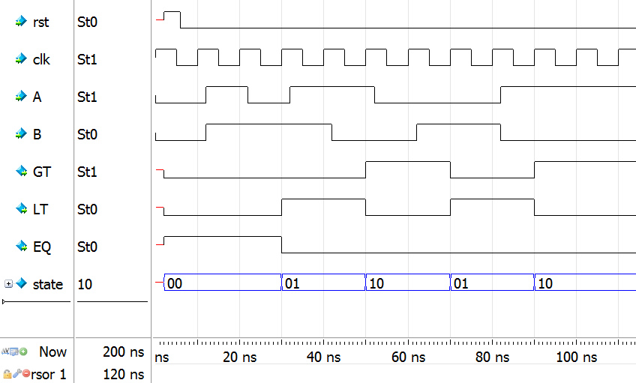
Moore Comparator Waveforms

Slide 23
Modeling a Register with Parallel Load
module Register #(parameter n = 4)
(input [n-1:0] Data_in, input load, clock, reset,
output reg [n-1:0] Data_out);
always @(posedge clock, posedge reset) // Asynchronous reset
if (reset) Data_out <= 0;
else if (load) Data_out <= Data_in;
endmodule

Slide 24
Modeling a Shift Register
module Shift_Register #(parameter n = 4)
(input Data_in, clock, reset, output Data_out);
reg [n-1:0] Q;
assign Data_out = Q[0]; // Serial Output
always @(posedge clock, negedge reset) // Asynchronous reset
if (!reset) Q <= 0; // Active Low reset
else Q <= {Data_in, Q[n-1:1]}; // Shifts to the right
endmodule

Slide 25
Modeling a Counter with Parallel Load
module Counter_with_Load #(parameter n = 4) // n-bit counter
( input [n-1:0] D, input Load, EN, clock,
output reg [n-1:0] Q, output Cout);
assign Cout = (&Q) & EN;
// Sensitive to Positive-edge
always @(posedge clock)
if (Load)
Q <= D;
else if (EN)
Q <= Q + 1;
endmodule
$$D_{3}$$
$$D_{2}$$
$$D_{1}$$
$$D_{0}$$
$$Load$$
$$Cout$$
4-bit Counter
$$EN$$
$$Cout$$
$$EN$$
$$clock$$
$$Q_{3}$$
$$Q_{2}$$
$$Q_{1}$$
$$Q_{0}$$

Slide 26
Modeling a Generic Up-Down Counter
module Up_Down_Counter #(parameter n = 16) // n-bit counter
( input [n-1:0] Data_in,
input [1:0] f, input reset, clock,
output reg [n-1:0] Count );
// Asynchronous reset
always @(posedge clock, posedge reset)
if (reset) Count <= 0;
else if (f == 1) Count <= Count + 1;
else if (f == 2) Count <= Count – 1;
else if (f == 3) Count <= Data_in;
endmodule
f = 0 ➔ Disable counter
f = 1 ➔ Count up
f = 2 ➔ Count down
f = 3 ➔ Load counter
Data_in
n
2
Up-Down
Counter
f
reset
clock
n
Count

Slide 27
Test Bench for the Up-Down Counter
module Up_Down_Counter_TB; // Test Bench
reg [7:0] Data_in; reg [1:0] f; reg rst, clk; wire [7:0] Count;
// Instantiate an 8-bit test counter
Up_Down_Counter #(8) test (Data_in, f, rst, clk, Count);
// Initialize Data_in (in hexadecimal)
initial Data_in = 8'h2A;
// Generate reset pulse
initial begin #2 rst=1; #4 rst=0; end
// Generate clock (cycle = 10)
initial clk = 1; always #5 clk = ~clk;
// Generate function sequence
initial begin
#2 f=3; #10 f=1; #30 f=2; #10 f=0; #10 f=1;
end
endmodule

Slide 28
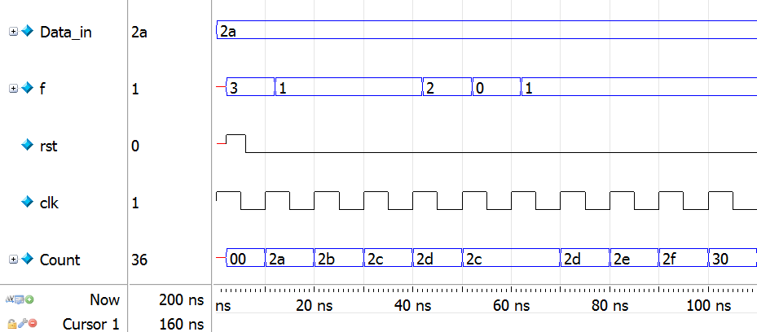
Up-Down Counter Waveforms

