Slide 1
Arithmetic Circuits
COE 202
Digital Logic Design
Dr. Muhamed Mudawar
King Fahd University of Petroleum and Minerals

Slide 2
Presentation Outline
Ripple-Carry Adder
Magnitude Comparator
Design by Contraction
Signed Numbers
Addition/Subtraction of Signed 2's Complement

Slide 3
Binary Addition
Start with the least significant bit (rightmost bit)
Add each pair of bits
Include the carry in the addition
carry
1
1
1
1
0
0
1
1
0
1
1
0
(54)
+
0
0
0
1
1
1
0
1
(29)
0
1
0
1
0
0
1
1
(83)
bit position:
7
6
5
4
3
2
1
0

Slide 4
Iterative Design: Ripple Carry Adder
Uses identical copies of a full adder to build a large adder
Simple to implement: can be extended to add any number of bits
The cell (iterative block) is a full adder
Adds 3 bits: a_{i}, b_{i}, c_{i}, Computes: Sum s_{i} and Carry-out c_{i+1}
Carry-out of cell i becomes carry-in to cell (i +1)
a_{i}
b_{i}
a₃
b₃
a₂
b₂
a₁
b₁
a₀
b₀
c_{i+1}
Full
Adder
c_{i}
c₄
Full
Adder
c₃
Full
Adder
c₂
Full
Adder
c₁
Full
Adder
c₀
s_{i}
s₃
s₂
s₁
s₀

Slide 5
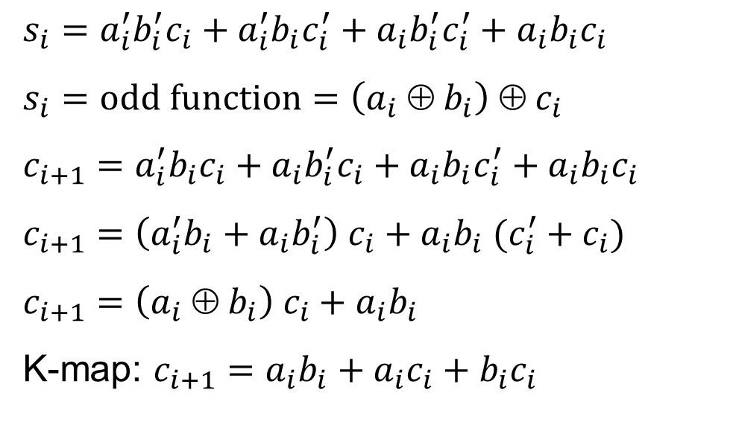
Full-Adder Equations
$s_{i}=a_{i}^{′}b_{i}^{′}c_{i}+a_{i}^{′}b_{i}c_{i}^{′}+a_{i}b_{i}^{′}c_{i}^{′}+a_{i}b_{i}c_{i}$
$s_{i}=odd function=\left(a_{i} ⊕ b_{i}\right) ⊕ c_{i}$
$c_{i+1}=a_{i}^{′}b_{i}c_{i}+a_{i}b_{i}^{′}c_{i}+a_{i}b_{i}c_{i}^{′}+a_{i}b_{i}c_{i}$
$c_{i+1}=\left(a_{i}^{′}b_{i}+a_{i}b_{i}^{′}\right) c_{i}+a_{i}b_{i} (c_{i}^{′}+c_{i})$
$c_{i+1}=\left(a_{i} ⊕ b_{i}\right) c_{i}+a_{i}b_{i}$
K-map: $c_{i+1}=a_{i}b_{i}+a_{i}c_{i}+b_{i}c_{i}$
a_{i}
b_{i}
c_{i+1}
Full
Adder
c_{i}
s_{i}
a_{i} b_{i} c_{i} | c_{i+1} | s_{i}
0 0 0 | 0 | 0
0 0 1 | 0 | 1
0 1 0 | 0 | 1
0 1 1 | 1 | 0
1 0 0 | 0 | 1
1 0 1 | 1 | 0
1 1 0 | 1 | 0
1 1 1 | 1 | 1
$$b_{i}c_{i}$$
K-Map of $s_{i}$
$$b_{i}c_{i}$$
K-Map of $c_{i+1}$
$$a_{i}$$
00
01
11
10
$$a_{i}$$
00
01
11
10
0
0
1
0
1
0
0
0
1
0
1
1
0
1
0
1
0
1
1
1

Slide 6
Carry Propagation
a₃
b₃
a₂
b₂
a₁
b₁
a₀
b₀
c₃
c₂
c₁
c₀
c₄
s₃
s₂
s₁
s₀
Major drawback of ripple-carry adder is the carry propagation
The carries are connected in a chain through the full adders
This is why it is called a ripple-carry adder
The carry ripples (propagates) through all the full adders

Slide 7
Longest Delay Analysis
a₃
b₃
a₂
b₂
a₁
b₁
a₀
b₀
c₃
c₂
c₁
Δ₁
c₀
Δ₂
Δ₁
Δ₂
Δ₂
Δ₂
c₄
s₃
s₂
s₁
s₀
Suppose the XOR delay is Δ₁ and AND-OR delay is Δ₂
For an N-bit ripple-carry adder, if all inputs are present at once:
Most-significant sum-bit delay = 2Δ₁ +(N – 1) Δ₂
Final Carry-out delay = Δ₁ + N Δ₂

Slide 8
Next . . .
Ripple-Carry Adder
Magnitude Comparator
Design by Contraction
Signed Numbers
Addition/Subtraction of Signed 2's Complement

Slide 9
Magnitude Comparator
A combinational circuit that compares two unsigned integers
Two Inputs:
Unsigned integer A (m-bit number)
Unsigned integer B (m-bit number)
Three outputs:
A > B (GT output)
A == B (EQ output)
A < B (LT output)
Exactly one of the three outputs must be equal to 1
While the remaining two outputs must be equal to 0
m-bit
Magnitude Comparator
GT: A > B
A[m–1:0]
m
EQ: A == B
B[m–1:0]
m
LT: A < B

Slide 10
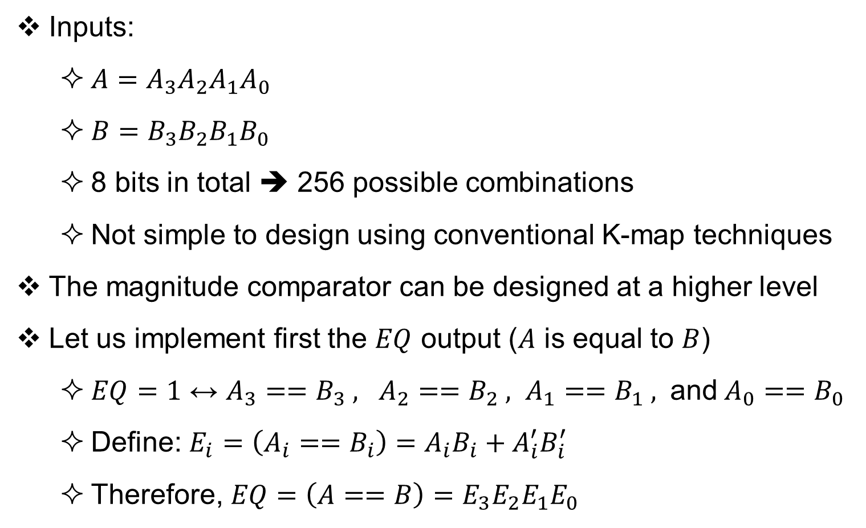
Example: 4-bit Magnitude Comparator
Inputs:
$A=A_{3}A_{2}A_{1}A_{0}$
$B=B_{3}B_{2}B_{1}B_{0}$
8 bits in total ➔ 256 possible combinations
Not simple to design using conventional K-map techniques
The magnitude comparator can be designed at a higher level
Let us implement first the $EQ$ output ($A$ is equal to $B$)
$EQ=1$ ↔ $A_{3}==B_{3} , A_{2}==B_{2} , A_{1}==B_{1} ,$ and$A_{0}==B_{0}$
Define: $E_{i}={\left(A_{i}==B_{i}\right)=A}_{i}B_{i}+A_{i}^{′}B_{i}^{′}$
Therefore, $EQ={\left(A==B\right)=E}_{3}E_{2}E_{1}E_{0}$

Slide 11
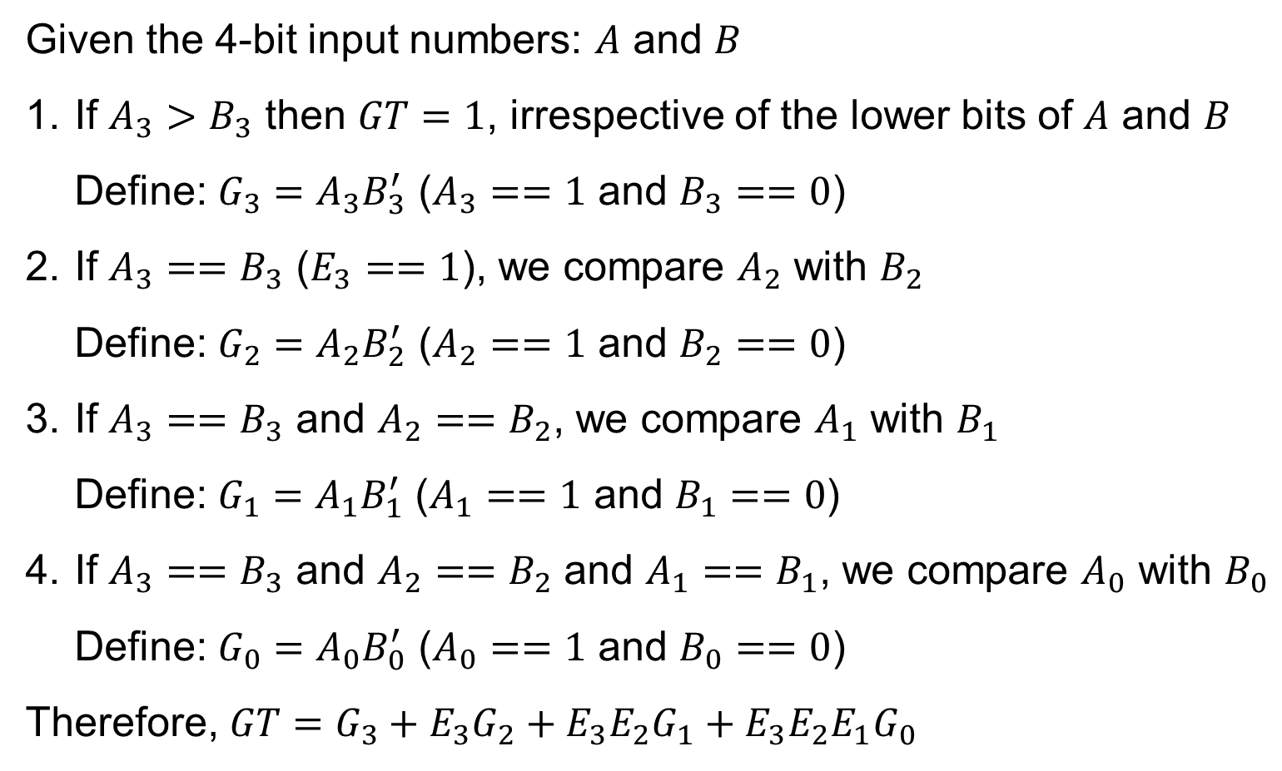
The Greater Than Output
Given the 4-bit input numbers: $A$ and $B$
If $A_{3}>B_{3}$ then $GT=1$, irrespective of the lower bits of $A$ and $B$
Define: $G_{3}=A_{3}B_{3}^{′}$ ($A_{3}==1$ and $B_{3}==0$)
If $A_{3}==B_{3}$ ($E_{3}==1$), we compare $A_{2}$ with $B_{2}$
Define: $G_{2}=A_{2}B_{2}^{′}$ ($A_{2}==1$ and $B_{2}==0$)
If $A_{3}==B_{3}$ and $A_{2}==B_{2}$, we compare $A_{1}$ with $B_{1}$
Define: $G_{1}=A_{1}B_{1}^{′}$ ($A_{1}==1$ and $B_{1}==0$)
If $A_{3}==B_{3}$ and $A_{2}==B_{2}$ and $A_{1}==B_{1}$, we compare $A_{0}$ with $B_{0}$
Define: $G_{0}=A_{0}B_{0}^{′}$ ($A_{0}==1$ and $B_{0}==0$)
Therefore, $GT=G_{3}+E_{3}G_{2}+E_{3}E_{2}G_{1}+E_{3}E_{2}E_{1}G_{0}$

Slide 12
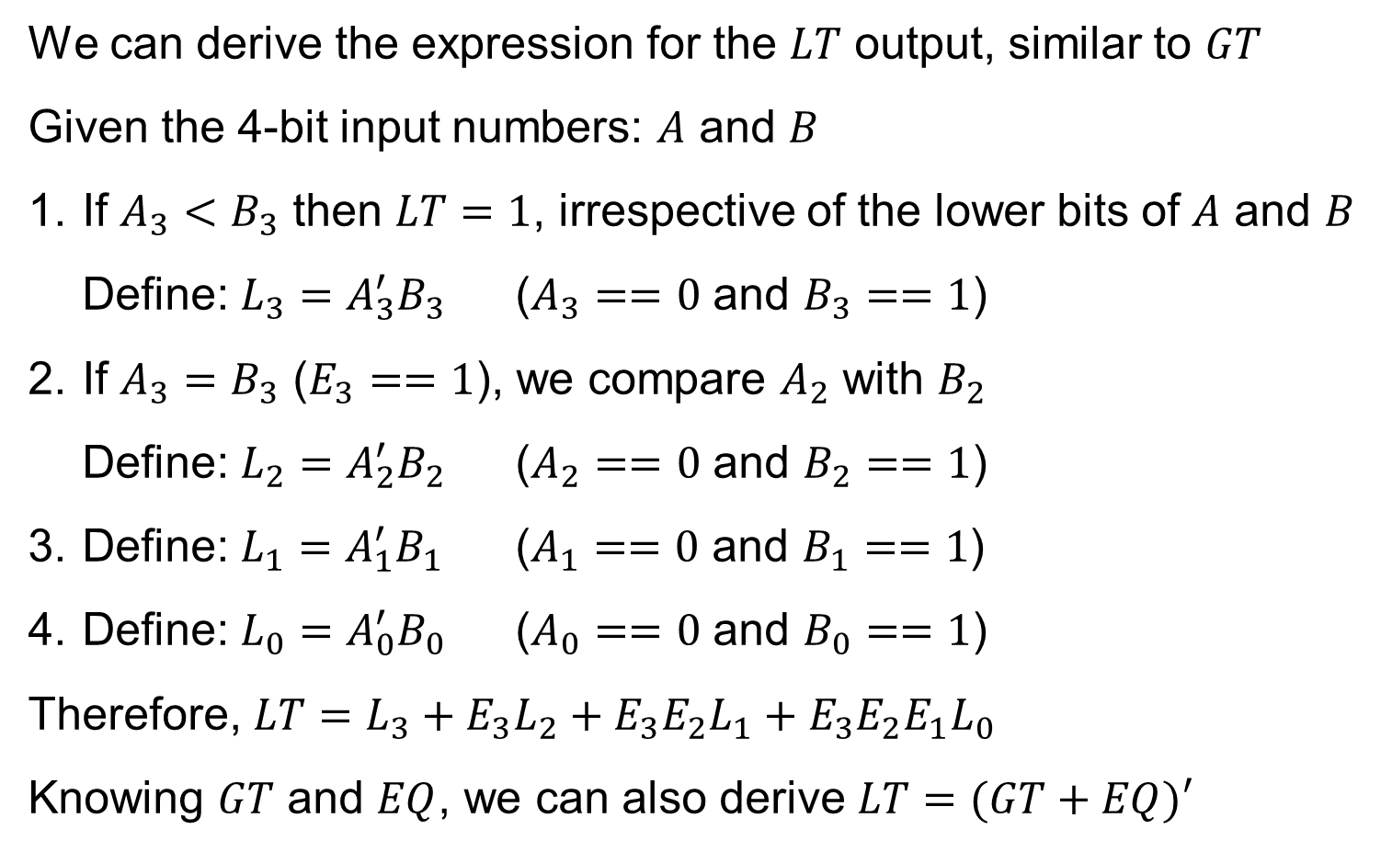
The Less Than Output
We can derive the expression for the $LT$ output, similar to $GT$
Given the 4-bit input numbers: $A$ and $B$
If $A_{3}<B_{3}$ then $LT=1$, irrespective of the lower bits of $A$ and $B$
Define: $L_{3}=A_{3}^{′}B_{3}$ ($A_{3}==0$ and $B_{3}==1$)
If $A_{3}=B_{3}$ ($E_{3}==1$), we compare $A_{2}$ with $B_{2}$
Define: $L_{2}=A_{2}^{′}B_{2}$ ($A_{2}==0$ and $B_{2}==1$)
Define: $L_{1}=A_{1}^{′}B_{1}$ ($A_{1}==0$ and $B_{1}==1$)
Define: $L_{0}=A_{0}^{′}B_{0}$ ($A_{0}==0$ and $B_{0}==1$)
Therefore, $LT=L_{3}+E_{3}L_{2}+E_{3}E_{2}L_{1}+E_{3}E_{2}E_{1}L_{0}$
Knowing $GT$ and $EQ$, we can also derive $LT=(GT+EQ)′$

Slide 13
Iterative Magnitude Comparator Design
The Magnitude comparator can also be designed iteratively
4-bit magnitude comparator is implemented using 4 identical cells
Design can be extended to any number of cells
Comparison starts at least-significant bit
Final comparator output: $GT=GT_{4} , EQ=EQ_{4} , LT=LT_{4}$
$A_{3}$
$B_{3}$
$A_{2}$
$B_{2}$
$A_{1}$
$B_{1}$
$A_{0}$
$B_{0}$
$GT_{4}$
Cell 3
$GT_{3}$
Cell 2
$GT_{2}$
Cell 1
$GT_{1}$
Cell 0
$GT_{0}=$ 0
$$EQ_{4}$$
$EQ_{3}$
$EQ_{2}$
$EQ_{1}$
$$EQ_{0}=1$$
$LT_{4}$
$LT_{3}$
$LT_{2}$
$LT_{1}$
$$LT_{0}=0$$

Slide 14

Cell Implementation
Each Cell $i$ receives as inputs:
Bit $i$ of inputs $A$ and $B$: $A_{i}$ and $B_{i}$
$GT_{i}$, $EQ_{i}$, and $LT_{i}$ from cell $(i−1)$
Each Cell $i$ produces three outputs:
$GT_{i+1}$, $EQ_{i+1}$, and $LT_{i+1}$
Outputs of cell $i$ are inputs to cell $(i+1)$
Output Expressions of Cell $i$
$EQ_{i+1}=E_{i} EQ_{i}$ $E_{i}=A_{i}^{′}B_{i}^{′}+A_{i}B_{i}$ ($A_{i}$ equals $B_{i}$)
$GT_{i+1}={A_{i}^{}B}_{i}^{′}+E_{i} GT_{i}$ $A_{i}B_{i}^{′}$ ($A_{i}$ > $B_{i}$)
$LT_{i+1}=A_{i}^{′}B_{i}+E_{i} LT_{i}$ $A_{i}^{′}B_{i}$ ($A_{i}$ < $B_{i}$)
Third output can be produced for first two: $LT=(EQ+GT)′$
$A_{i}$
$B_{i}$
$GT_{i+1}$
Cell $i$
$GT_{i}$
$EQ_{i+1}$
$EQ_{i}$
$LT_{i+1}$
$LT_{i}$

Slide 15
Next . . .
Ripple-Carry Adder
Magnitude Comparator
Design by Contraction
Signed Numbers
Addition/Subtraction of Signed 2's Complement

Slide 16
Design by Contraction
Contraction is a technique for simplifying the logic
Applying 0s and 1s to some inputs
Equations are simplified after applying fixed 0 and 1 inputs
Converting a function block to a more simplified function
Examples of Design by Contraction
Incrementing a number by a fixed constant
Comparing a number to a fixed constant

Slide 17
Designing an Incrementer
An incrementer is a special case of an adder
Sum = A + 1 (B = 0, C₀ = 1)
An n-bit Adder can be simplified into an n-bit Incrementer
$$a3$$
0
$$a2$$
0
$$a1$$
0
$$a0$$
0
0
$$a3$$
0
$$a2$$
0
$$a1$$
0
$$a0$$
$$c3$$
$$c2$$
$$c1$$
$$a0$$
1
$$c4$$
$$a_{0}^{′}$$
$$s3$$
$$s2$$
$$s1$$
$$s0$$

Slide 18
Simplifying the Incrementer Circuit
Many gates were eliminated
No longer needed when an input is a constant
Last cell can be replicated to implemented an n-bit incrementer
$$a3$$
$$a2$$
$$a1$$
$$a0$$
a [3:0]
4
$$c3$$
$$c2$$
$$c1$$
Incrementer
$$c4$$
c₄
4
s [3:0]
$$s3$$
$$s2$$
$$s1$$
$$s0$$

Slide 19
Next . . .
Ripple-Carry Adder
Magnitude Comparator
Design by Contraction
Signed Numbers
Addition/Subtraction of Signed 2's Complement

Slide 20
Signed Numbers
Several ways to represent a signed number
Sign-Magnitude
1's complement
2's complement
Divide the range of values into two parts
First part corresponds to the positive numbers (≥ 0)
Second part correspond to the negative numbers (< 0)
The 2's complement representation is widely used
Has many advantages over other representations

Slide 21
Sign-Magnitude Representation
n-bit number
Sign
Bit
bit
n-2
. . .
bit
2
bit
1
bit
0
Magnitude = n – 1 bits
Independent representation of the sign and magnitude
Leftmost bit is the sign bit: 0 is positive and 1 is negative
Using n bits, largest represented magnitude = 2^{n-1} – 1
Sign-magnitude
8-bit representation of +45
Sign-magnitude
8-bit representation of -45
0
0
1
0
1
1
0
1
1
0
1
0
1
1
0
1

Slide 22
Properties of Sign-Magnitude
Symmetric range of represented values:
For n-bit register, range is from -(2^{n-1} – 1) to +(2^{n-1} – 1)
For example, if n = 8 bits then range is -127 to +127
Two representations for zero: +0 and -0 NOT Good!
Two circuits are needed for addition & subtraction NOT Good!
In addition to an adder, a second circuit is needed for subtraction
Sign and magnitude parts should be processed independently
Sign bit should be examined to determine addition or subtraction
Addition of numbers of different signs is converted into subtraction
Increases the cost of the add/subtract circuit

Slide 23
Sign-Magnitude Addition / Subtraction
Eight cases for Sign-Magnitude Addition / Subtraction
Operation | ADD Magnitudes | Subtract Magnitudes
 |  | A >= B | A < B
(+A) + (+B) | +(A+B)
(+A) + (-B) |  | +(A–B) | -(B–A)
(-A) + (+B) |  | -(A–B) | +(B–A)
(-A) + (-B) | -(A+B)
(+A) – (+B) |  | +(A–B) | -(B–A)
(+A) – (-B) | +(A+B)
(-A) – (+B) | -(A+B)
(-A) – (-B) |  | -(A–B) | +(B–A)

Slide 24
1’s Complement Representation
Given a binary number A
The 1’s complement of A is obtained by inverting each bit in A
Example: 1’s complement of (01101001)₂ = (10010110)₂
If A consists of n bits then:
A + (1’s complement of A) = (2^{n} – 1) = (1…111)₂ (all bits are 1's)
Range of values is -(2^{n-1} – 1) to +(2^{n-1} – 1)
For example, if n = 8 bits, range is -127 to +127
Two representations for zero: +0 and -0 NOT Good!
1's complement of (0…000)₂ = (1…111)₂ = 2^{n} – 1
-0 = (1…111)₂ NOT Good!

Slide 25
2’s Complement Representation
Standard way to represent signed integers in computers
A simple definition for 2’s complement:
Given a binary number A
The 2’s complement of A = (1’s complement of A) + 1
Example: 2’s complement of (01101001)₂ =
(10010110)₂ + 1 = (10010111)₂
If A consists of n bits then
A + (2’s complement of A) = 2^{n}
2’s complement of A = 2^{n} – A

Slide 26
Computing the 2's Complement
starting value | 00100100₂ = +36
step1: Invert the bits (1's complement) | 11011011₂
step 2: Add 1 to the value from step 1 | + 1₂
sum = 2's complement representation | 11011100₂ = -36
2’s complement of 11011100₂ (-36) = 00100011₂ + 1 = 00100100₂ = +36
The 2’s complement of the 2’s complement of A is equal to A
Another way to obtain the 2's complement:
Start at the least significant 1
Leave all the 0s to its right unchanged
Complement all the bits to its left
Binary Value
= 00100 1 00
2's Complement
= 11011 1 00
least
significant 1

Slide 27
Properties of the 2’s Complement
Range of represented values: -2^{n-1} to +(2^{n-1} – 1)
For example, if n = 8 bits then range is -128 to +127
There is only one zero = (0…000)₂ (all bits are zeros)
The 2’s complement of A is the negative of A
The sum of A + (2’s complement of A) must be zero
The final carry is ignored
Consider the 8-bit number A = 00101100₂ = +44
2’s complement of A = 11010100₂ = -44
00101100₂ + 11010100₂ = 1 00000000₂ (8-bit sum is 0)
Ignore final carry = 2⁸

Slide 28
Values of Different Representations
8-bit Binary Representation | Unsigned Value | Sign Magnitude Value | 1's Complement Value | 2's Complement Value
00000000 | 0 | +0 | +0 | 0
00000001 | 1 | +1 | +1 | +1
00000010 | 2 | +2 | +2 | +2
. . . | . . . | . . . | . . . | . . .
01111101 | 125 | +125 | +125 | +125
01111110 | 126 | +126 | +126 | +126
01111111 | 127 | +127 | +127 | +127
10000000 | 128 | -0 | -127 | -128
10000001 | 129 | -1 | -126 | -127
10000010 | 130 | -2 | -125 | -126
. . . | . . . | . . . | . . . | . . .
11111101 | 253 | -125 | -2 | -3
11111110 | 254 | -126 | -1 | -2
11111111 | 255 | -127 | -0 | -1

Slide 29
2's Complement Signed Value
Positive numbers (sign-bit = 0)
Signed value = Unsigned value
Negative numbers (sign-bit = 1)
Signed value = Unsigned value – 2^{n}
n = number of bits
Negative weight for sign bit
The 2's complement representation assigns a negative weight to the sign bit (most-significant bit)
-128 + 32 + 16 + 4 = -76
8-bit Binary | Unsigned Value | Signed Value
00000000 | 0 | 0
00000001 | 1 | +1
00000010 | 2 | +2
. . . | . . . | . . .
01111101 | 125 | +125
01111110 | 126 | +126
01111111 | 127 | +127
10000000 | 128 | -128
10000001 | 129 | -127
10000010 | 130 | -126
. . . | . . . | . . .
11111101 | 253 | -3
11111110 | 254 | -2
11111111 | 255 | -1
1
0
1
1
0
1
0
0
-128
64
32
16
8
4
2
1

Slide 30
Next . . .
Ripple-Carry Adder
Magnitude Comparator
Design by Contraction
Signed Numbers
Addition/Subtraction of Signed 2's Complement

Slide 31
Converting Subtraction into Addition
When computing A – B, convert B to its 2's complement
A – B = A + (2’s complement of B)
Same adder is used for both addition and subtraction
This is the biggest advantage of 2's complement
Final carry is ignored, because
A + (2's complement of B) = A + (2^{n} – B) = (A – B) + 2^{n}
Final carry = 2^{n}, for n-bit numbers
borrow:
-1
-1
-1
carry:
1
1
1
1
0 1 0 0 1 1 0 1 0 1 0 0 1 1 0 1
– 0 0 1 1 1 0 1 0 + 1 1 0 0 0 1 1 0 (2's complement)
0 0 0 1 0 0 1 1 0 0 0 1 0 0 1 1 (same result)

Slide 32
Adder/Subtractor for 2's Complement
Same adder is used to compute: (A + B) or (A – B)
Subtraction (A – B) is computed as: A + (2's complement of B)
2's complement of B = (1's complement of B) + 1
Two operations: OP = 0 (ADD), OP = 1 (SUBTRACT)
B [n-1:0]
OP
OP = 0 (ADD)
B XOR 0 = B
S = A + B + 0 = A + B
OP = 1 (SUBTRACT)
B XOR 1 = 1's complement of B
S = A + (1's complement of B) + 1
S = A + (2's complement of B)
S = A – B
A [n-1:0]
n
n XOR
gates
n
n-bit input vectors
n
n-bit Adder
c₀
c_{n}
n
n-bit output vector
S [n-1:0]

Slide 33
Carry versus Overflow
Carry is important when …
Adding unsigned integers
Indicates that the unsigned sum is out of range
Sum > maximum unsigned n-bit value
Overflow is important when …
Adding or subtracting signed integers
Indicates that the signed sum is out of range
Overflow occurs when …
Adding two positive numbers and the sum is negative
Adding two negative numbers and the sum is positive
Simplest way to detect Overflow: V = C_{n–1} ⊕ C_{n}
C_{n-1} and C_{n} are the carry-in and carry-out of the most-significant bit

Slide 34
Carry and Overflow Examples
We can have carry without overflow and vice-versa
Four cases are possible (Examples on 8-bit numbers)
1
1
1
1
1
1
0
0
0
0
1
1
1
1
15
0
0
0
0
1
1
1
1
15
+
+
0
0
0
0
1
0
0
0
8
1
1
1
1
1
0
0
0
248 (-8)
0
0
0
1
0
1
1
1
23
0
0
0
0
0
1
1
1
7
Carry = 0 Overflow = 0
Carry = 1 Overflow = 0
1
1
1
1
0
1
0
0
1
1
1
1
79
1
1
0
1
1
0
1
0
218 (-38)
+
+
0
1
0
0
0
0
0
0
64
1
0
0
1
1
1
0
1
157 (-99)
1
0
0
0
1
1
1
1
143 (-113)
0
1
1
1
0
1
1
1
119
Carry = 0 Overflow = 1
Carry = 1 Overflow = 1

Slide 35
Range, Carry, Borrow, and Overflow
Unsigned Integers: n-bit representation
Signed Integers: 2's complement representation
Number < 0
Number > max
Borrow for
Subtraction
Finite Set of Unsigned Integers
Carry = 1 for
Addition
min = 0
max = 2^{n}–1
Number < min
Number > max
Negative
Overflow
Finite Set of Signed Integers
Positive
Overflow
min = -2^{n-1}
0
max = 2^{n-1}–1

