Slide 1
Characteristics of Logic Gates
COE 202
Digital Logic Design
Dr. Muhamed Mudawar
King Fahd University of Petroleum and Minerals

Slide 2
Presentation Outline
Timing Diagrams
Gate Delay and Circuit Delay
Fan-In and Fan-Out

Slide 3
Voltage Levels
Logic 1 is a range of voltage values
NOT just a single voltage value
Logic 0 is also a range of voltages
Not just zero volt
The voltage range between logic 0 and 1 is undefined
Digital signals are not allowed to use voltage values in the undefined range
Logic 1
Voltage Range
Undefined
Voltage
Range
Logic 0
Voltage Range

Slide 4
Timing Diagram
Shows the logic values of signals in a circuit versus time
Waveform: the shape of a signal over a period of time
Example: timing diagram of an AND gate (with zero delay)
x
0
1
1
0
1
1
0
x
z
y
1
1
0
0
0
1
1
y
AND gate
with zero delay
z
0
1
0
0
0
1
0
time

Slide 5
Gate Delay
A change in the inputs of a gate causes a change in its outputs
However, the change in the output signal is not instantaneous
There is a small delay between an input signal change and an output signal change, called gate delay
x
0
1
1
0
1
1
0
x
z
y
y
1
1
0
0
0
1
1
Gate delay = τ
τ
τ
τ
τ
z
0
1
0
0
0
1
0
time

Slide 6
Propagation Delay in a Circuit
In a given circuit, each gate has a delay
The circuit has a propagation delay between inputs and outputs
The propagation delay is computed along the critical path
To compute the propagation delay, start at the inputs:
Delay at each gate output = Maximum input delay + Gate delay
Propagation delay of a circuit = maximum delay at any output

Slide 7
Computing the Maximum Circuit Delay
Consider the following circuit with 8 inputs and 2 outputs
Delay of a 2-input AND gate = 2 ns
Delay of a 3-input AND gate = 3 ns
Delay of a 2-input OR gate = 2 ns
Delay of a 3-input OR gate = 3 ns
2 ns
5 ns
$$f$$
Compute the Maximum Circuit Delay
3 ns
8 ns
$$g$$
6 ns
3 ns

Slide 8
Rise-Time and Fall-Time
In logic simulators, a waveform is drawn as an ideal wave
The change from 0 to 1 (or from 1 to 0) is instantaneous
In reality, a signal has a non-zero rise-time and fall-time
Time taken to change from 10% to 90% of High voltage (and vice versa)
Ideal Wave
90%
50%
Real Wave
10%
Rise Time
Fall Time
Rise Time

Slide 9
Fan-In
The fan-in is the number of inputs to a gate
Example: a 3-input AND gate has a Fan-in of 3
Logic gates with a large fan-in tend to be slow
Increasing the Fan-in of a gate increases the gate delay
For example, a 3-input AND gate has a higher delay than a 2-input AND gate made with the same technology
Using logic gates with higher fan-in is useful when reducing the depth (number of levels) of a logic circuit

Slide 10
Fan-Out
In digital circuits, it is common for the output of one gate (called driver gate) to be connect to the inputs of several load gates
The fan-out of a gate is the number of gate inputs it can feed
There is a limit on the maximum fan-out of a gate
The output of a driver gate can supply a limited amount of current.
Each input of a load gate consumes a certain amount of current.
Therefore, the driver gate can only feed a limited number of load gates.
Driver
Gate
1
Load Gates
2
Fan-Out= 2

Slide 11
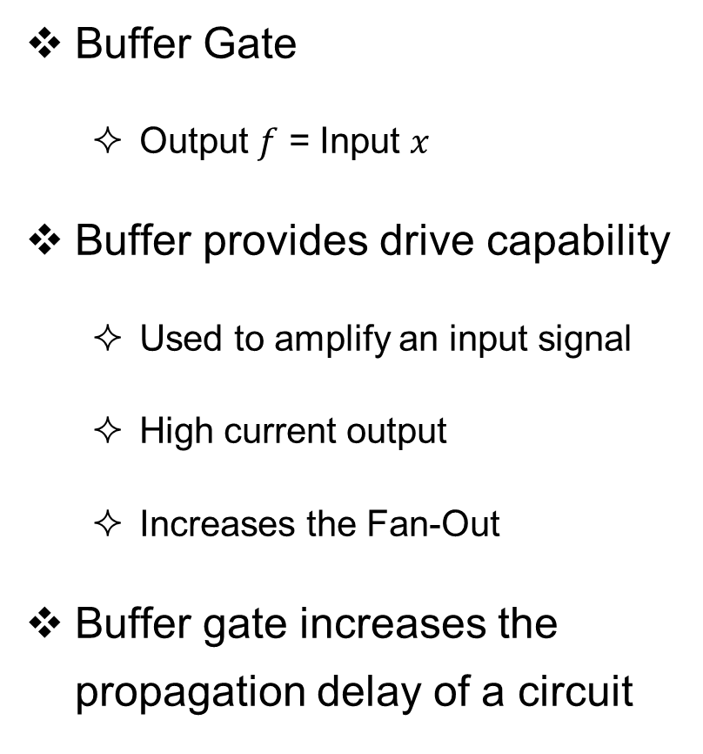
Increasing the Fan-Out with a Buffer Gate
Buffer Gate
Output $f$ = Input $x$
Buffer provides drive capability
Used to amplify an input signal
High current output
Increases the Fan-Out
Buffer gate increases the propagation delay of a circuit
Buffer Gate
$$x$$
$$f=x$$
1
Buffer
Gate
2
Load Gates
Fan-Out = N
N

