Slide 1
COE 561 Digital System Design & Synthesis Sequential Logic Synthesis
Dr. Aiman H. El-Maleh
Computer Engineering Department
King Fahd University of Petroleum & Minerals
[Adapted from slides of Prof. G. De Micheli: Synthesis & Optimization of Digital Circuits]

Slide 2
Outline
Modeling synchronous circuits
State-based models.
Structural models.
State-based optimization methods
State minimization.
State encoding
State encoding for two-level logic
Input encoding
Output encoding
State encoding for multiple-level logic
Structural-based optimization methods
Retiming

Slide 3
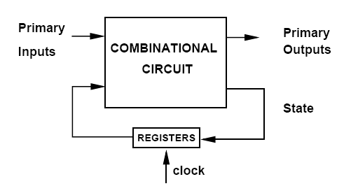
Synchronous Logic Circuits
Interconnection of
Combinational logic gates.
Synchronous delay elements
E-T or M-S registers.
Assumptions
No direct combinational feedback.
Single-phase clocking.

Slide 4
Modeling Synchronous Circuits
State-based model
Model circuits as finite-state machines.
Represented by state tables/diagrams.
Lacks a direct relation between state manipulation and corresponding area and delay variations.
Apply exact/heuristic algorithms for
State minimization.
State encoding.
Structural models
Represent circuit by synchronous logic network.
Apply
Retiming.
Logic transformations.

Slide 5
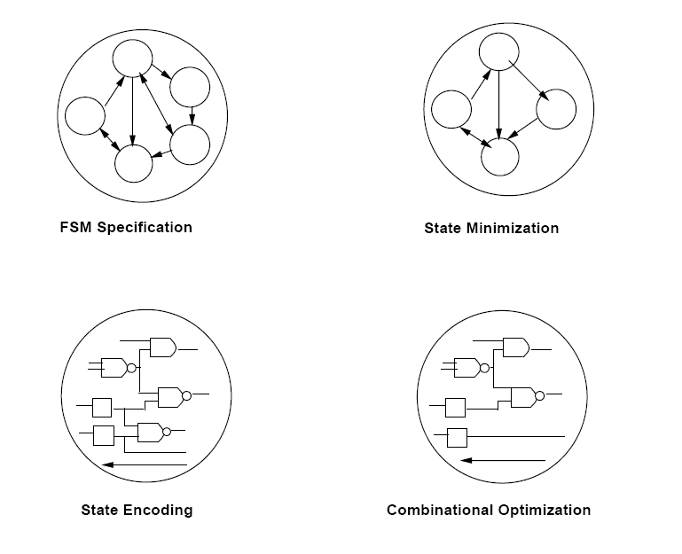
State-Based Optimization

Slide 6
Formal Finite-State Machine Model
Defined by the quintuple (Χ, Υ, S, δ, λ).
A set of primary inputs patterns Χ.
A set of primary outputs patterns Υ.
A set of states S.
A state transition function
δ : Χ × S → S.
An output function
λ: Χ × S → Υ for Mealy models
λ : S → Υ for Moore models.

Slide 7
State Minimization
Aims at reducing the number of machine states
reduces the size of transition table.
State reduction may reduce
the number of storage elements.
the combinational logic due to reduction in transitions
Completely specified finite-state machines
No don't care conditions.
Easy to solve.
Incompletely specified finite-state machines
Unspecified transitions and/or outputs.
Intractable problem.

Slide 8
State Minimization for Completely-Specified FSMs
Equivalent states
Given any input sequence the corresponding output sequences match.
Theorem: Two states are equivalent iff
they lead to identical outputs and
their next-states are equivalent.
Equivalence is transitive
Partition states into equivalence classes.
Minimum finite-state machine is unique.

Slide 9
Algorithm
Stepwise partition refinement.
Initially
∏₁ = States belong to the same block when outputs are the same for any input.
Refine partition blocks: While further splitting is possible
∏_{k+1} = States belong to the same block if they were previously in the same block and their next-states are in the same block of ∏_{k} for any input.
At convergence
Blocks identify equivalent states.

Slide 10
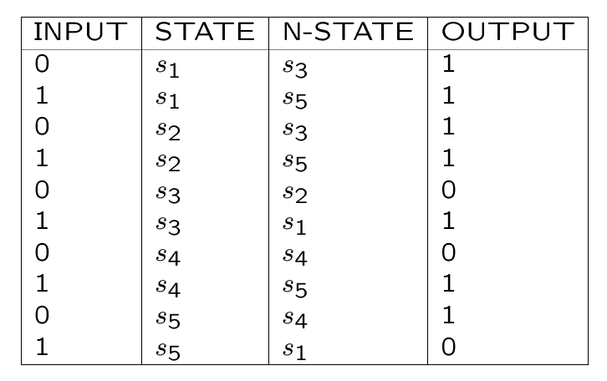
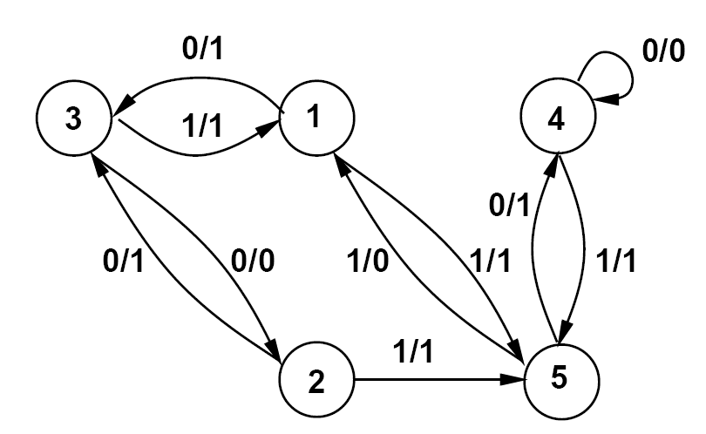
Example …
∏₁ = {(s1, s2), (s3, s4), (s5)}.
∏₂ = {(s1, s2), (s3), (s4), (s5)}.
∏₂ = is a partition into equivalence classes
States (s1, s2) are equivalent.

Slide 11
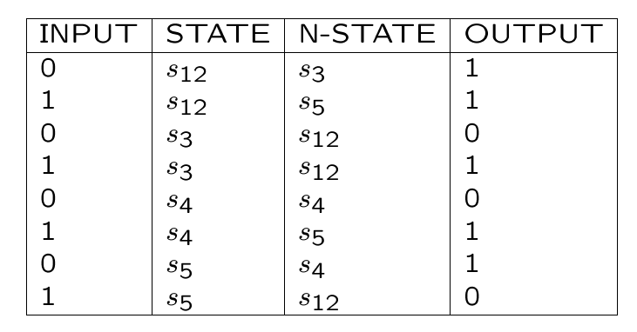
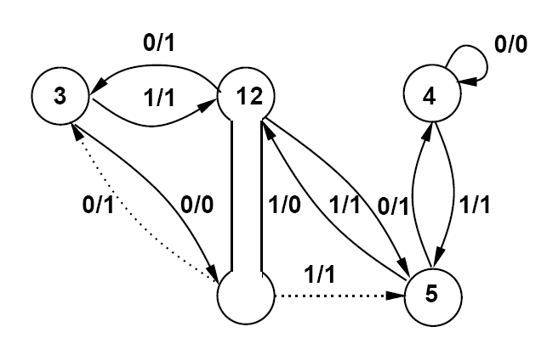
… Example …
Original FSM
Minimal FSM

Slide 12
… Example
Original FSM
{OUT_0} = IN_0 LatchOut_v1' + IN_0 LatchOut_v3' + IN_0' LatchOut_v2'
v4.0 = IN_0 LatchOut_v1' + LatchOut_v1' LatchOut_v2'
v4.1 = IN_0' LatchOut_v2 LatchOut_v3 + IN_0' LatchOut_v2'
v4.2 = IN_0 LatchOut_v1' + IN_0' LatchOut_v1 + IN_0' LatchOut_v2 LatchOut_v3
sis> print_stats
pi= 1 po= 1 nodes= 4 latches= 3
lits(sop)= 22 #states(STG)= 5
Minimal FSM
{OUT_0} = IN_0 LatchOut_v1' + IN_0 LatchOut_v2 + IN_0' LatchOut_v2'
v3.0 = IN_0 LatchOut_v1' + LatchOut_v1' LatchOut_v2‘
v3.1 = IN_0' LatchOut_v1' + IN_0' LatchOut_v2'
sis> print_stats
pi= 1 po= 1 nodes= 3 latches= 2
lits(sop)= 14 #states(STG)= 4

Slide 13
Computational Complexity
Polynomially-bound algorithm.
There can be at most |S| partition refinements.
Each refinement requires considering each state
Complexity O(|S|²).
Actual time may depend upon
Data-structures.
Implementation details.

Slide 14
State Minimization for Incompletely-Specified FSMs …
Applicable input sequences
All transitions are specified.
Does not lead to any unspecified transition.
Compatible states
Given any applicable input sequence the corresponding output sequences match.
Theorem: Two states are compatible iff
they lead to identical outputs (when both are specified),
their next-states are compatible (when both are specified).
Compatibility is not an equivalency relation (not transitive).

Slide 15
An Interesting Example
Moore machine with 3-states.
Replace don’t care output of s1 by 0 → Can’t be minimized.
Replace don’t care output of s1 by 1 → Can’t be minimized.
Replacing don’t cares with all possible assignments does not guarantee a minimum solution.
Maximal compatible classes
(s1, s2) ⇐ (s1, s3)
(s1, s3) ⇐ (s1, s2)
Machine can be reduced to two states.
Input | State | N-State | Out
0 | s1 | s2 | -
1 | s1 | s3 | -
0 | s2 | - | 0
1 | s2 | s1 | 0
0 | s3 | s1 | 1
1 | s3 | - | 1
Input | State | N-State | Out
0 | A | A | 0
1 | A | B | 0
0 | B | A | 1
1 | B | B | 1

Slide 16
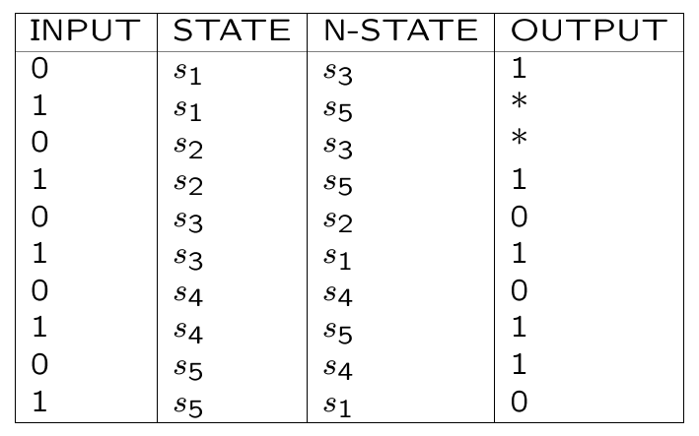
… State Minimization for Incompletely Specified FSMs
Minimum finite-state machine is not unique.
Implication relations make problem intractable.
Example
Replace * by 1.
{(s1, s2), (s3), (s4), (s5)}.
Replace * by 0.
{(s1, s5), (s2, s3, s4)}.
Compatible states (s1, s2).
Incompatible states (s1, s3),
(s1, s4), (s2, s5), (s3, s5),
(s4, s5).
If (s3, s4) are compatible
then (s1, s5) are compatible.

Slide 17
Compatibility and Implications …
Compatible pairs
(s1, s2)
(s1, s5) ⇐ (s3, s4)
(s2, s4) ⇐ (s3, s4)
(s2, s3) ⇐ (s1, s5)
(s3, s4) ⇐ (s2, s4) and (s1, s5)
Incompatible pairs
(s2, s5), (s3, s5)
(s1, s4), (s4, s5)
(s1, s3)

Slide 18
… Compatibility and Implications
A class of compatible states is such that all state pairs are compatible.
A class is maximal
If not subset of another class.
Closure property
A set of classes such that all compatibility implications are satisfied.
The set of maximal compatibility classes
Satisfies always the closure property.
May not provide a minimum solution.
Minimum covers may involve compatibility classes that are not necessarily maximal.

Slide 19
Maximal Compatible Classes
(s1, s2)
(s1, s5) ⇐ (s3, s4)
(s2, s3, s4) ⇐ (s1, s5)
Cover with MCC has cardinality 3.
Minimum cover: {(s1, s5) , (s2, s3, s4)}.
Minimum cover has cardinality 2.
Reduced Table
Input | State | N-State | Output
0 | A | B | 1
1 | A | A | 0
0 | B | B | 0
1 | B | A | 1

Slide 20
Finding Maximal Compatible Classes …
Knowing that s_{i} and s_{j} are two incompatible states implies that no maximal compatible class will contain both s_{i} and s_{j}.
Every set of states that does not contain any incompatible pair is a compatible set.
Associate a variable x_{i} to state s_{i} such that x_{i} =1 implies that s_{i} is an element of the set.
Write a conjunction of two-literal clauses.
Each clause corresponds to an incompatible pair.
Convert the expression into a prime and irredundant sum-of-product form.
Every term corresponds to a maximal compatible set and represents the sets that do no appear in the prime implicant.

Slide 21
… Finding Maximal Compatible Classes
Example
Incompatible pairs
(s2, s5), (s3, s5)
(s1, s4), (s4, s5)
(s1, s3)
Two-literal Clauses
(x₂’+x₅’) (x₃’+x₅’) (x₄’+x₅’) (x₁’+x₄’) (x₁’+x₃’)
Prime and Irredundant sum-of-product
= (x₂’ x₃’ x₄’+x₅’) (x₁’+ x₃’x₄’)
= x₁’ x₂’ x₃’ x₄’+ x₁’x₅’+ x₂’ x₃’ x₄’+ x₃’x₄’ x₅’
= x₁’ x₅’+ x₂’ x₃’ x₄’+ x₃’ x₄’ x₅’
Maximal Compatible Classes
x₁’x₅’ → (S₂,S₃,S₄)
x₂’ x₃’ x₄’→ (S₁,S₅)
x₃’x₄’ x₅’ → (S₁,S₂)

Slide 22
Formulation of the State Minimization Problem
A class is prime, if not subset of another class implying the same set or a subset of classes.
Compute the prime compatibility classes (PCC).
Select a minimum number of PCC such that
all states are covered.
all implications are satisfied.
Binate covering problem.
Upper bound on optimum solution given by
Cardinality of set of maximal compatible classes and
Original state set cardinality.
Lower bound on optimum solution given by
A unate cover solution that disregards implications.

Slide 23
Setting Up Covering Problem …
All states must be contained in at least one compatible class (covering).
All compatible classes implied by any compatible class must be contained in a compatible class in the solution (closure).
Associate a variable c_{i} to the i-th compatible class such that c_{i} =1 implies that class i is part of the solution.
We write a Boolean formula (product of sum form) to express the conditions for a set of compatible classes to represent a closed cover.
Terms representing covering constraints
Terms representing closure constraints.

Slide 24
… Setting Up Covering Problem …
Maximal compatibles classes
c₁:(s1, s2)
c₂:(s1, s5) ⇐ (s3, s4)
c₃:(s2, s3, s4) ⇐ (s1, s5)
Covering constraints
s1: (c₁ + c₂)
s2: (c₁ + c₃)
s3: (c₃)
s4: (c₃)
s5: (c₂)
Closure constraints
c₂ → c₃ : (c₂’ + c₃)
c₃ → c₂ : (c₃’ + c₂)

Slide 25
… Setting Up Covering Problem
Binate covering problem
(c₁ + c₂) (c₁ + c₃) (c₂) (c₃) (c₂’ + c₃) (c₃’ + c₂)
=(c₁ + c₂ c₃) (c₂) (c₃) (c₂’ + c₃) (c₃’ + c₂)
= (c₂ c₃) (c₂’ + c₃) (c₃’ + c₂)
= (c₂ c₃)
Minimum cover: {c₂ c₃}.
Minimum cover: {(s1, s5) , (s2, s3, s4)}.

Slide 26
Finding Prime Compatible Classes …
All maximal compatible classes are prime.
Let C₁ and C₂ be two compatible classes such that C₁ ⊃ C₂.
One tempted to favor C₁ over C₂ as it covers more states.
It might be better to choose C₂ in case that C₁ implies the selection of other compatible classes that would not be required if C₂ is selected.
The set of compatible classes implied by a compatible class is denoted as its class set (CS).
For each maximal compatible class (or prime) p of size k with a non-empty class set, consider all its subsets S_{p} of compatible classes of size k-1.
For each s ∈S_{p}, and if there is a prime q of size > k-1, such that s ⊂ q and CS_{s} ⊇ CS_{q} then s is not prime. Otherwise, it is prime.

Slide 27
… Finding Prime Compatible Classes
Maximal compatibles classes
(s1, s2)
(s1, s5) ⇐ (s3, s4)
(s2, s3, s4) ⇐ (s1, s5)
Prime compatibles classes
(s2, s3, s4)
(s2, s3) ⇐ (s1, s5) Not prime
(s2, s4) ⇐ (s3, s4) Prime
(s3, s4) ⇐ (s2, s4) and (s1, s5) Not prime
(s1, s5)
(s1) Not prime
(s5) Prime
(s2, s4)
(s2) Not prime
(s4) Prime
Set of prime compatible classes
(s1, s2), (s1, s5), (s2, s3, s4), (s2, s4), (s5), (s4)

Slide 28
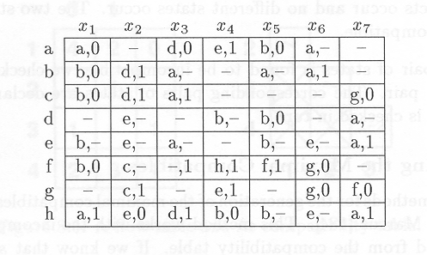
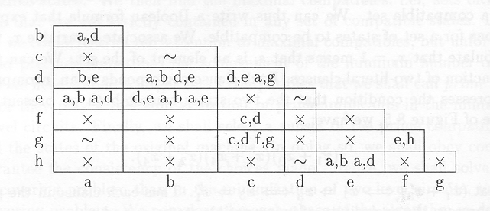
Additional State Minimization Example
Flow Table
Compatibility
Table

Slide 29
Maximal Compatibility Classes Computation
=
=
=
=
=

Slide 30
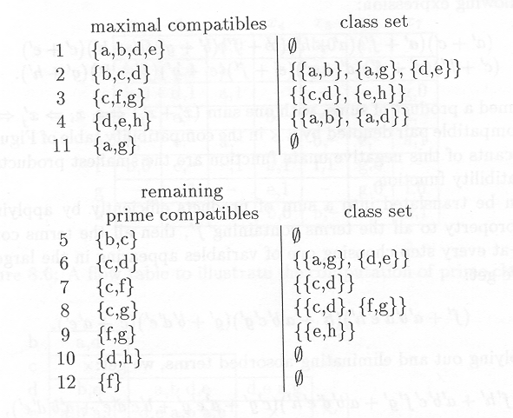
Prime Compatibility Classes Computation

Slide 31
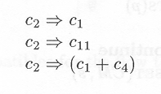
Setting Up the Covering Problem
Covering clauses: One clause for each state
For state a, the only two compatibles that cover it are 1 and 11.
Closure Constraints
Prime 2 ({b, c, d}) requires {(a, b), (a, g), (d, e)}.
Covering problem formulation

Slide 32
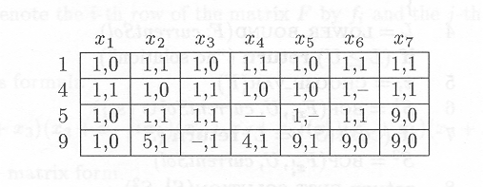
Reduced Table
Minimum cost solution: c₁=c₄=c₅=c₉=1.
Reduced table is not unique. It will lead to different implementations with different cost.

Slide 33
State Encoding
Determine a binary encoding of the states (|S|=n_{s}) that optimize machine implementation
Area
Cycle-time
Power dissipation
Testability
Assume D-type registers.
Circuit complexity is related to
Number of storage bits n_{b} used for state representation
Size of combinational component
There are possible encodings
Implementation Modeling
Two-level circuits.
Multiple-level circuits.

Slide 34
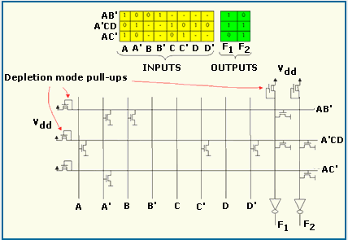
Two-Level Circuit Models
Sum of product representation.
PLA implementation.
Area
# of products (rows) × # I/Os (columns).
Delay
Twice # of products (2 column length) plus # I/Os (1 row length).
Note
# products considered as the size of a minimum implementation.
# I/Os depends on encoding length.

Slide 35
State Encoding for Two-Level Models
Early work focused on use of minimum-length codes i.e. using n_{b}= ⎡log₂ n_{s}⎤.
Most classical heuristics are based on reduced dependency criterion
Encode states so that state variables have least dependencies on those representing previous states.
Correlates weakly with minimality of sum-of-products representation.
Symbolic minimization of state table.
Equivalent to minimizing the size of sum-of-products form related to all codes that satisfy the corresponding constraints.
Constrained encoding problems.
Exact and heuristic methods.

Slide 36
Symbolic Minimization
Minimization of Boolean functions where codes of inputs and/or outputs are not specified.
Minimize tables of symbols rather than binary tables.
Extension to bvi and mvi function minimization.
Reduce the number of rows of a table, that can have symbolic fields.
Reduction exploits
Combination of input symbols in the same field.
Covering of output symbols.
Applications
Encoding of op-codes.
State encoding of finite-state machines.
Problems
Input encoding.
Output encoding.
Mixed encoding.

Slide 37
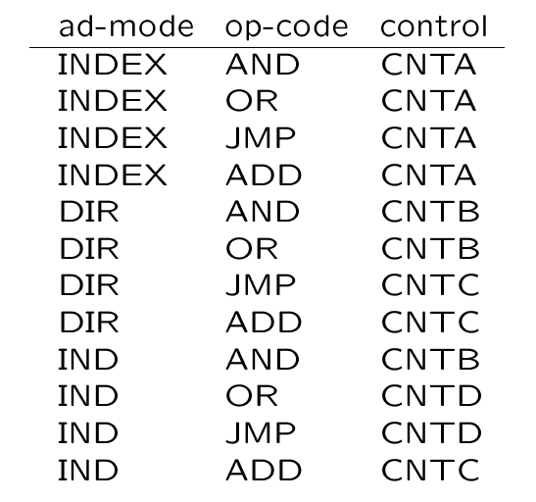
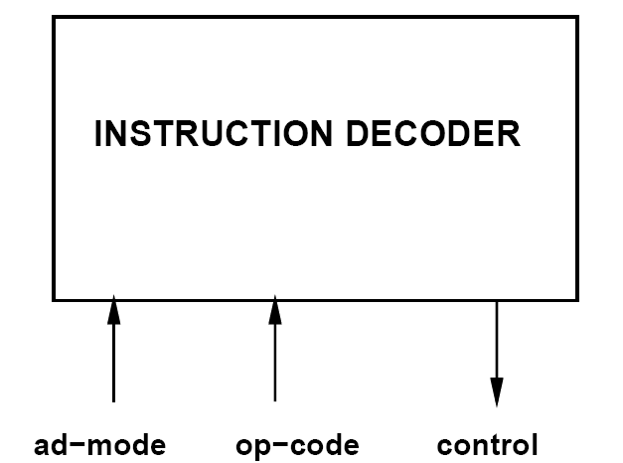
Input Encoding Example
Replace input symbols by binary strings to minimize corresponding
covers

Slide 38
Definitions
Symbolic cover
List of symbolic implicants.
List of rows of a table.
Symbolic implicant
Conjunction of symbolic literals.
Symbolic literals
Simple: one symbol.
Compound: the disjunction of some symbols.

Slide 39
Input Encoding Problem
Degrees of freedom in encoding the input symbols.
Goal
Reduce size of the representation.
Approach
Encode to minimize number of rows.
Encode to minimize number of bits.
Represent each string by 1-hot codes.
Minimize table with mvi minimizer.
Interpret minimized table
Compound mvi-literals.
Groups of symbols.

Slide 40
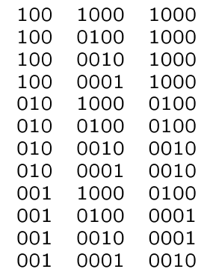
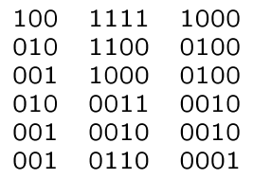
Input Encoding Example …
Input Encoding Problem
Encoded Cover
Minimum
Cover
0 0 0 1

Slide 41
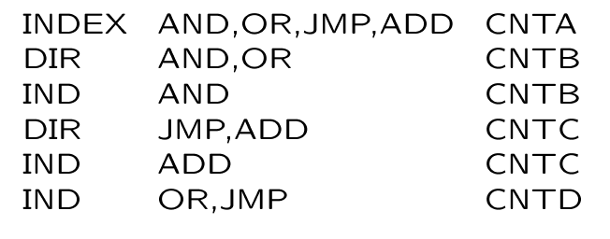
… Input Encoding Example
Examples of
Simple literal: AND
Compound literal: AND,OR
Minimum Symbolic Cover
Minimum Cover
0 0 0 1

Slide 42
Input Encoding Problem
Transform minimum symbolic cover into minimum bv-cover.
Map symbolic implicants into bv implicants (one to one).
Compound literals
Encode corresponding symbols so that their supercube does not include other symbol codes.
Replace encoded literals into cover.

Slide 43
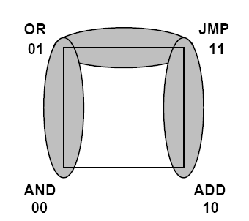
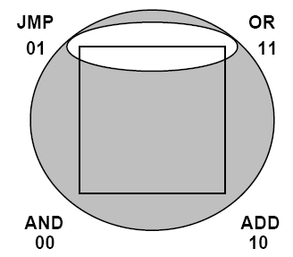
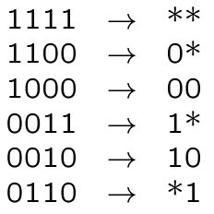
Example
Valid code
Compound literals
AND,OR,JMP,ADD
AND,OR
JMP,ADD
OR,JMP
Valid code
{AND 00, OR 01, JMP 11, ADD 10}
Replacement in cover
Invalid code
1

Slide 44
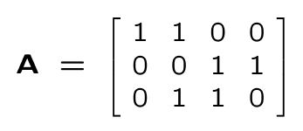
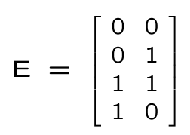
Input Encoding Algorithms
Problem specification
Constraint matrix A
One row for each constraint (literal) and one column for each symbol
a_{ij} = 1 iff symbol j belongs to literal i.
Solution sought for
Encoding matrix E
As many rows as the symbols.
Encoding length n_{b}.
Constraint matrix
Encoding matrix
AND OR JMP ADD
AND,OR
JMP,ADD
OR,JMP
AND
OR
JMP
ADD

Slide 45
Input Encoding Problem
Given constraint matrix A
Find encoding matrix E
Satisfying all input encoding constraints (due to compound literals)
With minimum number of columns (bits).
An encoding matrix E satisfies the encoding constraints by A if for each row a^{T} of A
The supercube of rows of E corresponding to 1’s in a^{T} does not intersect any of the rows of E corresponding to 0’s in a^{T}.
Identity matrix is always a valid encoding.
1-hot encoding
Theorem: Given a constraint matrix A, the encoding matrix E=A^{T} satisfies the constrains of A.

Slide 46
Dichotomy Theory
Dichotomy
Two sets (L, R).
Bipartition of a subset of the symbol set.
Encoding
Set of columns of E.
Each column corresponds to a bipartition of symbol set.
Rationale
Encoding matrix is equivalent to a set of bipartitions.
Each row of the constraint matrix implies some choice on the codes i.e. induces a bipartition.

Slide 47
Dichotomies
Dichotomy associated with row a^{T} of A
A set pair (L, R)
L has the symbols with the 1s in a^{T}
R has the symbols with the 0s in a^{T}
Seed dichotomy associated with row a^{T} of A
A set pair (L, R)
L has the symbols with the 1s in a^{T}
R has one symbol with a 0 in a^{T}
Dichotomy associated with constraint a^{T} = 1100
({AND, OR}; {JMP, ADD}).
The corresponding seed dichotomies are
({AND, OR}; {JMP})
({AND, OR}; {ADD}).

Slide 48
Definitions
Compatibility
(L₁, R₁) and (L₂, R₂) are compatible if
L₁ ∩ L₂ = ∅ and R₁ ∩ R₂ = ∅ or
L₁ ∩ R₂ = ∅ and R₁ ∩ L₂ = ∅.
Covering
Dichotomy (L₁, R₁) covers (L₂, R₂) if
L₁ ⊇ L₂ and R₁ ⊇ R₂ or
L₁ ⊇ R₂ and R₁ ⊇ L₂.
Prime dichotomy
Dichotomy that is not covered by any compatible dichotomy of a given set.
Union of two compatible dichotomies is a dichotomy covering both with smallest left and right blocks.

Slide 49
Exact Input Encoding
Compute all prime dichotomies.
Form a prime/seed dichotomy table.
Find minimum cover of seeds by primes.
Prime dichotomies can be computed based on Compatibility graphs of seed dichotomies by
Finding largest clique covering each edge
An encoding can be found based on
Compatibility graphs of seed dichotomies by a clique covering
Conflict graphs of seed dichotomies by a graph coloring

Slide 50
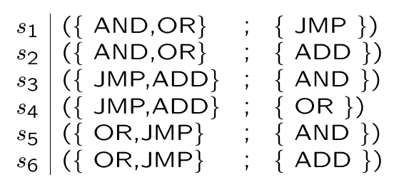
Example …
Encoding matrix
Seed dichotomies
Prime Dichotomies

Slide 51
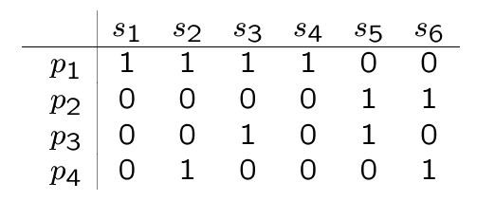
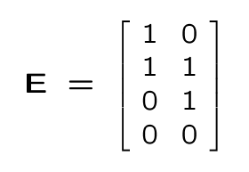
… Example
Table
Minimum cover: p₁ and p₂
Encoding
AND
OR
JMP
ADD

Slide 52
Heuristic Encoding
Determine dichotomies of rows of A.
Column-based encoding
Construct E column by column.
Iterate
Determine maximum compatible set.
Find a compatible encoding.
Use it as column of E.
Dichotomies
First two dichotomies are compatible.
Encoding column [1100]^{T} satisfies d₁ , d₂.
Need to satisfy d₃. Second encoding column [0110]^{T}.

Slide 53
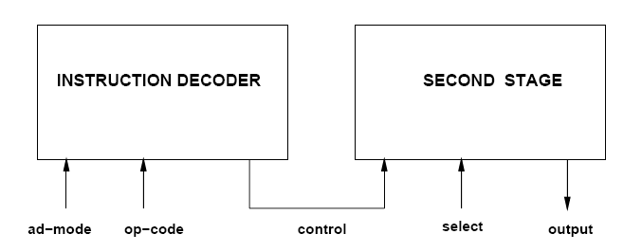
Output and Mixed Encoding
Output encoding
Determine encoding of output symbols.
Mixed encoding
Determine both input and output encoding
Examples
Interconnected circuits.
Circuits with feedback.

Slide 54
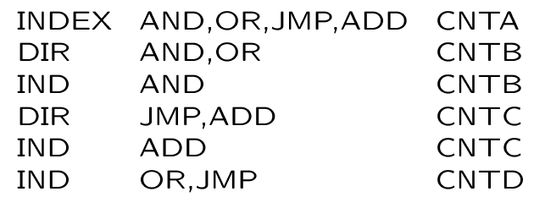
Symbolic Minimization
Extension to mvi-minimization.
Accounts for
Covering relations.
Disjunctive relations.
Exact and heuristic minimizers.
Minimum symbolic cover computed before
Can we use fewer implicants?
Can we merge implicants?

Slide 55
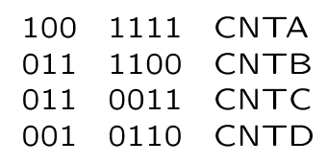
Covering Relations Example
Assume the code of CNTD covers the codes of CNTB and CNTC.
Possible codes
CNTA = 00, CNTB = 01,
CNTC =10 and CNTD = 11.

Slide 56
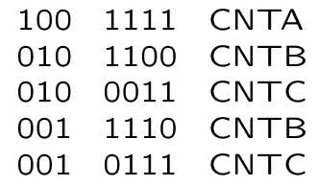
Disjunctive Relations Example
Assume the code of CNTD is the OR of the codes of CNTB and CNTC.
Possible codes
CNTA = 00, CNTB = 01,
CNTC =10 and CNTD = 11.

Slide 57
Output Encoding Algorithms
Often solved in conjunction with input encoding.
Exact algorithms
Prime dichotomies compatible with output constraints.
Construct prime/seed table.
Solve covering problem.
Heuristic algorithms
Construct E column by column.
Compatibility
(L₁, R₁) and (L₂, R₂) are compatible if L₁ ∩ R₂ = ∅ and R₁ ∩ L₂ = ∅.
Covering
Dichotomy (L₁, R₁) covers (L₂, R₂) if L₁ ⊇ L₂ and R₁ ⊇ R_{2.}
Prime dichotomies need to cover at least one element of all seed pairs.

Slide 58
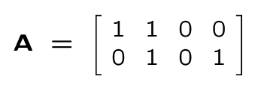
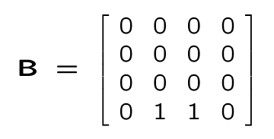
Example …
Input constraint matrix of second stage
Output constraint matrix of first stage
Assume the code of CNTD covers the codes of CNTB and CNTC.

Slide 59
… Example …
Seed dichotomies associated with A
Seed dichotomies s_{2A} and s_{4B} are not compatible with B.
Note that only one of the seed dichotomies S_{iA} or S_{iB} needs to be covered and not both.
S_{1A}: ( {CNTA, CNTB} ; {CNTC} )
S_{1B}: ( {CNTC} ; {CNTA, CNTB} )
S_{2A}: ( {CNTA, CNTB} ; {CNTD} )
S_{2B}: ( {CNTD} ; {CNTA, CNTB} )
S_{3A}: ( {CNTB, CNTD} ; {CNTA} )
S_{3B}: ( {CNTA} ; {CNTB, CNTD} )
S_{4A}: ( {CNTB, CNTD} ; {CNTC} )
S_{4B}: ( {CNTC} ; {CNTB, CNTD} )

Slide 60
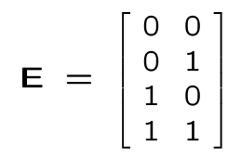
… Example …
Prime dichotomies compatible with B
Cover: p₁ and p₂
Encoding matrix
p3
S_{1A}
S_{4A}
P1: ({CNTC, CNTD}; {CNTA, CNTB})
P2: ({CNTB, CNTD}; {CNTA, CNTC})
P3: ({CNTA, CNTB, CNTD}; {CNTC})
P4: ({CNTA}; {CNTB, CNTD})
p2
S_{1B}
p1
S_{3A}
S_{2B}
S_{3B}
S_{1A}: ( {CNTA, CNTB} ; {CNTC} )
S_{1B}: ( {CNTC} ; {CNTA, CNTB} )
S_{2A}: ( {CNTA, CNTB} ; {CNTD} )
S_{2B}: ( {CNTD} ; {CNTA, CNTB} )
S_{3A}: ( {CNTB, CNTD} ; {CNTA} )
S_{3B}: ( {CNTA} ; {CNTB, CNTD} )
S_{4A}: ( {CNTB, CNTD} ; {CNTC} )
S_{4B}: ( {CNTC} ; {CNTB, CNTD} )

Slide 61
… Example
Heuristic encoding considers the dichotomy pairs associated with each row
Dichotomies d_{1B} and d_{2B} do not satisfy output constraints.
Dichotomies d_{1A} and d_{2A} are not compatible and considered one at a time yielding two-column encoding.
d_{1A}: ( {CNTC, CNTD} ; {CNTA, CNTB} )
d_{1B}: ( {CNTA, CNTB} ; {CNTC, CNTD} )
d_{2A}: ( {CNTB, CNTD} ; {CNTA, CNTC} )
d_{2B}: ( {CNTA, CNTC} ; {CNTB, CNTD} )

Slide 62
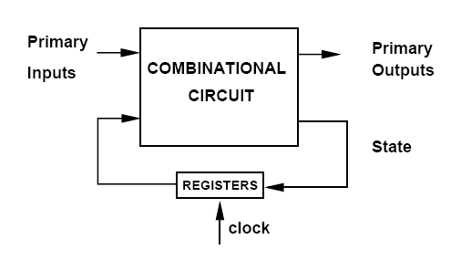
State Encoding of Finite-State Machines
Given a (minimum) state table of a finite-state machine
Find a consistent encoding of the states
that preserves the cover minimality
with minimum number of bits.
The state set must be encoded while satisfying simultaneously both input and output constraints.

Slide 63
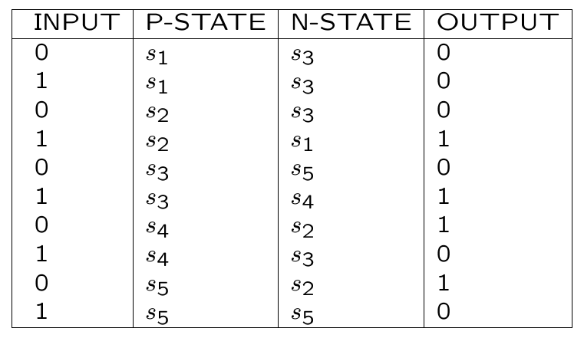
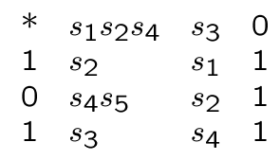
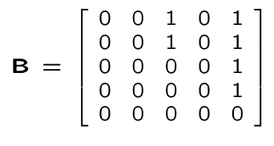
Example …
Minimum Symbolic Cover
Covering Constraints
s1 and s2 cover s3
s5 is covered by all other states.
Encoding Constraint Matrices

Slide 64
… Example …
After Implicant Merging:
0 s1, s2 s3 0
s2 s1 1
1 s3 s4 1
0 s4, s5 s2 1
s1, s4 s3 0
0 s3 s5 0
1 s5 s5 0
If s1 ⊇ s3 and s2 ⊇ s3:
* s1, s2, s4 s3 0
1 s2 s1 1
1 s3 s4 1
0 s4, s5 s2 1
0 s3 s5 0
1 s5 s5 0
Last two rows, output is 0 => no impact on output equation. If s5 is covered by all other states, a minimal code will have s5 assigned the 0 code, i.e. no impact on next state equations => last two rows can be eliminated.
* s1, s2, s4 s3 0
1 s2 s1 1
1 s3 s4 1
0 s4, s5 s2 1

Slide 65
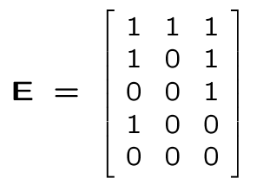
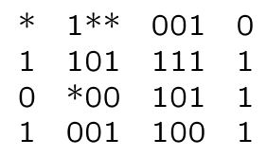
… Example
Encoding matrix (one row per state)
Encoded cover of combinational component
Covering Constraints
s1 and s2 cover s3
s5 is covered by all other states.

Slide 66
Limitation of Symbolic Minimization and Constrained Encoding
The minimum-length solution compatible with a set of constraints may require bits larger than ⎡log₂ n_{s}⎤.
Example: Consider an FSM whose minimal symbolic cover is:
00 s1, s2 s3 100
01 s2, s3 s1 010
10 s1, s3 s2 001
Satisfaction of input constraints requires at least 3 bits.
e.g. s1=100, s2=010, s3=001
PLA size is 3 rows and 11 columns (2 PI+3 PS+3 NS+3 PO)
Assume we do not satisfy first input constraint
2 bits are sufficient
PLA size is 4 rows and 9 columns (2 PI+2 PS+2 NS+3 PO)

Slide 67
State Encoding for Multiple-Level Models
Logic network representation.
Area: # of literals.
Delay: Critical path length.
Encoding based on cube-extraction heuristics [Mustang-Devadas].
Rationale
When two (or more) states have a transition to the same next-state
Keep the distance of their encoding short.
Extract a large common cube.
Exploit first stage of logic.
Works fine because most FSM logic is shallow.

Slide 68
Example
5-state FSM (3-bits).
s1 → s3 with input i.
s2 → s3 with input i’.
Encoding
s1 → 000 = a’b’c’.
s2 → 001 = a’b’c.
Transition
i a’b’c’ +i’ a’b’c = a’b’ (ic+i’c’)
6 literals instead of 8.

Slide 69
Algorithm
Examine all state pairs
Complete graph with |V| = |S|.
Add weight on edges
Model desired code proximity.
The higher the weight the lower the distance.
Embed graph in the Boolean space.
Objective is to minimize the cost function
Difficulties
The number of occurrences of common factors depends on the next-state encoding.
The extraction of common cubes interact with each other.

Slide 70
Mustang Algorithm Implementation …
Fanout-oriented algorithm
Consider state fanout i.e. next states and outputs.
Assign closer codes to pair of states that have same next state transition or same output.
Maximize the size of the most frequent common cubes.

Slide 71
… Mustang Algorithm Implementation …
Fanin-oriented algorithm
Consider state fan-in i.e. present states and inputs.
Assign closer codes to pair of states that have transition from same present state or same input.
Maximize the frequency of the largest common cubes.

Slide 72
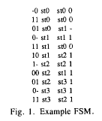
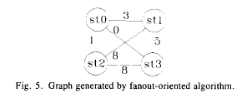
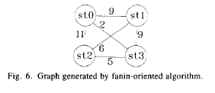
… Mustang Algorithm Implementation

Slide 73
Synchronous Logic Network …
Synchronous Logic Network
Variables.
Boolean equations.
Synchronous delay annotation.
Synchronous network graph
Vertices ↔ equations ↔ I/O , gates.
Edges ↔ dependencies ↔ nets.
Weights ↔ synch. delays ↔ registers.

Slide 74
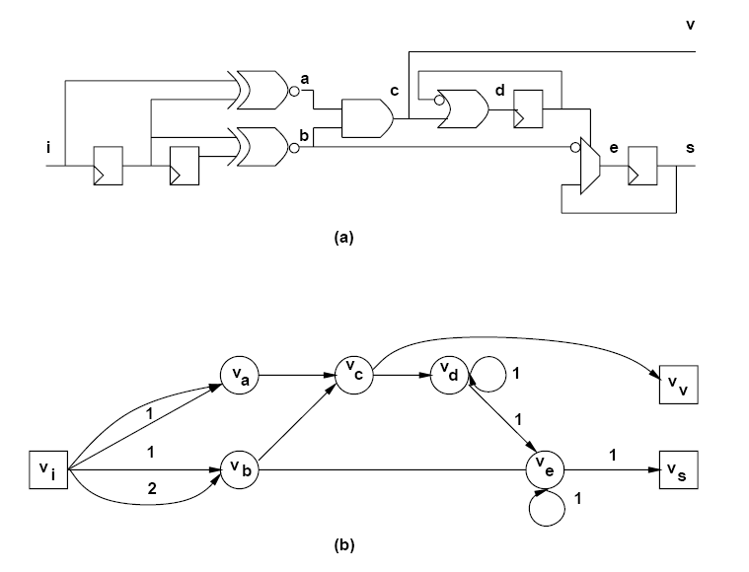
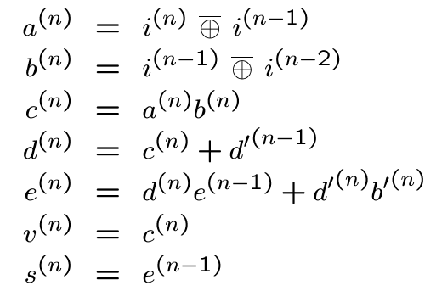
… Synchronous Logic Network

Slide 75
Approaches to Synchronous Logic Optimization
Optimize combinational logic only.
Optimize register position only
Retiming.
Optimize overall circuit
Peripheral retiming.
Synchronous transformations
Algebraic.
Boolean.

Slide 76
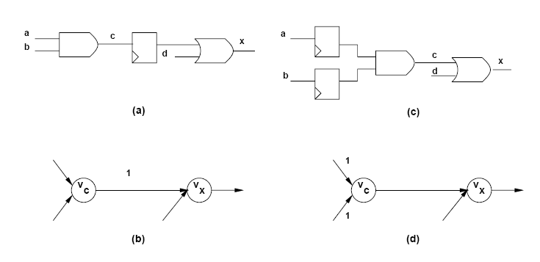
Retiming …
Minimize cycle-time or area by changing register positions.
Do not modify combinational logic.
Preserve network structure
Modify weights.
Do not modify graph structure.

Slide 77
… Retiming …
Global optimization technique [Leiserson].
Changes register positions
affects area
changes register count.
affects cycle-time
changes path delays between register pairs.
Solvable in polynomial time.
Assumptions
Vertex delay is constant: No fanout delay dependency.
Graph topology is invariant: No logic transformations.
Synchronous implementation
Cycles have positive weights.
Edges have non-negative weights.

Slide 78
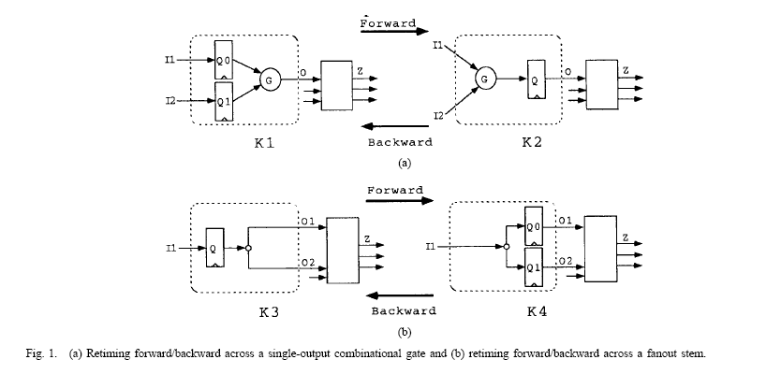
… Retiming …

Slide 79
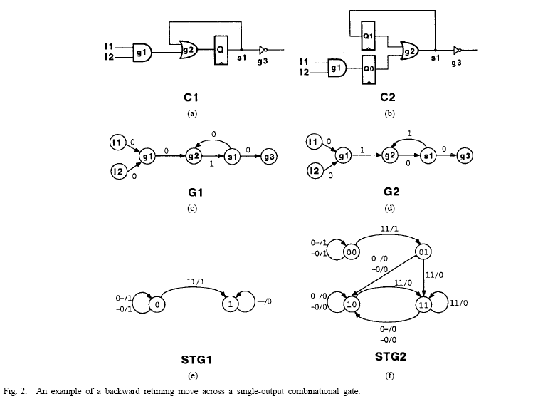
… Retiming …

Slide 80
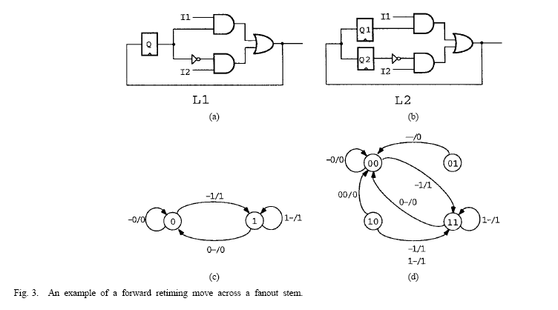
… Retiming

Slide 81
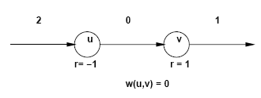
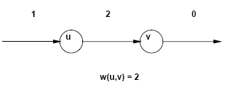
… Retiming …
Retiming of a vertex
Moving registers from output to inputs or vice versa
Integer
Positive value: from outputs to inputs
Negative value: from inputs to outputs
Retiming of a network
Vector of vertex retiming.
Definitions
Retiming of an edge (v_{i}, v_{j}):

Slide 82
Example
Node values indicate delay.
Retiming vector
[a b c d e f g h]= [0 0 -1 -1 -1 0 1 1]
[a b c d e f g h]= -[1 1 2 2 2 1 0 0]=
[1 1 0 0 0 1 2 2]
Original critical path is (v_{d}, v_{e}, v_{f}, v_{g}, v_{h})= 24 units
Retimed critical path is (v_{b}, v_{c}, v_{e})= 13 units

Slide 83
Behavior and Testability Preservation under Retiming …
A synchronizing sequence for a machine is an input sequence that brings the machine to a known and unique state determined without knowledge of output response or initial state of the machine.
An interesting class of synchronizing sequences allows the state reached after applying the synchronizing sequence to be either a single state or a set of equivalent states.
A synchronizing sequence (or a test) derived based on pessimistic 3-valued simulation is called structural; otherwise, it is called functional.
functional synchronizing sequences (or tests) correspond to those derived based on the state transition graph of a circuit.

Slide 84
… Behavior and Testability Preservation under Retiming …
Vector 11 synchronizes C1 to a single state and C2 to an equivalent set of states.
Any of the vectors (11, 00), (11, 01), (11, 10), (11, 11) synchronizes C2 to a single equivalent state.

Slide 85
… Behavior and Testability Preservation under Retiming …
Vector 11 is a functional synchronizing sequence for L1 but not for L2.
Any of the vectors (00, 11), (01, 11), (10, 11), (11, 11) is a synchronizing sequence for L2.

Slide 86
… Behavior and Testability Preservation under Retiming

