Slide 1
COE 561 Digital System Design & Synthesis Library Binding
Dr. Aiman H. El-Maleh
Computer Engineering Department
King Fahd University of Petroleum & Minerals
[Adapted from slides of Prof. G. De Micheli: Synthesis & Optimization of Digital Circuits]

Slide 2
Outline
Modeling and problem analysis
Rule-based systems for library binding
Heuristic Algorithms for library binding
Decomposition and partitioning
Structural matching/covering
Tree-based matching
Tree-based covering
Boolean matching/covering

Slide 3
Library Binding
Given an unbound logic network and a set of library cells
Transform into an interconnection of instances of library cells.
Optimize area, (under delay constraints.)
Optimize delay, (under area constraints.)
Optimize power, (under delay constraints.)
Called also technology mapping
Method used for re-designing circuits in different technologies.

Slide 4
Library Models
A cell library is a set of primitive gates including combinational, sequential, and interface elements.
Each cell is characterized by
Its function.
Input/output terminals.
Area, delay, capacitive load.
Combinational elements
Single-output functions: e.g. AND, OR, NAND, NOR, INV, XOR, XNOR, AOI.
Compound cells: e.g. adders, encoders.
Sequential elements
Flip-flops, registers, counters.
Miscellaneous
Tri-state drivers.
Schmitt triggers.

Slide 5
Major Approaches
Rule-based systems
Mimic designer activity.
Handle all types of cells including multiple-output, sequential and interface elements.
Requires creation and maintenance of set or rules.
Slower execution.
Heuristic algorithms
Restricted to single-output combinational cells.
Implementation of registers, input/output circuits and drivers straightforward.
Most tools use a combination of both.

Slide 6
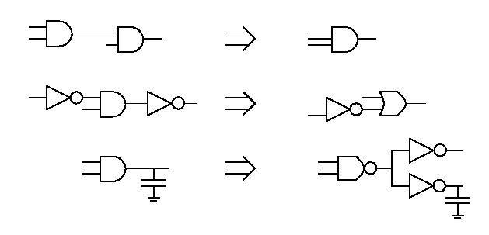
Rule-Based Library Binding
Binding by stepwise transformations.
Data-base
Set of patterns associated with best implementation.
Rules
Select subnetwork to be mapped.
Handle high-fanout problems, buffering, etc.

Slide 7
Rule-Based Library Binding
Execution of rules follows a priority scheme.
Search for a sequence of transformations.
A greedy search is a sequence of rules each decreasing cost.
Search space
Breadth (options at each step).
Depth (look-ahead).
Meta-rules determine dynamically breadth and depth.
Advantages
Applicable to all kinds of libraries.
Disadvantages
Large rule data-base
Completeness issue.
Data-base updates.

Slide 8
Algorithms for Library Binding
Mainly for single-output combinational cells.
Fast and efficient
Quality comparable to rule-based systems.
Library description/update is simple
Each cell modeled by its function or equivalent pattern.
Involves two steps
Matching
A cell matches a subnetwork if their terminal behavior is the same.
Input-variable assignment problem.
Covering
A cover of an unbound network is a partition into subnetworks which can be replaced by library cells.

Slide 9
Matching
Given two single-output combinational functions f(x) and g(x) with same number of support variables.
f matches g if there exists a permutation P such that f(x) = g(P x).
Example
f = ab + c ; g = p + qr.
By assigning {q, r, p} to {a, b, c}, f is equal to g.
f and g have a Boolean match.
By representing functions f and g by their AND-OR decomposition graphs, f and g have a structural match since their graphs are isomorphic.
Must ensure that vertices bound to inputs of a matched cell are outputs of other matched cells.

Slide 10
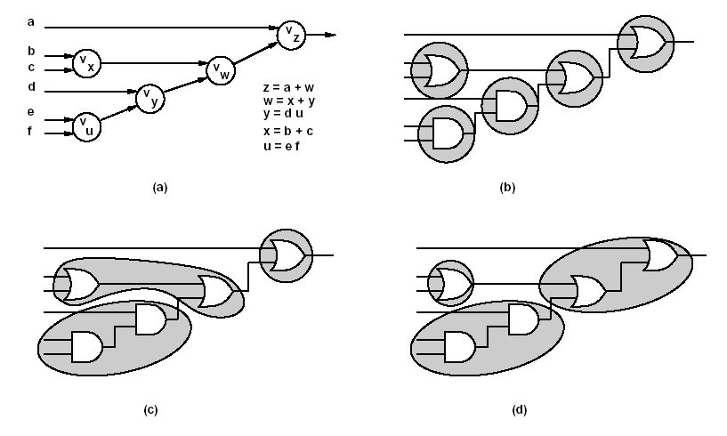
Assumptions
Network granularity is fine.
Decomposition into base functions: 2-input NAND, NOR, INV.
Trivial binding
Replacement of each vertex by base cell.

Slide 11
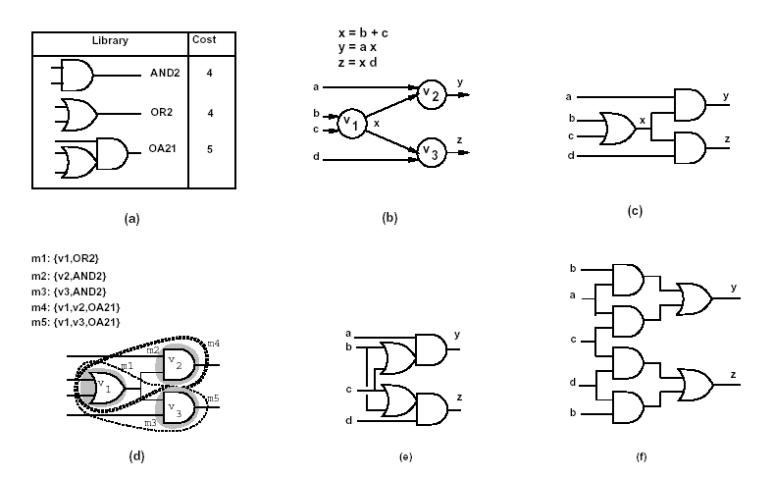
Example …

Slide 12
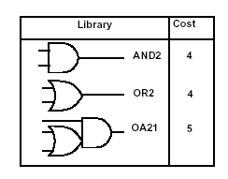
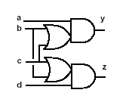
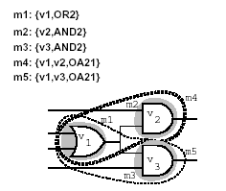
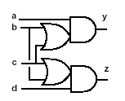
… Example
Vertex covering
Covering v1: (m1 +m4 +m5).
Covering v2: (m2 +m4).
Covering v3: (m3 +m5).
Input compatibility
Match m2 requires m1: (m2’ +m1).
Match m3 requires m1: (m3’ +m1).
Overall binate clause
(m1 +m4 +m5)(m2 +m4)(m3 +m5)(m2’ +m1)(m3’ +m1) = 1
Optimum solution: m1’m2’m3’m4m5
Cost=10

Slide 13
Heuristic Algorithms
To render covering problem tractable, network is decomposed and partitioned.
Decomposition
Cast network and library in standard form.
Decompose into base functions.
Example: NAND2 and INV.
Guarantees that each vertex is covered by at least one match.
Partitioning
Break network into cones called subject graphs.
Reduce to many multi-input single-output subnetworks.
Covering
Cover each subnetwork by library cells.

Slide 14
Partitioning
Rationale for partitioning
Size of each covering problem is smaller.
Covering problem becomes tractable.
Used to isolate combinational portions from sequential elements and I/Os.
Partitioning of combinational circuits
Mark vertices with multiple fanout.
Edges whose tails are marked vertices define partition boundary.

Slide 15
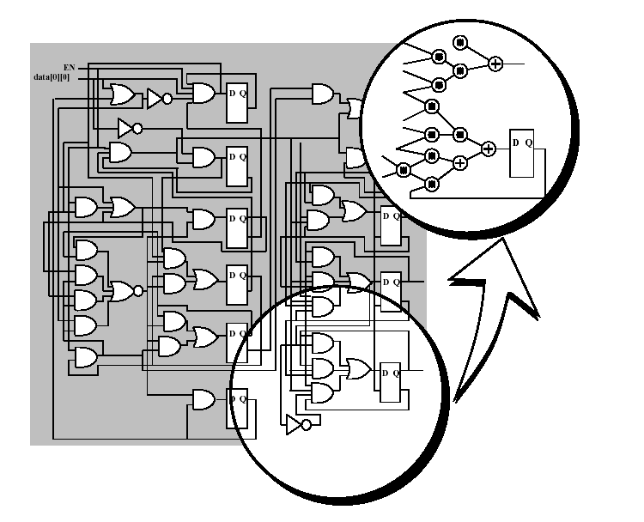
Decomposition

Slide 16
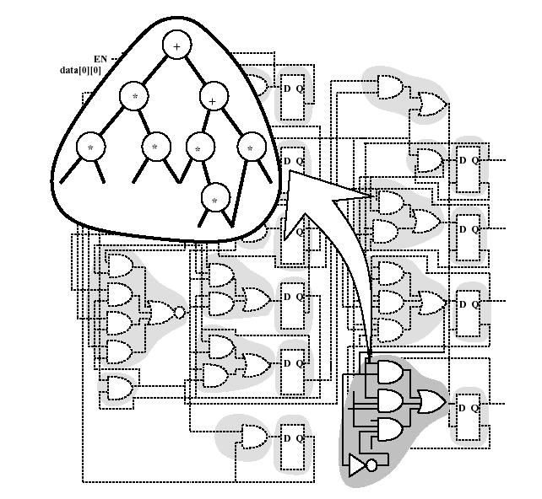
Partitioning

Slide 17
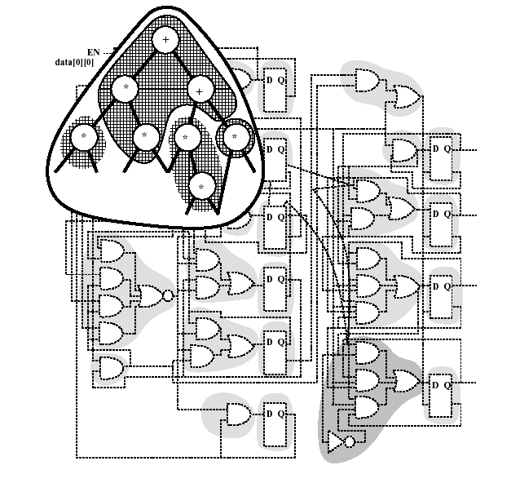
Covering

Slide 18
Matching
Structural matching
Model functions by patterns.
Example: trees, dags (fanout only at the inputs).
Both subject graph and library cells cast into comparable form (subject and pattern graphs).
Rely on pattern matching techniques.
Some library cells may have more than one pattern graph.
Boolean matching
Use Boolean models.
Solve tautology problem to check equivalence of two functions.
More powerful.

Slide 19
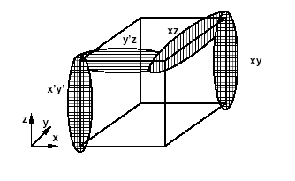
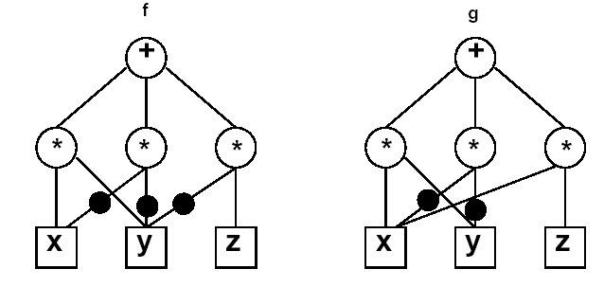
Boolean versus Structural Matching
Example
f = xy +x’y’ +y’z
g = xy +x’y’ +xz
Function equality is a tautology
Boolean match.
Patterns are different
No structural match.

Slide 20
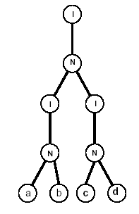
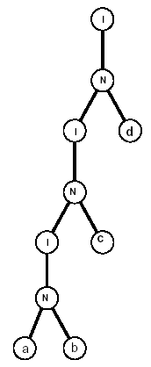
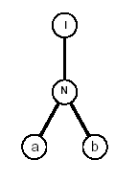
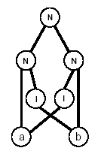
Structural Matching and Covering
Expression patterns
Represented by dags using a decomposition of 2-inp NAND and INV.
Identify pattern dags in network
Matching by sub-graph isomorphism.
Simplification
Use tree patterns.
Most library cells can be represented as trees.
Tree matching & tree covering is linear.
F = a b c d
F = a b c d
F = a b
F = a ⊕ b

Slide 21
Tree-Based Matching …
Network
Partitioned and decomposed
NOR2 (or NAND2) + INV.
Generic base functions.
Each partition called Subject tree.
Library
Represented by trees.
Possibly more than one tree per cell.
Pattern recognition
Simple binary tree match.
Aho-Corasick automaton.

Slide 22
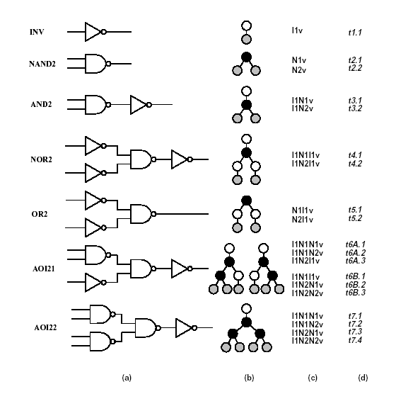
Simple Library

Slide 23
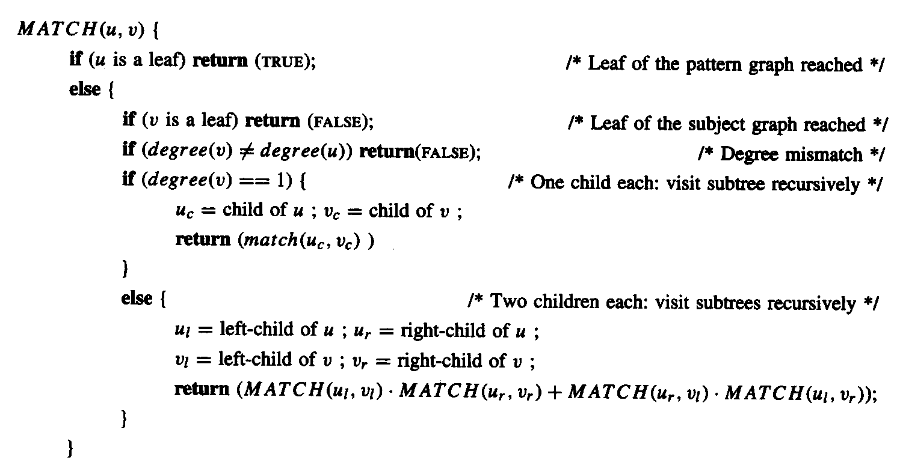
… Tree-Based Matching

Slide 24
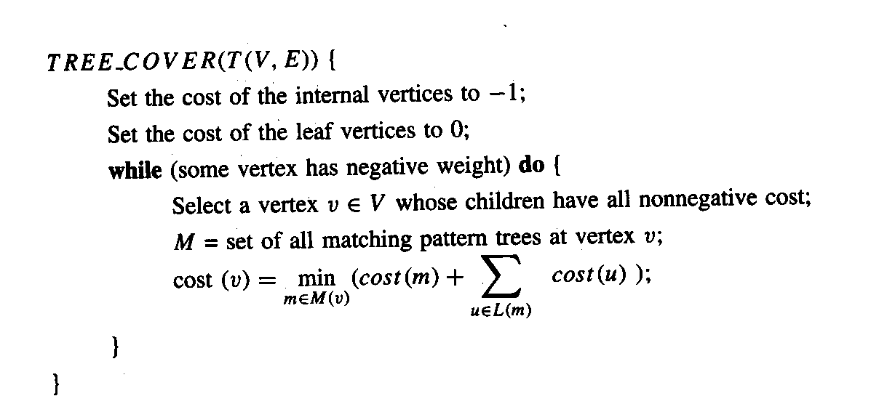
Tree-Based Covering
Dynamic programming
Visit subject tree bottom-up.
At each vertex attempt to match
Locally rooted subtree.
Check all library cells for a match.
Optimum solution for the subtree.

Slide 25
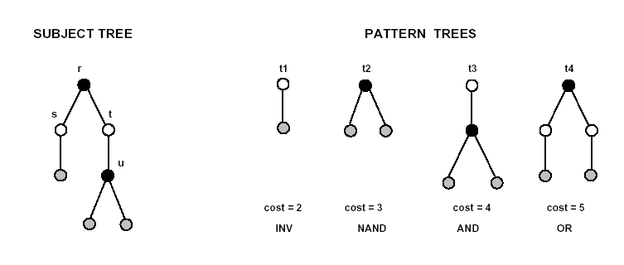
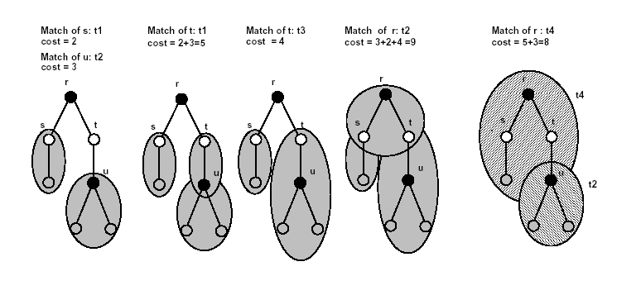
Example

Slide 26
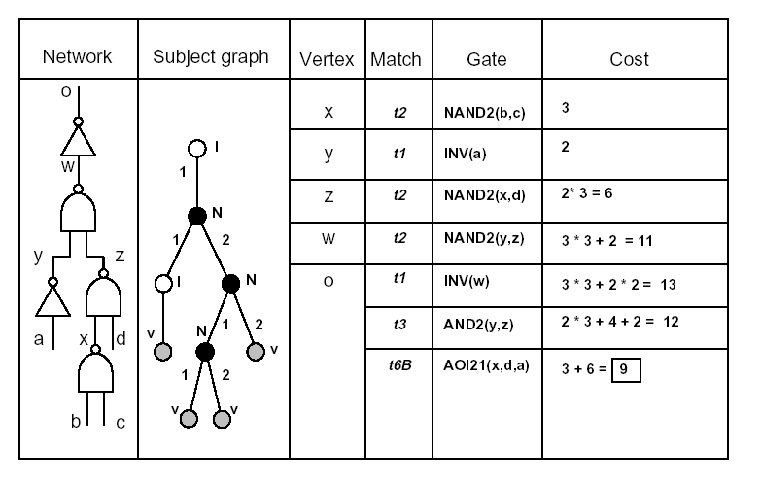
Minimum Area Cover Example
Minimum-area cover.
Area costs
INV:2; NAND2:3; AND2:4; AOI21:6.
Best choice
AOI21 fed by a NAND2 gate.

Slide 27
Minimum Delay Cover
Dynamic programming approach.
Cost related to gate delay.
Delay modeling
Constant gate delay: straightforward.
Load-dependent delay
Load fanout unknown.
Minimum delay cover with constant delays
The cell tree is isomorphic to a subtree with leaves L.
The vertex is labeled with the cell cost plus the maximum of the labels of L.

Slide 28
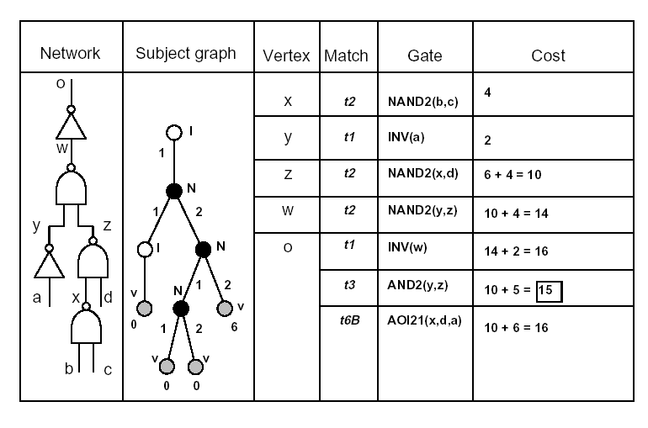
Minimum Delay Cover Example
Inputs data-ready times are 0 except for t_{d} = 6
Constant delays
INV:2; NAND2:4; AND2:5; AOI21:10.
Compute data-ready times bottom-up
t_{x} = 4; t_{y} = 2; t_{z} = 10; t_{w} = 14.
Best choice
AND2, two NAND2 and an INV gate.

Slide 29
Minimum Delay Cover Load-Dependent Delays
Model
For most libraries, input capacitances are a finite small set.
Label each vertex with all possible load values.
Dynamic programming approach
Compute an array of solutions for each vertex corresponding to different loads.
For each match, arrival time is computed for each load value.
For each input to a matching cell the best match for the given load is selected.
Optimum solution, when all possible loads are considered.

Slide 30
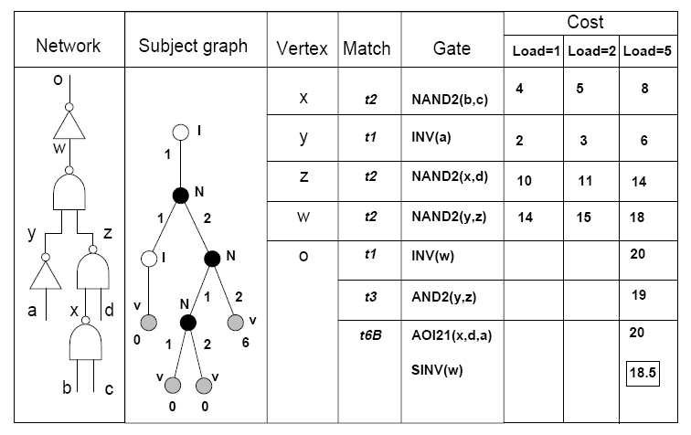
Example
Inputs data-ready times are 0 except for t_{d} = 6
Load-dependent delays
INV:1+l; NAND2:3+l; AND2:4+l; AOI21:9+l; SINV:1+0.5l.
Loads
INV:1; NAND2:1; AND2:1; AOI21:1; SINV:2.
Assume output load is 1
Same solution as before.
Assume output load is 5
Solution uses SINV cell.

Slide 31
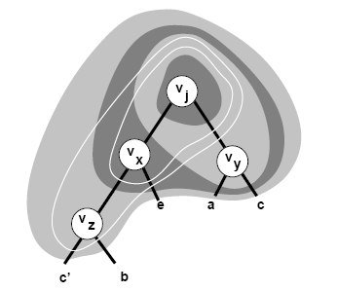
Boolean Matching/Covering
Decompose network into base functions.
When considering vertex v_{i}
Construct clusters by local elimination.
Several functions associated with v_{i}.
Limit size and depth of clusters.
j = x y; x = e + z;
y = a + c; z = c’ + b;
f_{j,1} = x y;
f_{j,2} = x (a + c);
f_{j,3} = (e + z) y;
f_{j,4} = (e + z) (a + c)
f_{j,5} = (e + c’ + b) y;
f_{j,6} = (e + c’ + b) (a + c);

Slide 32
Boolean Matching: P-Equivalence
Cluster function f(x): sub-network behavior.
Pattern function g(y): cell behavior.
P-equivalence
Exists a permutation operator P, such that f(x) = g(P x) is a tautology?
Approaches
Tautology check over all input permutations.
Multi-rooted pattern ROBDD capturing all permutations.

Slide 33
Signatures and Filters …
Drastically reduce the number of permutations to be considered.
Capture some properties of Boolean functions.
If signatures do not match, there is no match.
Used as filters to reduce computation.
Signatures
Unateness.
Symmetries.
Any pin assignment must associate
unate (binate) variables in f(x) with unate (binate) variables in g(y).
Variables or groups of variables
that are interchangeable in f(x) must be interchangeable in g(y).

Slide 34
… Signatures and Filters …
Cluster and pattern functions must have the same number of unate and binate variables to match.
If there are b binate variables, un upper bound on number of variable permutations is b! (n-b)!
(instead of n!)
Example
g = s1 s2 a + s1 s2’ b + s1’ s3 c + s1’s3’ d.
n=7 variables; 4 unate and 3 binate.
Only 3! 4! = 144 variable orders and corresponding OBDDs. need to be considered in worst case.
Compare this with overall number of permutations
7!=5040

Slide 35
… Signatures and Filters …
A symmetry set is a set of variables that are pairwise interchangeable.
A symmetry class is an ensemble of symmetry sets with the same cardinality.
A symmetry class C_{i} has symmetry sets with cardinality i.
A necessary condition for two functions to match is having symmetry classes of the same cardinality for each i.
Example
F = x1 x2 x3 + x4 x5 + x6 x7
Symmetry sets: (x1, x2, x3), (x4, x5), (x6, x7)
C₂= {(x4, x5), (x6, x7)}; |C₂|=2
C₃= {(x1, x2, x3)}; |C₃|=1

Slide 36
… Signatures and Filters …
Symmetry classes can be used to determine non-redundant variable orders
All variables in a given symmetry set are equivalent.
Number of permutations required is ∏_{i=1 to n} (|C_{i}|!).
Example
F = x1 x2 x3 + x4 x5 + x6 x7
Number of permutations = 2! = 2 variable orders.
(x1, x2, x3, x4, x5, x6, x7)
(x1, x2, x3, x6, x7, x4, x5)
Cluster function: f = abc.
Symmetries: {(a, b, c)} – 3 unate.
Pattern functions
g1 = a+b+c
Symmetries: {(a, b, c)} – 3 unate.
g2 = ab+c
Symmetries: {(a, b) (c)} -- 3 unate.
g3 = abc +a’b’c’
Symmetries: {(a, b, c)} -- 3 binate.

Slide 37
… Signatures and Filters
Taking advantage of both symmetric classes and unate-binate properties
Number of non-redundant permutations

