Slide 1
COE 561 Digital System Design & Synthesis Multiple-Level Logic Synthesis
Dr. Aiman H. El-Maleh
Computer Engineering Department
King Fahd University of Petroleum & Minerals
[Adapted from slides of Prof. G. De Micheli: Synthesis & Optimization of Digital Circuits]

Slide 2
Outline …
Representations.
Taxonomy of optimization methods.
Goals: area/delay.
Algorithms: Algebraic/Boolean.
Rule-based methods.
Examples of transformations.
Algebraic model.
Algebraic division.
Algebraic substitution.
Single-cube extraction.
Multiple-cube extraction.
Decomposition.
Factorization.
Fast extraction.

Slide 3
… Outline
External and internal don’t care sets.
Controllability don’t care sets.
Observability don’t care sets.
Boolean simplification and substitution.
Testability properties of multiple-level logic.
Synthesis for testability.
Network delay modeling.
Algorithms for delay minimization.
Transformations for delay reduction.

Slide 4
Motivation
Combinational logic circuits very often implemented as multiple-level networks of logic gates.
Provides several degrees of freedom in logic design
Exploited in optimizing area and delay.
Different timing requirements on input/output paths.
Multiple-level networks viewed as interconnection of single-output gates
Single type of gate (e.g. NANDs or NORs).
Instances of a cell library.
Macro cells.
Multilevel optimization is divided into two tasks
Optimization neglecting implementation constraints assuming loose models of area and delay.
Constraints on the usable gates are taken into account during optimization.

Slide 5
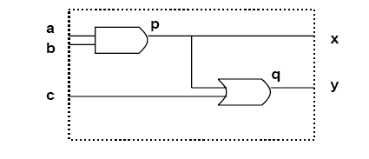
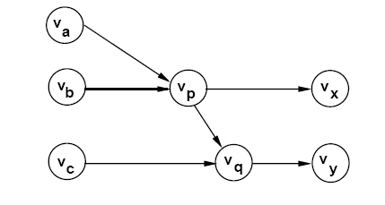
Circuit Modeling
Logic network
Interconnection of logic functions.
Hybrid structural/behavioral model.
Bound (mapped) networks
Interconnection of logic gates.
Structural model.
Example of Bound Network

Slide 6
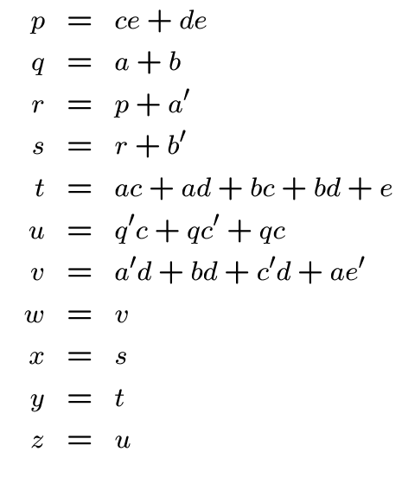
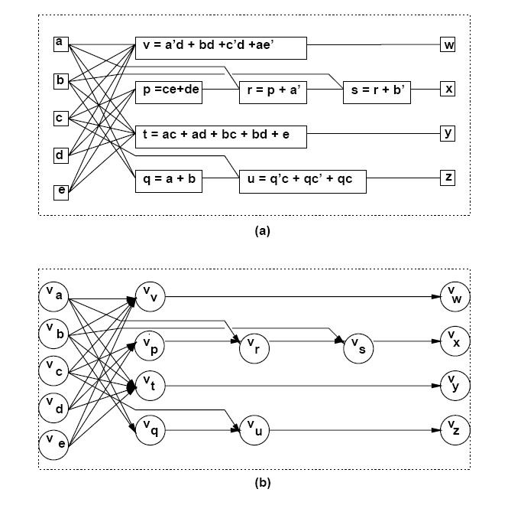
Example of a Logic Network

Slide 7
Network Optimization
Two-level logic
Area and delay proportional to cover size.
Achieving minimum (or irredundant) covers corresponds to optimizing area and speed.
Achieving irredundant cover corresponds to maximizing testability.
Multiple-level logic
Minimal-area implementations do not correspond in general to minimum-delay implementations and vice versa.
Minimize area (power) estimate
subject to delay constraints.
Minimize maximum delay
subject to area (power) constraints.
Minimize power consumption.
subject to delay constraints.
Maximize testability.

Slide 8
Estimation
Area
Number of literals
Corresponds to number of polysilicon strips (transistors)
Number of functions/gates.
Delay
Number of stages (unit delay per stage).
Refined gate delay models (relating delay to function complexity and fanout).
Sensitizable paths (detection of false paths).
Wiring delays estimated using statistical models.

Slide 9
Problem Analysis
Multiple-level optimization is hard.
Exact methods
Exponential complexity.
Impractical.
Approximate methods
Heuristic algorithms.
Rule-based methods.
Strategies for optimization
Improve circuit step by step based on circuit transformations.
Preserve network behavior.
Methods differ in
Types of transformations.
Selection and order of transformations.

Slide 10
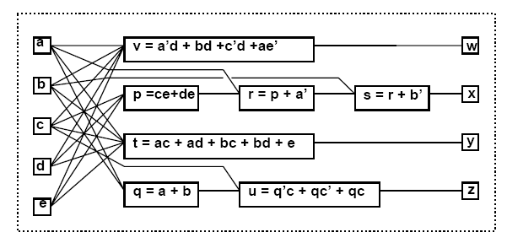
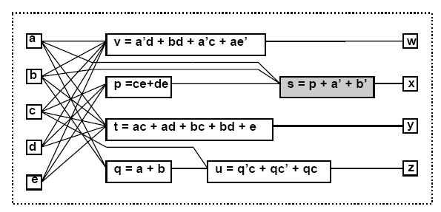
Elimination
Eliminate one function from the network.
Perform variable substitution.
Example
s = r +b’; r = p+a’
⇒ s = p+a’+b’.

Slide 11
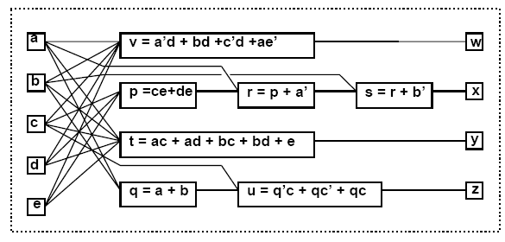
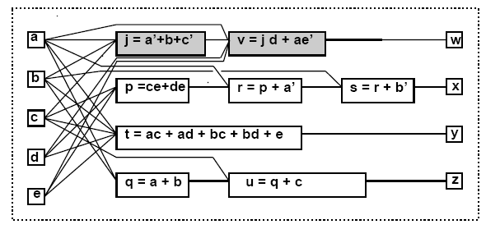
Decomposition
Break one function into smaller ones.
Introduce new vertices in the network.
Example
v = a’d+bd+c’d+ae’.
⇒ j = a’+b+c’; v = jd+ae’

Slide 12
Factoring
Factoring is the process of deriving a factored form from a sum-of-products form of a function.
Factoring is like decomposition except that no additional nodes are created.
Example
F = abc+abd+a’b’c+a’b’d+ab’e+ab’f+a’be+a’bf (24 literals)
After factorization
F=(ab+a’b’)(c+d) + (ab’+a’b)(e+f) (12 literals)

Slide 13
Extraction …
Find a common sub-expression of two (or more) expressions.
Extract sub-expression as new function.
Introduce new vertex in the network.
Example
p = ce+de; t = ac+ad+bc+bd+e; (13 literals)
p = (c+d)e; t = (c+d)(a+b)+e; (Factoring:8 literals)
⇒ k = c+d; p = ke; t = ka+ kb +e; (Extraction:9 literals)

Slide 14
… Extraction

Slide 15
Simplification
Simplify a local function (using Espresso).
Example
u = q’c+qc’ +qc;
⇒ u = q +c;

Slide 16
Substitution
Simplify a local function by using an additional input that was not previously in its support set.
Example
t = ka+kb+e.
⇒ t = kq +e; because q = a+b.

Slide 17
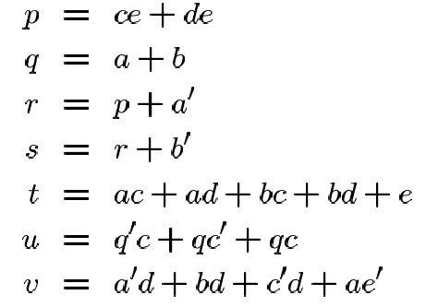
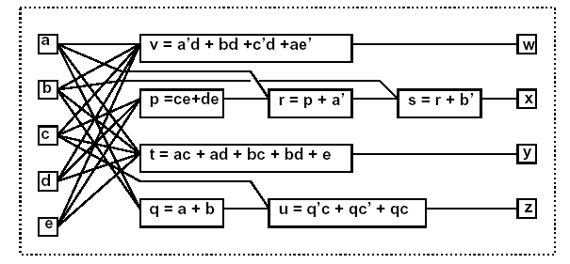
Example: Sequence of Transformations
Original Network (33 lit.)
Transformed Network (20 lit.)

Slide 18
Optimization Approaches
Algorithmic approach
Define an algorithm for each transformation type.
Algorithm is an operator on the network.
Each operator has well-defined properties
Heuristic methods still used.
Weak optimality properties.
Sequence of operators
Defined by scripts.
Based on experience.
Rule-based approach (IBM Logic Synthesis System)
Rule-data base
Set of pattern pairs.
Pattern replacement driven by rules.

Slide 19
Elimination Algorithm …
Set a threshold k (usually 0).
Examine all expressions (vertices) and compute their values.
Vertex value = n*l – n – l (l is number of literals; n is number of times vertex variable appears in network)
Eliminate an expression (vertex) if its value (i.e. the increase in literals) does not exceed the threshold.

Slide 20
… Elimination Algorithm
Example
q = a + b
s = ce + de + a’ + b’
t = ac + ad + bc + bd + e
u = q’c + qc’ + qc
v = a’d + bd + c’d + ae’
Value of vertex q=n*l–n–l=3*2-3-2=1
It will increase number of literals => not eliminated
Assume u is simplified to u=c+q
Value of vertex q=n*l–n–l=1*2-1-2=-1
It will decrease the number of literals by 1 => eliminated

Slide 21
MIS/SIS Rugged Script
sweep; eliminate -1
simplify -m nocomp
eliminate -1
sweep; eliminate 5
simplify -m nocomp
resub -a
fx
resub -a; sweep
eliminate -1; sweep
full-simplify -m nocomp
Sweep eliminates single-input Vertices and those with a constant function.
resub –a performs algebraic substitution of all vertex pairs
fx extracts double-cube and single-cube expression.

Slide 22
Boolean and Algebraic Methods …
Boolean methods
Exploit Boolean properties of logic functions.
Use don't care conditions induced by interconnections.
Complex at times.
Algebraic methods
View functions as polynomials.
Exploit properties of polynomial algebra.
Simpler, faster but weaker.

Slide 23
… Boolean and Algebraic Methods
Boolean substitution
h = a+bcd+e; q = a+cd
⇒ h = a+bq +e
Because a+bq+e = a+b(a+cd)+e = a+bcd+e;
Relies on Boolean property b+1=1
Algebraic substitution
t = ka+kb+e; q=a+b
⇒ t = kq +e
Because k(a+b) = ka+kb; holds regardless of any assumption of Boolean algebra.

Slide 24
The Algebraic Model …
Represents local Boolean functions by algebraic expressions
Multilinear polynomial (i.e. multi-variable with degree 1) over set of variables with unit coefficients.
Algebraic transformations neglect specific features of Boolean algebra
Only one distributive law applies
a . (b+c) = ab+ac
a + (b . c) ≠ (a+b).(a+c)
Symmetric distribution laws.
Complements are not defined
Cannot apply some properties like absorption, idempotence, involution and Demorgan’s, a+a’=1 and a.a’=0
Don't care sets are not used.

Slide 25
… The Algebraic Model
Algebraic expressions obtained by
Modeling functions in sum of products form.
Make them minimal with respect to single-cube containment.
Algebraic operations restricted to expressions with disjoint support
Preserve correspondence of result with sum-of-product forms minimal w.r.t single-cube containment.
Example
(a+b)(c+d)=ac+ad+bc+bd; minimal w.r.t SCC.
(a+b)(a+c)= aa+ac+ab+bc; non-minimal.
(a+b)(a’+c)=aa’+ac+a’b+bc; non-minimal.

Slide 26
Algebraic Division …
Given two algebraic expressions f_{dividend} and f_{divisor} , we say that f_{divisor} is an Algebraic Divisor of f_{dividend} , f_{quotient} = f_{dividend}/f_{divisor} when
f_{dividend} = f_{divisor} . f_{quotient} + f_{remainder}
f_{divisor} . f_{quotient} ≠ 0
and the support of f_{divisor} and f_{quotient} is disjoint.
Example
Let f_{dividend} = ac+ad+bc+bd+e and f_{divisor} = a+b
Then f_{quotient} = c+d f_{remainder} = e
Because (a+b) (c+d)+e = f_{dividend}
and {a,b} ∩ {c,d} = ∅
Non-algebraic division
Let f_{i} = a+bc and f_{j} = a+b.
Let f_{k} = a+c. Then, f_{i} = f_{j} . f_{k} = (a+b)(a+c)
but {a,b} ∩ {a,c} ≠ ∅

Slide 27
… Algebraic Division
An algebraic divisor is called a factor when the remainder is void.
a+b is a factor of ac+ad+bc+bd
An expression is said to be cube free when it cannot be factored by a cube.
a+b is cube free
ac+ad+bc+bd is cube free
ac+ad is non-cube free
abc is non-cube free

Slide 28
Algebraic Division Algorithm …
Quotient Q and remainder R are sum of cubes (monomials).
Intersection is largest subset of common monomials.

Slide 29
… Algebraic Division Algorithm …
Example
f_{dividend} = ac+ad+bc+bd+e;
f_{divisor} = a+b;
A = {ac, ad, bc, bd, e} and B = {a, b}.
i = 1
C^{B}₁ = a, D = {ac, ad} and D₁ = {c, d}.
Q = {c, d}.
i = 2 = n
C^{B}₂ = b, D = {bc, bd} and D₂ = {c, d}.
Then Q = {c, d} ∩ {c, d} = {c, d}.
Result
Q = {c, d} and R = {e}.
f_{quotient} = c+d and f_{remainder} = e.

Slide 30
… Algebraic Division Algorithm
Example
Let f_{dividend} = axc+axd+bc+bxd+e; f_{divisor} = ax+b
i=1, C^{B}₁ = ax, D = {axc, axd} and D₁ = {c, d}; Q={c, d}
i = 2 = n; C^{B}₂ = b, D = {bc, bxd} and D₂ = {c, xd}.
Then Q = {c, d} ∩ {c, xd} = {c}.
f_{quotient} = c and f_{remainder} = axd+bxd+e.
Theorem: Given algebraic expressions f_{i} and f_{j}, then f_{i}/f_{j} is empty when
f_{j} contains a variable not in f_{i}.
f_{j} contains a cube whose support is not contained in that of any cube of f_{i}.
f_{j} contains more cubes than f_{i}.
The count of any variable in f_{j} larger than in f_{i}.

Slide 31
Substitution
Substitution replaces a subexpression by a variable associated with a vertex of the logic network.
Consider expression pairs.
Apply division (in any order).
If quotient is not void
Evaluate area/delay gain
Substitute f_{dividend} by j.f_{quotient} + f_{remainder} where j = f_{divisor}
Use filters to reduce divisions.
Theorem
Given two algebraic expressions f_{i} and f_{j}, f_{i}/f_{j}=∅ if there is a path from v_{i} to v_{j} in the logic network.

Slide 32
Substitution algorithm

Slide 33
Extraction
Search for common sub-expressions
Single-cube extraction: monomial.
Multiple-cube (kernel) extraction: polynomial
Search for appropriate divisors.
Cube-free expression
Cannot be factored by a cube.
Kernel of an expression
Cube-free quotient of the expression divided by a cube (called co-kernel).
Kernel set K(f) of an expression
Set of kernels.

Slide 34
Kernel Example
f_{x} = ace+bce+de+g
Divide f_{x} by a. Get ce. Not cube free.
Divide f_{x} by b. Get ce. Not cube free.
Divide f_{x} by c. Get ae+be. Not cube free.
Divide f_{x} by ce. Get a+b. Cube free. Kernel!
Divide f_{x} by d. Get e. Not cube free.
Divide f_{x} by e. Get ac+bc+d. Cube free. Kernel!
Divide f_{x} by g. Get 1. Not cube free.
Expression f_{x} is a kernel of itself because cube free.
K(f_{x}) = {(a+b); (ac+bc+d); (ace+bce+de+g)}.

Slide 35
Theorem (Brayton and McMullen)
Two expressions f_{a} and f_{b} have a common multiple-cube divisor f_{d} if and only if
there exist kernels k_{a} ∈ K(f_{a}) and k_{b} ∈ K(f_{b}) s.t. f_{d} is the sum of 2 (or more) cubes in k_{a} ∩ k_{b} (intersection is largest subset of common monomials)
Consequence
If kernel intersection is void, then the search for common sub-expression can be dropped.
Example
f_{x} = ace+bce+de+g; K(f_{x}) = {(a+b); (ac+bc+d); (ace+bce+de+g)}
f_{y} = ad+bd+cde+ge; K(f_{y}) = {(a+b+ce); (cd+g); (ad+bd+cde+ge)}
f_{z} = abc; The kernel set of f_{z} is empty.
Select intersection (a+b)
f_{w} = a+b f_{x} = wce+de+g
f_{y} = wd+cde+ge f_{z} = abc

Slide 36
Kernel Set Computation …
Naive method
Divide function by elements in power set of its support set.
Weed out non cube-free quotients.
Smart way
Use recursion
Kernels of kernels are kernels of original expression.
Exploit commutativity of multiplication.
Kernels with co-kernels ab and ba are the same
A kernel has level 0 if it has no kernel except itself.
A kernel is of level n if it has
at least one kernel of level n-1
no kernels of level n or greater except itself

Slide 37
…Kernel Set Computation
Y= adf + aef + bdf + bef + cdf + cef + g
= (a+b+c)(d+e) f + g
Kernels | Co-Kernels | Level
(a+b+c) | df, ef | 0
(d+e) | af, bf, cf | 0
(a+b+c)(d+e) | f | 1
(a+b+c)(d+e)f+g | 1 | 2

Slide 38
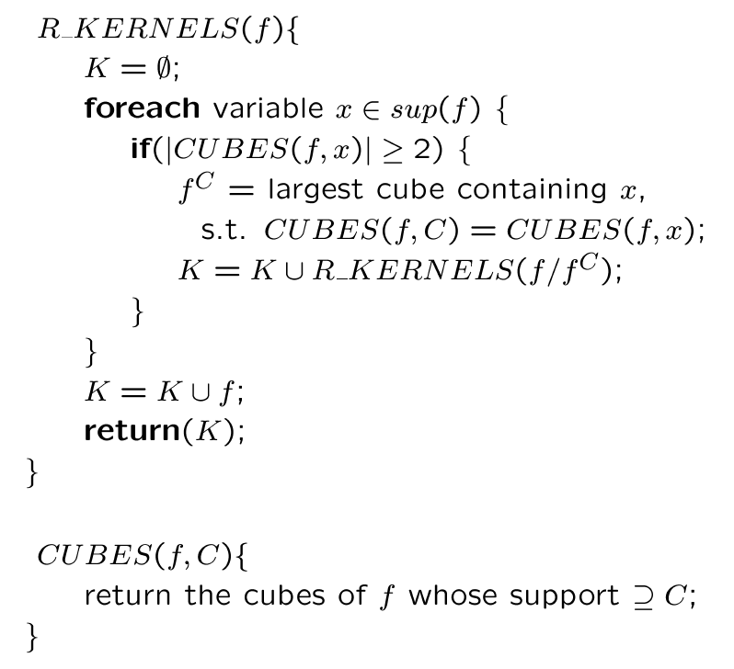
Recursive Kernel Computation: Simple Algorithm
f is assumed to be cube-free
If not divide it by its largest cube factor

Slide 39
Recursive Kernel Computation Example
f = ace+bce+de+g
Literals a or b. No action required.
Literal c. Select cube ce:
Recursive call with argument (ace+bce+de+g)/ce =a+b;
No additional kernels.
Adds a+b to the kernel set at the last step.
Literal d. No action required.
Literal e. Select cube e:
Recursive call with argument ac+bc+d
Kernel a+b is rediscovered and added.
Adds ac + bc + d to the kernel set at the last step.
Literal g. No action required.
Adds ace+bce+de+g to the kernel set.
K = {(ace+bce+de+g); (a+b); (ac+bc+d); (a+b)}.

Slide 40
Analysis
Some computation may be redundant
Example
Divide by a and then by b.
Divide by b and then by a.
Obtain duplicate kernels.
Improvement
Keep a pointer to literals used so far denoted by j.
J initially set to 1.
Avoids generation of co-kernels already calculated
Sup(f)={x₁, x₂, …x_{n}} (arranged in lexicographic order)
f is assumed to be cube-free
If not divide it by its largest cube factor
Faster algorithm

Slide 41
Recursive Kernel Computation

Slide 42
Recursive Kernel Computation Examples…
f = ace+bce+de+g; sup(f)={a, b, c, d, e, g}
Literals a or b. No action required.
Literal c. Select cube ce:
Recursive call with arguments: (ace+bce+de+g)/ce =a+b; pointer j = 3+1=4.
Call considers variables {d, e, g}. No kernel.
Adds a+b to the kernel set at the last step.
Literal d. No action required.
Literal e. Select cube e:
Recursive call with arguments: ac+bc+d and pointer j = 5+1=6.
Call considers variable {g}. No kernel.
Adds ac+bc+d to the kernel set at the last step.
Literal g. No action required.
Adds ace+bce+de+g to the kernel set.
K = {(ace+bce+de+g); (ac+bc+d); (a+b)}.

Slide 43
…Recursive Kernel Computation Examples
Y= adf + aef + bdf + bef + cdf + cef + g=(d+e)(a+b+c)f+g
Lexicographic order {a, b, c, d, e, f, g}
adf + aef + bdf + bef + cdf + cef + g
af
df
ef
bf
cf
f
d+e
a+b+c
d+e
a+b+c
d+e
ad+ae+bd+be+cd+ce

Slide 44
Matrix Representation of Kernels …
Boolean matrix
Rows: cubes. Columns: variables (in both true and complement form as needed).
Rectangle (R, C)
Subset of rows and columns with all entries equal to 1.
Prime rectangle
Rectangle not inside any other rectangle.
Co-rectangle (R, C’) of a rectangle (R, C)
C’ are the columns not in C.
A co-kernel corresponds to a prime rectangle with at least two rows & a kernel corresponds to its co-rectangle.

Slide 45
… Matrix Representation of Kernels …
f_{x} = ace+bce+de+g
Rectangle (prime): ({1, 2}, {3, 5})
Co-kernel ce.
Co-rectangle: ({1, 2}, {1, 2, 4, 6}).
Kernel a+b.

Slide 46
… Matrix Representation of Kernels …
Theorem: K is a kernel of f iff it is an expression corresponding to the co-rectangle of a prime rectangle of f.
The set of all kernels of a logic expression are in 1-1 correspondence with the set of all co-rectangles of prime rectangles of the corresponding Boolean matrix.
A level-0 kernel is the co-rectangle of a prime rectangle of maximal width.
A prime rectangle of maximum height corresponds to a kernel of maximal level.

Slide 47
… Matrix Representation of Kernels
Example
F = abc + abd + ae
Prime Rectangles & Co-Rectangles
PR:{(1,2),(1,2)}: corresponding to co-kernel ab
CR:{(1,2),(3,4,5)}: corresponding to kernel (c+d)
PR:{(1,2,3),(1)}: corresponding to co-kernel a
CR:{(1,2,3),(2,3,4,5)}: corresponding to kernel (bc+bd+e)
1 2 3 4 5
Cube a b c d e
1 abc 1 1 1
2 abd 1 1 1
3 ae 1 1

Slide 48
Single-Cube Extraction …
Form auxiliary function
Sum of all product terms of all functions.
Form matrix representation
A rectangle with at least two rows represents a common cube.
Rectangles with at least two columns may result in savings.
Best choice is a prime rectangle.
Use function ID for cubes
Cube intersection from different functions.

Slide 49
… Single-Cube Extraction
Expressions
f_{x} = ace+bce+de+g
f_{s} = cde+b
Auxiliary function
f_{aux} = ace+bce+de+g + cde+b
Matrix:
Prime rectangle: ({1, 2, 5}, {3, 5})
Extract cube ce.

Slide 50
Single-Cube Extraction Algorithm
Extraction of an l-variable cube with multiplicity n
saves (n l – n – l) literals

Slide 51
Multiple-Cube Extraction …
We need a kernel/cube matrix.
Relabeling
Cubes by new variables.
Kernels by cubes.
Form auxiliary function
Sum of all kernels.
Extend cube intersection algorithm.

Slide 52
… Multiple-Cube Extraction
f_{p} = ace+bce.
K(f_{p}) = {(a+b)}.
f_{q} = ae+be+d.
K(f_{q}) = {(a+b), (ae +be+d)}.
f_{r} = ae+be+de.
K(f_{r}) = {(a+b+d)}.
Relabeling
x_{a} = a; x_{b} = b; x_{ae} = ae; x_{be} = be; x_{d} = d;
K(f_{p}) = {(x_{a}, x_{b})}
K(f_{q}) = {(x_{a}, x_{b}); (x_{ae}, x_{be}, x_{d})}.
K(f_{r}) = {(x_{a}, x_{b}, x_{d})}.
f_{aux} = x_{a}x_{b} + x_{a}x_{b} +x_{ae}x_{be}x_{d} + x_{a}x_{b}x_{d}.
Common cube: x_{a}x_{b}.
x_{a}x_{b} corresponds to kernel intersection a+b.
Extract a+b from f_{p}, f_{q} and f_{r}.
Cube x_{a} x_{b} x_{ae} x_{be} x_{d}
x_{a}x_{b} 1 1
x_{a}x_{b} 1 1
x_{ae}x_{be}x_{d} 1 1 1
X_{a}x_{b}x_{d} 1 1 1

Slide 53
Kernel Extraction Algorithm …
N indicates the rate at which kernels are recomputed
K indicates the maximum level of the kernel computed

Slide 54
… Kernel Extraction Algorithm
Example
F1= ac+bc; Kernels: {(a+b)}
F2= ad+bd+cd; Kernels: {(a+b+c)}
F3= ab+ac; Kernels: {(b+c)}
Cube x_{a} x_{b} x_{c}
x_{a}x_{b} 1 1
x_{a}x_{b}x_{c} 1 1 1
x_{b}x_{c} 1 1
After extracting kernel (a+b), kernel (b+c)
is no longer a common kernel. This is why
kernel intersections need to be recomputed.

Slide 55
Tradeoffs in Kernel Extraction

Slide 56
Area Value of a Kernel …
Let n be the number of times a kernel is used
Let l be the number of literals in a kernel and c be the number of cubes in a kernel
Let CK_{i} be the co-kernel for kernel i
Initial cost = ∑_{i=1 to n} (|CK_{i}|*c+l)=nl + c *∑_{i=1 to n} |CK_{i}|
Resulting cost = l+∑_{i=1 to n} (|CK_{i}|+1) = n+l+ ∑_{i=1 to n} |CK_{i}|
Value of a kernel = initial cost – resulting cost
= {nl + c *∑_{i=1 to n} |CK_{i}|} – {n+l+ ∑_{i=1 to n} |CK_{i}|}
= nl – n – l + (c-1) * ∑_{i=1 to n} |CK_{i}|

Slide 57
… Area Value of a Kernel
Example:
X = acd + bcd = (a+b)cd (6 literals)
Y = adef + bdef = (a+b)def (8 lietrals)
Initial cost = 14 literals
After Kernel extraction:
Z=a+b (2 literals)
X=Zcd (3 literals)
Y=Zdef (4 lietrals)
Resulting cost = 9 literals
Savings = 14 – 9 = 5 literals
Value of kernel = nl – n –l + (c-1) * ∑_{i=1 to n} |CK_{i}|
=2*2-2-2+(2-1)*(2+3)=5 literals

Slide 58
Issues in Common Cube and Multiple-Cube Extraction
Greedy approach can be applied in common cube and multiple-cube extraction
Rectangle selection
Matrix update
Greedy approach may be myopic
Local gain of one extraction considered at a time
Non-prime rectangles can contribute to lower cost covers than prime rectangles
Quine’s theorem cannot be applied to rectangles

Slide 59
Decomposition …
Goals of decomposition
Reduce the size of expressions to that typical of library cells.
Small-sized expressions more likely to be divisors of other expressions.
Different decomposition techniques exist.
Algebraic-division-based decomposition
Give an expression f with f_{divisor} as one of its divisors.
Associate a new variable, say t, with the divisor.
Reduce original expression to f= t . f_{quotient} + f_{remainder} and t= f_{divisor.}
Apply decomposition recursively to the divisor, quotient and remainder.
Important issue is choice of divisor
A kernel.
A level-0 kernel.
Evaluate all kernels and select most promising one.

Slide 60
… Decomposition
f_{x} = ace+bce+de+g
Select kernel ac+bc+d.
Decompose: f_{x} = te+g; f_{t} = ac+bc+d;
Recur on the divisor f_{t}
Select kernel a+b
Decompose: f_{t} = sc+d; f_{s} = a+b;

Slide 61
Decomposition Algorithm
K is a threshold that determines the size of nodes
to be decomposed.

Slide 62
Factorization Algorithm
FACTOR(f)
If (the number of literals in f is one) return f
K =choose_Divisor(f)
(h, r) = Divide(f, k)
Return (FACTOR(k) FACTOR(h) + FACTOR(r))
Quick factoring: divisor restricted to first level-0 kernel found
Fast and effective
Used for area and delay estimation
Good factoring: best kernel divisor is chosen
Example: f = ab + ac + bd + ce + cg
Quick factoring: f = a (b+c) + c (e+g) + bd (8 literals)
Good factoring: f = c (a+e+g) + b(a+d) (7 literals)

Slide 63
One-Level-0-Kernel
One-Level-0-Kernel(f)
If (|f| ≤1) return 0
If (L = Literal_Count(f) ≤ 1) return f
For (i=1; i ≤n; i++){
If (L(i) > 1){
C= largest cube containing i s.t. CUBES(f,C)=CUBES(f,i)
return One-Level-0-Kernel(f/f^{C})
}
}
Literal_Count returns a vector of literal counts for each literal.
If all counts are ≤1 then f is a level-0 kernel
The first literal with a count greater than one is chosen.

Slide 64
Fast Extraction (FX) …
Very efficient extraction method
Based on extraction of double-cube divisors along with their complements and,
Single-cube divisors with two literals.
Number of divisors in polynomial domain.
Preserves single stuck-at fault testability.
[Rajski and Vasudevamurthy 1992].
Double-cube divisors are cube-free multiple-cube divisors having exactly two cubes.
The set of double-cube divisors of a function f, denoted D(f) = {d | d= {c_{i} \ (c_{i} ∩ c_{j}), c_{j} \ (c_{i} ∩ c_{j}) } } for i,j=1,..n, i≠j
n is number of cubes in f.
(c_{i} ∩ c_{j}) is called the base of a double-cube divisor.
Empty base is allowed.

Slide 65
… Fast Extraction (FX) …
Example: f = ade + ag + bcde +bcg.
Double-cube divisors and their bases:
A subset of double-cube divisors is represented by D_{x,y,s}
x is number of literals in first cube
y is number of literals in second cube
s is number of variables in support of D
A subset of single-cube divisors is denoted by S_{k} where k is number of literals in single-cube divisor.
Double-cube divisors | Base
de+g | a, bc
a+bc | g, de
ade+bcg | {}
ag+bcde | {}

Slide 66
Properties of Double-Cube and Single-Cube Divisors
Example:
xy+y’zp ∈ D_{2,3,4}
ab ∈ S₂
D_{1,1,1} and D_{1,2,2} are null set.
For any d ∈ D_{1,1,2} , d’∈S₂.
For any d ∈ D_{1,2,3} , d’∉D.
For any d ∈ D_{2,2,2} , d is either XOR or XNOR and d’ ∈ D_{2,2,2} .
For any d ∈ D_{2,2,3} , d’ ∈ D_{2,2,3}.
For any d ∈ D_{2,2,4} , d’∉D.

Slide 67
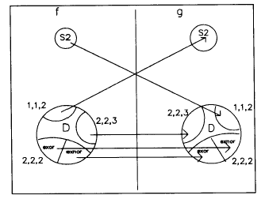
Extraction of Double-cube Divisor along with its Complement
Theorem: Let f and g be two expressions. Then, f has neither a complement double-cube divisor nor a complement single-cube divisor in g if
d_{i} ≠ s_{j}’ for every d_{i} ∈ D_{1,1,2} (f) , s_{j} ∈ S₂(g)
d_{i} ≠ s_{j}’ for every d_{i} ∈ D_{1,1,2} (g) , s_{j} ∈ S₂(f)
d_{i} ≠ d_{j}’ for every d_{i} ∈ D_{xor} (f) , d_{j} ∈ D_{xnor} (g)
d_{i} ≠ d_{j}’ for every d_{i} ∈ D_{xnor} (f) , d_{j} ∈ D_{xor} (g)
d_{i} ≠ d_{j}’ for every d_{i} ∈ D_{2,2,3} (f) , d_{j} ∈ D_{2,2,3} (g)

Slide 68
Weights of Double-cube Divisors and Single-Cube Divisors
Divisor weight represents literal savings.
Weight of a double-cube divisor d ∈ D_{x,y,s} is
w(d) = (p-1)(x+y) – p + ∑_{i=1 to p} |b_{i}| + C
p is the number of times double-cube divisor is used
Includes complements that are also double-cube divisors
|b_{i}| is the number of literals in base of double-cube divisor
C is the number of cubes containing both a and b in case cube ab is a complement of d ∈ D_{1,1,2}
(p-1)(x+y) accounts for the number of literals saved by implementing d of size (x+y) once
-p accounts for number of literals needed to connect d in its p occurrences
Weight of a single-cube divisor c ∈ S₂ is k – 2
K is the number of cubes containing c.

Slide 69
Fast Extraction Algorithm
Generate double-cube divisors with weights
Repeat
Select a double-cube divisor d that has a maximum weight W_{dmax}
Select a single-cube divisor s having a maximum weight W_{smax}
If W_{dmax} > W_{smax} select d else select s
W = max(W_{dmax}, W_{smax})
If W > 0 then substitute selected divisor
Recompute weights of affected double-cube divisors
Until (W<=0)

Slide 70
Fast Extraction Example
F = abc + a’b’c + ab’d + a’bd + acd + a’b’d’ (18 literals)
d | Base | Weight
ab+a’b’ | c | 4
bc+b’d | a | 0
ac+a’d | b | 0
b+d | ac | 2
abc+a’b’d’ | {} | -1
a’c+ad | b’ | 0
b’c+bd | a’ | 0
a’b’+ad | c | 0
c+d’ | a’b’ | 1
ab’+a’b | d | 4
b’+c | ad | 1
ad+a’d’ | b’ | 0
a’b+ac | d | 0
bd+b’d’ | a’ | 0
acd+a’b’d’ | {} | -1
Single-cube divisors with W_{smax} are either ac or a’b’ or ad with weight of 0
Double-cube divisor=ab + a’b’ is selected
[1]=ab + a’b’
F= [1]c + [1]’d + acd + a’b’d’
(14 literals)

Slide 71
Boolean Methods
Exploit Boolean properties.
Don't care conditions.
Minimization of the local functions.
Slower algorithms, better quality results.
Don’t care conditions related to embedding of a function in an environment
Called external don’t care conditions
External don’t care conditions
Controllability
Observability

Slide 72
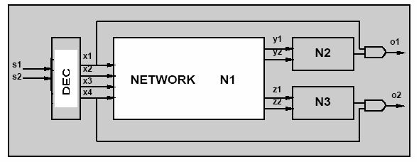
External Don't Care Conditions …
Controllability don't care set CDC_{in}
Input patterns never produced by the environment at the network's input.
Observability don't care set ODC_{out}
Input patterns representing conditions when an output is not observed by the environment.
Relative to each output.
Vector notation used: ODC_{out}.

Slide 73
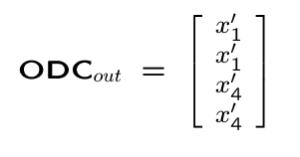
… External Don't Care Conditions
Inputs driven by a decoder.
CDC_{in} = x₁’x₂’x₃’x₄’+x₁x₂+x₁x₃+x₁x₄+x₂x₃+x₂x₄+x₃x₄.
Outputs observed when x₁+x₄=1.

Slide 74
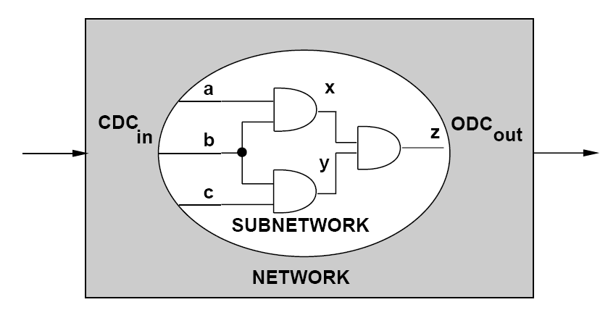
Internal Don't Care Conditions …
Induced by the network structure.
Controllability don't care conditions
Patterns never produced at the inputs of a subnetwork.
Observability don't care conditions
Patterns such that the outputs of a subnetwork are not observed.

Slide 75
… Internal Don't Care Conditions
Example: x = a’+b; y= abx + a’cx
CDC of v_{y} includes ab’x+a’x’.
ab’⇒x=0; ab’x is a don’t care condition
a’ ⇒ x=1; a’x’ is a don’t care condition
Minimize f_{y} to obtain: f_{y} = ax+a’c.

Slide 76
Satisfiability Don't Care Conditions
Invariant of the network
x = f_{x} → x ≠ f_{x} ⊆ SDC.
Useful to compute controllability don't cares.
Example
Assume x = a’ + b
Since x ≠ (a’ + b) is not possible, x ⊕ (a’ + b)=x’a’ + x’b + xab’ is a don’t care condition.

Slide 77
CDC Computation …
Network traversal algorithm
Consider different cuts moving from input to output.
Initial CDC is CDC_{in}.
Move cut forward.
Consider SDC contributions of predecessors.
Remove unneeded variables by consensus.
Consensus of a function f with respect to variable x is f_{x} . f_{x’}

Slide 78
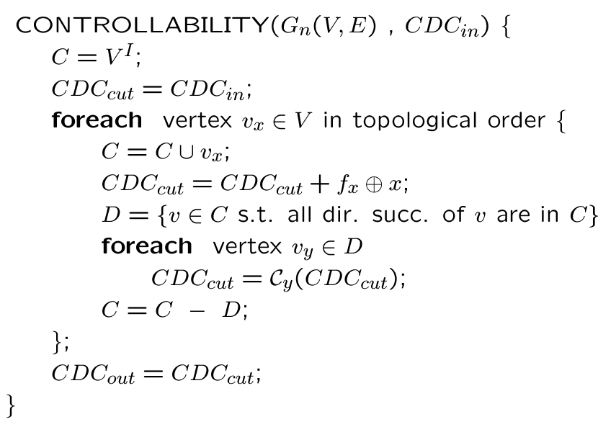
… CDC Computation …

Slide 79
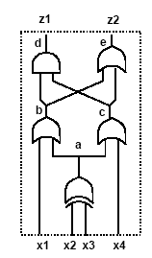
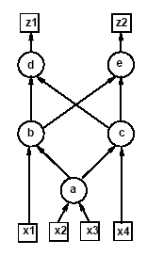
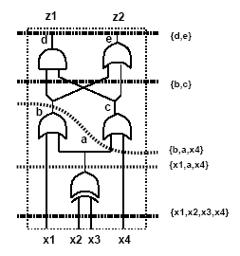
… CDC Computation …
Assume CDC_{in} = x₁’x₄’.
Select vertex v_{a}
Contribution to CDC_{cut}: a ⊕ (x₂ ⊕ x₃).
CDC_{cut} = x₁’x₄’ + a ⊕ (x₂ ⊕ x₃).
Drop variables D = {x₂, x₃}
CDC_{cut} = x₁’x₄’.
Select vertex v_{b}
Contribution to CDC_{cut} : b ⊕ (x₁ +a).
CDC_{cut} = x₁’x₄’ + b ⊕ (x₁ +a).
Drop variable D = {x₁}
CDC_{cut} = b’x₄’ +b’a.

Slide 80
… CDC Computation
Select vertex v_{c}
Contribution to CDC_{cut}: c ⊕ (x₄ + a).
CDC_{cut} = b’x₄’ +b’a + c ⊕ (x₄ + a).
Drop variables D = {a, x₄}
CDC_{cut} = b’c’.
Select vertex v_{d}
Contribution to CDC_{cut}: d ⊕ (bc).
CDC_{cut} = b’c’ + d ⊕ (bc).
Select vertex v_{e}
Contribution to CDC_{cut}: e ⊕ (b + c).
CDC_{cut} = b’c’ + d ⊕ (bc) + e ⊕ (b + c).
Drop variables D = {b, c}
CDC_{cut} = e’.
CDC_{cut} = e’ = z₂’.

Slide 81
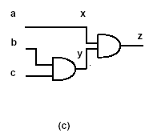
Network Perturbation
Modify network by adding an extra input δ.
Extra input can flip polarity of a signal x.
Replace local function f_{x} by f_{x} ⊕ δ.
Perturbed terminal behavior: f^{x}(δ).
A variable is observable if a change in its polarity is perceived at an output.
Observability don’t-care set ODC for variable x is (f^{x}(0) ⊕ f^{x}(1))’
f^{x}(0)=abc
f^{x}(1)=a’bc
ODC_{x}= (abc ⊕ a’bc)’ = b’+c’
Minimizing f_{x}=ab with ODC_{x}= b’+c’ leads to f_{x}=a.

Slide 82
Observability Don't Care Conditions
Conditions under which a change in polarity of a signal x is not perceived at the outputs.
Complement of the Boolean Difference
∂f/∂x = f|_{x=1} ⊕ f|_{x=0}
Equivalence of perturbed function: (f^{x}(0) ⊕ f^{x}(1))’.
Observability don't care computation
Problem
Outputs are not expressed as function of all variables.
If network is flattened to obtain f, it may explode in size.
Requirement
Local rules for ODC computation.
Network traversal.

Slide 83
Observability Don't Care Computation …
Assume single-output network with tree structure.
Traverse network tree.
At root
ODC_{out} is given.
At internal vertices assuming y is the output of x
ODC_{x} = (∂f_{y}/∂x)’ + ODC_{y} = (f_{y}|_{x=1} ⊕ f_{y}|_{x=0} )’+ ODC_{y}
Example
Assume ODC_{out} = ODC_{e} = 0.
ODC_{b} = (∂f_{e}/∂b)’
= ((b+c)|_{b=1} ⊕ (b+c)|_{b=0})’= c.
ODC_{c} = (∂f_{e}/∂c)’ = b.
ODC_{x1} = ODC_{b} + (∂f_{b}/∂x₁)’ = c+a1.
…

Slide 84
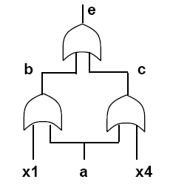
… Observability Don't Care Computation
General networks have fanout re-convergence.
For each vertex with two (or more) fanout stems
The contribution of the ODC along the stems cannot be added.
Wrong assumption is intersecting them
ODC_{a,b}=x₁+c=x₁+a+x₄
ODC_{a,c}=x₄+b=x₄+a+x₁
ODC_{a,b} ∩ ODC_{a,c}=x₁+a+x₄
Variable a is not redundant
Interplay of different paths.
More elaborate analysis.

Slide 85
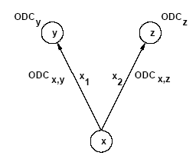
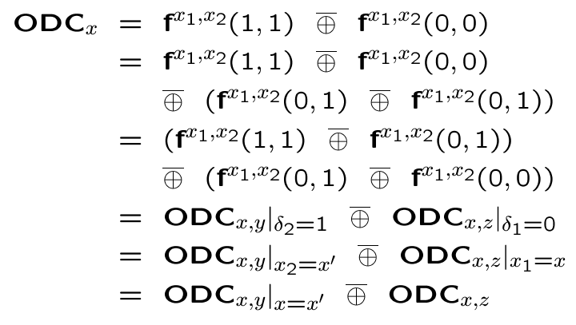
Two-way Fanout Stem …
Compute ODC sets associated with edges.
Combine ODCs at vertex.
Formula derivation
Assume two equal perturbations on the edges.

Slide 86
… Two-way Fanout Stem
ODC_{a,b} = x₁+c = x₁+a₂+x₄
ODC_{a,c} = x₄+b = x₄+a₁+x₁
ODC_{a} = (ODC_{a,b |a2=a’} ⊕ ODC_{a,c})’
= ((x₁+a’+x₄) ⊕ (x₄+a+x₁))’
= x₁+x₄
a₁
a₂

Slide 87
Multi-Way Stems Theorem
Let v_{x} ∈ V be any internal or input vertex.
Let {x_{i}; i = 1, 2, … , p} be the edge variables corresponding to {(x, y_{i}) ; i = 1, 2, … , p}.
Let ODC_{x,yi} ; i = 1, 2, … , p be the edge ODCs.
For a 3-fanout stem variable x:
ODC_{x} = ODC_{x,y1 |x2=x3=x’} ⊕ ODC_{x,y2 |x3=x’} ⊕ ODC_{x,y3}

Slide 88
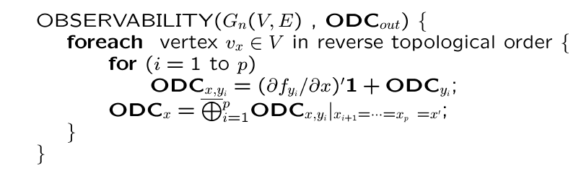
Observability Don't Care Algorithm …
For each variable, intersection of ODC at all outputs yields condition under which output is not observed
Global ODC of a variable
The global ODC conditions of the input variables is the input observability don’t care set ODC_{in}.
May be used as external ODC sets for optimizing a network feeding the one under consideration

Slide 89
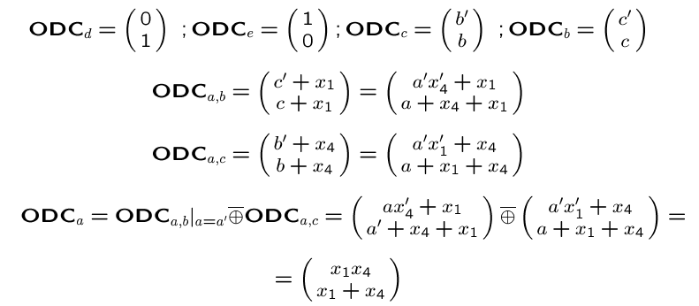
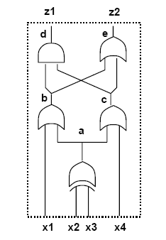
… Observability Don't Care Algorithm
Global ODC of a is (x1x4)(x1+x4)=x1x4

Slide 90
Transformations with Don't Cares
Boolean simplification
Use standard minimizer (Espresso).
Minimize the number of literals.
Boolean substitution
Simplify a function by adding an extra input.
Equivalent to simplification with global don't care conditions.
Example
Substitute q = a+cd into f_{h} = a+bcd+e to get f_{h} = a+bq +e.
SDC set: q⊕(a+cd) = q’a+q’cd+qa’(cd)’.
Simplify f_{h} = a+bcd+e with q’a+q’cd+qa’(cd)’ as don't care.
Simplication yields f_{h} = a+bq +e.
One literal less by changing the support of f_{h}.

Slide 91
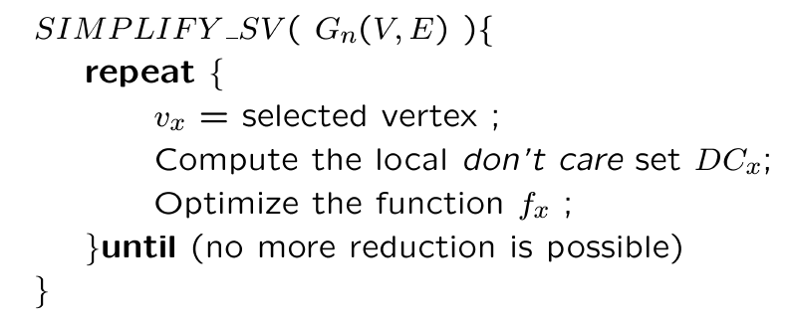
Single-Vertex Optimization

Slide 92
Optimization and Perturbations …
Replace f_{x} by g_{x}.
Perturbation δ_{x} = f_{x} ⊕ g_{x}.
Condition for feasible replacement
Perturbation bounded by local don't care set
δ_{x} ⊆ DC_{ext} + ODC_{x}
If f_{x} and g_{x} have the same support set S(x) then
δ_{x} ⊆ DC_{ext} +ODC_{x} + CDC_{S(x)}
If S(g_{x}) includes network variables
δ_{x} ⊆ DC_{ext} +ODC_{x} + SDC_{x}

Slide 93
… Optimization and Perturbations
No external don't care set.
Replace AND by wire: g_{x} = a
Analysis
δ_{x} = f_{x} ⊕ g_{x} = ab ⊕ a = ab’.
ODC_{x} = y’ = b’ +c’.
δ_{x} = ab’ ⊆ DC_{x} = b’ +c’ ⇒ feasible!

Slide 94
Synthesis and Testability
Testability
Ease of testing a circuit.
Assumptions
Combinational circuit.
Single or multiple stuck-at faults.
Full testability
Possible to generate test set for all faults.
Synergy between synthesis and testing.
Testable networks correlate to small-area networks.
Don't care conditions play a major role.

Slide 95
Test for Stuck-at-Faults
Net y stuck-at 0
Input pattern that sets y to true.
Observe output.
Output of faulty circuit differs.
{t | y(t) . ODC’_{y}(t) = 1}.
Net y stuck-at 1
Same, but set y to false.
{t | y’(t) . ODC’_{y}(t) = 1}.
Need controllability and observability.

Slide 96
Using Testing Methods for Synthesis …
Redundancy removal.
Use ATPG to search for untestable faults.
If stuck-at 0 on net y is untestable
Set y = 0.
Propagate constant.
If stuck-at 1 on y is untestable
Set y = 1.
Propagate constant.

Slide 97
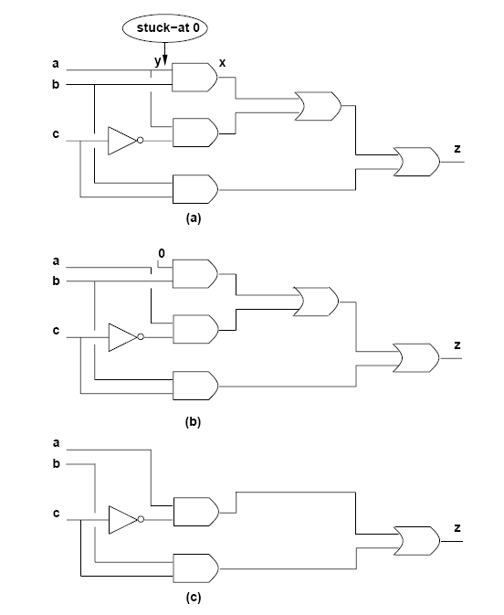
… Using Testing Methods for Synthesis

Slide 98
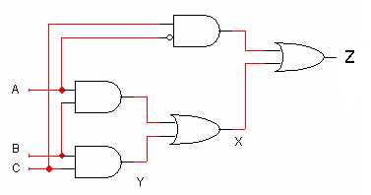
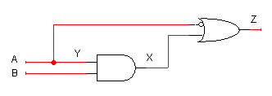
Redundancy Removal and Perturbation Analysis
Stuck-at 0 on y.
y set to 0. Namely g_{x} = f_{x}|_{y=0}.
Perturbation
δ = f_{x} ⊕ f_{x}|_{y=0} = y . ∂f_{x} / ∂y.
Perturbation is feasible ⇔ fault is untestable.
δ = y . ∂f_{x} / ∂y ⊆ DC_{x} ⇔ fault is untestable
Making f_{x} prime and irredundant with respect to DC_{x} guarantees that all single stuck-at faults in f_{x} are testable.

Slide 99
Synthesis for Testability
Synthesize networks that are fully testable.
Single stuck-at faults.
Multiple stuck-at faults.
Two-level forms
Full testability for single stuck-at faults
Prime and irredundant cover.
Full testability for multiple stuck-at faults
Prime and irredundant cover when
Single-output function.
No product term sharing in case of multiple outputs i.e. each output is prime and irredundant.

Slide 100
… Synthesis for Testability
A complete single-stuck-at fault test set for a single-output sum-of-product circuit is a complete test set for all multiple stuck-at faults.
Single stuck-at fault testability of multiple-level network does not imply multiple stuck-at fault testability.
Fast extraction transformations are single stuck-at fault test-set preserving transformations.
Algebraic transformations preserve multiple stuck-at fault testability but not single stuck-at fault testability
Factorization
Substitution (without complement)
Cube and kernel extraction

Slide 101
Synthesis of Testable Multiple-Level Networks …
A logic network G_{n}(V, E), with local functions in sum of product form.
Prime and irredundant (PI)
No literal nor implicant of any local function can be dropped.
Simultaneously prime and irredundant (SPI)
No subset of literals and/or implicants can be dropped.
A logic network is PI if and only if
its AND-OR implementation is fully testable for single stuck-at faults.
A logic network is SPI if and only if
its AND-OR implementation is fully testable for multiple stuck-at faults.

Slide 102
… Synthesis of Testable Multiple-Level Networks
Compute full local don't care sets.
Make all local functions PI w.r. to don't care sets.
Pitfall
Don't cares change as functions change.
Solution
Iteration (Espresso-MLD).
If iteration converges, network is fully testable.
Flatten to two-level form.
When possible -- no size explosion.
Make SPI by disjoint logic minimization.
Reconstruct multiple-level network
Algebraic transformations preserve multifault testability.

Slide 103
Timing Issues in Multiple-Level Logic Optimization
Timing optimization is crucial for achieving competitive logic design.
Timing verification: Check that a circuit runs at speed
Satisfies I/O delay constraints.
Satisfies cycle-time constraints.
Delay modeling.
Critical paths.
The false path problem.
Algorithms for timing optimization.
Minimum area subject to delay constraints.
Minimum delay (subject to area constraints).

Slide 104
Delay Modeling
Gate delay modeling
Straightforward for bound networks.
Approximations for unbound networks.
Network delay modeling
Compute signal propagation
Topological methods.
Logic/topological methods.
Gate delay modeling for unbound networks
Virtual gates: Logic expressions.
Stage delay model: Unit delay per vertex.
Refined models: Depending on size and fanout.

Slide 105
Network Delay Modeling …
For each vertex v_{i}.
Propagation delay d_{i}.
Data-ready time t_{i}.
Denotes the time at which the data is ready at the output.
Input data-ready times denote when inputs are available.
Computed elsewhere by forward traversal
The maximum data-ready time occurring at an output vertex
Corresponds to the longest propagation delay path
Called topological critical path

Slide 106
… Network Delay Modeling …
t_{g}= 3+0=3
t_{h}= 8+3=11
t_{k}= 10+3=13
t_{n}= 5+10=15
t_{p}= 2+max{15,3}=17
t_{l}= 3+max{13,17}=20
t_{m}= 1+max{3,11,20}=21
t_{x}= 2+21=23
t_{q}= 2+20=22
t_{y}= 3+22=25
Assume t_{a}=0 and t_{b}=10.
Propagation delays
d_{g} = 3; d_{h} = 8; d_{m} = 1; d_{k} = 10; d_{l} = 3;
d_{n} = 5; d_{p} = 2; d_{q} = 2; d_{x} = 2; d_{y} = 3;
Maximum data-ready time is t_{y}=25
Topological critical path: (v_{b}, v_{n}, v_{p}, v_{l}, v_{q}, v_{y}).

Slide 107
… Network Delay Modeling …
For each vertex v_{i}.
Required data-ready time t_{i}.
Specified at the primary outputs.
Computed elsewhere by backward traversal
Slack s_{i}.
Difference between required and actual data-ready times

Slide 108
… Network Delay Modeling
Required data-ready times
t_{x} = 25 and t_{y} = 25.
Propagation Delays :
d_{g} = 3; d_{h} = 8; d_{m} = 1; d_{k} = 10;
d_{l} = 3; d_{n} = 5; d_{p} = 2; d_{q} = 2;
d_{x} = 2; d_{y} = 3
Required Times & Slack:
s_{x}= 2; s_{y}=0
t_{m}= 25-2=23; s_{m}=23-21=2
t_{q}= 25-3=22; s_{q}=22-22=0
t_{l}= min{23-1,22-2}=20; s_{l}=0
t_{h}= 23-1=22; s_{h}=22-11=11
t_{k}= 20-3=17; s_{k}=17-13=4
t_{p}= 20-3=17; s_{p}=17-17=0
t_{n}= 17-2=15; s_{n}=15-15=0
t_{b}= 15-5=10; s_{b}=10-10=0
t_{g}= min{22-8;17-10;17-2}=7; s_{g}=4
t_{a}=7-3=4; s_{a}=4-0=4
Data-Ready Times:
t_{g}= 3+0=3
t_{h}= 8+3=11
t_{k}= 10+3=13
t_{n}= 5+10=15
t_{p}= 2+max{15,3}=17
t_{l}= 3+max{13,17}=20
t_{m}= 1+max{3,11,20}=21
t_{x}= 2+21=23
t_{q}= 2+20=22
t_{y}= 3+22=25

Slide 109
Topological Critical Path …
Assume topologic computation of
Data-ready by forward traversal.
Required data-ready by backward traversal.
Topological critical path
Input/output path with zero slacks.
Any increase in the vertex propagation delay affects the output data-ready time.
A topological critical path may be false.
No event can propagate along that path.
False path does not affect performance

Slide 110
… Topological Critical Path
Topological critical path: (v_{b}, v_{n}, v_{p}, v_{l}, v_{q}, v_{y}).

Slide 111
False Path Example
All gates have unit delay.
All inputs ready at time 0.
Longest topological path: (v_{a}, v_{c}, v_{d}, v_{y}, v_{z}).
Path delay: 4 units.
False path: event cannot propagate through it
Critical true path: (v_{a}, v_{c}, v_{d}, v_{y}).
Path delay: 3 units.

Slide 112
Algorithms for Delay Minimization …
Alternate
Critical path computation.
Logic transformation on critical vertices.
Consider quasi critical paths
Paths with near-critical delay.
Small slacks.
Small difference between critical paths and largest delay of a non-critical path leads to smaller gain in speeding up critical paths only.

Slide 113
… Algorithms for Delay Minimization
Most critical delay optimization algorithms have the following framework:

Slide 114
Transformations for Delay Reduction …
Reduce propagation delay.
Reduce dependencies from critical inputs.
Favorable transformation
Reduces local data-ready time.
Any data-ready time increase at other vertices is bounded by the local slack.
Example
Unit gate delay.
Transformation: Elimination.
Always favorable.
Obtain several area/delay trade-off points.

Slide 115
… Transformations for Delay Reduction
W is a minimum-weight separation set from U.
Iteration 1
Values of v_{p}, v_{q}, v_{u} = -1
Value of v_{s}=0.
Eliminate v_{p}, v_{q}. (No literal increase.)
Iteration 2
Value of v_{s}=2, v_{r}=0, v_{u}=-1.
Eliminate v_{u}. (No literal increase.)
Iteration 3
Eliminate v_{r} , v_{s}, v_{t}. (Literals increase.)

Slide 116
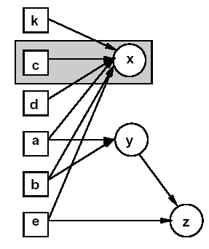
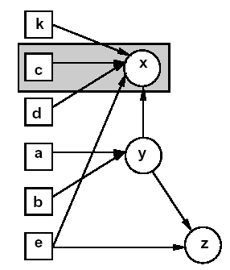
More Refined Delay Models
Propagation delay grows with the size of the expression and with fanout load.
Elimination
Reduces one stage.
Yields more complex and slower gates.
May slow other paths.
Substitution
Adds one dependency.
Loads and slows a gate.
May slow other paths.
Useful if arrival time of critical input is larger than other inputs

Slide 117
Speed-Up Algorithm …
Decompose network into two-input NAND gates and inverters.
Determine a subnetwork W of depth d.
Collapse subnetwork by elimination.
Duplicate input vertices with successors outside W
Record area penalty.
Resynthesize W by timing-driven decomposition.
Heuristics
Choice of W.
Monitor area penalty and potential speed-up.

Slide 118
… Speed-Up Algorithm
Example
NAND delay =2.
INVERTER delay =1.
All input data-ready=0 except t_{d}=3.
Critical Path: from V_{d} to V_{x} (11 delay units)
Assume V_{x} is selected and d=5.
New critical path: 8 delay units.

