Slide 1
COE 561 Digital System Design & Synthesis Two-Level Logic Synthesis
Dr. Aiman H. El-Maleh
Computer Engineering Department
King Fahd University of Petroleum & Minerals
[Adapted from slides of Prof. G. De Micheli: Synthesis & Optimization of Digital Circuits]

Slide 2
Outline
Programmable Logic Arrays
Definitions
Positional Cube Notation
Operations on Logic Covers
Exact Two-Level Optimization
Heuristic Two-Level Optimization
Expand
Reduce
Reshape
Irredundant
Espresso
Testability Properties of Two-Level Logic

Slide 3
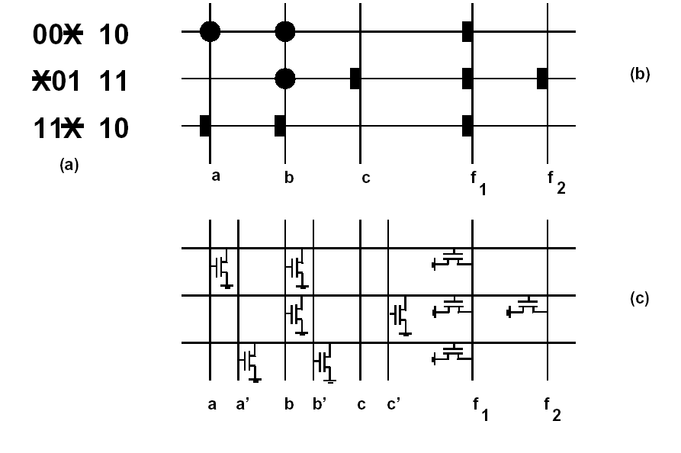
Programmable Logic Arrays …
Macro-cells with rectangular structure.
Implement any multi-output function.
Layout easily generated by module generators.
Fairly popular in the seventies/eighties (NMOS).
Still used for control-unit implementation.
f₁ = a’b’+b’c+ab f₂ = b’c

Slide 4
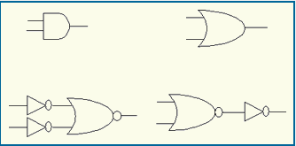
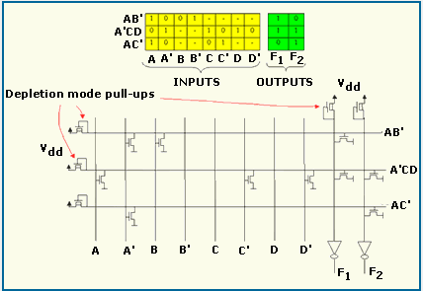
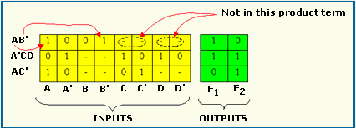
… Programmable Logic Arrays

Slide 5
Two-Level Optimization
Assumptions
Primary goal is to reduce the number of implicants.
All implicants have the same cost.
Secondary goal is to reduce the number of literals.
Rationale
Implicants correspond to PLA rows.
Literals correspond to transistors.

Slide 6
Definitions …
A cover of a Boolean function is a set of implicants that covers its minterms.
Minimum cover
Cover of the function with minimum number of implicants.
Global optimum.
Minimal cover or irredundant cover
Cover of the function that is not a proper superset of another cover.
No implicant can be dropped.
Local optimum.
Minimal cover w.r.t. 1-implicant containment
No implicant is contained by another one.
Weak local optimum.

Slide 7
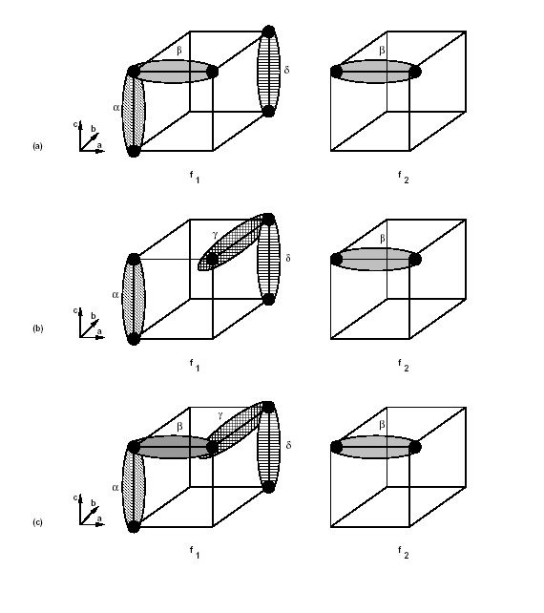
… Definitions …
f₁ = a’b’c’+a’b’c+ab’c
+abc+abc’
f₂ = a’b’c+ab’c
(a) cover is minimum.
(b) cover is minimal.
(c) cover is minimal w.r.t.
1-implicant containment.

Slide 8
… Definitions …
Prime implicant
Implicant not contained by any other implicant.
Prime cover
Cover of prime implicants.
Essential prime implicant
There exist some minterm covered only by that prime implicant.

Slide 9
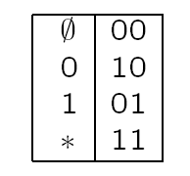
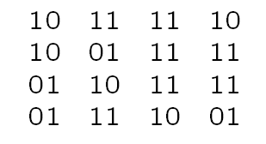
The Positional Cube Notation
Encoding scheme
One column for each variable.
Each column has 2 bits.
Example: f = a’d’ + a’b + ab’ + ac’d
Operations
Intersection: AND
Union: OR
a’d’
a’b
ab’
ac’d

Slide 10
Operations on Logic Covers
The intersection of two implicants is the largest cube contained in both. (bitwise AND)
The supercube of two implicants is the smallest cube containing both. (bitwise OR)
The distance between two implicants is the number of empty fields in their intersection.
An implicant covers another implicant when the bits of the former are greater than or equal to those of the latter.
Recursive paradigm
Expand about a variable.
Apply operation to cofactors.
Merge results.
Unate heuristics
Operations on unate functions are simpler.
Select variables so that cofactors become unate functions.

Slide 11
Cofactor Computation
Let α=a₁a₂…a_{n} and β =b₁b₂…b_{n} (i.e. n variables)
Cofactor of α w.r. to β
Void when α does not intersect β (i.e. distance is ≥ 1)
a₁ +b₁’ a₂ +b₂’ . . . a_{n} +b_{n}’
Cofactor of a set C = {γ_{i}} w.r. to β
Set of cofactors of γ_{i} w.r. to β.
Example: f = a’b’+ab
a’b’ 10 10
ab 01 01
Cofactor w.r. to (a) 01 11
First row: void.
Second row: 11 01.
Cofactor f_{a} = b

Slide 12
Sharp Operation #
The sharp operation α # β returns the sets of implicants covering all minterms covered by α and not by β.
Let α=a₁a₂…a_{n} and β =b₁b₂…b_{n}
Example: compute complement of cube ab
11 11 # 01 01 = {10 11; 11 10}= a’+b’
a₁.b’₁ a₂ … a_{n}
a₁ a₂.b’₂ … a_{n}
………………
a₁ a₂ … a_{n}.b’_{n}
α # β=

Slide 13
Disjoint Sharp Operation #
The disjoint sharp operation α # β returns the sets of implicants covering all minterms covered by α and not by β such that all implicants are disjoint.
Let α=a₁a₂…a_{n} and β =b₁b₂…b_{n}
Example: compute complement of cube ab
11 11 # 01 01 = {10 11; 01 10}= a’+ab’
a₁.b’₁ a₂ … a_{n}
a₁.b₁ a₂.b’₂ … a_{n}
………………
a₁.b₁ a₂.b₂ … a_{n}.b’_{n}
α # β=

Slide 14
Consensus
Let α=a₁a₂…a_{n} and β=b₁b₂…b_{n}
Consensus is void when two implicants have distance larger than or equal to 2.
Yields a single implicant when distance is 1.
Example: α=01 10 01 and β =01 11 10
Consensus(α,β)= {01 10 00, 01 11 00, 01 10 11}=01 10 11=ab’
a₁+b₁ a₂.b₂ … a_{n}.b_{n}
a₁.b₁ a₂+b₂ … a_{n}.b_{n}
………………
a₁.b₁ a₂.b₂ … a_{n}+b_{n}
Consensus(α,β)=

Slide 15
Computation of all Prime Implicants …
Let f= x f_{x} + x’ f_{x’}
There are three possibilities for a prime implicant of f
It is a prime of x f_{x} i.e. a prime of f_{x}
It is a prime of x’ f_{x’} i.e. a prime of f_{x’}
It is the consensus of two implicants one in x f_{x} and one in x’ f_{x’}
A unate cover, F, with SCC contains all primes.
P(F)=SCC(F)
Each prime of a unate function is essential.

Slide 16
… Computation of all Prime Implicants
Example: f=ab + ac + a’
Let us choose to split the binate variable a
Note that f_{a’} is tautology; P(f_{a’})=U; C(a’) ∩ P(f_{a’}) =10 11 11=P1=a’
P(f_{a})= {11 01 11; 11 11 01}=b+c; C(a) ∩ P(f_{a})={01 01 11; 01 11 01}=P2={ab, ac}
Consensus(P1,P2)= {11 01 11; 11 11 01}={b,c}
P(F)=SCC{10 11 11; 01 01 11; 01 11 01; 11 01 11; 11 11 01}
= {a’, ab, ac, b, c}
= {10 11 11; 11 01 11; 11 11 01}
= {a’, b, c}

Slide 17
Tautology …
Check if a function is always TRUE.
Plays an important role in all algorithms for logic optimization.
Recursive paradigm
Expand about a variable.
If all cofactors are TRUE then function is a tautology.
TAUTOLOGY
The cover has a row of all 1s (Tautology cube).
The cover depends on one variable only, and there is no column of 0s in that field.
NO TAUTOLOGY
The cover has a column of 0s (A variable that never takes a certain value).
When a cover is the union of two subcovers that depend on disjoint subsets of variables, then check tautology in both subcovers.

Slide 18
… Tautology
Unate heuristics
If cofactors are unate functions, additional criteria to determine tautology.
Faster decision.
A cover is not tautology if it is unate and there is not a row of all 1’s.
If a function is expanded in a unate variable, only one cofactor needs to be checked for tautology
Positive unate in variable xi, f_{xi} ⊇ f_{xi’} ; only f_{xi’} needs to be checked for tautology.
Negative unate in variable xi, f_{xi} ⊆ f_{xi’} ; only f_{xi} needs to be checked for tautology.

Slide 19
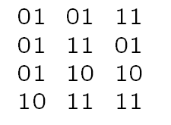
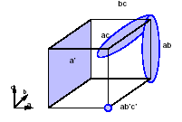
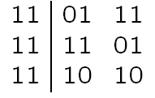
Tautology Example
f = ab+ac+ab’c’ +a’
Select variable a.
Cofactor w.r.to a’
11 11 11 => Tautology.
Cofactor w.r.to a is:
Select variable b.
Cofactor w.r. to b’ is:
Depends on a single variable, no column of 0’s => Tautology.
Cofactor w.r. to b is: 11 11 11 => Tautology
Function is a TAUTOLOGY.

Slide 20
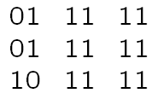
Containment
Theorem
A cover F contains an implicant α iff F_{α} is a tautology.
Consequence
Containment can be verified by the tautology algorithm.
Example
f = ab+ac+ab’c’+a’
Check covering of bc: C(bc) 11 01 01
Take the cofactor
Tautology; bc is contained by f

Slide 21
Complementation
Recursive paradigm
f = x · f_{x} + x’ · f_{x’} f’ = x · f’_{x} + x’ · f’_{x’}
Steps
Select a variable.
Compute cofactors.
Complement cofactors.
Recur until cofactors can be complemented in a straightforward way.
Termination rules
The cover F is void. Hence its complement is the universal cube.
The cover F has a row of 1s. Hence F is a tautology and its complement is void.
All implicants of F depend on a single variable, and there is not a column of 0s. The function is a tautology, and its complement is void.
The cover F consists of one implicant. Hence the complement is computed by De Morgan's law.

Slide 22
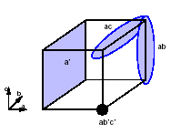
Complement of Unate Functions…
Theorem
If f is positive unate in variable x: f’ = f’_{x} +x’ · f’_{x’}.
If f is negative unate in variable x: f’ = x · f’_{x} +f’_{x’}.
Consequence
Complement computation is simpler.
Heuristic
Select variables to make the cofactors unate.
Example: f = ab+ac+a’
Select binate variable a.
Compute cofactors
F_{a’} is a tautology, hence F’_{a’} is void.
F_{a} yields:

Slide 23
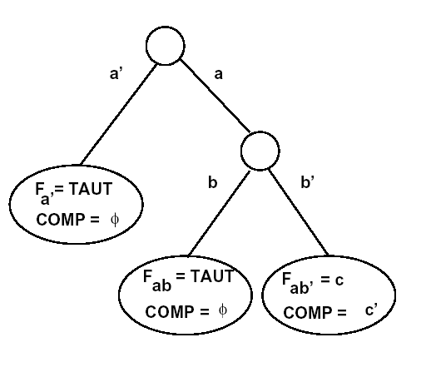
… Complement of Unate Functions
Select unate variable b.
Compute cofactors
F_{ab} is a tautology, hence F’_{ab} is void.
F_{ab’} = 11 11 01 and its complement is 11 11 10.
Re-construct complement
11 11 10 intersected with C(b’) = 11 10 11 yields 11 10 10.
11 10 10 intersected with C(a) = 01 11 11 yields 01 10 10.
Complement: F’ = 01 10 10 = a b’ c’.

Slide 24
Two-Level Logic Minimization
Exact methods
Compute minimum cover.
Often impossible for large functions.
Based on derivatives of Quine-McCluskey method.
Many minimization problems can be now solved exactly.
Usual problems are memory size and time.
Heuristic methods
Compute minimal covers (possibly minimum).
Large variety of methods and programs
MINI, PRESTO, ESPRESSO.

Slide 25
Exact Two-Level Logic Minimization
Quine's theorem
There is a minimum cover that is prime.
Consequence
Search for minimum cover can be restricted to prime implicants.
Quine McCluskey method
Compute prime implicants.
Determine minimum cover.
Prime implicant table
Rows: minterms.
Columns: prime implicants.
Exponential size
2^{n} minterms.
Up to 3^{n}/n prime implicants.
Remark:
Some functions have much fewer primes.
Minterms can be grouped together.

Slide 26
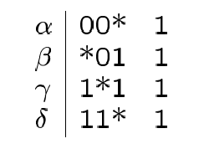
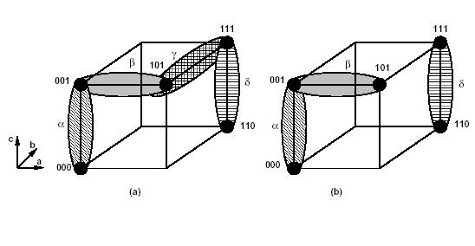
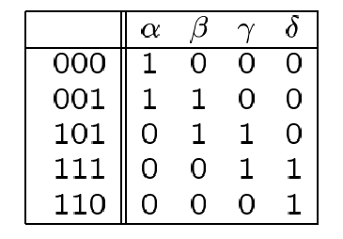
Prime Implicant Table Example
Function: f = a’b’c’+a’b’c+ab’c+abc’+abc
Prime Implicants
Implicant Table

Slide 27
Minimum Cover: Early Methods
Reduce table
Iteratively identify essentials, save them in the cover, remove covered minterms.
Use row and column dominance.
Petrick's method
Write covering clauses in POS form.
Multiply out POS form into SOP form.
Select cube of minimum size.
Remark
Multiplying out clauses is exponential.
Petrick's method example
POS clauses: (α)(α+β)(β+γ)(γ+ δ)(δ) = 1
SOP form: α β δ + α γ δ = 1
Solutions
{α, β, δ}
{α, γ, δ}

Slide 28
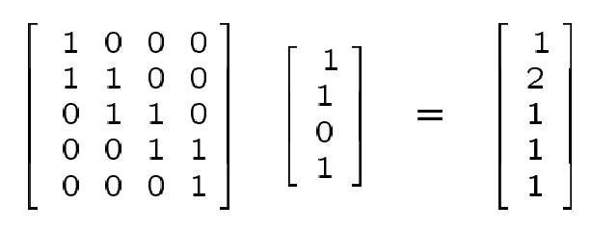
Matrix Representation
View table as Boolean matrix: A.
Selection Boolean vector for primes: x.
Determine x such that
A x ≥ 1.
Select enough columns to cover all rows.
Minimize cardinality of x
Example: x = [1101]^{T}
Set covering problem
A set S. (Minterm set).
A collection C of subsets. (Implicant set).
Select fewest elements of C to cover S.

Slide 29
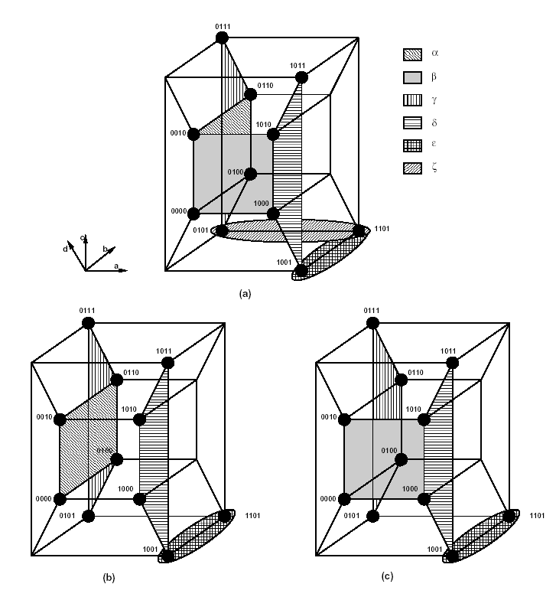
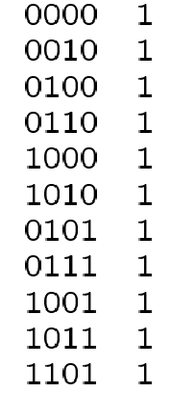
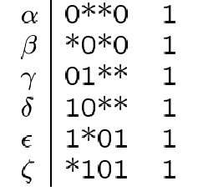
ESPRESSO-EXACT
Exact minimizer [Rudell].
Exact branch and bound covering.
Compact implicant table
Group together minterms covered by the same implicants.
Very efficient. Solves most problems.
Implicant table
after reduction

Slide 30
Minimum Cover: Recent Developments
Many minimization problems can be solved exactly today.
Usually bottleneck is table size.
Implicit representation of prime implicants
Methods based on BDDs [COUDERT]
to represent sets.
to do dominance simplification.
Methods based on signature cubes [MCGEER]
Represent set of primes.
A signature cube identifies uniquely the set of primes covering each minterm.
It is the largest cube of the intersection of corresponding primes.
The set of maximal signature cubes defines a minimum canonical cover.

Slide 31
Heuristic Minimization Principles
Provide irredundant covers with 'reasonably small' cardinality.
Fast and applicable to many functions.
Avoid bottlenecks of exact minimization
Prime generation and storage.
Covering.
Local minimum cover
Given initial cover.
Make it prime.
Make it irredundant.
Iterative improvement
Improve on cardinality by 'modifying' the implicants.

Slide 32
Heuristic Minimization Operators
Expand
Make implicants prime.
Remove covered implicants w.r.t. single implicant containment.
Irredundant
Make cover irredundant.
No implicant is covered by the remaining ones.
Reduce
Reduce size of each implicant while preserving cover.
Reshape
Modify implicant pairs: enlarge one and reduce the other.

Slide 33
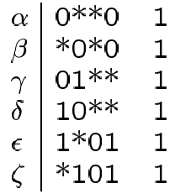
Example: MINI

Slide 34
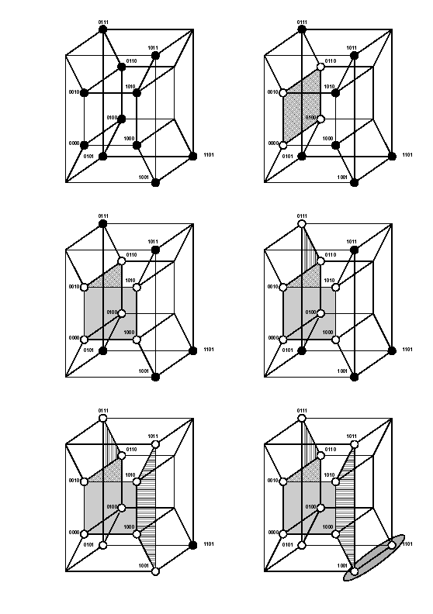
Example: Expansion
Expand 0000 to α=0∗∗0.
Drop 0100, 0010, 0110 from the cover.
Expand 1000 to β= ∗0∗0.
Drop 1010 from the cover.
Expand 0101 to γ= 01∗∗ .
Drop 0111 from the cover.
Expand 1001 to δ= 10∗∗.
Drop 1011 from the cover.
Expand 1101 to ε= 1∗01.
Cover is: {α, β, γ, δ, ε}
Prime.
Redundant.
Minimal w.r.t. scc.

Slide 35
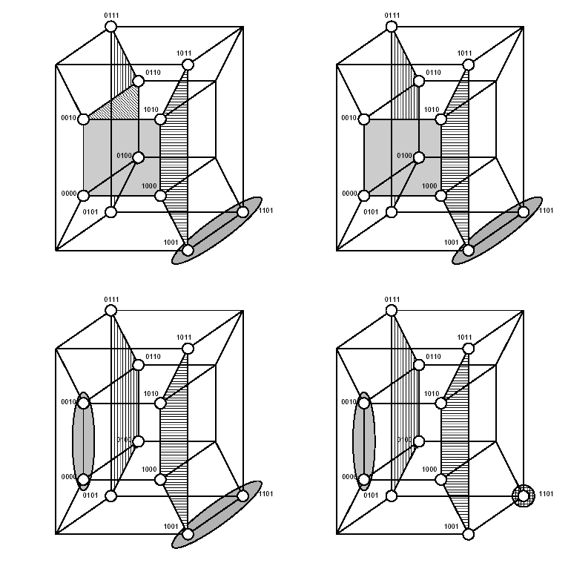
Example: Reduction
Reduce α=0∗∗0 to nothing.
Reduce β=∗0∗0 to β~=00∗0
Reduce ε=1∗01 to ε~=1101
Cover={β~, γ, δ, ε~}

Slide 36
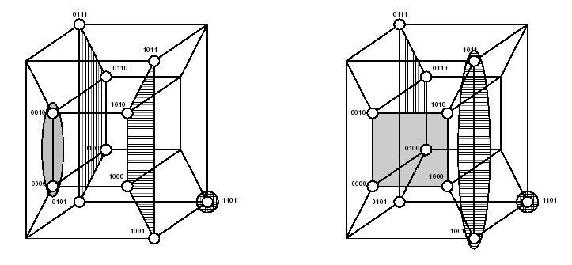
Example: Reshape
Reshape {β~, δ} to {β, δ~}
δ~=10∗1
Cover={β, γ, δ~, ε~}

Slide 37
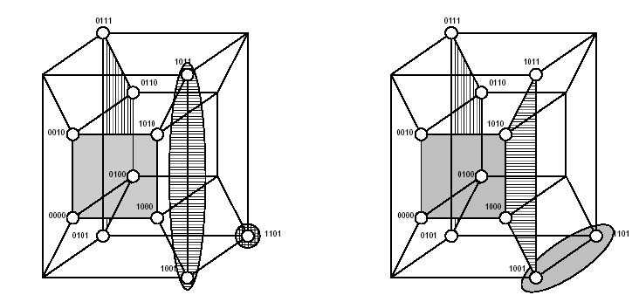
Example: Second Expansion
Cover={β, γ, δ~, ε~}
Expand δ~=10*1 to δ= 10∗∗.
Expand ε~=1101 to ε= 1∗01.
Cover={β, γ, δ, ε}; prime and irredundant

Slide 38
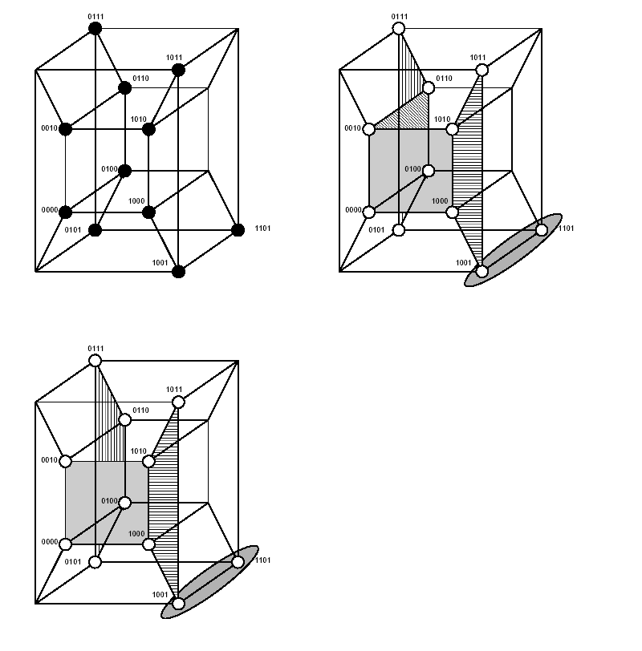
Example: ESPRESSO
Expansion
Cover is: {α, β, γ, δ, ε}.
Prime, redundant, minimal w.r.t. scc.
Irredundant
Cover is: {β, γ, δ, ε}
Prime, irredundant

Slide 39
Expand: Naive Implementation
For each implicant
For each care literal
Raise it to don't care if possible.
Remove all covered implicants.
Problems
Validity check.
Order of expansions.
Validity Check
Espresso, MINI
Check intersection of expanded implicant with OFF-set.
Requires complementation of {ON-set ∪ DC-Set}
Presto
Check inclusion of expanded implicant in the union of the ON-set and DC-set.
Can be reduced to recursive tautology check.

Slide 40
Expand Heuristics …
Expand first cubes that are unlikely to be covered by other cubes.
Selection
Compute vector of column sums.
Implicant weight: inner product of cube and vector.
Sort implicants in ascending order of weight.
Rationale
Low weight correlates to having few 1’s in densely populated columns.

Slide 41
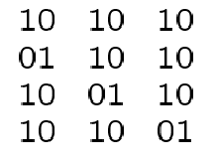
Example …
f = a’b’c’ +ab’c’ +a’bc’ +a’b’c
DC-set = abc’
Ordering
Vector: [313131]^{T}
Weights: (9, 7, 7, 7).
Select second implicant.
a’b’c’
ab’c’
a’bc’
a’b’c
31 31 31
3
1
3
1
3
1
OFF-set:
01 11 01
11 01 01
*
=
[ 9 7 7 7 ]

Slide 42
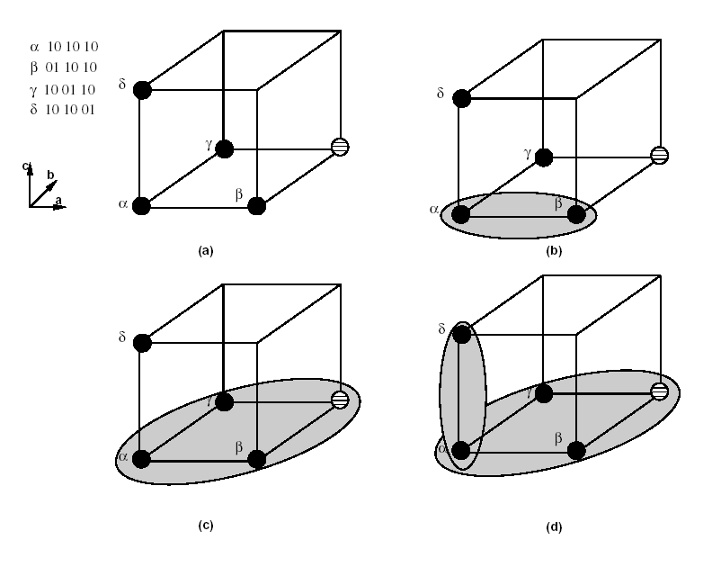
… Example
Expand 01 10 10
11 10 10 valid.
11 11 10 valid.
11 11 11 invalid.
Update cover to
11 11 10
10 10 01
Expand 10 10 01
11 10 01 invalid.
10 11 01 invalid.
10 10 11 valid.
Expanded cover
11 11 10
10 10 11

Slide 43
Expand in ESPRESSO …
Smarter heuristics for choosing literals to be expanded.
Four-step procedure in Espresso.
Rationale
Raise literals so that expanded implicant
Covers a maximal set of cubes.
As large as possible.
Definitions: For a cube α to be expanded
Free: Set of entries that can be raised to 1.
Overexpanded cube: Cube whose entries in free are simultaneously raised.
Feasibly covered cube: A cube β∈F^{ON} is feasibly covered iff supercube with α is distance 1 or more from each cube of F^{OFF} (i.e. does not intersect with offset).

Slide 44
… Expand in ESPRESSO …
1. Determine the essential parts.
Determine which entries can never be raised, and remove them from free .
Search for any cube in F^{OFF} that has distance 1 from α (corresponding column cannot be raised)
Determine which parts can always be raised, raise them, and remove them from free .
Search for any column that has only 0’s in F^{OFF}
2. Detection of feasibly covered cubes.
If there is an implicant β∈F^{ON} whose supercube with α is feasible repeat the following steps.
Raise the appropriate entry of α and remove it from free.
Remove from free entries that can never be raised or that can always be raised and update α.
Each cube remaining in the cover F^{ON} is tested for being feasibly covered.
α is expanded by choosing feasibly covered cube that covers the most other feasibly covered cubes.

Slide 45
… Expand in ESPRESSO
Only cubes ∈F^{ON} that are covered by the overexpanded cube of α need to be considered.
Cubes ∈ F^{OFF} that are 1 distance or more from the overexpanded cube of α do not need to be checked.
3. Expansion guided by the overexpanded cube.
When there are no more feasibly covered cubes while the overexpanded cube of α covers some other cubes of F^{ON}, repeat the following steps.
Raise a single entry of α as to overlap a maximum number of those cubes.
Remove from free entries that can never be raised or that can always be raised and update α.
This has the goal of forcing α to overlap with as many cubes as possible in F^{ON} .
4. Find the largest prime implicant covering α
When there are no cubes∈F^{ON} covered by the over-expanded cube of α
Formulate a covering problem and solve it by a heuristic method.
Find the largest prime implicant covering α.

Slide 46
Example
α
β
γ
δ
β = 01 10 10 is selected first for expansion
Free set includes columns {1,4,6}
Column 6 cannot be raised
Distance 1 from off-set 01 11 01
Supercube of β and α is valid
β = 11 10 10
Supercube of β and γ is valid
β = 11 11 10
Supercube of β and δ is invalid
Select γ since the expanded cube by γ covers that one by α
Delete implicants α and γ; β’ = 11 11 10
Next, expand δ = 10 10 01
Free set is {2, 4, 5}
Columns 2 and 4 cannot be raised
Column 5 of F^{OFF} has only 0’s. The 0 in column 5 can be raised
δ’ = 10 10 11
Final cover is {β’, δ’ }
OFF-set:
01 11 01
11 01 01

Slide 47
Another Expand Example …
F^{ON}= a’b’c’d’ + a’bd + bc’d + ab’d
F^{DC}= a’b’d + a’b’c + a’bc’d’ + ab’c’d’
Let assume that we will expand the cube a’b’c’d’
We can see that all variables can be raised.
Overexpanded cube is 1.
None of the cubes in the ON-set are feasibly covered.
First, we can expand any of the variables as none will overlap with cubes in the ON-set.
Assume that we expended a’b’c’d’ to a’b’c’.
Note that none of the columns can’t be raised.
Next, we expend a’b’c’ to a’c’ as it overlaps with two cubes in the ON-set i.e. a’bd and bc’d.
Note that we could have expended a’b’c’ to b’c’ but it overlaps with only one cube in the ON-set i.e. ab’d.

Slide 48
Third Expand Example …
F^{ON}= a’b’cd + a’bc’d + a’bcd + ab’c’d’ + ac’d
F^{DC}= a’b’c’d + abcd + ab’cd’
Let assume that we will expand the cube a’b’cd
We can see that variables a and d cannot be raised.
Overexpanded cube is a’d.
Note that only cubes a’bc’d and a’bcd need to be considered for being feasibly covered.
None of the offset cubes need to be checked as they are all distance 1 or more from the overexpanded cube.
Supercube of a’b’cd and a’bc’d is a’d.
Supercube of a’b’cd and a’bcd is a’cd.
So, a’bc’d is selected and the cube is expanded to a’d.

Slide 49
… Third Expand Example
Next, let us expand cube ab’c’d’.
We can see that variables a and b cannot be raised.
Overexpanded cube is ab’.
None of the remaining cubes can be feasibly covered.
None of the remaining cubes is covered by ab’.
Expansion is done to cover the largest prime implicant.
So, variable d is raised and the cube is expanded to ab’c’.
Finally, cube ac’d is expanded.
Variables c and d cannot be raised.
Overexpanded cube is c’d.
No remaining cubes covered with overexpanded cube.
Find the largest prime implicant covering the cube.
Largest prime implicant is c’d.
Final Expanded Cover is: a’d + ab’c’ + c’d

Slide 50
Finding Largest Prime Implicant Covering a Cube
Let C be the cube to be cover
Given a cover for the off-set R = {r_{i}}.
Form a Blocking Matrix B (for cube C)
Number of rows is equal to number of offset cubes, and number of columns is equal to number of literals.
All minimal column covers of B are the minimal subsets of literals of C that must be kept to ensure that

Slide 51
Finding Largest Prime Implicant Covering a Cube
Thus, each minimal column cover is a prime p that covers c, i.e. p ⊇ c.
Example:
F^{ON}= a’b’c’d’ + a’bd + bc’d + ab’d
F^{OFF}= a’d’ + bd’ + ab’cd
Find the largest prime implicant covering the cube ac’d

Slide 52
Finding Largest Prime Implicant Covering a Cube
a
b
c
d
A minimum cover for the Blocking matrix is {c, d}
Thus, we need to keep only c’ d in the cube a c’ d to get the largest prime implicant.
C = a c’ d
a’ d’
b d’
a b’ c d

Slide 53
Reduce Heuristics …
Goal is to decrease size of each implicant to smallest size so that successive expansion may lead to another cover with smaller cardinality.
Reduced covers are not prime.
Sort implicants
First process those that are large and overlap many other implicants
Heuristic: sort by descending weight (weight like expand)
For each implicant
Lower as many * as possible to 1 or 0.
Reducing an implicant α
Can be computed by intersecting α with complement of F–{α}.
May result in multiple implicants.
Must ensure result yields a single implicant.
Theorem
Let α∈ F and Q = {F ∪ F^{DC}}–{α}
Then, the maximally reduced cube is: α~ = α ∩ supercube (Q’_{α})

Slide 54
… Reduce Heuristics …
Expanded cover
11 11 10
10 10 11
Select first implicant 11 11 10 = c’
Complement of 10 10 11 (a’b’) is {01 11 11; 11 01 11} (a+b)
C’ intersected with 1 is c’.
Cannot be reduced.
Select second implicant 10 10 11 (a’b’)
Complement of c’ is c.
a’b’ intersected with c is a’b’c.
Reduced to 10 10 01 (a’b’c).
Reduced cover
11 11 10
10 10 01

Slide 55
… Reduce Heuristics
Another Reduce Example
F = a’b’ + c’
F^{DC} = bc’
Consider reducing c’
Q = {a’b’, bc’}
Q_{c’}={a’b’,b}
Q’_{c’}={ab’}, SC(Q’_{c’})={ab’}
Thus, c’ ∩ SC(Q’_{c’})=ab’c’
Note that if F^{DC} is not included in Q, we will not get the correct result
Q = {a’b’}
Q_{c’}={a’b’}
Q’_{c’}={a+b}, SC(Q’_{c’})={1}
Thus, c’ ∩ SC(Q’_{c’})=c’

Slide 56
Irredundant Cover …
Relatively essential set E^{r}
Implicants covering some minterms of the function not covered by other implicants in the cover.
α∈F is in E^{r} if it is not covered by {F ∪ F^{DC}}–{α}
Totally redundant set R^{t}
Implicants covered by the relatively essentials.
α∈F is in R^{t} if it is covered by {E^{r} ∪ F^{DC}}
Partially redundant set R^{p}
Remaining implicants.
R^{p} = F – {E^{r} ∪ R^{t}}

Slide 57
… Irredundant Cover …
Find a subset of R^{p} that, together with E^{r}, covers the function.
Modification of the tautology algorithm
Each cube in R^{p} is covered by other cubes in E^{r} and R^{p}.
Find mutual covering relations.
Determine set of cubes when removed makes function non-tautology.
Reduces to a covering problem
Heuristic algorithm.

Slide 58
… Irredundant Cover …
Covering problem formulated as follows:
Each column corresponds to an element of an R^{p}
Each row represents a subset of cubes of R^{p} whose joint removal uncovers (a portion of) the checked cube i.e. makes the containment check not tautology.
When we get to a leaf in the tautology algorithm (i.e. when we are able to determine the function is tautology), we examine the cubes which are in the cover in this leaf.
If there are 1’s from cubes from R^{r} or don’t care cubes, then it is not possible to avoid the function being a tautology in this leaf. No rows will be added in this case. Otherwise, all cubes in R^{p} resulting in 1 in this leaf must be removed to prevent this leaf from becoming tautology.
Note that there may be more than one row for each containment check.

Slide 59
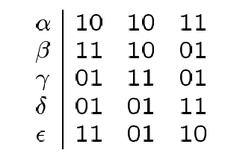
… Irredundant Cover …
E^{r} = {α, ε}
R^{t} = {}
R^{p} = {β, γ, δ }
Covering relations
β:
(α + γ + δ + ε )_{β}
(a’b’+ac+ab+bc’)_{b’c}
(a’ +a +0 +0 )_{b’c}
γ:
(α + β + δ + ε )_{γ}
(a’b’+b’c+ab+bc’)_{ac}
(0 +b’ +b +0 )_{ac}
Minimum cover: γ ∪ E^{r} = {α, ε, γ}
a’b’
b’c
ac
ab
bc’
β γ δ
β 1 1 0
1 1 0
0 1 1
δ 0 1 1

Slide 60
Irredundant Cover: Example 2
F = c’d’ + cd + a’b’ + a’c’ + bc’ + bd
Note that E^{r} = {c’d’, cd, a’b’}, R^{t} = {}, R^{p} = {a’c’, bc’, bd}
Coverage relations:
a’c’:
(c’d’ + cd + a’b’ + bc’ + bd)a’c’
(d’ + 0+ b’ + b + bd)a’c’
Expand on b:
B=1: (d’ + 0+ 0 + 1 + d)a’c’ => added row (1,1,1)
B=0: (d’ + 0+ 1 + 0 + 0)a’c’ => no rows added

Slide 61
Irredundant Cover: Example 2
bc’:
(c’d’ + cd + a’b’ + a’c’ + bd)bc’
(d’ + 0+ 0 + a’ + d)bc’
Expand on d:
D=1: (0 + 0+ 0 + a’ + 1)a’c’ => added row (0,1,1)
D=0: (1 + 0+ 0 + a’ + 0)a’c => no rows added
bd:
(c’d’ + cd + a’b’ + a’c’ + bc’)bd
(0 + c+ 0 + a’c’ + c’)bd
Expand on c:
C=1: (0 + 1+ 0 + 0 + 0)a’c’ => no rows added
C=0: (0 + 0+ 0 + a’ + 1)a’c’ => added row (0,1,1)

Slide 62
Irredundant Cover: Example 2
Coverage Matrix:
a’c’ bc’ bd
a’c’ 1 1 1
bc’ 0 1 1
bd 0 1 1
Thus, a minimum cover is to select either bc’ or bd.
Thus, we have the following two irredundant covers:
F = c’d’ + cd + a’b’ + bc’
F = c’d’ + cd + a’b’ + bd

Slide 63
Irredundant Cover: Example 3
F = a’cd + ab’c’ + acd’ + bcd + abd + abc + ac’d
Note that E^{r} = {a’cd, ab’c’, acd’}, R^{t} = {}, R^{p} = {bcd, abd, abc, ac’d}
Coverage relations:
bcd:
(a’cd + ab’c’ + acd’ + abd + abc + ac’d)bcd
(a’ + 0 + 0 + a + a + 0)bcd
=> added row (1,1,1,0)
abd:
(a’cd + ab’c’ + acd’ + bcd + abc + ac’d)abd
(0 + 0 + 0 + c + c + c’)bcd
=> added row (0,1,0,1)
=> added row (1,1,1,0)

Slide 64
Irredundant Cover: Example 3
abc:
(a’cd + ab’c’ + acd’ + bcd + abd + ac’d)abc
(0 + 0 + d’+ d + d + 0)abc
=> added row (1,1,1,0)
ac’d:
(a’cd + ab’c’ + acd’ + bcd + abd + abc)ac’d
(0 + b’ + 0+ 0 + b + 0)ac’d
=> added row (0,1,0,1)

Slide 65
Irredundant Cover: Example 3
Coverage Matrix:
bcd abd abc ac’d
bcd 1 1 1 0
abd 0 1 0 1
abd 1 1 1 0
abc 1 1 1 0
ac’d 0 1 0 1
Thus, a minimum cover is to select abd.
Thus, we have the following irredundant cover:
F = a’cd + ab’c’ + acd’ + abd

Slide 66
Essentials …
Essential prime implicants are part of any cover.
Theorem
Let F=G∪α, where α is a prime disjoint from G. Then, α is an essential prime iff Consensus(G,α) does not cover α.
Corollary
Let F^{ON} be a cover of the on-set and F^{DC} be a cover of the dc-set and α is a prime implicant. Then, α is an essential prime implicant iff H∪F^{DC} does not cover α, where H=Consensus( ((F^{ON} ∪F^{DC} )# α), α)
Example
a’b’
b’c
ac
ab
Test α :
F#α={ab’c, ab, ac}={ab, ac}
H= {b’c}
H_{α}={c}; not tautology
α not contained in H and essential
α 10 10 11
β 11 10 01
γ 01 11 01
δ 01 01 11

Slide 67
… Essentials
Another Example
F = a’b’ + c’
F^{DC} = bc’ + ac’
Let us consider if c’ is essential prime implicant
F#c’=a’b’c
H=a’b’
H∪ {F^{DC}}={a’b’,bc’,ac’}
{a’b’,bc’,ac’}_{c’}= {a’b’,b,a}=Tautology
Thus, c’ is not essential prime implicant
Note that if you do not include F^{DC}, you will get the incorrect result.

Slide 68
ESPRESSO Algorithm …
Compute the complement.
Find a prime cover: Expand.
Find a prime and irredundant cover: Irredundant.
Extract Essentials.
Iterate
Reduce, Expand, irredundant.
Cost functions
Cover cardinality ∅₁.
Weighted sum of cube and literal count ∅₂.

Slide 69
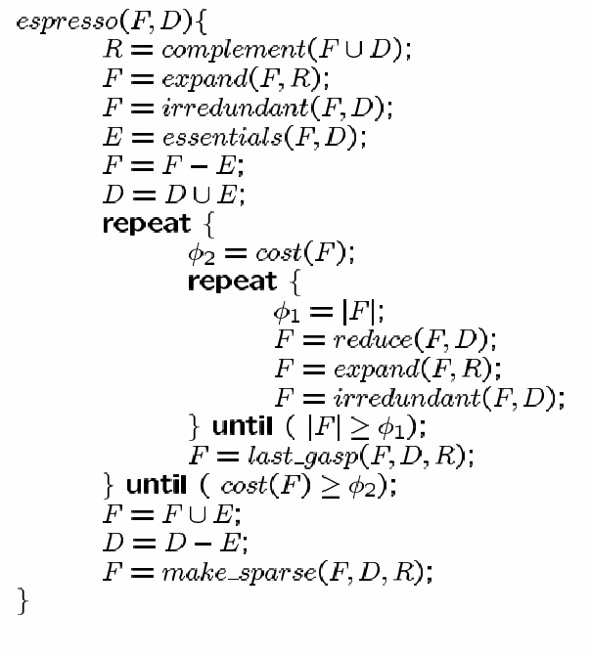
… ESPRESSO Algorithm
last_gasp: uses different heuristics for reduce and expand to get out of local minimum.
Reduce each cube independently to cover only minterms not covered by other implicants
The generated cover after reduce may not cover the function
Expand only those cubes that were reduced to cover reduced cubes
Call irredundant on the primes in the original cover and the newly generated primes
make_sparse: attempts to reduce the number of literals in the cover. Done by:
reducing the "sparse" variables (using a modified version of irredundant rather than reduce),
followed by expanding the "dense“ variables (using modified version of expand).

Slide 70
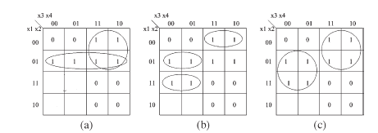
Last_gasp Example
Original cover = {x₁x₃’, x₁’x₂, x₁’x₃}
Reduced cover={x₁x₂x₃’, x₁’x₂x₃’, x₁’ x₂’x₃}
Cover after expansion= ={x₂x₃’, x₁’x₃}
Make irredundant of {x₁x₃’, x₁’x₂, x₁’x_{3,} x₂x₃’, x₁’x₃}
={x₂x₃’, x₁’x₃}
1
1
x
x
x
x
x
x

Slide 71
Espresso Format
Example Input
Espresso Output
.i 3
.o 2
.ilb a b c
.ob f1 f2
.p 6
00- 10
-01 11
1-1 10
11- 10
110 11
100 0-
.e
.i 3
.o 2
.ilb a b c
.ob f1 f2
.p 4
1-0 01
11- 10
00- 10
-01 11
.e

Slide 72
Testability Properties of Two-Level Logic Circuits
Single stuck-at fault model
Assumes a single line in the circuit faulty.
Faulty line is either stuck-at-0 or stuck-at-1.
Theorem
A two-level circuit is fully single stuck-at fault testable iff it is PRIME and IRREDUNDANT.
An untestable stuck-at fault corresponds to redundancy in the circuit
Redundant stuck-at-0 in any of the products indicates product term is redundant
Redundant stuck-at-1 in any of the products inputs indicates product term is not prime
Redundancy can be removed by injecting the redundant faulty value in the circuit and propagating constants

