Slide 1
COE 561 Digital System Design & Synthesis Architectural Synthesis
Dr. Aiman H. El-Maleh
Computer Engineering Department
King Fahd University of Petroleum & Minerals
[Adapted from slides of Prof. G. De Micheli: Synthesis & Optimization of Digital Circuits]

Slide 2
Outline
Motivation
Dataflow graphs & Sequencing graphs
Resources
Synthesis in temporal domain: Scheduling
Synthesis in spatial domain: Binding
Scheduling Models
Unconstrained scheduling
Scheduling with timing constraints
Scheduling with resource constraints
Algorithmic Solution to the Optimum Binding Problem
Register Binding Problem

Slide 3
Synthesis
Transform behavioral into structural view.
Architectural-level synthesis
Architectural abstraction level.
Determine macroscopic structure.
Example: major building blocks like adder, register, mux.
Logic-level synthesis
Logic abstraction level.
Determine microscopic structure.
Example: logic gate interconnection.

Slide 4
Synthesis and Optimization

Slide 5
Architectural-Level Synthesis Motivation
Raise input abstraction level.
Reduce specification of details.
Extend designer base.
Self-documenting design specifications.
Ease modifications and extensions.
Reduce design time.
Explore and optimize macroscopic structure
Series/parallel execution of operations.

Slide 6
Architectural-Level Synthesis
Translate HDL models into sequencing graphs.
Behavioral-level optimization
Optimize abstract models independently from the implementation parameters.
Architectural synthesis and optimization
Create macroscopic structure
data-path and control-unit.
Consider area and delay information of the implementation.

Slide 7
Dataflow Graphs …
Behavioral views of architectural models.
Useful to represent data-paths.
Graph
Vertices = operations.
Edges = dependencies.
Dependencies arise due
Input to an operation is result of another operation.
Serialization constraints in specification.
Two tasks share the same resource.

Slide 8
… Dataflow Graphs
Assumes the existence of variables who store information required and generated by operations.
Each variable has a lifetime which is the interval from birth to death.
Variable birth is the time at which the value is generated.
Variable death is the latest time at which the value is referenced as input to an operation.
Values must be preserved during life-time.

Slide 9
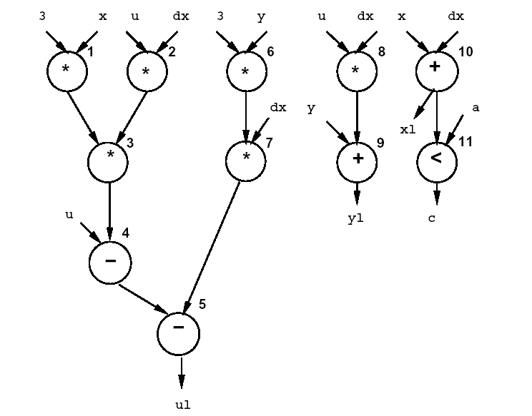
Sequencing Graphs
Useful to represent data-path and control.
Extended dataflow graphs
Control Data Flow Graphs (CDFGs).
Polar: source and sink.
Operation serialization.
Hierarchy.
Control-flow commands
branching and iteration.
Paths in the graph represent concurrent streams of operations.

Slide 10
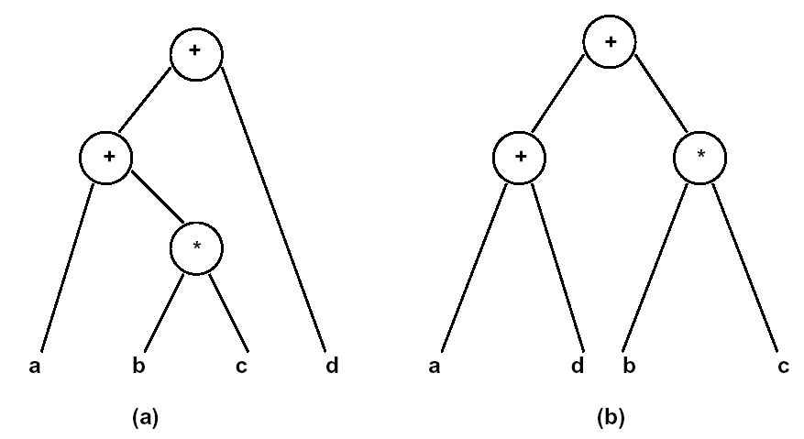
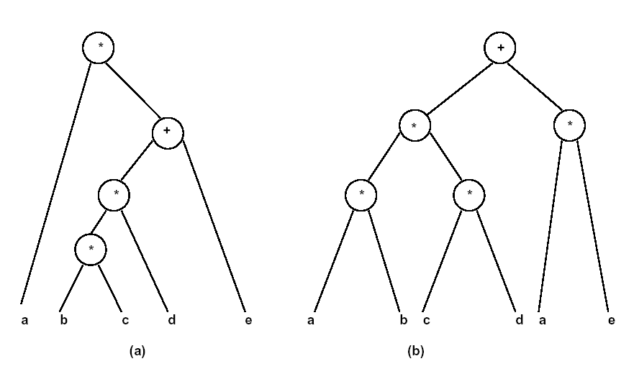
Behavioral-level optimization
Tree-height reduction using commutativity and associativity
x = a + b * c + d => x = (a + d) + b * c
Tree-height reduction using distributivity
x = a * (b * c * d + e) => x = a * b * c * d + a * e

Slide 11
Architectural Synthesis and Optimization
Synthesize macroscopic structure in terms of building-blocks.
Explore area/performance trade-offs
maximum performance implementations subject to area constraints.
minimum area implementations subject to performance constraints.
Determine an optimal implementation.
Create logic model for data-path and control.

Slide 12
Circuit Specification for Architectural Synthesis
Circuit behavior
Sequencing graphs.
Building blocks
Resources.
Functional resources: process data (e.g. ALU).
Memory resources: store data (e.g. Register).
Interface resources: support data transfer (e.g. MUX and Buses).
Constraints
Interface constraints
Format and timing of I/O data transfers.
Implementation constraints
Timing and resource usage.
Area
Cycle-time and latency

Slide 13
Resources
Functional resources: perform operations on data.
Example: arithmetic and logic blocks.
Standard resources
Existing macro-cells.
Well characterized (area/delay).
Example: adders, multipliers, ALUs, Shifters, ...
Application-specific resources
Circuits for specific tasks.
Yet to be synthesized.
Example: instruction decoder.
Memory resources: store data.
Example: memory and registers.
Interface resources
Example: busses and ports.

Slide 14
Resources and Circuit Families
Resource-dominated circuits.
Area and performance depend on few, well-characterized blocks.
Example: DSP circuits.
Non resource-dominated circuits.
Area and performance are strongly influenced by sparse logic, control and wiring.
Example: some ASIC circuits.

Slide 15
Synthesis in the Temporal Domain: Scheduling
Scheduling
Associate a start-time with each operation.
Satisfying all the sequencing (timing and resource) constraint.
Goal
Determine area/latency trade-off.
Determine latency and parallelism of the implementation.
Scheduled sequencing graph
Sequencing graph with start-time annotation.
Unconstrained scheduling.
Scheduling with timing constraints
Scheduling with resource constraints.

Slide 16
Scheduling …
4 Multipliers, 2 ALUs
1 Multiplier , 1 ALU

Slide 17
… Scheduling
2 Multipliers, 3 ALUs
2 Multipliers, 2 ALUs

Slide 18
Synthesis in the Spatial Domain: Binding
Binding
Associate a resource with each operation with the same type.
Determine area of the implementation.
Sharing
Bind a resource to more than one operation.
Operations must not execute concurrently.
Bound sequencing graph
Sequencing graph with resource annotation.

Slide 19
Example: Bound Sequencing Graph

Slide 20
Performance and Area Estimation
Resource-dominated circuits
Area = sum of the area of the resources bound to the operations.
Determined by binding.
Latency = start time of the sink operation (minus start time of the source operation).
Determined by scheduling
Non resource-dominated circuits
Area also affected by
registers, steering logic, wiring and control.
Cycle-time also affected by
steering logic, wiring and (possibly) control.

Slide 21
Scheduling
Circuit model
Sequencing graph.
Cycle-time is given.
Operation delays expressed in cycles.
Scheduling
Determine the start times for the operations.
Satisfying all the sequencing (timing and resource) constraint.
Goal
Determine area/latency trade-off.
Scheduling affects
Area: maximum number of concurrent operations of same type is a lower bound on required hardware resources.
Performance: concurrency of resulting implementation.

Slide 22
Scheduling Models
Unconstrained scheduling.
Scheduling with timing constraints
Latency.
Detailed timing constraints.
Scheduling with resource constraints.
Simplest scheduling model
All operations have bounded delays.
All delays are in cycles.
Cycle-time is given.
No constraints - no bounds on area.
Goal
Minimize latency.

Slide 23
Minimum-Latency Unconstrained Scheduling Problem
Given a set of operations V with integer delays D and a partial order on the operations E
Find an integer labeling of the operations ϕ : V → Z⁺, such that
t_{i} = ϕ(v_{i}),
t_{i} ≥ t_{j} + d_{j} ∀ i, j s.t. (v_{j}, v_{i}) ∈ E
and t_{n} is minimum.
Unconstrained scheduling used when
Dedicated resources are used.
Operations differ in type.
Operations cost is marginal when compared to that of steering logic, registers, wiring, and control logic.
Binding is done before scheduling: resource conflicts solved by serializing operations sharing same resource.
Deriving bounds on latency for constrained problems.

Slide 24
ASAP Scheduling Algorithm
Denote by t^{s} the start times computed by the as soon as possible (ASAP) algorithm.
Yields minimum values of start times.

Slide 25
ALAP Scheduling Algorithm
Denote by t^{L} the start times computed by the as late as possible (ALAP) algorithm.
Yields maximum values of start times.
Latency upper bound λ

Slide 26
Latency-Constrained Scheduling
ALAP solves a latency-constrained problem.
Latency bound can be set to latency computed by ASAP algorithm.
Mobility
Defined for each operation.
Difference between ALAP and ASAP schedule.
Zero mobility implies that an operation can be started only at one given time step.
Mobility greater than 0 measures span of time interval in which an operation may start.
Slack on the start time.

Slide 27
Example
Operations with zero mobility
{v1, v2, v3, v4, v5}.
Critical path.
Operations with mobility one
{v6, v7}.
Operations with mobility two
{v8, v9, v10, v11}

Slide 28
Scheduling under Resource Constraints
Classical scheduling problem.
Fix area bound - minimize latency.
The amount of available resources affects the achievable latency.
Dual problem
Fix latency bound - minimize resources.
Assumption
All delays bounded and known.

Slide 29
Minimum Latency Resource-Constrained Scheduling Problem
Given a set of ops V with integer delays D, a partial order on the operations E, and upper bounds {a_{k}; k = 1, 2, … , n_{res}}
Find an integer labeling of the operations ϕ : V → Z⁺, such that
t_{i} = ϕ(v_{i}),
t_{i} ≥ t_{j} + d_{j} ∀ i, j s.t. (v_{j}, v_{i}) ∈ E
and t_{n} is minimum.
Number of operations of any given type in any schedule step does not exceed bound.
:V→{1,2, …n_{res}}

Slide 30
Scheduling under Resource Constraints
Intractable problem.
Algorithms
Exact
Integer linear program.
Hu (restrictive assumptions).
Approximate
List scheduling.
Force-directed scheduling.

Slide 31
ILP Formulation …
Binary decision variables
X = { x_{il} ; i = 1, 2, … , n; l = 1, 2, … , λ+1}.
x_{il}, is TRUE only when operation v_{i} starts in step l of the schedule (i.e. l = t_{i}).
λ is an upper bound on latency.
Start time of operation v_{i}
Operations start only once
t_{i} =

Slide 32
… ILP Formulation …
Sequencing relations must be satisfied
Resource bounds must be satisfied

Slide 33
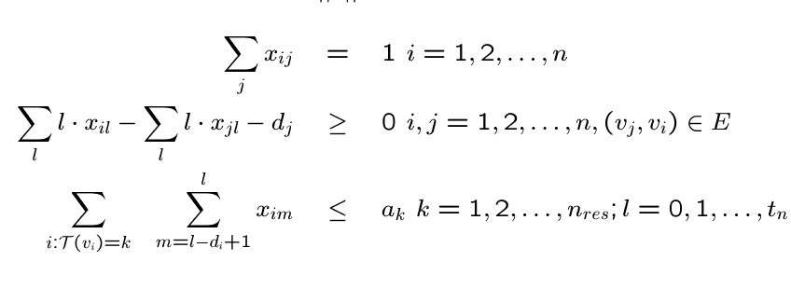
… ILP Formulation
Minimize c^{T} t such that
c^{T}=[0,0,…,0,1]^{T} corresponds to minimizing the latency of the schedule.
c^{T}=[1,1,…,1,1]^{T} corresponds to finding the earliest start times of all operations under the given constraints.

Slide 34
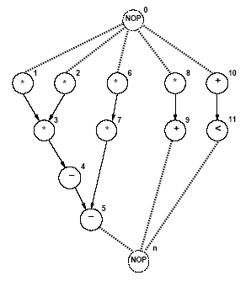
Example …
Resource constraints
2 ALUs; 2 Multipliers.
a₁ = 2; a₂ = 2.
Single-cycle operation.
d_{i} = 1 ∀i.
Operations start only once
x_{0,1}=1; x_{1,1}=1; x_{2,1}=1; x_{3,2}=1
x_{4,3}=1; x_{5,4}=1
x_{6,1}+ x_{6,2}=1
x_{7,2}+ x_{7,3}=1
x_{8,1}+ x_{8,2}+x_{8,3}=1
x_{9,2}+ x_{9,3}+x_{9,4}=1
x_{10,1}+ x_{10,2}+x_{10,3}=1
x_{11,2}+ x_{11,3}+x_{11,4}=1
x_{n,5}=1

Slide 35
… Example …
Sequencing relations must be satisfied
2x_{3,2}-x_{1,1} ≥1
2x_{3,2}-x_{2,1} ≥1
2x_{7,2}+3x_{7,3}-x_{6,1}-2x_{6,2} ≥1
2x_{9,2}+3x_{9,3}+4x_{9,4}-x_{8,1}-2x_{8,2}-3x_{8,3} ≥1
2x_{11,2}+3x_{11,3}+4x_{11,4}-x_{10,1}-2x_{10,2} -3x_{10,3} ≥1
4x_{5,4}-2x_{7,2}-3x_{7,3} ≥1
4x_{5,4}-3x_{4,3} ≥1
5x_{n,5}-2x_{9,2}-3x_{9,3}-4x_{9,4} ≥1
5x_{n,5}-2x_{11,2}-3x_{11,3}-4x_{11,4} ≥1
5x_{n,5}-4x_{5,4} ≥1

Slide 36
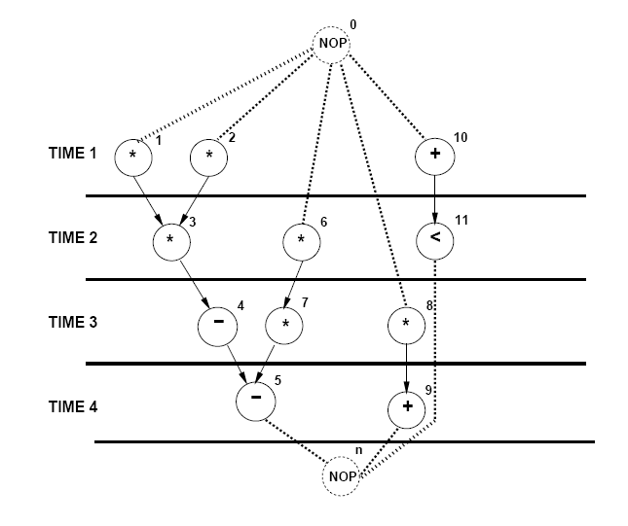
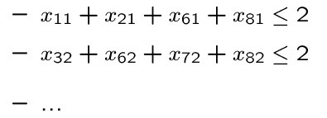
… Example
Resource bounds must be satisfied:
Any set of start times satisfying constraints provides a feasible solution.
Any feasible solution is optimum since sink (x_{n,5}=1) mobility is 0.

Slide 37
Dual ILP Formulation
Minimize resource usage under latency constraint.
Same constraints as previous formulation.
Additional constraint
Latency bound must be satisfied.
Resource usage is unknown in the constraints.
Resource usage is the objective to minimize.
Minimize c^{T} a
a vector represents resource usage
c^{T} vector represents resource costs

Slide 38
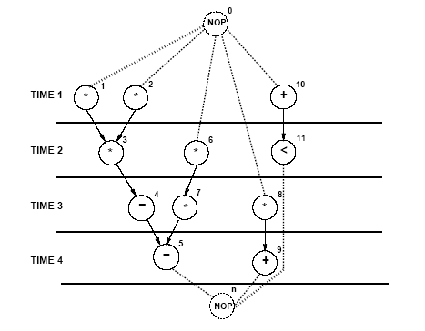
Example
Multiplier area = 5; ALU area = 1.
Objective function: 5a₁ +a₂. λ = 4
Start time constraints same.
Sequencing dependency constraints same.
Resource constraints
x_{1,1}+x_{2,1}+x_{6,1}+x_{8,1} – a₁ ≤ 0
x_{3,2}+x_{6,2}+x_{7,2}+x_{8,2} – a₁ ≤ 0
x_{7,3}+x_{8,3} – a₁ ≤ 0
x_{10,1} – a₂ ≤ 0
x_{9,2}+x_{10,2}+x_{11,2} – a₂ ≤ 0
x_{4,3}+x_{9,3}+x_{10,3}+x_{11,3}– a₂ ≤ 0
x_{5,4}+x_{9,4}+x_{11,4}– a₂ ≤ 0

Slide 39
ILP Solution
Use standard ILP packages.
Transform into LP problem [Gebotys].
Advantages
Exact method.
Other constraints can be incorporated easily
Maximum and minimum timing constraints
Disadvantages
Works well up to few thousand variables.

Slide 40
List Scheduling Algorithms
Heuristic method for
Minimum latency subject to resource bound.
Minimum resource subject to latency bound.
Greedy strategy.
Priority list heuristics.
Assign a weight to each vertex indicating its scheduling priority
Longest path to sink.
Longest path to timing constraint.

Slide 41
List Scheduling Algorithm for Minimum Latency …

Slide 42
… List Scheduling Algorithm for Minimum Latency
Candidate Operations U_{l,k}
Operations of type k whose predecessors are scheduled and completed at time step before l
Unfinished operations T_{l,k} are operations of type k that started at earlier cycles and whose execution is not finished at time l
Note that when execution delays are 1, T_{l,k} is empty.

Slide 43
Example
Assumptions
a₁ = 2 multipliers with delay 1.
a₂ = 2 ALUs with delay 1.
First Step
U_{1,1} = {v₁, v₂, v₆, v₈}
Select {v₁, v₂}
U_{1,2} = {v₁₀}; selected
Second step
U_{2,1} = {v₃, v₆, v₈}
select {v₃, v₆}
U_{2,2} = {v₁₁}; selected
Third step
U_{3,1} = {v₇, v₈}
Select {v₇, v₈}
U_{3,2} = {v₄}; selected
Fourth step
U_{4,2} = {v₅, v₉}; selected

Slide 44
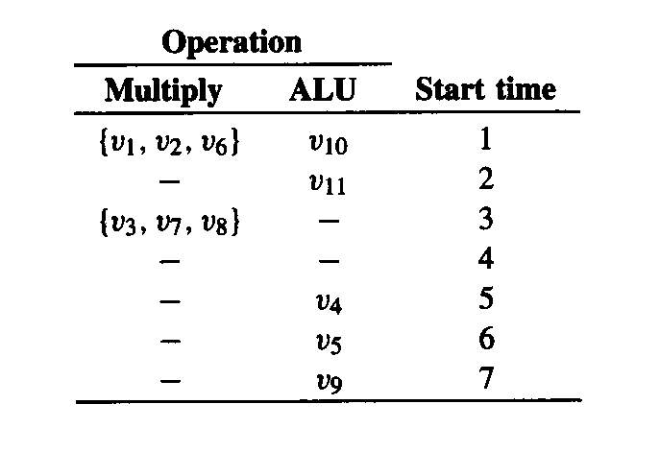
Example
Assumptions
a₁ = 3 multipliers with delay 2.
a₂ = 1 ALU with delay 1.

Slide 45
List Scheduling Algorithm for Minimum Resource Usage

Slide 46
Example
Assume λ=4
Let a = [1, 1]^{T}
First Step
U_{1,1} = {v₁, v₂, v₆, v₈}
Operations with zero slack {v₁, v₂}
a = [2, 1]^{T}
U_{1,2} = {v₁₀}
Second step
U_{2,1} = {v₃, v₆, v₈}
Operations with zero slack {v₃, v₆}
U_{2,2} = {v₁₁}
Third step
U_{3,1} = {v₇, v₈}
Operations with zero slack {v₇, v₈}
U_{3,2} = {v₄}
Fourth step
U_{4,2} = {v₅, v₉}
Both have zero slack; a = [2, 2]^{T}

Slide 47
Allocation and Binding
Allocation
Determine number of resources needed
Binding
Mapping between operations and resources.
Sharing
Assignment of a resource to more than one operation.
Optimum binding/sharing
Minimize the resource usage.

Slide 48
Optimum Sharing Problem
Scheduled sequencing graphs.
Operation concurrency well defined.
Consider operation types independently.
Problem decomposition.
Perform analysis for each resource type.
Minimize resource usage.

Slide 49
Compatibility and Conflicts
Operation compatibility
Same resource type.
Non concurrent.
Compatibility graph
Vertices: operations.
Edges: compatibility relation.
Conflict graph
Complement of compatibility graph.
Multiplier
ALU

Slide 50
Algorithmic Solution to the Optimum Binding Problem
Compatibility graph.
Partition the graph into a minimum number of cliques.
Find clique cover number.
Conflict graph.
Color the vertices by a minimum number of colors.
Find chromatic number.
NP-complete problems - Heuristic algorithms.

Slide 51
Example
1
2
1
2
ALU1: 1, 3, 5
ALU2: 2, 4
5
5
3
4
3
4

Slide 52
ILP Formulation of Binding
Boolean variables b_{ir}
Operation i bound to resource r.
Boolean variables x_{il}
Operation i scheduled to start at step l.
Each operation v_{i} should be assigned to one resource
At most, one operation can be executing, among those assigned to resource r, at any time step

Slide 53
Example…
Operation types: Multiplier, ALU
Unit execution delay
A feasible binding satisfies constraints

Slide 54
… Example
Constants in X are 0 except x_{1,1}, x_{2,1}, x_{3,2}, x_{4,3}, x_{5,4}, x_{6,2}, x_{7,3}, x_{8,3}, x_{9,4}, x_{10,1}, x_{11,2}.
An implementation with a₁=2 multipliers:
Solutions
b_{1,1}=1, b_{2,2}=1, b_{3,1}=1, b_{6,2}=1, b_{7,1}=1, b_{8,2}=1.

Slide 55
Register Binding Problem
Given a schedule
Lifetime intervals for variables.
Lifetime overlaps.
Conflict graph (interval graph).
Vertices ↔ variables.
Edges ↔ overlaps.
Find minimum number of registers storing all the variables.
Compatibility graph.

Slide 56
Example
Six intermediate variables that need to be stored in registers {z1, z2, z3, z4, z5, z6}
Six variables can be stored in two registers

Slide 57
Example
7 intermediate variables, 3 loop variables, 3 loop invariants
5 registers suffice to store 10 intermediate loop variables

Slide 58
Sharing and Binding for General Circuits
Area and delay influenced by
Steering logic, wiring, registers and control circuit.
E.g. multiplexers area and propagation delays depend on number of inputs.
Wire lengths can be derived from statistical models.
Binding affects the cycle-time
It may invalidate a schedule.
Control unit is affected marginally by resource binding.

Slide 59
Left-Edge Algorithm
Input
Set of intervals with left and right edge.
Rationale
Sort intervals by left edge.
Assign non-overlapping intervals to first color using the sorted list.
When possible intervals are exhausted increase color counter and repeat.

Slide 60
Example

