Slide 1
COE 561 Digital System Design & Synthesis Introduction to VHDL: Part I
Dr. Aiman H. El-Maleh
Computer Engineering Department
King Fahd University of Petroleum & Minerals

Slide 2
Outline …
Hardware description languages
VHDL terms
Design Entity
Design Architecture
VHDL model of full adder circuit
VHDL model of 1’s count circuit
Structural modeling of 4-bit comparator
Design parameterization using Generic
Test Bench example

Slide 3
… Outline
Signal assignment
VHDL Objects
Behavioral modeling in VHDL

Slide 4
Hardware Description Languages
HDLs are used to describe the hardware for the purpose of modeling, simulation, testing, design, and documentation.
Modeling: behavior, flow of data, structure
Simulation: verification and test
Design: synthesis
Two widely-used HDLs today
VHDL: VHSIC (Very High Speed Integrated Circuit ) Hardware Description Language
Verilog (from Cadence, now IEEE standard)

Slide 5
Styles in VHDL
Behavioral
High level, algorithmic, sequential execution
Hard to synthesize well
Easy to write and understand (like high-level language code)
Dataflow
Medium level, register-to-register transfers, concurrent execution
Easy to synthesize well
Harder to write and understand (like assembly code)
Structural
Low level, netlist, component instantiations and wiring
Trivial to synthesize
Hardest to write and understand (very detailed and low level)

Slide 6
VHDL Terms …
Entity:
All designs are expressed in terms of entities
Basic building block in a design
Ports:
Provide the mechanism for a device to communication with its environment
Define the names, types, directions, and possible default values for the signals in a component's interface
Architecture:
All entities have an architectural description
Describes the behavior of the entity
A single entity can have multiple architectures (behavioral, structural, …etc)
Configuration:
A configuration statement is used to bind a component instance to an entity-architecture pair.
Describes which behavior to use for each entity

Slide 7
… VHDL Terms …
Generic:
A parameter that passes information to an entity
Example: for a gate-level model with rise and fall delay, values for the rise and fall delays passed as generics
Process:
Basic unit of execution in VHDL
All operations in a VHDL description are broken into single or multiple processes
Statements inside a process are processed sequentially
Package:
A collection of common declarations, constants, and/or subprograms to entities and architectures.

Slide 8
VHDL Terms …
Attribute:
Data attached to VHDL objects or predefined data about VHDL objects
Examples:
maximum operation temperature of a device
Current drive capability of a buffer
VHDL is NOT Case-Sensitive
Begin = begin = beGiN
Semicolon “ ; ” terminates declarations or statements.
After a double minus sign (--) the rest of the line is treated as a comment

Slide 9
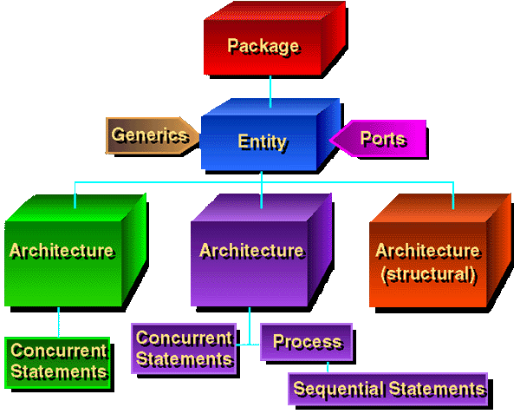
VHDL Models …

Slide 10
… VHDL Models
PACKAGE
DECLARATION
PACKAGE
BODY
(often used
functions,
constants,
components, …. )
ENTITY
(interface description)
ARCHITECTURE
(functionality)
CONFIGURATION
(connection entity ↔ architecture)

Slide 11
Design Entity …
In VHDL, the name of the system is the same as the name of its entity.
Entity comprises two parts:
parameters of the system as seen from outside such as bus-width of a processor or max clock frequency
connections which are transferring information to and from the system (system’s inputs and outputs)
All parameters are declared as generics and are passed on to the body of the system
Connections, which carry data to and from the system, are called ports. They form the second part of the entity.

Slide 12
Entity Examples …
Entity FULLADDER is
-- Interface description of FULLADDER
port ( A, B, C: in bit; SUM, CARRY: out bit); end FULLADDER;
FULL ADDER
A
B
C
SUM
CARRY

Slide 13
… Entity Examples
Entity Register is -- parameter: width of the register generic (width: integer); --input and output signals port ( CLK, Reset: in bit; D: in bit_vector(1 to width); Q: out bit_vector(1 to width)); end Register;
width
width
D
D
Q
Q
CLK
Reset

Slide 14
Architecture Examples: Behavioral Description
Entity FULLADDER is port ( A, B, C: in bit; SUM, CARRY: out bit); end FULLADDER;
Architecture CONCURRENT of FULLADDER is begin SUM <= A xor B xor C after 5 ns; CARRY <= (A and B) or (B and C) or (A and C) after 3 ns; end CONCURRENT;

Slide 15
Architecture Examples: Structural Description …
A
I₁ S
HA
I2 C
SUM
B
I₁ S
HA
I2 C
S₁
C₂
I₁
OR
I2 x
C
C₁
CARRY
Entity HA is
PORT (I1, I2 : in bit; S, C : out bit);
end HA ;
Architecture behavior of HA is
begin
S <= I1 xor I2;
C <= I1 and I2;
end behavior;
Entity OR is
PORT (I1, I2 : in bit; X : out bit);
end OR ;
Architecture behavior of OR is
begin
X <= I1 or I2;
end behavior;

Slide 16
Architecture Examples: Structural Description …
architecture STRUCTURAL of FULLADDER is signal S1, C1, C2 : bit; component HA port (I1, I2 : in bit; S, C : out bit); end component; component OR port (I1, I2 : in bit; X : out bit); end component; begin INST_HA1 : HA port map (I1 => B, I2 => C, S => S1, C => C1); INST_HA2 : HA port map (I1 => A, I2 => S1, S => SUM, C => C2); INST_OR : OR port map ( C2, C1, CARRY); end STRUCTURAL;
A
I₁ S
HA
I2 C
SUM
B
I₁ S
HA
I2 C
S₁
C₂
I₁
OR
I2 x
C
C₁
CARRY

Slide 17
VHDL Predefined Operators
Logical Operators: NOT, AND, OR, NAND, NOR, XOR, XNOR
Operand Type: Bit, Boolean, Bit_vector
Result Type: Bit, Boolean, Bit_vector
Relational Operators: =, /=, <, <=, >, >=
Operand Type: Any type
Result Type: Boolean
Arithmetic Operators: +, -, *, /
Operand Type: Integer, Real
Result Type: Integer, Real
Concatenation Operator: &
Operand Type: Arrays or elements of same type
Result Type: Arrays
Shift Operators: SLL, SRL, SLA, SRA, ROL, ROR
Operand Type: Bit or Boolean vector
Result Type: same type

Slide 18
VHDL Reserved Words
abs disconnect label package
access downto library Poll units
after linkage procedure until
alias else loop process use
all elsif variable
and end map range
architecture entity mod record wait
array exit nand register when
assert new rem while
attribute file next report with
begin for nor return xor
block function not select
body generate null severity
buffer generic of signal
bus guarded on subtype
case if open then
component in or to
configuration inout others transport
constant is out type

Slide 19
VHDL Language Grammar
Formal grammar of the IEEE Standard 1076-1993 VHDL language in BNF format
http://www.iis.ee.ethz.ch/~zimmi/download/vhdl93_syntax.html

Slide 20
One Entity Many Descriptions
A system (an entity) can be specified with different architectures
Entity
Architecture
A
Architecture
B
Architecture
C
Architecture
D

Slide 21
Example: Ones Count Circuit
Value of C1 C0 = No. of ones in the inputs A2, A1, and A0
C1 is the Majority Function ( =1 iff two or more inputs =1)
C0 is a 3-Bit Odd-Parity Function (OPAR3))
C1 = A1 A0 + A2 A0 + A2 A1
C0 = A2 A1’ A0’ + A2’ A1 A0’ + A2’ A1’ A0 + A2 A1 A0
= A0 ⊕ A1 ⊕ A2
A0
C0
A1
A2
C1

Slide 22
Ones Count Circuit Interface Specification
1
entity ONES_CNT is
port ( A : in BIT_VECTOR(2 downto 0);
C : out BIT_VECTOR(1 downto 0));
-- Function Documentation of ONES_CNT
-- (Truth Table Form)
-- ____________________
-- | A2 A1 A0 | C1 C0 |
-- |-----------------|------------- |
-- | 0 0 0 | 0 0 |
-- | 0 0 1 | 0 1 |
-- | 0 1 0 | 0 1 |
-- | 0 1 1 | 1 0 |
-- | 1 0 0 | 0 1 |
-- | 1 0 1 | 1 0 |
-- | 1 1 0 | 1 0 |
-- | 1 1 1 | 1 1 |
-- |__________ |________|
end ONES_CNT;
2
DOCUMENTATION
3

Slide 23
Ones Count Circuit Architectural Body: Data Flow
C1 = A1 A0 + A2 A0 + A2 A1
C0 = A2 A1’ A0’ + A2’ A1 A0’ + A2’ A1’ A0 + A2 A1 A0
= A0 ⊕ A1 ⊕ A2
Architecture Dataflow of ONES_CNT is
begin
C(1) <=(A(1) and A(0)) or (A(2) and A(0))
or (A(2) and A(1));
C(0) <= (A(2) and not A(1) and not A(0))
or (not A(2) and A(1) and not A(0))
or (not A(2) and not A(1) and A(0))
or (A(2) and A(1) and A(0));
-- C(0) <= A(2) xor A(1) xor A(0);
end Dataflow;

Slide 24
Ones Count Circuit Architectural Body: Structural …
C1 = A1 A0 + A2 A0 + A2 A1 = MAJ3(A)
C0 = A2 A1’ A0’ + A2’ A1 A0’ + A2’ A1’ A0 + A2 A1 A0
= OPAR3(A)
Structural Design Hierarchy
ONES_CNT
C1
Majority Fun
C0
Odd-Parity Fun
AND2
OR3
NAND3
NAND4
INV

Slide 25
Ones Count Circuit Architectural Body: Structural …
Entity MAJ3 is
PORT( X: in BIT_Vector(2 downto 0);
Z: out BIT);
end MAJ3;
Entity OPAR3 is
PORT( X: in BIT_Vector(2 downto 0);
Z: out BIT);
end OPAR3;

Slide 26
VHDL Structural Description of Majority Function …
G1
Maj3
Majority Function
x(0)
x(1)
G2
A1
G4
x(0)
A2
Z
x(2)
G3
A3
x(1)
x(2)
Architecture Structural of MAJ3 is
Component AND2
PORT( I1, I2: in BIT; O: out BIT);
end Component ;
Component OR3
PORT( I1, I2, I3: in BIT; O: out BIT);
end Component ;
Declare Components
To be Instantiated

Slide 27
VHDL Structural Description of Majority Function
SIGNAL A1, A2, A3: BIT; Declare Maj3 Local Signals
begin
-- Instantiate Gates
g1: AND2 PORT MAP (X(0), X(1), A1);
g2: AND2 PORT MAP (X(0), X(2), A2);
g3: AND2 PORT MAP (X(1), X(2), A3);
g4: OR3 PORT MAP (A1, A2, A3, Z);
end Structural;
Wiring of
Maj3
Components

Slide 28
VHDL Structural Description of Odd Parity Function …
Architecture Structural of OPAR3 is
Component INV
PORT( Ipt: in BIT; Opt: out BIT);
end Component ;
Component NAND3
PORT( I1, I2, I3: in BIT;
O: out BIT);
end Component ;
Component NAND4
PORT( I1, I2, I3, I4: in BIT; O: out BIT);
end Component ;
g1
g2
x(0)
A0B
x(1)
A1B
g3
x(2)
A2B
A1B
X(2)
g4
A0B
Z1
A1B
X(0)
g5
Z2
A2B
g8
Z
X(0)
Z3
X(1)
X(2)
g6
Z4
C0 Odd-Parity
(OPAR3)
A2B
X(1)
g7
A0B

Slide 29
VHDL Structural Description of Odd Parity Function
SIGNAL A0B, A1B, A2B, Z1, Z2, Z3, Z4: BIT;
begin
g1: INV PORT MAP (X(0), A0B);
g2: INV PORT MAP (X(1), A1B);
g3: INV PORT MAP (X(2), A2B);
g4: NAND3 PORT MAP (X(2), A1B, A0B, Z1);
g5: NAND3 PORT MAP (X(0), A1B, A2B, Z2);
g6: NAND3 PORT MAP (X(0), X(1), X(2), Z3);
g7: NAND3 PORT MAP (X(1), A2B, A0B, Z4);
g8: NAND4 PORT MAP (Z1, Z2, Z3, Z4, Z);
end Structural;

Slide 30
VHDL Top Structural Level of Ones Count Circuit
Architecture Structural of ONES_CNT is
Component MAJ3
PORT( X: in BIT_Vector(2 downto 0); Z: out BIT);
END Component ;
Component OPAR3
PORT( X: in BIT_Vector(2 downto 0); Z: out BIT);
END Component ;
begin
-- Instantiate Components
c1: MAJ3 PORT MAP (A, C(1));
c2: OPAR3 PORT MAP (A, C(0));
end Structural;

Slide 31
VHDL Behavioral Definition of Lower Level Components
Entity INV is
PORT( Ipt: in BIT;
Opt: out BIT);
end INV;
Architecture behavior of INV is
begin
Opt <= not Ipt;
end behavior;
Entity NAND2 is
PORT( I1, I2: in BIT;
O: out BIT);
end NAND2;
Architecture behavior of NAND2 is
begin
O <= not (I1 and I2);
end behavior;
Other Lower Level Gates Are Defined Similarly

Slide 32
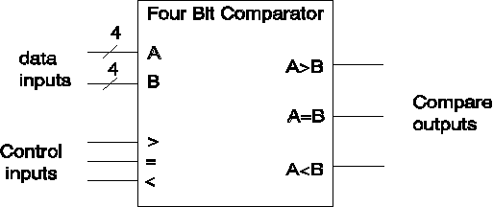
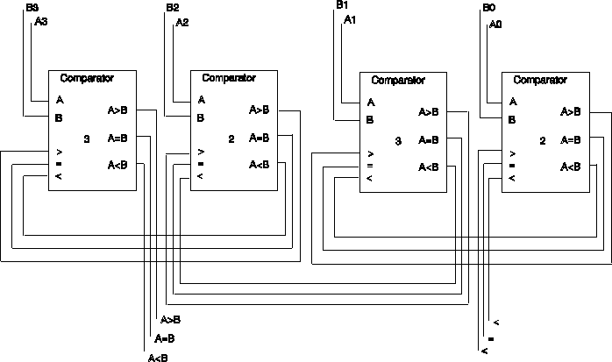
Structural 4-Bit Comparator

Slide 33
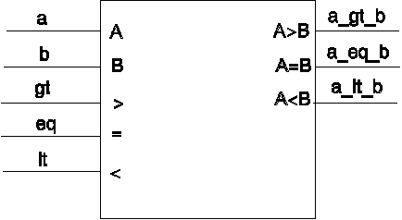
A Cascadable Single-Bit Comparator
When a > b the a_gt_b becomes 1
When a < b the a_lt_b becomes 1
If a = b outputs become the same as corresponding inputs

Slide 34
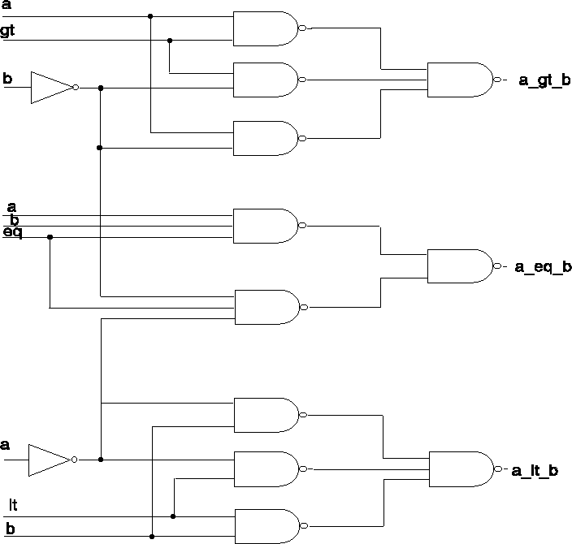
Structural Single-Bit Comparator
Design uses basic components
The less-than and greater-than outputs use the same logic

Slide 35
Structural Model of Single-Bit Comparator …
ENTITY bit_comparator IS
PORT (a, b, gt, eq, lt : IN BIT; a_gt_b, a_eq_b, a_lt_b : OUT BIT);
END bit_comparator;
ARCHITECTURE gate_level OF bit_comparator IS
--
COMPONENT n1 PORT (i1: IN BIT; o1: OUT BIT); END COMPONENT ;
COMPONENT n2 PORT (i1, i2: IN BIT; o1:OUT BIT); END COMPONENT;
COMPONENT n3 PORT (i1, i2, i3: IN BIT; o1: OUT BIT); END COMPONENT;
-- Component Configuration
FOR ALL : n1 USE ENTITY WORK.inv (single_delay);
FOR ALL : n2 USE ENTITY WORK.nand2 (single_delay);
FOR ALL : n3 USE ENTITY WORK.nand3 (single_delay);
--Intermediate signals
SIGNAL im1,im2, im3, im4, im5, im6, im7, im8, im9, im10 : BIT;

Slide 36
… Structural Model of Single-Bit Comparator
BEGIN
-- a_gt_b output
g0 : n1 PORT MAP (a, im1);
g1 : n1 PORT MAP (b, im2);
g2 : n2 PORT MAP (a, im2, im3);
g3 : n2 PORT MAP (a, gt, im4);
g4 : n2 PORT MAP (im2, gt, im5);
g5 : n3 PORT MAP (im3, im4, im5, a_gt_b);
-- a_eq_b output
g6 : n3 PORT MAP (im1, im2, eq, im6);
g7 : n3 PORT MAP (a, b, eq, im7);
g8 : n2 PORT MAP (im6, im7, a_eq_b);
-- a_lt_b output
g9 : n2 PORT MAP (im1, b, im8);
g10 : n2 PORT MAP (im1, lt, im9);
g11 : n2 PORT MAP (b, lt, im10);
g12 : n3 PORT MAP (im8, im9, im10, a_lt_b);
END gate_level;

Slide 37
Netlist Description of Single-Bit Comparator
ARCHITECTURE netlist OF bit_comparator IS
SIGNAL im1,im2, im3, im4, im5, im6, im7, im8, im9, im10 : BIT;
BEGIN
-- a_gt_b output
g0 : ENTITY Work.inv(single_delay) PORT MAP (a, im1);
g1 : ENTITY Work.inv(single_delay) PORT MAP (b, im2);
g2 : ENTITY Work.nand2(single_delay) PORT MAP (a, im2, im3);
g3 : ENTITY Work.nand2(single_delay) PORT MAP (a, gt, im4);
g4 : ENTITY Work.nand2(single_delay) PORT MAP (im2, gt, im5);
g5 : ENTITY Work.nand3(single_delay) PORT MAP (im3, im4, im5, a_gt_b);
-- a_eq_b output
g6 : ENTITY Work.nand3(single_delay) PORT MAP (im1, im2, eq, im6);
g7 : ENTITY Work.nand3(single_delay) PORT MAP (a, b, eq, im7);
g8 : ENTITY Work.nand2(single_delay) PORT MAP (im6, im7, a_eq_b);
-- a_lt_b output
g9 : ENTITY Work.nand2(single_delay) PORT MAP (im1, b, im8);
g10 : ENTITY Work.nand2(single_delay) PORT MAP (im1, lt, im9);
g11 : ENTITY Work.nand2(single_delay) PORT MAP (b, lt, im10);
g12 : ENTITY Work.nand3(single_delay) PORT MAP (im8, im9, im10, a_lt_b);
END netlist;

Slide 38
4-Bit Comparator Iterative Structural Wiring: “For …. Generate”Statement...
ENTITY nibble_comparator IS PORT (a, b : IN BIT_VECTOR (3 DOWNTO 0); -- a and b data inputs gt, eq, lt : IN BIT; -- previous greater, equal & less than a_gt_b, a_eq_b, a_lt_b : OUT BIT); -- a > b, a = b, a < b
END nibble_comparator; --
ARCHITECTURE iterative OF nibble_comparator IS
COMPONENT comp1
PORT (a, b, gt, eq, lt : IN BIT; a_gt_b, a_eq_b, a_lt_b : OUT BIT);
END COMPONENT;
FOR ALL : comp1 USE ENTITY WORK.bit_comparator (gate_level);
SIGNAL im : BIT_VECTOR ( 0 TO 8);
BEGIN
c0: comp1 PORT MAP (a(0), b(0), gt, eq, lt, im(0), im(1), im(2));

Slide 39
… 4-Bit Comparator: “For ……. Generate” Statement
c1to2: FOR i IN 1 TO 2 GENERATE
c: comp1 PORT MAP ( a(i), b(i), im(i*3-3), im(i*3-2), im(i*3-1), im(i*3+0), im(i*3+1), im(i*3+2) );
END GENERATE;
c3: comp1 PORT MAP (a(3), b(3), im(6), im(7), im(8), a_gt_b, a_eq_b, a_lt_b);
END iterative;
USE BIT_VECTOR for Ports a & b
Separate first and last bit-slices from others
Arrays FOR intermediate signals facilitate iterative wiring
Can easily expand to an n-bit comparator

Slide 40
4-Bit Comparator: “IF …… Generate” Statement …
ARCHITECTURE iterative OF nibble_comparator IS --
COMPONENT comp1 PORT (a, b, gt, eq, lt : IN BIT; a_gt_b, a_eq_b, a_lt_b : OUT BIT); END COMPONENT; --
FOR ALL : comp1 USE ENTITY WORK.bit_comparator (gate_level); CONSTANT n : INTEGER := 4;
SIGNAL im : BIT_VECTOR ( 0 TO (n-1)*3-1); --
BEGIN c_all : FOR i IN 0 TO n-1 GENERATE
l : IF i = 0 GENERATE
least: comp1 PORT MAP (a(i), b(i), gt, eq, lt, im(0), im(1), im(2) );
END GENERATE;

Slide 41
… 4-Bit Comparator: “IF …… Generate” Statement
--
m : IF i = n-1 GENERATE most: comp1 PORT MAP (a(i), b(i), im(i*3-3), im(i*3-2),
im(i*3-1), a_gt_b, a_eq_b, a_lt_b); END GENERATE;
--
r : IF i > 0 AND i < n-1 GENERATE
rest: comp1 PORT MAP (a(i), b(i), im(i*3-3), im(i*3-2),
im(i*3-1), im(i*3+0), im(i*3+1), im(i*3+2) );
END GENERATE;
--
END GENERATE; -- Outer Generate
END iterative;

Slide 42
4-Bit Comparator: Alternative Architecture (Single Generate)
ARCHITECTURE Alt_iterative OF nibble_comparator IS
constant n: Positive :=4;
COMPONENT comp1
PORT (a, b, gt, eq, lt : IN BIT; a_gt_b, a_eq_b, a_lt_b : OUT BIT);
END COMPONENT;
FOR ALL : comp1 USE ENTITY WORK.bit_comparator (gate_level);
SIGNAL im : BIT_VECTOR ( 0 TO 3*n+2);
BEGIN
im(0 To 2) <= gt & eq & lt;
cALL : FOR i IN 0 TO n-1 GENERATE
c : comp1 PORT MAP (a(i), b(i), im(i*3), im(i*3+1), im(i*3+2),
im(i*3+3), im(i*3+4), im(i*3+5) );
END GENERATE;
a_gt_b <= im(3*n);
a_eq_b <= im(3*n+1);
a_lt_b <= im(3*n+2);
END Alt_iterative ;

Slide 43
Design Parameterization …
GENERICs can pass design parameters
GENERICs can include default values
New versions of gate descriptions contain timing
ENTITY inv_t IS
GENERIC (tplh : TIME := 3 NS; tphl : TIME := 5 NS);
PORT (i1 : in BIT; o1 : out BIT);
END inv_t;
--
ARCHITECTURE average_delay OF inv_t IS
BEGIN
o1 <= NOT i1 AFTER (tplh + tphl) / 2;
END average_delay;

Slide 44
… Design Parameterization …
ENTITY nand2_t IS
GENERIC (tplh : TIME := 4 NS; tphl : TIME := 6 NS);
PORT (i1, i2 : IN BIT; o1 : OUT BIT);
END nand2_t;
--
ARCHITECTURE average_delay OF nand2_t IS
BEGIN
o1 <= i1 NAND i2 AFTER (tplh + tphl) / 2;
END average_delay;
ENTITY nand3_t IS
GENERIC (tplh : TIME := 5 NS; tphl : TIME := 7 NS);
PORT (i1, i2, i3 : IN BIT; o1 : OUT BIT);
END nand3_t;
--
ARCHITECTURE average_delay OF nand3_t IS
BEGIN
o1 <= NOT ( i1 AND i2 AND i3 ) AFTER (tplh + tphl) / 2;
END average_delay;

Slide 45
Using Default values …
ARCHITECTURE default_delay OF bit_comparator IS
Component n1 PORT (i1: IN BIT; o1: OUT BIT);
END Component;
Component n2 PORT (i1, i2: IN BIT; o1: OUT BIT);
END Component;
Component n3 PORT (i1, i2, i3: IN BIT; o1: OUT BIT);
END Component;
FOR ALL : n1 USE ENTITY WORK.inv_t (average_delay);
FOR ALL : n2 USE ENTITY WORK.nand2_t (average_delay);
FOR ALL : n3 USE ENTITY WORK.nand3_t (average_delay);
-- Intermediate signals
SIGNAL im1,im2, im3, im4, im5, im6, im7, im8, im9, im10 : BIT;
BEGIN
-- a_gt_b output
g0 : n1 PORT MAP (a, im1);
g1 : n1 PORT MAP (b, im2);
g2 : n2 PORT MAP (a, im2, im3);
g3 : n2 PORT MAP (a, gt, im4);
g4 : n2 PORT MAP (im2, gt, im5);
g5 : n3 PORT MAP (im3, im4, im5, a_gt_b);
No Generics Specified in Component Declarations

Slide 46
… Using Default values
-- a_eq_b output
g6 : n3 PORT MAP (im1, im2, eq, im6);
g7 : n3 PORT MAP (a, b, eq, im7);
g8 : n2 PORT MAP (im6, im7, a_eq_b);
-- a_lt_b output
g9 : n2 PORT MAP (im1, b, im8);
g10 : n2 PORT MAP (im1, lt, im9);
g11 : n2 PORT MAP (b, lt, im10);
g12 : n3 PORT MAP (im8, im9, im10, a_lt_b);
END default_delay;
Component declarations do not contain GENERICs
Component instantiation are as before
If default values exist, they are used

Slide 47
Assigning Fixed Values to Generic Parameters …
ARCHITECTURE fixed_delay OF bit_comparator IS
Component n1
Generic (tplh, tphl : Time); Port (i1: in Bit; o1: out Bit);
END Component;
Component n2
Generic (tplh, tphl : Time); Port (i1, i2: in Bit; o1: out Bit);
END Component;
Component n3
Generic (tplh, tphl : Time); Port (i1, i2, i3: in Bit; o1: out Bit);
END Component;
FOR ALL : n1 USE ENTITY WORK.inv_t (average_delay);
FOR ALL : n2 USE ENTITY WORK.nand2_t (average_delay);
FOR ALL : n3 USE ENTITY WORK.nand3_t (average_delay);
-- Intermediate signals
SIGNAL im1,im2, im3, im4, im5, im6, im7, im8, im9, im10 : BIT;
BEGIN
-- a_gt_b output
g0 : n1 Generic Map (2 NS, 4 NS) Port Map (a, im1);
g1 : n1 Generic Map (2 NS, 4 NS) Port Map (b, im2);
g2 : n2 Generic Map (3 NS, 5 NS) Port Map (a, im2, im3);

Slide 48
… Assigning Fixed Values to Generic Parameters
g3 : n2 Generic Map (3 NS, 5 NS) Port Map P (a, gt, im4);
g4 : n2 Generic Map (3 NS, 5 NS) Port Map (im2, gt, im5);
g5 : n3 Generic Map (4 NS, 6 NS) Port Map (im3, im4, im5, a_gt_b);
-- a_eq_b output
g6 : n3 Generic Map (4 NS, 6 NS) Port Map (im1, im2, eq, im6);
g7 : n3 Generic Map (4 NS, 6 NS) PORT MAP (a, b, eq, im7);
g8 : n2 Generic Map (3 NS, 5 NS) PORT MAP (im6, im7, a_eq_b);
-- a_lt_b output
g9 : n2 Generic Map (3 NS, 5 NS) Port Map (im1, b, im8);
g10 : n2 Generic Map (3 NS, 5 NS) PORT MAP (im1, lt, im9);
g11 : n2 Generic Map (3 NS, 5 NS) PORT MAP (b, lt, im10);
g12 : n3 Generic Map (4 NS, 6 NS) PORT MAP (im8, im9, im10, a_lt_b);
END fixed_delay;
Component declarations contain GENERICs
Component instantiation contain GENERIC Values
GENERIC Values overwrite default values

Slide 49
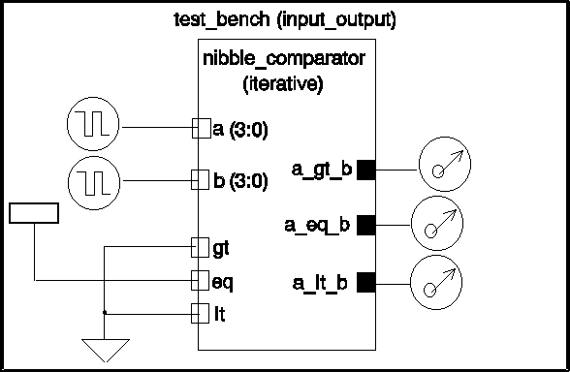
Structural Test Bench
A Testbench is an Entity without Ports that has a Structural Architecture
The Testbench Architecture, in general, has 3 major components:
Instance of the Entity Under Test (EUT)
Test Pattern Generator ( Generates Test Inputs for the Input Ports of the EUT)
Response Evaluator (Compares the EUT Output Signals to the Expected Correct Output)

Slide 50
Testbench Example …
Entity nibble_comparator_test_bench IS
End nibble_comparator_test_bench ;
--
ARCHITECTURE input_output OF nibble_comparator_test_bench IS
--
COMPONENT comp4 PORT (a, b : IN bit_vector (3 DOWNTO 0);
gt, eq, lt : IN BIT;
a_gt_b, a_eq_b, a_lt_b : OUT BIT);
END COMPONENT;
--
FOR a1 : comp4 USE ENTITY WORK.nibble_comparator(iterative);
--
SIGNAL a, b : BIT_VECTOR (3 DOWNTO 0);
SIGNAL eql, lss, gtr, gnd : BIT;
SIGNAL vdd : BIT := '1';
--
BEGIN
a1: comp4 PORT MAP (a, b, gnd, vdd, gnd, gtr, eql, lss);
--

Slide 51
…Testbench Example
a2: a <= "0000", -- a = b (steady state)
"1111" AFTER 0500 NS, -- a > b (worst case)
"1110" AFTER 1500 NS, -- a < b (worst case)
"1110" AFTER 2500 NS, -- a > b (need bit 1 info)
"1010" AFTER 3500 NS, -- a < b (need bit 2 info)
"0000" AFTER 4000 NS, -- a < b (steady state, prepare FOR next)
"1111" AFTER 4500 NS, -- a = b (worst case)
"0000" AFTER 5000 NS, -- a < b (need bit 3 only, best case)
"0000" AFTER 5500 NS, -- a = b (worst case)
"1111" AFTER 6000 NS; -- a > b (need bit 3 only, best case)
--
a3 : b <= "0000", -- a = b (steady state)
"1110" AFTER 0500 NS, -- a > b (worst case)
"1111" AFTER 1500 NS, -- a < b (worst case)
"1100" AFTER 2500 NS, -- a > b (need bit 1 info)
"1100" AFTER 3500 NS, -- a < b (need bit 2 info)
"1101" AFTER 4000 NS, -- a < b (steady state, prepare FOR next)
"1111" AFTER 4500 NS, -- a = b (worst case)
"1110" AFTER 5000 NS, -- a < b (need bit 3 only, best case)
"0000" AFTER 5500 NS, -- a = b (worst case)
“0111" AFTER 6000 NS; -- a > b (need bit 3 only, best case)
END input_output;

Slide 52
Signal Assignment …
Unconditional: Both Sequential & Concurrent
Conditional: Only Concurrent; Conditions Must Be Boolean, May Overlap and Need Not Be Exhaustive
Selected: Only Concurrent; Cases Must Not Overlap and Must Be Exhaustive
Conditional Signal Assignment
[ Label: ] target <= [Guarded] [Transport ]
Wave1 when Cond1 Else
Wave2 when Cond2 Else
……………………………..
Waven-1 when Condn-1 Else
Waven ; -- Mandatory Wave

Slide 53
… Signal Assignment
Selected Signal Assignment
With Expression Select
target <= [Guarded] [Transport]
Wave1 when Choice1 ,
Wave2 when Choice2 ,
……………………………
Waven-1 when Choicen-1 ,
Waven when OTHERS ;
VHDL-93: Any Wavei Can Be Replaced By the Keyword UNAFFECTED (Which Doesn’t Schedule Any Transactions on the Target Signal.)

Slide 54
Signal Assignment Examples
Example: A 2x4 Decoder
Signal D : Bit_Vector(1 To 4) := “0000”;
Signal S0, S1 : Bit;
…………………………………………
Decoder: D <= “0001” after T When S1=‘0’ and S0=‘0’ else “0010” after T When S1=‘0’ else
“0100” after T When S0=‘0’ else “1000” ;
Example: 4-Phase Clock Generator
Signal Phi4 : Bit_Vector(1 To 4) := “0000”;
…………………………………………
ClkGen: With Phi4 Select
Phi4 <= “1000” after T When “0000” , “0100” after T When “1000” ,
“0010” after T When “0100” ,
“0001” after T When “0010” ,
“1000” after T When “0001” ,
“0000” When Others ; -- Exhaustive

Slide 55
2x1 Multiplexer
Entity mux2_1 IS
Generic (dz_delay: TIME := 6 NS);
PORT (sel, data1, data0: IN BIT; z: OUT BIT);
END mux2_1;
Architecture dataflow OF mux2_1 IS
Begin
z <= data1 AFTER dz_delay WHEN sel=‘1’ ELSE
data0 AFTER dz_delay;
END dataflow;
sel
S1
data1
1D
z
Z
data0
0D

Slide 56
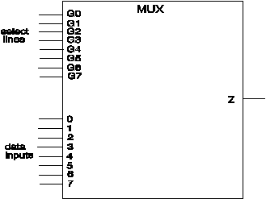
8x1 Multiplexer
USE WORK.basic_utilities.ALL; -- FROM PACKAGE USE: qit, qit_vector ENTITY mux_8_to_1 IS PORT (i7, i6, i5, i4, i3, i2, i1, i0 : IN qit; s7, s6, s5, s4, s3, s2, s1, s0 : IN qit; z : OUT qit ); END mux_8_to_1; -- ARCHITECTURE dataflow OF mux_8_to_1 IS SIGNAL sel_lines : qit_vector ( 7 DOWNTO 0); BEGIN sel_lines <= s7&s6&s5&s4&s3&s2&s1&s0; WITH sel_lines SELECT z <= '0' AFTER 3 NS WHEN "00000000", i7 AFTER 3 NS WHEN "10000000" | "Z0000000", i6 AFTER 3 NS WHEN "01000000" | "0Z000000", i5 AFTER 3 NS WHEN "00100000" | "00Z00000", i4 AFTER 3 NS WHEN "00010000" | "000Z0000", i3 AFTER 3 NS WHEN "00001000" | "0000Z000", i2 AFTER 3 NS WHEN "00000100" | "00000Z00", i1 AFTER 3 NS WHEN "00000010" | "000000Z0", i0 AFTER 3 NS WHEN "00000001" | "0000000Z", 'X' WHEN OTHERS; END dataflow;

Slide 57
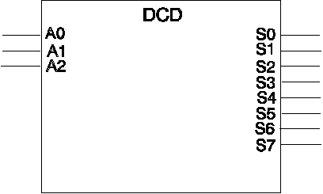
3-to-8 Decoder
USE WORK.basic_utilities.ALL; -- FROM PACKAGE USE : qit_vector ENTITY dcd_3_to_8 IS PORT (adr : IN qit_vector (2 DOWNTO 0); so : OUT qit_vector (7 DOWNTO 0)); END dcd_3_to_8; -- ARCHITECTURE dataflow OF dcd_3_to_8 IS
BEGIN WITH adr SELECT so <= "00000001" AFTER 2 NS WHEN "000", "00000010" AFTER 2 NS WHEN "00Z" | "001", "00000100" AFTER 2 NS WHEN "0Z0" | "010", "00001000" AFTER 2 NS WHEN "0ZZ" | "0Z1" | "01Z" | "011", "00010000" AFTER 2 NS WHEN "100" | "Z00", "00100000" AFTER 2 NS WHEN "Z0Z" | "Z01" | "10Z" | "101", "01000000" AFTER 2 NS WHEN "ZZ0" | "Z10" | "1Z0" | "110", "10000000" AFTER 2 NS WHEN "ZZZ" | "ZZ1" | "Z1Z" | "Z11" | "1ZZ" | "1Z1" | "11Z" | "111", "XXXXXXXX" WHEN OTHERS; END dataflow;

Slide 58
VHDL Objects …
VHDL OBJECT : Something that can hold a value of a given Data Type.
VHDL has 3 main classes of objects
CONSTANTS
VARIABLES
SIGNALS
Every object & expression must unambiguously belong to one named Data Type
Every object must be Declared.

Slide 59
… VHDL Object …
Syntax
Obj_Class <id_list> : Type/SubType [signal_kind] [:= expression];
≥ 1 identifier
( , )
Default Initial Value
(not Optional for Constant
Declarations)
Constant
Variable
Signal
F
i
l
e
BUS
Register
Only for Signals

Slide 60
… VHDL Object …
Value of Constants must be specified when declared
Initial values of Variables or Signals may be specified when declared
If not explicitly specified, Initial values of Variables or Signals default to the value of the Left Element in the type range specified in the declaration.
Examples:
Constant Rom_Size : Integer := 2**16;
Constant Address_Field : Integer := 7;
Constant Ovfl_Msg : String (1 To 20) := ``Accumulator OverFlow``;
Variable Busy, Active : Boolean := False;
Variable Address : Bit_Vector (0 To Address_Field) := ``00000000``;
Signal Reset: Bit := `0`;

Slide 61
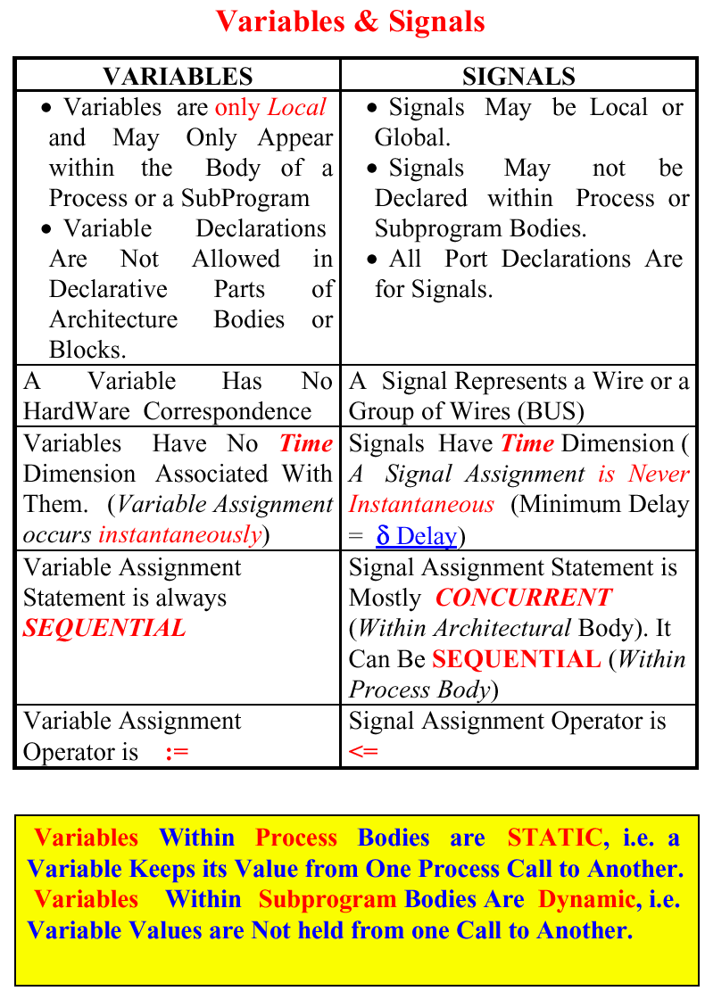
Variables vs. Signals

Slide 62
Concurrent Versus Sequential Statements
Sequential Statements
Used Within Process Bodies or SubPrograms
Order Dependent
Executed When Control is Transferred to the Sequential Body
Assert
Signal Assignment
Procedure Call
Variable Assignment
IF Statements
Case Statement
Loops
Wait, Null, Next, Exit, Return
Concurrent Statements
Used Within Architectural Bodies or Blocks
Order Independent
Executed Once At the Beginning of Simulation or Upon Some Triggered Event
Assert
Signal Assignment
Procedure Call (None of Formal Parameters May be of Type Variable )
Process
Block Statement
Component Statement
Generate Statement
Instantiation Statement

Slide 63
Process Statement …
Main Construct for Behavioral Modeling.
Other Concurrent Statements Can Be Modeled By an Equivalent Process.
Process Statement is a Concurrent Construct which Performs a Set of Consecutive (Sequential) Actions once it is Activated. Thus, Only Sequential Statements Are Allowed within the Process Body.
Optional
Optional
Process_Label: PROCESS (Sensitivity_List)
Process_Declarations;
Begin
Sequential Statements;
END Process;
Constant/Variables No Signal Declarations Allowed

Slide 64
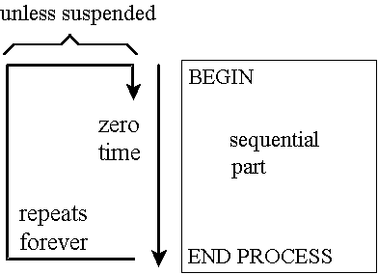
… Process Statement …
Unless sequential part is suspended
It executes in zero real and delta time
It repeats itself forever

Slide 65
… Process Statement
Whenever a SIGNAL in the Sensitivity_List of the Process Changes, The Process is Activated.
After Executing the Last Statement, the Process is SUSPENDED Until one (or more) Signal in the Process Sensitivity_List Changes Value where it will be REACTIVATED.
A Process Statement Without a Sensitivity_List is ALWAYS ACTIVE, i.e. After the Last Statement is Executed, Execution returns to the First Statement and Continues (Infinite Looping).
It is ILLEGAL to Use WAIT-Statement Inside a Process Which Has a Sensitivity_List .
In case no Sensitivity_List exists, a Process may be activated or suspended Using the WAIT-Statement.
Conditional and selective signal assignments are strictly concurrent and cannot be used in a process.

Slide 66
Process Examples
Process
Begin
A<= `1`;
B <= `0`;
End Process;
Sequential Processing:
First A is Scheduled to Have a Value `1`
Second B is Scheduled to Have a Value `0`
A & B Get their New Values At the SAME TIME (1 Delta Time Later)
Process
Begin
A<= `1`;
IF (A= `1`) Then Action1;
Else Action2;
End IF;
End Process;
Assuming a `0` Initial Value of A,
First A is Scheduled to Have a Value `1` One Delta Time Later
Thus, Upon Execution of IF_Statement, A Has a Value of `0` and Action 2 will be Taken.
If A was Declared as a Process Variable, Action1 Would Have Been Taken

Slide 67
Wait Statement
Syntax of Wait Statement :
WAIT; -- Forever
WAIT ON Signal_List; -- On event on a signal
WAIT UNTIL Condition; -- until event makes condition true;
WAIT FOR Time_Out_Expression;
WAIT FOR 0 any_time_unit; -- Process Suspended for 1 delta
When a WAIT-Statement is Executed, The process Suspends and Conditions for its Reactivation Are Set.
Process Reactivation conditions may be Mixed as follows
WAIT ON Signal_List UNTIL Condition FOR Time_Expression ;
wait on X,Y until (Z = 0) for 70 NS; -- Process Resumes After 70 NS OR (in Case X or Y Changes Value and Z=0 is True) Whichever Occurs First
Process Reactivated IF:
Event Occurred on the Signal_List while the Condition is True, OR
Wait Period Exceeds ``Time_Expression ``

Slide 68
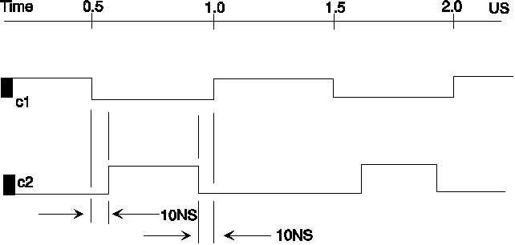
Using Wait for Two-Phase Clocking
c1 <= not c1 after 500ns; phase2: PROCESS BEGIN WAIT UNTIL c1 = '0'; WAIT FOR 10 NS; c2 <= '1'; WAIT FOR 480 NS; c2 <= '0'; END PROCESS phase2; . . .

Slide 69
Positive Edge-Triggered D-FF Examples
D_FF: PROCESS (CLK)
Begin
IF (CLK`Event and CLK = `1`) Then
Q <= D After TDelay;
END IF;
END Process;
D_FF: PROCESS -- No Sensitivity_List
Begin
WAIT UNTIL CLK = `1`;
Q <= D After TDelay;
END Process;
D_FF: PROCESS (Clk, Clr) -- FF With Asynchronous Clear
Begin
IF Clr= `1` Then Q <= `0` After TD0;
ELSIF (CLK`Event and CLK = `1`) Then Q <= D After TD1;
END IF;
END Process;

Slide 70
Sequential Statements
CONTROL STATEMENTS
Conditional
IF statements
CASE statement
Iterative
Simple Loop
For Loop
While Loop

Slide 71
Conditional Control – IF Statement
Syntax: 3-Possible Forms
(i) IF condition Then
statements;
End IF;
(ii) IF condition Then
statements;
Else
statements;
End IF;
(iii) IF condition Then
statements;
Elsif condition Then
statements;
……….
Elsif condition Then
statements;
End IF;

Slide 72
Conditional Control – Case Statement
Syntax:
(i) CASE Expression is
when value => statements;
when value1 | value2 | ...| valuen => statements;
when discrete range of values => statements;
when others => statements;
End CASE;
Values/Choices should not overlap (Any value of the Expression should Evaluate to only one Arm of the Case statement).
All possible choices for the Expression should be accounted for Exactly Once.

Slide 73
Conditional Control – Case Statement
If ``others`` is used, It must be the last ``arm`` of the CASE statement.
There can be Any Number of Arms in Any Order (Except for the others arm which should be Last)
CASE x is
when 1 => y :=0;
when 2 | 3 => y :=1;
when 4 to 7 => y :=2;
when others => y :=3;
End CASE;

Slide 74
Ones Count Circuit Architectural Body: Behavioral (Truth Table)
Architecture Truth_Table of ONES_CNT is
begin
Process(A) -- Sensitivity List Contains only Vector A
begin
CASE A is
WHEN "000" => C <= "00";
WHEN "001" => C <= "01";
WHEN "010" => C <= "01";
WHEN "011" => C <= "10";
WHEN "100" => C <= "01";
WHEN "101" => C <= "10";
WHEN "110" => C <= "10";
WHEN "111" => C <= "11";
end CASE;
end process;
end Truth_Table;

Slide 75
Loop Control …
Simple Loops
Syntax:
[Loop_Label:] LOOP
statements;
End LOOP [Loop_Label];
The Loop_Label is Optional
The exit statement may be used to exit the Loop. It has two possible Forms:
exit [Loop_Label]; -- This may be used in an if statement
exit [Loop_Label] when condition;

Slide 76
…Loop Control
Process
variable A : Integer :=0;
variable B : Integer :=1;
Begin
Loop1: LOOP
A := A + 1;
B := 20;
Loop2: LOOP
IF B < (A * A) Then
exit Loop2;
End IF;
B := B - A;
End LOOP Loop2;
exit Loop1 when A > 10;
End LOOP Loop1;
End Process;

Slide 77
FOR Loop
Need Not Be Declared
Syntax:
[Loop_Label]: FOR Loop_Variable in range LOOP
statements;
End LOOP Loop_Label;
Process
variable B : Integer :=1;
Begin
Loop1: FOR A in 1 TO 10 LOOP
B := 20;
Loop2: LOOP
IF B < (A * A) Then
exit Loop2;
End IF;
B := B - A;
End LOOP Loop2;
End LOOP Loop1;
End Process;

Slide 78
Ones Count Circuit Architectural Body: Behavioral (Algorithmic)
Architecture Algorithmic of ONES_CNT is
begin
Process(A) -- Sensitivity List Contains only Vector A
Variable num: INTEGER range 0 to 3;
begin
num :=0;
For i in 0 to 2 Loop
IF A(i) = '1' then
num := num+1;
end if;
end Loop;
--
-- Transfer "num" Variable Value to a SIGNAL
--
CASE num is
WHEN 0 => C <= "00";
WHEN 1 => C <= "01";
WHEN 2 => C <= "10";
WHEN 3 => C <= "11";
end CASE;
end process;
end Algorithmic;

Slide 79
WHILE Loop
Syntax:
[Loop_Label]: WHILE condition LOOP
statements;
End LOOP Loop_Label;
Process
variable B:Integer :=1;
Begin
Loop1: FOR A in 1 TO 10 LOOP
B := 20;
Loop2: WHILE B < (A * A) LOOP
B := B - A;
End LOOP Loop2;
End LOOP Loop1;
End Process;

Slide 80
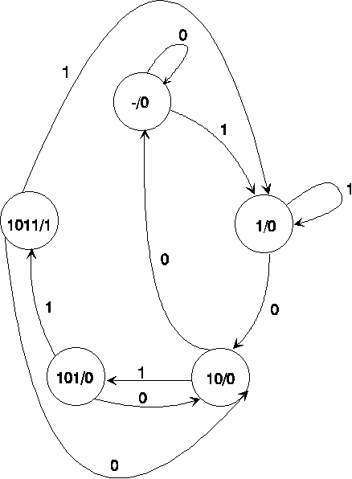
A Moore 1011 Detector using Wait
ENTITY moore_detector IS
PORT (x, clk : IN BIT;
z : OUT BIT);
END moore_detector;

Slide 81
A Moore 1011 Detector
ARCHITECTURE most_behavioral_state_machine OF moore_detector IS TYPE state IS (reset, got1, got10, got101, got1011); SIGNAL current : state := reset; BEGIN PROCESS (clk) BEGIN IF (clk = '1' and CLK’Event) THEN CASE current IS WHEN reset => IF x = '1' THEN current <= got1; ELSE current <= reset; END IF; WHEN got1 => IF x = '0' THEN current <= got10; ELSE current <= got1; END IF; WHEN got10 => IF x = '1' THEN current <= got101; ELSE current <= reset; END IF; WHEN got101 => IF x = '1' THEN current <= got1011; ELSE current <= got10; END IF; WHEN got1011 => IF x = '1' THEN current <= got1; ELSE current <= got10; END IF; END CASE; END IF; END PROCESS; z <= '1' WHEN current = got1011 ELSE '0'; END most_behavioral_state_machine;

Slide 82
Generalized VHDL Mealy Model
Architecture Mealy of fsm is
Signal D, Y: Std_Logic_Vector( ...); -- Local Signals
Begin
Register: Process( Clk)
Begin
IF (Clk`EVENT and Clk = `1`) Then Y <= D;
End IF;
End Process;
Transitions: Process(X, Y)
Begin
D <= F1(X, Y);
End Process;
Output: Process(X, Y)
Begin
Z <= F2(X, Y);
End Process;
End Mealy;
X
Z
F2
Y
F1
Register
D

Slide 83
Generalized VHDL Moore Model
Architecture Moore of fsm is
Signal D, Y: Std_Logic_Vector( ...); -- Local Signals
Begin
Register: Process( Clk)
Begin
IF (Clk`EVENT and Clk = `1`) Then Y <= D;
End IF;
End Process;
Transitions: Process(X, Y)
Begin
D <= F1(X, Y);
End Process;
Output: Process(Y)
Begin
Z <= F2(Y);
End Process;
End Moore;
X
F1
Z
F2
Y
D
Register

Slide 84
FSM Example …
Entity fsm is
port ( Clk, Reset : in Std_Logic;
X : in Std_Logic_Vector(0 to 1);
Z : out Std_Logic_Vector(1 downto 0));
End fsm;
Architecture behavior of fsm is
Type States is (st0, st1, st2, st3);
Signal Present_State, Next_State : States;
Begin
register: Process(Reset, Clk)
Begin
IF Reset = `1` Then
Present_State <= st0; -- Machine Reset to st0
elsIF (Clk`EVENT and Clk = `1`) Then
Present_State <= Next_state;
End IF;
End Process;

Slide 85
… FSM Example
Transitions: Process(Present_State, X)
Begin
CASE Present_State is
when st0 =>
Z <= ``00``;
IF X = ``11`` Then Next_State <= st0;
else Next_State <= st1; End IF;
when st1 =>
Z <= ``01``;
IF X = ``11`` Then Next_State <= st0;
else Next_State <= st2; End IF;
when st2 =>
Z <= ``10``;
IF X = ``11`` Then Next_State <= st2;
else Next_State <= st3; End IF;
when st3 =>
Z <= ``11``;
IF X = ``11`` Then Next_State <= st3;
else Next_State <= st0; End IF;
End CASE;
End Process;
End behavior;

Slide 86
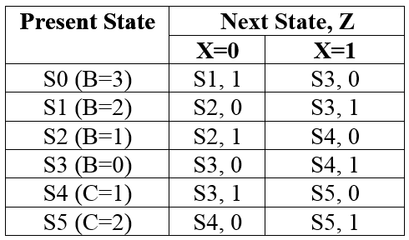
FSM Modeling Example
It is required to design a sequential circuit using Mealy model that computes the equation Z=3*X-3, where X is an unsigned number that will be fed serially.

Slide 87
FSM Modeling Example
entity Y3XM3SEQ is
port (Z: out bit; X, Reset, CLK: in bit);
end Y3XM3SEQ;
Architecture Behavioral of Y3XM3SEQ is
Type state IS (S0, S1, S2, S3, S4, S5);
signal CS, NS: state;
begin
process(CLK, Reset)
begin
if (Reset='1') Then
CS <= S0;
elsif (Clk'EVENT and Clk = '1') Then
CS <= NS;
end if;
end process;

Slide 88
FSM Modeling Example
process (X , CS)
begin
Z <= '0'; NS <= S0;
case CS is
when S0 => if (X='1') then NS<=S3; else Z<='1'; NS<=S1; end if;
when S1 => if (X='1') then Z<='1'; NS<=S3; else NS<=S2; end if;
when S2 => if (X='1') then NS<=S4; else Z<='1'; NS<=S2; end if;
when S3 => if (X='1') then Z<='1'; NS<=S4; else NS<=S3; end if;
when S4 => if (X='1') then NS<=S5; else Z<='1'; NS<=S3; end if;
when S5 => if (X='1') then Z<='1'; NS<=S5; else NS<=S4; end if;
end case;
end process;
end Behavioral;

Slide 89
FSM Test Bench
entity Y3XM3SEQ_TB is
end Y3XM3SEQ_TB;
Architecture Behavioral of Y3XM3_TB is
component Y3XM3SEQ is
port (Z: out bit; X, Reset, CLK: in bit);
end component;
Signal CLK, Reset, X, Z: bit ;
begin
M1: Y3XM3SEQ port map (Z, X, Reset, CLK);
CLK <= not CLK after 10 ps;

Slide 90
FSM Test Bench
process begin
--Applying X=1
wait until (CLK='0'); Reset<='1';
wait until (CLK='0'); Reset<='0'; X<='1';
wait until (CLK='0'); X<='0';
wait until (CLK='0'); X<='0';
wait until (CLK='0'); X<='0';
--Applying X=5
wait until (CLK='0'); Reset<='1';
wait until (CLK='0'); Reset<='0'; X<='1';
wait until (CLK='0'); X<='0';
wait until (CLK='0'); X<='1';
wait until (CLK='0'); X<='0';
wait;
end process; end Behavioral;

