Slide 1
Program Design and Analysis Chapter 5
COE 306: Introduction to Embedded Systems
Dr. Aiman El-Maleh
Computer Engineering Department
College of Computer Sciences and Engineering
King Fahd University of Petroleum and Minerals

Slide 2
Next . . .
Embedded Software Components
State Machines
Circular Buffers
Queues
Models of Programs
The Compilation Process
Compiler Optimizations

Slide 3
Embedded Software Components
Embedded code must
run at a required rate to meet system deadlines,
fit into the allowed amount of memory,
meet power consumption requirements
Some of the most common software components in embedded systems are:
1. State machines: well suited to reactive systems such as user interfaces
2. Circular buffers: useful in digital signal processing
3. Queues: useful in digital signal processing

Slide 4
Software State Machine
Finite State Machine (FSM) keeps internal state as a variable, changes state based on inputs
Uses: control-dominated code; reactive systems
FSM state diagrams can greatly reduce the chances of human error
A way of describing and documenting desired behavior precisely and unambiguously
Force you to understand your system behavior more clearly
Using a state machine implementation, rather than hand-coded logic, can ensure the structure is implemented correctly

Slide 5
State Machine Example: Seat Belt Controller
Turn on buzzer if a person sits in a seat and does not fasten the seat belt within a fixed amount of time
Inputs:
Seat sensor: to know when a person has sat down
Seat belt sensor: to know when the belt is fastened
Timer: to know when the fixed interval has elapsed
Output: the buzzer

Slide 6
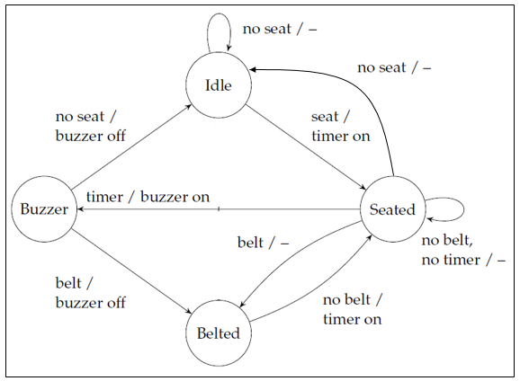
State Machine Example: Seat Belt Controller

Slide 7
Seat Belt Controller: C Code
#define IDLE 0 #define SEATED 1 #define BELTED 2 #define BUZZER 3
buzzer_on = OFF; timer_on = OFF;
switch(state) {
case IDLE:
if (seat) { state = SEATED; timer_on = TRUE; } break;
case SEATED:
if (belt) state = BELTED;
else if (!seat) {state = IDLE;}
else if (timer) {state = BUZZER; buzzer_on = TRUE; } break;
case BELTED:
if (!belt) { state = SEATED; timer_on = TRUE; } break;
case BUZZER:
if (belt) {state = BELTED; buzzer_on = OFF;}
else if (!seat) { state = IDLE; buzzer_on = OFF; }
}

Slide 8
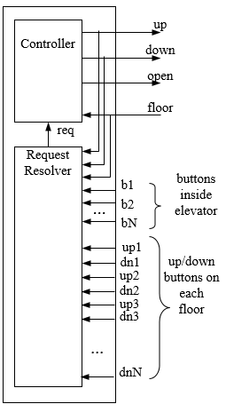
State Machine Example: An Elevator System
An elevator system of an N-Story building is composed of two units, a controller unit and a request resolver unit.
The request resolver unit receives N buttons inside the elevator to indicate the desired floor. It also receives two buttons from each floor one for going up and another for going down requests.

Slide 9
State Machine Example: An Elevator System
In addition, it receives a floor input indicating the current floor level and the two signals up and down indicating the direction of movement of the elevator.
The controller unit receives the requested floor from the request resolver unit and a floor input indicating the current floor level.
It generates three control signals as outputs: up, down and open. The signals up and down control the direction of movement of the elevator while the open signals control the elevator door.
The system will move the elevator either up or down to reach the requested floor.

Slide 10
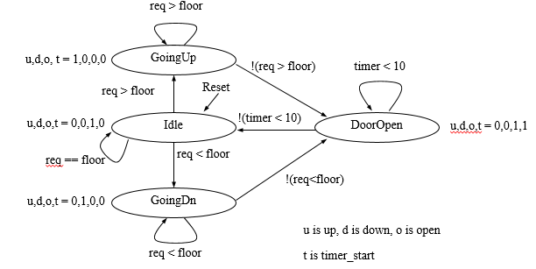
State Machine Example: An Elevator System
Once at the requested floor, the elevator door is opened for at least 10 seconds, and is kept open until the requested floor changes.
It must be ensured that the elevator door is never open while the elevator is moving.

Slide 11
State Machine Example: An Elevator System
#define IDLE 0
#define GOINGUP 1
#define GOINGDN 2
#define DOOROPEN 3
int timer=0;
int req=0, floor=0;
int up, down, open, timer_start;
Timer0 match and MCR registers are
LPC_TIM0->MR0 and LPC_TIM0->MCR
For TC registers to start counting, the least significant bit of the Timer Control Register (LPC_TIM0->TCR) must be set
To clear the MR0 interrupt flag, set the least significant bit in the Interrupt Register (LPC_TIM0->IR)
void TIMER0_IRQHandler() {
timer=1;
LPC_TIM0->IR |= 1;
}

Slide 12
State Machine Example: An Elevator System
void UnitControl() {
NVIC_EnableIRQ(1); int state = IDLE;
while (1) {
switch (state) {
IDLE: up=0; down=0; open=1; timer_start=0;
if (req==floor) {state = IDLE;}
if (req > floor) {state = GOINGUP;}
if (req < floor) {state = GOINGDN;}
break;
GOINGUP: up=1; down=0; open=0; timer_start=0;
if (req > floor) {state = GOINGUP;}
if (!(req>floor)) {state = DOOROPEN;}
break;

Slide 13
State Machine Example: An Elevator System
GOINGDN: up=0; down=1; open=0; timer_start=0;
if (req < floor) {state = GOINGDN;}
if (!(req<floor)) {state = DOOROPEN;} break;
DOOROPEN: up=0; down=0; open=1;
if (timer_start==0){
timer=0; timer_start=1; LPC_TIM0->TCR |= 1;
LPC_TIM0->MR0 = 250000000; // clk freq = 25 MHZ
LPC_TIM0->MCR |= 5; }
if (!timer) {state = DOOROPEN;}
else {state = IDLE;} break;
} // switch statement
} // while
}

Slide 14
Circular Buffer
A data structure that allows efficient stream processing
Commonly used in signal processing:
new data constantly arrives;
each datum has a limited lifetime.
Use a circular buffer to hold the data stream
x1
x2
x3
x4
x5
x6
Data stream
t₁
t₂
t₃
x1
x5
x2
x6
x3
x7
x4
Circular buffer

Slide 15
Circular Buffer: C Implementation
Data structure
put()
init()
get()
void init() {
for (int i = 0; i < SIZE; i++)
buffer[i] = 0;
pos = SIZE - 1;
}
#define SIZE 3
int buffer[SIZE];
int pos;
void put(int value) {
pos = (pos + 1) % SIZE;
buffer[pos] = value;
}
/* get the ith value earlier from the circular buffer; zero being the newest value */
int get(int i) {
int index = (pos - i) % SIZE;
If (index >=0)
return buffer[index];
else return buffer[SIZE+index];
}

Slide 16
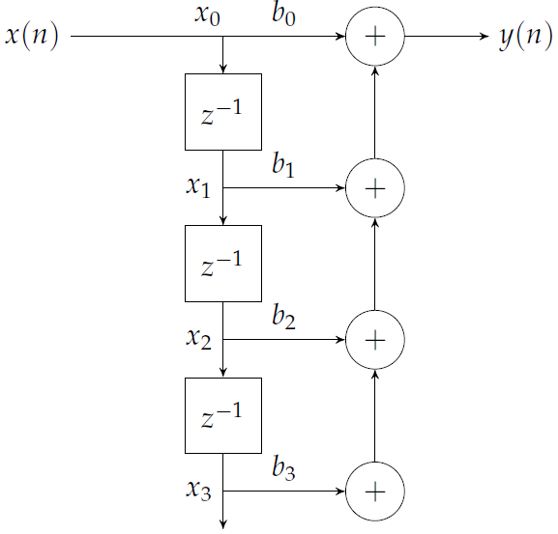
Using Circular Buffers: FIR Filter
One output:
for (i = 0; i < SIZE; i++)
y += x[i] * b[i];
Processing as a stream using
a circular buffer:
int fir(int x) {
int i, y;
put(x);
for (i = 0, y = 0; i < SIZE; i++)
y += b[i] * get(i);
return y;
}

Slide 17
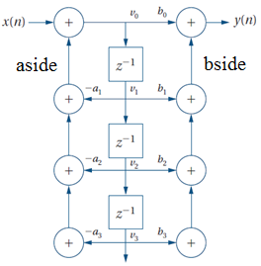
Using Circular Buffers: IIR Filter
int a[4] = {0, a1, a2, a3};
int b[4] = {b0, b1, b2, b3};
#define SIZE 3
int iir(int x) {
int i, t, aside=0, bside=0, v0, y;
for (i=0; i<SIZE; i++){
t = get(i);
aside += -a[i+1] * t;
bside += b[i+1] * t; }
v0 = x + aside
y = b[0] * v0 + bside;
put(v0); // put the new value
return result; }

Slide 18
Queues
Used when data arrival and departure or amount is unpredictable
A queue is also referred to as an elastic buffer
Circular buffer has a fixed number of data elements while a queue may have varying number of elements
Queues can be implemented based on linked lists or arrays
A linked list allows arbitrary sizes but requires dynamic memory allocation

Slide 19
An Array-Based Queue
#define SIZE 5
int q[SIZE];
int head, tail;
void queue_init() {
head = 0;
tail = 0;
}
void enqueue(int value) {
if ((tail+1) % SIZE == head)
error("The queue is full");
q[tail] = value;
tail = (tail+1) % SIZE;
}
int dequeue() {
int value;
if (head == tail)
error("The queue is empty");
value = q[head];
head = (head+1) % SIZE;
return value;
}
A counter could be used to determine whether queue is full or empty

Slide 20
An Array-Based Queue
void queue_init() {
head = NULL;
tail = head;
}
int dequeue() {
int value;
if (head == NULL)
error("The queue is empty");
else if (head == tail){
value = q[head];
head = NULL;
tail = head;
return value;
} else {
value = q[head];
head = (head+1) % SIZE;
return value;
}
}
void enqueue(int value) {
if(head == NULL){
head = 0;
tail = head;
q[tail] = value;
}
else if((tail+1)%SIZE==head)
error("The queue is full");
else {
tail = (tail+1) % SIZE;
q[tail] = value;
}
}

Slide 21
Producer/Consumer Systems
Queues allow varying input and output rates
Queues modify the flow of control in the system as well as store data

Slide 22
Models of Programs
Source code is not a good representation for programs:
clumsy
language-dependent
Compilers derive intermediate representations to manipulate and optimize the program
Abstraction allows easier analysis
One general model describes all language-specific models

Slide 23
Data Flow Graph (DFG)
A data flow graph is a model of a program with no conditionals
Describes the minimal ordering requirements on operations
Single-Assignment Form: A variable appears only once on the left-hand side
x = a + b;
y = c - d;
z = x * y;
y = b + d;
original basic block
x = a + b;
y = c - d;
z = x * y;
y1 = b + d;
single assignment form

Slide 24
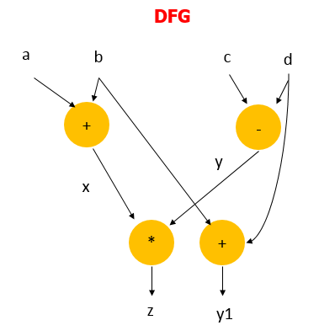
Data Flow Graph (DFG)
x = a + b;
y = c - d;
z = x * y;
y1 = b + d;
single assignment form
The data flow graph determines feasible reorderings of
operations, which may help reduce pipeline or cache conflicts

Slide 25
Control-Data Flow Graph (CDFG)
CDFG: represents control and data
Uses data flow graphs as components
A CDFG has two types of nodes:
Data flow nodes: encapsulates a complete data flow graph
Write operations in basic block form for simplicity
Decision nodes: describe all types of control (branch)

Slide 26
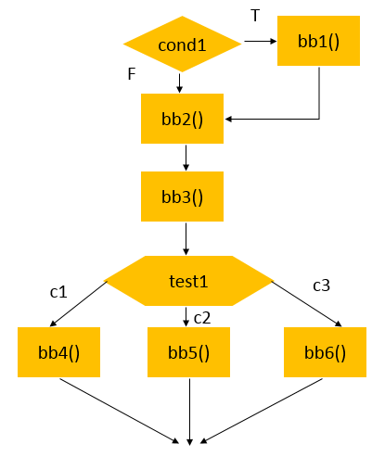
CDFG Example
if (cond1) bb1();
else bb2();
bb3();
switch (test1) {
case c1: bb4(); break;
case c2: bb5(); break;
case c3: bb6(); break;
}

Slide 27
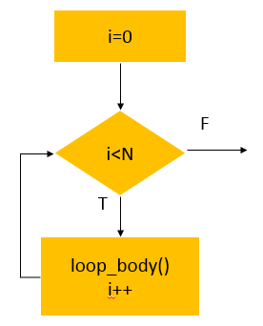
CDFG: For Loop
For Loop:
for (i=0; i<N; i++)
loop_body();
Equivalent While Loop:
i=0;
while (i<N) {
loop_body();
i++;
}

Slide 28
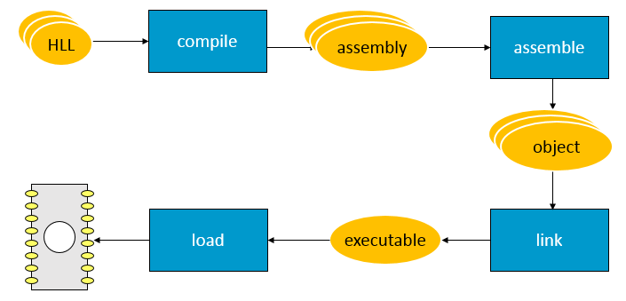
Compilation and Execution
an image of the program’s bits in memory

Slide 29
From Assembly Code to Execution
Assembly Code
Human-readable
Abstracts out instruction format
Abstracts out exact addresses
The Assembler
Translates assembly code to binary representation (object code) according to instruction formats
Partially translates labels into addresses
The Linker
Determines all addresses across multiple program files
Generates the executable binary file

Slide 30
The Assembler
Labels are the most important abstraction provided by the assembler
Label processing requires two passes:
1. Determine label addresses
By advancing a Program Location Counter (PLC)
PLC is incremented by instruction size (4 bytes in ARM)
2. Assemble instructions using computed label values
The ORG pseudo-op specifies the origin, i.e., first address of the program
Relocatable code requires alternative mechanisms both in assembly code and generated object code

Slide 31
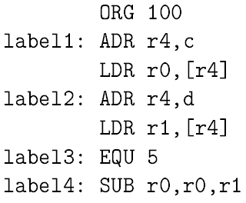
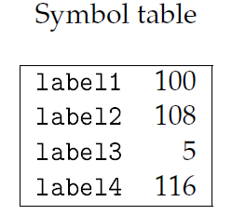
The Symbol Table
Label addresses, resulting from the first pass, are recorded in a symbol table
A pseudo-op allows adding symbols to the table without occupying space in program memory: EQU—does not advance PLC
Example:

Slide 32
Object File
Header
location of main entry point (if any)
size and position of pieces of file
Text Segment: instructions
Data Segment
static data (local/global vars, strings, constants)
Relocation Information
Instructions and data that depend on actual addresses
Linker patches these bits after relocating segments
Symbol Table
External (exported) references
Unresolved (imported) references

Slide 33
Object File Formats
Unix
a.out
COFF: Common Object File Format
ELF: Executable and Linking Format
…
Windows
PE: Portable Executable
All support both executable and object files

Slide 34
Linking
Combines several object modules into a single executable module
Allows programs to be divided into multiple files
Allows using pre-assembled libraries
Puts modules in order
Modifies object code to make the necessary links between files
Relocate each object’s text and data segments
Resolve as-yet-unresolved symbols
Record top-level entry point in executable file

Slide 35
The Linker
The linker proceeds in two phases:
1. Determine the first address in each object file, based on:
The order in which the files are to be loaded
The size of each object file
2. Merge symbol tables, and update relative addresses in object files
The assembler must identify label references in object files
Both absolute and relative addressing are important in embedded systems
Interrupts and I/O registers require absolute addressing

Slide 36
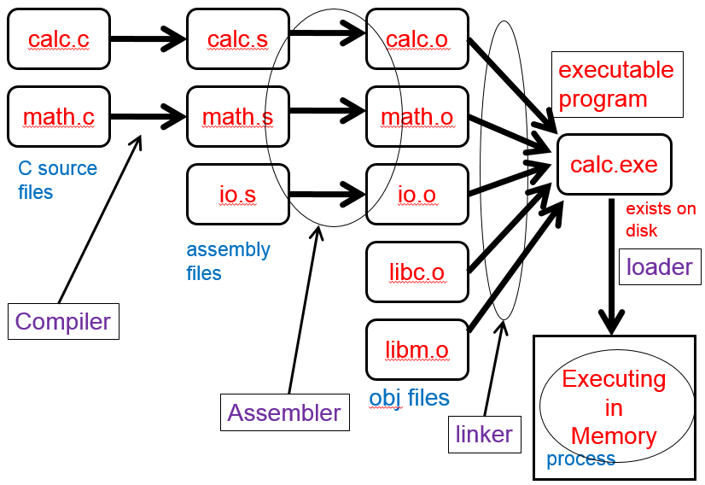
Example

Slide 37
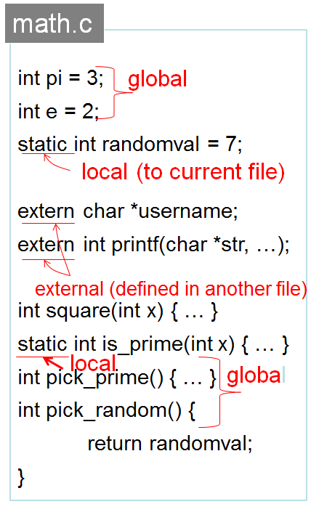
Example

Slide 38
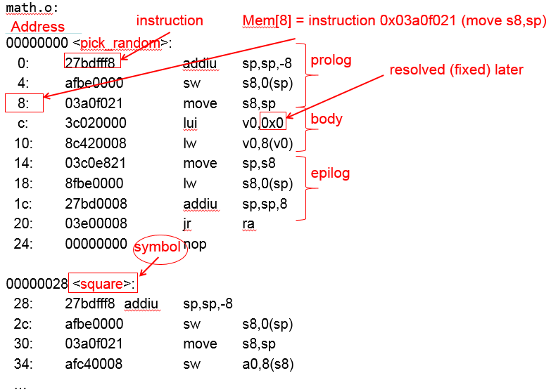
Example: Objdump Disassembly

Slide 39
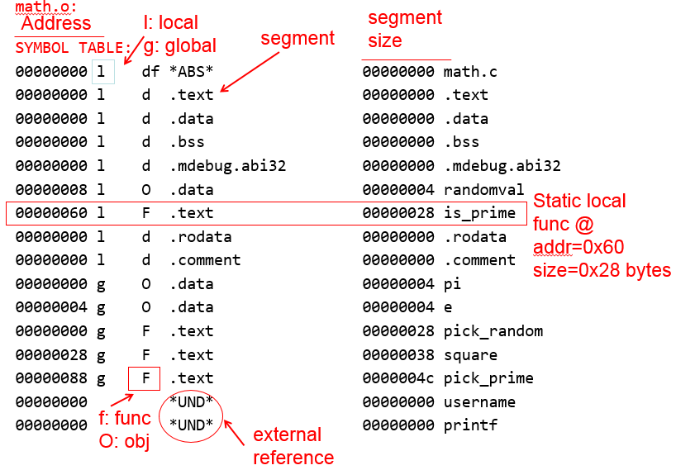
Example: Objdump Symbols

Slide 40
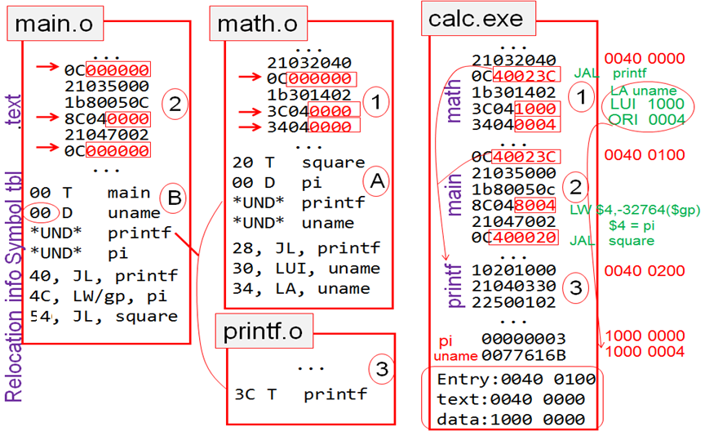
Linking Example

Slide 41
Loaders
Loader reads executable from disk into memory
Initializes registers, stack, arguments to first function
Jumps to entry-point
Part of the Operating System (OS)

Slide 42
Static vs. Dynamic Linking
Static Linking: Link a separate copy of the code to every executable program
Big executable files (all/most of needed libraries inside)
Don’t benefit from updates to library
No load-time linking
Dynamic Linking: Link a single copy of the code to all programs dynamically at the start of program execution
Small executable files (just point to shared library)
Library update benefits all programs that use it
Load-time cost to do final linking
But dll code is probably already in memory
And can do the linking incrementally, on-demand

Slide 43
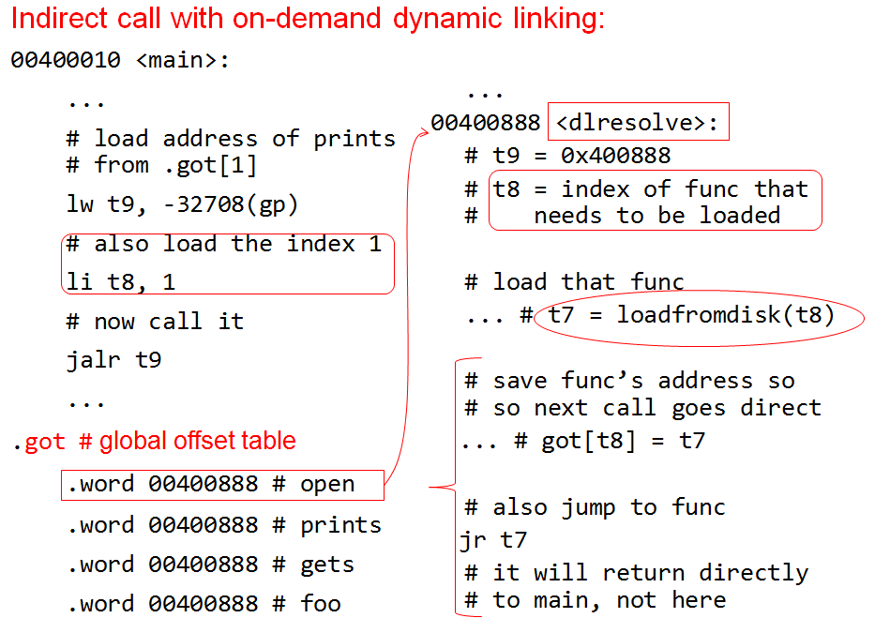
Dynamic Linking Example

Slide 44
Linking Considerations: Memory Map
The linker controls where object code is placed in memory
We may need to control the placement of several types of data:
Interrupt vectors and other information for I/O devices must be placed in specific locations
Memory management tables must be set up
Global variables used for communication between processes must be put in locations that are accessible to all the users of that data

Slide 45
Linking Considerations: Reentrant Programs
Many programs should be designed to be reentrant
A program is reentrant if can be interrupted by another call to the function without changing the results of either call
Non-Reentrant Program:
int foo = 1;
int task1() {
foo = foo + 1;
return foo;
}
Reentrant Program:
int foo = 1;
int task1(int foo) {
return foo+ 1;
}

Slide 46
The Compilation Process
Understanding the compiler → writing high-level code that results in efficient compiler-generated assembly code
Sometimes, you must write your own assembly code to meet performance goals
Compilation = translation + optimization
High-level language code → assembly code
Compiler determines quality of code:
use of CPU resources
memory access scheduling
code size

Slide 47
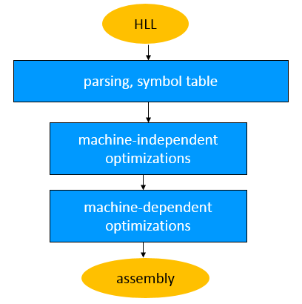
The Compilation Process
Parsing, symbol table, semantic analysis
Syntax checking
Abstract syntax tree
Machine-independent optimizations
Arithmetic simplification
Instruction-level optimizations
Generate assembly or intermediate code
Optimize code, e.g. address reuse in x[i] = c * x[i]

Slide 48
Statement Translation and Optimization
Source code is translated into intermediate form such as CDFG
CDFG is transformed/optimized
CDFG is translated into instructions with optimization decisions
Instructions are further optimized

Slide 49
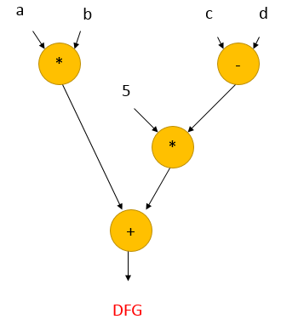
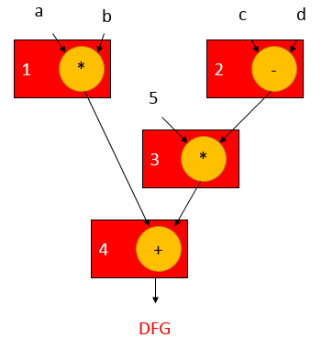
Basic Compilation: Expressions
Expression: x=a*b + 5*(c-d)
ADR r4,a
MOV r1,[r4]
ADR r4,b
MOV r2,[r4]
MUL r3,r1,r2
ADR r4,c
MOV r1,[r4]
ADR r4,d
MOV r5,[r4]
SUB r6,r4,r5
MUL r7,r6,#5
ADD r8,r7,r3
ADR r1,x
STR r8,[r1]
Post Order Traversal
Hand Written Assembly

Slide 50
Basic Compilation: Expressions
ldr r2, [fp, #−16]
ldr r3, [fp, #−20]
mul r1, r3, r2 ; multiply
ldr r2, [fp, #−24]
ldr r3, [fp, #−28]
rsb r2, r3, r2 ; subtract
mov r3, r2
mov r3, r3, asl #2
add r3, r3, r2 ; add
add r3, r1, r3 ; add
str r3, [fp, #−32] ; assign
GCC Compiler Generated Assembly

Slide 51
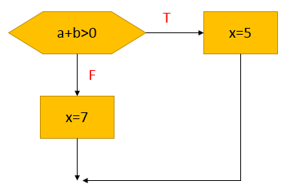
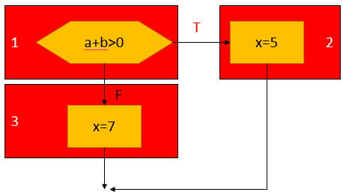
Basic Compilation : Control Structures
if (a+b > 0)
x = 5;
else
x = 7;
ADR r5,a
LDR r1,[r5]
ADR r5,b
LDR r2,b
ADDS r3,r1,r2
BLE label3
LDR r3,#5
ADR r5,x
STR r3,[r5]
B stmtend
label3:
LDR r3,#7
ADR r5,x
STR r3,[r5]
stmtend: ...
Hand Written Assembly

Slide 52
Basic Compilation : Control Structures
ldr r2, [fp, #-16]
ldr r3, [fp, #-20]
add r3, r2, r3
cmp r3, #0 ; test the branch condition
ble .L3 ; branch to false block if <=
mov r3, #5 ; true block
str r3, [fp, #-32]
b .L4 ; go to end of if statement
.L3: ; false block
mov r3, #7
str r3, [fp, #-32]
.L4:
GCC Compiler Generated Assembly

Slide 53
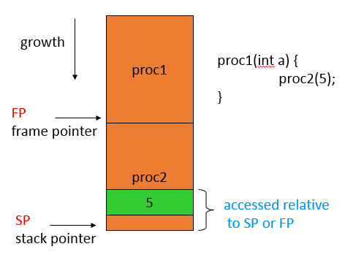
Basic Compilation: Procedures
Need code to:
call and return
pass parameters and results
Parameters and returns are passed on stack
Procedures with few parameters may use registers
Local variables are stored in the stack
Procedure Stack

Slide 54
ARM Procedure Linkage
APCS (ARM Procedure Call Standard):
r0-r3 pass parameters into procedure. Extra parameters are put on stack frame; r0 holds return value
r11 is frame pointer, r13 is stack pointer
GCC-generated assembly for: y = p1(a, b, c, d, e);
ldr r3,[fp,#-32] ; get e
str r3,[sp,#0] ; put e in p1()'s stack frame
ldr r0,[fp,#-16] ; get a
ldr r1,[fp,#-20] ; get b
ldr r2,[fp,#-24] ; get c
ldr r3, [fp, #-28] ; put d into r3
bl p1 ; call p1()
mov r3, r0 ; move return value into r3
str r3, [fp, #-36] ; store into y in stack frame

Slide 55
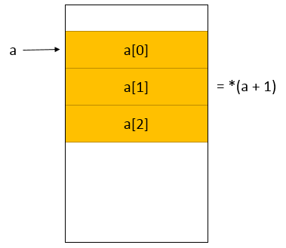
Basic Compilation: Data Structures
Different types of data structures use different data layouts
Some offsets into data structure can be computed at compile time, others must be computed at run time
One-dimensional arrays:
C array name points to 0th element
a[i] = *(a + i)
Assembly: i *sizeof(<type-of-a>)

Slide 56
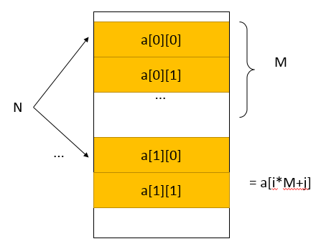
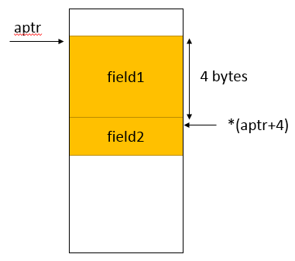
Basic Compilation: Data Structures
2-Dimensional Array:
a[i][j] = a[i*M + j]
Row-major vs. column-major
Structures:
Fields within structures are static offsets
Row-major layout
struct {
int field1;
char field2;
} mystruct;
struct mystruct a, *aptr = &a;

Slide 57
Compiler Optimizations: Expression Simplification
Constant folding:
8+1 = 9
Constant propagation:
Algebraic:
a*b + a*c = a*(b+c)
Strength reduction:
a*2 = a<<1

Slide 58
Compiler Optimizations: Dead Code Elimination
Dead Code
Unreachable code. Can never be executed
Can be present either intentionally, or by mistake
Identified by reachability analysis
Dead Code Elimination
Analyzing code for reachability, and trimming away dead code
e.g. variables assigned but never read

Slide 59
Compiler Optimizations: Procedure Inlining
Eliminates procedure linkage overhead
int foo(a,b,c) { return a + b - c;}
z = foo(w,x,y);
ð
z = w + x - y;

Slide 60
Compiler Optimizations: Loop Transformations
Goals:
reduce loop overhead
increase opportunities for pipelining
improve memory system performance
Loop unrolling
Reduces loop overhead, enables some other optimizations
for (i=0; i<4; i++)
a[i] = b[i] * c[i];
a[0] = b[0] * c[0];
a[1] = b[1] * c[1];
a[2] = b[2] * c[2];
a[3] = b[3] * c[3];
for (i=0; i<2; i++) {
a[i*2] = b[i*2] * c[i*2];
a[i*2+1] = b[i*2+1] * c[i*2+1];
}
Unrolled Loop
Partially Unrolled Loop

Slide 61
Compiler Optimizations: Loop Transformations
Loop fusion combines two loops into one
ð
Loop distribution breaks one loop into two
Allows parallel execution of loops
for (i=0; i<N; i++) a[i] = b[i] * 5;
for (j=0; j<N; j++) w[j] = c[j] * d[j];
for (i=0; i<N; i++) {
a[i] = b[i] * 5; w[i] = c[i] * d[i];
}

Slide 62
Compiler Optimizations: Loop Tiling
Loop tiling breaks a loop into a set of nested loops
Objective: Enhance cache reuse
for (i = 0; i < N; i++)
for (j = 0; j < N; j++)
a[i][j] += b[j][i];
for (i = 0; i < N; i += 4)
for (j = 0; j < N; j +=4)
for (ii = i; ii < i+4; ii++)
for (jj = j; jj < j+4; jj++)
a[ii][jj] += b[jj,ii];
ð

Slide 63
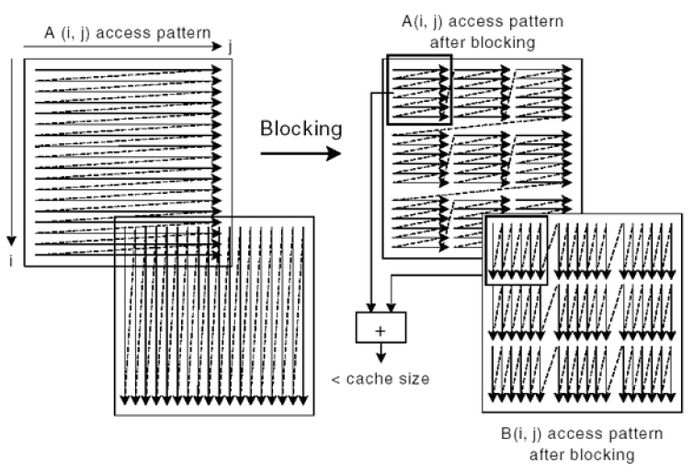
Compiler Optimizations: Loop Tiling
Assume array stored row-wise
Without loop tiling access to Array B causes cash misses

Slide 64
Compiler Optimizations: Array Padding
Adding dummy data elements to change the layout of the array in cache
The dummy data is not used
They change how useful data fall into cache lines
Can significantly reduce cache conflicts in loops
Assume that the first array element of array b is mapped to the same cache line as the first element of array a
int a[1024];
int pad[x];
int b[1024];
for (i = 1; i < 1024; i++)
sum += a[i] * b[i];
int a[1024];
int b[1024];
for (i = 1; i < 1024; i++)
sum += a[i] * b[i];

Slide 65
Compiler Optimizations: Register Allocation
Register Allocation: Assigning registers to declared and temporary variables so as to minimize the total number of required registers
If available registers are not enough, memory is used:
Extra CPU time
Uses up instruction and data memory

Slide 66
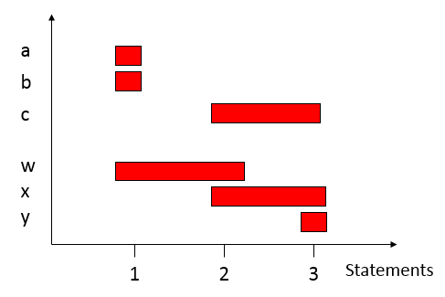
Register Allocation: Lifetime Graph
Example
w = a + b;
x = c + w;
y = c + x;
Maximum number of variables in use at any statement → maximum number of registers required = 3

Slide 67
Register Allocation: Graph Coloring
Graph Coloring Problem: Color all nodes using the smallest number of colors such that no two adjacent nodes share the same color
Graph coloring in NP-complete
A solution can be verified in polynomial time
Conflict Graph
w = a + b;
x = c + w;
y = c + x;
a
b
3 colors
3 registers
w
c
x
y

Slide 68
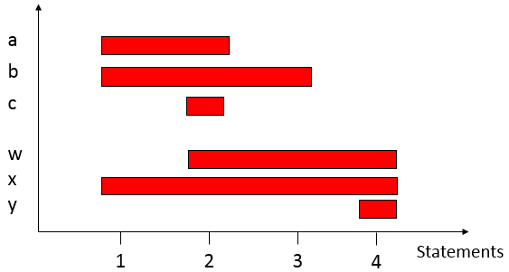
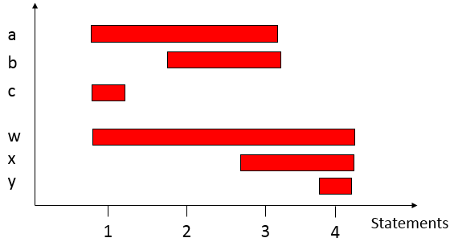
Register Allocation: Operator Scheduling
x = a + b;
w = a + c;
w= w * b;
y = w * x;
w = a + c;
w= w * b;
x = a + b;
y = w * x;
5 registers
4 registers

