Slide 1
Analog to Digital Conversion (ADC)
COE 306: Introduction to Embedded Systems
Dr. Aiman El-Maleh
Computer Engineering Department
College of Computer Sciences and Engineering
King Fahd University of Petroleum and Minerals

Slide 2
Next . . .
A/D Conversion Process
ADC Process Accuracy
Conversion Time & Converter Rate
Types of ADC Techniques

Slide 3
Signal Types
Analog Signals
An analog signal is a continuous signal that contains time-varying quantities. Measures one quantity in terms of some other quantity.
  Example
    in an analog audio signal, the instantaneous voltage of the signal varies continuously with the pressure of the sound
t

Slide 4
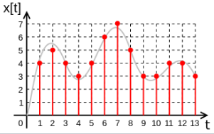
Signal Types
Digital Signals
A digital signal is a signal that is being used to represent data as a sequence of discrete values; at any given time it can only take on one of a finite number of values
The precision of the signal is determined by how many samples are recorded per unit of time

Slide 5
Analog-Digital Converter (ADC)
An electronic integrated circuit which converts a signal from analog (continuous) to digital (discrete) form
Provides a link between the analog world of transducers and the digital world of signal processing and data handling
t
t

Slide 6
A/D Conversion Process
Two main steps:
Sampling and Holding
Quantization and Encoding
Analog-to-Digital Converter
Quantizing
and
Encoding
Sampling and Hold
t
Input: Analog Signal
t

Slide 7
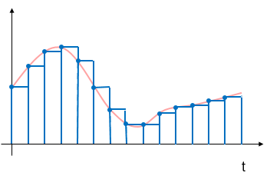
A/D Conversion Process
Sampling & Hold
Measuring analog signals at uniform time intervals
  Ideally twice as fast as what we are sampling
Digital system works with discrete states
  Taking samples from each location
Reflects sampled and hold signal
  Digital approximation
t

Slide 8
A/D Conversion Process
Quantizing
Separating the input signal into K discrete states
K=2^{N}
  N is the number of bits of the ADC
Analog quantization size
  Q=(V_{max}-V_{min})/2^{N}
  Q is the Resolution
Encoding
Assigning a unique digital code to each state

Slide 9
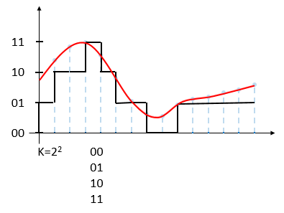
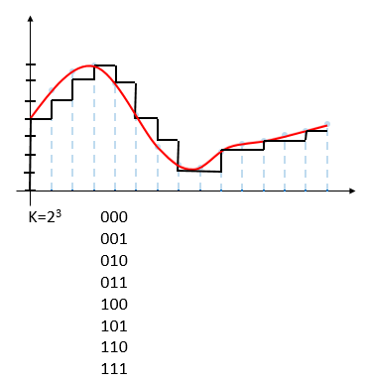
A/D Conversion Process
Quantization & Coding
Use original analog signal
Apply 2 bit coding
Apply 3 bit coding
Better representation of input information with additional bits

Slide 10
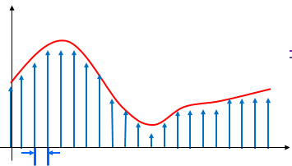
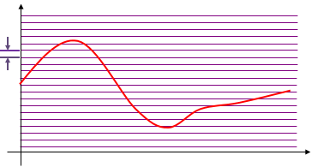
ADC Process-Accuracy
Sampling Rate, Ts
Based on number of steps required in the conversion process
Increases the maximum frequency that can be measured
Resolution (bit depth), Q
Improves accuracy in measuring amplitude of analog signal

Slide 11
ADC Process-Accuracy
Increasing sampling rate and the number of used quantized values result in better accuracy ADC signals.

Slide 12
ADC-Error Possibilities
Aliasing (sampling)
  Occurs when the input signal is changing much faster than the sample rate
  Should follow the Nyquist Rule when sampling
    Use a sampling frequency at least twice as high as the maximum frequency in the signal to avoid aliasing
    f_{sample}>2*f_{signal}
Quantization Error (resolution)
  Optimize resolution
  Dependent on ADC converter of microcontoller

Slide 13
Aliasing Example

Slide 14
Quantization Error & Effective Number of Bits
Encoding a signal (A/2) sinωt with A being the full scale using n-bit ADC will give an error variance
Signal to Noise Ratio
Effective number of bits of an n-bit ADC
  n’ giving the correct SNR
Example:
  AD9235 12-bit 20 to 65 MHz
  SNR = 70 dB
  Effective number of bits = 11.4
q
ε(x)

Slide 15
Conversion Time & Converter Rate
Conversion Time
  Required time (tc) before the converter can provide valid output data
Converter Throughput Rate
  The number of times the input signal can be sampled maintaining full accuracy
  Inverse of the total time required for one successful conversion
  Inverse of Conversion time if No S/H(Sample and Hold) circuit is used
Input voltage change during the conversion process introduces an undesirable uncertainty
Full conversion accuracy is realized only if this uncertainty is kept low below the converter’s resolution

Slide 16
Conversion Time & Converter Rate
  Rate of Change x tc ≤ resolution
Example
  8-bit ADC
  Conversion Time: 100μsec
  Sinusoidal input
    Rate of change
    Let FS = 2A
  Limited to Low frequency of 12.4 Hz
  Few Applications

Slide 17
Types of ADC Techniques
Counter or Tracking ADC
Flash ADC
Successive Approximation ADC
Single Slope Integration ADC
Dual Slope ADC
Delta-Sigma ADC

Slide 18
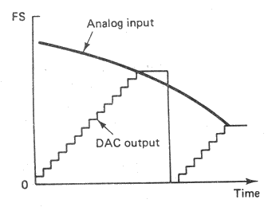
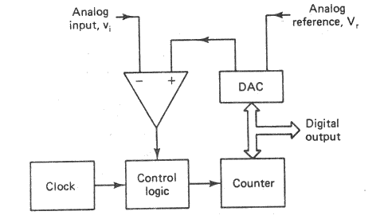
Counter Type ADC
Operation
  Reset and Start Counter
  DAC convert Digital output of Counter to Analog signal
  Compare Analog input and Output of DAC
    Vi > V_{DAC}
      Continue counting
    Vi ≤ V_{DAC}
      Stop counting
  Digital Output = Output of Counter
Disadvantage
  Conversion time is varied
    2^{n} Clock Period for Full Scale input

Slide 19
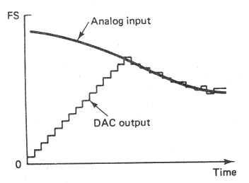
Tracking Type ADC
Tracking or Servo Type
  Using Up/Down Counter to track input signal continuously
    For slow varying input

Slide 20
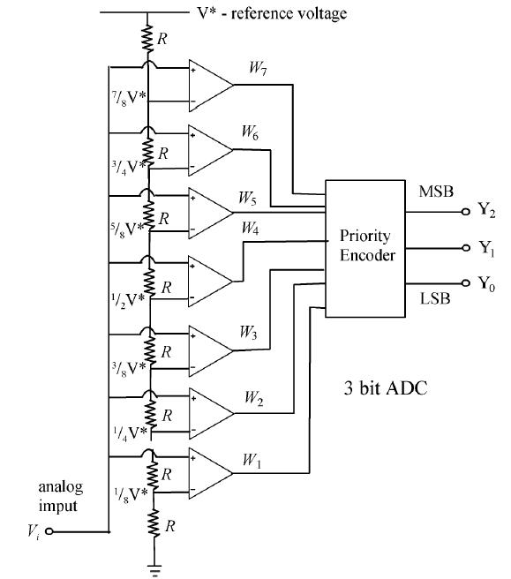


Flash ADC
Also known as parallel ADC
Elements
  Priority Encoder – Converts output of comparators to binary
  Comparators

Slide 21
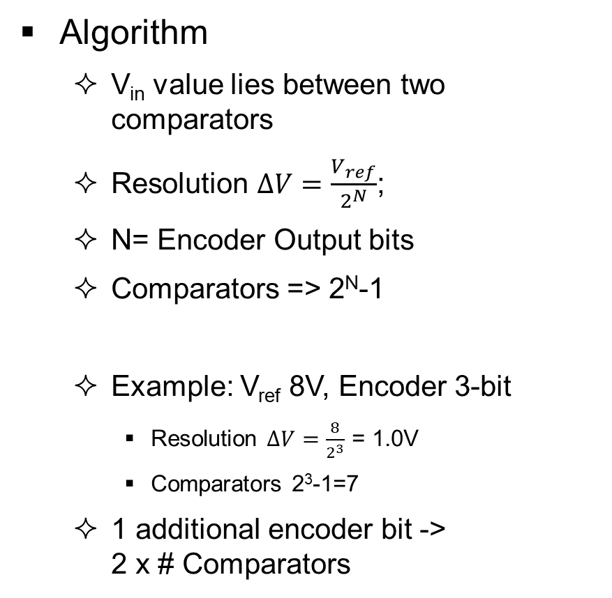
Flash ADC
Algorithm
  V_{in} value lies between two comparators
  Resolution $∆V=\frac{V_{ref}}{2^{N}}$;
  N= Encoder Output bits
  Comparators => 2^{N}-1
  Example: V_{ref} 8V, Encoder 3-bit
    Resolution $∆V=\frac{8}{2^{3}}$ = 1.0V
    Comparators 2³-1=7
  1 additional encoder bit -> 2 x # Comparators

Slide 22
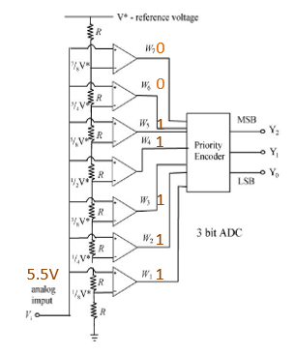
Flash ADC
Example
V_{in} = 5.5V, V_{ref}= 8V
V_{in} lies in between V_{comp5} & V_{comp6}
V_{comp5} = V_{ref}*5/8 = 5V
V_{comp6} = V_{ref}*6/8 = 6V
Comparator 1 - 5 => output 1
Comparator 6 - 7 => output 0
Encoder Octal Input = sum(0011111) = 5
Encoder Binary Output = 1 0 1

Slide 23
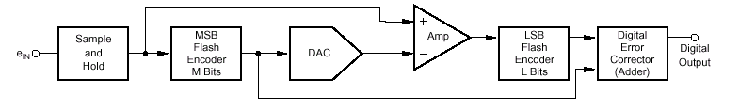
Flash ADC
Typical performance:
  4 to 12 bits
  15 to 300 MHz
  High power
Half-Flash ADC
  2-step technique
    1st flash conversion with 1/2 the precision
    Subtracted with a DAC
    New flash conversion

Slide 24
Half-Flash ADC
Example
  4-bit precision is divided into two stages with each stage generating 2 bits
  In the first stage, the comparators will be fed by the values 12/16V_{ref}, 8/16V_{ref} and 4/16V_{ref} => this will generate 2 bits
  The generated 2 bits will be converted to analog signal using DAC and then subtracted from the analog signal
  In the second stage, the comparators will be fed by the values 3/16V_{ref}, 2/16V_{ref} and 1/16V_{ref}

Slide 25
Flash ADC
Advantages
Simplest in terms of operational theory
Most efficient in terms of speed, very fast
    limited only in terms of comparator and gate propagation delays
Disadvantages
Lower precision
Expensive
For each additional output bit, the number of comparators is nearly doubled
    i.e. for 8 bits, 255 comparators needed

Slide 26
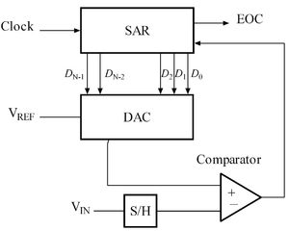
Successive Approximation ADC
Most Commonly used in medium to high speed Converters
Based on approximating the input signal with binary code and then successively revising this approximation until best approximation is achieved
SAR(Successive Approximation Register) holds the current binary value
DAC = Digital to Analog Converter
EOC = End of Conversion
SAR = Successive Approximation Register
S/H = Sample and Hold Circuit
V_{in} = Input Voltage
Comparator
V_{ref} = Reference Voltage

Slide 27
Successive Approximation ADC
Uses an n-bit DAC and original analog results
Performs a binary comparison of V_{DAC} and V_{in}
MSB is initialized at 1 for DAC
If V_{in} > V_{DAC} (V_{REF} / 2^1) then MSB is set to 1 otherwise 0
If V_{in} > V_{DAC} (V_{REF} / 2^(n-i)) for bit i, bit i is set to 1 otherwise 0
Algorithm is repeated up to LSB
At end DAC in = ADC out
N-bit conversion requires N comparison cycles

Slide 28
Successive Approximation ADC
Example
  5-bit ADC, V_{in}=0.6V, V_{ref}=1V
Cycle 1 => MSB=1
  SAR = 1 0 0 0 0
  V_{DAC} = V_{ref}/2^{^1} = .5 V_{in} > V_{DAC} SAR unchanged = 1 0 0 0 0
Cycle 2
  SAR = 1 1 0 0 0
  V_{DAC} = .5 +.25 = .75 V_{in} < V_{DAC} SAR bit3 reset to 0 = 1 0 0 0 0
Cycle 3
  SAR = 1 0 1 0 0
  V_{DAC} = .5 + .125 = .625 V_{in} < V_{DAC} SAR bit2 reset to 0 = 1 0 0 0 0
DAC bit/voltage
Bit | 4 | 3 | 2 | 1 | 0
Voltage | .5 | .25 | .125 | .0625 | .03125

Slide 29
Successive Approximation ADC
Cycle 4
  SAR = 1 0 0 1 0
  V_{DAC} = .5+.0625=.5625 V_{in} > V_{DAC} SAR unchanged = 1 0 0 1 0
Cycle 5
  SAR = 1 0 0 1 1
  V_{DAC} = .5+.0625+.03125= .59375
  V_{in} > V_{DAC} SAR unchanged = 1 0 0 1 1

Slide 30
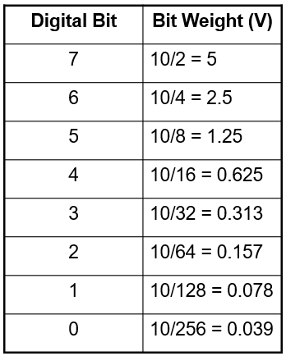
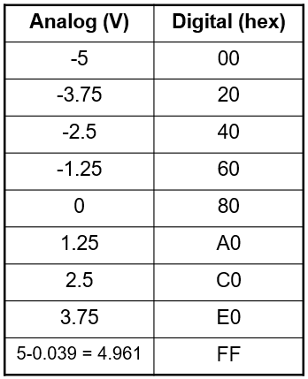
Successive Approximation ADC
Example: -5 V to +5 V analog range, n=8

Slide 31
Successive Approximation ADC
Advantages
Capable of high speed and reliable
  Typical conversion time
    1 to 50 μs
Medium accuracy compared to other ADC types
Good tradeoff between speed and cost
Capable of outputting the binary number in serial (one bit at a time) format.
Disadvantages
Higher precision successive approximation ADC’s will be slower
  Typical number of bits
    8 to 16 bits
Speed limited to ~5Msps

Slide 32
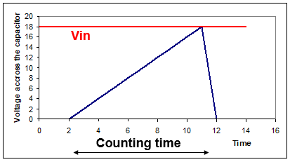
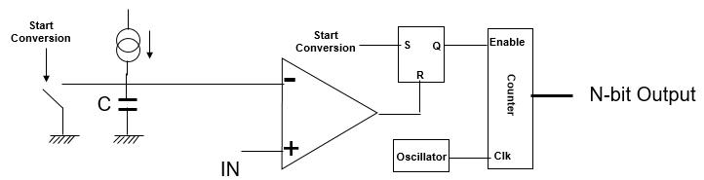
Single Slope Integration ADC
Start to charge a capacitor at constant current
Count clock ticks during this time
Stop when the capacitor voltage reaches the input
Cannot reach high precision
  capacitor
  comparator

Slide 33
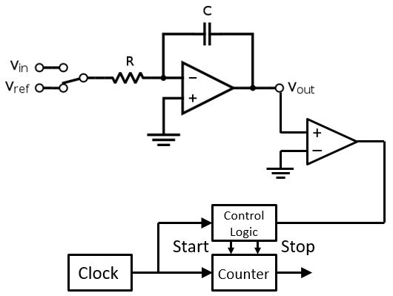
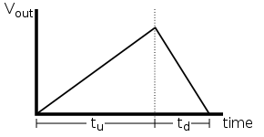
Dual Slope ADC
Input voltage is applied to input of integrator and allowed to ramp for a fixed time period (t_{u})
Then, a known reference voltage of opposite polarity is applied to integrator and is allowed to ramp until integrator output returns to zero (t_{d})
The input voltage is computed as a function of the reference voltage, the constant run-up time period, and the measured run-down time period

Slide 34
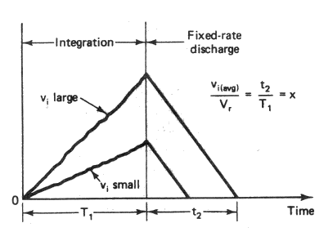
Dual Slope ADC
The run-down time measurement is usually made in units of the converter's clock, so longer integration times allow for higher precision
The speed of the converter can be improved by sacrificing precision
Advantages
  Capacitor value is not important although has to be of good quality
Typical precision
  12 to 16 bit
Conversion time
  Depends on the clock frequency

Slide 35
Dual Slope ADC
Advantages
Insensitive to errors in component values
Greater noise immunity than other ADC types
High accuracy
Disadvantages
Slow
High precision external components required to achieve accuracy
Costly

Slide 36
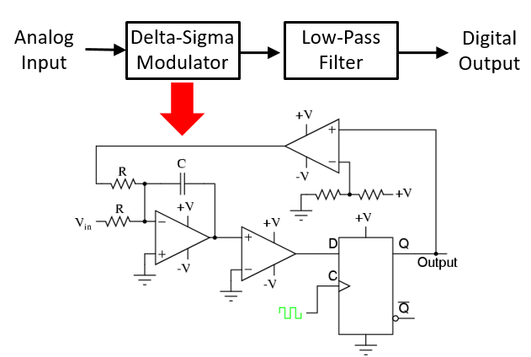
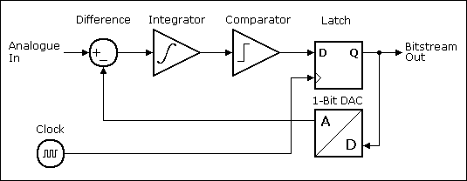
Delta-Sigma ADC
Over sampled input signal goes to the integrator
Output of integration is compared to GND
  1 if ≥ 0 otherwise 0
Output is serial bit stream with # of 1’s proportional to V_{in}
1 bit DAC generates +v if bit is 1 and –v if bit is 0
Iteration drives integration of error to zero

Slide 37
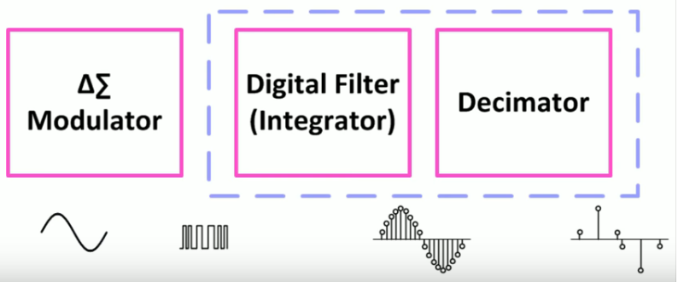
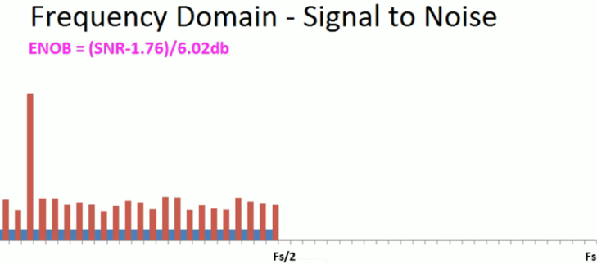
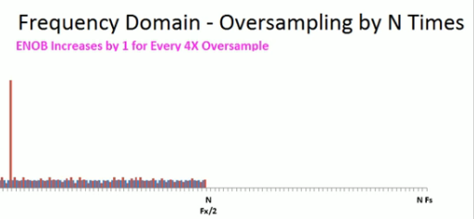
Delta-Sigma ADC

Slide 38
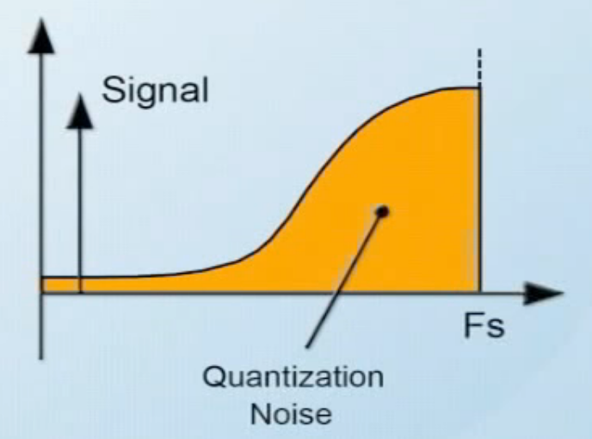
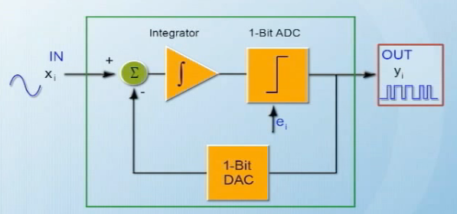
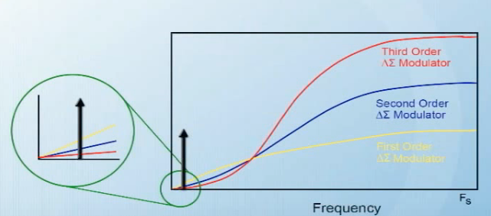
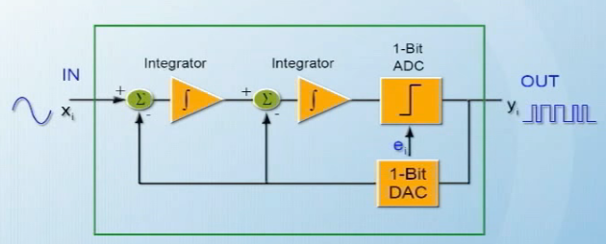
Delta-Sigma ADC – Noise Shaping
1st order Delta-Sigma
2nd order Delta-Sigma

Slide 39
Outputs of Delta Sigma Modulator
Input | δ | ∑ | Out | DAC
0.4v | 0.4v | 0.4v | 1 | +1v
0.4v | -0.6v | -0.2v | 0 | -1v
0.4v | 1.4v | 1.2v | 1 | +1v
0.4v | -0.6v | 0.6v | 1 | +1v
0.4v | -0.6v | 0.0v | 1 | +1v
0.4v | -0.6v | -0.6v | 0 | -1v
0.4v | 1.4v | 0.8v | 1 | +1v
0.4v | -0.6v | 0.2v | 1 | +1v
0.4v | -0.6v | -0.4v | 0 | -1v
0.4v | 1.4v | 1.0v | 1 | +1v
Input | δ | ∑ | Out | DAC
0.8v | 0.8v | 0.8v | 1 | +1v
0.8v | -0.2v | 0.6v | 1 | +1v
0.8v | -0.2v | 0.4v | 1 | +1v
0.8v | -0.2v | 0.2v | 1 | +1v
0.8v | -0.2v | 0.0v | 1 | +1v
0.8v | -0.2v | -0.2v | 0 | -1v
0.8v | 1.8v | 1.6v | 1 | +1v
0.8v | -0.2v | 1.4v | 1 | +1v
0.8v | -0.2v | 1.2 | 1 | +1v
0.8v | -0.2v | 1.0 | 1 | +1v
Average=0.4v
Average=0.8v
http://www.analog.com/en/design-center/interactive-design-tools/sigma-delta-adc-tutorial.html

Slide 40
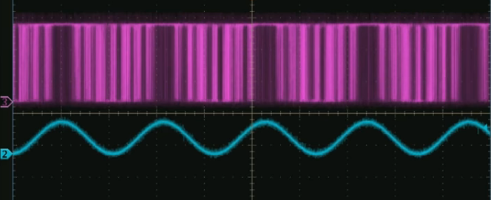
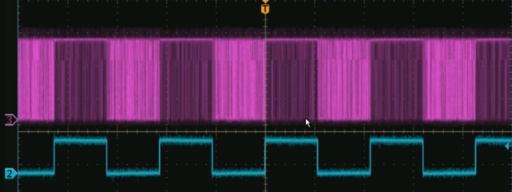


Outputs of Delta Sigma Modulator

Slide 41
Delta-Sigma ADC
Advantages
High precision
Low cost
External sample & hold circuits are not required
Requirements for analog anti-aliasing filters are minimum
Disadvantages
Slow due to oversampling

Slide 42
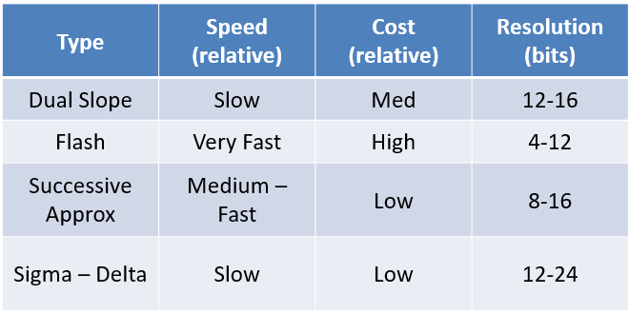
ADC Types Comparison

Slide 43
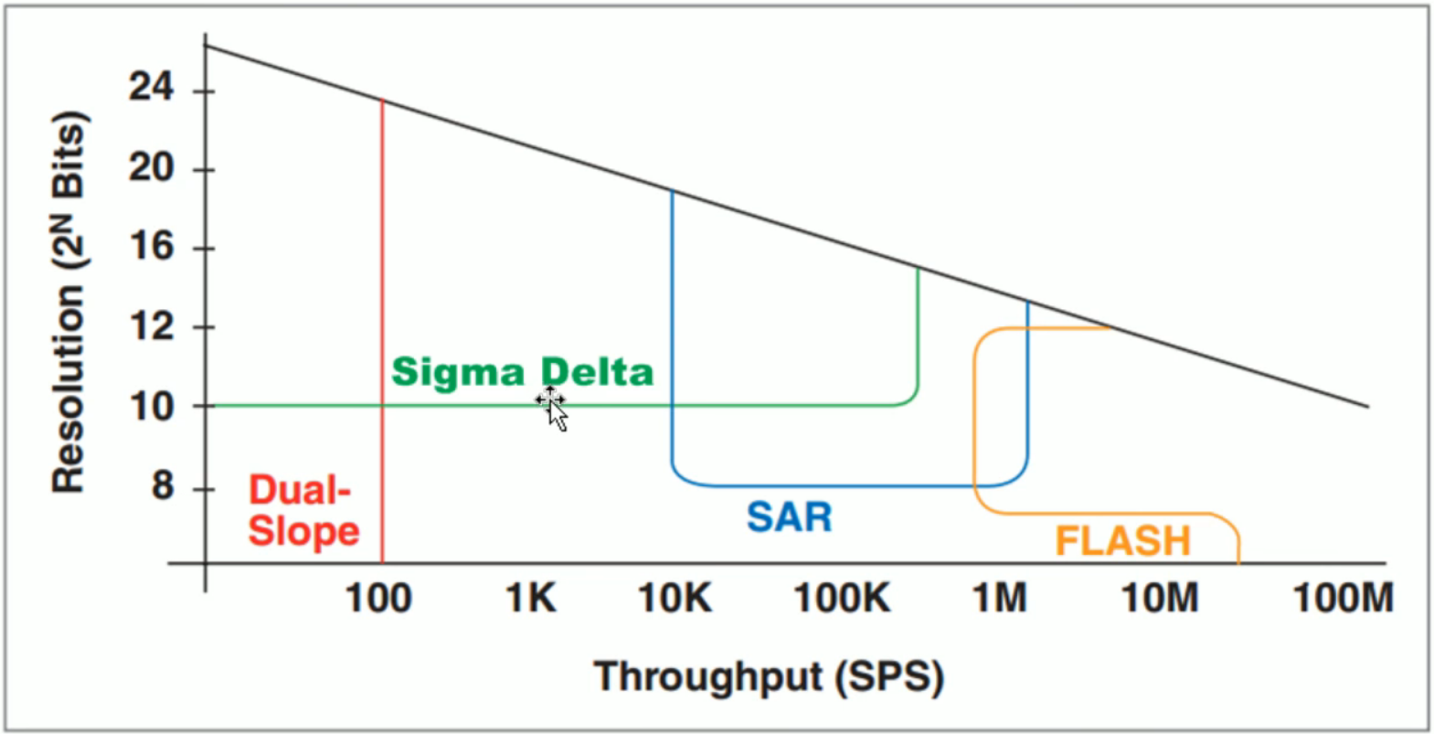
ADC Types Comparison

