Slide 1
Program Design and Analysis Chapter 5
COE 306: Introduction to Embedded Systems
Dr. Aiman El-Maleh
Computer Engineering Department
College of Computer Sciences and Engineering
King Fahd University of Petroleum and Minerals

Slide 2
Next . . .
Embedded Software Components
State Machines
Circular Buffers
Queues
Models of Programs
The Compilation Process

Slide 3
Embedded Software Components
Embedded code must
run at a required rate to meet system deadlines,
fit into the allowed amount of memory,
meet power consumption requirements
Some of the most common software components in embedded systems are:
1. State machines: well suited to reactive systems such as user interfaces
2. Circular buffers: useful in digital signal processing
3. Queues: useful in digital signal processing

Slide 4
Software State Machine
State machine keeps internal state as a variable, changes state based on inputs
Uses: control-dominated code; reactive systems
Example: Seat Belt Controller
Turn on buzzer if a person sits in a seat and does not fasten the seat belt within a fixed amount of time
Inputs:
Seat sensor: to know when a person has sat down
Seat belt sensor: to know when the belt is fastened
Timer: to know when the fixed interval has elapsed
Output: the buzzer
States: Idle, seated, buzzer, belted

Slide 5
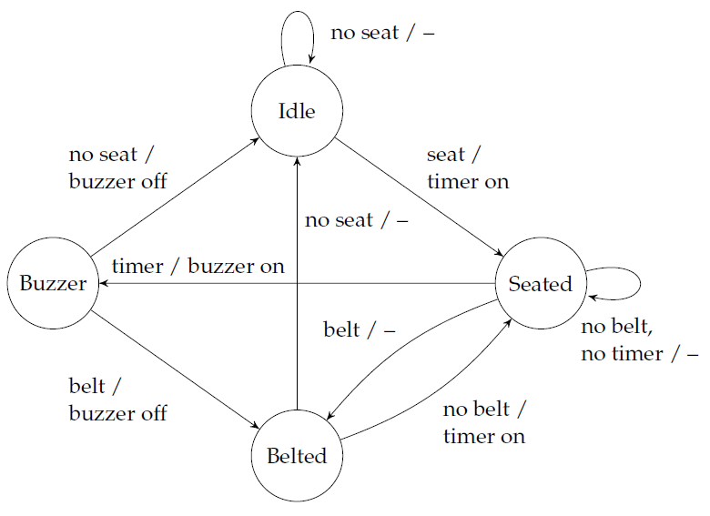
State Machine Example: Seat Belt Controller

Slide 6
Seat Belt Controller: C Code
#define IDLE 0 #define BELTED 2 #define SEATED 1 #define BUZZER 3
buzzer_on = OFF; timer_on = OFF;
switch(state) {
case IDLE:
if (seat) { state = SEATED; timer_on = TRUE; } break;
case SEATED:
if (belt) state = BELTED;
else if (timer) {state = BUZZER; buzzer_on = TRUE; } break;
case BELTED:
if (!seat) state = IDLE;
else if (!belt) { state = SEATED; timer_on = TRUE; } break;
case BUZZER:
if (belt) {state = BELTED; buzzer_on = OFF;}
else if (!seat) { state = IDLE; buzzer_on = OFF; }
}

Slide 7
Circular Buffer
A data structure that allows efficient stream processing
Commonly used in signal processing:
new data constantly arrives;
each datum has a limited lifetime.
Use a circular buffer to hold the data stream
x1
x2
x3
x4
x5
x6
Data stream
t₁
t₂
t₃
x1
x5
x2
x6
x3
x7
x4
Circular buffer

Slide 8
Circular Buffer: C Implementation
Data structure
put()
init()
get()
void init() {
for (int i = 0; i < SIZE; i++)
buffer[i] = 0;
pos = SIZE - 1;
}
#define SIZE 3
int buffer[SIZE];
int pos;
void put(int value) {
pos = (pos + 1) % SIZE;
buffer[pos] = value;
}
/* get the ith value from the circular buffer; zero being the newest value */
int get(int i) {
int index = (pos - i) % SIZE;
return buffer[index];
}

Slide 9
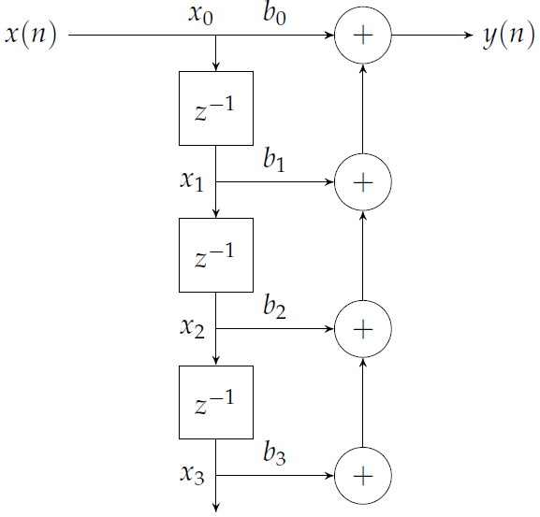
Using Circular Buffers: FIR Filter
One output:
for (i = 0; i < SIZE; i++)
y += x[i] * b[i];
Processing as a stream using
a circular buffer:
int fir(int value) {
int i, y;
put(value);
for (i = 0, y = 0; i < SIZE; i++)
y += b[i] * get(i);
return y;
}

Slide 10
Queues
Used when data arrival and departure or amount is unpredictable
A queue is also referred to as an elastic buffer
Circular buffer has a fixed number of data elements while a queue may have varying number of elements
Queues can be implemented based on linked lists or arrays
A linked list allows arbitrary sizes but requires dynamic memory allocation

Slide 11
An Array-Based Queue
#define SIZE 5
int q[SIZE];
int head, tail;
void queue_init() {
head = 0;
tail = 0;
}
void enqueue(int value) {
if ((tail+1) % SIZE == head)
error("The queue is full");
q[tail] = value;
tail = (tail+1) % SIZE;
}
int dequeue() {
int value;
if (head == tail)
error("The queue is empty");
value = q[head];
head = (head+1) % SIZE;
return value;
}

Slide 12
Producer/Consumer Systems
Queues allow varying input and output rates
Queues modify the flow of control in the system as well as store data

Slide 13
Models of Programs
Source code is not a good representation for programs:
clumsy
language-dependent
Compilers derive intermediate representations to manipulate and optimize the program.
Abstraction allows easier analysis
One general model describes all language-specific models

Slide 14
Data Flow Graph (DFG)
A data flow graph is a model of a program with no conditionals
Describes the minimal ordering requirements on operations
Single-Assignment Form: A variable appears only once on the left-hand side
x = a + b;
y = c - d;
z = x * y;
y = b + d;
original basic block
x = a + b;
y = c - d;
z = x * y;
y1 = b + d;
single assignment form

Slide 15
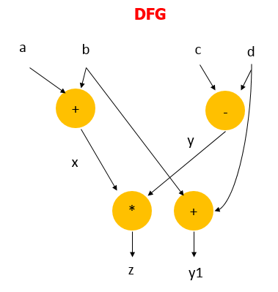
Data Flow Graph (DFG)
x = a + b;
y = c - d;
z = x * y;
y1 = b + d;
single assignment form
The data flow graph determines feasible reorderings of
operations, which may help reduce pipeline or cache conflicts

Slide 16
Control-Data Flow Graph (CDFG)
CDFG: represents control and data.
Uses data flow graphs as components.
A CDFG has two types of nodes:
Data flow nodes: encapsulates a complete data flow graph
Write operations in basic block form for simplicity
Decision nodes: describe all types of control (branch)

Slide 17
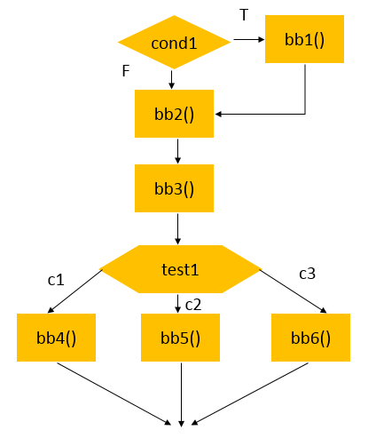
CDFG Example
if (cond1) bb1();
else bb2();
bb3();
switch (test1) {
case c1: bb4(); break;
case c2: bb5(); break;
case c3: bb6(); break;
}

Slide 18
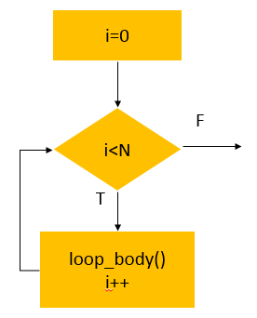
CDFG: For Loop
For Loop:
for (i=0; i<N; i++)
loop_body();
Equivalent While Loop:
i=0;
while (i<N) {
loop_body(); i++; }

Slide 19
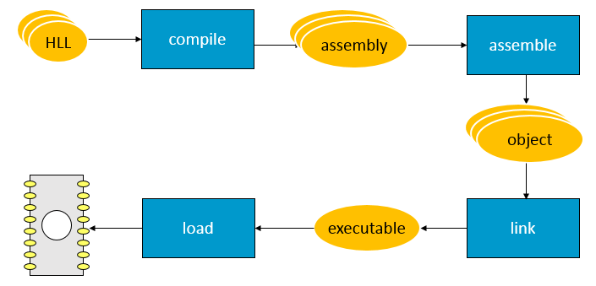
Compilation and Execution
an image of the program’s bits in memory

Slide 20
From Assembly Code to Execution
Assembly Code
Human-readable
Abstracts out instruction format
Abstracts out exact addresses
The Assembler
Translates assembly code to binary representation (object code) according to instruction formats
Partially translates labels into addresses
The Linker
Determines all addresses across multiple program files
Generates the executable binary file

Slide 21
The Assembler
Labels are the most important abstraction provided by the assembler
Label processing requires two passes:
1. Determine label addresses
By advancing a Program Location Counter (PLC)
PLC is incremented by instruction size (4 bytes in ARM)
2. Assemble instructions using computed label values
The ORG pseudo-op specifies the origin, i.e. first address, of the program
Relocatable code requires alternative mechanisms both in assembly code and generated object code

Slide 22
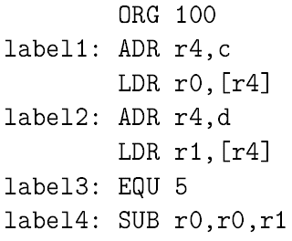
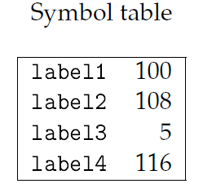
The Symbol Table
Label addresses, resulting from the first pass, are recorded in a symbol table
A pseudo-op allows adding symbols to the table without occupying space in program memory: EQU—does not advance PLC
Example:

Slide 23
Object File
Header
location of main entry point (if any)
size and position of pieces of file
Text Segment: instructions
Data Segment
static data (local/global vars, strings, constants)
Relocation Information
Instructions and data that depend on actual addresses
Linker patches these bits after relocating segments
Symbol Table
External (exported) references
Unresolved (imported) references

Slide 24
Object File Formats
Unix
a.out
COFF: Common Object File Format
ELF: Executable and Linking Format
…
Windows
PE: Portable Executable
All support both executable and object files

Slide 25
Linking
Combines several object modules into a single executable module
Allows programs to be divided into multiple files
Allows using pre-assembled libraries
Puts modules in order
Modifies object code to make the necessary links between files
Relocate each object’s text and data segments
Resolve as-yet-unresolved symbols
Record top-level entry point in executable file

Slide 26
The Linker
The linker proceeds in two phases:
1. Determine the first address in each object file, based on:
The order in which the files are to be loaded
The size of each object file
2. Merge symbol tables, and update relative addresses in object files
The assembler must identify label references in object files
Both absolute and relative addressing are important in embedded systems:
Interrupts and I/O registers require absolute addressing

Slide 27
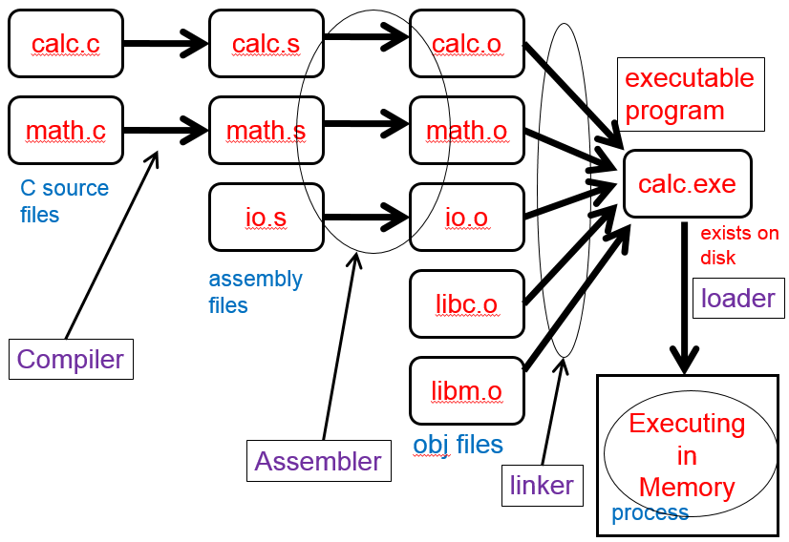
Example

Slide 28
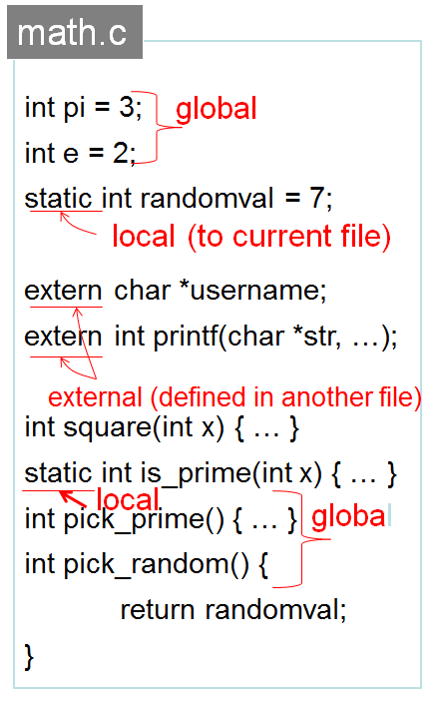
Example

Slide 29
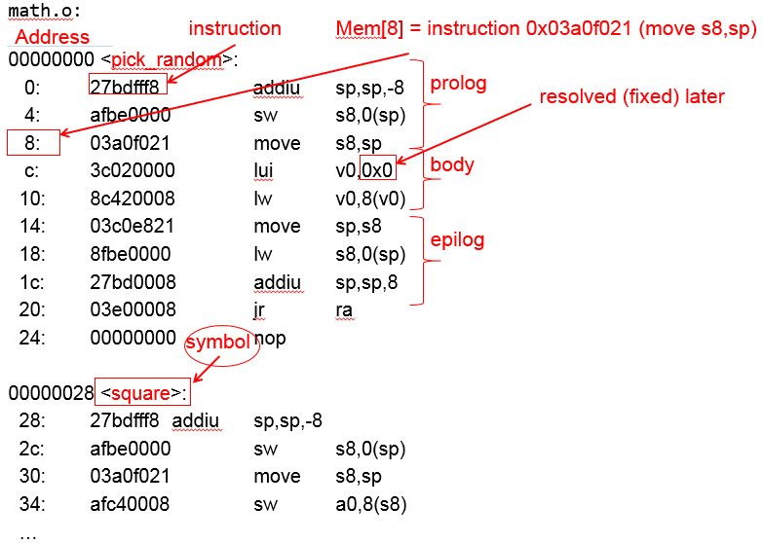
Example: Objdump Disassembly

Slide 30
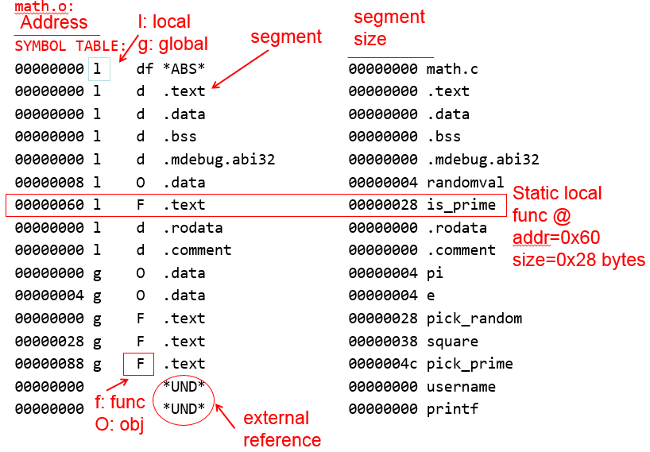
Example: Objdump Symbols

Slide 31
main.o
math.o
calc.exe
...
0C000000
21035000
1b80050C
8C040000
21047002
0C000000
...
...
21032040
0C000000
1b301402
3C040000
34040000
...
...
21032040
0C40023C
1b301402
3C041000
34040004
...
0C40023C
21035000
1b80050c
8C048004
21047002
0C400020
...
10201000
21040330
22500102
...
0040 0000
JAL printf
1
math
1
LA uname
.text
2
LUI 1000
ORI 0004
0040 0100
20 T square
00 D pi
*UND* printf
*UND* uname
A
2
00 T main
00 D uname
*UND* printf
*UND* pi
main
B
Symbol tbl
LW $4,-32764($gp)
$4 = pi
28, JL, printf
30, LUI, uname
34, LA, uname
JAL square
40, JL, printf
4C, LW/gp, pi
50, JL, square
0040 0200
printf
3
Relocation info
printf.o
00000003
0077616B
1000 0000
pi
uname
1000 0004
...
3
Entry:0040 0100
text:0040 0000
data:1000 0000
3C T printf

Slide 32
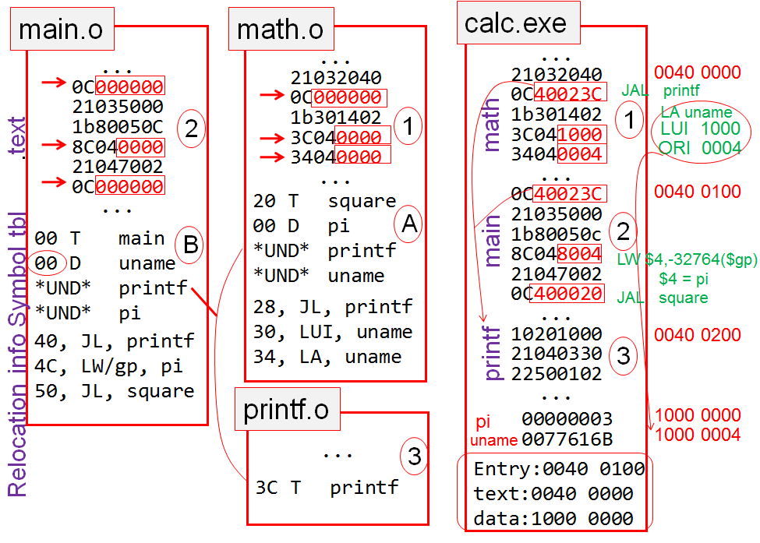
Linking Example

