Slide 1
CPUs Chapter 3
COE 306: Introduction to Embedded Systems
Dr. Aiman El-Maleh
Computer Engineering Department
College of Computer Sciences and Engineering
King Fahd University of Petroleum and Minerals

Slide 2
Next . . .
Input and Output (I/O) Devices
Busy-Wait (Polling) I/O
Interrupt I/O
Supervisor Mode, Exceptions, and Traps
Caches and CPUs
Memory Management
CPU Performance
CPU Power Consumption & Management

Slide 3
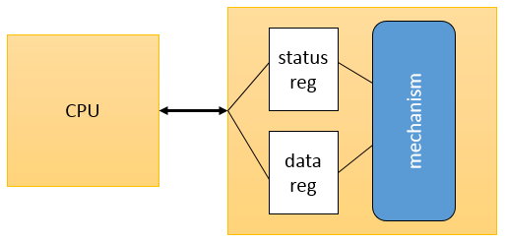
Input and Output (I/O) Devices
Examples: keyboard, mouse, disk drive
Usually include some non-digital component
Typical digital interface to CPU:
Data registers hold values that are treated as data by the device, such as the data read or written by a disk.
Status registers provide information about the device’s operation, such as whether the current transaction has completed.

Slide 4
I/O Device Example: 8251 UART
Universal asynchronous receiver transmitter (UART): provides serial communication
8251 UART functions are integrated into standard PC interface chip
Allows many communication parameters to be programmed
Characters are transmitted separately

Slide 5
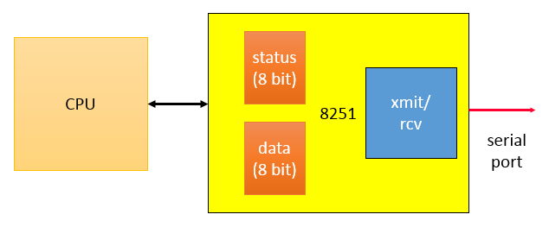
8251 CPU Interface
Serial communication parameters
Baud (bit) rate
Number of bits per character
Parity/no parity
Even/odd parity
Length of stop bit (1, 1.5, 2 bits)

Slide 6
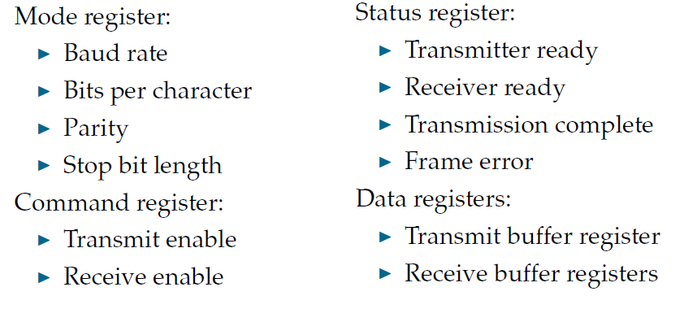
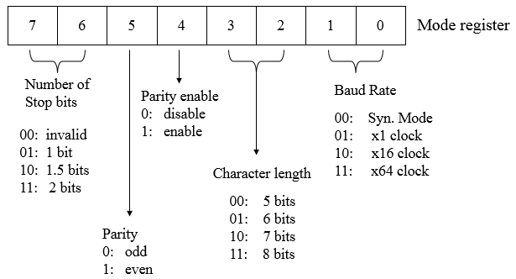
8251 Registers

Slide 7
Input and Output Primitives
I/O instructions
Separate address space
Example: x86 use in and out instructions
Memory-mapped I/O
An address for each I/O device register
Communicate with devices: read/write instructions
Common in most architectures

Slide 8
Busy-Wait I/O
I/O devices are slower than CPUs
Must finish an I/O operation before starting the next
True for both reading and writing
Simplest way to program device
Use instructions to test when device is ready.
Polling
Asking an I/O device whether it is finished by reading its status register

Slide 9
Polling Example
Output a string, character by character
The device has two registers: one for the character to be written and a status register. When writing, we must set the output status register to 1 to start writing and wait for it to return to 0.
.
#define OUT_CHAR 0x1000
#define OUT_STATUS 0x1001
char *mystring = “Hello, World!”;
char *current_char;
current_char = mystring;
while (* current_char != ‘\0’){
(* (char *) OUT_CHAR) = *current_char;
(* (char *) OUT_STATUS) = 1;
while ( (* (char *) OUT_STATUS) != 0);
current_char++;
}

Slide 10
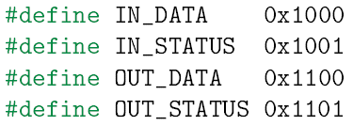
Another Polling Example
Copy characters from input to output
The input device sets its status register to 1 when a new character has been input; we must set the status register back to 0 after the character has been read so that the device is ready to input another character.
When writing, we must set the output status register to 1 to start writing and wait for it to return to 0.
while (1) {
while (* (char *) IN_STATUS == 0);
c = * (char *) IN_DATA;
* (char *) IN_STATUS=0;
* (char *) OUT_DATA = c;
* (char *) OUT_STATUS = 1;
while (* (char *) OUT_STATUS != 0);
}
char c;

Slide 11
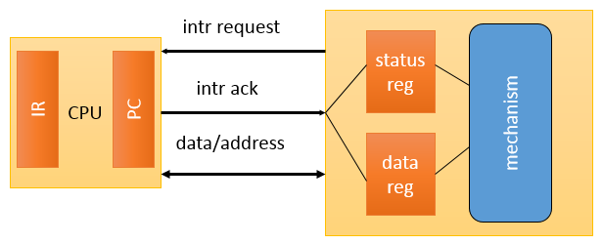
Interrupt I/O
Busy/wait I/O is very inefficient
CPU can’t do other work while testing device
Hard to do simultaneous I/O
Interrupt mechanism
1. I/O device asserts an interrupt request signal
2. CPU asserts interrupt acknowledge signal
3. PC is set to the address of interrupt handler
4. When the interrupt handler finishes, it returns to the foreground program

Slide 12
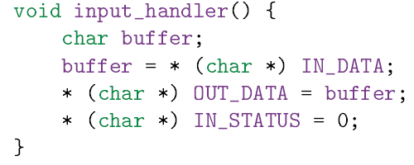
Interrupt Example
Copy characters from input to output using interrupts
What is the limitation of this code?
How can we improve it?

Slide 13
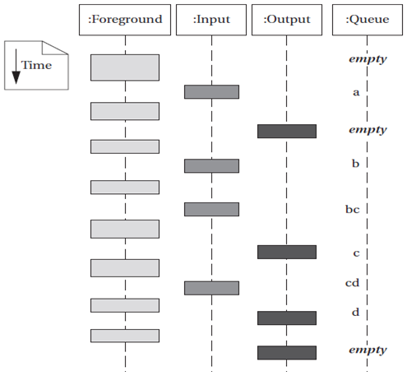
Interrupt I/O with Buffer
Copying Characters from Input to Output with Interrupts and Buffers

Slide 14
Another Interrupt Example
Input Device
8-bit status register at address 0xA0
Bit 0 is a data ready flag set whenever new data is received
once data is processed, data ready flag must be reset
8-bit data register at address 0xA1
generates an interrupt request upon receiving new data
Output Device
8-bit status register at address 0xB0
Bit 0 is a ready to send flag set by device when ready to send data
Bit 1 is a transmit enable bit reset by device after each transmission
16-bit data register at address 0xB1
generates an interrupt request when ready to send new data

Slide 15
Another Interrupt Example
Write software that collects 8-bits received through the input device, and accumulates them until the output device becomes ready to send
Once the output device becomes ready to send data, the accumulated data is sent using the output device
The first data received after sending replaces the previous accumulated data

Slide 16
Another Interrupt Example
#define DEV1_STATUS 0xA0
#define DEV1_DATA 0xA1
#define DEV2_STATUS 0xB0
#define DEV2_DATA 0xB1
short data = 0; // 16-bit data
void device1_handler(void) {
data += (* (char *) DEV1_DATA);
(* (char *) DEV1_STATUS) &= 0xfe; // reset data ready flag
}
void device2_handler(void) {
(* (short *) DEV2_DATA) = data;
(* (char *) DEV2_STATUS) |= 2; // transmit enable
data = 0; }

Slide 17
Interrupts vs. Polling I/O
Polling
takes CPU time even when no requests pending
overhead may be reduced at expense of response time
Interrupts
no overhead when no requests pending
facilitate concurrency
can be hard to debug
What if ISR does not save & restore a used register?
Foreground program can exhibit mysterious bugs
Bugs will be hard to repeat---depend on interrupt timing

Slide 18
Interrupt Implementation
The CPU checks the interrupt request line before executing every instruction
If asserted, the CPU sets PC to the beginning of the interrupt handler
The interrupt handler code can reside anywhere in memory.
Its starting address is stored in a predefined location
CPU’s interrupt mechanism resembles its subroutine function
High-level language interface for interrupt handlers
depends on CPU and compiler

Slide 19
Supporting Multiple I/O Devices-Priorities
Interrupt Priorities allow the CPU to recognize some interrupts as more important than others
Multiple interrupt request signals, e.g. L1, L2, . . . , Ln
Lower number signals have higher priority
Interrupt acknowledge signal carries the request number
A device knows its request is accepted by seeing its priority number on the interrupt acknowledge lines
Priorities are set by connecting request lines
Changing priorities requires hardware modification

Slide 20
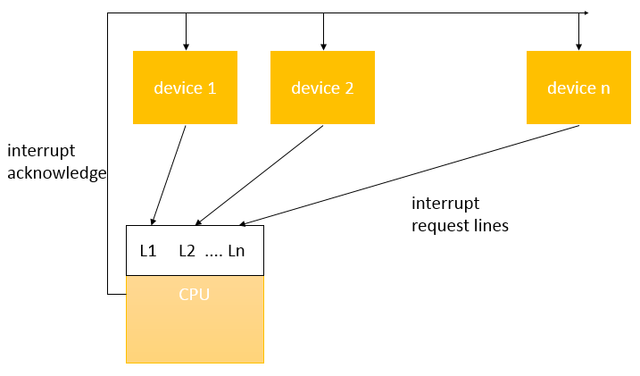
Multiple Interrupt Request Lines
log₂ n

Slide 21
Interrupt Priorities
Interrupt Masking
A lower-priority interrupt does not occur while a higher-priority interrupt is being handled
Priority register: holds priority of currently handled interrupt
Non-Maskable Interrupt (NMI)
The highest-priority interrupt
Usually reserved for interrupts caused by power failures
Typically, up to 8 priorities
How to support more than 8 devices?

Slide 22
Interrupt Priorities
More priority levels can be added with external logic
When more than one device are connected to the same interrupt line, the CPU does not know which device caused the interrupt
The handler uses software polling to check the status of each device to know the device who requested the interrupt
It can assign priority among the requesting devices by arranging the order of checking their status

Slide 23
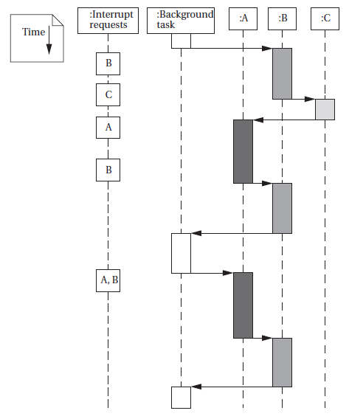
Example: Prioritized I/O
Assume that we have devices A, B, and C. A has priority 1 (highest priority), B priority 2, and C priority 3.

Slide 24
Supporting Multiple I/O Devices-Vectors
Interrupt Vectors allow interrupting device to specify its handler
Requires additional interrupt vector lines from device to CPU
Device sends interrupt vector after its request is acknowledged
CPU uses interrupt vector as an index to a memory table
The location referenced in the interrupt vector table by the vector number specifies the address of the handler
Each device stores its vector number
It can be changed without modifying the system software

Slide 25
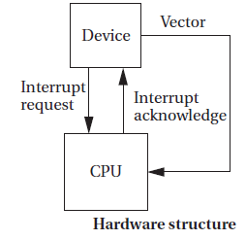
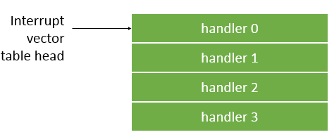
Interrupt Sequence
CPU acknowledges request
Device sends vector
CPU calls handler
Handler Software processes request
CPU restores state to foreground program

Slide 26
Interrupt Overhead
Interrupt Overhead
Branch penalty
Automatically storing and restoring CPU registers
Acknowledging interrupts and waiting for vectors
Additional saving and restoring of registers by the handler
Returning incurs another branch penalty
Optimizing Interrupt Handlers
Minimize number of registers used by the handler that need to be saved and restored
Requires writing interrupt handlers in assembly

Slide 27
Interrupts in ARM7
Interrupt requests (IRQ)
Fast interrupt requests (FIQ) – higher priority
Interrupt table: address 0
Table entries: subroutine calls to the handlers
Interrupt response latency: 4 – 27 cycles
Responding to an interrupt request
Save PC
Copy CPSR to SPSR
Set CPSR for the interrupt
Set PC to the interrupt vector
Leaving the interrupt handler
Restore PC
Restore CPSR from SPSR
Clear interrupt disable flag

Slide 28
Supervisor Mode
Supervisor mode is an execution mode on some processors which enables execution of all instructions, including privileged instructions. It may also give access to a different address space, to memory management hardware and to other peripherals. This is the mode in which the operating system usually runs.
Supervisor mode has privileges that user modes do not, e.g. MMU control
ARM Supervisor Mode
Instruction: SWI
Similar to interrupts, but uses special registers

Slide 29
Exceptions
Exception is an internally detected error
Examples: division by zero, undefined instructions, illegal memory access
Exceptions are synchronous with instructions but unpredictable
Checked during execution; handled like interrupts
Require prioritization and vectoring
Priorities and vector numbers are usually fixed by the architecture
Vectors allow user-provided handlers

Slide 30
Traps
A trap is a software interrupt; an instruction that explicitly generates an exception
The main purpose of a trap is to provide a fixed subroutine that various programs can call without having to actually know the run-time address
MS-DOS is the perfect example. The int 21h instruction is an example of a trap invocation to transfer control to DOS entry point
ARM uses SWI instruction for traps
Example: entering supervisor mode

Slide 31
Co-Processors
Reserved op-codes for co-processor operations
CPU passes co-processor instructions to co-processor
Co-processors have access to CPU registers
CPU may suspend or continue execution while waiting for co-processors
A co-processor instruction without a co-processor
Illegal instruction trap
Trap handler can emulate the instruction in software
Software emulation is slow, but provides compatibility
ARM supports up to 16 co-processors
Example: floating-point unit

Slide 32
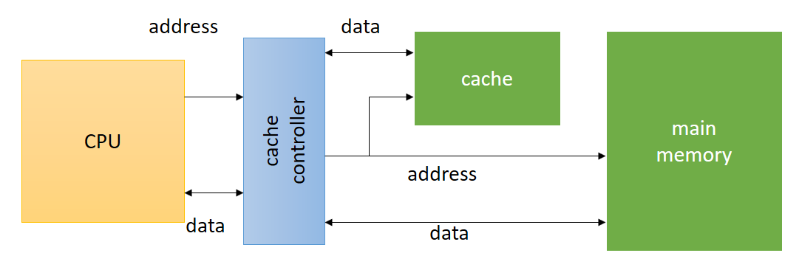
Memory System Overview
The memory system comprises cache and main memory
Caches increase the average performance of the memory system
Memory Management Units (MMUs) perform address translations that provide a larger virtual memory space in a small physical memory

Slide 33
Caches
Cache memory is a small fast memory that holds copies of some of the contents of main memory
May have caches for:
instructions; data; data + instructions (unified).
It speeds up average memory access time
It increases the variability of memory access time
accesses in the cache will be fast,
access to locations not cached will be slow
It is effective when the CPU is using only a relatively small set of memory locations at any one time; the set of active locations is often called the working set

Slide 34
Cache and Main Memory
Cache hit: required location is in cache
Cache miss: required location is not in cache
Types of cache misses
Compulsory (Cold) miss: occurs the first time a location is accessed
Capacity miss: caused by a too-large working set
Conflict miss: two memory locations map to the same cache location
h = cache hit rate; cache hit probability
t_{cache} = cache access time, t_{main} = memory access time
Average memory access time: t_{avg} = t_{cache} + (1-h) t_{main}

Slide 35
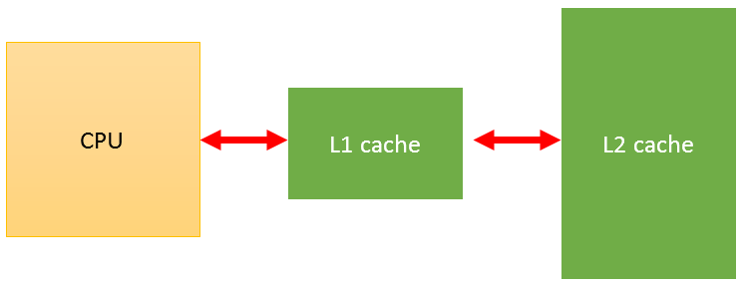
Multiple Levels of Cache
L1 cache: fastest; closest to CPU; usually on-chip
L2 cache: feeds L1 cache; usually off-chip
h₁ = L1 cache hit rate.
h₂ = L2 cache hit rate.
Average memory access time
t_{avg} = t_{L1} + (1-h₁)t_{L2} + (1-h₁)(1-h₂)t_{main}

Slide 36
Cache Organizations & Policies
Cache organizations
Fully-associative: any memory location can be stored anywhere in the cache (almost never implemented).
Direct-mapped: each memory location maps onto one cache entry.
N-way set-associative: each memory location maps into one of n sets.
Replacement policy: strategy for choosing which cache entry to remove to make room for new memory location
Two popular strategies: Random, Least-recently used (LRU)
Write operations
Write-through: immediately copy write to main memory
Write-back: write to main memory only when location is removed from cache

Slide 37
Example Cache Implementations
ARM600: 4-KB, 64-way unified cache
StrongARM
16 Kbyte, 32-way, 32-byte block instruction cache.
16 Kbyte, 32-way, 32-byte block data cache (write-back).
C5510: 16-KB instruction cache, 2-way, 4x32-bit words per line

Slide 38
Virtual Memory
Virtual Memory: is imaginary memory; it gives you the illusion of a memory arrangement that’s not physically there
Logical Address: The program’s abstract address space
Physical Address: Actual location in physical memory (RAM)
Memory management unit (MMU) translates addresses

Slide 39
Advantages of Virtual Memory
Flexibility: Decouples a process’ view of memory from physical memory
Process memory can be moved and resized based on run-time behavior
A process can address more or less memory than physically installed
Abstraction: A process views memory as a single contiguous, private address space (virtual memory)
Efficiency: Processes can be allocated different amounts of memory; Better utilization of physical memory
Protection: A process cannot access a memory address of another process

Slide 40
Memory Management Unit Tasks
Allows programs to move in physical memory during execution
Allows virtual memory:
memory images kept in secondary storage
images returned to main memory on demand during execution
Page fault: request for location not resident in memory

Slide 41
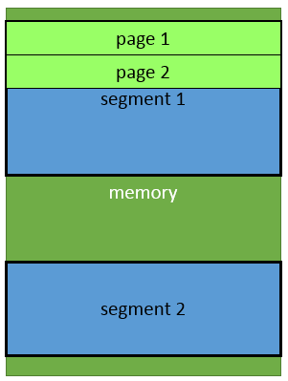
Address Translation
Requires some sort of register/table to allow arbitrary mappings of logical to physical addresses.
Two basic schemes:
segmentation
paging
Segmentation and paging can be combined (x86)

Slide 42
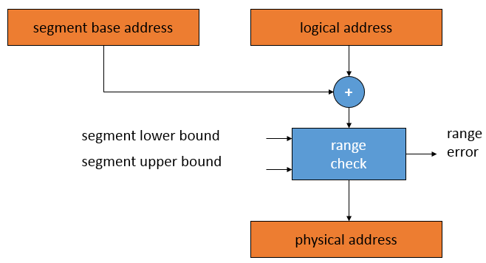
Segmentation
Segment
Large, arbitrarily-sized region of memory
Described by a start address and a size
Segment address translation

Slide 43
Paging
Paging divides the linear address space into …
Fixed-sized blocks called pages, e.g. 4 KB pages
Operating system allocates main memory for pages
Pages can be spread all over main memory
Pages in main memory can belong to different programs
If main memory is full then pages are stored on the hard disk
OS has a Virtual Memory Manager (VMM)
Uses page tables to map the pages of each running program
Manages the loading and unloading of pages
As a program is running, CPU does address translation
Page fault: issued by CPU when page is not in memory

Slide 44
Paging – cont’d
Main Memory
The operating system uses page tables to map the pages in the linear virtual address space onto main memory
Page m
. . .
Page n
. . .
. . .
linear virtual address space of Program 1
linear virtual address space of Program 2
Page 2
Page 2
Page 1
Page 1
Page 0
Page 0
Hard Disk
The operating system swaps pages between memory and the hard disk
Each running program has its own page table
Pages that cannot fit in main memory are stored on the hard disk
As a program is running, the processor translates the linear virtual addresses onto real memory (called also physical) addresses

Slide 45
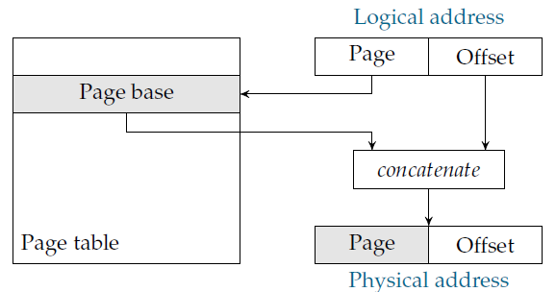
Paging
Page: Small, equally-sized region of memory
Simpler hardware for address translation
Allows fragmentation
Page address translation

Slide 46
The Page Table
Typically, pages are 512 B – 4 KB → large page table
The page table is in memory
Address translation requires memory access
Flat vs. tree page table
Why use a tree page table?
How to speed up address translation?
Use a cache; TLB: Translation Lookaside Buffer
Page Table Entry components
Base address
Present bit; Dirty bit (page content has been modified)
Permission bits

Slide 47
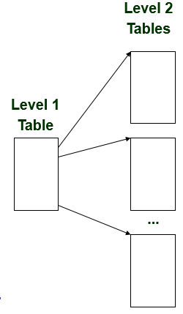
Multi-Level Page Tables
Given:
4KB (2¹²) page size
32-bit address space
4-byte page table entry (PTE)
Problem:
Would need a 4 MB page table!
2²⁰ *4 bytes Per-process
Common solution
Multi-level page tables
E.g., 2-level table (Pentium)
Level-1 table: 1024 entries, each of which points to a Level 2 page table
Level-2 table: 1024 entries, each of which points to a page

Slide 48
MMU in ARM
Optional
Provides address translation and memory protection
Supported types of memory regions:
Section: 1 MB
Large page: 64 KB
Small page: 4 KB
An address is marked as section-mapped or page-mapped
Two-level address translation

Slide 49
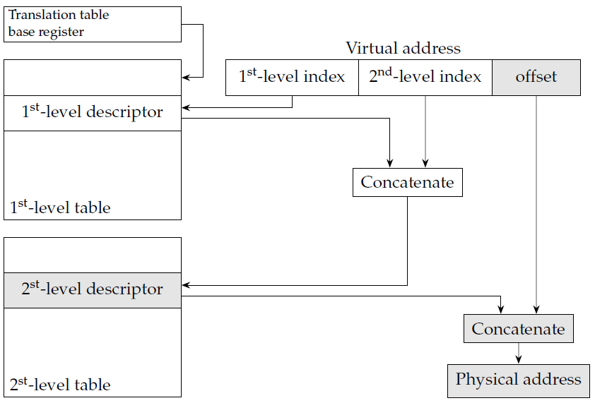
Two-Level Address Translation

Slide 50
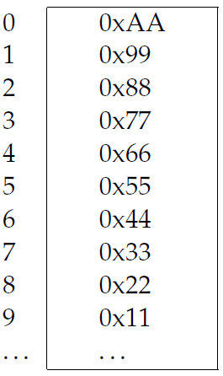
Virtual Memory System Example
Logical address is 32 bits, page size is 4 kB. Consider the given page table below:
How many address bits are used to identify the page (page number)?
How many virtual pages can there be?
How many address bits are used for the offset within a page?
Given the logical address 0x4365, what is the page number? what is the offset?
What is the corresponding physical address?
Which is larger: virtual memory or physical memory?

Slide 51
CPU Performance
Elements of CPU performance
Cycle time
CPU pipeline
Memory system
Performance measures
Latency: time it takes for an instruction to get through the pipeline
Throughput: number of instructions executed per time period
Pipelining increases throughput without reducing latency
Various conditions can cause pipeline bubbles that reduce utilization: Branches, Data hazards, Memory system delays (cache miss penalty)

Slide 52
CPU Power Consumption
Most modern CPUs are designed with power consumption in mind to some degree
Power vs. energy
Power is the rate at which energy is transferred
Heat depends on power consumption
Battery life depends on energy consumption
CMOS power consumption
Voltage: power consumption proportional to V²
Toggling: more activity means more power
Leakage: basic circuit characteristics; can be eliminated by disconnecting power

Slide 53
CPU Power-Saving Strategies
Reduce power supply voltage
Run at lower clock frequency
Disable function units with control signals when not in use
Disconnect parts from power supply when not in use
Power management styles
Static power management: does not depend on CPU activity
Example: user-activated power-down mode; sleep mode; entered with an instruction and exited with an interrupt
Dynamic power management: based on CPU activity
Example: disabling off function units, frequency scaling

Slide 54
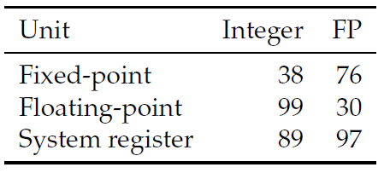
EXAMPLE: POWERPC 603
Consumes 2.2W at 80 MHz
Unused execution units are shut down by switching off their clocks
Unused pipeline stages are turned off
8 KB 2-way set-associative cache is organized into 8 subarrays
At most 2 are accessed in a clock cycle
Experimentally obtained % idle times while running the SPEC integer and floating-point benchmarks:

Slide 55
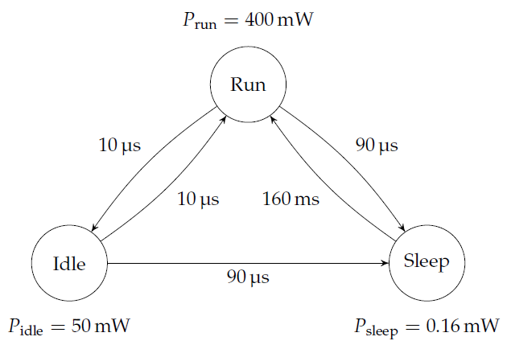
Power-Down Costs
Going into a power-down mode costs: time and energy
Must determine if going into mode is worthwhile
Can model CPU power states with power state machine
Run mode is normal operation
Idle mode saves power by stopping CPU
clock. System unit modules—real-time
clock, operating system timer, interrupt
control, general-purpose I/O, and
power manager remain operational
Sleep mode shuts off most of
chip’s activity
STRONG ARM SA-1100

