Slide 1
ICS103 Programming in C Lecture 14: Searching and Sorting

Slide 2
Outline
Searching
Linear Search Algorithm
Linear Search Implementation
Binary Search Algorithm
Binary Search Implementation
Sorting
Selection Sort Algorithm
Selection Sort Implementation
Bubble Sort Algorithm
Bubble Sort Implementation

Slide 3
Introduction to Searching
Searching means scanning through a list of items (in an array) to find if a particular one exists.
It usually requires the user to specify the target item – the item he wishes to locate
If the target item is found, the item or its location (index) is returned, otherwise, an appropriate message or flag is returned.
An important issue in processing a search request is response time. Some factors affecting response time are:
The size of the array to search from
The organization of data in the array; random or ordered
The searching method or algorithm; linear or binary
In this lecture, we study two searching methods; Linear Search and Binary Search.

Slide 4
Linear Search Algorithm
This involves searching through the array sequentially until the target item is found or the array is exhausted.
If the target is found, its location is returned, otherwise a flag such as –1 is returned. Here is the algorithm for Linear Search
Assume that the target has not been found
Start with initial array element
Repeat while the target is not found and there are more array elements
If the current element matches the target
Set a flag to indicate that the target has been found
else
Advance to the next array element
If the target was found
Return the target index as the search result
else
Return -1 as the search result

Slide 5
Linear Search Implementation
#include <stdio.h>
#define SIZE 8
int linear_search(double a[], double target, int size);
void read_array(double a[], int size);
int main(void) {
double x[SIZE], target;
int index;
read_array(x, SIZE);
printf("Enter Element to search for: ");
scanf("%lf", &target);
index = linear_search(x, target, SIZE);
if (index != -1)
printf("Target was found at index %d\n", index);
else
printf("Sorry, target item was not found");
system("pause");
return 0;
}
void read_array (double a[], int size) {
int i;
printf("Enter %d integer numbers separated by blanks\n> ", size);
for (i = 0; i < size; ++i)
scanf("%lf", &a[i]);
}
/* Searches for target in an array using Linear search;
* Returns index of target or -1 if not found */
int linear_search(double a[], double target,
int size)
{
int i, found = 0, where;
i = 0;
while (!found && i < size) {
if (a[i] == target)
found = 1;
else
++i;
}
if (found)
where = i;
else
where = -1;
return where;
}

Slide 6
Binary Search Algorithm
For a list of n elements, the linear search takes an average of n/2 comparisons to find an item, with the best case being 1 comparison and the worst case being n comparisons.
However, if the list is ordered, it is a waste of time to look for an item using linear search - it would be like looking for a word in a dictionary sequentially.
In this case we apply a more efficient method called binary search. Binary search works by comparing the target with the item at the middle of the list. This leads to one of three results:
If the middle item is the target – we are done.
If the middle item is less than target, we apply the algorithm to the upper half of the list.
If the middle item is bigger than the target, we apply the algorithm to the lower half of the list.
This process is repeated until the item is found or the list is exhausted

Slide 7
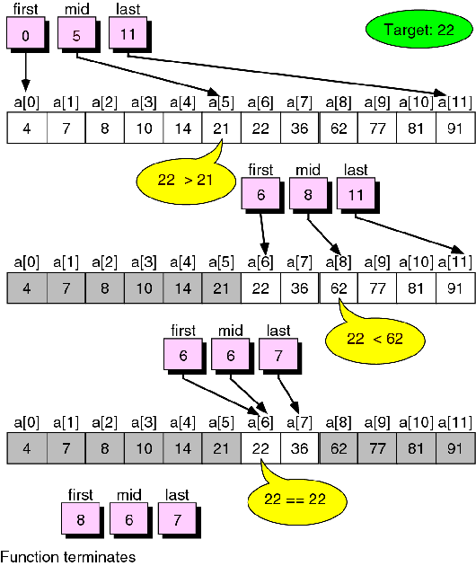
Binary Search Algorithm ….

Slide 8
Binary Search Implementation
#include <stdio.h>
#define SIZE 8
int binary_search (double x[], int low, int high, double target);
void read_array(double a[], int size);
int main(void) {
double x[SIZE], target;
int index;
read_array(x, SIZE);
printf("Enter Element to search for: ");
scanf("%lf", &target);
index = binary_search(x, 0, SIZE-1, target);
if (index != -1)
printf("Target was found at index %d\n", index);
else
printf("Sorry, target item was not found");
system("pause");
return 0;
}
void read_array (double a[], int size) {
int i;
printf("Enter %d integer numbers separated by blanks\n> ", size);
for (i = 0; i < size; ++i)
scanf("%lf", &a[i]);
}
int binary_search (double x[], int low, int high, double target) {
int middle;
while (low <= high) {
middle = (low + high)/2;
if (x[middle] == target)
return (middle);
else if (x[middle] < target)
low = middle + 1
else
high = middle - 1;
}
return -1;
}

Slide 9
Introduction to Sorting
Sorting is the re-arrangement of a collection of data according to some key-field.
It is a common activity in data management. Even when a list is maintained in a certain order, there is often a need to re-arrange the list in a different order.
Because it takes so much processing time, sorting is a serious topic in computer science, and many different sorting algorithms have been designed.
We shall consider two of such sorting methods; Selection sort and Bubble sort.

Slide 10
Selection Sort Algorithm
Selection sort involved scanning through the list to find (or select) the smallest element and swap it with the first element.
The rest of the list is then search for the next smallest and swap it with the second element.
This process is repeated until the rest of the list reduces to one element, by which time the list is sorted.
The following table shows how selection sort works.

Slide 11
Selection Sort Implementation
#include <stdio.h>
#define SIZE 10
void selection_sort(double a[], int size);
void read_array(double a[], int size);
void print_array(double a[], int size);
int find_min(double a[], int start, int size);
void swap(double *a, double *b);
int main(void) {
double x[SIZE];
int i;
read_array(x, SIZE);
printf("Before Sorting: ");
print_array(x, SIZE);
selection_sort(x, SIZE);
printf("After Sorting: ");
print_array(x, SIZE);
system("pause");
return 0;
}
void selection_sort(double a[], int size) {
int i, min_pos;
for (i = 0; i<= size-2; i++) {
min_pos = find_min(a, i, size);
swap(&a[i], &a[min_pos]);
}
}
int find_min(double a[], int start, int size) {
int i, min_index = start;
for (i=start+1; i<size; i++)
if (a[i] < a[min_index])
min_index = i;
return min_index;
}
void swap(double *a, double *b) {
double temp = *a;
*a = *b;
*b = temp;
}
void read_array (double a[], int size) {
int i;
printf("Enter %d integer numbers separated by blanks\n> ", size);
for (i = 0; i < size; ++i)
scanf("%lf", &a[i]);
}
void print_array(double a[], int size) {
int i;
for (i = 0; i < size; ++i)
printf("%.1f ", a[i]);
printf("\n");
}

Slide 12
Bubble Sort Algorithm
The idea of Bubble (or exchange) sort is to scan through the list and swap each pair of adjacent elements that are in the wrong order.
The process is repeated each time from index zero to one less than the previous limit until either the list is exhausted or until a pass that involve no swap is encountered.
At the end of first pass, the largest element will move (or bubble up) to the end of the list.
At the end of the second swap, the second largest will move to its right place, etc.
The following table shows a trace of how bubble sort works.

Slide 13
Bubble Sort Implementation
#include <stdio.h>
#define SIZE 10
void bubble_sort(double a[], int size);
void read_array(double a[], int size);
void print_array(double a[], int size);
void swap(double *a, double *b);
int main(void) {
double x[SIZE];
int i;
read_array(x, SIZE);
printf("Before Sorting: ");
print_array(x, SIZE);
bubble_sort(x, SIZE);
printf("After Sorting: ");
print_array(x, SIZE);
system("pause");
return 0;
}
void swap(double *a, double *b) {
double temp = *a;
*a = *b;
*b = temp;
}
void bubble_sort(double a[], int size) {
int i, pass = 1, swap_occurs;
do{
swap_occurs = 0;
for(i = 1; i <= size - pass; i++) {
if (a[i - 1] > a[i]) {
swap(&a[i-1], &a[i]);
swap_occurs = 1;
}
}
pass++;
} while (swap_occurs && pass <= size-1);
}
void read_array (double a[], int size) {
int i;
printf("Enter %d integer numbers separated by blanks\n> ", size);
for (i = 0; i < size; ++i)
scanf("%lf", &a[i]);
}
void print_array(double a[], int size) {
int i;
for (i = 0; i < size; ++i)
printf("%.1f ", a[i]);
printf("\n");
}

