Slide 1
Conditional Processing
COE 205
Computer Organization and Assembly Language
Dr. Aiman El-Maleh
College of Computer Sciences and Engineering
King Fahd University of Petroleum and Minerals
[Adapted from slides of Dr. Kip Irvine: Assembly Language for Intel-Based Computers]

Slide 2
Outline
Boolean and Comparison Instructions
Conditional Jumps
Conditional Loop Instructions
Translating Conditional Structures
Indirect Jump and Table-Driven Selection
Application: Sorting an Integer Array

Slide 3
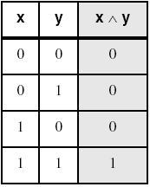
AND Instruction
Bitwise AND between each pair of matching bits
AND destination, source
Following operand combinations are allowed
AND reg, reg
AND reg, mem
AND reg, imm
AND mem, reg
AND mem, imm
AND instruction is
often used to
clear selected bits
AND
Operands can be 8, 16, or 32 bits and they must be of the same size
0 0 1 1 1 0 1 1
AND
0 0 0 0 1 1 1 1
cleared
0 0 0 0 1 0 1 1
unchanged

Slide 4
Converting Characters to Uppercase
AND instruction can convert characters to uppercase
'a' = 0 1 1 0 0 0 0 1 'b' = 0 1 1 0 0 0 1 0
'A' = 0 1 0 0 0 0 0 1 'B' = 0 1 0 0 0 0 1 0
Solution: Use the AND instruction to clear bit 5
mov ecx, LENGTHOF mystring
mov esi, OFFSET mystring
L1: and BYTE PTR [esi], 11011111b ; clear bit 5
inc esi
loop L1

Slide 5
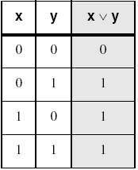
OR Instruction
Bitwise OR operation between each pair of matching bits
OR destination, source
Following operand combinations are allowed
OR reg, reg
OR reg, mem
OR reg, imm
OR mem, reg
OR mem, imm
OR instruction is
often used to
set selected bits
OR
Operands can be 8, 16, or 32 bits and they must be of the same size
0 0 1 1 1 0 1 1
OR
1 1 1 1 0 0 0 0
set
1 1 1 1 1 0 1 1
unchanged

Slide 6
Converting Characters to Lowercase
OR instruction can convert characters to lowercase
'A' = 0 1 0 0 0 0 0 1 'B' = 0 1 0 0 0 0 1 0
'a' = 0 1 1 0 0 0 0 1 'b' = 0 1 1 0 0 0 1 0
Solution: Use the OR instruction to set bit 5
mov ecx, LENGTHOF mystring
mov esi, OFFSET mystring
L1: or BYTE PTR [esi], 20h ; set bit 5
inc esi
loop L1

Slide 7
Converting Binary Digits to ASCII
OR instruction can convert a binary digit to ASCII
0 = 0 0 0 0 0 0 0 0 1 = 0 0 0 0 0 0 0 1
'0' = 0 0 1 1 0 0 0 0 '1' = 0 0 1 1 0 0 0 1
Solution: Use the OR instruction to set bits 4 and 5
or al,30h ; Convert binary digit 0 to 9 to ASCII
What if we want to convert an ASCII digit to binary?
Solution: Use the AND instruction to clear bits 4 to 7
and al,0Fh ; Convert ASCII '0' to '9' to binary

Slide 8
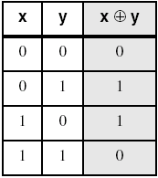
XOR Instruction
Bitwise XOR between each pair of matching bits
XOR destination, source
Following operand combinations are allowed
XOR reg, reg
XOR reg, mem
XOR reg, imm
XOR mem, reg
XOR mem, imm
XOR instruction is
often used to
invert selected bits
XOR
Operands can be 8, 16, or 32 bits and they must be of the same size
0 0 1 1 1 0 1 1
XOR
1 1 1 1 0 0 0 0
inverted
1 1 0 0 1 0 1 1
unchanged

Slide 9
Affected Status Flags
The six status flags are affected
Carry Flag: Cleared by AND, OR, and XOR
Overflow Flag: Cleared by AND, OR, and XOR
Sign Flag: Copy of the sign bit in result
Zero Flag: Set when result is zero
Parity Flag: Set when parity in least-significant byte is even
Auxiliary Flag: Undefined by AND, OR, and XOR

Slide 10
String Encryption Program
Tasks:
Input a message (string) from the user
Encrypt the message
Display the encrypted message
Decrypt the message
Display the decrypted message
Sample Output
Enter the plain text: Attack at dawn.
Cipher text: «¢¢Äîä-Ä¢-ïÄÿü-Gs
Decrypted: Attack at dawn.

Slide 11
Encrypting a String
KEY = 239 ; Can be any byte value
BUFMAX = 128
.data
buffer BYTE BUFMAX+1 DUP(0)
bufSize DWORD BUFMAX
The following loop uses the XOR instruction to transform every character in a string into a new value
mov ecx, bufSize ; loop counter
mov esi, 0 ; index 0 in buffer
L1:
xor buffer[esi], KEY ; translate a byte
inc esi ; point to next byte
loop L1

Slide 12
TEST Instruction
Bitwise AND operation between each pair of bits
TEST destination, source
The flags are affected similar to the AND Instruction
However, TEST does NOT modify the destination operand
TEST instruction can check several bits at once
Example: Test whether bit 0 or bit 3 is set in AL
Solution: test al, 00001001b ; test bits 0 & 3
We only need to check the zero flag
; If zero flag => both bits 0 and 3 are clear
; If Not zero => either bit 0 or 3 is set

Slide 13
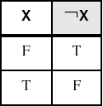
NOT Instruction
Inverts all the bits in a destination operand
NOT destination
Result is called the 1's complement
Destination can be a register or memory
NOT reg
NOT mem
None of the Flags is affected by the NOT instruction
NOT

Slide 14
CMP Instruction
CMP (Compare) instruction performs a subtraction
Syntax: CMP destination, source
Computes: destination – source
Destination operand is NOT modified
All six flags: OF, CF, SF, ZF, AF, and PF are affected
CMP uses the same operand combinations as SUB
Operands can be 8, 16, or 32 bits and must be of the same size
Examples: assume EAX = 5, EBX = 10, and ECX = 5
cmp eax, ebx
cmp eax, ecx
; OF=0, CF=1, SF=1, ZF=0
; OF=0, CF=0, SF=0, ZF=1

Slide 15
Unsigned Comparison
CMP can perform unsigned and signed comparisons
The destination and source operands can be unsigned or signed
For unsigned comparison, we examine ZF and CF flags
CMP does a subtraction and CF is the borrow flag
CF = 1 if and only if unsigned destination < unsigned source
Assume AL = 5 and BL = -1 = FFh
cmp al, bl ; Sets carry flag CF = 1
Unsigned Comparison | ZF | CF
unsigned destination < unsigned source |  | 1
unsigned destination > unsigned source | 0 | 0
destination = source | 1
To check for equality, it is enough to check ZF flag

Slide 16
Signed Comparison
For signed comparison, we examine SF, OF, and ZF
Recall for subtraction, the overflow flag is set when …
Operands have different signs and result sign ≠ destination sign
CMP AL, BL (consider the four cases shown below)
Signed Comparison | Flags
signed destination < signed source | SF ≠ OF
signed destination > signed source | SF = OF, ZF = 0
destination = source | ZF = 1
Case 1
AL = 80
BL = 50
OF = 0
SF = 0
AL > BL
Case 2
AL = -80
BL = -50
OF = 0
SF = 1
AL < BL
Case 3
AL = 80
BL = -50
OF = 1
SF = 1
AL > BL
Case 4
AL = -80
BL = 50
OF = 1
SF = 0
AL < BL

Slide 17
Next . . .
Boolean and Comparison Instructions
Conditional Jumps
Conditional Loop Instructions
Translating Conditional Structures
Indirect Jump and Table-Driven Selection
Application: Sorting an Integer Array

Slide 18
Conditional Structures
No high-level control structures in assembly language
Comparisons and conditional jumps are used to …
Implement conditional structures such as IF statements
Implement conditional loops
Types of Conditional Jump Instructions
Jumps based on specific flags
Jumps based on equality
Jumps based on unsigned comparisons
Jumps based on signed comparisons
Jumps based on the value of CX or ECX

Slide 19
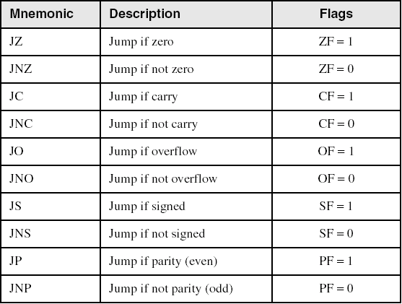
Jumps Based on Specific Flags
Conditional Jump Instruction has the following syntax:
Jcond destination ; cond is the jump condition
Destination
Destination Label
Prior to 386
Jump must be within –128 to +127 bytes from current location
IA-32
32-bit offset permits jump anywhere in memory

Slide 20
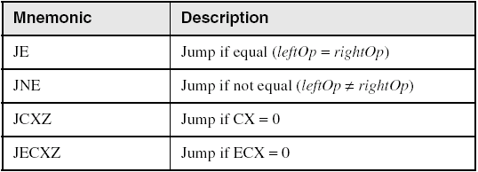
Jumps Based on Equality
JE is equivalent to JZ
JNE is equivalent to JNZ
JECXZ
Checked once at the beginning
Terminate a loop if ECX is zero
jecxz L2 ; exit loop
L1: . . . ; loop body
loop L1
L2:

Slide 21
Examples of Jump on Zero
Task: Check whether integer value in EAX is even
Solution: TEST whether the least significant bit is 0
If zero, then EAX is even, otherwise it is odd
Task: Jump to label L1 if bits 0, 1, and 3 in AL are all set
Solution:
test eax, 1 ; test bit 0 of eax
jz EvenVal ; jump if Zero flag is set
and al,00001011b ; clear bits except 0,1,3
cmp al,00001011b ; check bits 0,1,3
je L1 ; all set? jump to L1

Slide 22
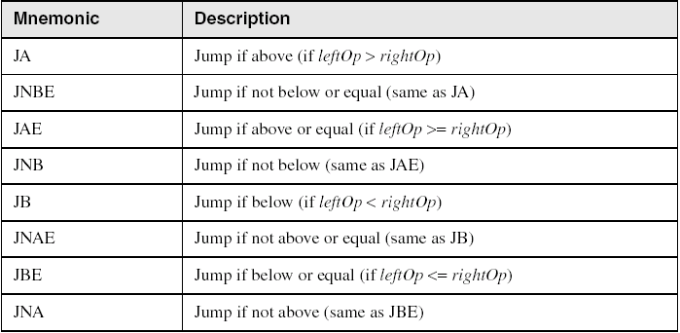
Jumps Based on Unsigned Comparison
Task: Jump to a label if unsigned EAX is less than EBX
Solution:
cmp eax, ebx
jb IsBelow
JB condition
CF = 1

Slide 23
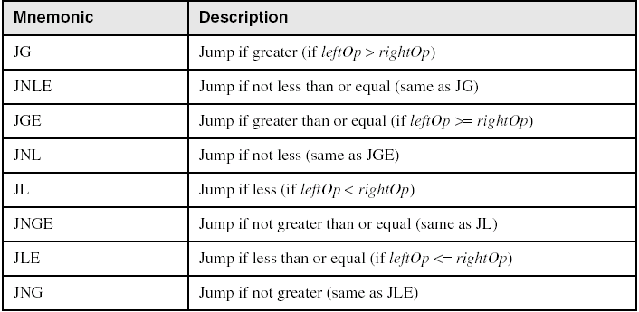
Jumps Based on Signed Comparisons
Task: Jump to a label if signed EAX is less than EBX
Solution:
cmp eax, ebx
jl IsLess
JL condition
OF ≠ SF

Slide 24
Compare and Jump Examples
Jump to L1 if unsigned EAX is greater than Var1
Solution:
cmp eax, Var1
ja L1
JA condition
CF = 0, ZF = 0
Jump to L1 if signed EAX is greater than Var1
Solution:
cmp eax, Var1
jg L1
JG condition
OF = SF, ZF = 0
Jump to L1 if signed EAX is greater than or equal to Var1
Solution:
cmp eax, Var1
jge L1
JGE condition
OF = SF

Slide 25
Computing the Max and Min
Compute the Max of unsigned EAX and EBX
Solution:
mov Max, eax ; assume Max = eax
cmp Max, ebx
jae done
mov Max, ebx ; Max = ebx
done:
Compute the Min of signed EAX and EBX
Solution:
mov Min, eax ; assume Min = eax
cmp Min, ebx
jle done
mov Min, ebx ; Min = ebx
done:

Slide 26
Application: Sequential Search
; Receives: esi = array address
; ecx = array size
; eax = search value
; Returns: esi = address of found element
search PROC USES ecx
jecxz notfound
L1:
cmp [esi], eax ; array element = search value?
je found ; yes? found element
add esi, 4 ; no? point to next array element
loop L1
notfound:
mov esi, -1 ; if not found then esi = -1
found:
ret ; if found, esi = element address
search ENDP

Slide 27
BT Instruction
BT = Bit Test Instruction
Syntax:
BT r/m16, r16
BT r/m32, r32
BT r/m16, imm8
BT r/m32, imm8
Copies bit n from an operand into the Carry flag
Example: jump to label L1 if bit 9 is set in AX register
bt AX, 9 ; CF = bit 9
jc L1 ; jump if Carry to L1

Slide 28
Next . . .
Boolean and Comparison Instructions
Conditional Jumps
Conditional Loop Instructions
Translating Conditional Structures
Indirect Jump and Table-Driven Selection
Application: Sorting an Integer Array

Slide 29
LOOPE and LOOPZ
Syntax:
LOOPE destination
LOOPZ destination
Logic:
ECX ← ECX – 1
if ECX > 0 and ZF=1, jump to destination
Useful when scanning an array for the first element that does not match a given value.

Slide 30
LOOPNE and LOOPNZ
Syntax:
LOOPNE destination
LOOPNZ destination
Logic:
ECX ← ECX – 1;
if ECX > 0 and ZF=0, jump to destination
Useful when scanning an array for the first element that matches a given value.

Slide 31
LOOPZ Example
The following code finds the first negative value in an array
.data
array SWORD 17,10,30,40,4,-5,8
.code
mov esi, OFFSET array – 2 ; start before first
mov ecx, LENGTHOF array ; loop counter
L1:
add esi, 2 ; point to next element
test WORD PTR [esi], 8000h ; test sign bit
loopz L1 ; ZF = 1 if value >= 0
jnz found ; found negative value
notfound:
. . . ; ESI points to last array element
found:
. . . ; ESI points to first negative value

Slide 32
Your Turn . . .
Locate the first zero value in an array
If none is found, let ESI be initialized to -1
.data
array SWORD -3,7,20,-50,10,0,40,4
.code
mov esi, OFFSET array – 2 ; start before first
mov ecx, LENGTHOF array ; loop counter
L1:
add esi, 2 ; point to next element
cmp WORD PTR [esi], 0 ; check for zero
loopne L1 ; continue if not zero
JE Found
MOV ESI, -1
Found:

Slide 33
Next . . .
Boolean and Comparison Instructions
Conditional Jumps
Conditional Loop Instructions
Translating Conditional Structures
Indirect Jump and Table-Driven Selection
Application: Sorting an Integer Array

Slide 34
Block-Structured IF Statements
IF statement in high-level languages (such as C or Java)
Boolean expression (evaluates to true or false)
List of statements performed when the expression is true
Optional list of statements performed when expression is false
Task: Translate IF statements into assembly language
Example:
mov eax,var1
cmp eax,var2
jne elsepart
mov X,1
jmp next
elsepart:
mov X,2
next:
if( var1 == var2 )
X = 1;
else
X = 2;

Slide 35
Your Turn . . .
Translate the IF statement to assembly language
All values are unsigned
if( ebx <= ecx )
{
eax = 5;
edx = 6;
}
cmp ebx,ecx
ja next
mov eax,5
mov edx,6
next:
There can be multiple correct solutions

Slide 36
Your Turn . . .
Implement the following IF in assembly language
All variables are 32-bit signed integers
if (var1 <= var2) {
var3 = 10;
}
else {
var3 = 6;
var4 = 7;
}
mov eax,var1
cmp eax,var2
jle ifpart
mov var3,6
mov var4,7
jmp next
ifpart: mov var3,10
next:
There can be multiple correct solutions

Slide 37
Compound Expression with AND
HLLs use short-circuit evaluation for logical AND
If first expression is false, second expression is skipped
if ((al > bl) && (bl > cl)) {X = 1;}
; One Possible Implementation ...
cmp al, bl ; first expression ...
ja L1 ; unsigned comparison
jmp next
L1: cmp bl,cl ; second expression ...
ja L2 ; unsigned comparison
jmp next
L2: mov X,1 ; both are true
next:

Slide 38
Better Implementation for AND
if ((al > bl) && (bl > cl)) {X = 1;}
The following implementation uses less code
By reversing the relational operator, We allow the program to fall through to the second expression
Number of instructions is reduced from 7 to 5
cmp al,bl ; first expression...
jbe next ; quit if false
cmp bl,cl ; second expression...
jbe next ; quit if false
mov X,1 ; both are true
next:

Slide 39
Your Turn . . .
Implement the following IF in assembly language
All values are unsigned
if ((ebx <= ecx) &&
(ecx > edx))
{
eax = 5;
edx = 6;
}
cmp ebx,ecx
ja next
cmp ecx,edx
jbe next
mov eax,5
mov edx,6
next:

Slide 40
Application: IsDigit Procedure
Receives a character in AL
Sets the Zero flag if the character is a decimal digit
if (al >= '0' && al <= '9') {ZF = 1;}
IsDigit PROC
cmp al,'0' ; AL < '0' ?
jb L1 ; yes? ZF=0, return
cmp al,'9' ; AL > '9' ?
ja L1 ; yes? ZF=0, return
test al, 0 ; ZF = 1
L1: ret
IsDigit ENDP

Slide 41
Compound Expression with OR
HLLs use short-circuit evaluation for logical OR
If first expression is true, second expression is skipped
Use fall-through to keep the code as short as possible
if ((al > bl) || (bl > cl)) {X = 1;}
cmp al,bl ; is AL > BL?
ja L1 ; yes, execute if part
cmp bl,cl ; no: is BL > CL?
jbe next ; no: skip if part
L1: mov X,1 ; set X to 1
next:

Slide 42
WHILE Loops
A WHILE loop can be viewed as
IF statement followed by
The body of the loop, followed by
Unconditional jump to the top of the loop
while( eax < ebx) { eax = eax + 1; }
This is a possible implementation:
top: cmp eax,ebx ; eax < ebx ?
jae next ; false? then exit loop
inc eax ; body of loop
jmp top ; repeat the loop
next:

Slide 43
Your Turn . . .
Implement the following loop, assuming unsigned integers
while (ebx <= var1) {
ebx = ebx + 5;
var1 = var1 - 1
}
top: cmp ebx,var1 ; ebx <= var1?
ja next ; false? exit loop
add ebx,5 ; execute body of loop
dec var1
jmp top ; repeat the loop
next:

Slide 44
Yet Another Solution for While
Check the loop condition at the end of the loop
No need for JMP, loop body is reduced by 1 instruction
while (ebx <= var1) {
ebx = ebx + 5;
var1 = var1 - 1
}
cmp ebx,var1 ; ebx <= var1?
ja next ; false? exit loop
top: add ebx,5 ; execute body of loop
dec var1
cmp ebx, var1 ; ebx <= var1?
jbe top ; true? repeat the loop
next:

Slide 45
Next . . .
Boolean and Comparison Instructions
Conditional Jumps
Conditional Loop Instructions
Translating Conditional Structures
Indirect Jump and Table-Driven Selection
Application: Sorting an Integer Array

Slide 46
Indirect Jump
Direct Jump: Jump to a Labeled Destination
Destination address is a constant
Address is encoded in the jump instruction
Address is an offset relative to EIP (Instruction Pointer)
Indirect jump
Destination address is a variable or register
Address is stored in memory/register
Address is absolute
Syntax: JMP mem32/reg32
32-bit absolute address is stored in mem32/reg32 for FLAT memory
Indirect jump is used to implement switch statements

Slide 47
Switch Statement
Consider the following switch statement:
Switch (ch) {
case '0': exit();
case '1': count++; break;
case '2': count--; break;
case '3': count += 5; break;
case '4': count -= 5; break;
default : count = 0;
}
How to translate above statement into assembly code?
We can use a sequence of compares and jumps
A better solution is to use the indirect jump

Slide 48
Implementing the Switch Statement
case0:
exit
case1:
inc count
jmp exitswitch
case2:
dec count
jmp exitswitch
case3:
add count, 5
jmp exitswitch
case4:
sub count, 5
jmp exitswitch
default:
mov count, 0
exitswitch:
There are many case labels. How to jump to the correct one?
Answer: Define a jump table and use indirect jump to jump to the correct label

Slide 49
Jump Table and Indirect Jump
Jump Table is an array of double words
Contains the case labels of the switch statement
Can be defined inside the same procedure of switch statement
jumptable DWORD case0,
case1,
case2,
case3,
case4
Indirect jump uses jump table to jump to selected label
movzx eax, ch ; move ch to eax
sub eax, '0' ; convert ch to a number
cmp eax, 4 ; eax > 4 ?
ja default ; default case
jmp jumptable[eax*4] ; Indirect jump
Assembler converts labels to addresses

Slide 50
Next . . .
Boolean and Comparison Instructions
Conditional Jumps
Conditional Loop Instructions
Translating Conditional Structures
Indirect Jump and Table-Driven Selection
Application: Sorting an Integer Array

Slide 51
Bubble Sort
Consider sorting an array of 5 elements: 5 1 3 2 4
First Pass (4 comparisons) 5 1 3 2 4
Compare 5 with 1 and swap: 1 5 3 2 4 (swap)
Compare 5 with 3 and swap: 1 3 5 2 4 (swap)
Compare 5 with 2 and swap: 1 3 2 5 4 (swap)
Compare 5 with 4 and swap: 1 3 2 4 5 (swap)
Second Pass (3 comparisons)
Compare 1 with 3 (No swap): 1 3 2 4 5 (no swap)
Compare 3 with 2 and swap: 1 2 3 4 5 (swap)
Compare 3 with 4 (No swap): 1 2 3 4 5 (no swap)
Third Pass (2 comparisons)
Compare 1 with 2 (No swap): 1 2 3 4 5 (no swap)
Compare 2 with 3 (No swap): 1 2 3 4 5 (no swap)
No swapping during 3rd pass ⇒ array is now sorted
largest

Slide 52
Bubble Sort Algorithm
Algorithm: Sort array of given size
bubbleSort(array, size) {
comparisons = size
do {
comparisons--;
sorted = true; // assume initially
for (i = 0; i<comparisons; i++) {
if (array[i] > array[i+1]) {
swap(array[i], array[i+1]);
sorted = false;
}
}
} while (! sorted)
}

Slide 53
Bubble Sort Procedure – Slide 1 of 2
;---------------------------------------------------
; bubbleSort: Sorts a DWORD array in ascending order
; Uses the bubble sort algorithm
; Receives: ESI = Array Address
; ECX = Array Length
; Returns: Array is sorted in place
;---------------------------------------------------
bubbleSort PROC USES eax ecx edx
outerloop:
dec ECX ; ECX = comparisons
jz sortdone ; if ECX == 0 then we are done
mov EDX, 1 ; EDX = sorted = 1 (true)
push ECX ; save ECX = comparisons
push ESI ; save ESI = array address

Slide 54
Bubble Sort Procedure – Slide 2 of 2
innerloop:
mov EAX,[ESI]
cmp EAX,[ESI+4] ; compare [ESI] and [ESI+4]
jle increment ; [ESI]<=[ESI+4]? don’t swap
xchg EAX,[ESI+4] ; swap [ESI] and [ESI+4]
mov [ESI],EAX
mov EDX,0 ; EDX = sorted = 0 (false)
increment:
add ESI,4 ; point to next element
loop innerloop ; end of inner loop
pop ESI ; restore ESI = array address
pop ECX ; restore ECX = comparisons
cmp EDX,1 ; sorted == 1?
jne outerloop ; No? loop back
sortdone:
ret ; return
bubbleSort ENDP

Slide 55
Summary
Bitwise instructions (AND, OR, XOR, NOT, TEST)
Manipulate individual bits in operands
CMP: compares operands using implied subtraction
Sets condition flags for later conditional jumps and loops
Conditional Jumps & Loops
Flag values: JZ, JNZ, JC, JNC, JO, JNO, JS, JNS, JP, JNP
Equality: JE(JZ), JNE (JNZ), JCXZ, JECXZ
Signed: JG (JNLE), JGE (JNL), JL (JNGE), JLE (JNG)
Unsigned: JA (JNBE), JAE (JNB), JB (JNAE), JBE (JNA)
LOOPZ (LOOPE), LOOPNZ (LOOPNE)
Indirect Jump and Jump Table

