Slide 1
Data Representation
COE 205
Computer Organization and Assembly Language
Dr. Aiman El-Maleh
College of Computer Sciences and Engineering
King Fahd University of Petroleum and Minerals
[Adapted from slides of Dr. Kip Irvine: Assembly Language for Intel-Based Computers]

Slide 2
Outline
Introduction
Numbering Systems
Binary & Hexadecimal Numbers
Base Conversions
Integer Storage Sizes
Binary and Hexadecimal Addition
Signed Integers and 2's Complement Notation
Binary and Hexadecimal subtraction
Carry and Overflow
Character Storage

Slide 3
Introduction
Computers only deal with binary data (0s and 1s), hence all data manipulated by computers must be represented in binary format.
Machine instructions manipulate many different forms of data:
Numbers:
Integers: 33, +128, -2827
Real numbers: 1.33, +9.55609, -6.76E12, +4.33E-03
Alphanumeric characters (letters, numbers, signs, control characters): examples: A, a, c, 1 ,3, ", +, Ctrl, Shift, etc.
Images (still or moving): Usually represented by numbers representing the Red, Green and Blue (RGB) colors of each pixel in an image,
Sounds: Numbers representing sound amplitudes sampled at a certain rate (usually 20kHz).
So in general we have two major data types that need to be represented in computers; numbers and characters.

Slide 4
Numbering Systems
Numbering systems are characterized by their base number.
In general a numbering system with a base r will have r different digits (including the 0) in its number set. These digits will range from 0 to r-1
The most widely used numbering systems are listed in the table below:

Slide 5
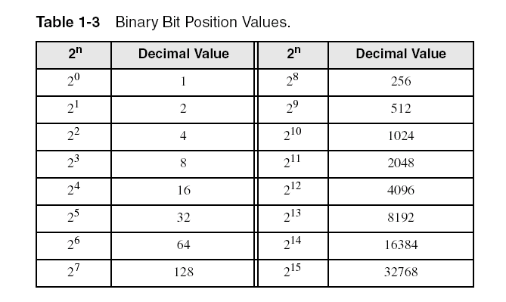
Binary Numbers
Each digit (bit) is either 1 or 0
Each bit represents a power of 2
Every binary number is a sum of powers of 2

Slide 6
Converting Binary to Decimal
Weighted positional notation shows how to calculate the decimal value of each binary bit:
Decimal = (d_{n-1} × 2^{n-1}) + (d_{n-2} × 2^{n-2}) + ... + (d₁ × 2¹) + (d₀ × 2⁰)
d = binary digit
binary 10101001 = decimal 169:
(1 × 2⁷) + (1 × 2⁵) + (1 × 2³) + (1 × 2⁰) = 128+32+8+1=169

Slide 7
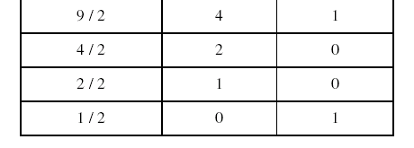
Convert Unsigned Decimal to Binary
Repeatedly divide the decimal integer by 2. Each remainder is a binary digit in the translated value:
least significant bit
most significant bit
37 = 100101
stop when quotient is zero

Slide 8
Another Procedure for Converting from Decimal to Binary
Start with a binary representation of all 0’s
Determine the highest possible power of two that is less or equal to the number.
Put a 1 in the bit position corresponding to the highest power of two found above.
Subtract the highest power of two found above from the number.
Repeat the process for the remaining number

Slide 9
Another Procedure for Converting from Decimal to Binary
Example: Converting 76d to Binary
The highest power of 2 less or equal to 76 is 64, hence the seventh (MSB) bit is 1
Subtracting 64 from 76 we get 12.
The highest power of 2 less or equal to 12 is 8, hence the fourth bit position is 1
We subtract 8 from 12 and get 4.
The highest power of 2 less or equal to 4 is 4, hence the third bit position is 1
Subtracting 4 from 4 yield a zero, hence all the left bits are set to 0 to yield the final answer

Slide 10
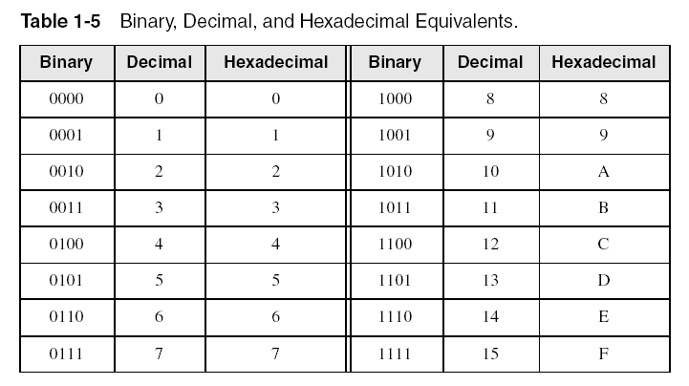
Hexadecimal Integers
Binary values are represented in hexadecimal.

Slide 11
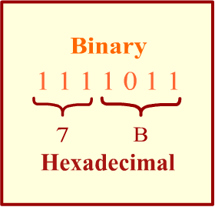
Converting Binary to Hexadecimal
Each hexadecimal digit corresponds to 4 binary bits.
Example: Translate the binary integer 000101101010011110010100 to hexadecimal

Slide 12
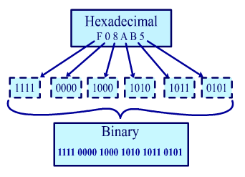
Converting Hexadecimal to Binary
Each Hexadecimal digit can be replaced by its 4-bit binary number to form the binary equivalent.

Slide 13
Converting Hexadecimal to Decimal
Multiply each digit by its corresponding power of 16:
Decimal = (d3 × 16³) + (d2 × 16²) + (d1 × 16¹) + (d0 × 16⁰)
d = hexadecimal digit
Examples:
Hex 1234 = (1 × 16³) + (2 × 16²) + (3 × 16¹) + (4 × 16⁰) =
Decimal 4,660
Hex 3BA4 = (3 × 16³) + (11 * 16²) + (10 × 16¹) + (4 × 16⁰) =
Decimal 15,268

Slide 14
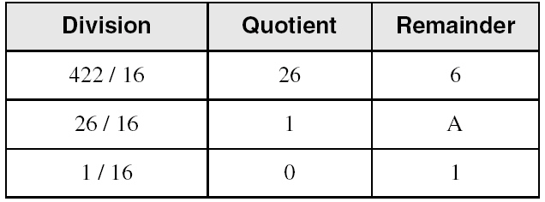
Converting Decimal to Hexadecimal
Repeatedly divide the decimal integer by 16. Each remainder is a hex digit in the translated value:
least significant digit
most significant digit
stop when quotient is zero
Decimal 422 = 1A6 hexadecimal

Slide 15
Integer Storage Sizes
Standard sizes:
What is the largest unsigned integer that may be stored in 20 bits?

Slide 16
Binary Addition
Start with the least significant bit (rightmost bit)
Add each pair of bits
Include the carry in the addition, if present
carry:
1
0
0
0
0
0
1
0
0
(4)
+
0
0
0
0
0
1
1
1
(7)
0
0
0
0
1
0
1
1
(11)
bit position:
7
6
5
4
3
2
1
0

Slide 17
Hexadecimal Addition
Divide the sum of two digits by the number base (16). The quotient becomes the carry value, and the remainder is the sum digit.
1
1
36 28 28 6A
42 45 58 4B
78 6D 80 B5
21 / 16 = 1, remainder 5
Important skill: Programmers frequently add and subtract the addresses of variables and instructions.

Slide 18
Signed Integers
Several ways to represent a signed number
Sign-Magnitude
1's complement
2's complement
Divide the range of values into 2 equal parts
First part corresponds to the positive numbers (≥ 0)
Second part correspond to the negative numbers (< 0)
Focus will be on the 2's complement representation
Has many advantages over other representations
Used widely in processors to represent signed integers

Slide 19
Two's Complement Representation
Positive numbers
Signed value = Unsigned value
Negative numbers
Signed value = Unsigned value - 2^{n}
n = number of bits
Negative weight for MSB
Another way to obtain the signed value is to assign a negative weight to most-significant bit
= -128 + 32 + 16 + 4 = -76
8-bit Binary value | Unsigned value | Signed value
00000000 | 0 | 0
00000001 | 1 | +1
00000010 | 2 | +2
. . . | . . . | . . .
01111110 | 126 | +126
01111111 | 127 | +127
10000000 | 128 | -128
10000001 | 129 | -127
. . . | . . . | . . .
11111110 | 254 | -2
11111111 | 255 | -1
1
0
1
1
0
1
0
0
-128
64
32
16
8
4
2
1

Slide 20
Forming the Two's Complement
starting value | 00100100 = +36
step1: reverse the bits (1's complement) | 11011011
step 2: add 1 to the value from step 1 | + 1
sum = 2's complement representation | 11011100 = -36
Sum of an integer and its 2's complement must be zero:
00100100 + 11011100 = 00000000 (8-bit sum) ⇒ Ignore Carry
The easiest way to obtain the 2's complement of a binary number is by starting at the LSB, leaving all the 0s unchanged, look for the first occurrence of a 1. Leave this 1 unchanged and complement all the bits after it.

Slide 21
Sign Bit
Highest bit indicates the sign. 1 = negative, 0 = positive
If highest digit of a hexadecimal is > 7, the value is negative
Examples: 8A and C5 are negative bytes
A21F and 9D03 are negative words
B1C42A00 is a negative double-word

Slide 22
Sign Extension
Step 1: Move the number into the lower-significant bits
Step 2: Fill all the remaining higher bits with the sign bit
This will ensure that both magnitude and sign are correct
Examples
Sign-Extend 10110011 to 16 bits
Sign-Extend 01100010 to 16 bits
Infinite 0s can be added to the left of a positive number
Infinite 1s can be added to the left of a negative number
10110011 = -77
11111111 10110011 = -77
01100010 = +98
00000000 01100010 = +98

Slide 23
Two's Complement of a Hexadecimal
To form the two's complement of a hexadecimal
Subtract each hexadecimal digit from 15
Add 1
Examples:
2's complement of 6A3D = 95C3
2's complement of 92F0 = 6D10
2's complement of FFFF = 0001
No need to convert hexadecimal to binary

Slide 24
Two's Complement of a Hexadecimal
Start at the least significant digit, leaving all the 0s unchanged, look for the first occurrence of a non-zero digit.
Subtract this digit from 16.
Then subtract all remaining digits from 15.
Examples:
2's complement of 6A3D = 95C3
2's complement of 92F0 = 6D10
2's complement of FFFF = 0001
F F F 16
6 A 3 D
--------------
9 5 C 3
F F 16
9 2 F 0
--------------
6 D 1 0

Slide 25
Binary Subtraction
When subtracting A – B, convert B to its 2's complement
Add A to (–B)
0 0 0 0 1 1 0 0 0 0 0 0 1 1 0 0
0 0 0 0 0 0 1 0 1 1 1 1 1 1 1 0 (2's complement)
0 0 0 0 1 0 1 0 0 0 0 0 1 0 1 0 (same result)
Carry is ignored, because
Negative number is sign-extended with 1's
You can imagine infinite 1's to the left of a negative number
Adding the carry to the extended 1's produces extended zeros
–
+
Practice: Subtract 00100101 from 01101001.

Slide 26
Hexadecimal Subtraction
When a borrow is required from the digit to the left, add 16 (decimal) to the current digit's value
Last Carry is ignored
16 + 5 = 21
-1
1
1
C675
A247
242E
C675
5DB9 (2's complement)
242E (same result)
-
+
Practice: The address of var1 is 00400B20. The address of the next variable after var1 is 0040A06C. How many bytes are used by var1?

Slide 27
Ranges of Signed Integers
The unsigned range is divided into two signed ranges for positive and negative numbers
Practice: What is the range of signed values that may be stored in 20 bits?

Slide 28
Carry and Overflow
Carry is important when …
Adding or subtracting unsigned integers
Indicates that the unsigned sum is out of range
Either < 0 or > maximum unsigned n-bit value
Overflow is important when …
Adding or subtracting signed integers
Indicates that the signed sum is out of range
Overflow occurs when
Adding two positive numbers and the sum is negative
Adding two negative numbers and the sum is positive
Can happen because of the fixed number of sum bits

Slide 29
Carry and Overflow Examples
We can have carry without overflow and vice-versa
Four cases are possible
1
1
1
1
1
1
0
0
0
0
1
1
1
1
15
0
0
0
0
1
1
1
1
15
+
+
0
0
0
0
1
0
0
0
8
1
1
1
1
1
0
0
0
245 (-8)
0
0
0
1
0
1
1
1
23
0
0
0
0
0
1
1
1
7
Carry = 0 Overflow = 0
Carry = 1 Overflow = 0
1
1
1
1
0
1
0
0
1
1
1
1
79
1
1
0
1
1
0
1
0
218 (-38)
+
+
0
1
0
0
0
0
0
0
64
1
0
0
1
1
1
0
1
157 (-99)
1
0
0
0
1
1
1
1
143
(-113)
0
1
1
1
0
1
1
1
119
Carry = 0 Overflow = 1
Carry = 1 Overflow = 1

Slide 30
Character Storage
Character sets
Standard ASCII: 7-bit character codes (0 – 127)
Extended ASCII: 8-bit character codes (0 – 255)
Unicode: 16-bit character codes (0 – 65,535)
Unicode standard represents a universal character set
Defines codes for characters used in all major languages
Used in Windows-XP: each character is encoded as 16 bits
UTF-8: variable-length encoding used in HTML
Encodes all Unicode characters
Uses 1 byte for ASCII, but multiple bytes for other characters
Null-terminated String
Array of characters followed by a NULL character

Slide 31
ASCII Codes
Examples:
ASCII code for space character = 20 (hex) = 32 (decimal)
ASCII code for ‘A' = 41 (hex) = 65 (decimal)
ASCII code for 'a' = 61 (hex) = 97 (decimal)

Slide 32
Control Characters
The first 32 characters of ASCII table are used for control
Control character codes = 00 to 1F (hex)
Examples of Control Characters
Character 0 is the NULL character ⇒ used to terminate a string
Character 9 is the Horizontal Tab (HT) character
Character 0A (hex) = 10 (decimal) is the Line Feed (LF)
Character 0D (hex) = 13 (decimal) is the Carriage Return (CR)
The LF and CR characters are used together
They advance the cursor to the beginning of next line
One control character appears at end of ASCII table
Character 7F (hex) is the Delete (DEL) character

Slide 33
Parity Bit
Data errors can occur during data transmission or storage/retrieval.
The 8th bit in the ASCII code is used for error checking.
This bit is usually referred to as the parity bit.
There are two ways for error checking:
Even Parity: Where the 8th bit is set such that the total number of 1s in the 8-bit code word is even.
Odd Parity: The 8th bit is set such that the total number of 1s in the 8-bit code word is odd.

