Slide 1
Basic Concepts
COE 205
Computer Organization and Assembly Language
Dr. Aiman El-Maleh
College of Computer Sciences and Engineering
King Fahd University of Petroleum and Minerals
[Adapted from slides of Dr. Kip Irvine: Assembly Language for Intel-Based Computers]

Slide 2
Outline
Welcome to COE 205
Assembly-, Machine-, and High-Level Languages
Assembly Language Programming Tools
Programmer’s View of a Computer System
Basic Computer Organization

Slide 3
Welcome to COE 205
Assembly language programming
Basics of computer organization
CPU design
Software Tools
Microsoft Macro Assembler (MASM) version 6.15
Link Libraries provided by Author (Irvine32.lib and Irivine16.lib)
Microsoft Windows debugger
ConTEXT Editor

Slide 4
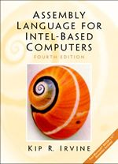
Textbook
Kip Irvine: Assembly Language for Intel-Based Computers
4th edition (2003)
5th edition (2007)

Slide 5
Course Objectives
After successfully completing the course, students will be able to:
Describe the basic components of a computer system, its instruction set architecture and its basic fetch-execute cycle operation.
Describe how data is represented in a computer and recognize when overflow occurs.
Recognize the basics of assembly language programming including addressing modes.
Analyze, design, implement, and test assembly language programs.
Recognize, analyze, and design the basic components of a simple CPU including datapath and control unit design alternatives.

Slide 6
Course Learning Outcomes
Ability to analyze, design, implement, and test assembly language programs.
Ability to use tools and skills in analyzing and debugging assembly language programs.
Ability to design the datapath and control unit of a simple CPU.
Ability to demonstrate self-learning capability.
Ability to work in a team.

Slide 7
Required Background
The student should already be able to program confidently in at least one high-level programming language, such as Java or C.
Prerequisite
COE 202: Fundamentals of computer engineering
ICS 102: Introduction to computing
Only students with computer engineering major should be registered in this course.

Slide 8
Grading Policy
Discussions & Reflections 5%
Programming Assignments 10%
Quizzes 10%
Exam I 15% (Sat. Oct. 30, 2010)
Exam II 20% (Sat. Dec. 18, 2010)
Laboratory 20%
Final 20%
Attendance will be taken regularly.
3 Absences result in -0.5.
Excuses for officially authorized absences must be presented no later than one week following resumption of class attendance.
Late assignments will be accepted but you will be penalized 10% per each late day.
A student caught cheating in any of the assignments will get 0 out of 10%.
No makeup will be made for missing Quizzes or Exams.

Slide 9
Course Topics
Introduction and Information Representation: 7 lectures Introduction to computer organization. Instruction Set Architecture. Computer Components. Fetch-Execute cycle. Signed number representation ranges. Overflow.
Assembly Language Concepts: 7 lectures Assembly language format. Directives vs. instructions. Constants and variables. I/O. INT 21H. Addressing modes.
8086 Assembly Language Programming: 19 lectures Register set. Memory segmentation. MOV instructions. Arithmetic instructions and flags (ADD, ADC, SUB, SBB, INC, DEC, MUL, IMUL, DIV, IDIV). Compare, Jump and loop (CMP, JMP, Cond. jumps, LOOP). Logic, shift and rotate. Stack operations. Subprograms. Macros. I/O (IN, OUT). String instructions. Interrupts and interrupt processing, INT and IRET.

Slide 10
Course Topics
CPU Design: 12 lectures Register transfer. Data-path design. 1-bus, 2-bus and 3-bus CPU organization. Fetch and execute phases of instruction processing. Performance consideration. Control steps. CPU-Memory interface circuit. Hardwired control unit design. Microprogramming. Horizontal and Vertical microprogramming. Microprogrammed control unit design.

Slide 11
Next …
Welcome to COE 205
Assembly-, Machine-, and High-Level Languages
Assembly Language Programming Tools
Programmer’s View of a Computer System
Basic Computer Organization

Slide 12
Some Important Questions to Ask
What is Assembly Language?
Why Learn Assembly Language?
What is Machine Language?
How is Assembly related to Machine Language?
What is an Assembler?
How is Assembly related to High-Level Language?
Is Assembly Language portable?

Slide 13
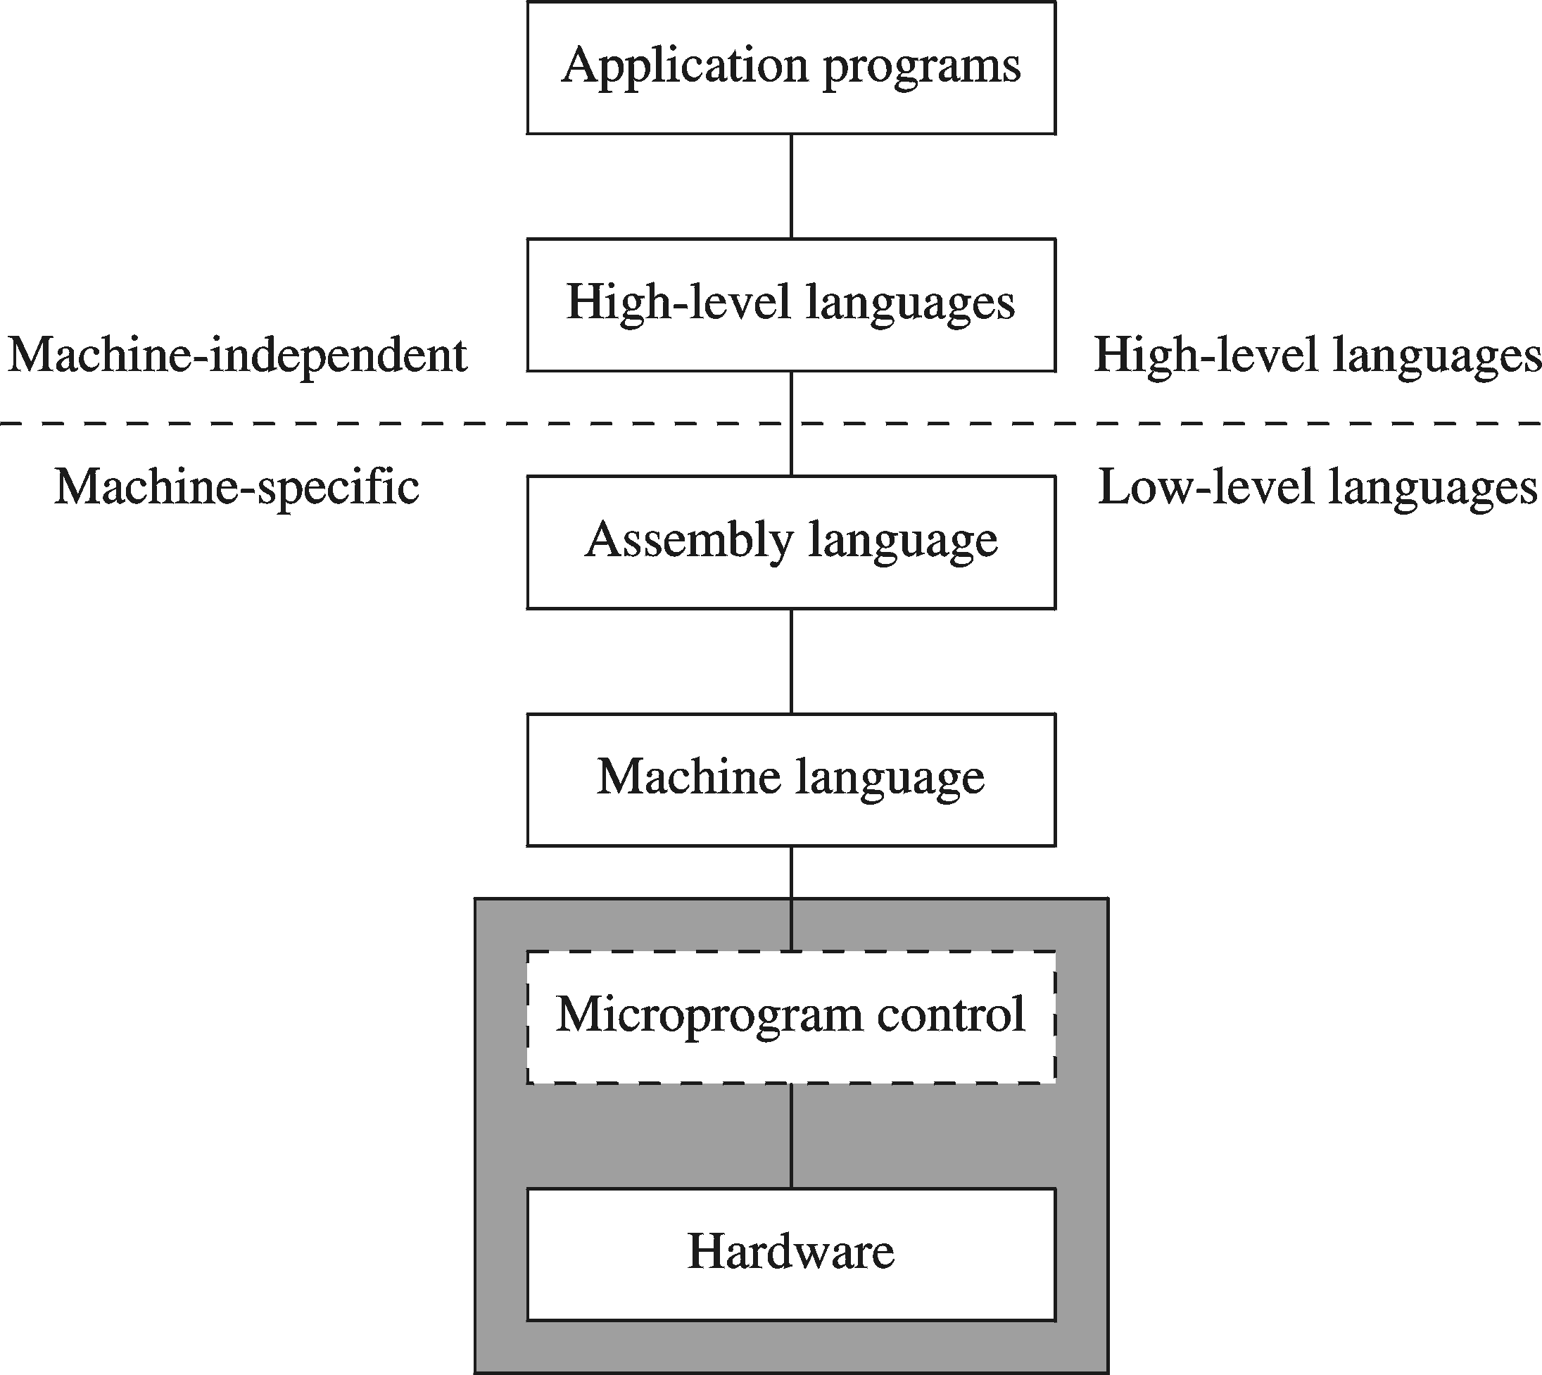
A Hierarchy of Languages

Slide 14
Assembly and Machine Language
Machine language
Native to a processor: executed directly by hardware
Instructions consist of binary code: 1s and 0s
Assembly language
A programming language that uses symbolic names to represent operations, registers and memory locations.
Slightly higher-level language
Readability of instructions is better than machine language
One-to-one correspondence with machine language instructions
Assemblers translate assembly to machine code
Compilers translate high-level programs to machine code
Either directly, or
Indirectly via an assembler

Slide 15
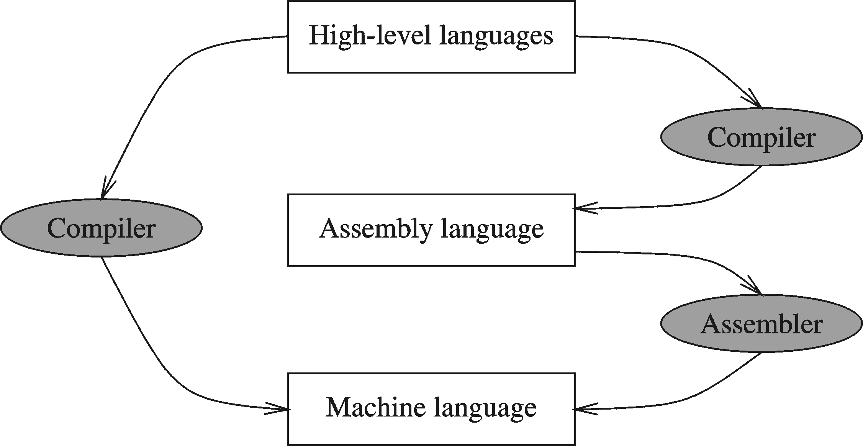
Compiler and Assembler

Slide 16
Instructions and Machine Language
Each command of a program is called an instruction (it instructs the computer what to do).
Computers only deal with binary data, hence the instructions must be in binary format (0s and 1s) .
The set of all instructions (in binary form) makes up the computer's machine language. This is also referred to as the instruction set.

Slide 17
Instruction Fields
Machine language instructions usually are made up of several fields. Each field specifies different information for the computer. The major two fields are:
Opcode field which stands for operation code and it specifies the particular operation that is to be performed.
Each operation has its unique opcode.
Operands fields which specify where to get the source and destination operands for the operation specified by the opcode.
The source/destination of operands can be a constant, the memory or one of the general-purpose registers.

Slide 18
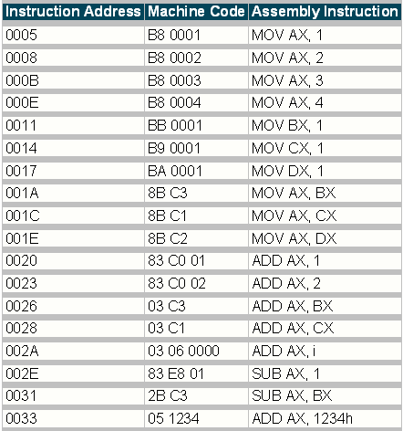
Assembly vs. Machine Code

Slide 19
Translating Languages
English: D is assigned the sum of A times B plus 10.
High-Level Language: D = A * B + 10
A statement in a high-level language is translated typically into several machine-level instructions
Intel Assembly Language:
mov eax, A
mul B
add eax, 10
mov D, eax
Intel Machine Language:
A1 00404000
F7 25 00404004
83 C0 0A
A3 00404008

Slide 20
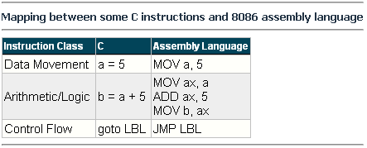
Mapping Between Assembly Language and HLL
Translating HLL programs to machine language programs is not a one-to-one mapping
A HLL instruction (usually called a statement) will be translated to one or more machine language instructions

Slide 21
Advantages of High-Level Languages
Program development is faster
High-level statements: fewer instructions to code
Program maintenance is easier
For the same above reasons
Programs are portable
Contain few machine-dependent details
Can be used with little or no modifications on different machines
Compiler translates to the target machine language
However, Assembly language programs are not portable

Slide 22
Why Learn Assembly Language?
Accessibility to system hardware
Assembly Language is useful for implementing system software
Also useful for small embedded system applications
Space and Time efficiency
Understanding sources of program inefficiency
Tuning program performance
Writing compact code
Writing assembly programs gives the computer designer the needed deep understanding of the instruction set and how to design one
To be able to write compilers for HLLs, we need to be expert with the machine language. Assembly programming provides this experience

Slide 23
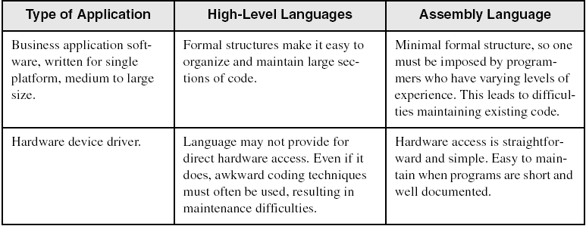
Assembly vs. High-Level Languages
Some representative types of applications:

Slide 24
Next …
Welcome to COE 205
Assembly-, Machine-, and High-Level Languages
Assembly Language Programming Tools
Programmer’s View of a Computer System
Basic Computer Organization

Slide 25
Assembler
Software tools are needed for editing, assembling, linking, and debugging assembly language programs
An assembler is a program that converts source-code programs written in assembly language into object files in machine language
Popular assemblers have emerged over the years for the Intel family of processors. These include …
TASM (Turbo Assembler from Borland)
NASM (Netwide Assembler for both Windows and Linux), and
GNU assembler distributed by the free software foundation
We will use MASM (Macro Assembler from Microsoft)

Slide 26
Linker and Link Libraries
You need a linker program to produce executable files
It combines your program's object file created by the assembler with other object files and link libraries, and produces a single executable program
LINK32.EXE is the linker program provided with the MASM distribution for linking 32-bit programs
We will also use a link library for input and output
Called Irvine32.lib developed by Kip Irvine
Works in Win32 console mode under MS-Windows

Slide 27
Assemble and Link Process
Source
File
Assembler
Object
File
Source
File
Assembler
Object
File
Linker
Executable
File
Source
File
Assembler
Object
File
Link
Libraries
A project may consist of multiple source files
Assembler translates each source file separately into an object file
Linker links all object files together with link libraries

Slide 28
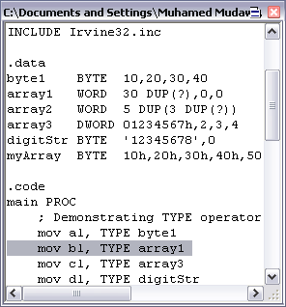
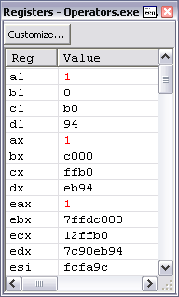
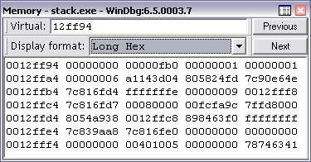
Debugger
Allows you to trace the execution of a program
Allows you to view code, memory, registers, etc.
We will use the 32-bit Windows debugger

Slide 29
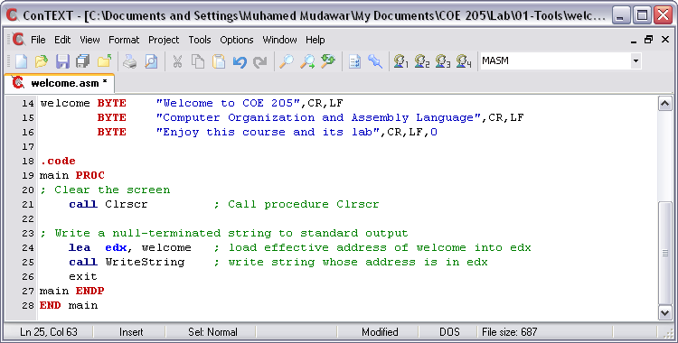
Editor
Allows you to create assembly language source files
Some editors provide syntax highlighting features and can be customized as a programming environment

Slide 30
Next …
Welcome to COE 205
Assembly-, Machine-, and High-Level Languages
Assembly Language Programming Tools
Programmer’s View of a Computer System
Basic Computer Organization

Slide 31
Programmer’s View of a Computer System
Increased level of abstraction
Application Programs
High-Level Language
Level 5
Assembly Language
Level 4
Operating System
Level 3
Instruction Set
Architecture
Level 2
Microarchitecture
Level 1
Each level hides the details of the level below it
Digital Logic
Level 0

Slide 32
Programmer's View – 2
Application Programs (Level 5)
Written in high-level programming languages
Such as Java, C++, Pascal, Visual Basic . . .
Programs compile into assembly language level (Level 4)
Assembly Language (Level 4)
Instruction mnemonics are used
Have one-to-one correspondence to machine language
Calls functions written at the operating system level (Level 3)
Programs are translated into machine language (Level 2)
Operating System (Level 3)
Provides services to level 4 and 5 programs
Translated to run at the machine instruction level (Level 2)

Slide 33
Programmer's View – 3
Instruction Set Architecture (Level 2)
Specifies how a processor functions
Machine instructions, registers, and memory are exposed
Machine language is executed by Level 1 (microarchitecture)
Microarchitecture (Level 1)
Controls the execution of machine instructions (Level 2)
Implemented by digital logic (Level 0)
Digital Logic (Level 0)
Implements the microarchitecture
Uses digital logic gates
Logic gates are implemented using transistors

Slide 34
Instruction Set Architecture (ISA)
Collection of assembly/machine instruction set of the machine
Machine resources that can be managed with these instructions
Memory
Programmer-accessible registers.
Provides a hardware/software interface

Slide 35
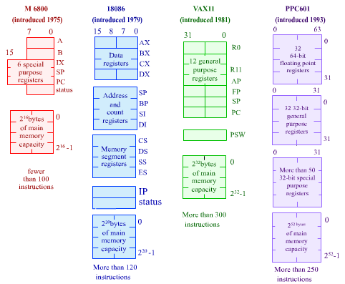
Instruction Set Architecture (ISA)

Slide 36
Next …
Welcome to COE 205
Assembly-, Machine-, and High-Level Languages
Assembly Language Programming Tools
Programmer’s View of a Computer System
Basic Computer Organization

Slide 37
Basic Computer Organization
Since the 1940's, computers have 3 classic components:
Processor, called also the CPU (Central Processing Unit)
Memory and Storage Devices
I/O Devices
Interconnected with one or more buses
Bus consists of
Data Bus
Address Bus
Control Bus
data bus
registers
Processor
(CPU)
Memory
I/O
I/O
Device
Device
#1
#2
ALU
CU
clock
control bus
address bus

Slide 38
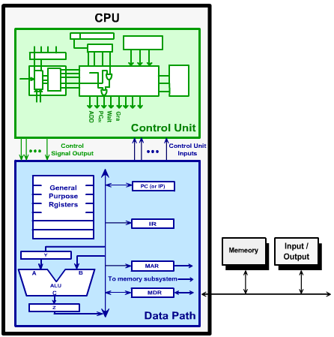
Processor (CPU)
Processor consists of
Datapath
ALU
Registers
Control unit
ALU
Performs arithmetic
and logic instructions
Control unit (CU)
Generates the control signals required to execute instructions
Implementation varies from one processor to another

Slide 39
Clock
Synchronizes Processor and Bus operations
Clock cycle = Clock period = 1 / Clock rate
Clock rate = Clock frequency = Cycles per second
1 Hz = 1 cycle/sec 1 KHz = 10³ cycles/sec
1 MHz = 10⁶ cycles/sec 1 GHz = 10⁹ cycles/sec
2 GHz clock has a cycle time = 1/(2×10⁹) = 0.5 nanosecond (ns)
Clock cycles measure the execution of instructions
Cycle 1
Cycle 2
Cycle 3

Slide 40
Memory
Ordered sequence of bytes
The sequence number is called the memory address
Byte addressable memory
Each byte has a unique address
Supported by almost all processors
Physical address space
Determined by the address bus width
Pentium has a 32-bit address bus
Physical address space = 4GB = 2³² bytes
Itanium with a 64-bit address bus can support
Up to 2⁶⁴ bytes of physical address space

Slide 41
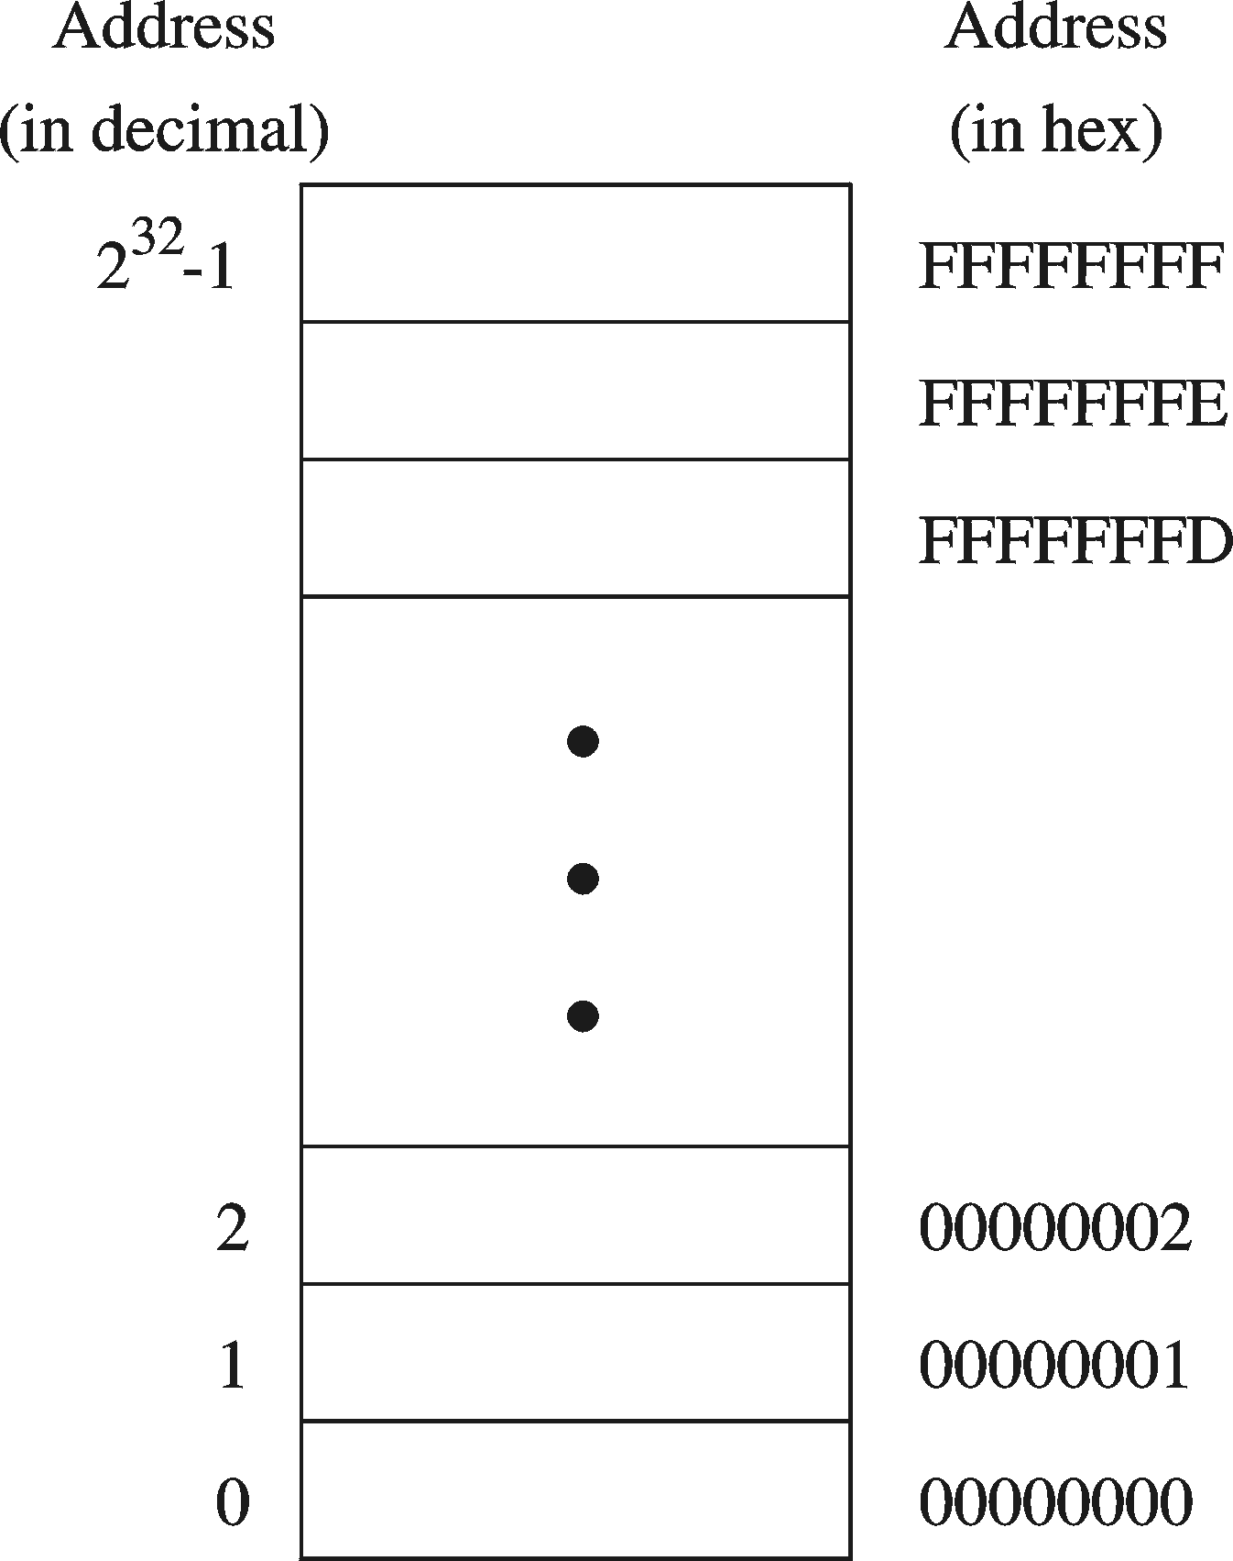
Address Space
Address Space is the set of memory locations (bytes) that can be addressed

Slide 42
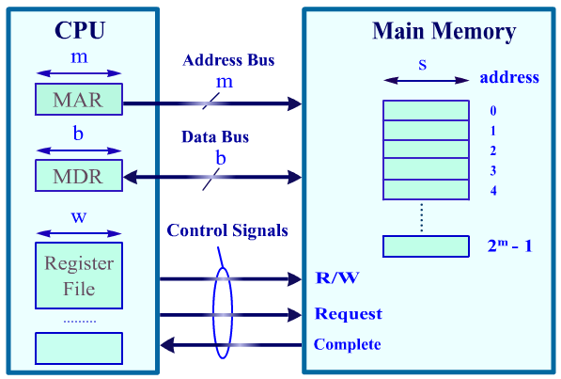
CPU Memory Interface
Address Bus
Memory address is put on address bus
If memory address = m bits then 2^{m} locations are addressed
Data Bus: b-bit bi-directional bus
Data can be transferred in both directions on the data bus
Note that b is not necessary equal to w or s. So data transfers might take more than a single cycle (if w > b) .
Control Bus
Signals control
transfer of data
Read request
Write request
Complete transfer

Slide 43
Memory Devices
Random-Access Memory (RAM)
Usually called the main memory
It can be read and written to
It does not store information permanently (Volatile , when it is powered off, the stored information are gone)
Information stored in it can be accessed in any order at equal time periods (hence the name random access)
Information is accessed by an address that specifies the exact location of the piece of information in the RAM.
DRAM = Dynamic RAM
1-Transistor cell + trench capacitor
Dense but slow, must be refreshed
Typical choice for main memory
SRAM: Static RAM
6-Transistor cell, faster but less dense than DRAM
Typical choice for cache memory

Slide 44
Memory Devices
ROM (Read-Only-Memory)
A read-only-memory, non-volatile i.e. stores information permanently
Has random access of stored information
Used to store the information required to startup the computer
Many types: ROM, EPROM, EEPROM, and FLASH
FLASH memory can be erased electrically in blocks
Cache
A very fast type of RAM that is used to store information that is most frequently or recently used by the computer
Recent computers have 2-levels of cache; the first level is faster but smaller in size (usually called internal cache), and the second level is slower but larger in size (external cache).

Slide 45
Processor-Memory Performance Gap
CPU: 55% per year
1000
“Moore’s Law”
100
Processor-Memory
Performance Gap: (grows 50% per year)
Performance
10
DRAM: 7% per year
1
1981
1982
1983
1984
1985
1986
1987
1988
1989
1990
1991
1992
1993
1994
1995
1996
1997
1998
1980
1999
2000
1980 – No cache in microprocessor
1995 – Two-level cache on microprocessor

Slide 46
The Need for a Memory Hierarchy
Widening speed gap between CPU and main memory
Processor operation takes less than 1 ns
Main memory requires more than 50 ns to access
Each instruction involves at least one memory access
One memory access to fetch the instruction
Additional memory accesses for instructions involving memory data access
Memory bandwidth limits the instruction execution rate
Cache memory can help bridge the CPU-memory gap
Cache memory is small in size but fast

Slide 47
Typical Memory Hierarchy
Registers are at the top of the hierarchy
Typical size < 1 KB
Access time < 0.5 ns
Level 1 Cache (8 – 64 KB)
Access time: 0.5 – 1 ns
L2 Cache (512KB – 8MB)
Access time: 2 – 10 ns
Main Memory (1 – 2 GB)
Access time: 50 – 70 ns
Disk Storage (> 200 GB)
Access time: milliseconds
Microprocessor
Registers
L1 Cache
L2 Cache
Faster
Memory Bus
Bigger
Memory
I/O Bus
Disk, Tape, etc

Slide 48
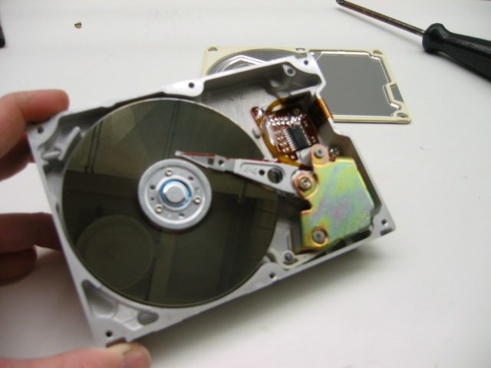
Magnetic Disk Storage
Disk Access Time =
Seek Time +
Rotation Latency +
Transfer Time
Sector
Read/write head
Actuator
Recording area
Seek Time: head movement to the desired track (milliseconds)
Rotation Latency: disk rotation until desired sector arrives under the head
Transfer Time: to transfer data
Track 2
Track 1
Track 0
Arm
Direction of rotation
Platter
Spindle

Slide 49
Example on Disk Access Time
Given a magnetic disk with the following properties
Rotation speed = 7200 RPM (rotations per minute)
Average seek = 8 ms, Sector = 512 bytes, Track = 200 sectors
Calculate
Time of one rotation (in milliseconds)
Average time to access a block of 32 consecutive sectors
Answer
Rotations per second
Rotation time in milliseconds
Average rotational latency
Time to transfer 32 sectors
Average access time
= 7200/60 = 120 RPS
= 1000/120 = 8.33 ms
= time of half rotation = 4.17 ms
= (32/200) * 8.33 = 1.33 ms
= 8 + 4.17 + 1.33 = 13.5 ms

