Slide 1
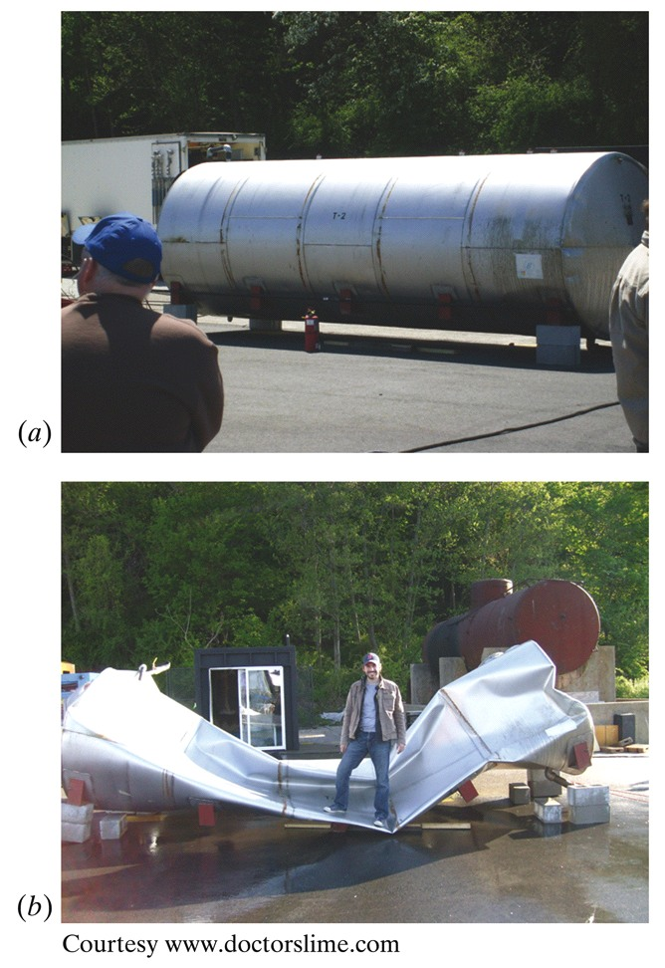
الديناميكا الحرارية والميكانيكا الإحصائية للغازات المثالية
Instructor:
Name: Dr. Zain Yamani
Director of CENT-KFUPM
[www.kfupm.edu.sa/cent]
Phone: 013-860-4363
Mobile: 0504608515
E-mail: zhyamani@kfupm.edu.sa
Time of meetings: Saturdays 9.30 – 11.30 a.m.
المحاضرة الثانية
7 رجب، 1439 هـ

Slide 2
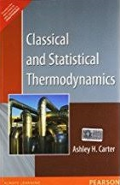
Remarks
Unfortunately, we could not have a lecture last Saturday
Today we need to focus and push forward
How do we write (proper) lessons
I hope you have been reading chapter 11, Classical and Statistical Thermodynamics, by Ashley Carter
Engage with me by typing on the chat, or call me on my Office number: 013-860-4363
What to share and what not to share
For correspondence, always put the proper heading in the Subject heading: TD&SM-IG-1439_SN_issue

Slide 3
Over all plan for the five lectures:
Lecture-1: review of what we (all) probably know + details that we probably skipped when we were freshmen taking chapter ~ 21 of HRW or Serway.
Lecture-2: complete the thermodynamics formalism for ideal gases, and answer your questions (if any??!) ☺
Lecture-3: introduce counting probabilities, and learn its relations to statistical mechanics.
Lecture-4: apply statistical mechanics to ideal gases
Lecture-5: special topics on this subject [& address your questions, if any ☺]

Slide 4
Let us continue addressing the following questions:
How fast do molecules travel in air? (v_{rms}, <v>, v_{mp})
How can we calculate the speed of sound in air?
How often do molecules collide in air (collision frequency, mean free path, mean free time)?
What is the molar heat capacity (or specific heat) of gases.
What is the relation between p & V for an adiabatic process. (Q = 0)
p-V for (non) ideal gas

Slide 5
Some TD review:
What is the relation between the Gas Constant R and Boltzmann’s constant k?

Slide 6
Some TD review:
What is the relation between the Gas Constant R and Boltzmann’s constant k?
Avogadro’s number: N_{A} = 6.02 x 10²³ mol⁻¹
[really large ☺]
R = N/n k = N_{A} k

Slide 7
Some TD review:
What is the relation between the mass of an objects and its number of molecules?

Slide 8
Some TD review:
What is the relation between the mass of an objects and its number of molecules?

Slide 9
State some relations that you ought to know from introductory Thermodynamics

Slide 10
State variables
Equation of state
Expansivity (or coefficient of volume expansion)
Compressibility
The (three or four) TD laws

Slide 12
Before we study the Ideal Gas, let’s take some mathematics

Slide 13
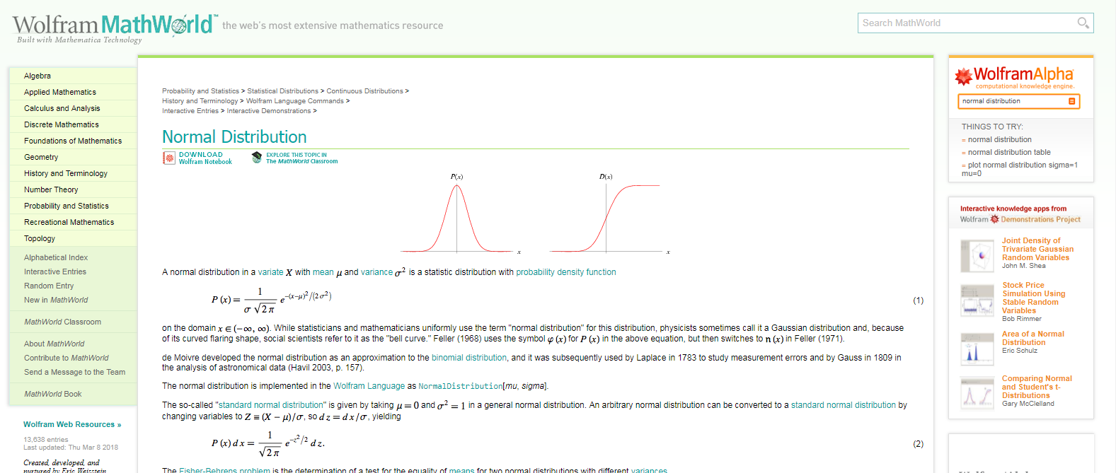
Integration for Gaussian distribution
http://mathworld.wolfram.com/NormalDistribution.html

Slide 14
Learn to integrate $e^{−αx^{2}}$ and related integrals

Slide 16
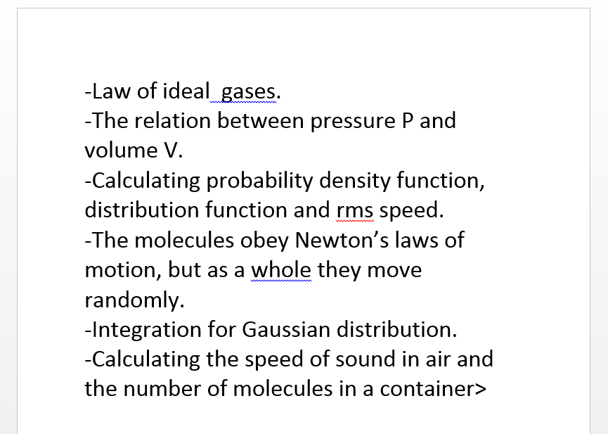
How do we write (proper) lessons

Slide 17
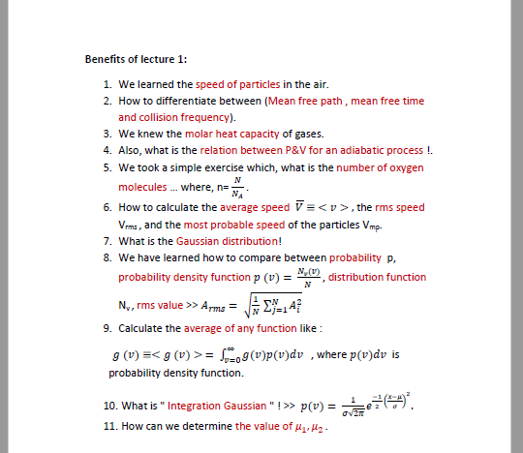
How do we write (proper) lessons

