Slide 1
Introduction to Lagrangian and Hamiltonian Mechanics
Day-1: Introduction
Zain Yamani
CENT Director @ KFUPM
SPS Vice President

Slide 2
Introduction
The nature of physics.. What do we study.. What we do not?? How we express ourselves.
The fields of physics..
Physics in nature and technology
The methods of physics
Dealing with number/ math in physics
What is the relation between math and physics (Data: Tables.. Figures.. Equations)
Using our imagination when we draw graphs (evolution of location (x,y,z) in time, for example).. or v(t) or U(x) or …?

Slide 3
Introduction
Differentiation
Partial differentiation
Find a minimum of a function.. through differentiation.
Using Mathematica.. Symbolically, Numerically..
A bit about Mathematica
Expound on numerical solutions in physics problems

Slide 4
Introduction to Lagrangian and Hamiltonian Mechanics
Day-2: Calculus of Variation
Outline:
Review
Coordinate systems
A step back to Newtonian Mechanics
Calculus of Variations

Slide 5
Coordinate systems
Euclidean
Orthogonal
Rotation
Definition of a (2-D) vector
Definition of a (3-D) vector
[What about 4-D vector?]

Slide 6
Coordinate systems
Cartesian coordinates (position, velocity, acceleration…etc.)
Spherical coordinates (same thing ☺)
Cylindrical coordinates (here too)
Defining operators: gradient, divergence, curl, Laplacian
Kinetic energy in Cartesian and non-Cartesian systems
Generalized Coordinates; degrees of freedom, constraints…

Slide 7
Introduction to Lagrangian and Hamiltonian Mechanics
Day-3: Get Ready for Lagrangian Mechanics
Outline:
Review
A step back to Newtonian Mechanics
Variational Calculus
Lagrangian Mechanics

Slide 8
A step back with mechanics.. Newton’s Law
Free fall, down the frictionless incline, mass-spring system, pendulum
Points of equilibria
Solving differential equation:
Ordinary DE.. 1st order, 2nd order.. constant coefficients.. non constant coefficients (Legendre.. Hermite…)
Partial DE

Slide 9
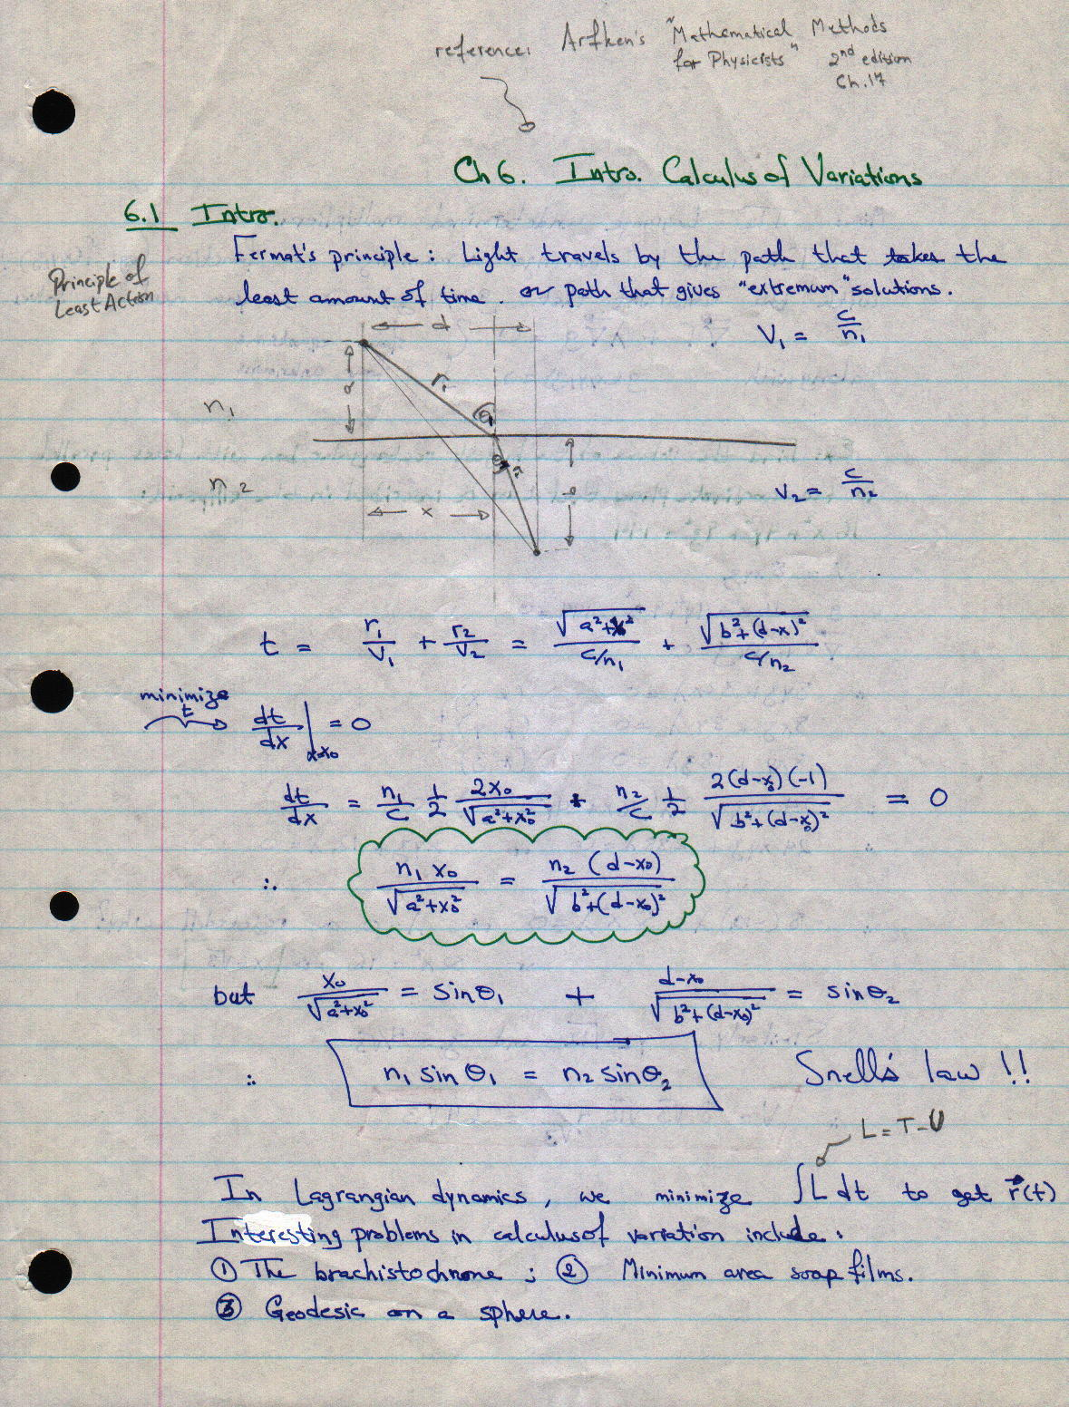
Calculus of Variations
Functional; independent; dependent (one more more)
Action
The handout for Euler Equation (ref. Fox).. From my website
With/without constraints
Prove that the short distance between two point in Euclidean space is a straight line (in a plane, in 3-D).

Slide 10
Introduction to Lagrangian and Hamiltonian Mechanics
Day-4: Lagrangian Mechanics
Outline:
Review
Lagrangian Mechanics

Slide 11
Lagrangian Mechanics
Hamilton’s principle.. Minimize the action with the Lagrangian [L = T-V] as functional
Euler Lagrange Equations (ELE)
Example-1: Freely falling object
Example-2: Projectile motion (neglecting air resistance)
Example-3: slide down an incline (1-D)
Example-4: mass spring system
Example-5: the simple pendulum
Example-6: solving the impossible ☺☺
Example-7: slide down an incline revisited (2-D + constraint)
Example-8: the sliding bead on the rotating circular rim

Slide 12
Introduction to Lagrangian and Hamiltonian Mechanics
Day-5: Hamiltonian Mechanics
Outline:
Review
Lagrangian Mechanics with constraints
Hamiltonian Mechanics

Slide 13
Lagrangian Mechanics
Conjugate momentum
Cyclic coordinates
What about:
Constraints: the Euler-Lagrange equation is stated slightly differently
Velocity dependent potential [L is defined differently]

Slide 14
Hamiltonian Mechanics
Legendre transformations: L → H
Ignorable coordinates
Doing mechanics using the Hamiltonian (the canonical equations)
Example-1: Freely falling object
Example-2: Projectile motion (neglecting air resistance)
Example-3: mass spring system
Example-4: the simple pendulum
Example-5: The central force problem (mostly Lagrangian Mechanics)

Slide 15
Hamiltonian Mechanics
A step into quantum mechanics Hamiltonians

