Slide 1
Chapter 24
Electric Potential

Slide 3
Book’s Problems
Ch 24 Problems:
2, 4, 9, 15, 21, 35, 36, 41, 45, 46, 55, 62, 63, 64, 66, 84, 108.

Slide 4
Electric Potential Energy and Work
You are taking charge at constant speed with force F_{a} from i to f.
Work Energy Principle
and
Test charge
Work done by electric force
F
F_{a}
Q+
+q
f
Δr
i
Work done by external agent
Source charge

Slide 5
Electric Potential Energy Difference (ΔU): point Charge
Electric force F is conservative force like force of gravity, so the work depends on ‘i’ and ‘f’.
You are taking charge at constant speed with force F_{a} from i to f.
F
F_{a}
Q+
+q
i
f
r₀
r

Slide 6
ΔU due to negative point charge
Electric force F is conservative force like force of gravity, so the work depends on ‘i’ and ‘f’.
You are taking charge at constant speed with force F_{a} from i to f.
F
F_{a}
-Q
+q
i
f
r₀
r
Potential energy depends on the sine of the charge

Slide 7
Electric Potential: Point Charge
When final point is at infinity, i.e. r =∞, tere will be no attraction or repulsion, so U = 0
F
Q+
F_{a}
∞
+q
f
i
r₀
r
In General: Electric potential Energy U of a test charge “q” at a distance “r” from source charge “Q”,

Slide 8
Potential Energy due to group of point charges
+q₁
r₁
+Q
r₂
P
-q₂
r₃
+q₃
Electric Potential Energy of Charge “Q”
Don’t forget the sign of the charges!

Slide 9
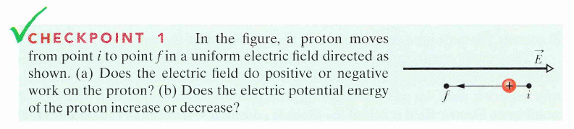

Negative
increase

Slide 10
T072: Q12. A charge q1 = -5.0 μC and a charge q2 = 6.0μC are located at (8.0 cm, 0.0) and (0.0 cm, 6.0 cm) respectively in the xy plane. How much work was done, by an external agent, to bring these charges to their final positions starting from infinite separation.[Consider V = 0 at infinity]
(Ans: – 2.7 J)
T081: Q#14 Figure 6 shows three points X, Y and Z forming an equilateral triangle of side S in a uniform electric field of strength E. A unit positive test charge is moved from X to Y, then from Y to Z, and from Z back to X. Which one of the following correctly gives the work done by an external agent in moving the charge along the various parts of the path?
(Ans: 0, -E*S*Sin(60 degrees) , + E*S*Sin(60 degrees).)
S
X
Y
Z
E
Figure 6
T081: Q#2: Three point charges are initially infinitely far apart. Two of the point charges are identical and have charge Q. If zero net work is required to assemble the three charges at the corners of an equilateral triangle of side d, then the value of the third charge is (Ans: - Q/2.)

Slide 11
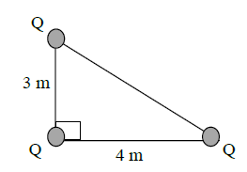
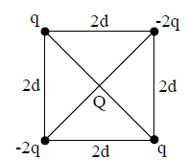
T062: Q11.: Figure (3) shows three charges located at the corners of a triangle. How much energy would be needed to remove the 4 μC charge to infinity? [Assume V = 0 at infinity.] (8.2J)
T102-Q12.
How much work is required to set up the arrangement of charges shown in Figure 6, if Q = − 3 μC? Assume that the charged particles are initially infinitely far apart and at rest. Take the potential to be zero at infinity.
A) +0.06 J
T101-Q15.
In Figure 4, four charges are fixed at the corners of a square whose sides are of length 2d. The work done by an external agent to bring a fifth charge, Q, from infinity to the center of the square as shown in the figure is: (assume the potential at infinity to be zero)
A) – 1.4kqQ/d.

Slide 12
T102-Q12.
How much work is required to set up the arrangement of charges shown in Figure 6, if Q = − 3 μC? Assume that the charged particles are initially infinitely far apart and at rest. Take the potential to be zero at infinity.
A) +0.06 J

Slide 13
T92-Q17. Three electrons are initially infinitely far from each other. How much work (by an external agent) is required to place them on the corners of an equilateral triangle of side
length 1.00 nm?
A) + 6.91 × 10-19 J
T83-Q11.
Four equal positive charges, each 3.2 μC, are held at the four corners of a square of edge 0.50m. How much work is required to move one of those charges far away from other three?
A) − 0.50 J
T83-Q12.
An electric field of 100 V/m strength is often observed near the surface of earth. What would be the electric potential at a point on the earth surface? (Radius of Earth= 6.37 x 10⁶ m)
A) 6.37 x 10⁸ V

Slide 14
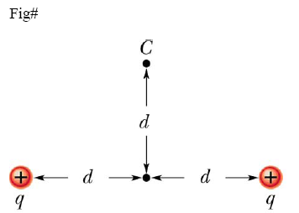
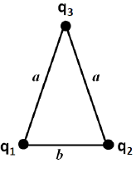
T91-Q12.
Two charges q = + 2.0 µC are fixed a distance 2d = 2.0 cm apart (see Figure 5). With V = 0 at
infinity, how much work needs to be done by an external agent to move one of the charges to
point C?
A) + 0.75 J
T111-Q13. Three charged particles, q₁ = +10 nC, q₂ = –20 nC, and q₃ = +30 nC, are positioned at the corners of a triangle, as shown in Figure 6. If a = 10 cm and b = 6.0 cm, how much work must be done by an external agent to move q₃ to infinity?
A) +2.7 × 10-⁵J
103-Q12.
Calculate the electrostatic potential energy between a proton and an electron in a hydrogen atom of radius 52.9 pm (1 m = 1×10¹² pm). Assume the electrostatic potential energy between the proton and electron is zero at infinite separation. Express your answer in electron-volts (eV).
A) −27.2

Slide 15
103-Q12.
Calculate the electrostatic potential energy between a proton and an electron in a hydrogen atom of radius 52.9 pm (1 m = 1×10¹² pm). Assume the electrostatic potential energy between the proton and electron is zero at infinite separation. Express your answer in electron-volts (eV).
A) −27.2

Slide 16
Electric Potential Difference (ΔV)
Electrical potential is defined as electric potential energy per unit charge
Potential difference is potential energy difference per unit charge
F
Q+
+1
Unit of V = J/C = Volt (V)
f
i
Potential difference between two points is defined as the work done to bring a unit positive charge from one point to another against the electric force

Slide 17
Electric Potential Energy: Point Charge
When r =∞, V = 0
F
Q+
F_{a}
∞
+1
f
i
r₀
r
Therefore, for point source charge
and

Slide 18
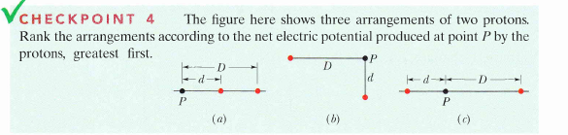
Potential due to group of point charges
r₁
+1 (unit positive charge)
+q₁
P
r₂
-q₂
Net potential at point P
r₃
+q₃
Don’t forget the sign of the charges!

Slide 19
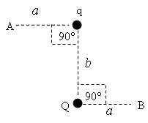
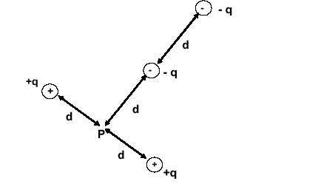
T081: Q12. Point charges q and Q are placed as shown in Fig. 4. If q = +2.0 nC and Q = -2.0 nC, a = 3.0 m, and b = 4.0 m, what is the electric potential difference (V_{A}-V_{B})?
(Ans: 4.8 V)
T03-Q13.
Consider two points in an electric field. The potentials at point P₁ is V₁ = −0.24 kV, and at point P₂ is V₂ = + 0.36 kV. How much work is done by an external force in moving a charge q = −8.0 μC from P₂ to P₁? A) 4.8 mJ
T051: Q#12. What is the net potential at point P due to four point charges arranged in the configuration as shown in the Figure 1. Here q = 36 nC, d = 0.5 m. )
( Ans: Vp = 324 V.)
T081: Q10.: Points A (2.0 m, 3.0 m) and B (5.0 m, 7.0 m) are located in a region where the electric field is uniform and is given by E = 3i +4j (N/C). What is potential difference (V_{A}-V_{B})? (Ans: 24 V)

Slide 20
T081: Q12. Point charges q and Q are placed as shown in Fig. 4. If q = +2.0 nC and Q = -2.0 nC, a = 3.0 m, and b = 4.0 m, what is the electric potential difference (V_{A}-V_{B})?
(Ans: 4.8 V)

Slide 21
T081: Q10.: Points A (2.0 m, 3.0 m) and B (5.0 m, 7.0 m) are located in a region where the electric field is uniform and is given by E = 3i +4j (N/C). What is potential difference (V_{A}-V_{B})? (Ans: 24 V)

Slide 22
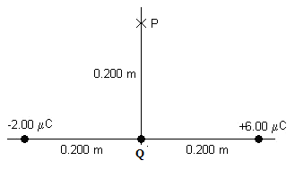
T101-Q10.
A system consists of a negatively-charged particle moving in an electric field. When the charged particle moves in the direction of the electric field
A) The electric potential energy increases.
B) The work done by the electric force on the particle is positive.
C) The electric potential energy decreases.
D) The kinetic energy of the particle increases.
E) The particle acceleration is in the direction of the electric field.
T101-Q12.
Three point charges −2.00 μC, Q, and +6.00 μC are fixed along the x-axis as shown in Figure 3. If the net electric potential at point P due to these charges is Zero, the charge Q is:
A) –2.83 μC

Slide 23
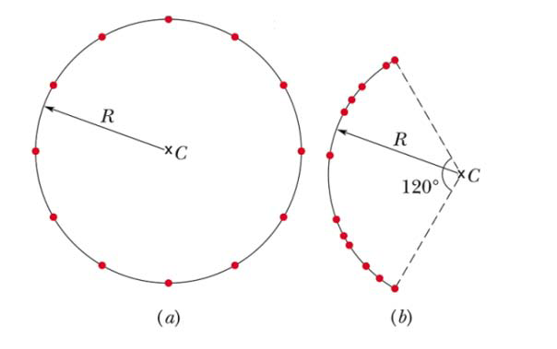
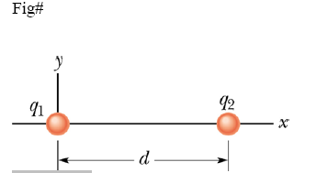
T102-Q13.
Figure 7 shows two different arrangements of 12 electrons fixed in space. In the arrangement (a) they are uniformly spaced around a circle of radius R and in (b) they are non-uniformly spaced along an arc of the original circle. Which of the following statements is TRUE?
A) The electric potential at the center C is the same in both (a) and (b).
T91-Q10.
In Figure 4, particles of charges q₁ = + 5e and q₂ = – 15e are fixed in place with separation d. With V = 0 at infinity, at what point between the two particles and on the x axis is the net
electric potential zero? [e = 1.6 × 10⁻¹⁹ C]
A) x = d/4

Slide 24
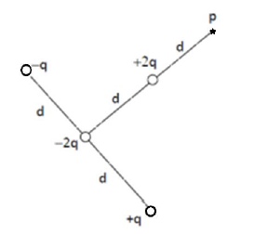
T91-Q9.
A uniform electric field is given by i E ˆ 12î (N/C). The coordinates (in meters) of two points in the xy plane are P₁ = (– 2.0, + 1.0) and P₂ = (+ 1.0, + 5.0). What is the potential difference V₁ – V₂?
A) + 36 V
T111-Q15.
Consider the four charges distributed as shown in Figure 8. What is the net electric potential at point P due to the four charges, if V = 0 at infinity, q = 10 nC, and d = 10 cm?
A) +900 V

Slide 25
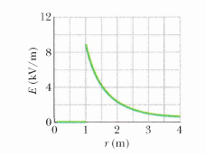
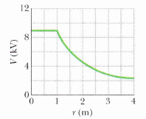
Metal and Potential
S
Outside the sphere (r > R): Charge concentrate at the centre like point charge
+
+
+
+
+
+
+
P
R
+
At the surface (r = R): Charge concentrate at the centre like point charge
+
r
+
+
E = 0
+
+
+
+
i
+
+
f
+
But inside the surface (r < R), E = 0
+
q
+
+
To take charge from inside “i” to the surface “f”, there will be no work done
The metallic body has same potential inside outside

Slide 26
Metal and Potential
+
+
+
+
+
+
+
+
+
+
+
+
+
+
+
+
+
+
+
+
+
E= 0
V≠0
+
+
+
E=0
E=0
+
+
+
+
V≠0
+
V≠0
+
+
+
+
+
+
+
+
+
+
+
+
+
+
+
Potential inside the metallic sphere = Potential at the surface
Surface with same potential = Equipotential Surface

Slide 27
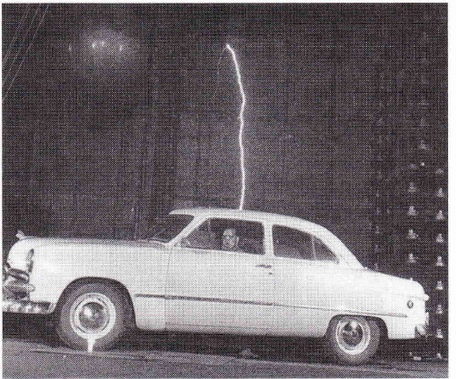
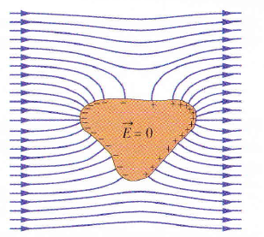
Metal and Potential

Slide 28
Metal and Potential
+
+
+
+
+
+
+
+
+
+
+
+
+
+
+
+
+
+
+
+
+
+
+
+
+
+
+
+
+
+
+
+
+
+
+
+
q
q₂
q₁
+
+
+
+
The charge will flow form one sphere to another until both have the same potential.
Battery cause to flow the charge because it has potential difference at its two terminals

Slide 29
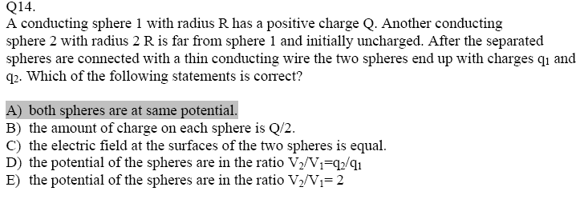
T071: Q#18. A charged solid conducting sphere has a radius = 20 cm and a potential of 400V. Calculate the electric field 40 cm from the center of the sphere,
(Ans: 500 V/m)
T071: Q14. A conducting sphere with a radius of 10 cm, has a surface charge density of 4 ×10⁻⁶ C/m2. The electric potential, at r = 5 cm from the center of the sphere is ( assume V= 0 at infinity):
(Ans: 4.5×10⁴ V)
T081: Q#11: Eight isolated identical spherical raindrops are each at a potential of 100 V at the surface, relative to the potential at infinity. They are combined together to make one spherical raindrop whose potential at the surface is:
(Ans: 400 V)

Slide 30
T101-Q14.
A solid conducting sphere of radius 5.0 cm has a charge 0.25 × 10⁻⁹ C distributed uniformly on its surface. If point A is located at the center of the sphere and point B is 15 cm from the center of the sphere, what is the magnitude of the electric potential difference between these
two points?
A) 30 V
T92-Q15. An isolated conducting sphere has radius R = 0.20 m and a charge of +20 μC. Point A is at a distance of 3R from the center of the sphere. If V_{C} is the electric potential at the center of the sphere, what is the electric potential difference V_{C} – V_{A}?
A) +6.0 × 10⁵ V
T91-Q11.
A conducting spherical shell has a radius of 0.800 m and carries a net charge of + 2.00 µC. Point A is a distance r_{A} = 0.500 m from the center of the shell, and point B is a distance r_{B} = 1.50 m from the center of the shell. Take V = 0 at infinity. What is the electric potential difference V_{B} – V_{A}?
A) − 10.5 kV

Slide 31
071-Q18. Consider two conducting spheres, A and B, having the same size. Sphere A carries a charge of −2.0 μC and sphere B carries a charge of + 6.0 μC. The spheres are touched together and then separated. What is the final charge on sphere A?
(Ans: + 2.0 μC.)
Little difficult-Q18. Consider two conducting spheres, A and B. Sphere A carries −2.0 μC has double radius than the sphere B that carries a charge of + 6.0 μC. The spheres are touched together and then separated. What is the final charge on sphere A? (Ans: Bring your answer)
T61-Q#13. A point charge of 5.0 × 10⁻⁹ C is transferred, by an external agent, from infinity to the surface of a ball of radius 5.0 cm. If the ball has the charge density 5.0 × 10⁻⁴ C/m², then the amount of work done, by the external agent, in the process is: [Assume V = 0 at infinity.]
(Ans: 1.4×10⁻² J )
T062: Q10.: Two charged spherical conductors having radii 4.0 cm and 6.0 cm are connected by a long conducting wire. A total charge of 20 μC is placed on this combination of two spheres. Find the charges on each sphere (smaller first).
(8 μC and 12 μC)

Slide 32
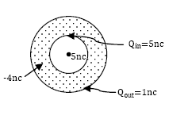
T111-Q12.
Consider two conducting spheres A and B. Sphere A has radius R_{A} and carries charge q. Sphere B has radius R_{B} = 3R_{A} and initially uncharged. Sphere A is far from sphere B. The spheres are connected with a thin conducting wire. After the connection, what is the ratio of the charge on A to that on B (q_{A}/q_{B} )?
A) 1/3
T102-Q18.
A hallow spherical conductor of inner radius 2.0 cm and outer radius 4.0 cm has a net charge of – 4.0 nC. If a point charge of 5.0 nC is placed at the center of the hallow spherical conductor, the charge density on the outer surface of the conductor is:
A) + 50 nC/m²
T102-Q20. Eight identical spherical raindrops are each at a potential V (assuming the potential to be zero at infinity). They combine to make one spherical raindrop whose potential is:
A) 4V

Slide 33
T102-Q18.
A hallow spherical conductor of inner radius 2.0 cm and outer radius 4.0 cm has a net charge of – 4.0 nC. If a point charge of 5.0 nC is placed at the center of the hallow spherical conductor, the charge density on the outer surface of the conductor is:
A) + 50 nC/m²

Slide 34
T102-Q20. Eight identical spherical raindrops are each at a potential V (assuming the potential to be zero at infinity). They combine to make one spherical raindrop whose potential is:
A) 4V

Slide 35
T91-Q11.
A conducting spherical shell has a radius of 0.800 m and carries a net charge of + 2.00 µC. Point A is a distance r_{A} = 0.500 m from the center of the shell, and point B is a distance r_{B} = 1.50 m from the center of the shell. Take V = 0 at infinity. What is the electric potential difference V_{B} – V_{A}?
A) − 10.5 kV

Slide 36
Lecture 2

Slide 37
Equipotential Surfaces
If a surface has same potential everywhere it is called equipotential surface
+q
-q
Electric Filed must be perpendicular to equipotential surfaces

Slide 38
Equipotential Surfaces
Electric Filed must be perpendicular to equipotential surfaces
+
-
+1C

Slide 39
Equipotential Surface
+
+
+
+
+
+
+
-
-
-
-
-
-
-
+q
+q
+q
i
f
+q
-Q
i
f
No work is done when charge moves in equipotential surface
Work is done only if charge moves in different potentials
Electric force is conservative force so work done by it only depends on the change in initial and final positions.

Slide 40
Electric Field (E) and Electric Potential (V)

Slide 41
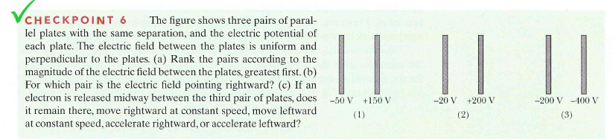

Slide 42
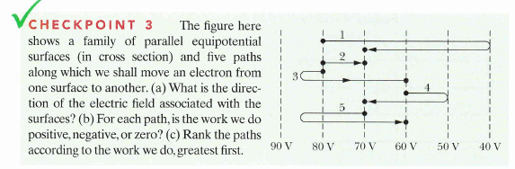
Checkpoint
Rightward
1, 2, 3, 5 positive and 4 negative
3, than 1, 2 and 5 tie, then 4
T91-Q13.
In a certain region of space the electric potential increases uniformly from east to west, and does not vary in any other direction. The electric field:
A) points east and does not vary with position.

Slide 43
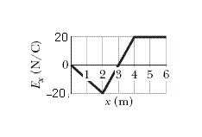
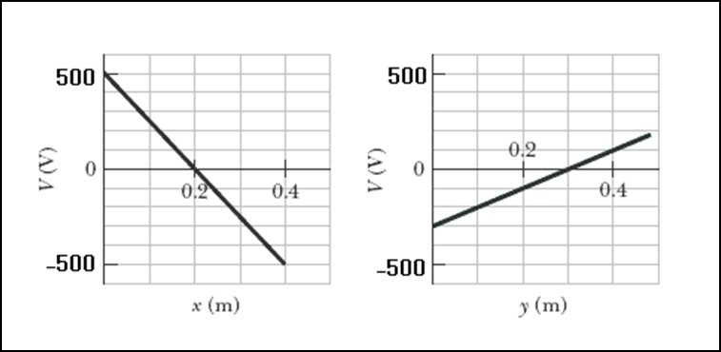
T072: Q10.: Over a certain region of space, the electric potential is give by: V(x,y) = x²+y²+2xy where V is in volts and x and y are in meters. Find the magnitude of the electric field at the point P (1.0 , 2.0).
(Ans: 8.5 N/C)
T052: Q#16. In a certain region of the xy plane, the electric potential is given by V (x,y) = 2xy – 3x² + 5y, where At which point is the electric field equal to zero?
(Ans: –2.5, –7.5)
T102-Q10. Figure 4 shows the x component of the electric field as a function of x in a region. The y and z components of the electric field are zero in this region. If the electric potential at x = 0 is 10 V, what is the electric potential at x = 3 m?
A) +40 V
T102-Q11. A particle of charge 2 ×10-3 C is placed in an xy plane where the electric potential depends on x and y as shown in Figure 5. The potential does not depend on z. What is the electric force (in N) on the particle?
A)5i - 2ˆj

Slide 44
T102-Q10. Figure 4 shows the x component of the electric field as a function of x in a region. The y and z components of the electric field are zero in this region. If the electric potential at x = 0 is 10 V, what is the electric potential at x = 3 m?
A) +40 V

Slide 45
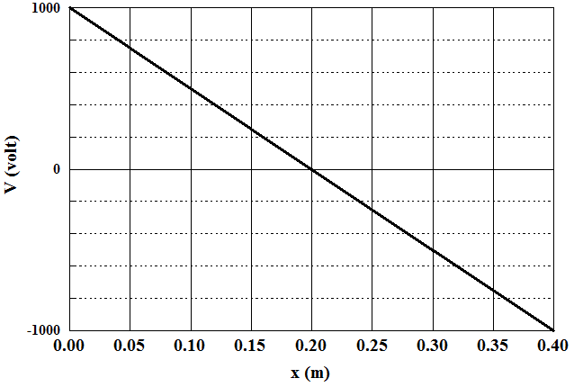
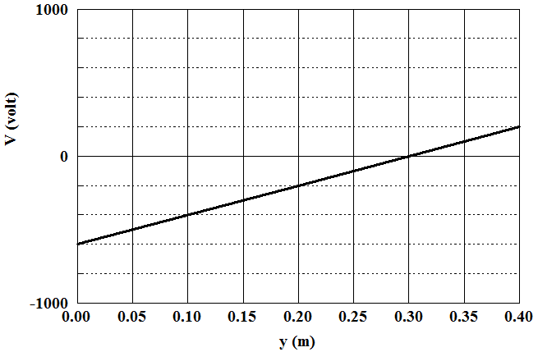
T92-Q13. A charge of +28 nC is placed at the origin in a uniform electric field that is directed along the positive y-axis and has a magnitude of 4.0 × 10⁴ V/m. The work done by the electric field when the charge moves to the point (3.0 m, 4.0 m) is:
A) +4.5 mJ
T92-Q14. An electron is placed in an xy plane where the electric potential depends on x and y as shown in Figure 4 (the potential does not depend on z). What is the electric field (in units of kV/m)?
A) 5i – 2j

Slide 46
T83-Q10.
The electric potential at points in xy plane is given by V= 2x²y+32. What is the electric field at ( 2.0 m, 3.0 m)
A) -24i - 8.0 j
T111-Q14.
The electric potential (in volts) in a certain region of space is given by V = 3xy. What is the magnitude of the electric field (in units of V/m) at the point (1.0 m, 1.0 m)?
A) 4.2
T103-Q14.
The electric potential in a certain region is given by V = 4 x z − 5 y + 3 z², where x, y, and z are in meters, and V is in volts. Find the magnitude of the electric field at the point (+2 m, −1 m, +3 m).
A) 29 V/m
T101-Q11.
If the electric field has magnitude of 200 V/m and makes an angle of 30° with the positive x-axis, what is the potential difference V_{B}-V_{A} between point A(0, 0) and point B(3.0 m, 0 m)?
A) − 520 V

Slide 47
T103-Q14.
The electric potential in a certain region is given by V = 4 x z − 5 y + 3 z², where x, y, and z are in meters, and V is in volts. Find the magnitude of the electric field at the point (+2 m, −1 m, +3 m).
A) 29 V/m

Slide 48
T101-Q11.
If the electric field has magnitude of 200 V/m and makes an angle of 30° with the positive x-axis, what is the potential difference V_{B}-V_{A} between point A(0, 0) and point B(3.0 m, 0 m)?
A) − 520 V

Slide 49
Accelerating Charge by potential Difference
The repulsive force acting on the charge q is
E
+
+
-
+
-
+
+
-
Work done by the electric field
+
-
-
+
+
+
+
-
-q
-
-
-
-
+
+
+
+
-
-
-
-
+
+
+
+
+
-
-
-
-
+
-
+
+
-
-
-
V_{i}
d
V_{f}
Electron Volt (eV):
1 eV = 1.6 x 10⁻¹⁹ C. 1 V = 1.6 x 10⁻¹⁹ (C V) = 1.6 x 10⁻¹⁹ J
1eV = KE gained by an electron when accelerated trough a potential difference of 1V

Slide 50
T071: Q12. An electron is accelerated from a speed of 3×10⁶ m/s to 8×10⁶ m/s. Calculate the potential through which electron has to pass to gain this acceleration?
(Ans: 157 V)
Q#4. A proton with a speed of 3.0×10⁵ m/s moves in uniform electric field of 1.9×10³ N/C. The field is acting to decelerate the proton. How far does the proton travel before it is brought to rest? (Ans: 0.25 m )
T081: Q13.Two identical and isolated 8.0 μC point charges are positioned on the x-axis, one is at x = +1.0 m and the other is at x = -1.0 m. They are released from rest simultaneously. What is the kinetic energy of either of the charges after it has moved 2.0 m along the x axis? (Ans: 96 mJ)
T052: Q#13. Two electrons are initially far away. Each electron is moving toward the other one with a speed of 500 m/s. Find the closest distance they can get to each other. (Ans: 1.01 mm)
T61-Q#12. An electron starts from rest at a point 10 cm from a positively charged conducting plate, with a surface charge density σ = +1 × 10⁻⁹ C/m². The electron is attracted to the plate until it collides with the plate. With what speed will the electron collide with plate? (Ans: 2.0 × 10⁶ m/s

Slide 51
T052: Q#13. Two electrons are initially far away. Each electron is moving toward the other one with a speed of 500 m/s. Find the closest distance they can get to each other. (Ans: 1.01 mm)

Slide 52
long square charged sheet has an edge length L.
a. Find the magnitude of an electric field to either side of an insulating sheet if the charge +Q is in one side.
b. The magnitude of an electric field to either side of the sheet if the sheet is conducting and it has -Q charge.
c. The magnitude of an electric field if the sheet is insulating and a charge is +Q on each side.
d. The magnitude of an electric field in between two insulating plates having equal and opposite charges of magnitude Q.
e. The magnitude of an electric field in between two conducting plates having equal and opposite charges of magnitude Q.
f. If electric file E is passed through a chargeless conducting square sheet of length L, perpendicular to its surface from right to left, find the charge on the left surface.
g. If electric file E is passed through a chargeless non-conducting square sheet of length L, perpendicular to its surface from right to left, find the charge on the left surface.

Slide 53
T101-Q13.
A +60 × 10−6 C charge is held fixed at the origin. If a +10 × 10⁻⁶ C charge is released from rest at a point x = 40 cm, what is its kinetic energy the instant it passes the point x = 70 cm?
A) 5.8 J
T102-Q9.
An electron is released from rest in a downward electric field of magnitude 1500 N/C. Determine the change in electric potential energy of the electron when it has moved a vertical distance of 20 m in this electric field.
A) – 4.8 × 10⁻¹⁵ J
T83-Q9.A proton with a speed of 2.00 x 10⁵ m/s enters a region of space in which source charges have created an electric potential. What is the proton’s speed after it has moved through a potential difference of + 100 V?
A) 1.44 x 10⁵ m/s
T92-Q16. An electron is projected with an initial kinetic energy of 3.6 × 10-24 J toward a fixed proton. If the electron is initially infinitely far from the proton, at what distance from the proton is its speed equal to twice its initial speed?
A) 21 μm

Slide 54
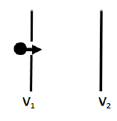
T111-Q11.
Figure 4 shows an electron moving to the right between two parallel charged plates. The electric potentials of the plates are V₁ = –70 V and V₂ = –50 V. What is the change in the kinetic energy of the electron as it moves from the left to the right plate?
A) +3.2 × 10⁻¹⁸J
T103-Q15.
A proton of kinetic energy 4.8 × 10⁶ eV travels head-on toward a lead nucleus (with 82 protons). Assuming that the proton does not penetrate the nucleus and that the only force between the proton and the nucleus is Coulomb force, calculate the smallest separation between the proton and the nucleus when the proton comes momentarily to rest.
A) 2.5 × 10⁻¹⁴ m
Book’s Problem: A particle, with mass = 9.0×10⁻⁹ kg and charge = +8 nC , has a kinetic energy of 36 μJ at point A and moves to point B where the potential is 3.0×10³ V greater than that at point A. What is the particle's kinetic energy at point B? (Ans: 12 μJ)

Slide 55
T111-Q11.
Figure 4 shows an electron moving to the right between two parallel charged plates. The electric potentials of the plates are V₁ = –70 V and V₂ = –50 V. What is the change in the kinetic energy of the electron as it moves from the left to the right plate?
A) +3.2 × 10⁻¹⁸J

Slide 56
Potential: Electric Dipole
Electric dipole moment (p)
P
+q
The direction of dipole moment is taken from –ve to +ve charge
r
d
θ
The Electric potential at Point P due to a dipole is
-q
Ch24-19. The NH3 molecule has a permanent electric dipole moment equal to 1.47 D, where D = 1 Debye unit = 3.34 x10⁻³⁰ C.m. Calculate the electric potential due to NH₃ molecule at a point 52 nm away along the axis of dipole.

Slide 57
Summary Ch 24

Slide 58
Summary Ch 24
S
+
+
+
+
+
+
P
V due to dipole
+
R
+
+
r
+
+
E_{inside} = 0
+
+
+
+
+
+
+
+
q
+
+

Slide 59
Book’s Problem: A graph of the x-component of the electric field as a function of x in a region of space is shown in figure. The y and z components of the electric field are zero in the region. If the electric potential at the origin is 10V, (a) what is the electric potential at x = 2.0 m, (b) what is the greatest positive value of the electric potential for points on the x axis for which 0 <= x <= 6m, and (c) for what value of x is the electric potential zero?
(Ans: (a) 30V (b) 40V (c) 5.5 m
20
E_{x} N/C
0
1
2
3
4
5
6
x(m)
-20
Book’s Problem:-A spherical drop of water carrying a charge of 30pC has a potential of 500 V at its surface (with V =0 at infinity). (a) What is the radius of the drop? (b) If two such drops of the same charge and radius combine to form a single spherical drop, what is the potential at the surface of the new drop?
(Ans: (a) 5.4x10⁻⁴m (b) 790 V

