Slide 1
Lecture 1
Sec (1-4)

Slide 2
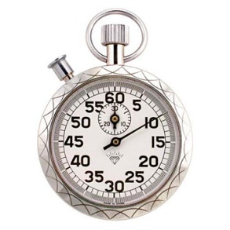
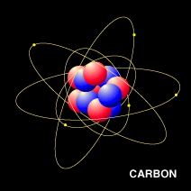
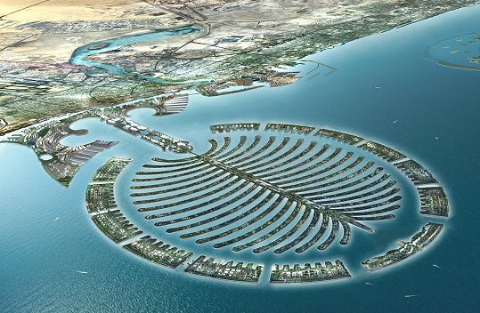
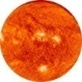

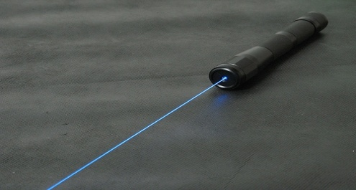
What is Physics?
Physics is a study of Physical things and their properties.
Physical things: things that can be sensed or felt
Big system: Sun and earth
Atom: invisible, small
Watch: visible
Time- invisible
Laser: visible, radar -invisible
Physics study their properties as well
Anything in the land and space is physical

Slide 3
Every physical thing need to measured or counted!
If you count or measure something, the accuracy of measurement becomes crucial and we have to write the result in significant figures.
What is significant figure?
Population of KSA in 2009 = 25,391,100
Net worth property of Richest Person in KSA, Al-Waleed bin Talal is:
$19.4 Billion (2013)
Population of KSA = 25 Million
Population of KSA = 25.4 ± 0.1 Million
Significant Figure
uncertainty

Slide 4
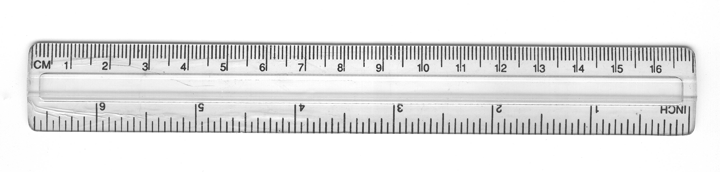
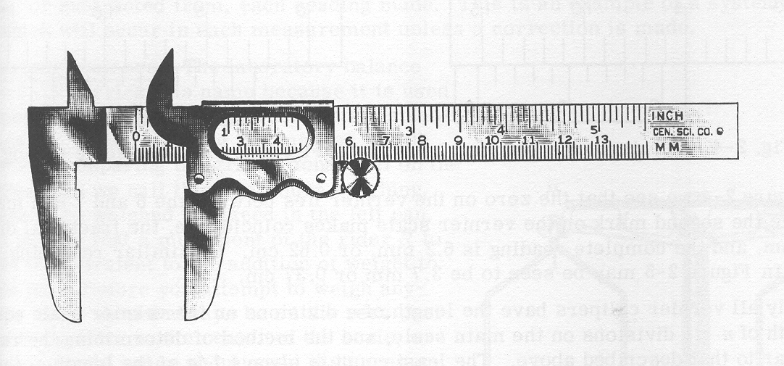
Significant Figures: Measurement of Length
Ruler
Smallest division = 1 mm → 3.1 cm
Calipers
Smallest division = 0.1 mm → 3.16 cm
Look at your watch and compare it with stop watch in your smart phone

Slide 5
Significant Figures: Rules
(1) All nonzero digits are significant:
1.234 g has 4 significant figures,
1.2 g has 2 significant figures.
(4) Trailing zeroes that are also to the right of a decimal point in a number are significant:
0.0230 mL has 3 significant figures,
0.20 g has 2 significant figures.
(2) Zeroes between nonzero digits are significant:
1002 kg has 4 significant figures,
3.07 mL has 3 significant figures.
(5) When a number ends in zeroes that are not to the right of a decimal point, the zeroes are not necessarily significant:
190 miles may be 2 or 3 significant figures,
50600 calories may be 3, 4, or 5 significant figures.
(3) Leading zeros to the left of the first nonzero digits are not significant; such zeroes merely indicate the position of the decimal point:
0.001 ºC has only 1 significant figure,
0.012 g has 2 significant figures.

Slide 6
Rounding up numbers: Rules
Round off rule: If the number after the last significant number is more than or equal to 5 round it off to one higher number but if it is less than 5, keep the same.
Example: for 3 significant figure
25.15 Kg = 25.2 Kg (last digit is equal to 5)
25.57 Kg = 25.6 Kg (last digit is Higher than 5)
25.53 Kg = 25.5 Kg (last digit is smaller than 5)
Example: for 2 significant figure
25.2 Kg =25 Kg (last digit is less than 5)
25.6 Kg = 26 Kg (last digit is Higher than 5)
25.5 Kg = 26 Kg (last digit is equal to 5)
Open the XL page and try the value of Pi.

Slide 7
Scientific Notation: Significant Figure
Scientific notation for Significant Figure avoids all confusion. For example, depending on whether the number of significant figures is 3, 4, or 5, we would write 50600 calories as:
5.06 × 10⁴ calories (3 significant figures)
5.060 × 10⁴ calories (4 significant figures), or
5.0600 × 10⁴ calories (5 significant figures).
Population of KSA in 2009 = 25,391,100
Population of KSA scientific notation = 2.5 x 10⁷ ( 2 significant digit)
= 2.54 x 10⁷ ( 3 significant digit)
= 2.539 x 10⁷ (4 significant digit)
Net worth property of Richest Person in KSA, Al-Waleed bin Talal is: $13.3 Billion
Scientific notation $1.33x10¹⁰

Slide 8
Mathematical Operation: Rules
In addition and subtraction, the result is rounded off to the last common digit occurring furthest to the right in all components. Another way to state this rules, it that, in addition and subtraction, the result is rounded off so that it has the same number of decimal places as the measurement having the fewest decimal places. For example,
100 (assume 3 significant figures) + 23.643 (5 significant figures) = 123.643,
which should be rounded to 124 (3 significant figures).
(2) In multiplication and division, the result should be rounded off so as to have the same number of significant figures as in the component with the least number of significant figures. For example,
3.0 (2 significant figures ) × 12.60 (4 significant figures) = 37.8000
which should be rounded off to 38 (2 significant figures).
Final Example:
(5.00 / 1.235) + 3.000 + (6.35 / 4.0)=4.04858... + 3.000 + 1.5875=8.630829...
Answer: 8.6

Slide 9
Some Examples
# | Examples | Scientific notation | Computer notation
1 | 37.76 + 3.907 + 226.4 = 268.1 | 2.681x10² | 2.681E02
2 | 319.15 - 32.614 = 286.54 | 2.8654x10² | 2.8654E02
3 | 104.630 + 27.08362 + 0.61 = 132.32 | 1.32x10² | 1.32E02
4 | 125 - 0.23 + 4.109 = 129 | 1.29x10² | 1.29E02
5 | 2.02 × 2.5 = 5.0 | 5.0x10⁰ | 5.0E0
6 | 600.0 / 5.2302 = 114.7 | 1.147x10² | 1.147E02
7 | 0.0032 × 273 = 0.87 | 8.7x10⁻¹ | 8.7E-01
8 | (5.5)³ = 1.7 x 10²
9 | 0.556 × (40 - 32.5) = 4
10 | 45 × 3.00 = 1.4 x 10²
11 | 3.00 x 10⁵ - 1.5 x 10² = 299850 =3.00 x 10⁵ | Subtracted number is smaller than error

Slide 10


Three fundamental physical quantities
T
M
L
Fundamental Quantities
International Standard (SI) Units
Length [L]
Meter (m)
Mass [M]
Kilogram (Kg)
Time [T]
Second (s)

Slide 11
Changing Units: Time
1 min = 60s
You can write
You can write
60 s
1 min
= 1
= 1
1 min
60 s
Change min to s
Change s to min
4531 min
4531 s
= 4531 min x 1
= 4531 s x 1
60 s
1 min
= 4531 min x
= 4531 s x
1 min
60 s
= 271860 s
= 45.31 min
= 2.7186 x 10⁵ s

Slide 12
Changing Units: Length (Distance)
100 cm = 1 m
You can write
You can write
100 cm
1 m
= 1
= 1
1 m
1 00 cm
Change m to cm
Change cm to m
4531 m
4531 cm
= 4531 m x 1
= 4531 cm x 1
100 cm
1 m
= 4531 m x
= 4531 cm x
1 m
100 cm
= 453100 cm
= 45.31 m
= 4.531 x 10⁵ cm

Slide 13
Conversion to Meter
Metric System
British System
Factor | Name | Symbol
10²⁴ | yotta | Y
10²¹ | zetta | Z
10¹⁸ | exa | E
10¹⁵ | peta | P
10¹² | tera | T
10⁹ | giga | G
10⁶ | mega | M
10³ | kilo | k
10² | hecto | h
10¹ | deka | da
Terra meter
Giga meter
Mega meter
Kilometer
Meter
Centimeter
Millimeter
Micrometer
Nanometer
Pico meter
1 mile = 1760 yards
1 mile = 8 furlong
1 furlong = 10 chains
1 chain = 4 rods
1 rod = 5 1/2 yards
1 yard = 3 feet
1 foot = 12 inches
1 inch = 2.54 cm
1 mile = 1609 m
10⁻¹ | deci | d
10⁻² | centi | c
10⁻³ | milli | m
10⁻⁶ | micro | µ
10⁻⁹ | nano | n
10⁻¹² | pico | p
10⁻¹⁵ | femto | f
10⁻¹⁸ | atto | a
10⁻²¹ | zepto | z
10⁻²⁴ | yocto | y
Convert 4531 feet to meter
4531 ft
12 in
2.54 cm
1 m
= 4531 ft x
x
x
1 ft
1 in
100 cm
= 1381.049 m
Test: Convert 4531 rod to nanometer

Slide 14
Changing Units: Mass
1000 g = 1 Kg
You can write
You can write
1000 g
1 Kg
= 1
= 1
1 Kg
1 000 g
Change Kg to g
Change g to kg
431 Kg
431 g
= 431 Kg x 1
= 431 g x 1
1000 g
1 Kg
= 431 Kg x
= 431 g x
1 Kg
1000 g
= 431000 g
= 0.431 Kg
= 4.31 x 10⁵ g

Slide 15
Conversion to Kg
British System
Metric System
1 ton = 20 cwt
1 ton = 2240 lb.
1 ton = 1.12 US ton
1 cwt = 4 quarters
1 quarter = 2 stone.
1 stone = 14 lb.
1 lb. = 16 oz.
1 oz. = 16 drams
1 oz. = 437.5 grains
1 US ton = 2000 lb.
Terra gram
Giga gram
Mega gram
Kilogram
Gram
miliigram
Microgram
nanogram
1 lb = 453.6 g
1Kg = 2.2 lb
Convert 5301 oz (aunce) to milligram
5301 oz
1 lb
453.6 g
1000 mg
= 5301 oz x
x
x
16 oz
1 lb
1 g
= 1.5 x 10⁸ mg
Test: Convert 5301 ton to oz

Slide 16
Changing Units: Time
60s = 1 min
You can write
You can write
60 s
1 min
= 1
= 1
1 min
60 s
Change ‘min’ to ‘s’
Change ‘s’ to ‘day’
720 min
720 s
= 720 min x 1
= 720 s x 1
60 s
1 min
1 hr
1 day
= 720 s x
x
x
= 720 min x
1 min
60 s
60 min
24 hr
= 43200 s
= 0.431 day
= 4.32 x 10⁴ s

Slide 17
Exercises:
Ex1. Speed of a car is 2800 cm/s, find the speed in mi/hr
1 mile = 1609 m
= 2800 cm/s
1 m
1 mi
= 2800 cm/s x
x
100 cm
1609 m
60 s
60 min
= 0.017 mi/s
x
x
1 min
1 hr
= 62.6 mi/hr
VVIP Question
Practice Many times
Ex2: Density of a body is 2800 lb/ft³, find the Density in Kg/m³
1 lb = 453.6 g
1 ft = 12 in
1 in = 2.54 cm

Slide 18
Lecture 2
Sec (5-7)

Slide 19
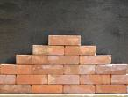
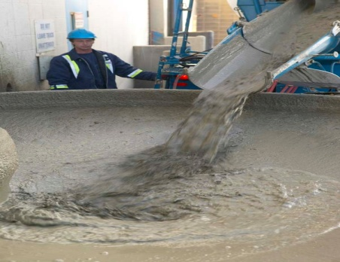
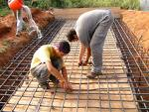
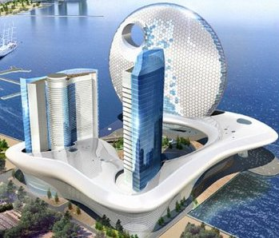
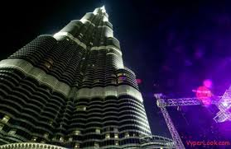
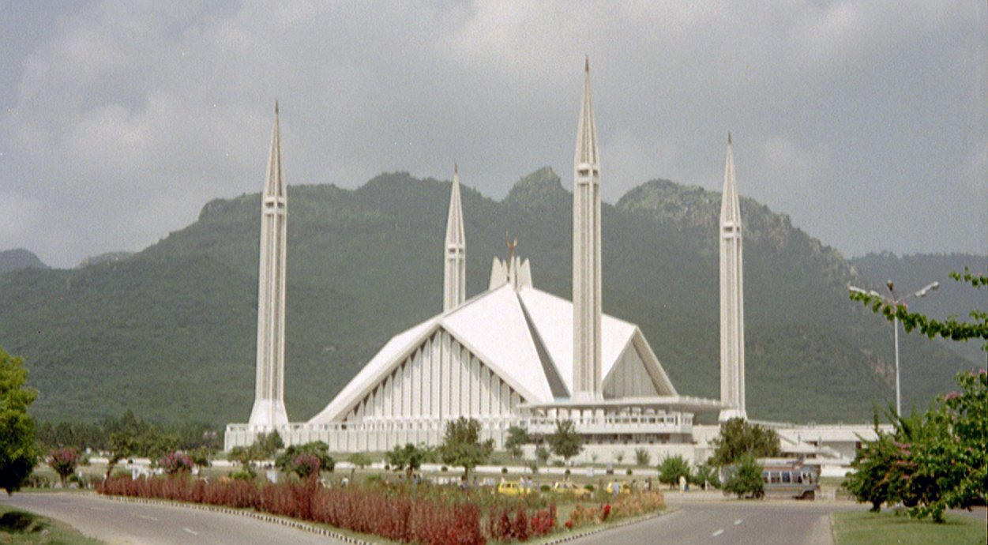
What do I mean by fundamental?
Concrete
Bricks
Rod
You can build anything out of building blocks!

Slide 20
Three fundamental physical quantities
T
M
L
Fundamental Quantities
International Standard (SI) Units
Length [L]
Meter (m)
Mass [M]
Kilogram (Kg)
Time [T]
Second (s)

Slide 21
One Dimension: Length or Distance
Length of a rope = l = L
Distance/displacement = s = L
l
Numbers and π has no dimension
r
Circumference of a circle = 2πr = L
b
Perimeter of a rectangle = 2(l+b) = L
l
Do not add or subtract dimensions

Slide 22
Tow Dimension: Area
Area of a Rectangle (A) = l.b = L.L = L²
Area of a square (A) = l.l = L.L = L²
Area of a circle (A) = πr² = L²
Area of a triangle (A) = (1/2)base . height = L²
h
b
Surface Area of a sphere/ball (A) = 4πr² = L²

Slide 23
Three Dimension: Volume
Volume (V) = base Area. Height = L².L = L³
Volume of a box (V) = l.b.h = L.L.L = L³
Volume of a sphere/ball (V) =(4/3) πr³ = L.L.L = L³
Volume of a cylinder (V) = πr².h= L².L = L³

Slide 24
Mixed Dimensions-I
Mass
M
Density (ρ) =
=
= ML⁻³
Volume
L³
displacement
L
Velocity (v) =
=
= LT⁻¹
time
T
distance
L
Speed (v) =
=
= LT⁻¹
time
T
Velocity change
L/T
Acceleration (a) =
=
= LT⁻²
time
T
Momentum (p) =
Mass . velocity = m . v = MLT⁻¹

Slide 25
Mixed Dimensions: II
Force (F) =
mass . acceleration = m . a = MLT⁻²
Force
MLT⁻²
Pressure (P) =
=
= M L⁻¹T⁻²
Area
L²
Work/Energy (W/E) =
displacement . force = L MLT⁻² = ML²T⁻²
Torque(T) =
displacement x force = L MLT⁻² = ML²T⁻²
Work
ML²T⁻²
Power (P) =
=
= M L²T⁻³
Time
T
Moment of Inertia (I) =
Mass .(distance)² = ML²

Slide 26
Dimensional Analysis I
Question 1: Find the dimension of “a” in above equation!
Question 2: Find the dimension of “a” in above equation!
Question 3: Find the dimension of “a” in above equation!

Slide 27
Dimensional Analysis II
Question 4: Prove through Dimensional analysis
ρ = density
g = acceleration due to gravity
h = height
Question 5: Prove through Dimensional analysis
Δp = change in momentum
m = mass
r = radius
V = velocity
Question 6: Find the dimension of “G”.
M = mass
m = mass
r = distance
Question 7: Work (W) Potential Engery (PE) and Kinetic Energy (KE) have the same dimension
s = displacement
Question 8: prove through dimensional Analysis

Slide 28
Dimensional Analysis III
Question 9: Find the value of x, y and z
ρ = density
g = acceleration due to gravity
h = height
Question 10: Find the value of x, y and z
m = mass
r = radius
v = velocity
Question 11: Find the value of x and y
T= Time Period
l = length
g= acceleration due to gravity
Question 12: Find the value of x and y
ρ = density
B = Bulk modulus (Force/Area)
Question 13: Find the Dimension of A and B
(1)
y= displacement
t = time
(2)

Slide 29
Few Examples Old Exams
091-Q1.
Consider a cube of iron of mass 8.0 kg and side 4.0 inches. What is its density in kg/m³? (1 inch = 2.54 cm)
A) 7.6×10³
B) 6.9×10³
C) 9.8×10³
D) 4.3×10³
E) 10 ×10³
T 101-Q2. The mass of a piece of card board is 20 g. Its length and width are 8.0 and 3.0 inches, respectively. If the thickness of the card board is 0.50 mm, what is the density of the card board in kg/m³? (1 inch = 2.54 cm)
A) 2.58 × 10³
B) 1.67 × 10⁻²
C) 1.67 x 10⁻³
D) 2.58 x 10⁻⁴
E) 2.45 x 10⁵

Slide 30
Few Examples Old Exams
T82-Q1.
Iron has a density of 7.87 g/cm³. What is the mass of an iron block having a volume of 2 in³ ? (1 in = 2.54 cm)
A) 0.26 kg
B) 0.33 kg
C) 0.55 kg
D) 0.76 kg
E) 0.13 kg
092-Q2.
Gold has a density of 19.3 g/cm³. If a sample of gold of mass 30.5 g is pressed so as to make a sheet of 1.00 micrometer thickness, what is the area of the sheet?
(1 micrometer = 10⁻⁶ m)
A) 1.58 m²
B) 3.05 m²
C) 2.45 m²
D) 5.32 m²
E) 10.5 m²

Slide 31
Few Examples Old Exams
092-Q1. The force F applied on a particle is given by the relation F = K ρ A B², where K is a dimensionless constant, ρ is a density and A is an area. Find the dimension of B.
A) L/T
B) L²/T²
C) T/L
D) T²/L²
E) M/T
T82-Q2.
The speed of sound v in a fluid depends upon the fluid density ρ and its bulk modulus B
as follows: v = ρ^{n} B^{m}. Using dimensional analysis, find the values of constants n and m,
respectively. The unit of density ρ is kg/m³ and that of bulk modulus B is kg / (m.s²)
A) -1/2, +1/2
B) -1/2, -1/2
C) +1/2, -1/2
D) +1/2, +1/2
E) - 1, + 1

Slide 32
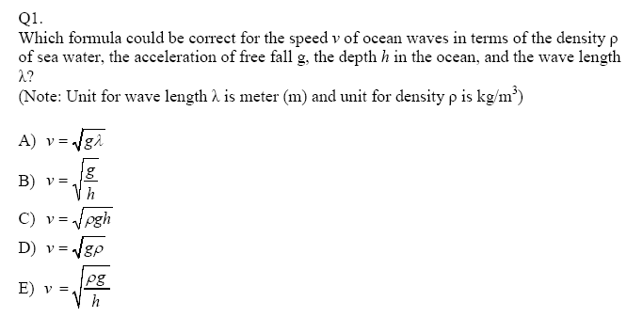
Few Examples Old Exams
T101
091-Q2.
Consider the following physical relation: M = C ρªr^{b}, where M is mass, ρ is density, r is distance and a and b are exponents. C is a dimensionless constant. What are the values of a and b so that the equation is dimensionally correct?
A) a = 1 and b = 3
B) a = 1 and b = 2
C) a = 2 and b = 2
D) a = 2 and b = 1
E) a = 3 and b = 1

Slide 33
Two rods are made of the same material. Girder A is 5 times longer than the rod B and has a cross-sectional area 6 times greater than B. What is the ratio of the mass density of rod A to the mass density of rod B?
Ch1: 25: Iron has a density of 7.87 g/cm³ and the mass of an iron atom is 5.1 x 10⁻²⁶ Kg. If the atoms are spherical and tightly packed,
what is the volume of an iron atom?
What is the distance between the centers of two atoms?
How many number of atoms can be in 1cm³?

Slide 34
T81-Q1. What is the height of a 2.913 kg solid gold cylinder whose radius is 2 cm? The density of gold is 19.32 g/cm³. (Ans: 12 cm)
T072 : Q1.: The position y of a particle moving along the y axis depends on the time t according to the equation y = At² +Bt. The dimensions of the quantities A and B are respectively: (Ans: L/T, L/T²)
T071: Q1.: A swimming pool is filled with 16,500 ft³of water. What is the volume of water in m³? (12 inch = 1 ft and 2.54 cm = 1 inch). (Ans: 467 m³)
T071: Q2.: The position x of a particle is given by , x = Bt² +(C/B) t where x is in meters and t is in seconds. The dimension of C is: ( Ans: L²/T³ )
T062: Q1: From the fact that the average density of the Earth is 5.50 g/cm³ and its mean radius is 6.37 ×10⁶ m, the mass of the Earth is: (Ans: 5.95 × 10²⁴ kg )
T052: Q1. A nucleus of volume 3.4 x 10 ³ fm ³ and mass of 1.0x 10 ² u has a density of: (1 fm = 10⁻¹⁵ m, 1 u = 1.7 x 10⁻²⁷ kg) (Ans: 5.0 × 10¹⁶ kg/m ³)
T041: Q1 .1 shake = 10⁻⁸ seconds. Find out how many nano seconds (ns) are there in 1 shake.(1 nano = 10⁻⁹) (Ans: 10 ns )
T41-Q2: A drop of oil (mass = 0.90 milligram and density = 918 Q0 kg/m**3) spreads out on a surface and forms a circular thin film of radius = 41.8 cm and thickness h (see Fig 8). Find h in nano meter (nm). (1 nano = 10**(-9)) (Ans:1.8 nm )
T991: Q2 How many molecules of water are there in a cup containing 250 cm³ of water? Molecular mass of H₂O = 18 g/mole; Density of water = 1.0 g/cm³; Avogadro s number = 6.02 x 10²³ molecules/mole (Ans: 8.4 x10²⁴)

Slide 35
Ch1-Q7:Antarctica is roughly semicircular, with a radius of 2000Km. The average thickness of it’s ice cover is 3000m. How many cubic cm of ice does Antarctica contain? (ignore the curvature of earth)
Volume (V) = A x h
Area of circle = лr²
h
Area of semicircle (A) = (½)лr²
r
V = (½)лr² x h

Slide 36
Ch1-39: A cord is a volume of cut wood equal to a stack 8 ft long, 4 ft wide, and 4ft high. How many cords are in 1.0 m³ ?
1 m
8 ft
v
1 m
V
4ft
4ft
1 m
1 ft = 12 inches
1 inch = 2.54 cm
Volume = A x h = l x b x h
Nv = V → N = V/v
v = 3.6 m³
N = 0.3

Slide 37
Ch1:50- A unit of area often used in measuring land areas is the hectare, defined as 10⁴ m². An open – pit cold mine consumes 75 hectares of land, down to a depth of 26 m, each year. What volume of earth in cubic Km³ is removed in this time?
75 x 10⁴ m²
26 m
Volume (V) = Area x depth

