Slide 1
Chapter 15
Oscillations

Slide 2
15.1 Oscillatory motion
Motion which is periodic in time, that is, motion that repeats itself in time.
Examples:
Power line oscillates when the wind blows past it
Bridges oscillates when the wind blows past it
Earthquake oscillations move buildings
Breaking a glass
Sometimes the oscillations are so severe, that the system exhibiting oscillations break apart.

Slide 3
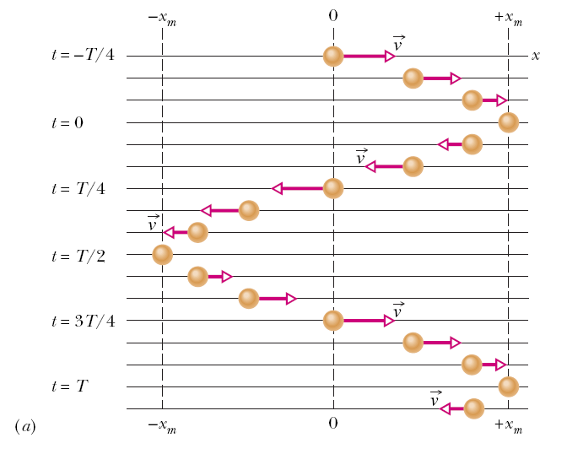
15.2 Simple Harmonic Motion
In the figure snapshots of a simple oscillatory system is shown. A particle repeatedly moves back and forth about the point x=0.
The time taken for one complete oscillation is the period, T. In the time of one T, the system travels from x=+x_{m}, to –x_{m}, and then back to its original position x_{m}.
The velocity vector arrows are scaled to indicate the magnitude of the speed of the system at different times. At x=±x_{m}, the velocity is zero.

Slide 4
15.2 Simple Harmonic Motion
Frequency of oscillation is the number of oscillations that are completed in each second.
The symbol for frequency is f, and the SI unit is the hertz (abbreviated as Hz).
It follows that

Slide 5
15.2 Simple Harmonic Motion
Any motion that repeats itself is periodic or harmonic.
If the motion is a sinusoidal function of time, it is called simple harmonic motion (SHM).
Mathematically SHM can be expressed as:
Here,
x_{m} is the amplitude (maximum displacement of the system)
t is the time
ω is the angular frequency, and
φ is the phase constant or phase angle
(ωt+φ) is the phase

Slide 6
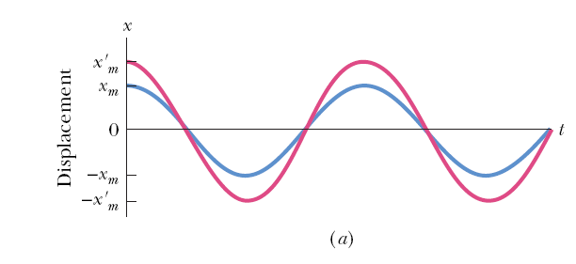
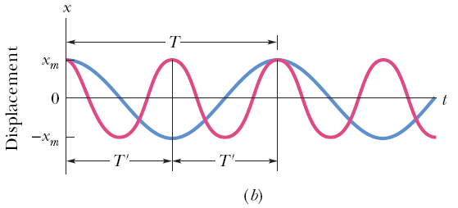
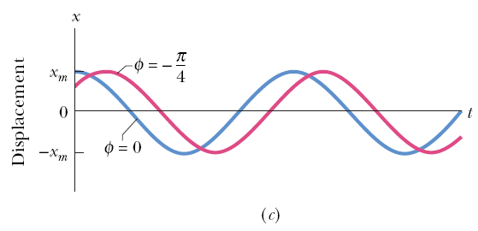
15.2 Simple Harmonic Motion
Figure a plots the displacement of two SHM systems that are different in amplitudes, but have the same period.
Figure b plots the displacement of two SHM systems which are different in periods but have the same amplitude.
The value of the phase constant term, φ, depends on the value of the displacement and the velocity of the system at time t = 0.
Figure c plots the displacement of two SHM systems having the same period and amplitude, but different phase constants.

Slide 7
15.2 Simple Harmonic Motion
For an oscillatory motion with period T,
The cosine function also repeats itself when the argument increases by 2π. Therefore,
Here, ω is the angular frequency, and measures the angle per unit time. Its SI unit is radians/second. To be consistent, φ then must be in radians.

Slide 9
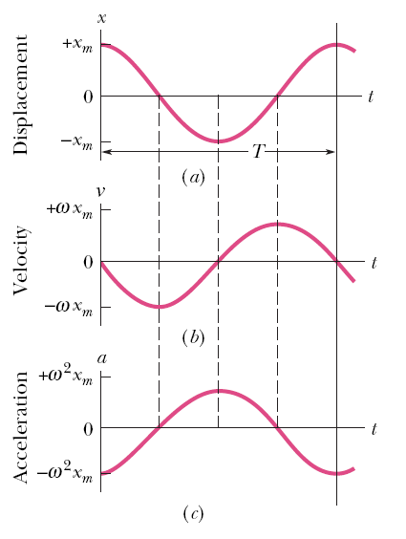
15.2 Simple Harmonic Motion
The velocity of SHM:
The maximum value (amplitude) of velocity is ωx_{m}. The phase shift of the velocity is π/2, making the cosine to a sine function.
The acceleration of SHM is:
The acceleration amplitude is ω²x_{m}.
In SHM a(t) is proportional to the displacement but opposite in sign.

Slide 10
15.3 Force Law for SHM
From Newton’s 2nd law:
SHM is the motion executed by a system subject to a force that is proportional to the displacement of the system but opposite in sign.

Slide 11
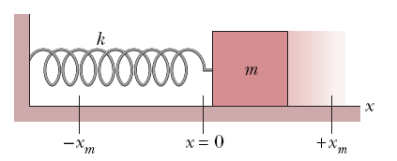
15.3 Force Law for SHM
The block-spring system shown on the right forms a linear SHM oscillator.
The spring constant of the spring, k, is related to the angular frequency, ω, of the oscillator:

Slide 13
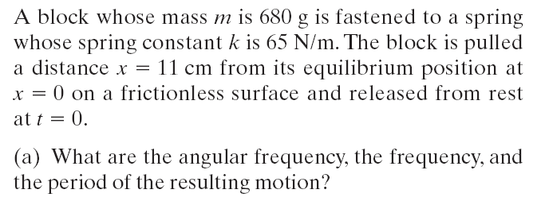
Example, force law:

Slide 14
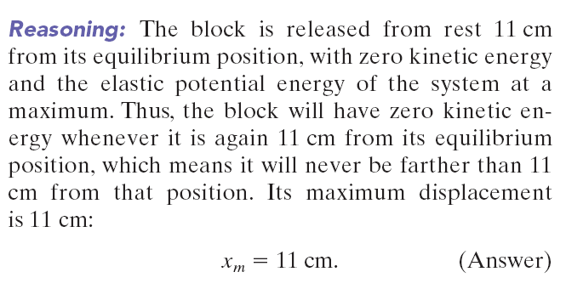
Example, force law:

Slide 15
Example, force law:

Slide 16
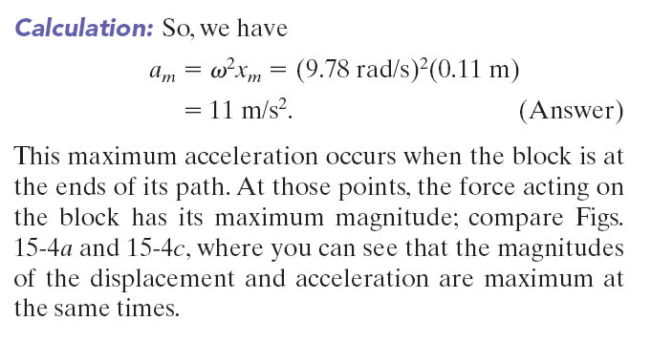
Example, force law:

Slide 17
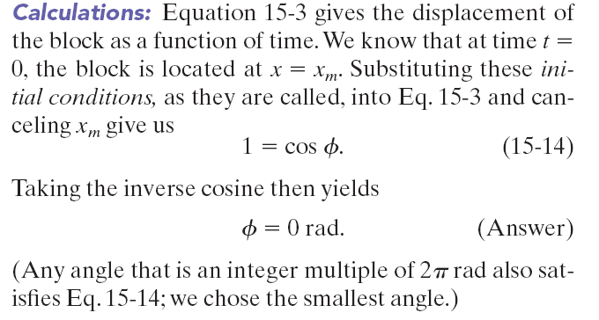
Example, force law:

Slide 18
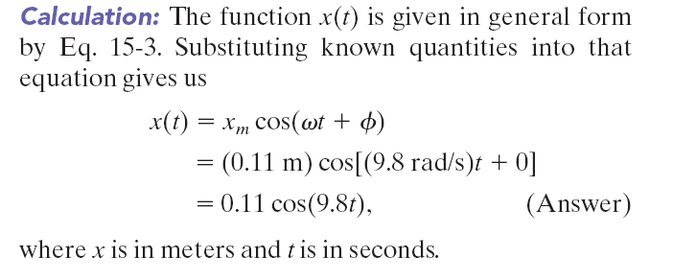
Example, force law:

Slide 19
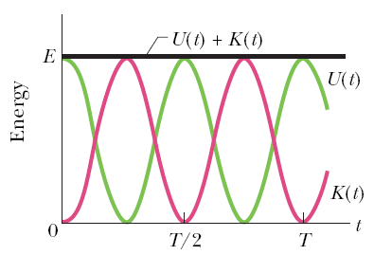
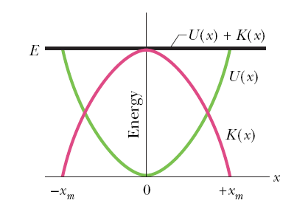
15.4: Energy in SHM
The potential energy of a linear oscillator is associated entirely with the spring.
The kinetic energy of the system is associated entirely with the speed of the block.
The total mechanical energy of the system:

Slide 21
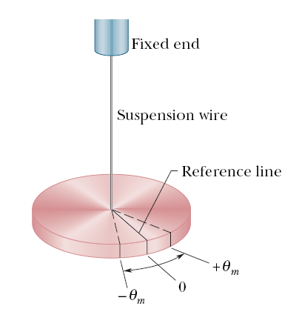
15.4: An Angular SHM
The figure shows an example of angular SHM. In a torsion pendulum involves the twisting of a suspension wire as the disk oscillates in a horizontal plane.
The torque associated with an angular displacement of θ is given by:
is the torsion constant, and depends on the length, diameter, and material of the suspension wire.
The period, T, relates to κ as:
Here, I is the rotational inertia of the oscillating disk.

Slide 22
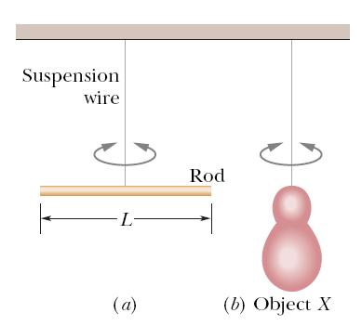
Example, angular SHM:
Figure a shows a thin rod whose length L is 12.4 cm
and whose mass m is 135 g, suspended at its midpoint
from a long wire. Its period T_{a} of angular SHM is measured
to be 2.53 s. An irregularly shaped object, which we
call object X, is then hung from the same wire, as in Fig. b, and its period T_{b} is found to be 4.76 s. What is the
rotational inertia of object X about its suspension axis?
Answer: The rotational inertia of either the rod or
object X is related to the measured period. The rotational inertia of a thin rod about a perpendicular axis through its midpoint
is given as 1/12 mL².Thus, we have, for the rod in Fig. a,
Now let us write the periods, once for the rod and once for object X:
The constant κ, which is a property of the wire, is the same for both figures; only the periods and the rotational inertias differ.
Let us square each of these equations, divide the second by the first, and solve the resulting equation for I_{b}. The result is

Slide 23
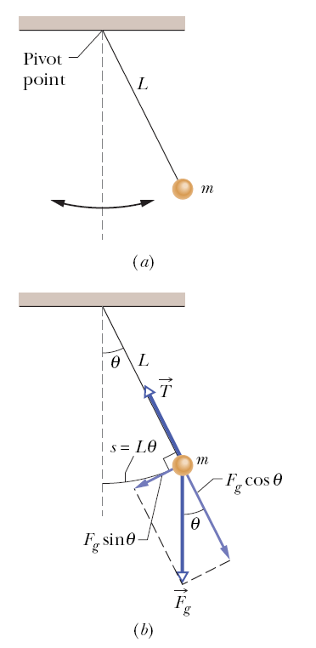
15.6: Pendulums
In a simple pendulum, a particle of mass m is suspended from one end of an unstretchable massless string of length L that is fixed at the other end.
The restoring torque acting on the mass when its angular displacement is θ, is:
α is the angular acceleration of the mass. Finally,
This is true for small angular displacements, θ.

Slide 24
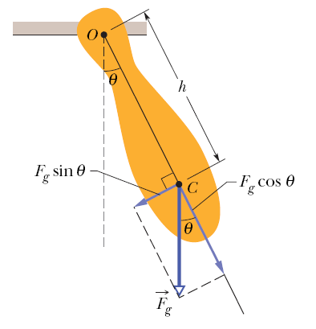
15.6: Pendulums
A physical pendulum can have a complicated distribution of mass. If the center of mass, C, is at a distance of h from the pivot point (figure), then for small angular amplitudes, the motion is simple harmonic.
The period, T, is:
Here, I is the rotational inertia of the pendulum about O.

Slide 25
15.6: Pendulums
In the small-angle approximation we can assume that θ << 1 and use the approximation sin θ ≅ θ. Let us investigate up to what angle θ is the approximation reasonably accurate?
θ (degrees) θ (radians) sin θ
5 0.087 0.087
10 0.174 0.174
15 0.262 0.259 (1% off)
20 0.349 0.342 (2% off)
Conclusion: If we keep θ < 10 ° we make less than 1 % error.

Slide 26
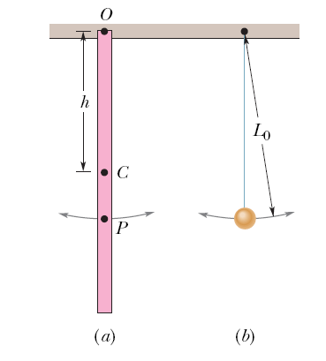
Example, pendulum:
In Fig. a, a meter stick swings about a pivot point at one end, at distance h from the stick’s center of mass.
What is the period of oscillation T?
KEY IDEA: The stick is not a simple pendulum because
its mass is not concentrated in a bob at the end opposite
the pivot point—so the stick is a physical pendulum.
Calculations: The period for a physical pendulum depends on the rotational inertia, I, of the stick about the pivot point. We can treat the stick as a uniform rod of length L and mass m. Then I =1/3 mL², where the distance h is L.
Therefore,
Note the result is independent of the pendulum’s mass m.

Slide 27
Example, pendulum, continued:
(b) What is the distance L₀ between the pivot point O of the stick and the center of oscillation of the stick?
Calculations: We want the length L₀ of the simple pendulum (drawn in Fig. b) that has the same period as the physical pendulum (the stick) of Fig. a.

