Slide 1
Chapter 11
Data Analysis
NT
Lec-No-35-37
Notes:
1

Slide 2
Lec-No-35

Slide 3
Ch-11-DATA ANALYSIS METHODS-NT-1

Slide 4
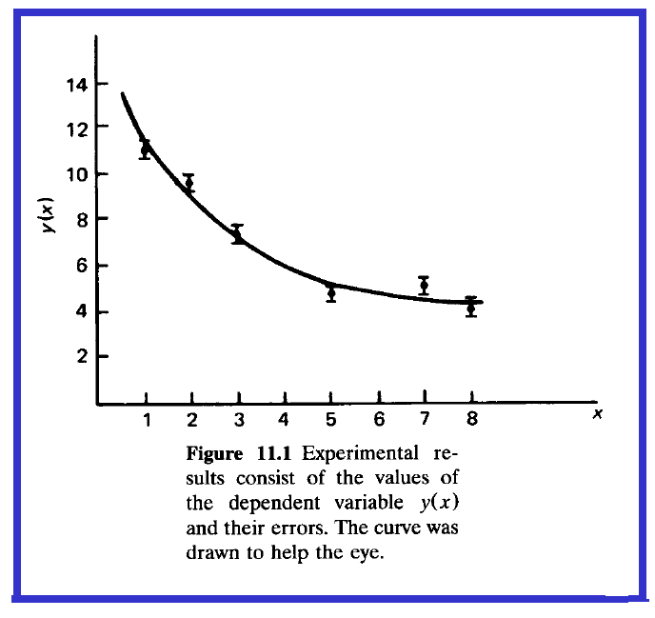
Ch-11-DATA ANALYSIS METHODS-NT-2

Slide 5
Ch-11-DATA ANALYSIS METHODS-NT-3

Slide 6
Ch-11-DATA ANALYSIS METHODS-NT-4

Slide 7
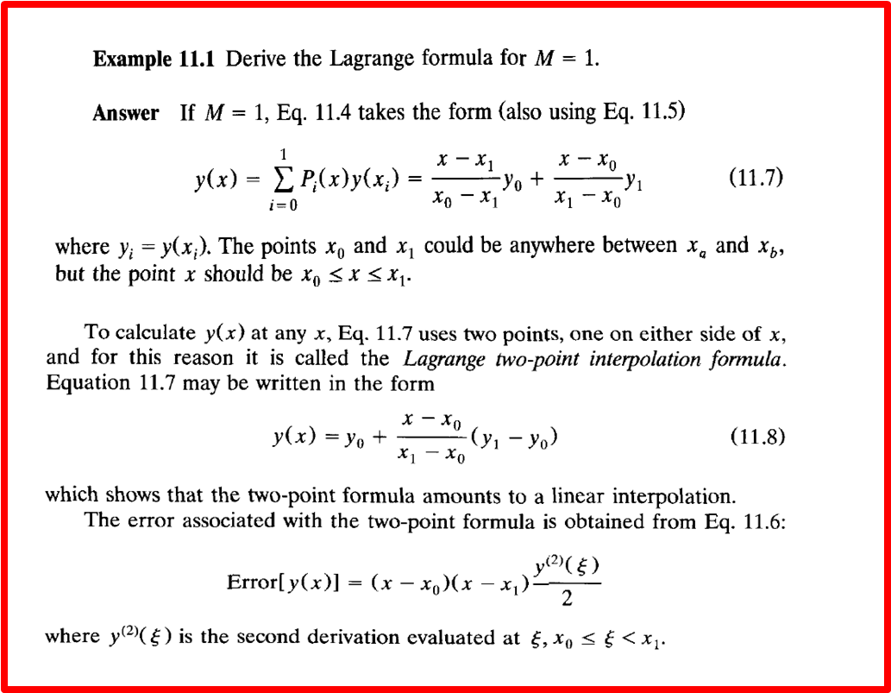
Ch-11-DATA ANALYSIS METHODS-NT-5

Slide 8
Ch-11-DATA ANALYSIS METHODS-NT-6

Slide 9
Ch-11-DATA ANALYSIS METHODS-NT-7

Slide 10
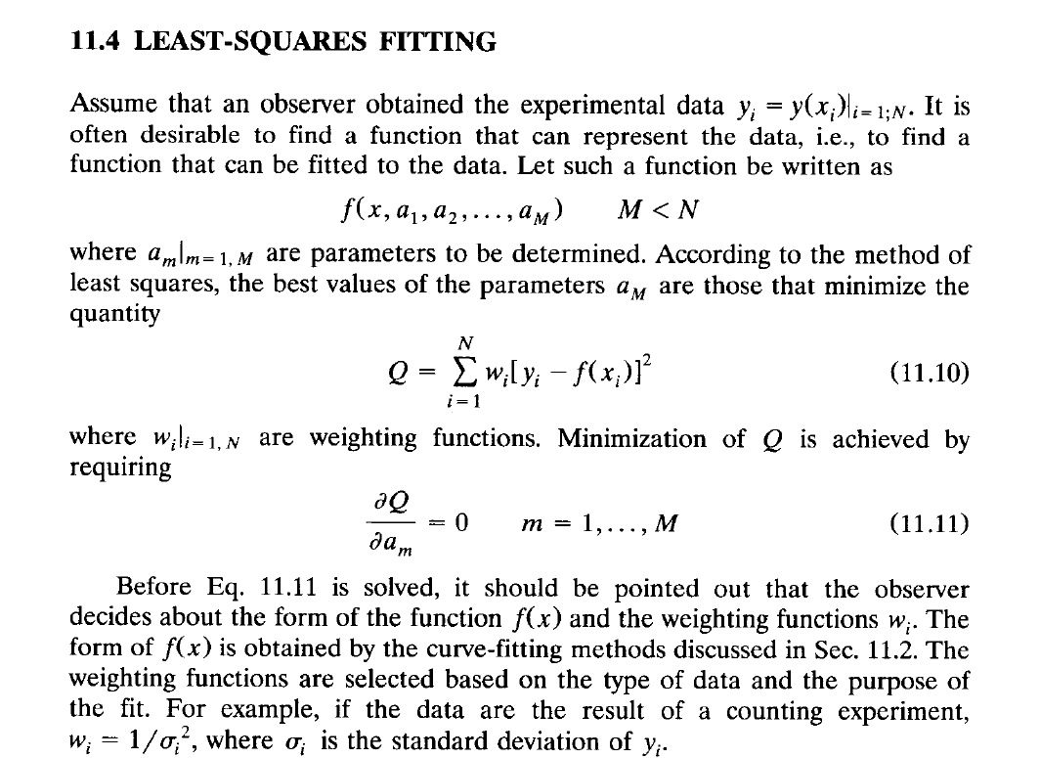
Ch-11-DATA ANALYSIS METHODS-NT-8

Slide 11
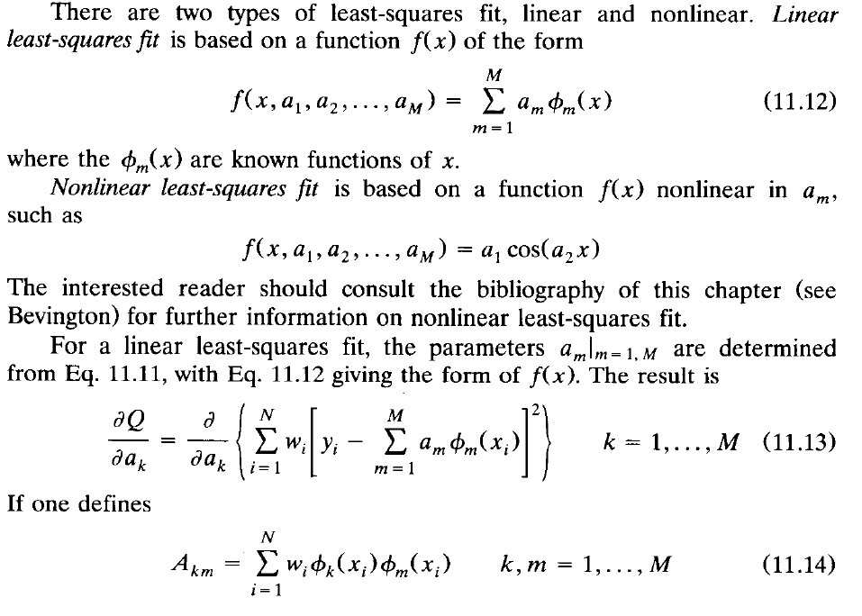
Ch-11-DATA ANALYSIS METHODS-NT-9

Slide 12
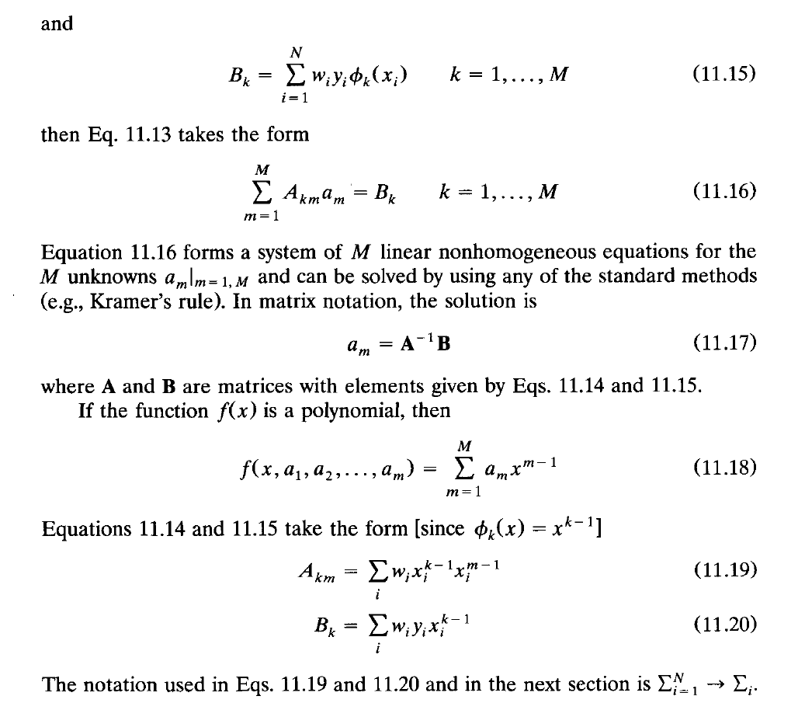
Ch-11-DATA ANALYSIS METHODS-NT-10

Slide 13
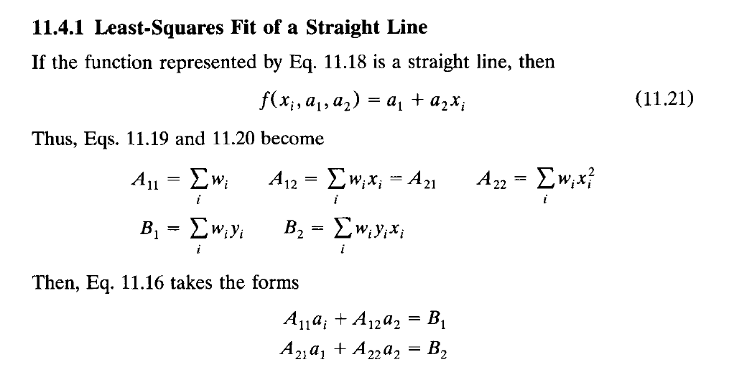
Ch-11-DATA ANALYSIS METHODS-NT-11

Slide 14
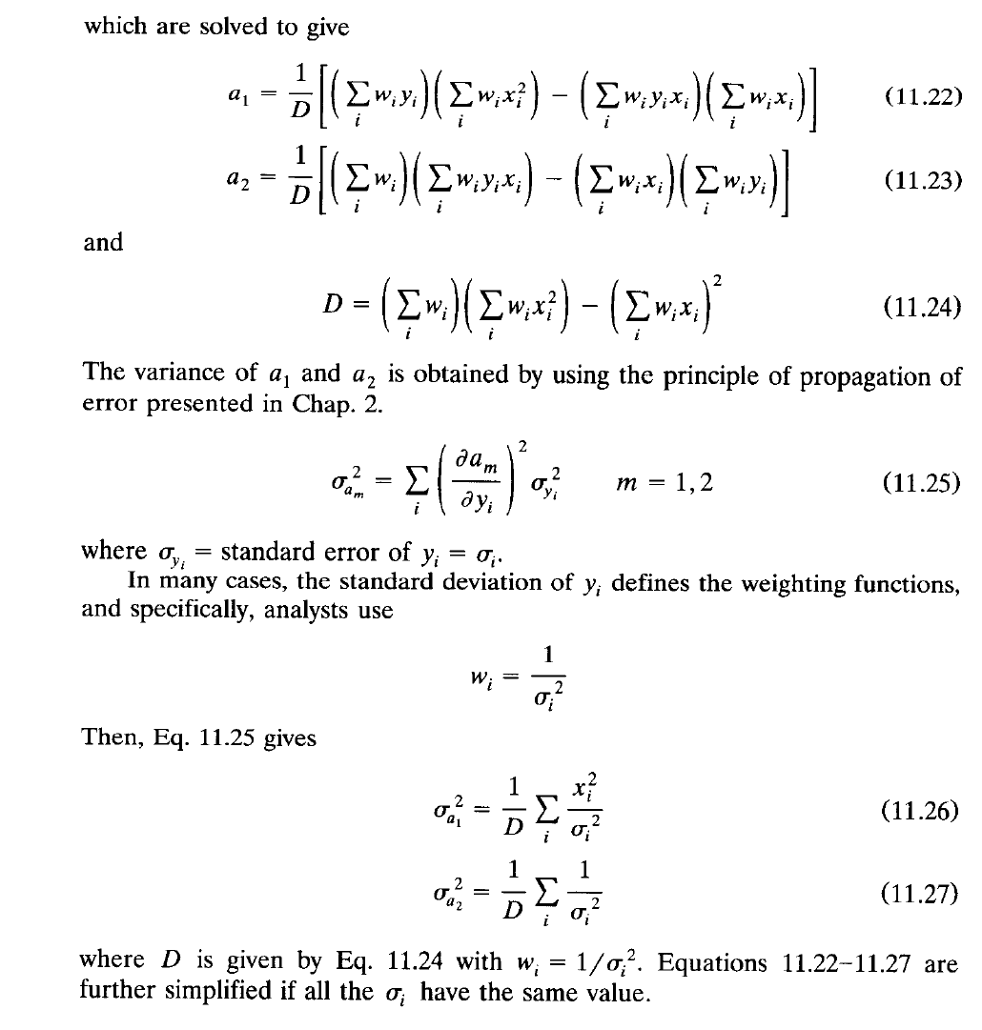
Ch-11-DATA ANALYSIS METHODS-NT-12

Slide 15
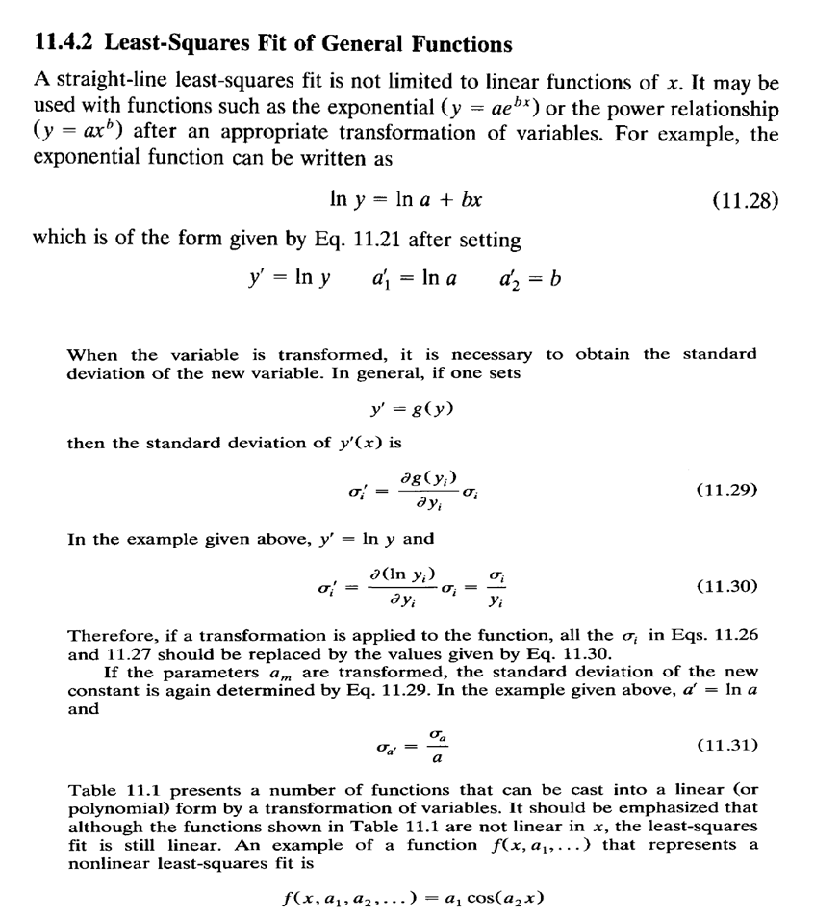
Ch-11-DATA ANALYSIS METHODS-NT-13

Slide 16
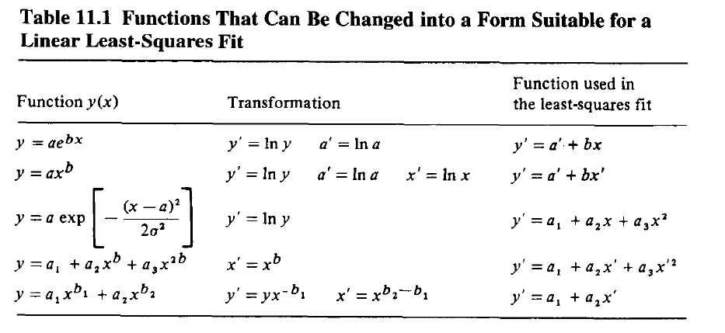
Ch-11-DATA ANALYSIS METHODS-NT-14

Slide 17
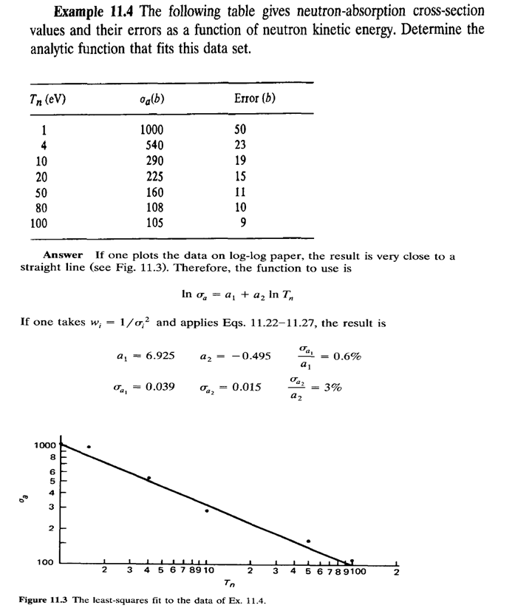
Ch-11-DATA ANALYSIS METHODS-NT-15

Slide 18
11.6 DATA SMOOTHING, Ch-11-NT-16

Slide 19
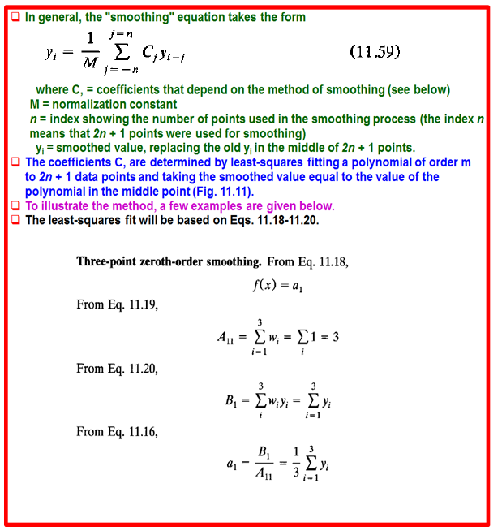
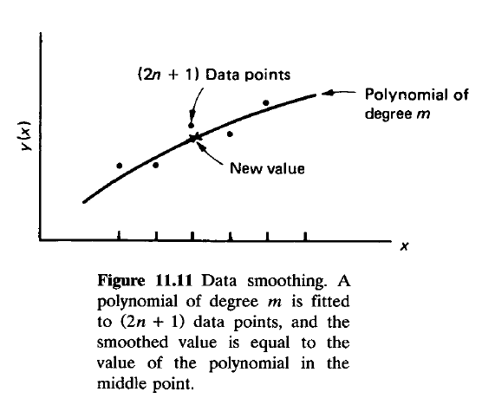
11.6 DATA SMOOTHING, Ch-11-NT-17

Slide 20
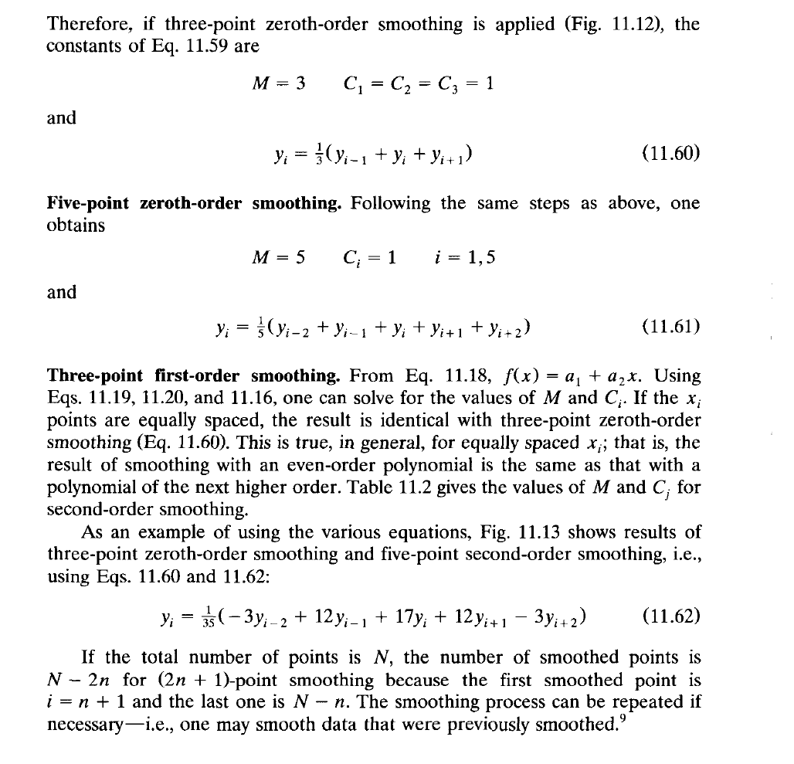
11.6 DATA SMOOTHING, Ch-11-NT-18

Slide 21
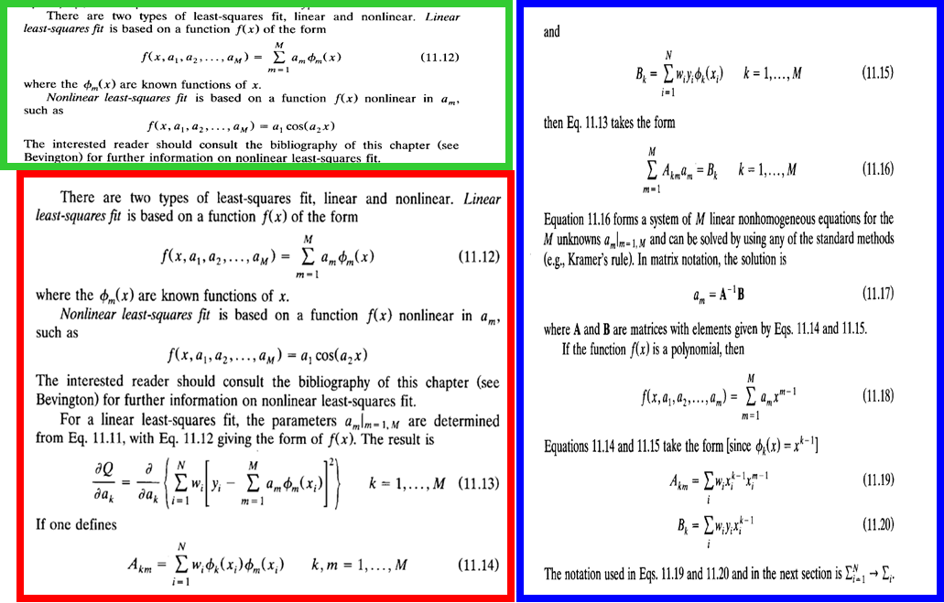
11.6 DATA SMOOTHING, Ch-11-NT-19

Slide 22
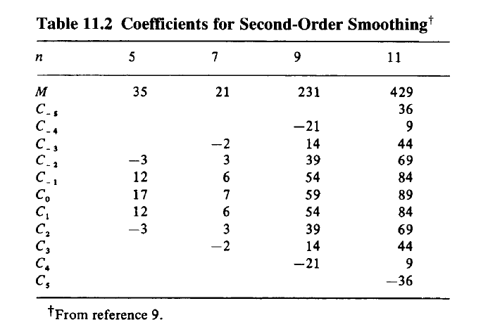
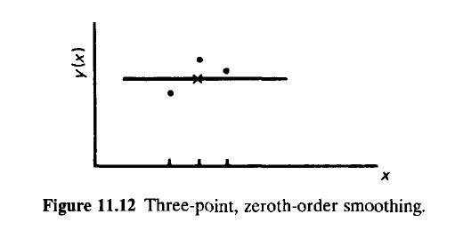
11.6 DATA SMOOTHING, Ch-11-NT-20

Slide 23
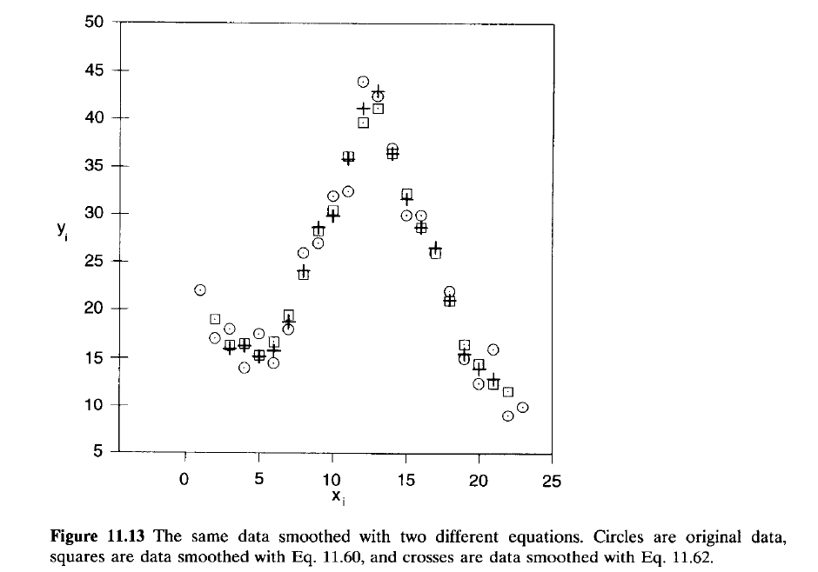
11.6 DATA SMOOTHING, Ch-11-NT-21

Slide 24
11.6 DATA SMOOTHING, Ch-11-NT-22

