Slide 3
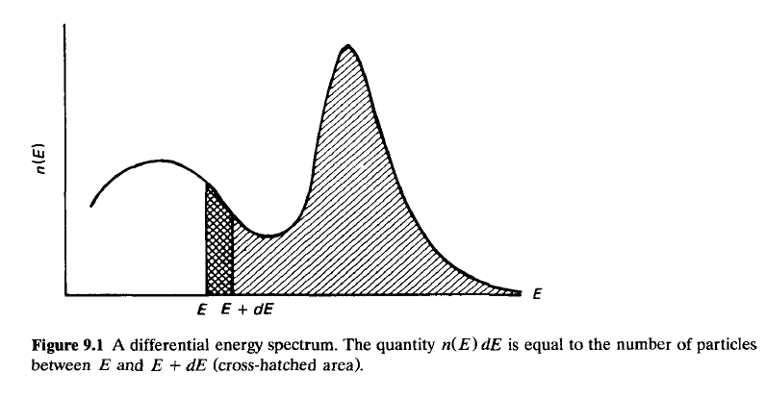

Slide 7
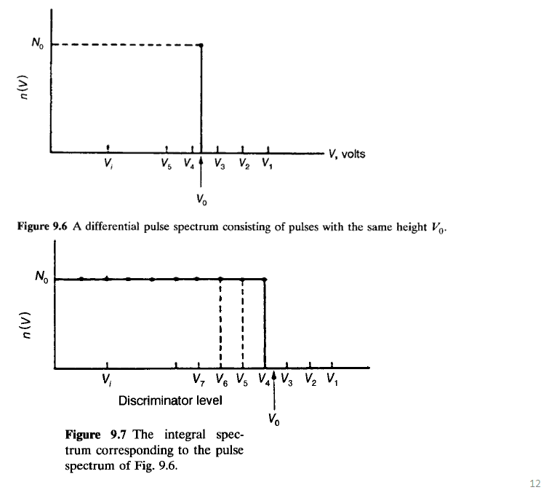

Slide 9
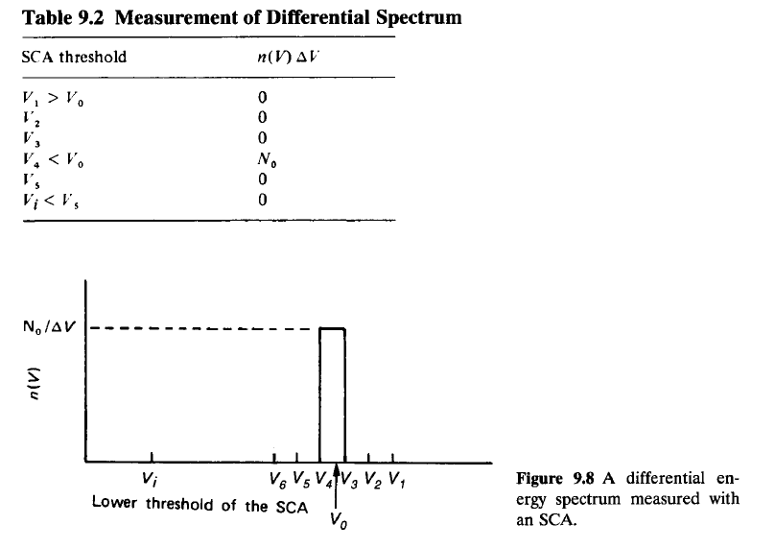

Slide 10
9.5 THE RELATIONSHIP BETWEEN PULSE-HEIGHT DISTRIBUTION AND ENERGY SPECTRUM NT-24
9.5 THE RELATIONSHIP BETWEEN PULSE-HEIGHT DISTRIBUTION AND ENERGY SPECTRUM
the energy spectrum of particles emitted by a source is measured through height distribution produced by the particles recorded by a detector and appropriate electronics .
Fundamental requirements for the detector and the electronics are as follows:
1. The particle should deposit all its energy or a known constant fraction of it in the detector.
2. The voltage pulse produced by the detector should be proportional to the
particles energy dissipated in it
3. The electronic amplification should be the same for all pulse heights.
Charged particles deposit all their energy in the detector, as long as their range is shorter than the size of the detector.
Gammas do not necessarily deposit all their energy in the detector, regardless of detector size.
Neutrons are detected indirectly through other particles produced by nuclear reactions. The energy deposited in the detector depends not only on the energy of the neutron but also on the energy and type of the reaction products.
The events that transform the particle energy into a voltage pulse are statistical in nature.
Even if all the particles deposit exactly the same energy in the detector, the output pulses will not be the same but they will have a certain distribution.
As a result of incomplete energy deposition and the statistical nature of the events that take place in the detector, the shape of the pulse-height distribution is different from that of the source energy spectrum.
In other words, two spectra are involved in every measurement:
1. The source spectrum: This is the energy spectrum of particles emitted by the
source.
2. The measured spectrum: This is the measured pulse height distribution.
Consider, for example, the measured pulse-height distribution shown in Fig. 9.9b produced by a monoenergetic gamma source.
The observer records the data shown in Fig. 9.9b, which is not identical to that of the source, Fig. 9.9a
The objective of the measurement is to obtain the spectrum of Fig. 9.9a, but the observer actually measures the distribution shown by Fig. 9.9b.
The task of the observer is, therefore, to apply appropriate corrections to the measured spectrum to finally obtain the source spectrum.

Slide 11
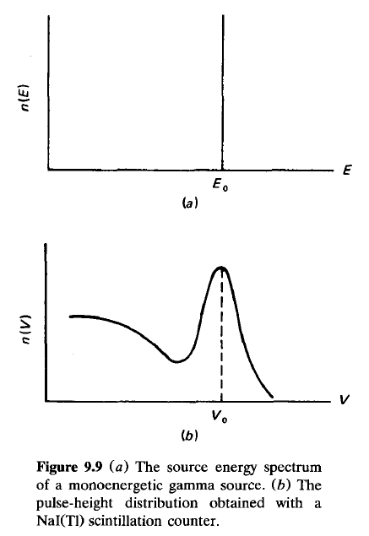
9.5 THE RELATIONSHIP BETWEEN PULSE-HEIGHT DISTRIBUTION AND ENERGY SPECTRUM-new-NT-24

Slide 12
. ENERGY RESOLUTION-NT-24

Slide 13
9.6 ENERGY RESOLUTION OF A DETECTION SYSTEM-new
9.6 ENERGY RESOLUTION OF A DETECTION SYSTEM
performance of a detection system is characterized by the width of the pulse-height distribution obtained with particles of the same energy (monoenergetic source).
Even in the case where each particle deposits exactly the same energy in the detector, the pulse-height distribution will not be a single line (like that shown in Fig. 9.9a);
It will have a certain finite width (Fig. 9.10) due to:
1. Statistical fluctuations in the number of charge carriers produced in the detector
2. Electronic noise in detector itself, the preamplifier, and the amplifier
3. Incomplete collection of the charge produced in the detector
The width, measured at half of the maximum of the bell-shaped curve, is indicated by Γ or by full width at half maximum (FWHM).
The ability of a detector to identify particles of different energies, called the energy resolution, is given either in terms of Γ or in terms of the ratio R(E,), where
The width Γ is given in energy units, while the ratio R(Eo) is given as a percentage.
The most important elements affecting the energy resolution of a radiation detection system are the three statistical factors mentioned above in relation to the width Γ.
It is worth repeating that in energy measurements it is the energy resolution of the counting system (detector-preamplifier-amplifier) that is the important quantity and not the energy resolution of just the detector.

Slide 14
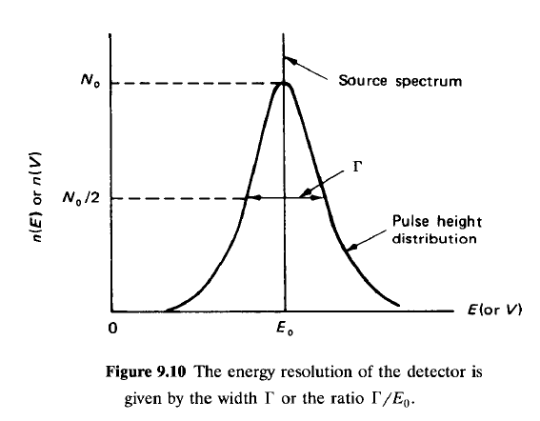
9.6 ENERGY RESOLUTION OF A DETECTION SYSTEM-NT-25

Slide 15
9.6.1 The Effect of Statistical Fluctuations: The Fano Factor
9.6.1 The Effect of Statistical Fluctuations: The Fano Factor
Consider a monoenergetic source of charged particles being detected by a silicon semiconductor detector. (The discussion would apply to a gas-filled counter as well.)
The average energy w needed to produce one electron-hole pair in silicon is 3.66 eV, although the energy gap (E_{g}) is 1.1 eV.
This difference between w and E, shows that part of the energy of the incident particles is dissipated into processes that do not generate charge carriers.
Any process that consumes energy without producing electron-hole pairs is, of course, useless to the generation of the detector signal.
If the energy deposited in the detector is E, the average number of charge carriers is E/w.
If the process of the electron-hole generation were purely statistical, Poisson statistics would apply and the standard deviation of the number of pairs would be
Experience has shown that the fluctuations are smaller than what Eq. 9.3 gives.
The observed statistical fluctuations are expressed in terms of the Fano factor
The two extreme values of F are 0 and 1.
F = 0 means that there are no statistical fluctuations in the number of pairs produced.
That would be the case if all the energy was used for production of charge carriers.
F = 1 means that the number of pairs produced is governed by Poisson statistics.

Slide 16
9.6.1 The Effect of Statistical Fluctuations: The Fano Factor-new-NT-26

Slide 17
Fano factors have been calculated and also measured.
For semiconductor detectors, F values as low as 0.06 have been reported .
For gas-filled counters, reported F values lie between 0.2 and 0.5.
Values of F < 1 mean that the generation of electron-hole pairs does not exactly follow Poisson statistics.
Since Poisson statistics applies to outcomes that are independent, it seems that the ionization events in a counter are interdependent.
The width Γ of a Gaussian distribution, such as that shown in Fig. 9.10, is related to the standard deviation σ by:
Equation 9.5 shows that the width Γ_{f}, which is due to the statistical fluctuations, is roughly proportional to the square root of the energy (the Fano factor is a weak function of energy).
To compare the contribution of the statistical fluctuations to the resolution of different types of detectors at a certain energy, one can use Eqs. 9.2 and 9.6 and write for detectors 1 and 2
It can be seen from Eq. 9.7 that the resolution is better for the detector with the smaller average energy needed for the creation of a charge carrier pair (and smaller Fano factor).
Thus, the energy resolution of a semiconductor detector (w - 3 eV, F < 0.1) should be expected to be much better than the resolution of a gas-filled counter (w = 30 eV, F .= 0.2), and indeed it is .

Slide 18
9.6.1 The Effect of Statistical Fluctuations: The Fano Factor-new-NT-27

Slide 19
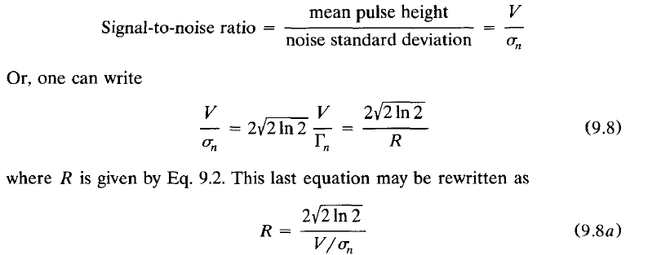
9.6.2 The Effect of Electronic Noise on Energy Resolution-NT-new-28
9.6.2 The Effect of Electronic Noise on Energy Resolution
The electronic noise consists of a small voltage variation around the zero line (Fig. 9.11), with average voltage v _{n} # 0.
To see the effect of the noise on the energy resolution, consider pulses of constant height V.
In the absence of noise, the FWHM of the distribution of these pulses is zero.
If noise is present, the pulses will be superimposed on the noise with the results that the pulses are not of equal height any more (Fig. 9.12), and that the pulses form a Gaussian distribution centered at V and having a width equal to Γ_{n} = 2(√2ln2)σ_{n}.
The width Γ_{n} is due to the noise only and has nothing to do with statistical effects in the detector.
The signal-to-noise ratio is frequently the quantity used to indicate the magnitude of the noise.
It is defined by:
This last equation may be rewritten as to show that the higher the signal-to-noise ratio is, the better the resolution becomes (other things being equal, of course).

Slide 20
9.6.2 The Effect of Electronic Noise on Energy Resolution-NT-new-28

Slide 21
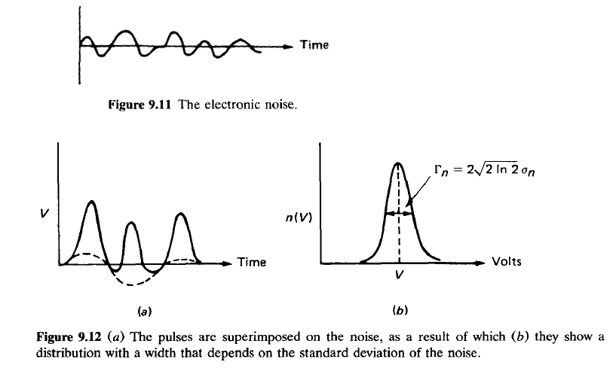
9.6.2 The Effect of Electronic Noise on Energy Resolution-NT-new-29

Slide 22
9.6.3 The Effect of Incomplete Charge Collection-NT-new-30
9.6.3 The Effect of Incomplete Charge Collection
The effect of incomplete charge collection in gas counters is small compared to the effect of the statistical fluctuations.
In semiconductor detectors, incomplete charge collection is due to trapping of carriers.
The amount of charge trapped is approximately proportional to the energy deposited in the detector, which in turn, is proportional to the energy of the incident particle.
For this reason, the resolution is affected by trapping effects more at high energy than at low energy.
trapping effects depend on the material of which the detector is made and on radiation damage suffered by the semiconductor..
Usually, the effect of incomplete charge collection is included in the statistical fluctuations.
9.6.4 The Total Width Γ:
The total widthΓ(or the total energy resolution) is obtained by adding in quadrature the contributions from the statistical effects (Γ_{f}) and from the noise and incomplete charge collection (Γ_{n}) .
Thus,
For gas and scintillator counters, the main contribution comes from the statistical fluctuations.
For semiconductor detectors at low energies, measurements have shown that Γ_{n} ≥ Γ_{f}
At higher energies this is reversed, since Γ_{n} is essentially independent of energy while Γ_{f} increases with it (see Eq. 9.6).

Slide 23
9.6.3 The Effect of Incomplete Charge Collection-NT-new-30

Slide 24
9.7 DETERMINATION OF THE ENERGY RESOLUTION-THE RESPONSE FUNCTION new-NT-31
9.7 DETERMINATION OF THE ENERGY RESOLUTION-THE RESPONSE FUNCTION
A monoenergetic source produces a pulse-height distribution that may be a Gaussian (Fig. 9.10) or a more complicated function (Fig. 9.9).
one concludes that although all the particles start at the source with the same energy, there is a probability that they may be recorded within a range of energies.
That probability is given by the response function or energy resolution function R(E, E') of the detection system, defined as:
R(E, E') dE = probability that a particle emitted by the source with energy E‘ will be recorded with energy between E and E + dE
One measures, a pulse-height distribution, but the energy calibration of the system provides a one-to-one correspondence between energy and pulse height.
If one defines S( E) dE = source spectrum = number of particles emitted by the source with energy between E and E + dE and
M( E) dE = measured spectrum = number of particles recorded as having energy between E and E + dE
then the three functions R(E, E'), S(E), and M(E) are related by:
Equation 9.10 is an integral equation with the source spectrum S(E) being the unknown.
The procedure by which S(E) is obtained, after R(E, E') and M(E) have been determined, is called unfolding of the measured spectrum.
Methods of unfolding are discussed in Chaps. 11-14.
To determine the response function of a detection system at energy E, the energy spectrum of a monoenergetic source emitting particles with that energy is recorded.
Since the resolution changes with energy, the measurement is repeated using several sources spanning the energy range of interest.
Figure 9.13 shows response functions for several commonly encountered cases.

Slide 25
9.7 DETERMINATION OF THE ENERGY RESOLUTION-THE RESPONSE FUNCTION new-NT-31

Slide 26
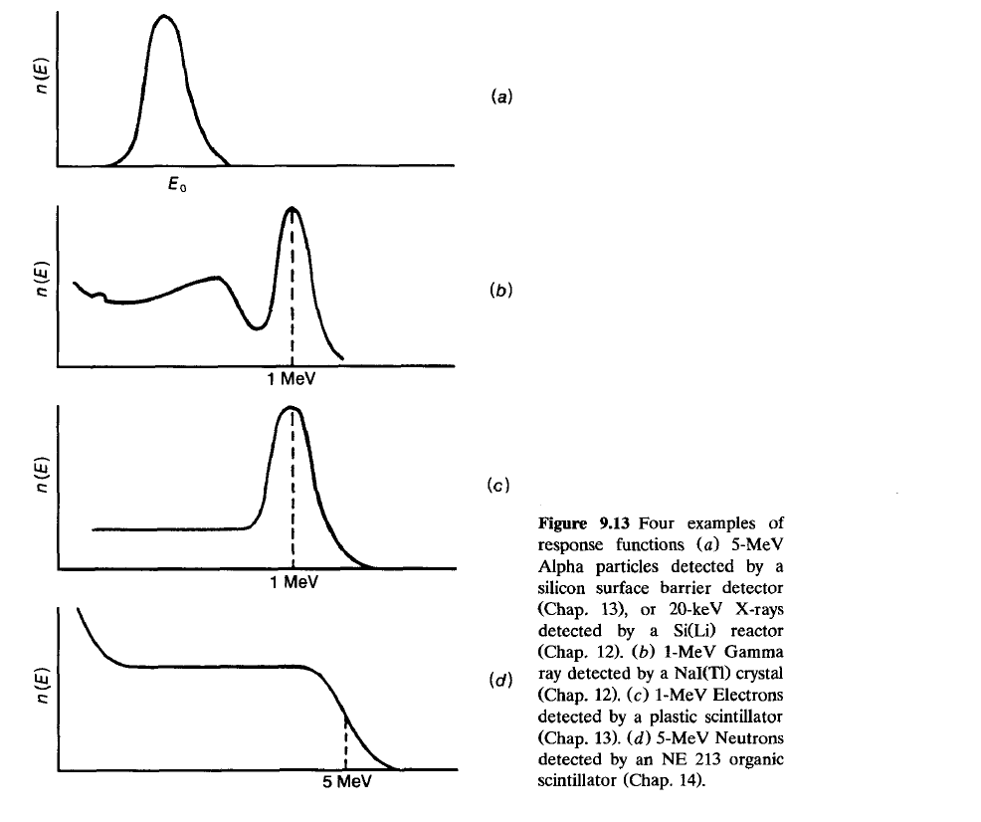
9.7 DETERMINATION OF THE ENERGY RESOLUTION-THE RESPONSE FUNCTION new-NT-32

Slide 27
9.8 THE IMPORTANCE OF GOOD ENERGY RESOLUTION-NT-new-32
9.8 THE IMPORTANCE OF GOOD ENERGY RESOLUTION
The importance of good energy resolution becomes obvious if the energy spectrum to be measured consists of several energies.
Consider as an example the source spectrum of Fig. 9.14, consisting of two energies E₁ and E₂.
Assume that this spectrum is measured with a system having energy resolution equal to Γ and examine the following cases.
Case I: E₂ - E₁ > 2Γ. The measured spectrum is shown in Fig. 9.15 for this case. The system can resolve the two peaks-i.e., the two peaks can be identified as two separate energies.
Case II: E₂ - E₁ = 2Γ This case is shown in Fig. 9.16. The peaks can still be resolved.
Case III: E₂ - E₁ = Γ This case is shown in Fig. 9.17. The solid line shows how the measured spectrum will look as the sum of the two peaks (dashed lines).
It is obvious that it is difficult to identify two distinct peaks if E₂ - E₁ = Γ , and the situation will be worse if E₂ - E₁ < Γ.
The three cases examined above intend to show how important good energy resolution is for the measurement of spectra with many energy peaks.
If the response function of the detector is not known and the measured spectrum shows no well-identified peaks, the following criterion is used for the energy resolution required to identify the peaks of about equal magnitude:
To be able to resolve two energy peaks at E₁ and E₂ the resolution of the system should be such that :

Slide 28
9.8 THE IMPORTANCE OF GOOD ENERGY RESOLUTION-NT-new-32

Slide 29
9.8 THE IMPORTANCE OF GOOD ENERGY RESOLUTION-NT-new-33

Slide 30
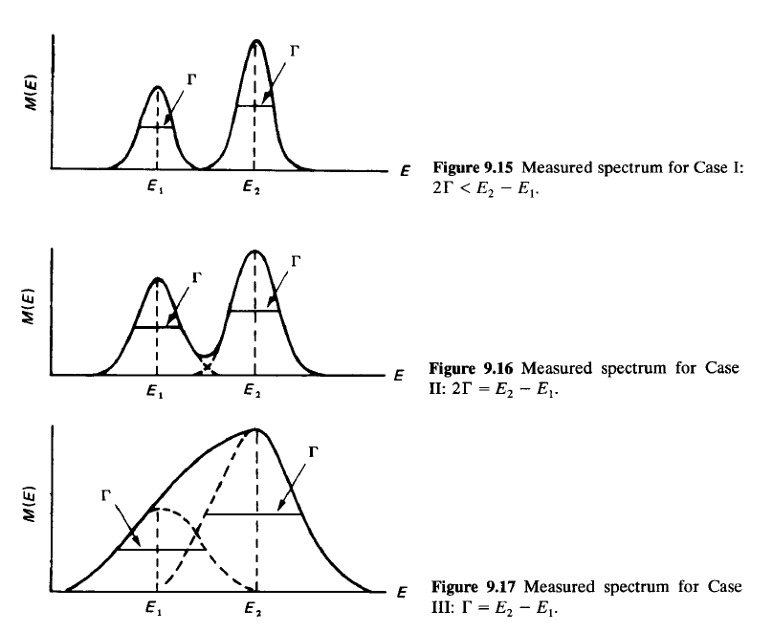
9.8 THE IMPORTANCE OF GOOD ENERGY RESOLUTION-NT-new-34

Slide 31
9.9 MULTICHANNEL ANALYZER (MCA)-NT-new-35
9.9 BRIEF DESCRIPTION OF A MULTICHANNEL ANALYZER (MCA)
To measure an energy spectrum of a radioactive source the use of an instrument called the multichannel analyzer (MCA).
Multichannel analyzers are used in either of two different modes: The pulse-height analysis (PHA) mode or the multichannel scaling (MCS) mode.
The MCS mode is used to count events as a function of time.
The individual channels of the memory count all incoming pulses for a preset time width Δt.
After time Δt, the counting operation is switched automatically to the next channel in the memory, thus producing in the end a time sequence of the radiation being detected.
For example, if the radiation source is a short-lived isotope, the MCS mode will provide the exponential decay curve that can be used for the measurement of the half-life of this isotope.
The PHA mode is the traditional function of an MCA .
used to sort out incoming pulses according to their height and store the number of pulses of a particular height in a corresponding address of the MCA memory called the channel number.
In the PHA mode, an MCA performs the function of a series of SCAs placed adjacent to one another.
When only one SCA with width ΔE is used, the experimenter has to sweep the spectrum by moving the lower threshold of the SCA manually (see Sec. 9.4).
On the other hand, if one had many SCAs, all counting simultaneously, the whole spectrum would be recorded simultaneously.

Slide 32
9.9 MULTICHANNEL ANALYZER (MCA)-NT-new-35

Slide 33
This is exactly what the MCA does, although its principle of operation is not based on a series of SCAs.
Figure 9.18 shows a simplified block diagram of an MCA.
In the PHA mode, the incoming pulse enters into a unit called the analog-to-digital converter (ADC).
The ADC digitizes the pulse amplitude: it produces a number proportional to the height of the pulse, a number that determines the channel where the pulse will be stored.
The size of the ADC, given in terms of channels, defines the absolute resolution of the system.
Actually, the ADC determines the number of discrete parts into which the pulse height can be subdivided.
Commercial ADCs have at the present time a size up to 16384 channels, with the full scale adjustable in steps of 256, 512, 1024, etc., channels.
The number of discrete parts (channels) into which the input pulse range (0 to + 10 V) is divided is called the conversion gain.
The conversion gain is set by a stepwise control knob located on the front of the instrument.
As an example, if the conversion gain is set at 2048 channels, it means that the maximum pulse height (10 V) is divided into that many parts.
Therefore, the resolution of the MCA at this setting is 10 V/2048 = 4.88 mV/channel
The memory of the MCA is a data-storage unit arranged in a series of channels.
Every channel is capable of storing up to 2²⁰ - 1 data (pulses), in most cases.
Commercial MCAs have memories with up to 16384 channels.
Normally, the MCA provides for selection and use of the full memory, only half of it, or one-fourth of it.
Transfer of data from one fraction of the memory to another is also possible...

Slide 34
9.9 MULTICHANNEL ANALYZER (MCA)-NT-new-36

Slide 35
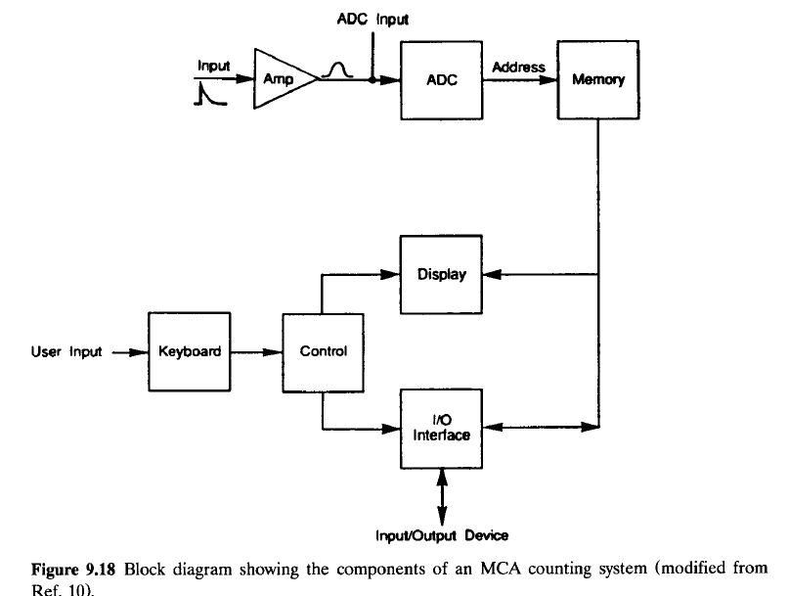
9.9 MULTICHANNEL ANALYZER (MCA)-NT-new-37

Slide 36
In the PHA mode, the first channel of the region used is called channel zero and records, in almost all late model MCAs, the live time of the analysis, in seconds.
If the full memory or the first half or first quarter of the memory is used, channel zero is the address 0000.
If the second half of 4096 memory is used, channel zero is address 2048; if the second quarter is used, channel zero is address 1024; and so on.
How does one determine the size of the MCA memory needed for a specific experiment?
The decision is made based on the requirements for the PHA mode.
One equation frequently used is :
where Γ is the FWHM of the detector used.
The factor h is equal to the number of channels at or above the FWHM of the peak. Its value is between 3 and 5.
As an example, assume that the energy range of interest is 0 to 2.0 MeV and consider a NaI(T1) and a Ge detector.
The resolution of the NaI(T1) detector is about 50 keV.
Therefore, the minimum number of channels is (h = 5)

Slide 37
9.9 MULTICHANNEL ANALYZER (MCA)-NT-new-38

Slide 38
MCA
the ADC, not the memory, determines the absolute resolution of an MCA.
An MCA with an ADC of 1000 channels and a memory of 2000 channels has an actual resolution of only 1000 channels.
In using an MCA to record a spectrum, there is "dead time" involved, which is, essentially, the time it takes to store the pulse in the appropriate channel.
That time depends on and increases with the channel number.
Commercial MCAs have a meter that shows, during counting, the percentage of dead time.
They also have timers that determine the counting period in live time or clock time. In clock time mode, the counting continues for as long as the clock is set up.
In live time mode, an automatic correction for dead time is performed.
In this case, the percent dead time indication can be used to determine the approximate amount of actual time the counting will take.
For example if the clock is set to count for 5 min (in live mode) and the dead time indicator shows 25 percent, the approximate actual time of this measurement is going to be
Modern MCAs, be able to
1. Perform the energy calibration of the system
2. Determine the energy of a peak
3. Integrate the area over a desired range of channels
4. Identify an isotope, based on the energy peaks recorded, etc.

Slide 39
9.9 MULTICHANNEL ANALYZER (MCA)-NT-new-39

Slide 40
9.10 CALIBRATION OF A MULTICHANNEL ANALYZER-NT-new-40
9.10 CALIBRATION OF A MULTICHANNEL ANALYZER
The calibration of an MCA follows these steps:
Determination of range of energies involved. Assume this is 0≤E≤E_{m} (MeV).
2. Determination of preamplifier-amplifier setting.
Using a source that emits particles of known energy, one observes the signal generated on the screen of the oscilloscope.
It should be kept in mind that the maximum possible signal at the output of the amplifier is 10 V.
In energy spectrum measurements, one should try to stay in the range 0-9 V.
Assume that the particle energy E₁ results in pulse height V₁.
Is this amplification proper for obtaining a pulse height V _{m} ≤10 V for energy E_{m}?
The pulse height and particle energy are proportional.
Therefore,
If V_{m} < 10 V, then the amplification setting is proper.
If V, 2 10 V, the
amplification should be reduced. (If Vm < 2 V, amplification should be increased.
It is good practice, but not necessary, to use the full range of allowed
voltage pulses.) The maximum pulse Vm can be changed by changing the
amplifier setting.
3. Determination of MCA settings. One first decides the part of the MCA
memory to be used. Assume that the MCA has a 1024-channel memory and it
has been decided to use 256 channels, one-fourth of the memory. Also assume
that a spectrum of a known source with energy El is recorded and that the peak
is registered in channel C,. Will the energy Em be registered in Cm < 256, or
will it be out of scale?
The channel number and energy are almost proportional,+ i.e., Ei - Ci.
Therefore
If Cm 1 256, the setting is proper and may be used. If Cm > 256, a new
setting should be employed. This can be done in one of two ways or a
combination of the two:
1. The fraction of the memory selected may be changed. One may use 526
channels of 1024, instead of 256.
2. The conversion gain may be changed. In the example discussed here, if a
peak is recorded in channel 300 with conversion gain of 1024, that same peak
will be recorded in channel 150 if the conversion gain is switched to 512.
There are analyzer models that do not allow change of conversion gain. For
such an MCA, if C, is greater than the total memory of the instrument, one
should return to step 2 and decrease Vm by reducing the gain of the amplifier.

Slide 41
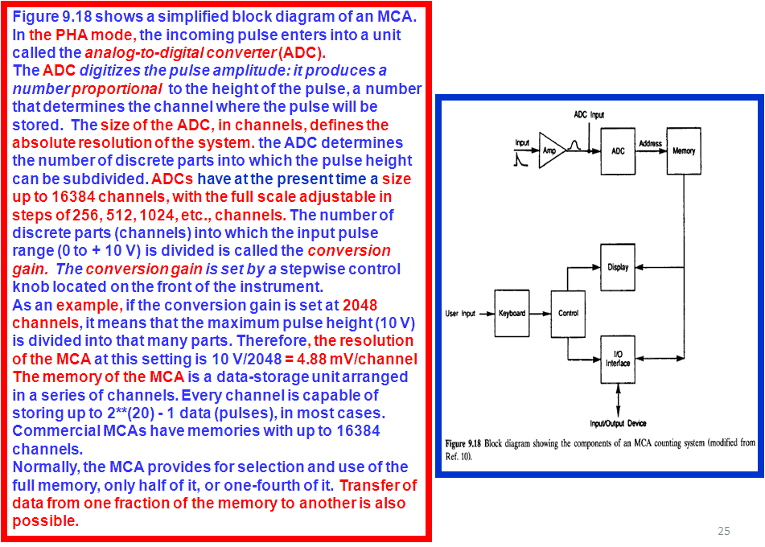
MCA

Slide 47
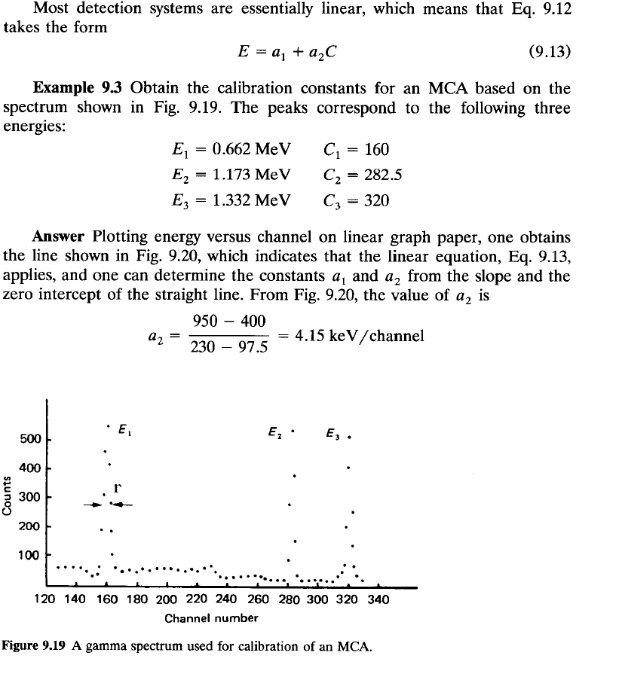

Slide 48
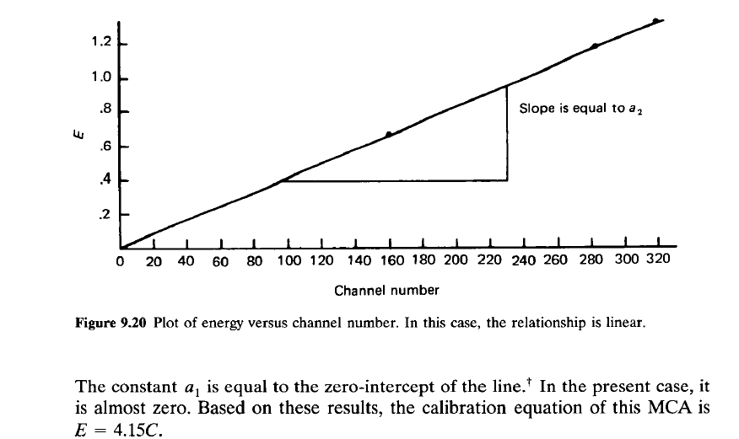

Slide 49
